Slide 1
Teachers are some of the kindest, most altruistic and smartest people on the planet yet they can create some of the most claustrophobic and toxic cultures within which to work. Not with the children, but with one another. Why is this? How is this? And what are the impacts?
How do we resolve this?

Slide 2
What do you want today?

Slide 3
The Trust Revolution in Schools
Collaborative Culture Change
Jeanie Davies

Slide 4
42,830 full time equivalent (FTE) qualified teachers left the state sector, a ‘wastage rate’(interesting term!) of 9.9%.
Of these 42,830 teachers, 83% (35,800 teachers) left for reasons other than retirement
This is an increase of 31% in 6 years.
In 2017, for the first time since records began the number of teachers leaving the profession was higher than the number entering.
20% of NQTs leave the state sector within 2 years

Slide 5
Workload, government pressures and ideology are often cited as reasons for teachers’ underperformance and leaving the profession. These are ubiquitous pressures across the state school system, yet some schools thrive and retain staff whilst others do not.

Slide 6
Government
Funding
Ofsted & Accountability
Society

Slide 7
The outcomes of the cage
The outcome of this cage? Workload generated by a frenetic need to do and change in a reaction to the idea that if the pressure and stress comes from ‘out there’ then the solution must be found externally too. When on red alert from danger, being chased by an attacker, for example, we frantically look around for the next alleyway to duck through, the next implement to use as a weapon, the next person to bolster our gang. And that’s how we behave in schools; looking for the next course, the next piece of software, the next concept to solve our issues.

Slide 8
Amygdala – Fight, Flight or Freeze
Location: Part of Limbic System, at the end of the hippocampus
Function: Responsible for the response and memory of emotions, especially fear - flight, fight or freeze

Slide 9
Lean into Trust
The idea that the answer is ‘out there’ is a fallacy; it isn’t. The answers are in your school – you just need to access them by looking internally, connecting dots and enabling people to join one other,
In short, how we react to our cage is generating fear-based cultures in schools, triggering us individually and as a tribe. This is what lies at the root of the predicament we currently face in the education system, and I invite you to join me in the watershed revolution to turn away from fear and instead lean into trust.

Slide 10
The year of the coin

Slide 11
Social Capital
Notes:
First 6 mins

Slide 12
Professional Capital
Human Capital + Social Capital + Decisional Capital

Slide 13
Professional Capital
Human Capital + Social Capital + Decisional Capital

Slide 14
Professional Capital
Human Capital + Social Capital + Decisional Capital

Slide 15
Professional Capital
Human Capital + Social Capital + Decisional Capital

Slide 16
Success comes directly from social capital
If you concentrate your efforts on increasing individual talent, you will have a devil of a job producing greater social capital. There is just no mechanism or motivation to bring all that talent together.
The reverse is not true. High social capital does generate human capital.
Individuals get confidence, learning & feedback from having the right kind of interactions and relationships around them.
Fullan & Hargreaves 2012

Slide 17
Success comes directly from social capital
Think about it
Teachers don’t go home grinding teeth about the children
CPD in schools is usually exclusively about generating individual human capital – skills for the individual

Slide 18
Trust and coaching

Slide 19
Why look at this?
Although a powerful tool in developing people, coaching evaporates in schools that have cultures that cannot support it. Unless the school, at a systemic level, can trust and embrace challenging questions, give open, kind, robust feedback and is able to compassionately celebrate and learn from failure, coaching can become another bought in piece of training that does not make the seismic shifts promised.

Slide 20
Enabling Trust (social capital and psychological safety) to support coaching and a move to excellence
“A coaching culture is one where coaching, the use of reflective and provocative questions, is used consistently by all employees and by key partners, to help develop understanding, insight and personal responsibility for those responsible in delivering the organisational outcomes. While it is not the only way which the organisation leads and manages its employees or works with its partners, it is the primary leadership, development and learning style used in the organisation.” (Passmore et al, 2011)

Slide 21
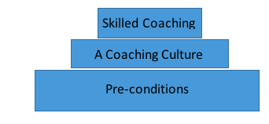
What are the value of the four identified models as pre-conditions to enable a coaching culture to thrive in a school and, what is the impact of the introduction of these models in a school?

Slide 22
Collaboration, upskilling one another, improved teaching and learning, wellbeing
Outcomes
Culture desired
Trust-based culture
The ability to speak openly
The ability to see failure as an opportunity to learn
The ability to give & receive robust, curious feedback
The ability to be adult
Preconditions
The Catalysts
The ZOUD
Transactional Analysis
Growth Mindset
Feedback Model

Slide 23
Pre-conditions and Catalysts to a trust-based culture
The Ability to speak openly - The ZOUD
Growth Mindset
Adult to adult interactions
Open feedback

Slide 24

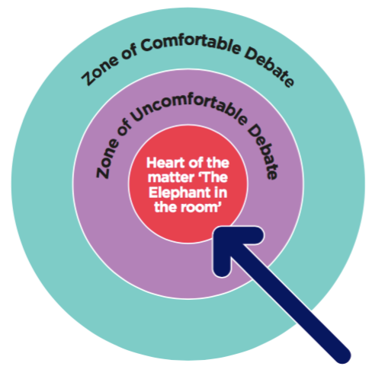
The ability to speak openly and enter the zone of uncomfortable discussion
Model: The ZOUD (Bowman, 1995)
Challenging Coaching . John Blakemore & Ian Day
Notes:
11.45 start

Slide 25
Examples of where the ZOUD was
not used
Jimmy Saville
BHS
The 2008 Financial Crash
  The truth is like poetry – and most people f*cking hate poetry
              The Big Short

Slide 26
Why do some cultures avoid
the ZOUD?
Hierarchy
Ego
‘Protecting’ others
Historical Issues
Too much hassle
Group Think – that’s not what we do around here
A Parent – Child Culture – I tell, you do.
Notes:
(example of likelihood of help in a crowd)

Slide 27

How strong is the ZOUD at your school?
Are difficult issues raised?
Are assumptions tackled?
Are habits examined?
When was the last time you had an uncomfortable conversation?
Notes:
Make link between PEAK & the ZOUD
SLT perspective
TA perspective
Class teacher perspective
What evidence?

Slide 28
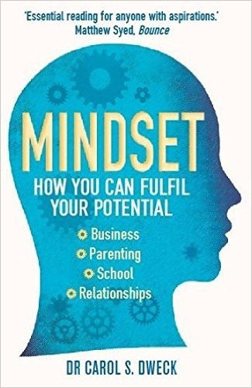
The ability to inhabit a growth mindset Model: Mindset (Dweck, 2006)
Mindset is the attitude needed to enable growth and change – it is fundamental - if you do not believe growth and change are possible they never will be

Slide 29
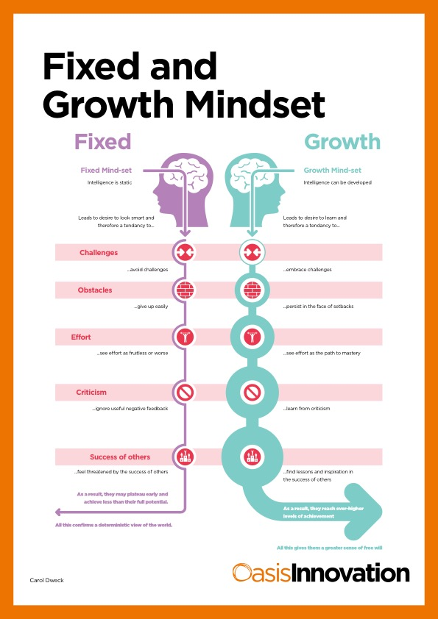
What is your mindset like?

Slide 30
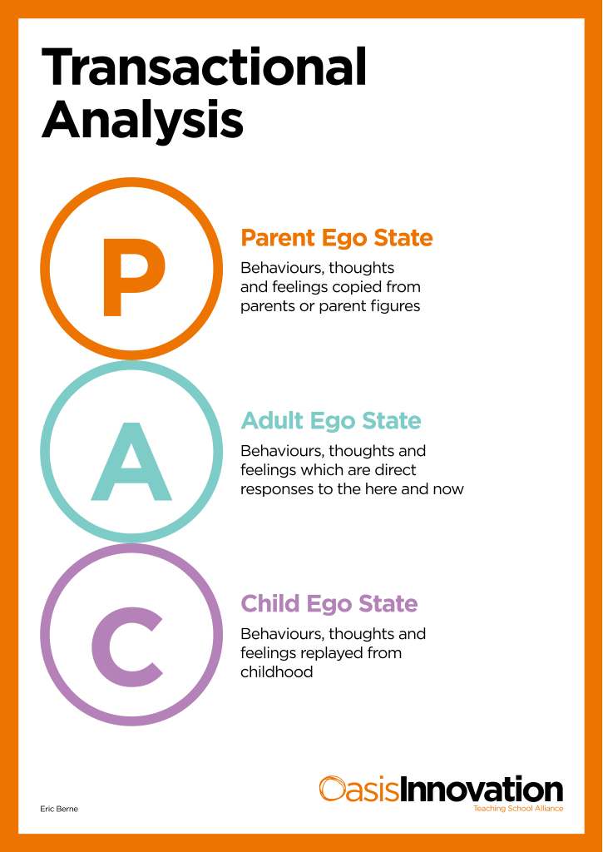
The ability to create adult to adult interactions Model: Transactional Analysis (Berne, 1964)

Slide 31
Parent ego state
This is a set of feelings, thinking and behaviour that we have copied from our parents and significant others.
As we grow up we take in ideas, beliefs, feelings and behaviours from our parents and caretakers. For example, we may notice that we are saying things just as our father, mother, grandmother may have done, even though, consciously, we don't want to. We do this as we have lived with this person so long that we automatically reproduce certain things that were said to us, or treat others as we might have been treated.
Content from Businessballs.com

Slide 32
Adult ego state
The Adult ego state is about direct responses to the here and now. We deal with things that are going on today in ways that are not unhealthily influenced by our past.
The Adult ego state is about being spontaneous and aware with the capacity for intimacy. When in our Adult we are able to see people as they are, rather than what we project onto them. We ask for information rather than stay scared and rather than make assumptions. Taking the best from the past and using it appropriately in the present is an integration of the positive aspects of both our Parent and Child ego states. So this can be called the Integrating Adult. Integrating means that we are constantly updating ourselves through our every day experiences and using this to inform us.
Content from Businessballs.com

Slide 33
Child ego state
The Child ego state is a set of behaviours, thoughts and feelings which are replayed from our own childhood.
Perhaps the boss calls us into his or her office, we may immediately get a churning in our stomach and wonder what we have done wrong. If this were explored we might remember the time the head teacher called us in to tell us off. Of course, not everything in the Child ego state is negative. We might go into someone's house and smell a lovely smell and remember our grandmother's house when we were little, and all the same warm feelings we had at six year's of age may come flooding back.
We might have had a traumatic experience yesterday which goes into the Child ego state as an archaic memory that hampers our growth. Positive experiences will also go into the Child ego state as archaic memories. The positive experiences can then be drawn on to remind us that positive things do happen.
Content from Businessballs.com
Notes:
Use the example bits

Slide 34

The Parent - Child trap
A Parent - Child Culture does not allow for coaching. If you protect and chastise your colleagues as a parent would a child you rob them of the accountability of being an adult. You make them children.

Slide 35
When, professionally, have you been…
In the child state?
In the adult state?
In the parent state?

Slide 36
The ability to give robust feedback
Model: The feedback model (Davies 2015)
1 – Contracting
I’d like to give you some feedback..... Find somewhere appropriate to do this, if needs be ask for the space to be made for the feedback conversation.
2 – Context
Yesterday…… Describe the situation. Be as specific as possible and give the feedback in a timely way.
3 – Behaviour
You said to me/You did X…….Describe the behaviour as clearly as possible, as if you were watching a film. Avoid drawing conclusions.
4 – Impact on what happened /how you felt
The impact of this is (This made me feel)……This is often the hardest BUT the most important stage. Explain the positive or negative impact that you experienced or have been experiencing as a result of the behaviour
5 – Curiosity – I wondered what the reasons are for this happening?

Slide 37
Robust Kindness
Telling the Truth about Performance
The ability to give robust feedback
Model: The feedback model (Davies 2015)

Slide 38
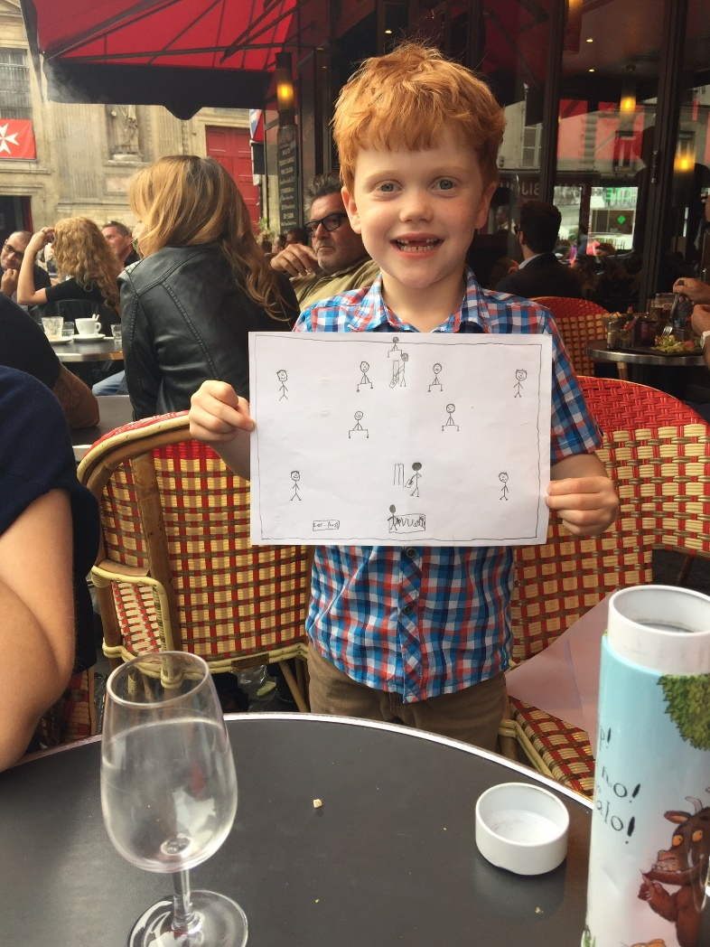
Feedback – what is it?
A member of staff takes you aside and says ‘Do you have a moment? I’d like to give you some feedback.’
How do you feel?

Slide 39
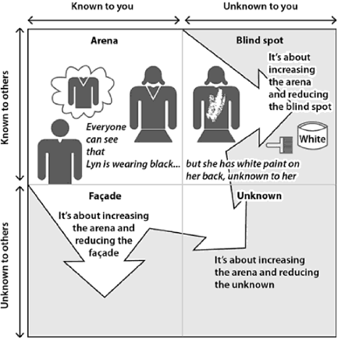
Johari Window
Image from Challenging Coaching – Blakey & Day

Slide 40

Positive Feedback
Reinforces good practices/behaviours
Motivates
Enhances the relationship
People need praise in different ways

Slide 41
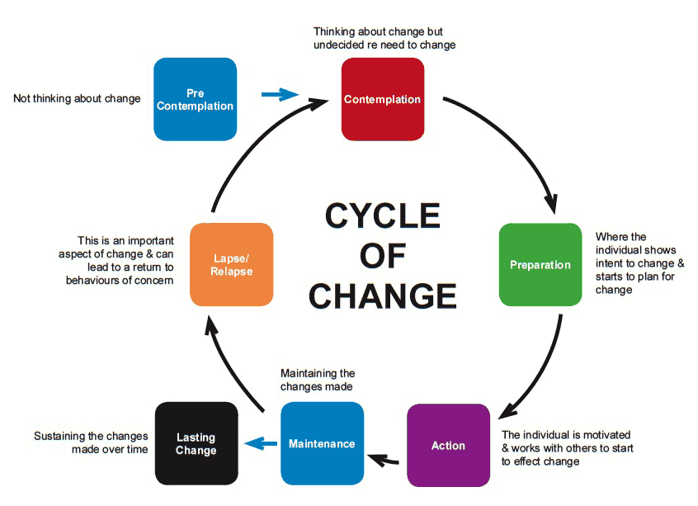
Corrective Feedback

Slide 42
Why don’t people give corrective feedback?
Most often, we’re worried about the other person’s reaction: What if she gets angry? What if he cries? What if she tells me I’m an idiot? What if he gets defensive and starts blaming me? Another thing that makes it hard is not knowing what to say. “I can’t actually tell that person I think he has a bad attitude,” we say to ourselves. “He’ll just tell me he has great attitude, and that I don’t understand/like/respect him, and it will go from bad to worse.”
With all that running through your head…it’s easy to convince yourself it’s not that big a deal, or it will go away, or – this is the worst – If that person were really professional, he/she would figure it out and just stop doing it. That can make you feel completely justified and self-righteous about not giving the feedback. I’ve seen too many people ultimately lose their jobs because their colleagues were not brave enough to give them the needed corrective feedback – and then made it their problem for not magically knowing what they were doing wrong.

Slide 43
What we did at Hogwarts
Staff Culture Vision
‘Hogwarts will be an empowered group of collaborative professionals who upskill one another by knowing what exceptional looks like and hold each other in high regard by giving developmental feedback to ensure excellence. Hogwarts will be impact & expertise driven and each individual will feel responsibility for the collective.’

Slide 44
What we did at Hogwarts
A baseline culture survey and sharing findings with staff
Launch of the identified models alongside the vision, all staff reading Mindset (Dweck,20016) and deep and regular training related to individual contexts regarding ZOUD, growth mindset, TA, and the feedback model
Awards around feedback to promote using the model
Timetabling explicit collaboration opportunities and the introduction of after school ‘tea’ to bring people together
Instigation and chairing of an exceptional learning assistant working group to look at maximizing the impact of learning assistants within the academy and looking to shift embedded mindsets and beliefs that were running counter to the vision

Slide 45
What we did at Hogwarts
Leadership Skills
SLT leadership training focusing on development areas within their roles and change management
Modelling and training of developmental conversations and rigorous objective setting, including the coach sitting in on all performance development meetings, over a two-year period to model, prompt and embed the identified models.

Slide 46
What we did at Hogwarts
Process and Structure
Re-organisation of the Hogwarts hierarchy and clarification of roles
Detailed planning of the school year in entirety, encapsulating every event, training, review, data capture etc. and movement of scheduling and diary management online to create clarity and transparency for all
Clarification and appointment of key subject area leads and a programme of training subject leads in change management and subject area planning and leadership
Introduction and training on a new performance development model which included objective setting around explicit Hogwarts professional behaviours as well as role or teaching objectives
Regular PULSE surveys to feed into the creation and direction for continuous professional development

Slide 47
Outcomes
The SLT felt the effects of the ZOUD most strongly; relationships here were reportedly most strengthened and disagreement is now seen as something healthy
Staff at each level reported that it is safer to speak up, altering how hierarchy was seen
Difficult conversations were increasingly seen as an opportunity to help colleagues, rather than damaging one another
Staff felt empowered and were encouraged by one another to take responsibility for remedying their own issues through feedback. Safety in connecting through feedback was reported as increasing, reducing fear.
Mindset shifted people in the academy in terms of being exposed to an alternative way of thinking and, through its implementation, a tipping point was reported where culturally it was seen as desirable to have a growth mindset.

Slide 48
Proactive Staff
“Now staff come to pupil progress meetings prepared to lead, not reactive, but being proactive”
Teachers feel they are responsible and can change things rather than believing that it is down to the leadership.
Increased wellbeing
Increased efficacy in the school through the well-being and collaboration the models have engendered.
“So, if you are happy to be where you’re at and you feel valued and you feel you’re all in it together, you know, more of a team work, it’s going to feed back into the children.”
Better outcomes for children
A more harmonious working environment and increased communication allowing staff to share working practices and feedback to one another enabling better outcomes for the children.
Genuine investment
Being part of something. Instead of feeling competitive, the collegiate feeling from being connected to each other and the possibility of improvement through growth mindset means staff feel more invested.
“a genuine investment in you as a person and yes they want you to do well for the children and also for yourself.”

Slide 49
Learnings
Trust – Leadership that is truly able to trust is key.
The act of training around social capital, coming together as people
Clarity of roles has been cited by the teacher as having impact on efficacy of the academy.
“We are content in our roles and we’re clear in our roles, so then that will feedback into our classrooms and our everyday jobs”. (T)
This clear structure, in which people feel content and secure, should not be underestimated. If roles and structures aren’t clear, the confusion and instability of who to interact with means that concepts brought in can’t trickle through the stream efficiently.
A school that is in special measures or indeed does not have the basic systems and skill sets in place to function at a basic level as a piece of learning will not able to focus on these ideas. In essence a school in chaos is not a place to use these models for effective change.
Not a quick fix - The leap from this to real behavioural change is challenging and time and resource consuming, needing commitment and compassion from the leadership. Indeed, this may be the biggest challenge in the current education environment.

Slide 50
You are the culture

Slide 51
Jeanie Davies – The Trust Revolution in Schools:Routledge
Jeanie@lcc-consultancy.co.uk

