Slide 1

OFSTED ITT Inspection Update
Centre for Teacher Education
November 2020
Notes:
Slides 1-5 10.50-11.15

Slide 2
Overview
Update on OFSTED/ Core Content Framework
Update on CTE preparations
Priorities
  What can we achieve in the time we have?
  What do we have to do between now and January?
  How can we use existing structures (meetings etc)?
  How can we effectively communicate details with staff, students and schools given the current situation?
  What is the impact of continuing issues with Covid-19 into Spring?

Slide 3
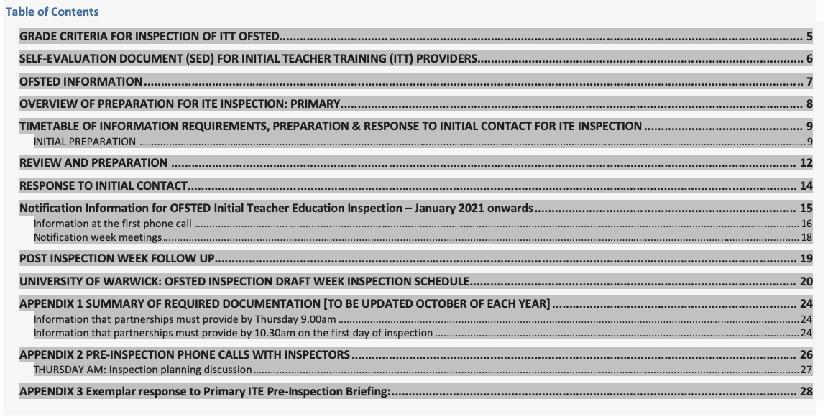

Slide 4
Centre, Alliance and School-based provision/ ITT Core Content
Do we provide our students/ trainees with the knowledge they need?
Procedural Knowledge: ITT Core Content
Knowing how…. to plan, teach and assess
Declarative knowledge: ITT Core Content
Knowing that… (content / knowledge per se)
Critical knowledge: Universities and particularly Russell Group
Knowing why… (principles and theory underpinning professional approaches)
Knowing why… (ethical stance of teacher)

Slide 5
Focus for OFSTED ITE Inspection
COVID-19 (coronavirus)
As schools and educational settings return to a new form of reality, those in ITE will be looking to provide an ambitious curriculum that can be flexibly adapted to meet the ever-changing landscape.
We introduced a transition statement in the good criteria of our handbook, for the education and training judgement, so that partnerships who can demonstrate that they have an ambitious and compliant curriculum, will not be unfairly penalised if they are not able to deliver it in its entirety.

Slide 6
OFSTED ITT Inspection Grade 2 criteria (extracts)
Intent: principles informing the ITE curriculum
Ambitious
In primary and secondary programmes, the ITT core content framework defines in detail the minimum entitlement of all trainee teachers, which all ITT partnerships must incorporate – in full – within their curriculums. The ITE curriculum covers the full entitlement described in the ITT core content framework, including all ‘learn that’ and ‘learn how to’ statements.
Designed around subject and phase
The course structure is designed around subject- and/or phase-specific dimensions.28 The application of any generic principles is taught and practised as and when appropriate.
Purposefully integrated
The ITE curriculum is purposefully integrated across its different partnership settings.
Inclusion and teaching pupils with SEND are meaningfully integrated into all aspects of the training programme.
Informed by up-to-date or pertinent research
The ITE curriculum is designed to ensure that trainees engage with up-to- date or pertinent research findings, for example the research informing the ITT core content framework (for primary and secondary phase trainees).
Trainees know about up-to-date research for promoting inclusion and teaching pupils with SEND, and those who speak EAL. They are able to apply this knowledge in their subject and phase.

Slide 7
Self evaluation / Pre-inspection phone calls with inspectors
the partnership’s context, and the progress it has made since the previous inspection, including assessment of the partnership’s current strengths and weaknesses, and any specific progress made on areas for improvement identified at previous inspections that remain relevant under the current inspection framework
how leaders ensure, and assure themselves of, the ambition of the ITE curriculum, that it is designed around subject and phase dimensions, and that it is coherently planned and sequenced towards cumulatively sufficient knowledge and skills for future learning and employment
for partnerships that include primary and secondary trainees, the way in which leaders have translated the ITT core content framework into a carefully sequenced curriculum for trainees and how they have ensured that all aspects of that framework are covered. Inspectors will also discuss aspects of the programme that go beyond that framework. The discussion will explore how and why leaders have prioritised particular aspects of the programme
how the partnership assesses trainees formatively throughout the course (and summatively against the teachers’ standards for primary and secondary trainees, including those on the assessment only route and the early years teachers’ standards for early years trainees)
how trainees are taught to promote pupils’ positive behaviour and attitudes, and how their practice in meeting the needs of pupils who speak English as an additional language (EAL) and pupils with special educational needs and/or disabilities (SEND) is developed throughout the ITE curriculums offered
how leaders have ensured that the partnership is contributing to and meeting the local demand for teachers
any enhancements and adaptations to the programme to meet the needs of current trainees and local/national priorities
how leaders ensure (where applicable) that the centre-based and placement-based ITE curriculums are integrated to ensure that trainees make the best possible progress in their teaching
how leaders ensure, and assure themselves, that trainees receive clear, consistent and effective training and mentoring
how leaders ensure formative and summative assessment of trainees’ progress in mastering the components of the ITE curriculum, without creating an unnecessary burden.

Slide 8
Additional Questions
11. How does the university ensure the quality of ITE provision across the partnership with schools?
Impact of COVID
Evaluation of the ITT changes to any of the above and their impact arising linked to Covid-19
Evaluation of additional measures to ensure quality, consistency and parity of training for training during COVID-19

Slide 9
Task: Staff Development day & WaSP
In your phase teams discuss the Self evaluation questions and record your feedback
See agenda for timings
Secondary meet in Andy Hind’s BBColl room
Primary meet in Des’ BBColl room
Record your feedback on the self-evaluation form in Teams
https://livewarwickac.sharepoint.com/:f:/r/sites/OFSTEDInspection/Shared%20Documents/General/Preparation%20phase?csf=1&web=1&e=kAODll

