Slide 1
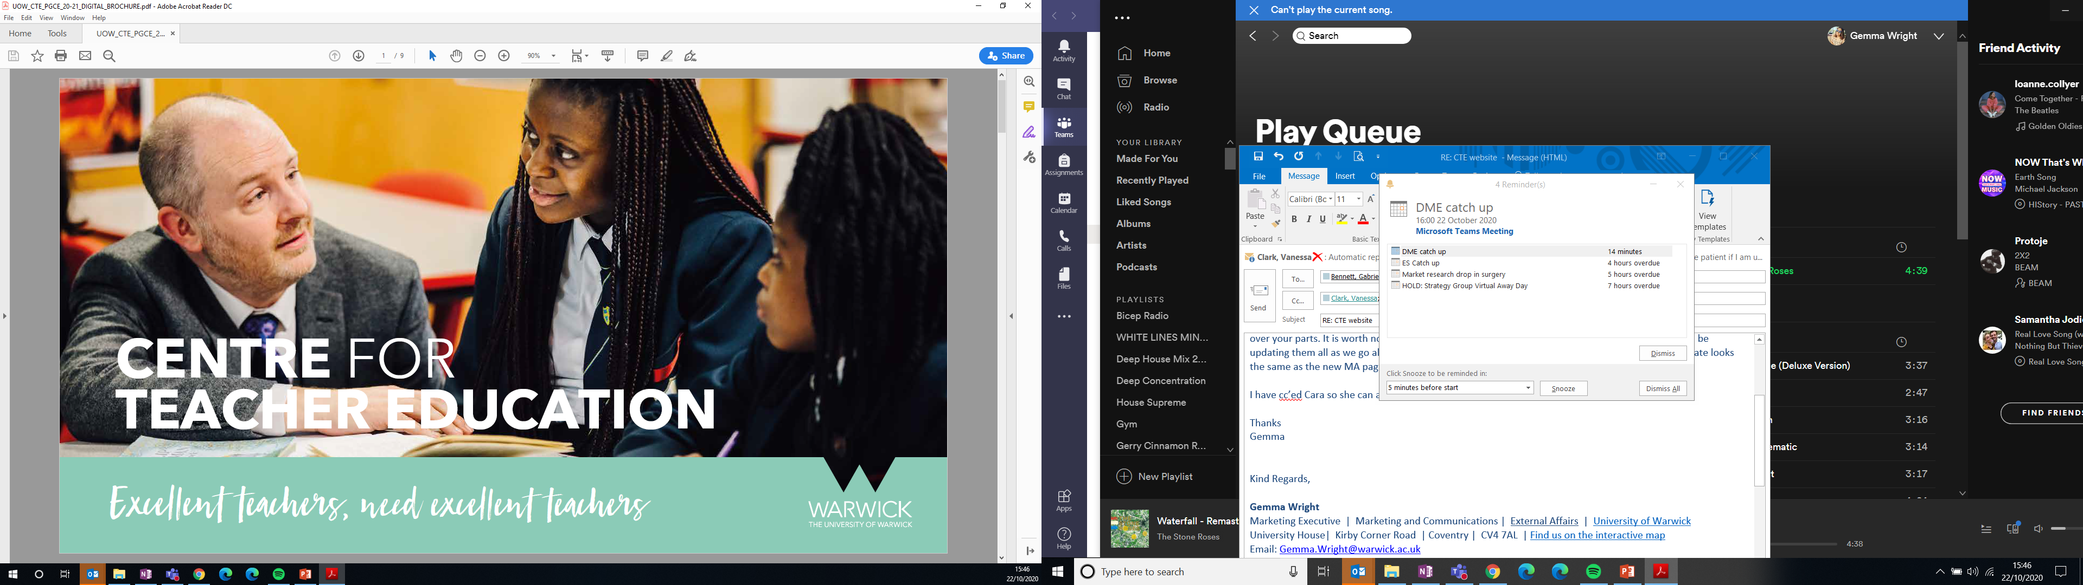
Warwick and Schools’ Partnership meeting
Thursday 1 December 2022

Slide 2
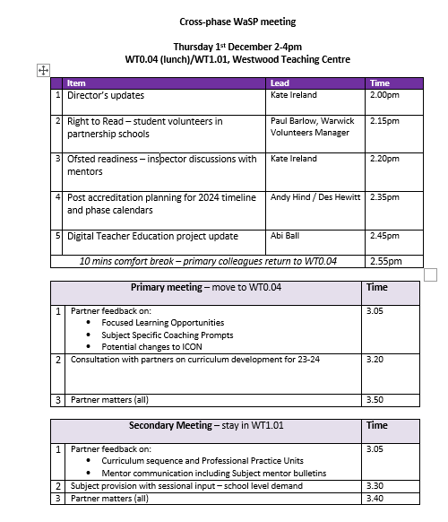

Slide 3

Director’s Update
ITT Accreditation outcome and next steps
The Shape and Size of Warwick’s ITE Partnership 2024 including funding models
School Direct lead partners’ consultation
Digital teaching and learning
International QTS DfE pilot
Teacher supply in hard to recruit areas
Ofsted inspection preparation (agenda item 3 – refer to paper)
Notes:
Kate to lead

Slide 4

2024 curriculum design process

Slide 5
Curriculum design context: response to ITT Market Review
Appreciative enquiry to identify current strengths
  Partnerships
  Warwick Teacher Values
  Academic and professional
New quality criteria
  Curriculum focus
  Course length
  Intensive training and Practice
  Opportunity for course refresh
Notes:
Kate to lead

Slide 6
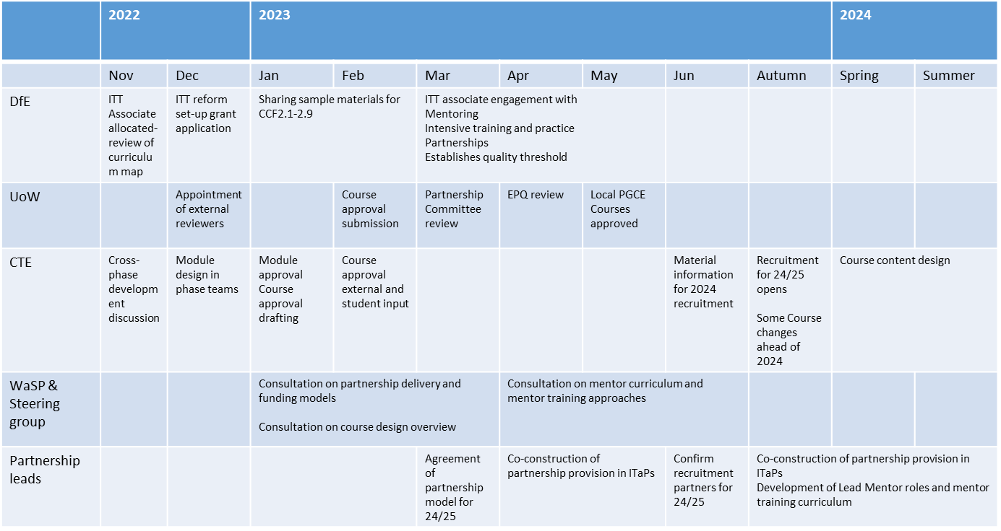
Timeline – 2024 curriculum design process
Notes:
Kate to lead

Slide 7
CTE’s commitments
Work to develop existing strengths to encompass positive changes in ITT in close partnership with schools
Sustain partnerships that contribute to teacher supply regionally and nationally
Recognise and mitigate challenges for partner schools in adapting to the new ITT quality requirements
Notes:
Kate to lead

Slide 8
A call to the WaSP group
Co-construct and consult on new course design that is of consistently high quality, integrates all elements of the curriculum and is agile enough to respond to partnership needs.
Notes:
Kate to lead

Slide 9
Digital Teacher Education Project

Slide 10
Mentoring
Digital Communities of Practice
(DCOPs)
Reusable Learning Objects (RLOs)
Student Experience & Quality Assurance
Local PGCE enrichment
Remote PGCE QTS growth
Remote PGCE non QTS growth
Remote CPD provision
Notes:
Kate to lead

Slide 11

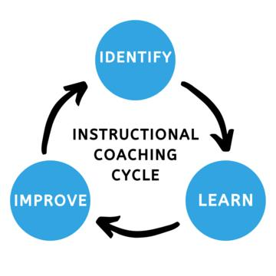

Mentoring
Aim: Support mentors (School and University based) and student teachers to be aware of best practice, engaging in deep coaching meetings.
To trial assistive technologies through otter.ai in supporting content
Focus:
QTS formative assessment.
  Opportunity to align all school-based training with the CRD.
  Supports the trainee to take active ownership of their personal curriculum.

Slide 12
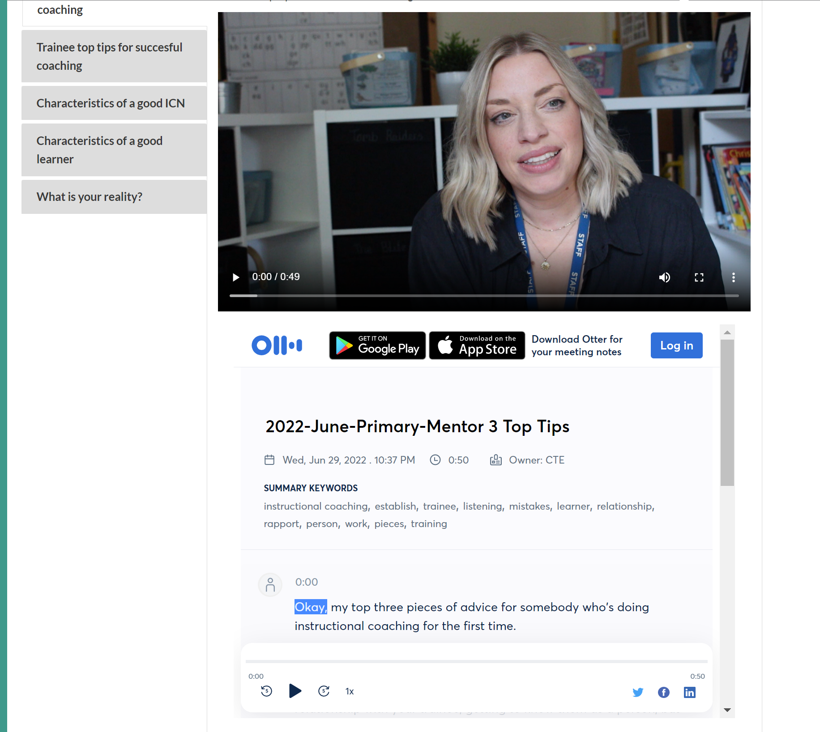
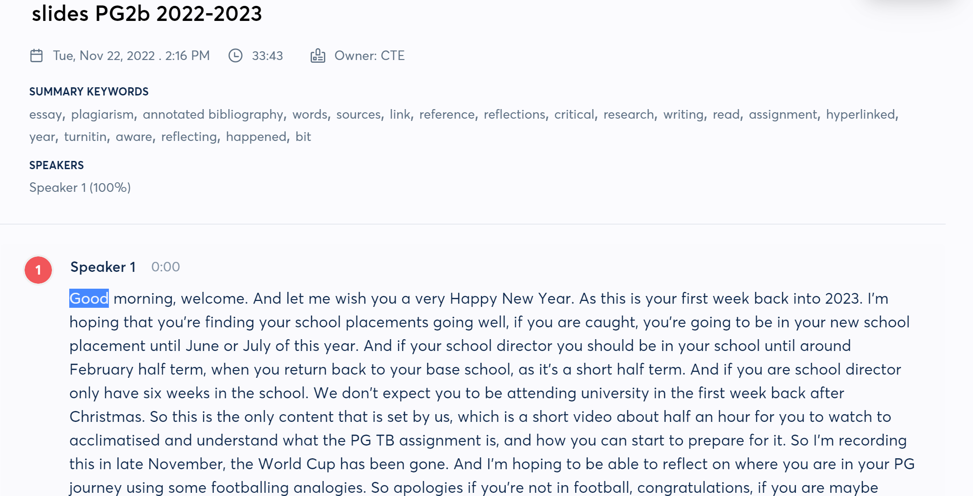
Mentoring and Otter.ai
Example here

Slide 13

Key Impacts and reflections
Reflections:
Cost-benefit in terms of time taken to capture, edit, catalogue, make accessible and disseminate need to be considered.
Future use – permissions for recording children remains a significant barrier.
Students and mentors willing to embrace this (remote I-QTS), could this be a strategy for more remote partners?
Audio/text/video technology – On demand – searchable, clickable, in appropriate format
Plea: Talk to me if you have a policy that lets you record/share videos for training purposes (primary and secondary level)

Slide 14
DCOP (Digital Communities of Practice)
Aim: Identify the ways that multiple users engage with and create a DCOP through shared domain, practice, and community.
Focus:
An outward facing site, bringing together stakeholders from University, schools and students is necessary for a DCOP to be established.
A strong COP focuses on a shared problem, active learning and effective decision making.

Slide 15
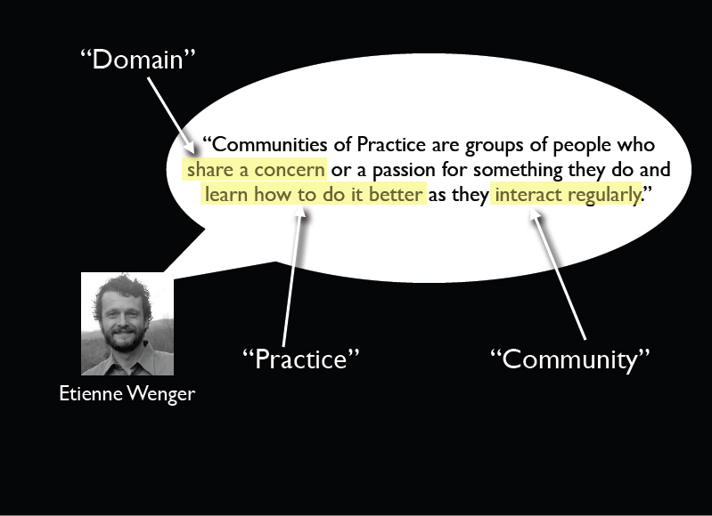
What is one?

Slide 16
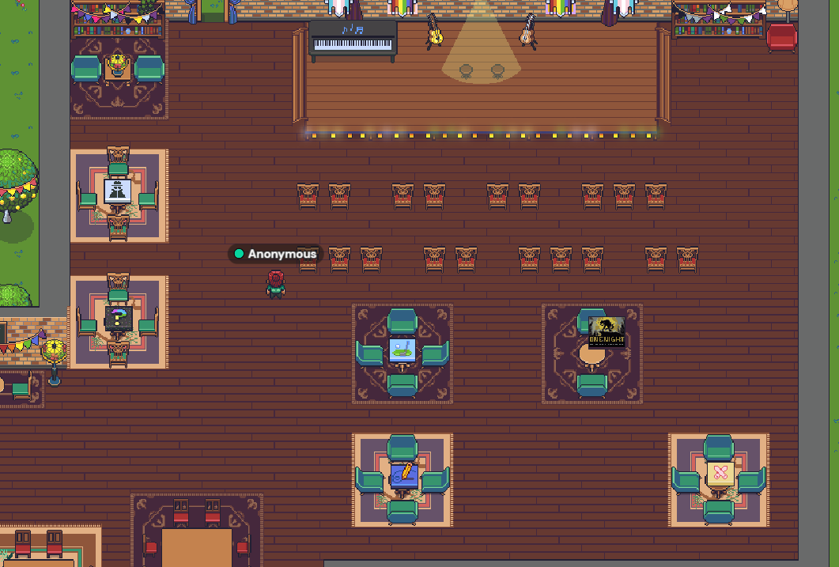
Key Impacts and reflections
It’s ongoing work.
Project finishing July 23.
Focus on Rainbow Allies
Establishing principles rather than platforms

Slide 17
What are RLOs?
Instructional design components that can be used for multiple purposes.
They are usually small components that are developed for a specific use, but which can be conveniently reused in multiple settings, often with little or no editing.
Some practitioners describe them as ‘Lego bricks’.
Notes:
Secondary example – Professional Enquiry Session on Challenging Behaviour (October) – rewards and sanctions records
Primary example – Professional Enquiry resource on Learning to Plan – the process
IQTS example – Professional Enquiry reflective practice models

Slide 18
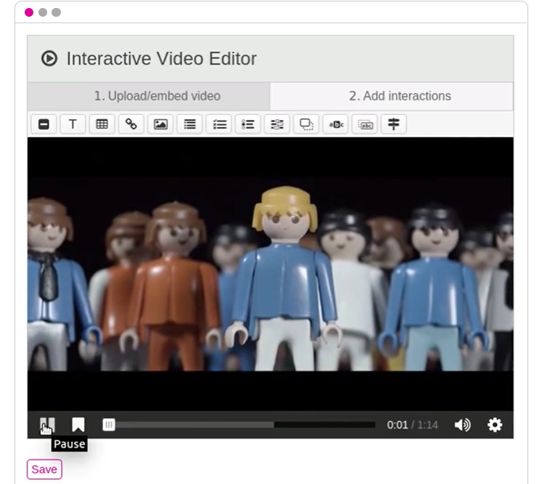
Key Impacts and reflections
Established RLO definition for CTE.
Identified and shared existing RLOs.
Delivered CPD sessions on developing RLOs (e.g., H5P, Padlet).
PGCE-IQTS provided focus
Building up a bank of resources

Slide 19

Student Experience and QA
Aim: To develop a more comprehensive understanding of potential approaches and related tools for student experience and quality assurance activities across local QTS, remote QTS and non QTS teacher CPD programmes.
Focus: Professional Practice (or Work-Based Learning [WBL]) element of the programmes. ​
This project includes an exploratory/developmental study of two portfolios relevant to work-based learning.

Slide 20
Key Impacts and reflections
Using multiple systems not tailored for a specific purpose moves us away from our core purpose.
Seeking digital solutions to our courses that improve student experience.
Mosaic trial has received positive comments from trainees and staff taking part
Moving on the procurement process has started.
Impact could be felt on you as PM/Alliance Lead – dashboards of all trainees may be achievable

Slide 21
Where we are (Dec 2022)
Mentoring
  A lot of time spent with legal depts around sign off
  Laying the foundations for utilising “GoReact” as a platform to capture, reflect and progress student teacher skills using video capture.
Digital Communities of Practice
  Rainbow Allies used as a DCOP, using Gather town.
  Successful Warwick Innovation Fund bid awarded to support the setting up the DCOP, encouraging engagement and using its development as an exemplar going forward.

Slide 22
Where we are (Dec 2022)
Reusable Learning Objects
  Existing RLOs identified.
  Created a Reusable Learning Objects Repository in Moodle.
  Staff development sessions delivered.
  Staff supported through production of RLOs using H5P.
Student Experience and QA
  Testing and evaluation of Mosaic.
  Piloting of Mosaic.
  Piloting of OneFile.

Slide 23
Secondary breakout remain in WT10.1
Primary breakout in WT0.04 (ground floor)

Slide 24
Feedback on 2022/23 changes
Professional Practice Units
Communication with subject mentors e.g., Mentoring Matters Bulletin
Professional Practice Tutor support
Notes:
Kate to lead

Slide 25
Mentor briefing focus
Shift to curriculum focus for briefings: PPU and session links
Subject specific input
  Subject session content
  Setting subject specific targets
  Developing a subject mentoring network
Notes:
Kate to lead

Slide 26
2023/24
New assessments for Subject Studies and Professional Enquiry
Developing authenticity and inclusivity of academic assessment
  Wider formats for demonstrating learning outcomes e.g., professional outputs
Notes:
Kate to lead

Slide 27
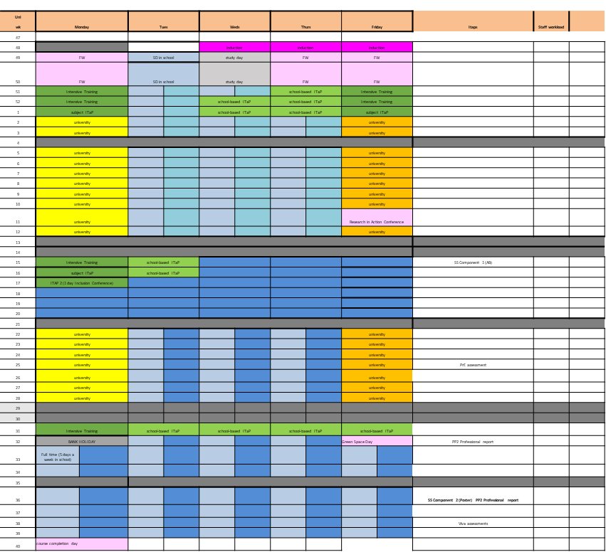
2024 possible course structure
Timing, structure and content of ITaPs
ITaP 1 Behaviour, planning and subject knowledge
ITaP 2 Adaptive teaching
ITaP 3 Working as part of a team
Second placement – SD or Core model?
Notes:
Kate to lead

Slide 28
Increasing subject range
Considering the demand for subject range in secondary
Use of Sessional teaching staff to support wider subject range – call for interest
Notes:
Kate to lead

Slide 29
Thank you for your time
Next meeting Thursday 30 March 2023

