Slide 1

Centre for Teacher Education
WaSP Thursday 13 July 2023

Slide 2
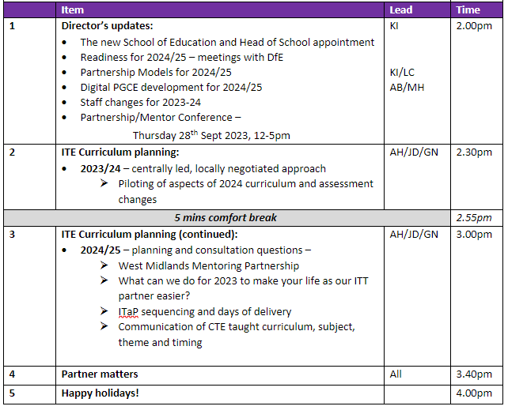

Slide 3
Partnerships 2024/25
Update on partnership models

Slide 4
Model 1: Placement only
Model 2: Recruitment and placement provision management
Model 3: Additional responsibility for the Develop and Embed elements of ITaP provision

Slide 5
Funding will align with current core placement funding (Model 1)
Additional funding to reflect recruitment & placement (Model 2)
Model 3 partners will receive funding in line with a current School Direct partner via a combination of ‘per trainee’ and ‘activity’ funding. The new DfE category is ‘Lead Partner’

Slide 6
Model 1: £1,600 per trainee per year, pro rata for duration and timing of placement
Model 2: Additional £200 per trainee to reflect recruitment and placement management

Slide 7
Model 3: Capacity for recruiting 10+ trainees as a Lead Partner
Lead Partner delivers UoW curriculum content via ITaP Develop days to own and other Warwick trainees
Funding equivalence to current School Direct fee
Achieved based on the Lead Partner recruiting 10+ trainees
Funding subject to unanticipated factors, e.g. further DfE guidance

Slide 8
Cross-Phase Developments
2023/24
2024/25
Alliance days for Primary and Secondary cohorts align on the calendar:
Mon 9th Oct;
Friday 12th Jan;
Monday 8th April
Pilot ITaP in Behaviour management
Mentoring conference including subject specialisms and piloting of part of new mentor curriculum (28/09/23 from 12:00)
New course roll-out
4 cross-phase ITaPs (Behaviour, Planning, Adaptive teaching, Literacy and early reading)
New partnership teaching on ITaPs
New mentor training curriculum
Lead Mentor role established.
First teaching for Social Science, D&T and Business and Economics
2/3 Modules to count for PGCE (1 carried at L6)
Introduction of digital partnership PGCE
First teaching for Social Science, D&T and Business and Economics

Slide 9
Primary Course update
Changes for 2023/24

Slide 10
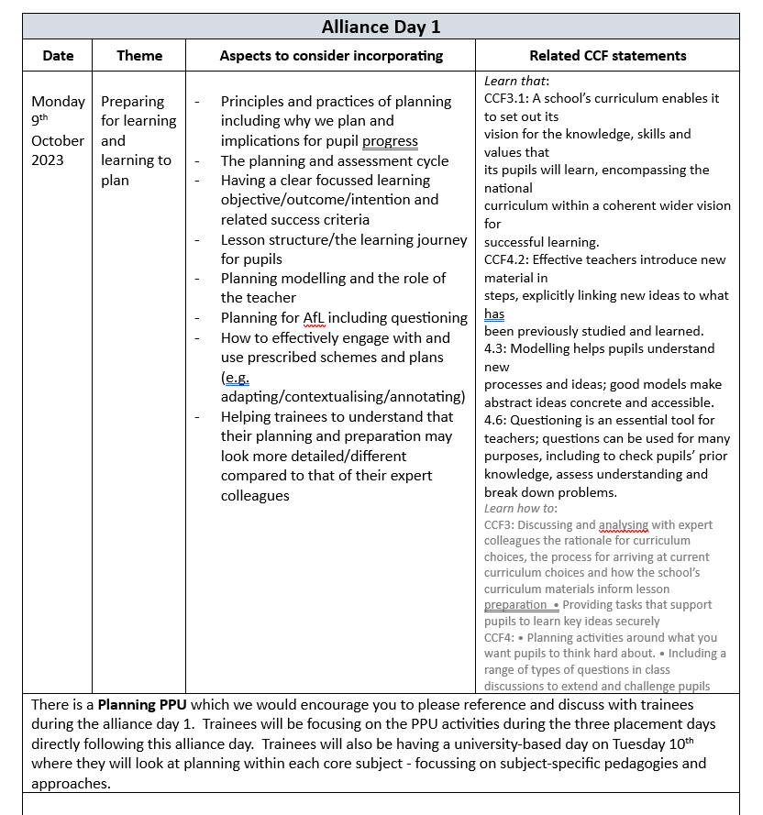
2023/24
Revised calendar and combined timetable to enable Core and SD to follow the same programme
Themed alliance days (one per term):
Preparation for learning/planning; Wider Curriculum;
AoL
Pilot ITaP in Behaviour management
Pilot aspects of ITap in Planning and SSP/Early Reading
Minor updates to PPUs(formerly FLOs) and the CRD
M-level assignments – change of order

Slide 11
Secondary Course update
Changes for 2023 and 2024

Slide 12
2023/24
New assignment briefs for Subject Studies and PEn
SS – Annotated bibliography and critical discussion on an issue or subject pedagogy (60%) follow up presentation (40%)
PEn – Research summary, teachers notes and adapted teaching sequence (100%)
Pilot ITaP in Behaviour management
Minor updates to PPUs and CRD
Maths subject move to Fridays
Mentoring conference including subject specialisms and piloting of part of new mentor curriculum (28/09/23 from 12:00)
Subject lead contact with mentor (SWAY bulletins)
Recruiting for Social Science, D&T and Business and Economics

