Slide 1

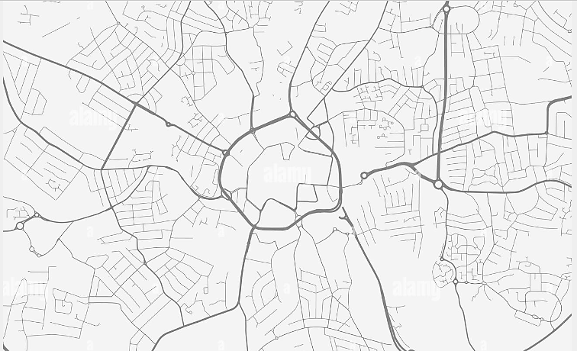
What is the Coventry Oracy Hub?
Coventry has emerged as a trailblazer in oracy education, proudly home to 3 Voice 21 Centres of Excellence, 42 Voice 21 accredited schools and a growing network of schools committed to advancing oracy practices. This positions Coventry as one of the UK’s leading cities in the drive for confident communicators.
Coventry Oracy Hub aims to foster shared learning, collaboration and city-wide impact. By bringing together educators, practitioners and organisations, there are endless possibilities for our children and young people across the city.

Slide 2
Why Oracy?
Research shows that oracy significantly enhances academic achievement, with studies indicating that strong speaking and listening skills improve literacy, critical thinking, and overall learning outcomes (Alexander, 2012; EEF, 2021). Additionally, oracy fosters social and emotional development, helping students build confidence, empathy, and collaborative skills, which are crucial for personal and professional success (Mercer et al., 2019)
Why Coventry?
Coventry is a city steeped in history, innovation and diversity, celebrated for its medieval heritage, engineering legacy and vibrant arts scene, while also being a hub of education with two world-class universities. However, the city faces significant challenges, including high levels of poverty, unemployment, health inequalities and crime, which disproportionately affect its children and young people. By prioritising oracy education, Coventry has the opportunity to empower its youth, bridge gaps in aspiration and attainment and transform life chances for future generations.

Slide 3
How?
Oracy Hub
CPD
Sharing resources
Bitesize CPD
Authentic opportunities for talk
City-wide celebrations
In-school showcases
Sharing in-school planning
Initially, the hub is focusing on:
- Regular, bitesize, online CPD opportunities. The foci of these was chosen at the initial launch.
- Showcasing strategies through in-school showcases, beginning with the centres of excellence.
- Collaboratively planned, authentic opportunities for the youngest voices in the city to be heard.

Slide 4
Want to join us?
Sally Edwards: sally.edwards@castlephoenixtrust.org.uk
Mel Dipple: mel@voice21.org
We currently have over 80 leaders and practitioners across Coventry signed up to be part of the hub. You do not need to be a Voice 21 school.
If you’d like more information or would like to join us at our first CPD session next week, please get in touch:

Slide 5



Coventry Oracy Hub Upcoming Dates
Next Spotlight CPD Sessions:
Tuesday 8th April, 3:45–4:15: “Listen Up! Teaching Listening Explicitly“
Tuesday 6th May, 3:45–4:15:
“Word Play: The Explicit Teaching of Vocabulary”
Charter Primary Open Morning
Thursday 22nd May – more information to follow
Event Date
Thursday 26th June – more information to follow
Notes:
Mel and Sally

