Slide 1
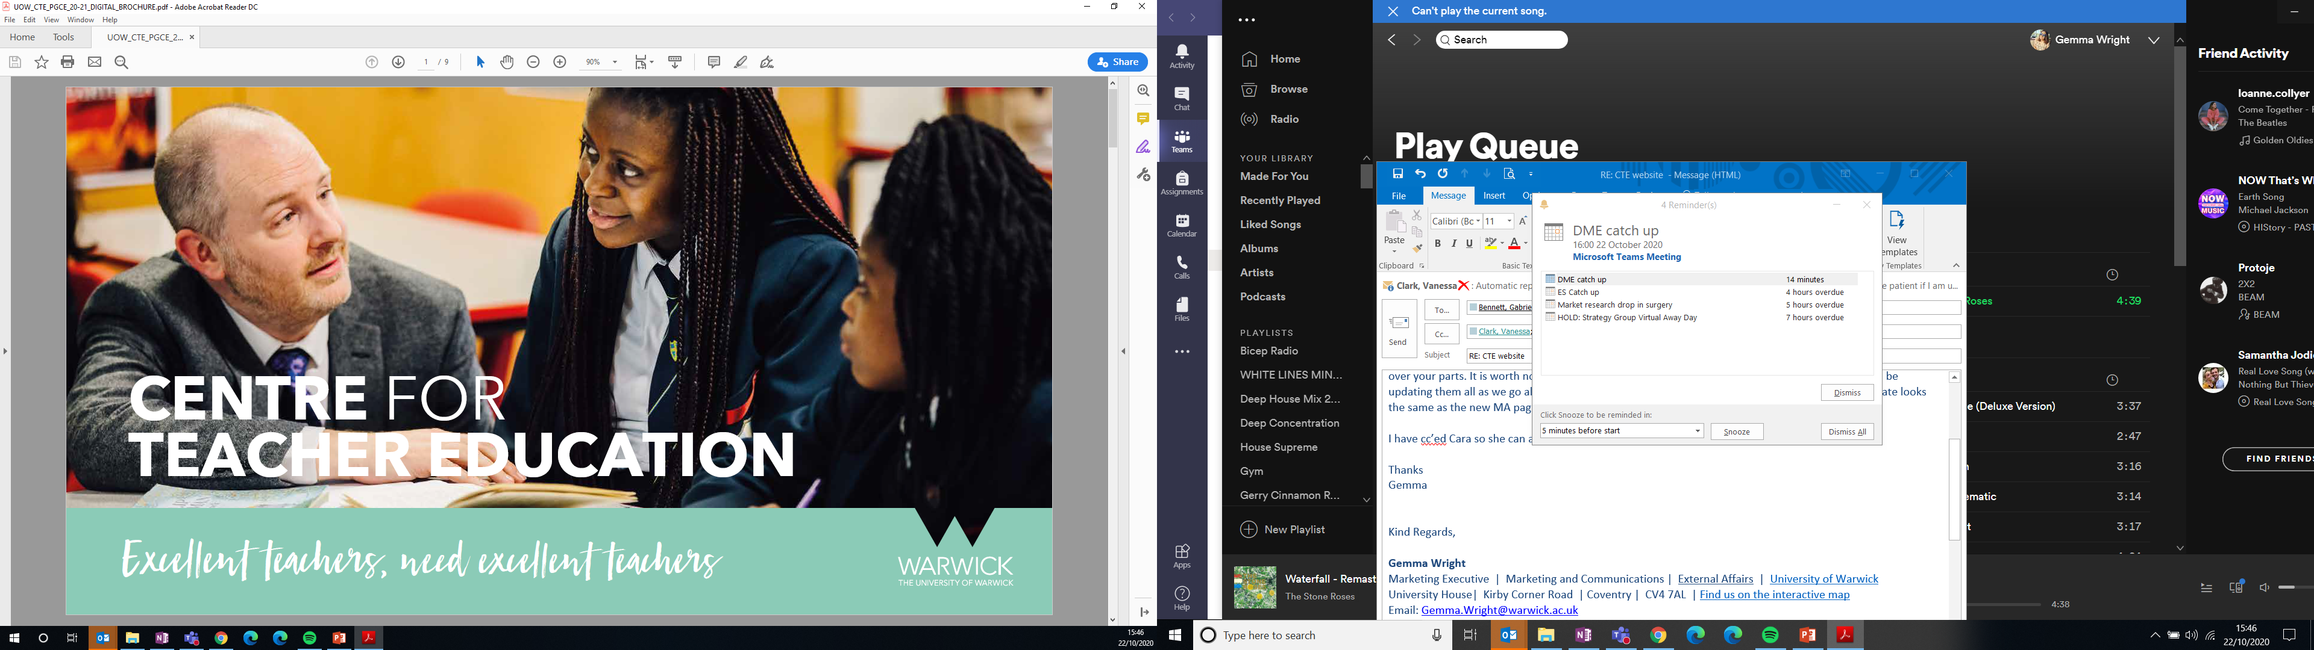
Warwick and Schools’ Partnership meeting
Thursday 30 March 2023

Slide 2

Director’s Update
Kate Ireland

Slide 3

PGCERT
Professional Education
Centre for
Teacher Education
DESIGNED TO GIVE THE TWO THINGS THAT TEACHERS NEED MOST: FLEXIBILITY AND CONSISTENCY.

Slide 4
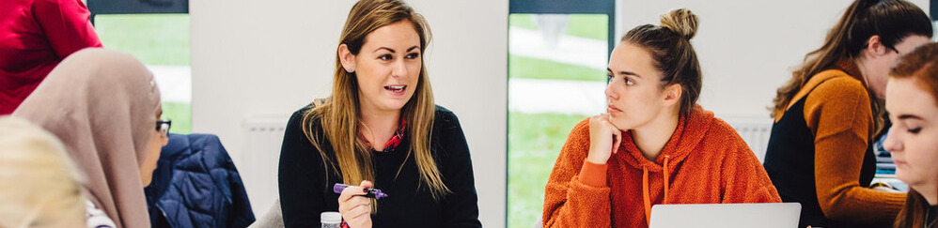
WHO IS THE POSTGRADUATE CERTIFICATE FOR?
For individual classroom teachers and school leaders who want to exchange their work-based learning and professional development for academic credit.
For school leaders who want a way to reward staff for work-based learning with academic credit.
WHY IS ACADEMIC CREDIT WORTH HAVING?
A teacher or school leader can add it to their CV and take with them.
Academic credit denotes a level of critical engagement and reflection higher than that required by other CPD courses such as NPQ qualifications – it shows that you have taken your evaluation of your work to the ‘next level’.
Academic credits can be used towards the MA in Professional Education at the Centre for Teacher Education, Warwick.

Slide 5



Slide 6
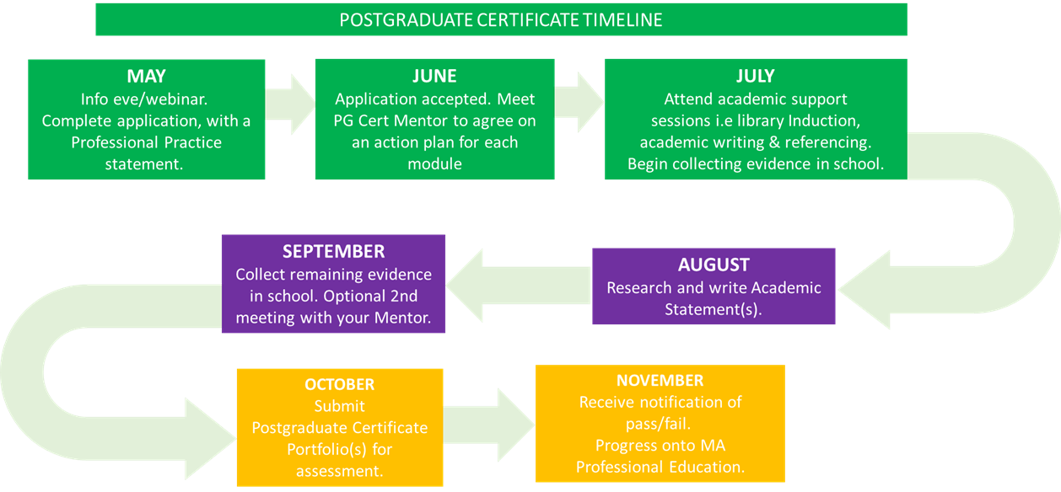

Slide 7
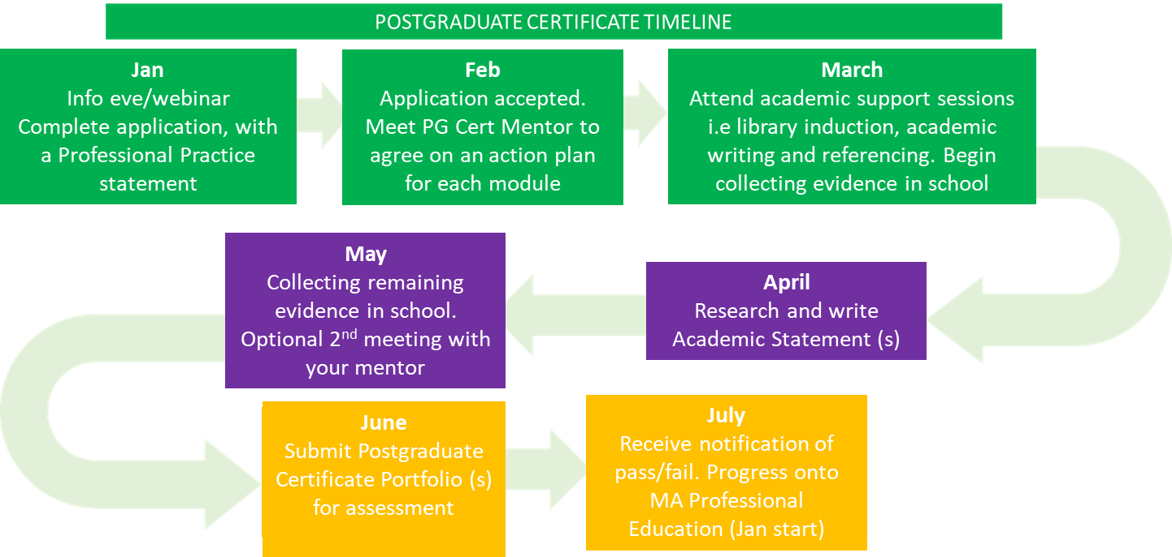

Slide 8

2024 curriculum design and stage 2 readiness update
Andy Hind

Slide 9
Timeline – 2024 curriculum design process
 | 2022 |  | 2023 |  |  |  |  |  |  | 2024
 | Nov | Dec | Jan | Feb | Mar | Apr | May | Jun | Autumn | Spring | Summer
DfE | ITT Associate allocated- review of curriculum map | ITT reform set-up grant application |  |  | Sharing sample materials for CCF2.1-2.9 | ITT associate engagement with ITaP |  | ITT associate engagement with Partnerships | ITT associate engagement with Mentor curriculum | Approval from the DfE to deliver from 2024
UoW |  | Appointment of external reviewers |  |  | Course approval submission | Partnership Committee review | EPQ review Local PGCE Courses approved
CTE | Cross-phase development discussion | Module design in phase teams | Module approval Course approval drafting | Course approval external and student input |  |  |  | Material information for 2024 recruitment | Recruitment for 24/25 opens Some Course changes ahead of 2024 | Course content design
WaSP & Steering group |  |  | Consultation on partnership delivery and funding models Consultation on course design overview |  |  | Consultation on mentor curriculum and mentor training approaches
Partnership leads |  |  |  |  | Agreement of partnership model for 24/25 | Co-construction of partnership provision in ITaPs |  | Confirm recruitment partners for 24/25 | Co-construction of partnership provision in ITaPs Development of Lead Mentor roles and mentor training curriculum

Slide 10
Curriculum design context: response to ITT Market Review
Approval of new modules and course for 2024
  - More authentic forms of assessment
  - Inclusive approach to assessment
  - Alignment of phase approaches where appropriate
Readiness checks
  - Teaching material samples to the DfE by 19th April
  - QA associate readiness checks in spring/summer and autumn term covering ITaPs, Mentor Curriculum and Partnerships

Slide 11
ITaP updates
ITaP focus | CCF links | Timing | Length
Foundations of teaching | Setting high expectation Planning structured lessons Introducing new content | Sept/Oct | 8-10 days
Adaptive Teaching | Adapting practice to meet the needs of disadvantaged learners (including SEND & EAL) | Jan | 4-6 days
Literacy and early reading | Supporting reading, writing and oracy (early reading in Primary) (Subject specific literacy in Secondary | Oct (Oct and May for Secondary) | 5-7 days
Alignment of phase focus to cover
Behaviour Management and Planning in foundation phase
Adaptive Teaching, SEND and EAL in term 2
Literacy and early reading (including SSP), term 1 (primary), term 1 and 3 (secondary)

Slide 12
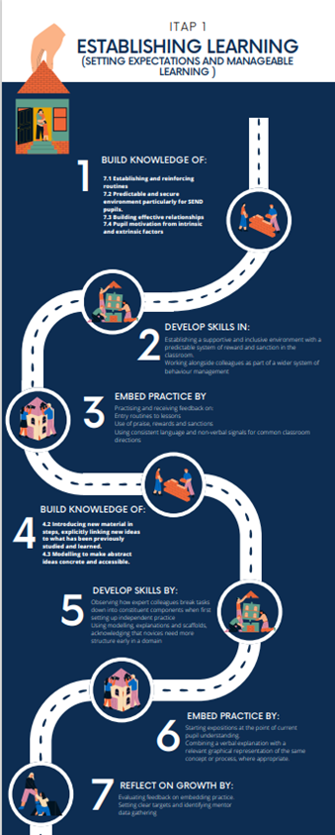
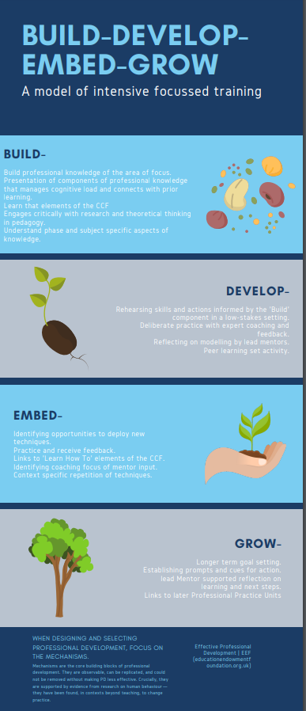

Slide 13

Mentoring Conference 2023 proposals
and Mentor Curriculum planning
Julie Taylor and Kate Hamer

Slide 14
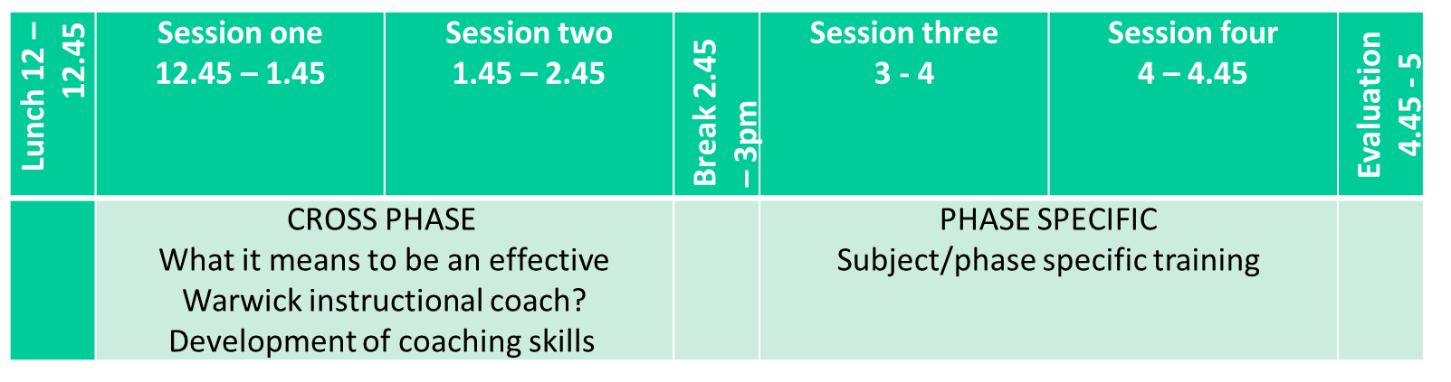
Partnership conference
Proposed date: Thursday 21st or 28th September 2023
Time: 12pm – 5pm: starting with a 45mins lunch, 15 mins coffee break.
Synchronous and Face to Face.
Asynchronous resources.

Slide 15
Mentor curriculum – 20 hours
Assumption that fundamental skills of a mentor are in place through cross-institution provider (NASBTT?)
Mentoring conference will focus on Warwick mentor curriculum guided by the PPUs
Mentors will work with lead mentors to understand what it is to be a phase/subject mentor supporting the trainee through the phases of learning
        Foundation
        Establishing
        Independence/teacher ready

Slide 16

Digital Teacher Education Project
Abi Ball

Slide 17
Strategic priorities:
At the end of the Phase II Strategy renewal process, CTE established six departmental strategic priorities that it intends to implement over the next five years:
  Respond to the changes and evolution of teacher education.
  Be the very best teacher educators.
  Deliver transformational teaching and learning: Develop our digital distinctiveness.
  Achieve sustainable target recruitment numbers.
  Build and maintain an environment in which staff and students flourish.
  Increase and disseminate our wider educational impact on a regional, national, and international level.
Notes:
This is a summary of the work undertaken in CTE during the first year of the Strategy Renewal Process (2022) on strategic priorities three and six. This work has taken place under the auspices of the CTE Digital Teacher Education Project.

Slide 18
Challenges
How to:
  utilise our expertise in online and blended learning on all our programmes.
  offer cost-effective teacher training in geographically dispersed, hard to recruit to locations where ‘in person’ attendance at university sessions is not possible.
  compete with other digital teacher education providers who offer a lower cost model approach to ITE.
Notes:
Challenges to extending CTE’s portfolio and expertise.

Slide 19
Four project strands:
Mentoring (Anna Donnelly, Jonty Leese (L))
Digital Communities of Practice (DCOPs) (Miriam Averna-Joint, Abigail Ball (CL), Jonty Leese(CL), and Jen Rowan-Lancaster
Reusable Learning Objects (RLOs) (Abigail Ball (L), Will Haywood, and Kirsty Weeks)
Student Experience and Quality Assurance (QA) (Georgina Newton (L) and Deborah Roberts)
Notes:
Four key project strands were established to address these challenges.

Slide 20
Mentoring
Purpose:
To consider how CTE can provide video technology for students and mentors to easily record and share video content.
To encourage mentors to use instructional coaching principles during their mentoring sessions to support students’ learning.
Activity:
Testing GoReact on the pilot International QTS/PGCE programme as a possible solution for the remote observation of student teaching practice and the quality assurance of mentor meetings.
Notes:
Purpose: This will enable CTE to develop its digital distinctiveness and to increase and disseminate its wider educational impact irrespective of where our students and mentors are located.
Activity: This will reduce the need for physical moderation meetings, reducing staff travel time and costs. It will also ensure that our mentors are using appropriate instructional coaching principles to support our students’ learning.
GoReact: Video recording software similar to Iris.

Slide 21
Mentoring
Impact:
Developed a collection of resources to help students use video capture to support their teaching and to benefit their reflective practice and critical thinking skills.
Produced video content for use in mentor training sessions to support instructional coaching principles across the CTE partnership.
Next steps:
Evaluation of GoReact.
Disseminating video recording and sharing guidance for students and mentors.
Creating best practice guidance for using video as a moderation tool.
Obtaining funding for GoReact licence.
Working with Coventry LEA to establish a policy for using video to record pupil interactions with students during their teaching practice.
Rolling policy out to our partners.

Slide 22
Digital Communities of Practice (DCOP)
A community of practice is a group of people who:
‘share a concern or a passion for something they do and learn how to do it better as they interact regularly.’
Wenger-Trayner and Wenger-Trayner (2015, para. 5)
A digital (virtual or online) community of practice has the same definition, but it is created, developed, and maintained using the internet.
(Sibbald, Burnet, Callery and Mitchell, 2022)

Slide 23
DCOPs
Purpose:
To establish best practice guidance to facilitate the exchange of ideas and expertise among CTE’s stakeholders, allowing them to learn from one another and to stay up to date with the latest developments in their field, irrespective of their location.
Activity:
Testing the effectiveness of different methods of establishing and running a DCOP using Rainbow Allies as a pilot community.
Piloting gather.town as a possible DCOP enabler.
Notes:
Purpose: Once again this will enable CTE to develop its digital distinctiveness and to increase and disseminate its wider educational impact irrespective of where our students and partners are located.
Activity: Although strategic priority five was not originally included within the scope of this project, the work of this strand will also enable us to build and maintain a supportive environment in which our staff, partners and students can flourish.
Rainbow Allies: is one of many Equality, Diversity and Inclusion initiatives at Warwick that is looking to create an open, safe, and inclusive environment for all LGBTQUA+ colleagues, students, and visitors at Warwick.
Gather.town: Web-conferencing software where participants can see themselves as little characters (or avatars) in the virtual room they are occupying. They can move around the room and interact with other participants either in public areas (like cafés) or private areas (like meeting rooms) using audio, video, and chat. Participants can also interact with objects that have been uploaded into the room such as images or links.

Slide 24
DCOPs
Impact:
The knowledge gained has enriched our understanding of communities of practice generally and DCOPs specifically.
Using the expertise within CTE, cross phase and cross programme has highlighted increased opportunities for collaboration.
We have also established publicly available good practice guidance for setting up DCOPs.
Next steps:
Continuing to experiment with different iterations of DCOPs including trialling pop-up communities of practice at cross-phase online conferences.
Taking lessons learnt into the planning of our new online PGCE programmes for 2024.
Championing social justice communities of practice as a unique characteristic of the Warwick Teacher curriculum.
Evaluating gather.town as a tool for enabling the development of DCOPs.
Creating a business case for the roll out of gather.town.
Disseminating the good practice guidance for DCOPs across our partnership.
Notes:
Impact: Anyone can learn from our experiences and create their own DCOP for whatever purpose they need.

Slide 25
What is a RLO?
Reusable Learning Object (RLO) are instructional design components that can be used for multiple purposes.
They are usually small electronic components that have been developed for a specific use.
They can be conveniently reused in multiple settings, often with little or no editing (Pappas, 2016).
Some practitioners describe them as ‘Lego bricks.'

Slide 26
RLOs
Purpose:
To establish an evidence-informed process for developing, storing, sharing, and updating a collection of RLOs that are built around the Warwick Teacher Values of Social Justice, Intellectual Curiosity, and Creativity.
Activity:
Developing a collection of RLOs that reflect the five core areas of the Initial Teacher Training (ITT) Core Content Framework (Behaviour Management, Pedagogy, Curriculum, Assessment, and Professional Behaviours) and are suitable for use on all our programmes.
Notes:
Purpose: The development of this collection will enable us to utilise our expertise in online and blended learning on all our programmes, to offer cost-effective teacher training resources in geographically dispersed, hard to recruit to locations.

Slide 27
RLOs
Impact:
CTE has a growing collection of RLOs available for staff to use on any PGCE programme across all five core areas of the ITT Core Content Framework.
Developing RLOs for use in the Professional Practice Units (PPUs).
Showcasing our work to our stakeholders.
Developed publicly available guidance on how to create RLOs.
Next steps:
Evaluation of the RLOs in use across all PGCE programmes. This includes those used for pre-session activities, session activities and PPUs.
Develop further RLOs as part of the curriculum planning activities for 2024.
Establish a publicly available storage solution for the RLOs at Warwick.
Develop a process for the annual review of CTE RLOs to ensure they stay up to date and relevant.
Notes:
PPUs are on-placement experiences designed to integrate provider-led and in school-experiences.

Slide 28
Student Experience and QA
Purpose:
To provide recommendations for the purchase/development of a digital data management system for the work-based learning elements of our QTS programmes.
Activity:
Testing Mosaic on the pilot International QTS programme as a possible digital data management system.
Notes:
Activity: This reduces the need for all our stakeholders to integrate with multiple systems thus enabling efficiencies in stakeholder time costs. In our satisfaction surveys, students and mentors indicate that having multiple disconnected systems, alongside our current assessment solution is unwieldy and time-consuming. Thus, an innovative solution is critical to maintain engagement from our current partner schools and to sustain us as a provider of choice within the sector.

Slide 29
Student Experience and QA
Impact:
Positive feedback has been received from participants on the pilot in relation to logging assessment information, navigation, security and use on mobile devices.
Although we are only part way through the pilot period, Mosaic has shown itself to offer significant advantages over the current Excel spreadsheet solution.
Next steps:
Evaluation of Mosaic as a digital data management system.
Pilot the use of OneFile on the Assessment Only programme in the summer term to establish if it is a viable alternative to Mosaic.
Undertake efficiencies identification work.
Secure funding.
Initiate tender process.
Notes:
Due to the ongoing pilot work (until end of term three) and subsequent evaluation, we will be continuing with the current digital data management system for the Professional Enquiry module in academic year 23/24. Any new system will be introduced for academic year 24/25.

Slide 30

Alliance Day Planning 2022-23
Jonty Leese

Slide 31
What our expectation are and why:
before the cycle
during the cycle
future cycles
Notes:
Due to the ongoing pilot work (until end of term three) and subsequent evaluation, we will be continuing with the current digital data management system for the Professional Enquiry module in academic year 23/24. Any new system will be introduced for academic year 24/25.

Slide 32
At the start of the year: Before the cycle (2022-23)
Thematic Content shared for both SD and Core (Secondary)
The LOs shared are the same ones that we use to plan our core day delivery with
Menu of suggested theme and content shared with SD if primary only context (Primary)
Why:
Time to prepare for all phases
Planning appropriate expert colleagues in school
Familiarise selves with new paperwork/processes (PPU/FLOs, CRD)
Notes:
Due to the ongoing pilot work (until end of term three) and subsequent evaluation, we will be continuing with the current digital data management system for the Professional Enquiry module in academic year 23/24. Any new system will be introduced for academic year 24/25.

Slide 33
Before every alliance day: During the cycle
Communication with partners in advance
Plans and links to CCF, PPUs returned to us (feedback offered)
We pop in to see what’s happening and hear student voice (feedback offered)
You share student voice after each session
Why:
“Fidelity” of delivery, every provider should be covering the same core LOs (secondary)
Coverage of the CCF (P and S)
Integration with PPUs (P and S)
Breadth of training (P and S)
Notes:
Due to the ongoing pilot work (until end of term three) and subsequent evaluation, we will be continuing with the current digital data management system for the Professional Enquiry module in academic year 23/24. Any new system will be introduced for academic year 24/25.

Slide 34
End of the year and Next year: Future Cycles 2023-2024
Feedback always appreciated at the end of this cycle to feed forward
Clear controls to prepare you for 2024/25 changes with an “ingathering” strategy to support you if these days are hard to cover
Expectation of meeting these standards.
Secondary: Content, days and themes remain the same. Dates may change slightly​
Primary: Reduced to three alliance days (Specific focus for each day)
Consideration of standardised planning pro forms
Why?
Full entitlement to the curriculum (CCF, PPUs, CRD)
Floor level comfortably met
Parity for trainees
Notes:
Due to the ongoing pilot work (until end of term three) and subsequent evaluation, we will be continuing with the current digital data management system for the Professional Enquiry module in academic year 23/24. Any new system will be introduced for academic year 24/25.

Slide 35
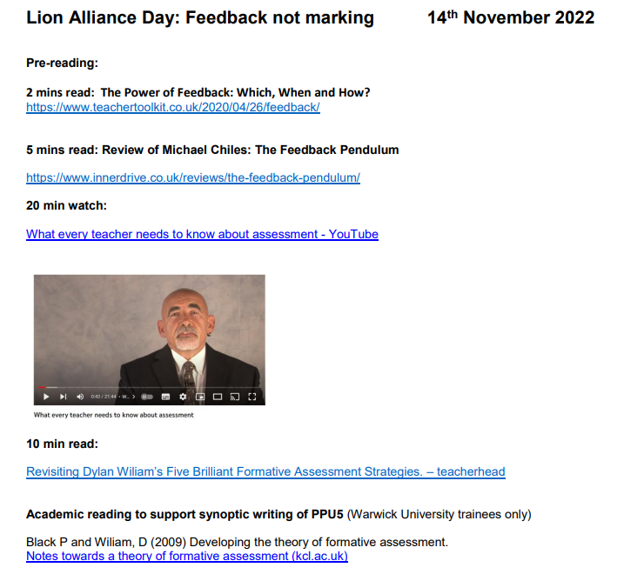
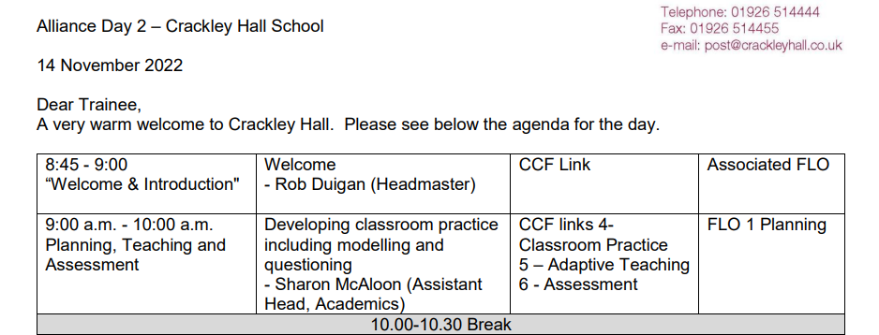

Examples for next year…
Or delivery of ITAP elements

Slide 36
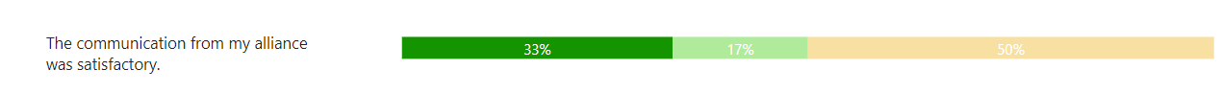
Take Away from mid term evaluations
Feedback always appreciated at the end of this cycle to feed forward
Communicate clearly
Notes:
Due to the ongoing pilot work (until end of term three) and subsequent evaluation, we will be continuing with the current digital data management system for the Professional Enquiry module in academic year 23/24. Any new system will be introduced for academic year 24/25.

Slide 37
Primary curriculum updates for this term
Jo Dobb

Slide 38
Integration of the taught programme:
University and School Placement
Understanding of the Warwick Curriculum: Q. How well do you feel you can make links with what the trainees have learnt in university during mentoring sessions? Q: Talk to me about how your school provides effective ITT training provision informed by and building on the Warwick curriculum Talk through ways in which we share the ITE curriculum:
FLOs | Email bulletins for Mentors
Week-by-week guidance in Placement Guide | CRD –assessing trainees against our ITE curriculum
Subject Specific Coaching Prompts | Curriculum Maps (handbook)
Q. Any further training/support that you would benefit from?
Notes:
Due to the ongoing pilot work (until end of term three) and subsequent evaluation, we will be continuing with the current digital data management system for the Professional Enquiry module in academic year 23/24. Any new system will be introduced for academic year 24/25.

Slide 39
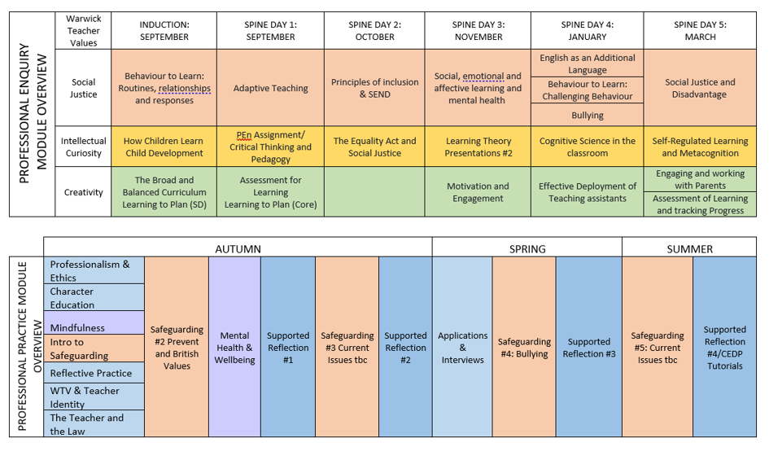
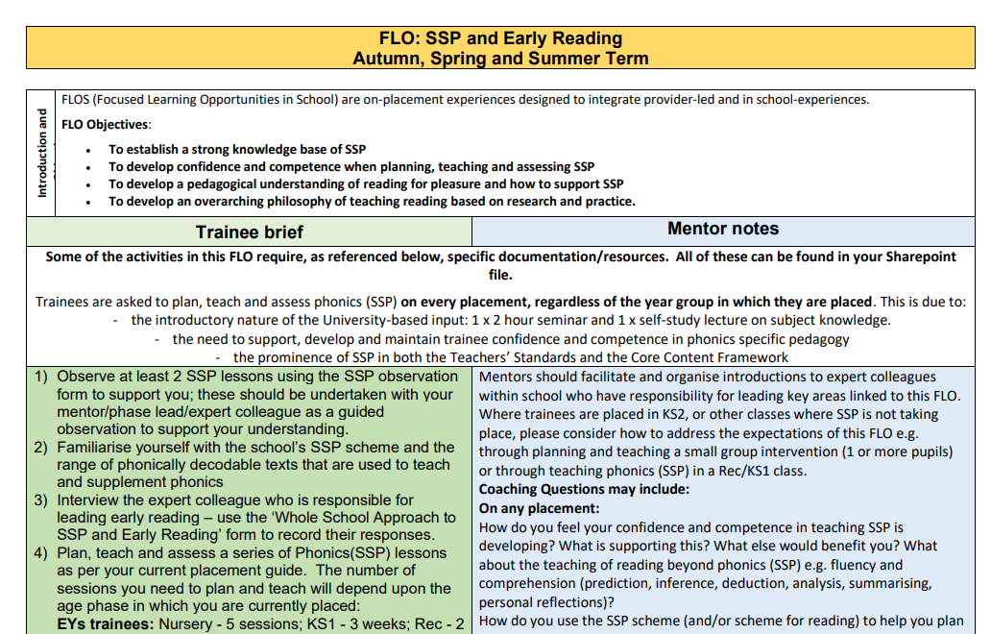
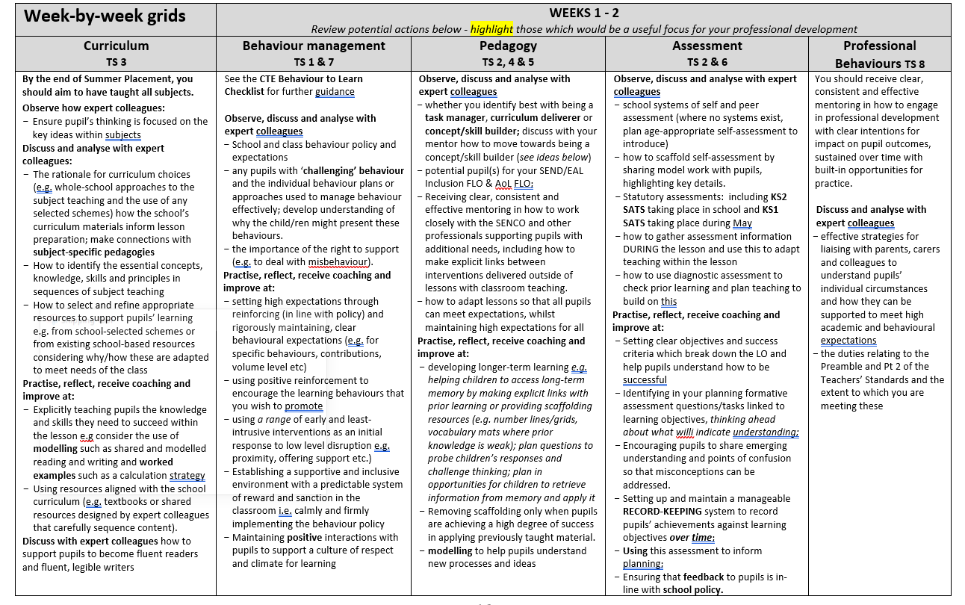
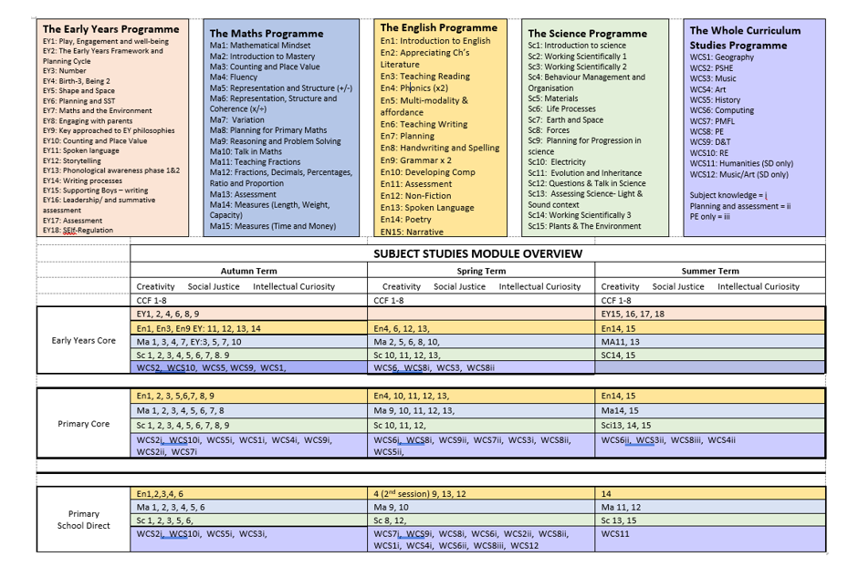
Integration of the curriculum: University and School Placement

Slide 40
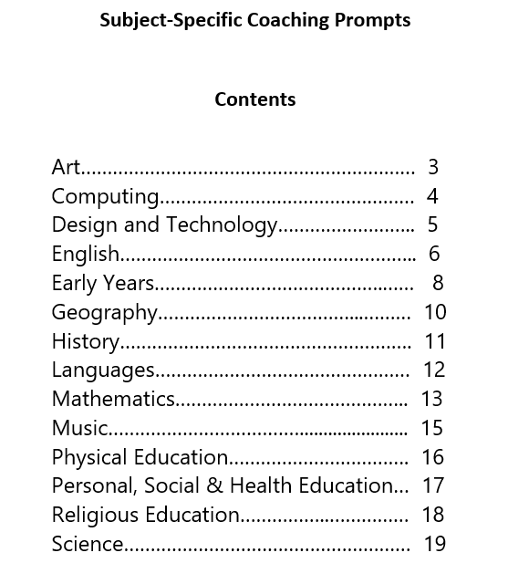
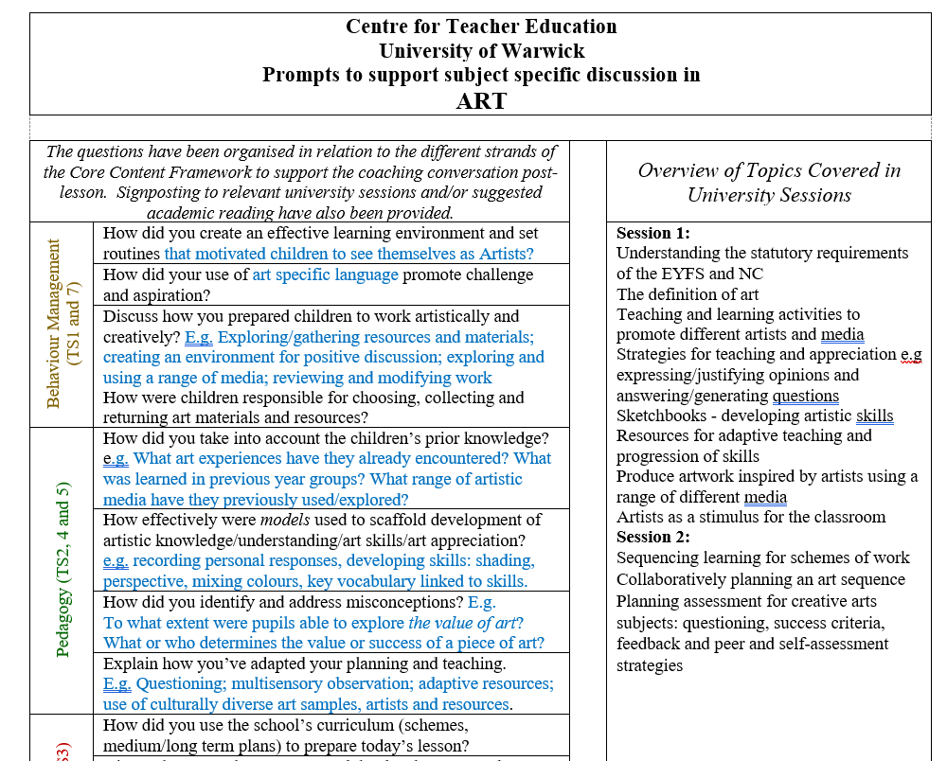
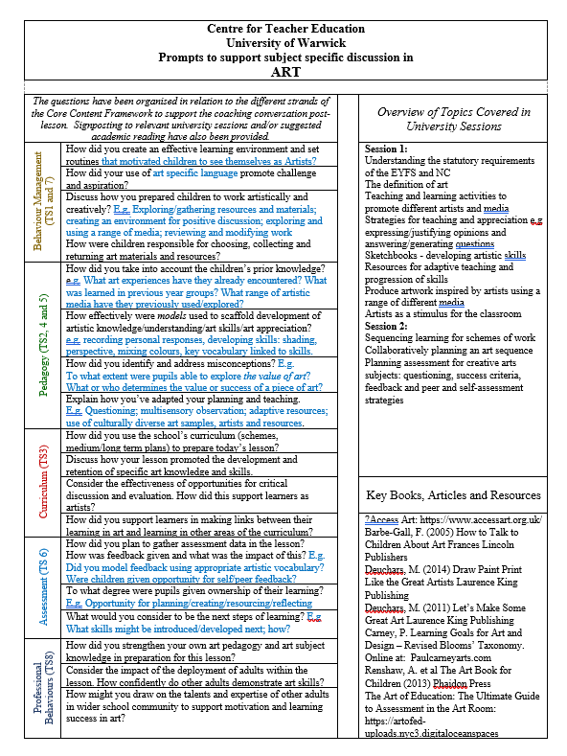
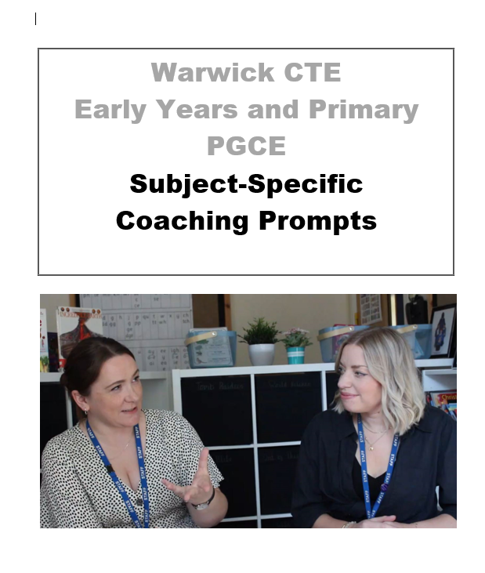
Subject-Specific Coaching Prompts

Slide 41
Core and SD Professional Enquiry - Spring Term
PEN Spine Days | Lectures and workshops:
February (day 4) | Behaviour to learn Deployment of TAs Cognitive Science in the classroom Introduction to Teaching Pupils with EAL B2L #2 More challenging behaviour
Early March (day 5) | Assessment for learning #2 Anti-bullying and restorative justice Disadvantage, underperformance and social justice Communicating with parents Self-regulation and metacognition Cognitive Science presentations
Late March | AOL carousel (self-study for SD)
Notes:
Due to the ongoing pilot work (until end of term three) and subsequent evaluation, we will be continuing with the current digital data management system for the Professional Enquiry module in academic year 23/24. Any new system will be introduced for academic year 24/25.

Slide 42
Subject Studies: Core
Primary
Eng: Poetry, non-fiction
Maths: Measures (length, weight, capacity), time and money
Science: Assessing science, working scientifically #2, plants and the environment
WCS: PE#2, Art #2, Music #2, Computing #2 (all with focus a on planning and assessment)
Flotsam Day 2: Planning themes, LO and SC, creative arts and immigration
Early Years
Eng: Poetry, non-fiction
Maths: Maths in reception
Science: Assessing science, working scientifically #2, plants and the environment
EYFS focussed sessions: Boys’ writing in reception, leadership of EYFS, assessment and transition from 2-7.
Flotsam Day 2: Planning themes, LO and SC, creative arts and immigration

Slide 43
Subject Studies: School Direct
Spring Term
Eng: Grammar/ Non-Fiction
Maths: Reasoning and problem solving
Sci: Forces
Plus lectures in each on oracy/talk
PML; D&T; PSHE; Computing x2; Geography; PE x 2
Music & Art Planning
Cross-Curricular theme day
Assignment support x 2
Summer Term
History & Geography planning
Eng: Poetry
Maths: Teaching Fractions/FDPRP
Sci: Assessing Science/Plants and the environment

Slide 44
Core and SD – Professional Practice
Spring Term
FLOs
  SSP and early reading
  Adaptive Teaching
  AfL
  Cognitive Science
  Talk for Learning/The role of the adult (EY)
Reflection sessions
Personalised provision (BM, Ass, SSP, Planning, V&P)
Inclusion Day (SEND/EAL)
Tutorials – long term Summer targets (SD)
Applications and interviews (lecture)
Safeguarding update
Summer Term
FLOs
  SSP and early reading
  Professional Responsibilities
  Inclusion
  AOL
  WCS
Safeguarding update
Tutorials – long term Summer targets (Core)
Applications and interviews (1:1)
ECT conference

Slide 45
2023-2024
3 alliance days
Autumn term: Planning
Spring term: Cross-Curricular approaches
Summer term: Assessment of Learning

Slide 46
AOB
Recruitment
Thank you to schools for shadowing and welcoming colleagues to share good practice in selection interviews.
If you haven't yet done so, please contact Vikki Armeson (Secondary) or Kirsty Weeks (Primary) with dates when we could join your event or to enquire about visiting CTE on an interview day.

Slide 47
Breakout sessions
Primary - please move to WA1.10, Avon 1st floor
Secondary - please remain in WA0.24
Thank you.

