Slide 1

MDP -Tracking and Reporting
All mentor engagement is tracked within the MDP (Moodle)
MDP Directory
This will enable the UoW to provide evidence, if asked, to support your DfE funding claims
Guidance on DfE claims found at: DfE Guide

Slide 2
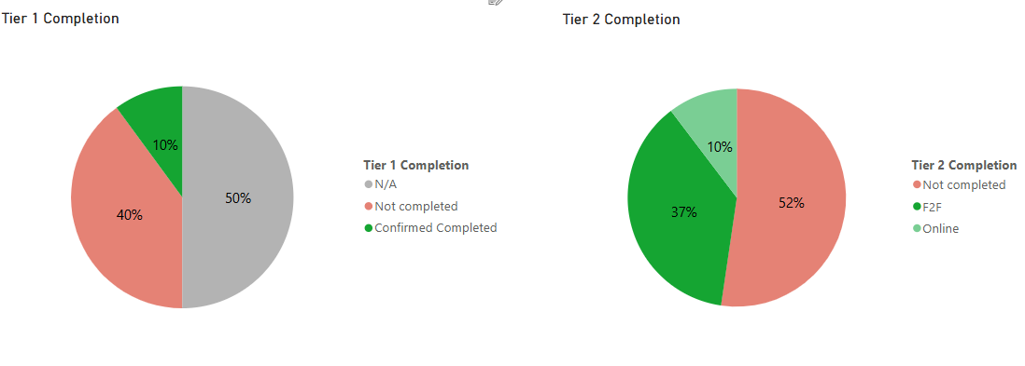
388 Mentors are registered on Moodle
Tier 1 Completion
Tier 2 Completion
6 mentors have completed Tier 3 units already!

Slide 3
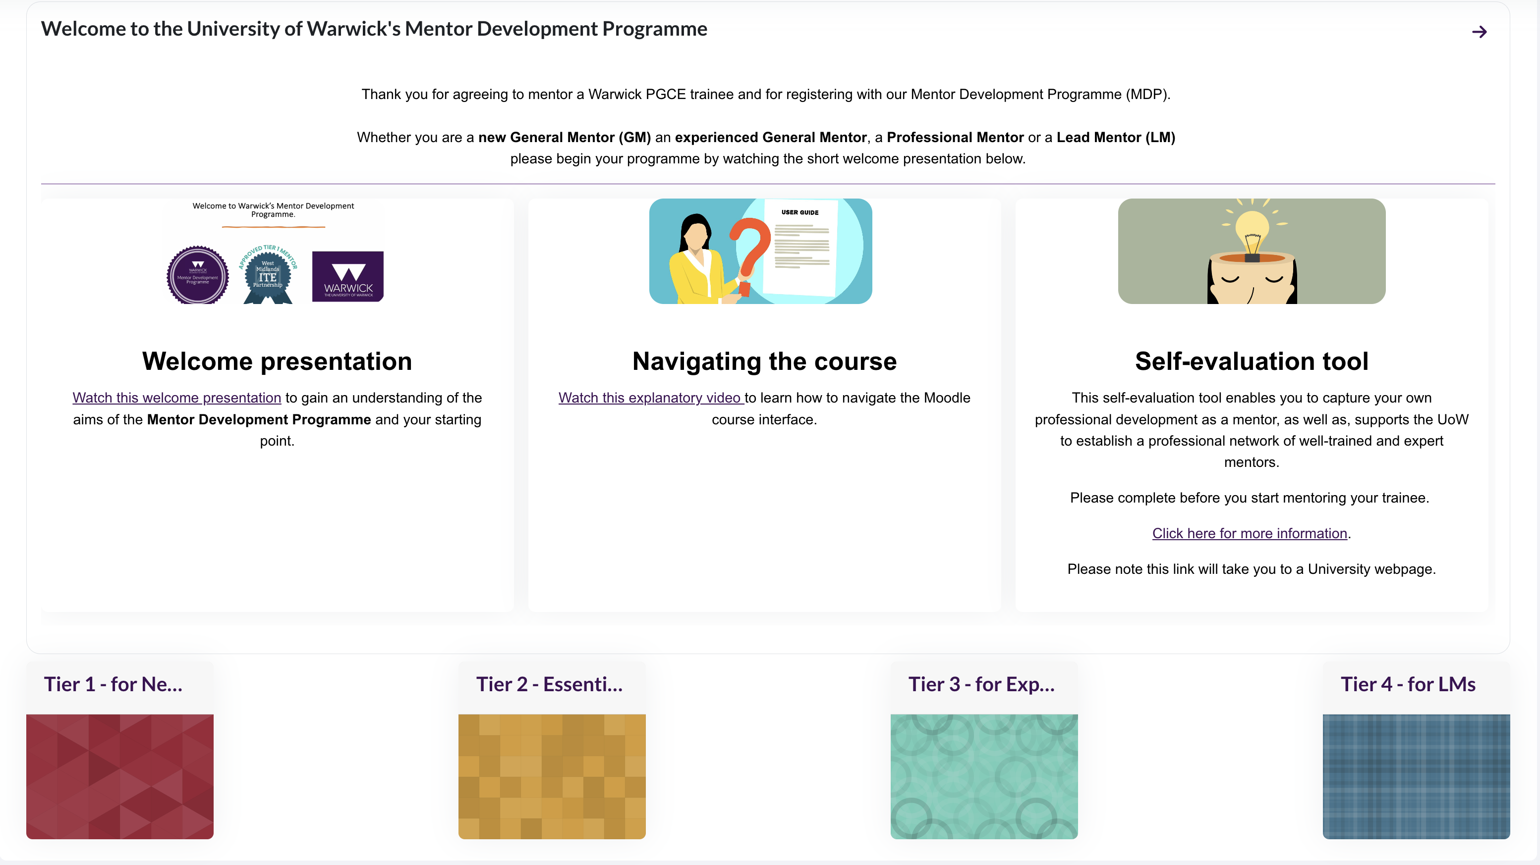

Slide 4

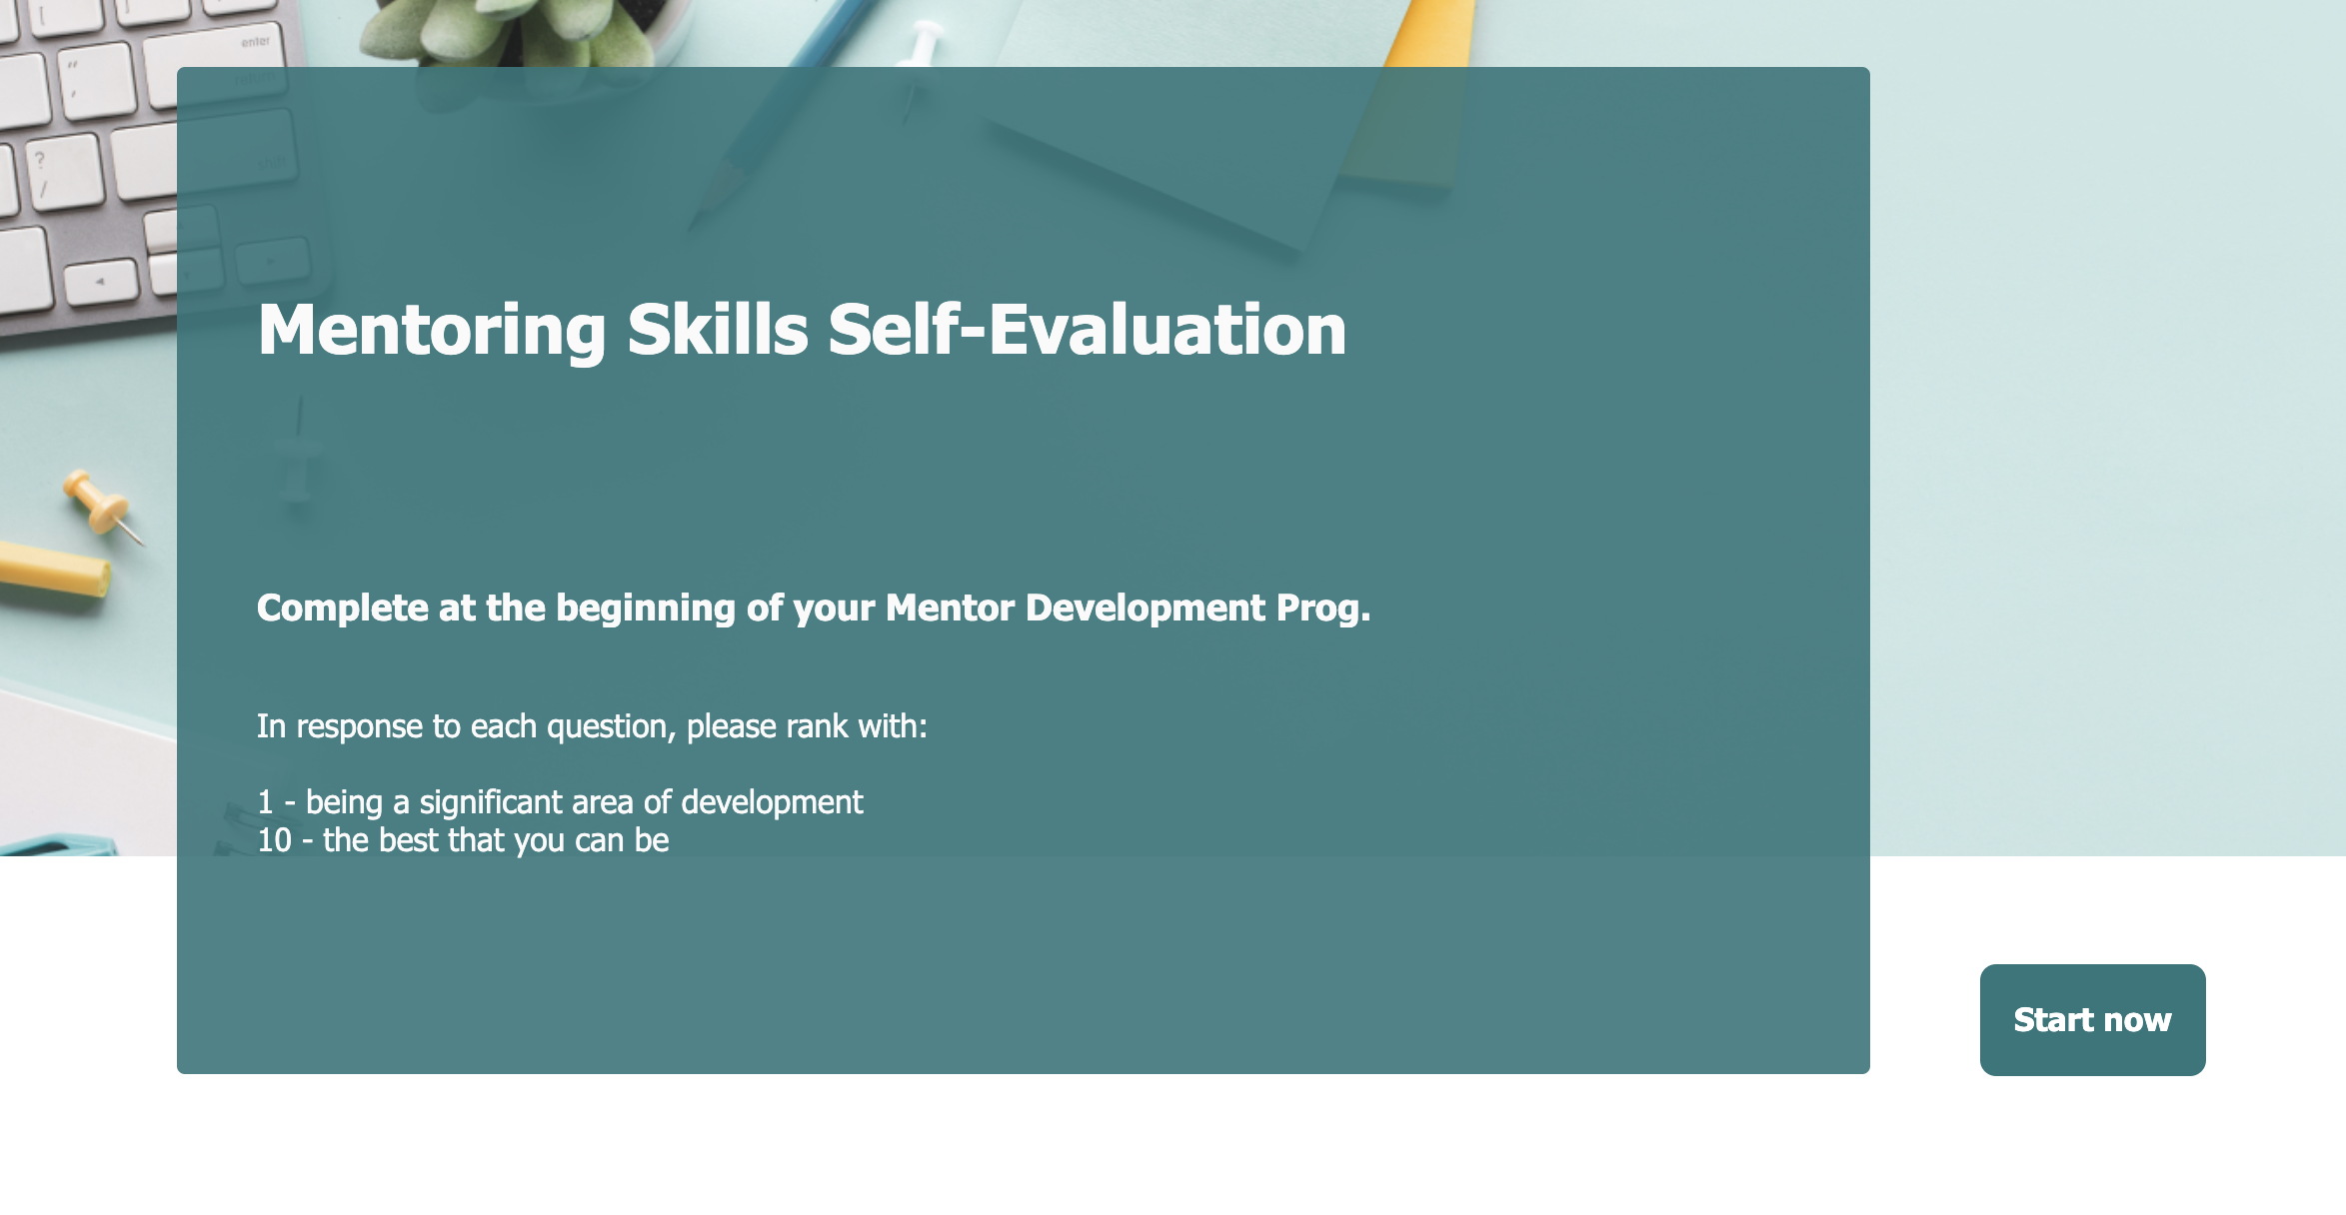
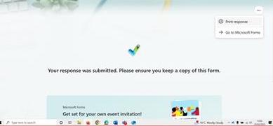

Slide 5
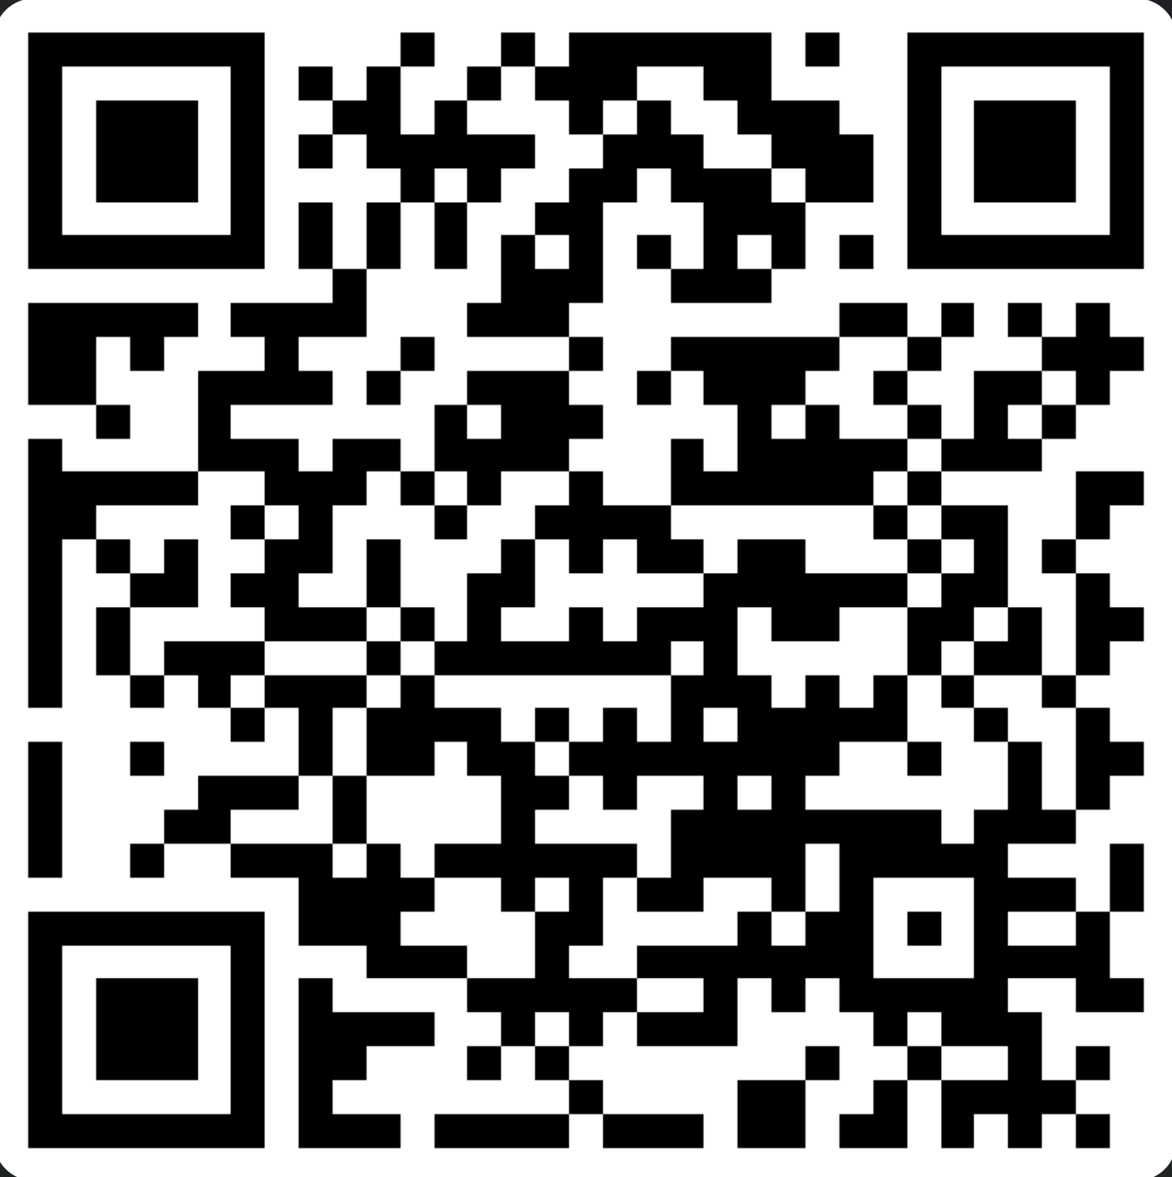
Recognising Excellence in Mentoring
If you know of a mentor who deserves to be recognised for their mentoring role, please use the QR to enter their details.
Effective mentors:
Support the trainee to reflect on their practice.
Listen carefully to the trainee and asks questions which extend the trainee’s thinking.
Uses classroom data to help the trainee see their current reality in their teaching.
Uses deliberate practice mentoring tools such as scripting, modelling, co-planning etc.
Recognises how the trainee’s wellbeing impacts their development and supports accordingly.
Engage in professional development to continuously improve their mentoring skills.
Inspires the trainee to be a successful teacher.
Nominations will close on the ?

