Slide 1

MDP -Tracking and Reporting
All mentor engagement is tracked within the MDP (Moodle)
Show tracker
This will enable the UoW to provide evidence, if asked, to support your DfE funding claims
Guidance on DfE claims found at:

Slide 2
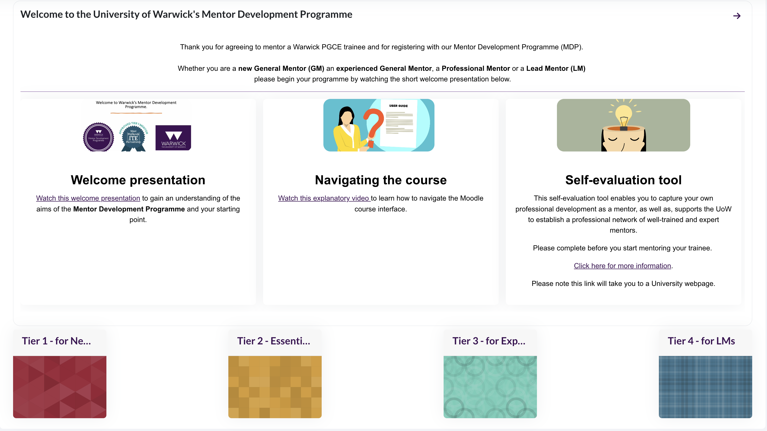

Slide 3

