Slide 1

Meeting of Warwick and Schools Partnership (WaSP)
2.00pm – 4.00pm,
Wednesday 27th November 2024

Slide 2
Updates from Andy Hind

Slide 3
CTE strategic updates
School of Education, Learning and Communication Science
  The vision: an exciting, interdisciplinary place to work, research and teach.
  New PSS structure in place from Nov 1st. Education and Student Experience team covering recruitment, partnership and on-course support for CTE. Head of Operations Ciara Cooper. Heads of CTE section, Emma Rawlings and Alex Cooper.
  Increased engagement with research activity and PGR teaching.
  School level strategic refresh to take place in 2025.
Inspection outcomes
Home PGCE primary and secondary, Outstanding in all aspects
iQTS grade 1

Slide 4
CTE strategic updates
Implementation in compliance with new ITT criteria
  Mentor Development Platform established and implemented.
    Adaptation to recent changes in criteria relating to required hours.
  ITaP programme elements delivered in partnership.
  First home digital cohort with Lead Partners CET and Greenwood Academies. Potential for new partnerships, particularly in ‘cold spots’ in line with CTE strategic plans.
  Implementation of new platforms to improve student and partner experience (Axia, MDP, Kaltura)
Next steps and challenges
  Recruitment
  Addressing early implementation issues with new IT.
  Evaluation of ITaPs
  Adaptation of mentor training structures in response to changes in the ITT criteria
  Support for University of Cumbria approval of TDA delivery.
  Changes to degree apprenticeship requirements mean that a post-graduate DA route may now be viable.

Slide 5

PRIMARY/early years pgce updates
Julie Taylor
November 2024
Every child in every classroom deserves a great teacher every day.

Slide 6

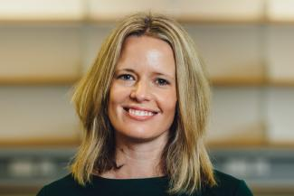
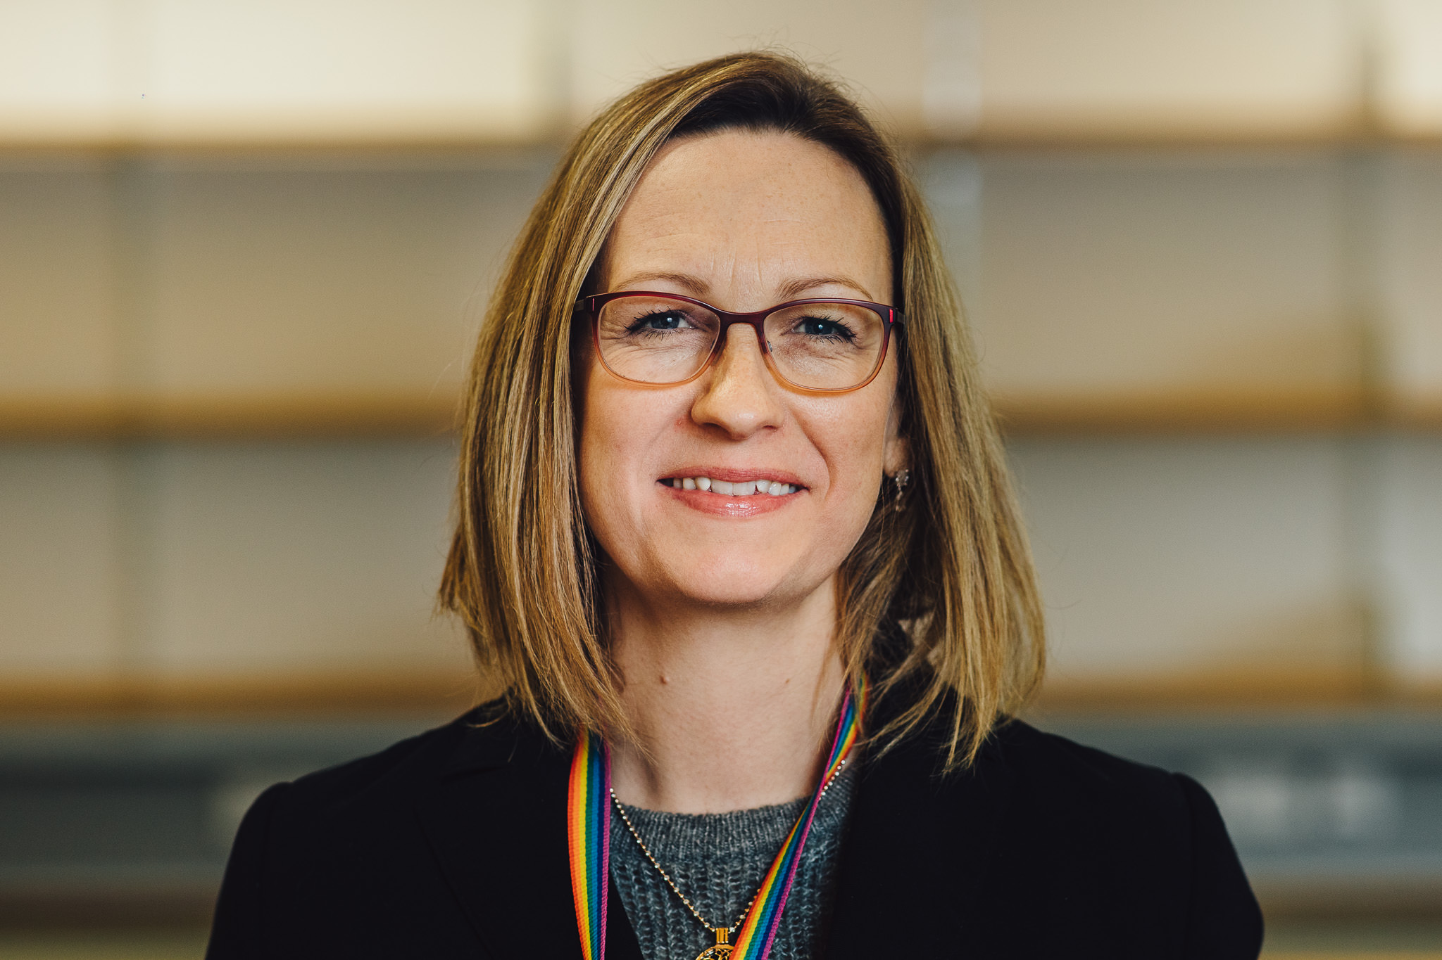
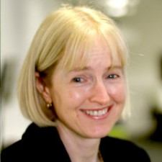
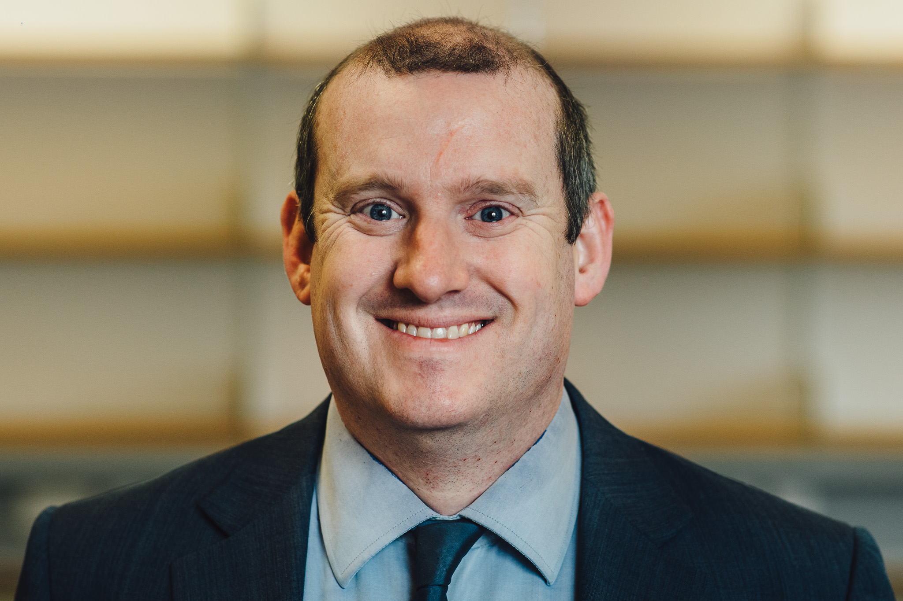
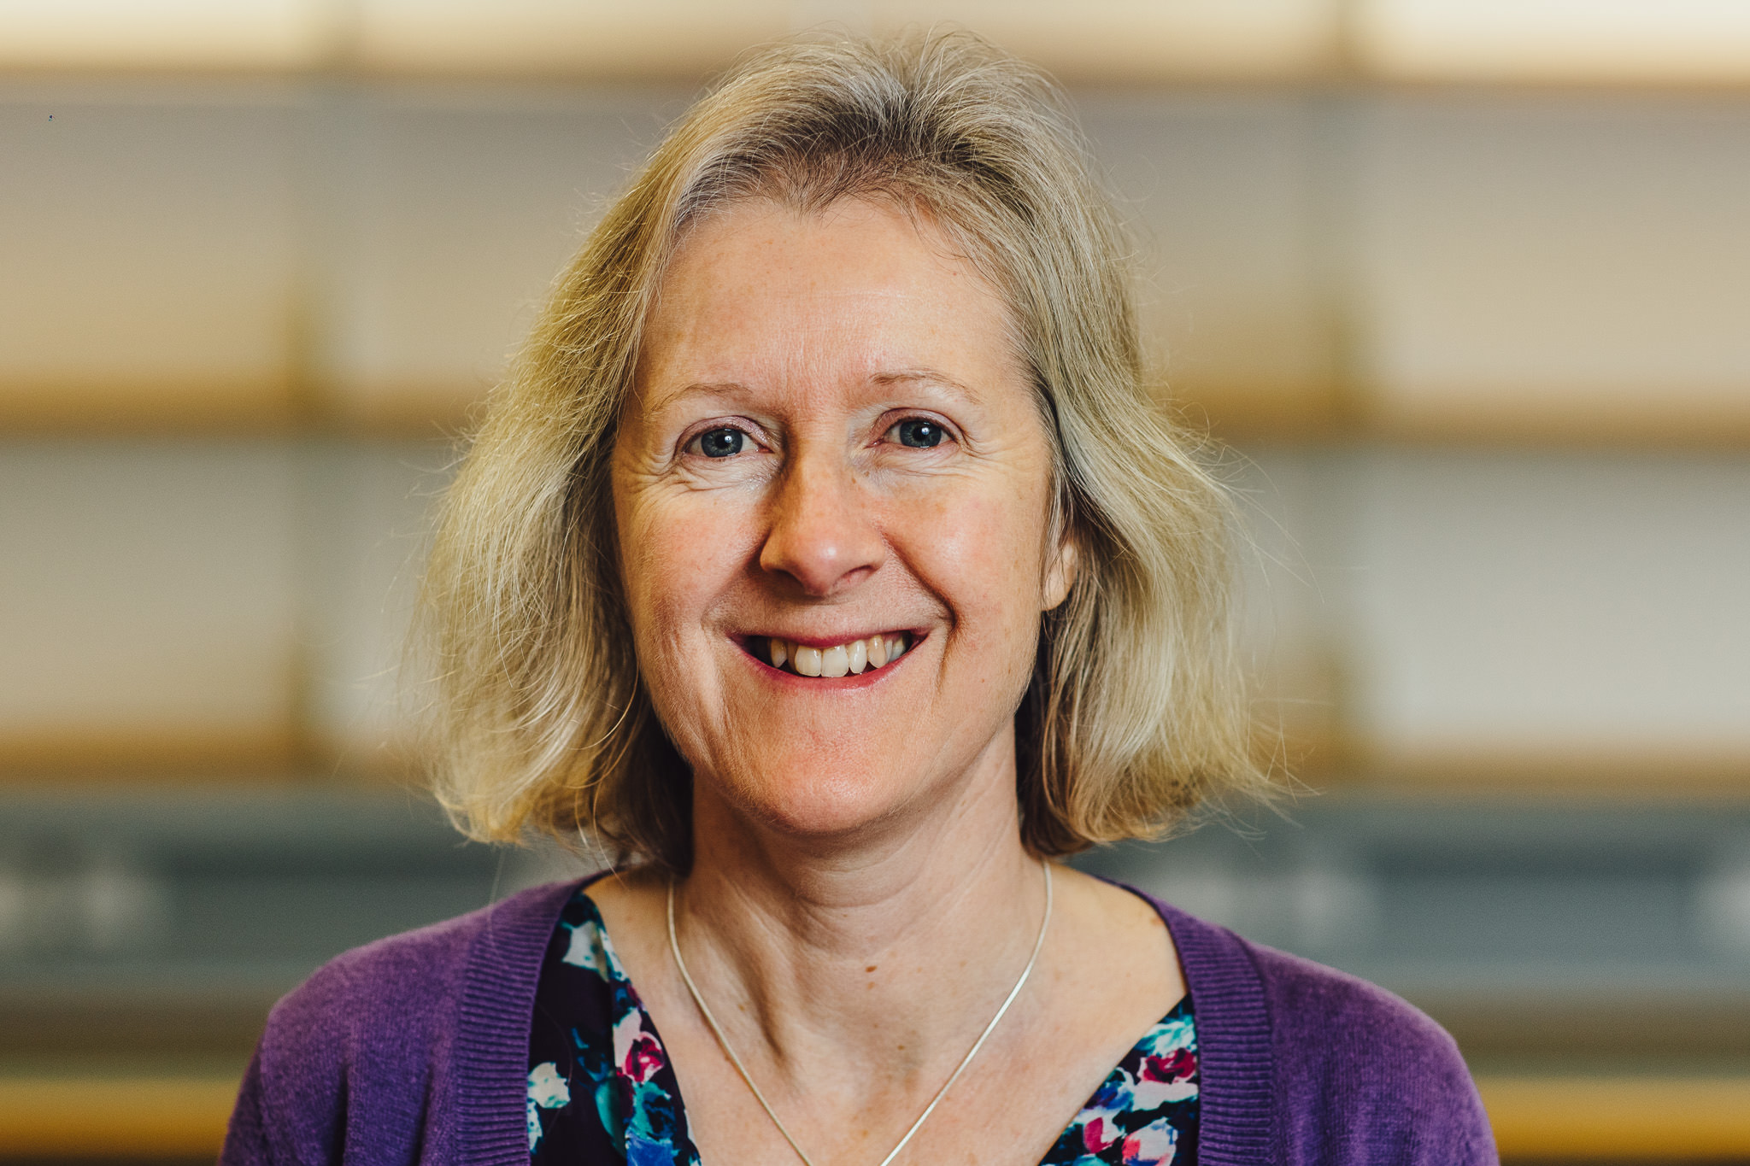
Primary/Early Years Team
Course Leads:
Head of CTE: Dr Andy Hind
Head of Primary: Julie Taylor
Senior Leads:
University Provision/QA Lead: Dr Deborah Roberts
School-Based Provision: Jo Dobb
Deputy Senior Tutor/AO Lead/Science Lead: Sally Spicer
Module Leads:
Subject Studies: Mark Harris (also oversees UoC primary)
Professional Enquiry: Deborah Roberts
Professional Practice: Deborah Roberts

Slide 7
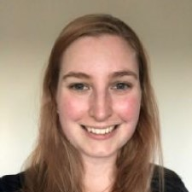
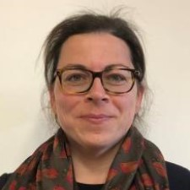
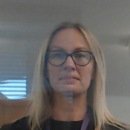
Emily Davies: Interim MA Lead/Recruitment Lead/Wider Curriculum Lead
Anna Donnelly: Mentoring Lead/English Lead/Lead for UG Primary
Louisa Brown: Early Years Lead

Slide 8
Autumn Term Updates
Primary numbers: On course: Primary – 55 (1 TWD) ; Early Years – 14; Digital – 2 (1 TWD)
Positive feedback from cross phase foundation week sessions and cross phase ITAP workshops – primary and secondary students collaborating well and demonstrating greater understanding and respect for each other’s phases
Tutors currently marking first part of revised Subject Studies assessment focus on talk – Lit review – presentation submission in January – developed new assessment criteria
Students on block placement - ULMs undertaking school visits/digital meetings
Digital PGCE trainees – good feedback so far – central spine with iQTS students delivered on Thursdays – bespoke content in morning and afternoon sessions to mirror core content from F2F PGCE
Axia working well – mentors appreciating a central platform
SSLC feedback positive –more self study time
Inclusion enhancement content very well received
RIA and interdisciplinary conference in December

Slide 9
Primary/Early Years PPUs and ITAPs
Autumn
ITaP #1: Behaviour to Learn
ITaP #2: Preparing for Teaching and Learning
ITaP #3: SSP and Early Reading
PPU1 Talk for Learning
PPU2 Maths Misconceptions
PPU3 Foundation Subjects
Spring
ITaP #4: Adaptive Teaching
PPU4: SSP and Early Reading
PPU6: Cognitive Science
PPU5: Assessment for Learning
Summer
PPU4: SSP and Early Reading
PPU8: Wider Professional Responsibilities
PPU7: Assessment of Learning
Notes:
ITaP3 – preparation for PP1 assessment
3 activity outputs for each PPU
ITaP embed booklets – time in school to complete – attached to ITaPS

Slide 10
Collaborative Assessment Points
Collaborative Assessment Point 1a – w/c 21st October (focus on professional behaviours)
Collaborative Assessment Point 1b – w/c 16th December
Collaborative Assessment Point 2 – w/c 3rd March
Collaborative Assessment Point 3a – w/c 12th May
Collaborative Assessment Point 3b - w/c 23rd June

Slide 11
University Assessment
MODULE​ | M-LEVEL ASSESSMENT ​ | FOCUS​
SUBJECT STUDIES​ | Written assignment (2500 words)​ November Presentation (10 minutes)​ January | Reflection on a Specific Subject Pedagogy (theory/then theory in practice)​
PROFESSIONAL ENQUIRY​ | Written assignment (4000 words)​ - April | An aspect of pedagogy – theory into practice​
PROFESSIONAL PRACTICE​ | 1. Written Reflection (2000 words) - February – after ½ term 2. Professional Dialogue (equivalent to 2000 words) - June | Reflections on selected aspects of professional practice​
 | School-based observation of teaching practice (for award of QTS)​ CAP3b - June | Assessment against Teachers’ Standards​ ​

Slide 12
Secondary pgce updates
Dr Alison Morgan
2024
Every child in every classroom deserves a great teacher every day.

Slide 13

‘Leaders’ values underpin and inform their work across the partnership. All involved strive to achieve the shared goal of social justice, and all partners have a clear understanding of their role in helping to develop trainees. This has a profound impact on trainees.’

Slide 14
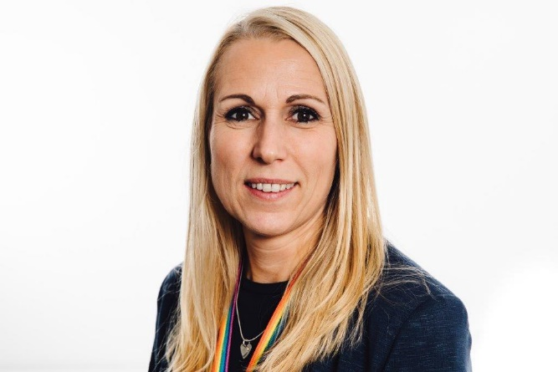
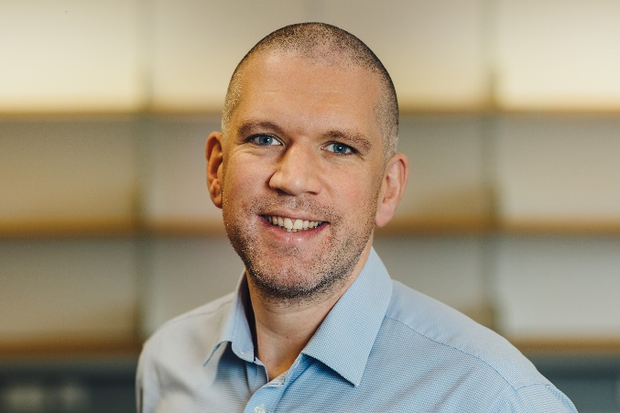
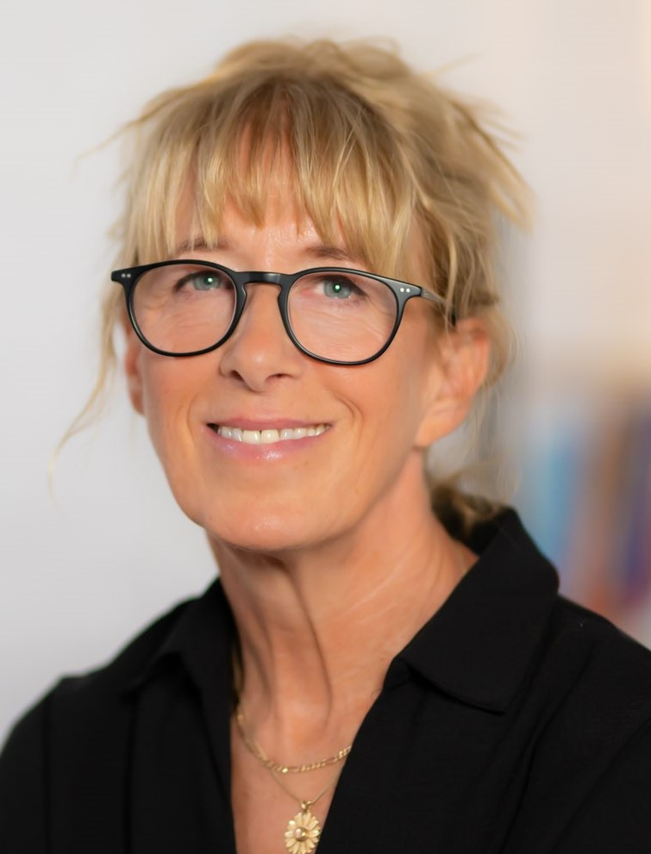
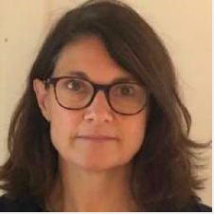
Introductions – Who’s Who in the Senior Team
Course Leads:
Head of CTE: Dr Andy Hind
Head of Secondary: Dr Alison Morgan
Senior Leads:
University Provision: Jonty Leese
School-Based Provision: Kate Hamer
Senior Tutor: Rachel Cooper
Mentoring Lead: Penny Ottewill
Module Leads:
Subject Studies: Jonty Leese
Professional Enquiry: Jonty Leese
Professional Practice: Kate Hamer

Slide 15
Key updates to 24/25
Introduction of 2 new subjects (D&T, Social Sciences)
Expansion of cross-phase teaching & learning (Foundation Week, ITaPs, digital & iQTS)
Upgrade of Professional Practice Module & introduction of new assignments
Digital PGCE
Axia Platform
Mentor Development Programme

Slide 16
24/25 Cohort
Home: 130 (university-led: 76; partner-led: 54)
Digital: 15 (partner-led)
Monday
Friday
Art & Design: 12
Computer Science: 2
Drama : 4
English: 23
MFL: 12
Music: 4
RE: 2
Design & Technology: 8
Geography: 3
History: 8
Maths: 20
PE: 6
Science: chemistry: 7; biology: 8, physics: 7
Social Sciences: 5

Slide 17
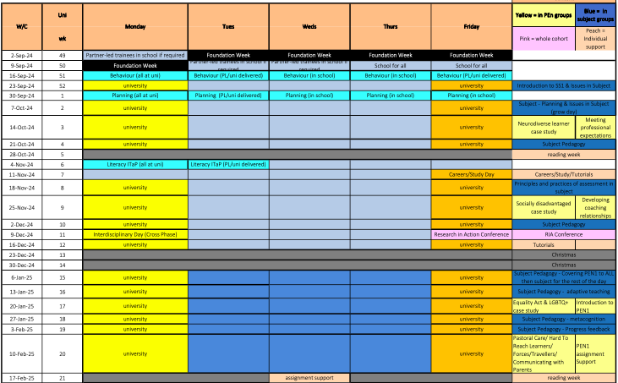
Notes:
Highlights: careers day, RiA conference, interdisciplinary SG day
Comp placements after half term.

Slide 18
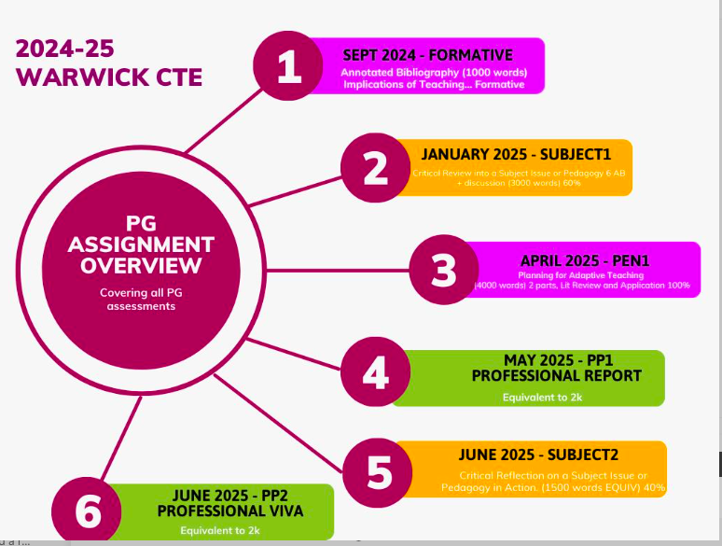
University Assessment

Slide 19
Professional Practice Units (PPUs) & Intensive Training & Practice Booklets
PPU1: Professional Roles and Observation of Expert Practice
PPU2: Understanding Learning in Subject
PPU3: Understanding Classroom Assessment in Subject
PPU4: Establishing Classroom Relationships
PPU5: Deeper Learning in Subject
PPU6: Activating Metacognition
PPU7: Assessing & Reporting Progress
PPU8: Working as Part of a Professional Team
ITAP1: Behaviour to Learn
ITAP2: Preparation for Teaching and Learning
ITAP3: Systematic Synthetic Phonics and Literacy*
ITAP4: Adaptive Teaching
Notes:
ITaP3 – preparation for PP1 assessment
3 activity outputs for each PPU
ITaP embed booklets – time in school to complete – attached to ITaPS

Slide 20

CTE on tour
WMG: artificial intelligence
Lion Alliance: misconceptions, independent learning, history, English, science
Higham Lane: English
President Kennedy: English
Notes:
WMG – JL last year
BH – JaL working on GSD

Slide 21


Sally Edwards and Kate Rogers

Slide 22
Why Oracy?

Slide 23










Slide 24
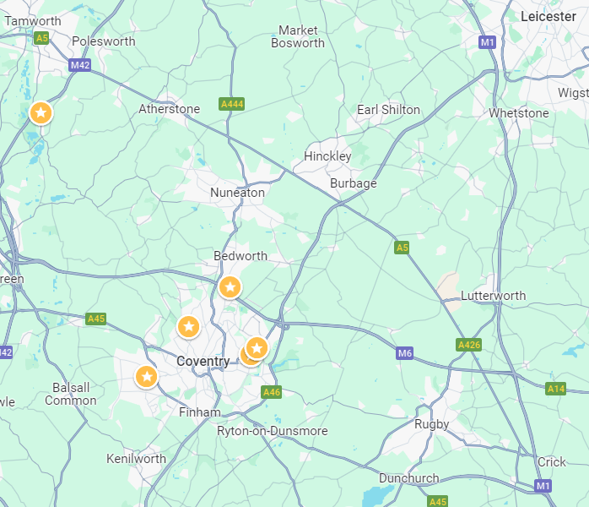






Castle Phoenix Trust
Charter Academy
Hill Farm Primary
Richard Lee Primary
Caludon Castle
Foxford
Kingsbury

Slide 25







Learning to talk
Learning through talk
Learning to listen

Slide 26



Vocabulary
Talk protocols
Active listening
Talk tactics
Every voice
Learning to talk
Learning through talk
Learning to listen

Slide 27
Oracy as ordinary.

Slide 28


Castle Phoenix Trust in Collaboration
January 2025

Slide 29
Partner Updates

Slide 30

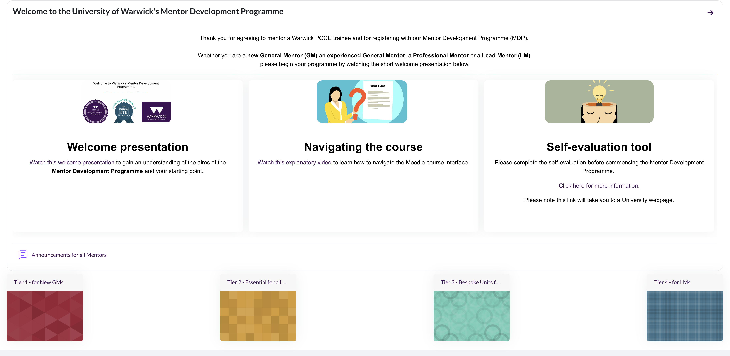
Mentor Development Programme Updates: Penny

Slide 31

MDP statistics – 26th November 2024
 | Registered on MDP | No engaged with Tier 1 (Badges) | No completed Tier 1 (Certified) | No completed Tier 2 (Conf attendance)
Primary | 82 | 17 | 11 | 39
Secondary | 181 | 32 | 24 | 104
International | 52 | 13 | 9 | 24
Total | 315 | 62 | 44 | 167

Slide 33
ITaP
Feedback and Review: Jo

Slide 34
ITaP reflection and evaluation
Timing and impact on timetabling/access to expert colleagues
Choice of foci
Manageability and relevance of the Embed Day booklet activities
Impact on trainee understanding and preparedness to teach/ongoing practice
From model 3 partners: support for delivery and usefulness of materials

Slide 35

QUESTIONS
AND DISCUSSION

Slide 36
PRIMARY MOVE TO WT 0.04
Module Leads: exploration of level 7 assessments:

Slide 37
Model 3 Partner SLMs:
QA processes and plans

Slide 38
Timeline for QA of Model 2 and 3 partner schools
Peer dialogue meeting – January – 60mins
Actions follow up meeting – May – 30mins
End of year review meeting – July – 60mins
Year ahead plan – September – 60mins

