Slide 1

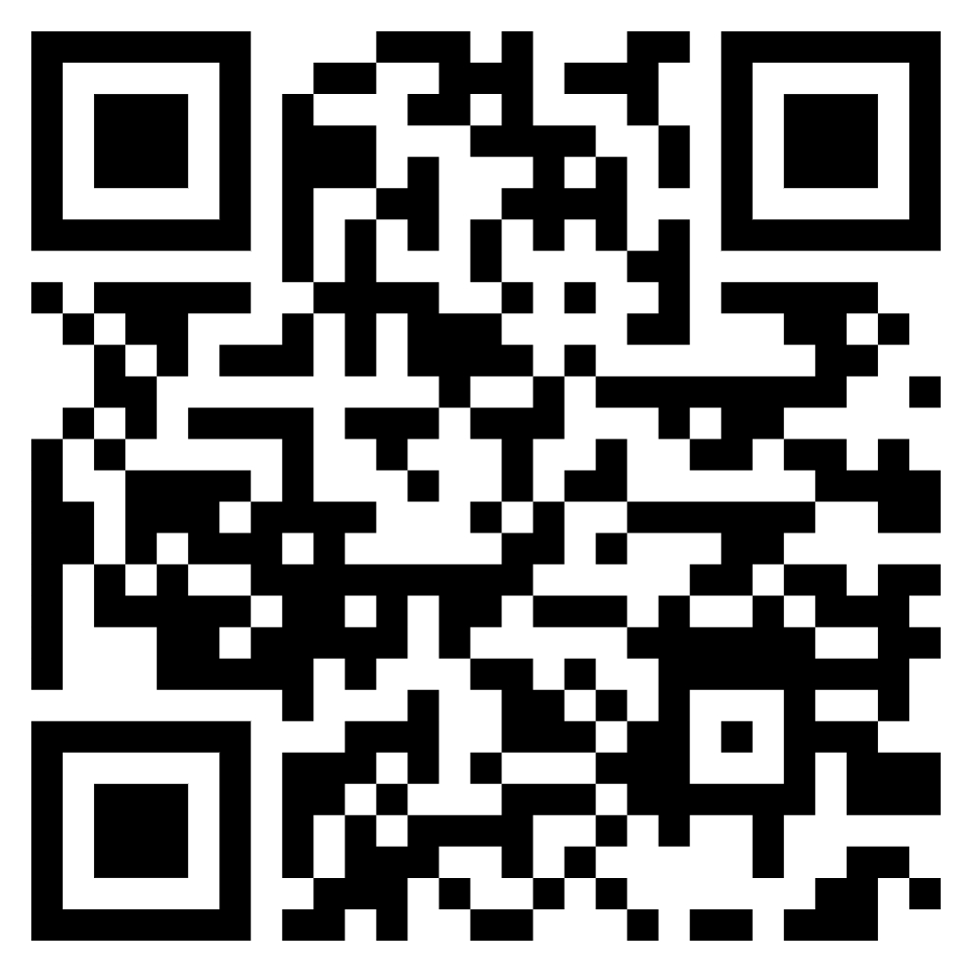
Centre for teacher education
WaSP meeting
Wednesday March 12th
2024/25

Slide 2
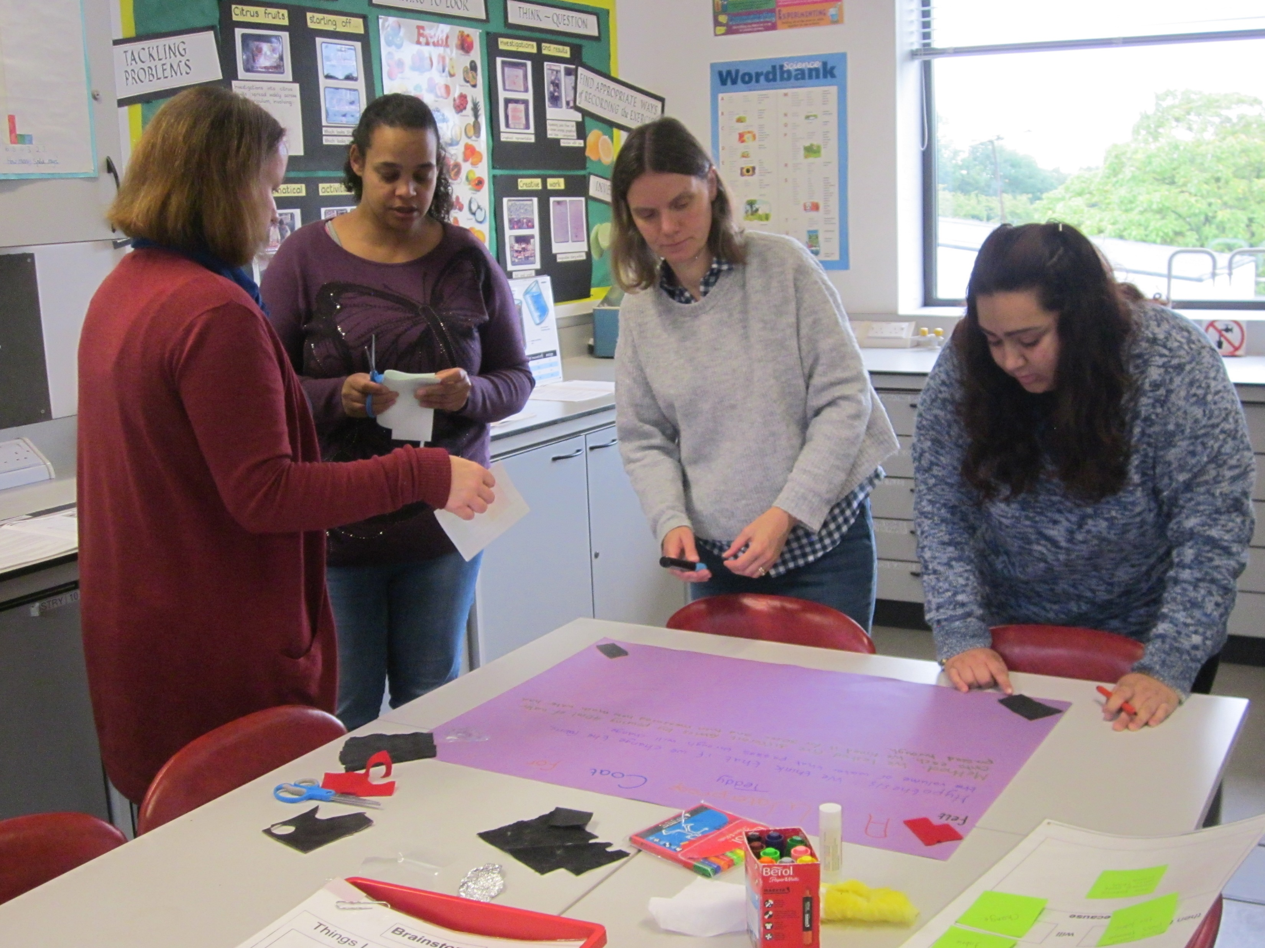
WELcome and Introductions
March 2025

Slide 3



What is the Coventry Oracy Hub?
Coventry has emerged as a trailblazer in oracy education, proudly home to 3 Voice 21 Centres of Excellence, 42 Voice 21 accredited schools and a growing network of schools committed to advancing oracy practices. This positions Coventry as one of the UK’s leading cities in the drive for confident communicators.
Coventry Oracy Hub aims to foster shared learning, collaboration and city-wide impact. By bringing together educators, practitioners and organisations, there are endless possibilities for our children and young people across the city.

Slide 4
Why Oracy?
Research shows that oracy significantly enhances academic achievement, with studies indicating that strong speaking and listening skills improve literacy, critical thinking, and overall learning outcomes (Alexander, 2012; EEF, 2021). Additionally, oracy fosters social and emotional development, helping students build confidence, empathy, and collaborative skills, which are crucial for personal and professional success (Mercer et al., 2019)
Why Coventry?
Coventry is a city steeped in history, innovation and diversity, celebrated for its medieval heritage, engineering legacy and vibrant arts scene, while also being a hub of education with two world-class universities. However, the city faces significant challenges, including high levels of poverty, unemployment, health inequalities and crime, which disproportionately affect its children and young people. By prioritising oracy education, Coventry has the opportunity to empower its youth, bridge gaps in aspiration and attainment and transform life chances for future generations.

Slide 5
How?
Oracy Hub
CPD
Sharing resources
Bitesize CPD
Authentic opportunities for talk
City-wide celebrations
In-school showcases
Sharing in-school planning
Initially, the hub is focusing on:
- Regular, bitesize, online CPD opportunities. The foci of these was chosen at the initial launch.
- Showcasing strategies through in-school showcases, beginning with the centres of excellence.
- Collaboratively planned, authentic opportunities for the youngest voices in the city to be heard.

Slide 6
Want to join us?
Sally Edwards: sally.edwards@castlephoenixtrust.org.uk
Mel Dipple: mel@voice21.org
We currently have over 80 leaders and practitioners across Coventry signed up to be part of the hub. You do not need to be a Voice 21 school.
If you’d like more information or would like to join us at our first CPD session next week, please get in touch:

Slide 7



Coventry Oracy Hub Upcoming Dates
Next Spotlight CPD Sessions:
Tuesday 8th April, 3:45–4:15: “Listen Up! Teaching Listening Explicitly“
Tuesday 6th May, 3:45–4:15:
“Word Play: The Explicit Teaching of Vocabulary”
Charter Primary Open Morning
Thursday 22nd May – more information to follow
Event Date
Thursday 26th June – more information to follow
Notes:
Mel and Sally

Slide 8

WaSP Updates
March 2025
Notes:
BW

Slide 9

Early Career Teacher Entitlement: September 2025
From September 2025 a revised framework covering both a new teacher’s initial teacher training year and their two-year induction period comes into operation combining the existing CCF (Core Content Framework) and the ECF (Early Career Framework).
This framework named the ITTECF sets out the training entitlement for teachers in the first 3 years of their teaching career (initial teacher training year and statutory induction period).
ECTE – Early Career Teacher Entitlement – this new terminology will now be used to encompass all entitlements for Early Career Teachers and includes access to training based upon the ITTECF Framework (ECF Programme) along with the statutory entitlements of timetable reduction, mentoring, review and assessment (Appropriate Body).

Slide 10
Early Career Teacher Entitlement: September 2025
Schools will be required to provide ECTs with training based upon the ITTECF as part of their statutory induction entitlement.
Schools can choose to deliver this training in one of two ways:
Use a government funded Lead Provider, usually through working with a Delivery Partner such as a Teaching School Hub.
OR
Use government provided materials to create a training programme that you deliver to your ECTs yourself, which will be subject to fidelity checks from your Appropriate Body (AB)
All schools will continue to be required to register their ECTs with an Appropriate Body before Induction can commence.

Slide 11
Mentor Training as part of the ITTECF
Currently new ECT mentors also undertake a two-year programme of training, designed to support them in mentoring their ECT through the ECF programme.
From September 2025, this training entitlement will reduce to a one-year programme, enabling mentors to be trained quickly and reducing on-going workload pressures.
Mentors who have already completed or are completing the current ECF mentor training will not have to repeat this training, although mentors already partway through the 2 year programme will continue into the second year.

Slide 12
In partnership with Warwick…
Worked with colleagues regarding these changes to update the CEDP which trainees complete at the end of the course with a view to supporting their transition to employing schools and first year as an ECT.
We will be speaking with all trainees as part of the ECT Conference at the end of the course about the ECTE and the role of the Appropriate Body.
Contact details:
tshub@lawrencesheriffschool.com
rebecca.wheeler@lawrencesheriffschool.com
sally.hewitt@lawrencesheriffschool.com

Slide 13












Partner updates

Slide 14

Nic McKie:
Coaching in Education

Slide 15


THE EDUCATION BLUEPRINT FOR PEOPLE DEVELOPMENT

Slide 16

There is growing consensus that culture is key
92%
80%
53%
of executives believe that improving culture will improve
business value.
of job-hunters say
they are seeking a strong developmental culture.
of earnings calls between January 2020 and April 2022
addressed organisational culture.
Harvard Business School. 2021
Modern CEO Survey, Accenture 2021
Accenture data science analysis of earnings call transcripts of ~8,700 global companies for the period
of January 2020 to April 2022
Notes:
OPTIONAL slide

Slide 17

62%
see increased retention of
high-performers, compared to 28% of organisations without a strong coaching culture.*
69%
69% see increased employee engagement scores, compared to 39% of organisations without a strong coaching culture.**
*Building Strong Coaching cultures for the Future. HCI & ICF, 2019
**"Building A Coaching culture for Change Management. HCI & ICF, 2018.

Slide 18

77%
Are more successful at attracting talent then their competitors.*
61%
are classed as high-performing, compared to 27% or organisations without a strong coaching culture.**
*Building Strong Coaching cultures for the Future. HCI & ICF, 2019
**"Building A Coaching culture for Change Management. HCI & ICF, 2018.

Slide 19

The difference it is making | Authors
Improve staff performance / teaching practice | Adam, (2021), Allan (2007); Gore (2014); Kidd (2009); Shidler (2009)
Enhance staff wellbeing | Adams (2012), Grant, Green & Rysaasrdt (2010)
Embed continuing professional development | Brown (2011); Reinke, Stormont, Herman & Newcomer (2014)
Provide peer support between educators | Charteries at Smardon (2014); Jewett & McFee; Lofthouse & Hall (2014); Zqpeda, Parlyo & Il;gan (2012)
Support trainee teachers | Hookerr (2014); Lu (2010); Trutwein & Ammerman (2010)
Improve conversations about teacher’s professional learning and development | Barr & van Nieuwerbugh (2015)

Slide 20


Slide 21


Slide 22

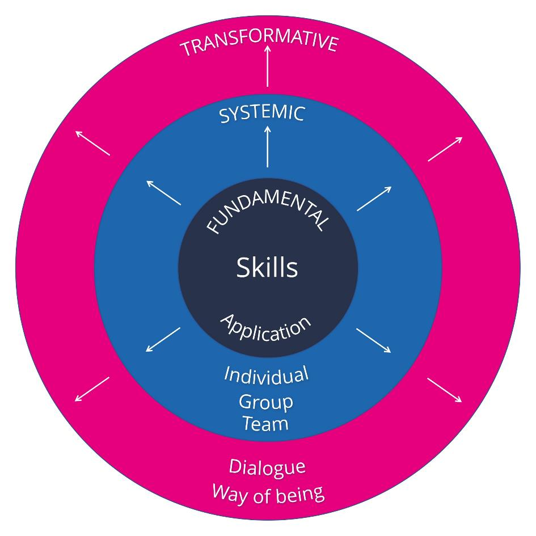
Your people development blueprint

Slide 23

The Education Blueprint For People Development

Slide 24






Slide 25
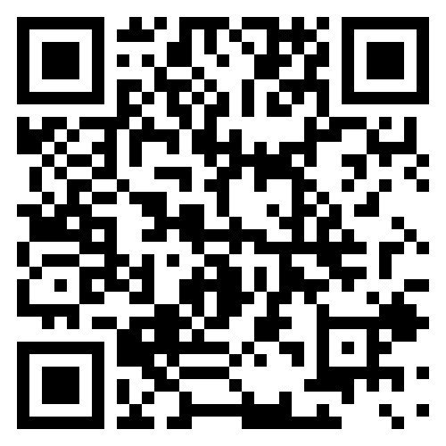
Book a free consultation

Slide 26
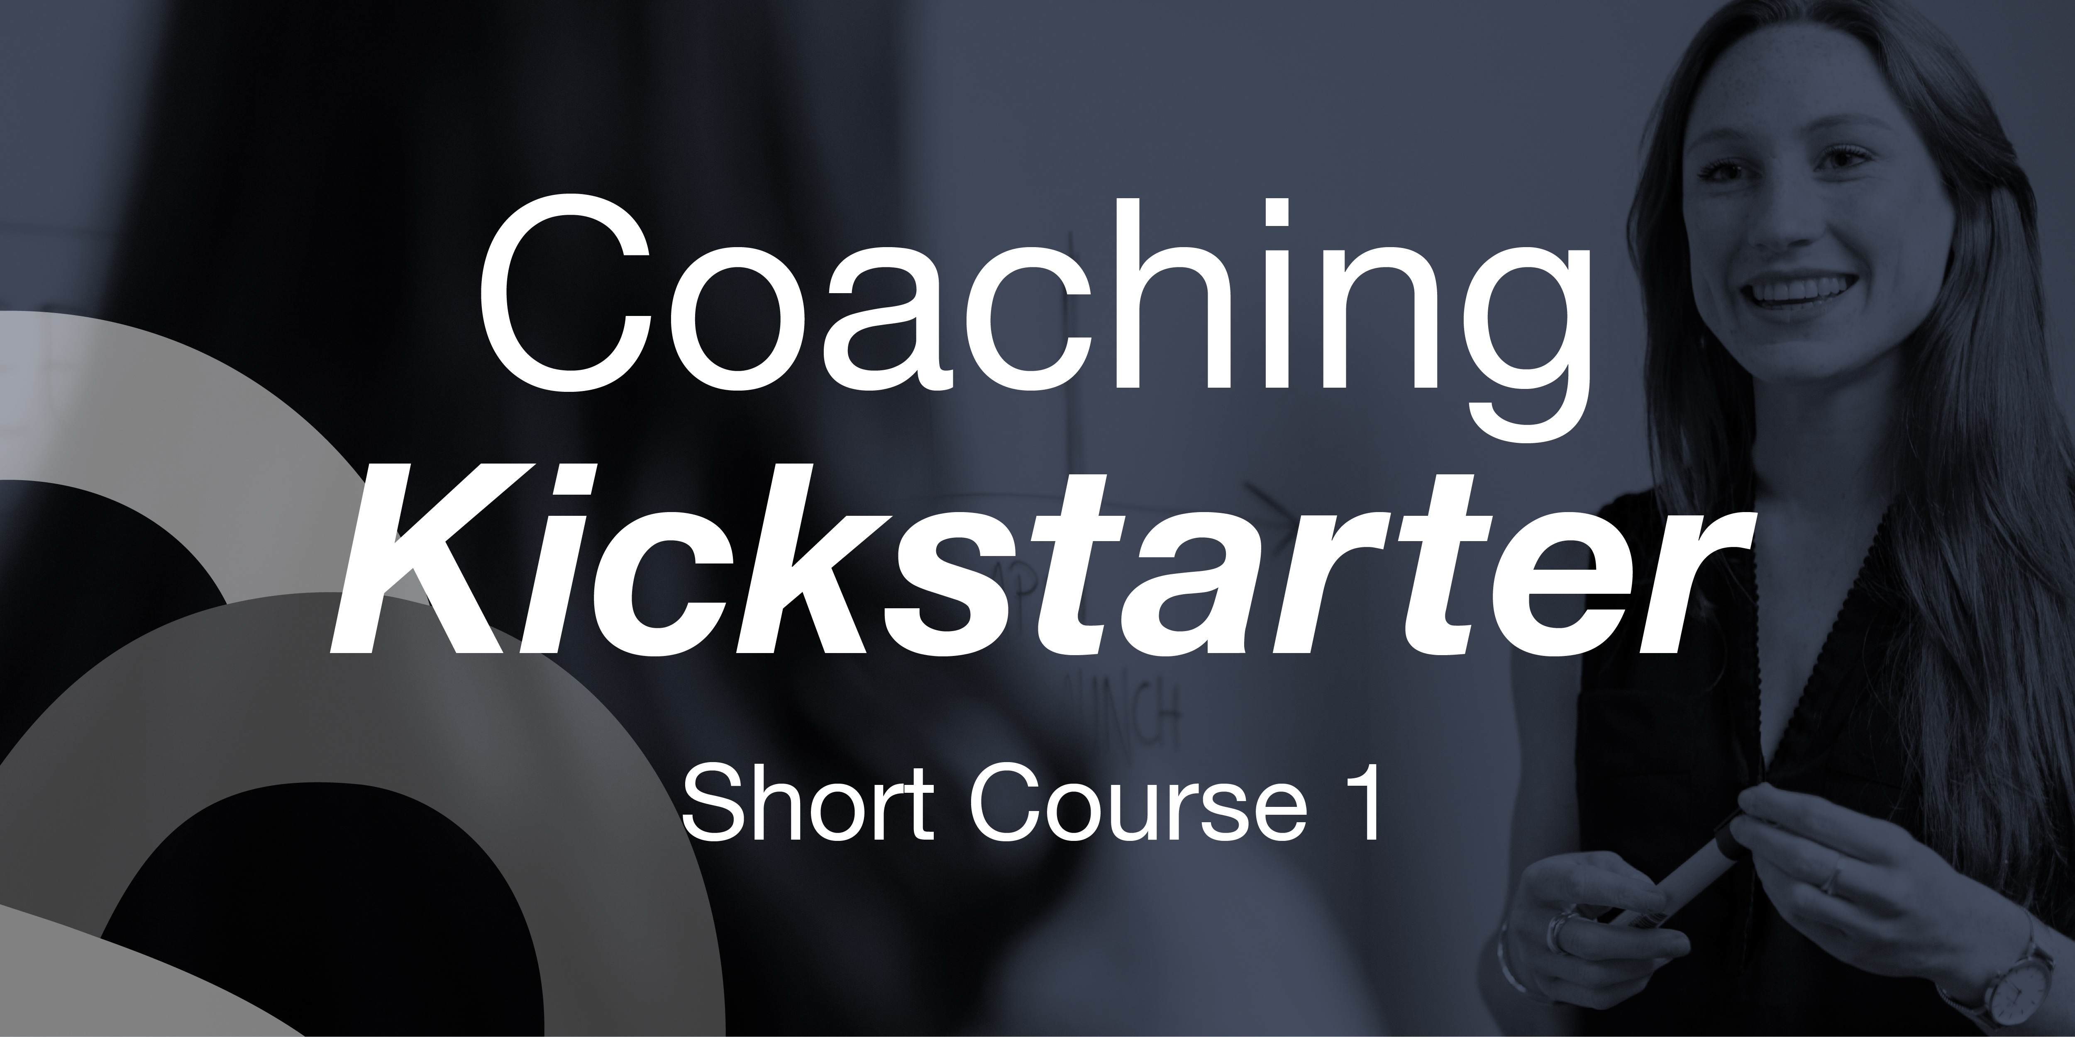
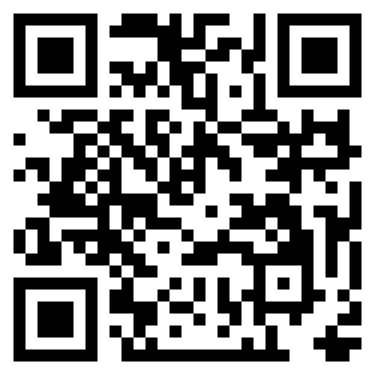
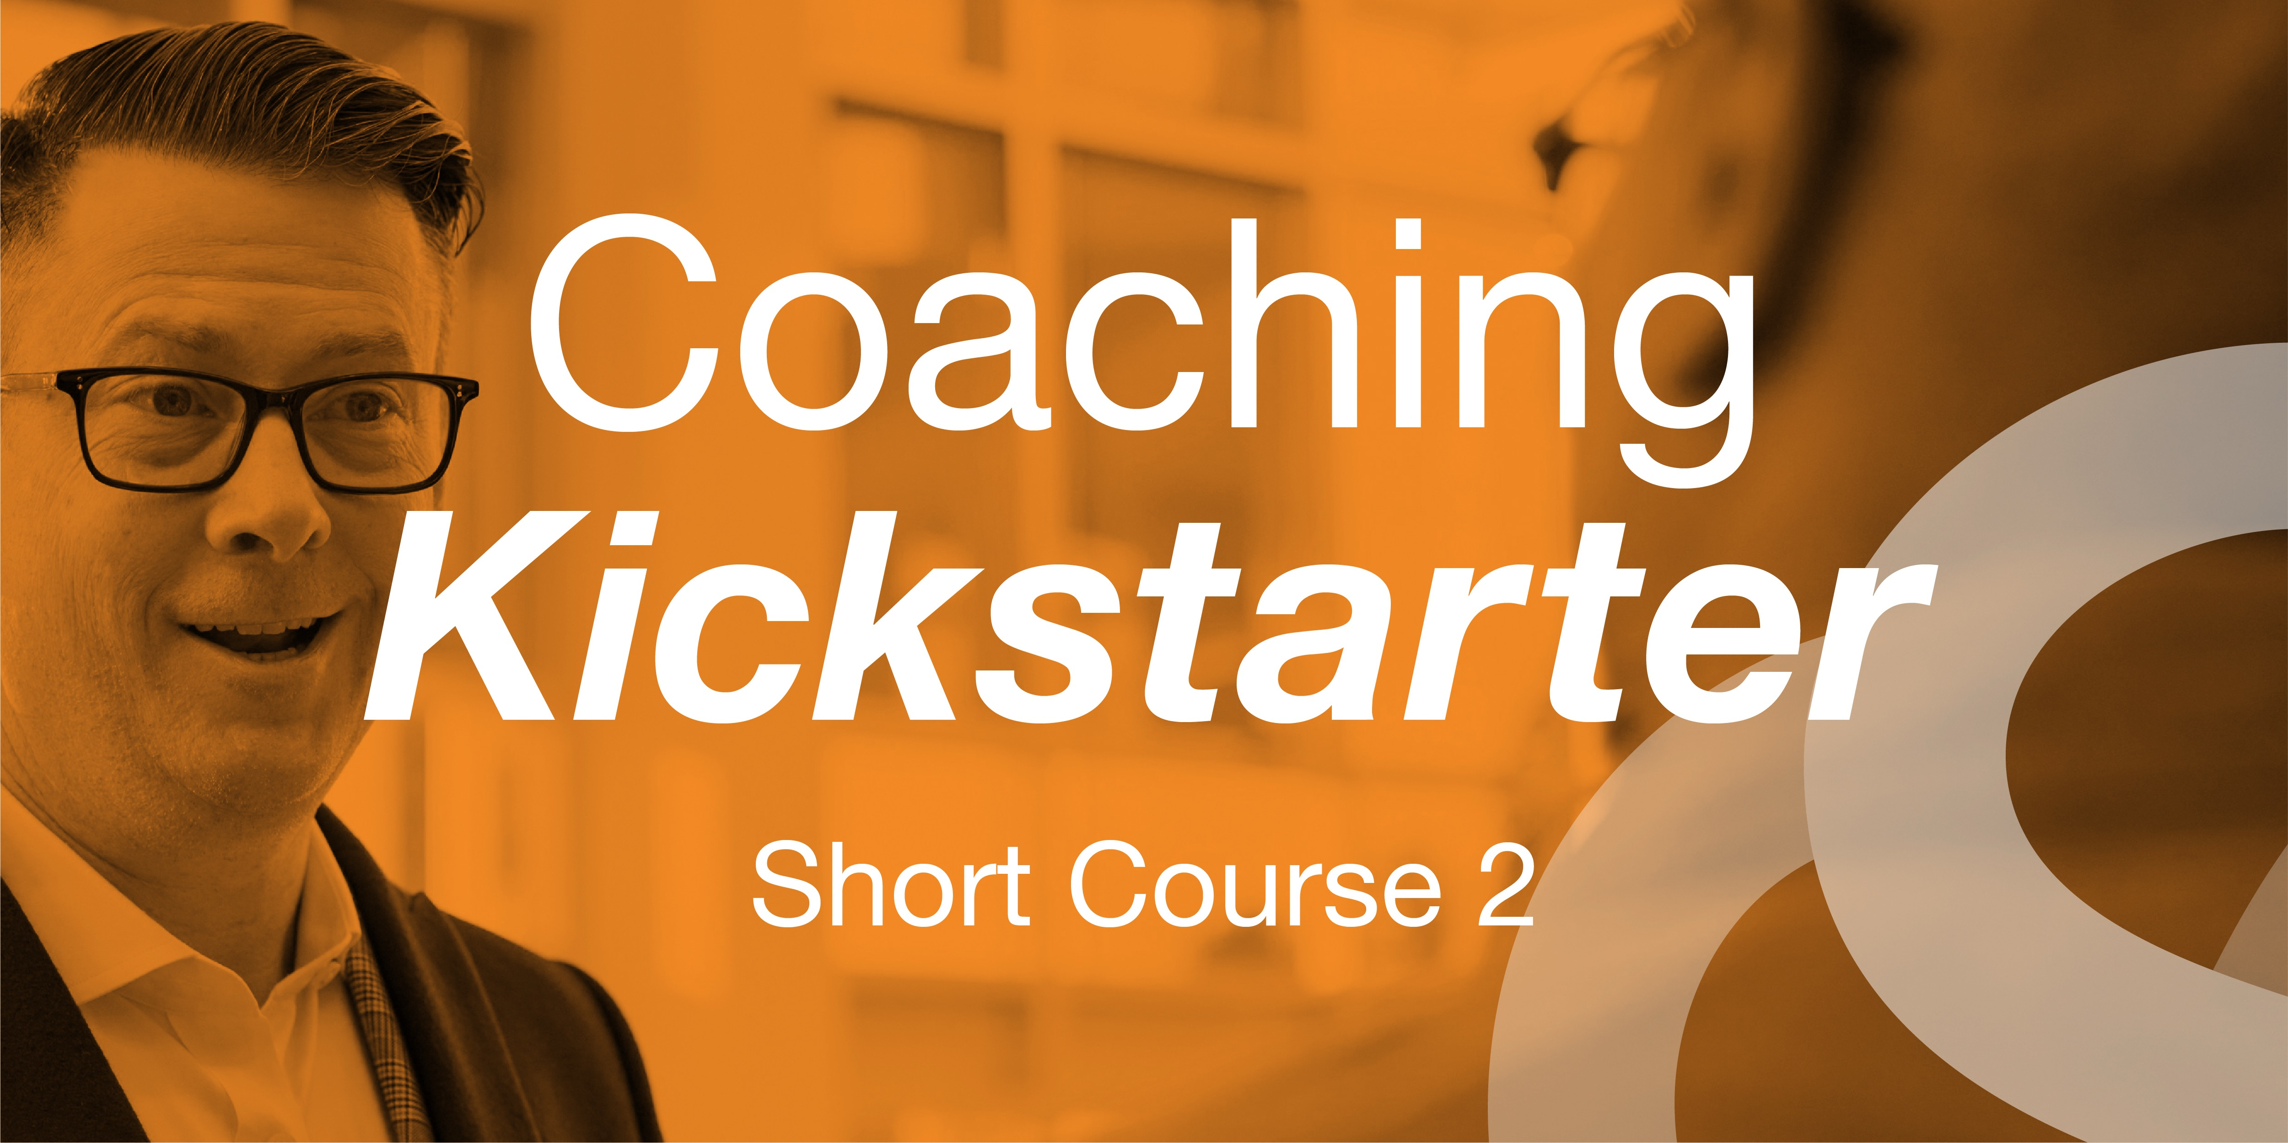

Slide 27




Contact Persyou
Visit: www.persyou.com
Email: hello@persyou.com
LinkedIn: www.linkedin.com/company/persyou
Podcast: Inspiring Leadership
Our services
Executive 1-to-1 coaching
Team coaching
Coaching Culture Awards
Bespoke people development
Get the ‘All Ways Coaching’ Book

Slide 28

MDP -Tracking and Reporting
All mentor engagement is tracked within the MDP (Moodle)
MDP Directory
The UoW will provide evidence, if asked, to support your DfE funding claims
Guidance on DfE claims: https://claim-funding-for-mentor-training.education.gov.uk/

Slide 29
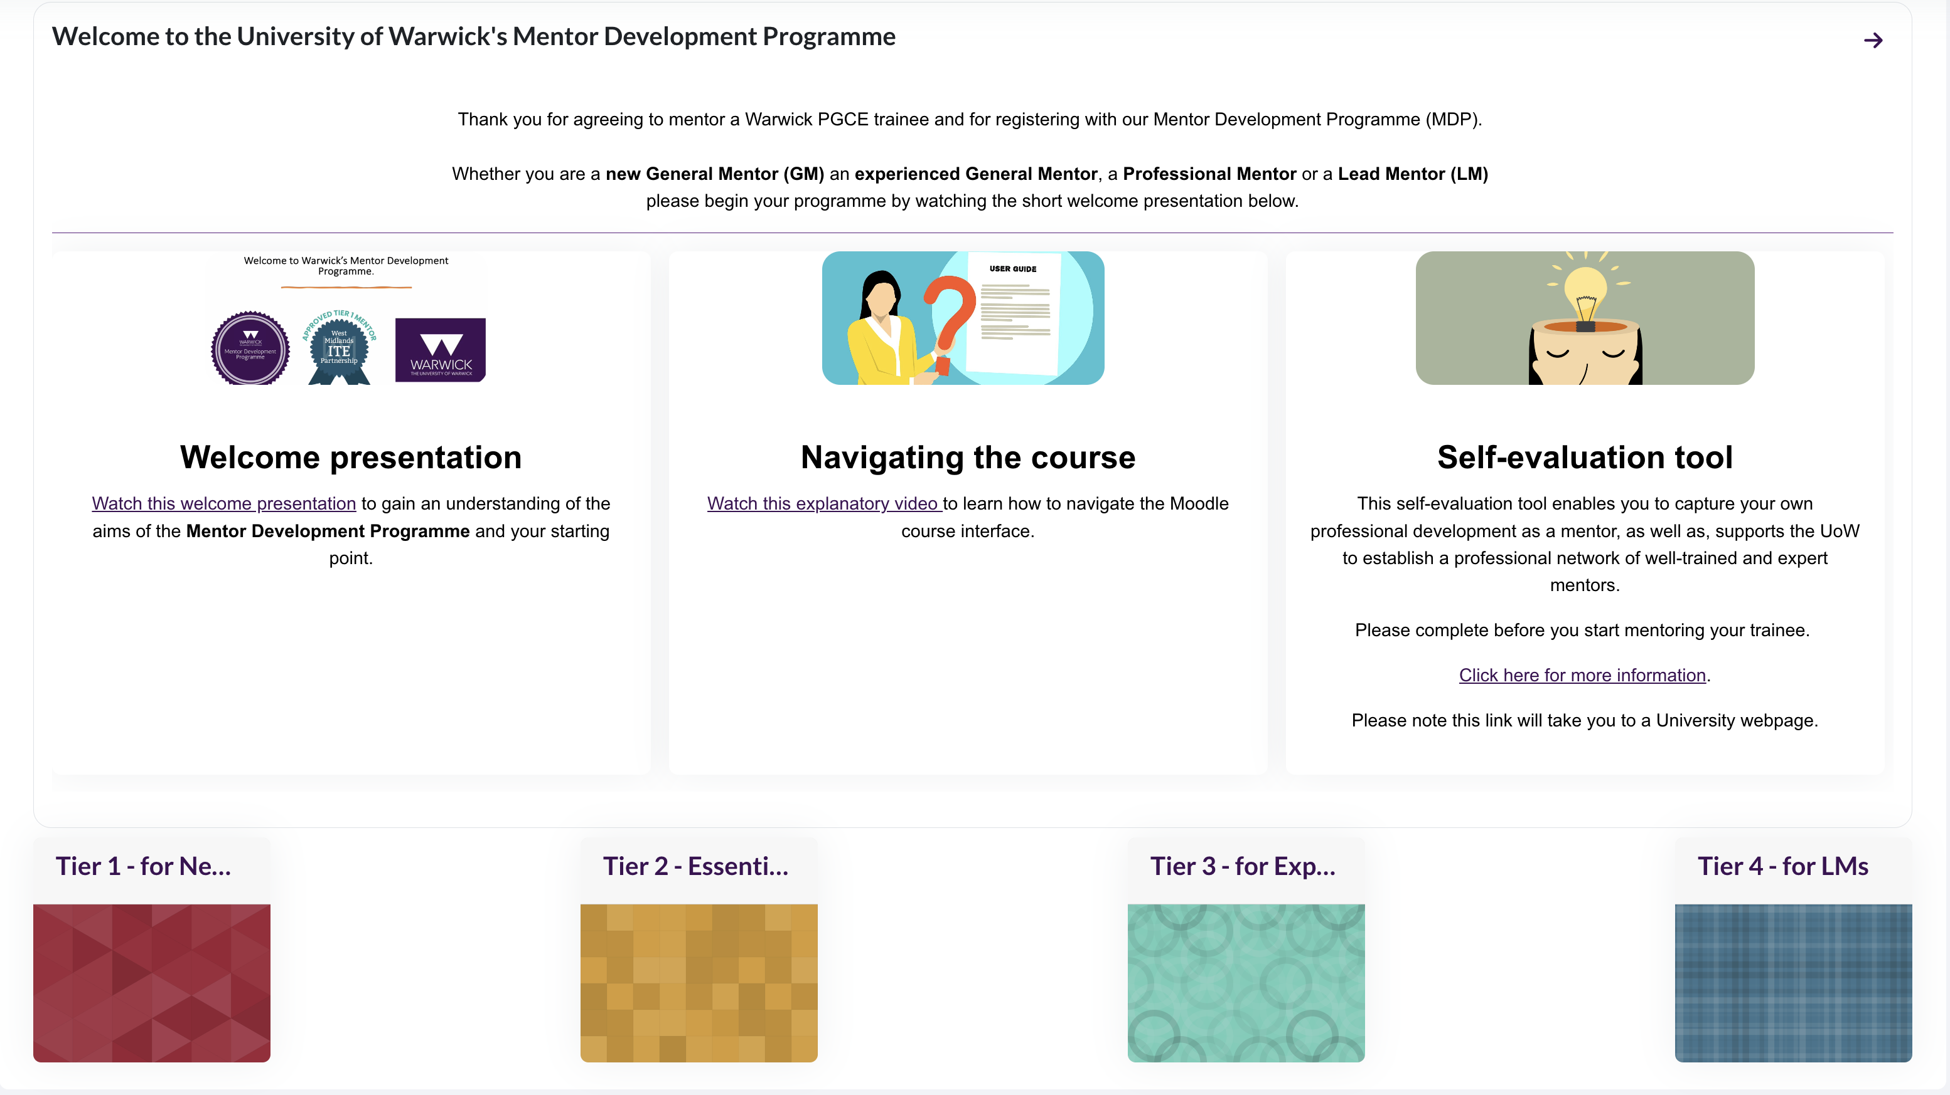

Slide 30




Slide 31
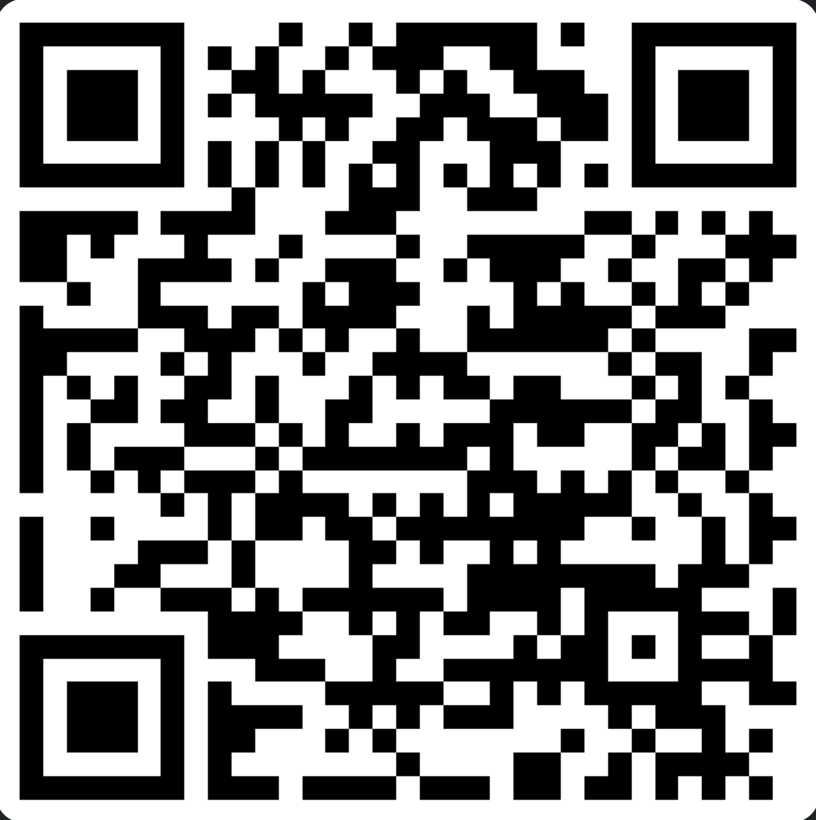
Recognising Excellence in Mentoring
If you know of a mentor who deserves to be recognised for their mentoring role, please use the QR to enter their details.
Effective mentors:
Support the trainee to reflect on their practice.
Listen carefully to the trainee and asks questions which extend the trainee’s thinking.
Use classroom data to help the trainee see their current reality in their teaching.
Use deliberate practice mentoring tools such as scripting, modelling, co-planning etc.
Recognise how the trainee’s wellbeing impacts their development and supports accordingly.
Engage in professional development to continuously improve their mentoring skills.
Inspire the trainee to be a successful teacher.
Nominations will close on the 10th June

Slide 32

PRIMARY/early years pgce updates
Julie Taylor
March 2025
Every child in every classroom deserves a great teacher every day.

Slide 33
Spring Term Updates
Primary numbers: On course: Primary – 53 (2 TWD) ; Early Years – 15 (+ 1 returner); Digital – 2 (1 TWD)
RIA, interdisciplinary and inclusion conference – very positive feedback
Revised Subject Studies assessment had very positive outcomes – Lit review/presentation – presentation provided a different type of assessment which students engaged well with
Students have completed their second block placement and CAP2 has been finalised - ULMs have been undertaking school visits/digital meetings this term and have seen good progress considering the length of the placement
Inclusion enhancement content continues to be very well received – students have also had bespoke EAL content plus the recent Inclusion ITAP – ensures students feel well prepared to meet the needs of all learners. Applicants to the course very interested in this.
School partners have co-constructed/delivered sessions related to EAL, pupil disadvantage and applying for jobs
Students currently engaging with enhanced placement opportunities – provide additional experiences beyond their placements to give them a rich and varied experience – new for 24/25 continuous provision in KS1
To ensure they are prepared to teach at 80%, students start their Summer Term block placement on 25th March, students will all move age phases - uni led students will remain in same school wherever possible, lead partner students return to host school.

Slide 34
Mentor Briefing for Summer Placement
Mentor briefing for new mentors/class teachers – 4.00-5.00pm on Tuesday 25th March
Mentor briefing for experienced mentors – 4.00-4.45 pm Wednesday 26th March
Model 3 partners – please support us to encourage mentor engagement with these
They should also be receiving Anna’s ITE bulletin aimed at developing understanding of the Warwick curriculum and providing useful CPD opportunities/readings etc

Slide 35
Primary/Early Years PPUs and ITAPs
Autumn
ITaP #1: Behaviour to Learn
ITaP #2: Preparing for Teaching and Learning
ITaP #3: SSP and Early Reading
PPU1 Talk for Learning
PPU2 Maths Misconceptions
PPU3 Foundation Subjects
Spring
ITaP #4: Adaptive Teaching
PPU4: SSP and Early Reading
PPU6: Cognitive Science
PPU5: Assessment for Learning
Summer
PPU4: SSP and Early Reading
PPU8: Wider Professional Responsibilities
PPU7: Assessment of Learning
Notes:
ITaP3 – preparation for PP1 assessment
3 activity outputs for each PPU
ITaP embed booklets – time in school to complete – attached to ITaPS

Slide 36
Collaborative Assessment Points
Collaborative Assessment Point 1a – w/c 21st October (focus on professional behaviours)
Collaborative Assessment Point 1b – w/c 16th December
Collaborative Assessment Point 2 – w/c 3rd March
Collaborative Assessment Point 3a – w/c 12th May
Collaborative Assessment Point 3b - w/c 23rd June

Slide 37
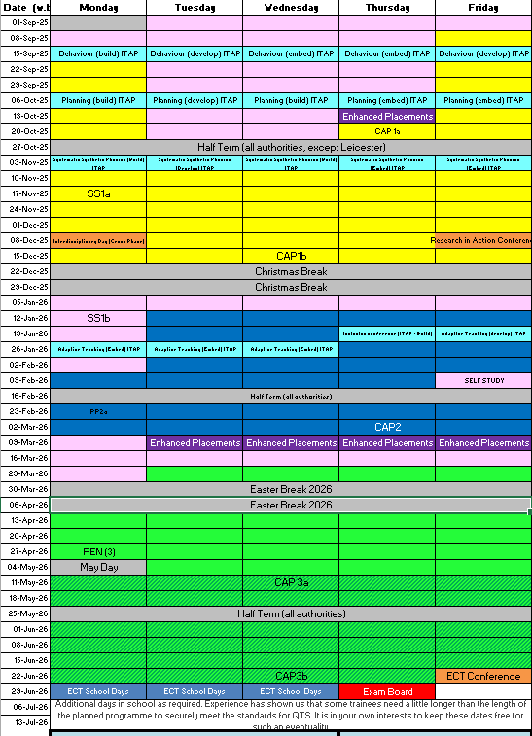
Primary Calendar 2526
Midweek school experiences in autumn first half term
2-week gap between ITaP1, 2 and 3; ITaP4 earlier in placement
At least 2 settings for Uni-led trainees

Slide 38
SECONDARY pgce updates
Alison Morgan
March 2025
Every child in every classroom deserves a great teacher every day.

Slide 39
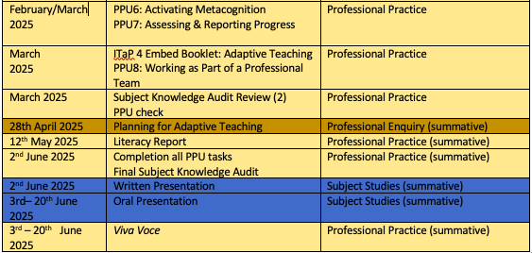
Key Updates
139 on course (includes 14 digital)
92% pass rate for Subject Studies 1 Assignment
SEND mini placement summer term
91 accepted offers for 25/26 (up 36% on same time last year)
External Examiner visits 12-14 May

Slide 40
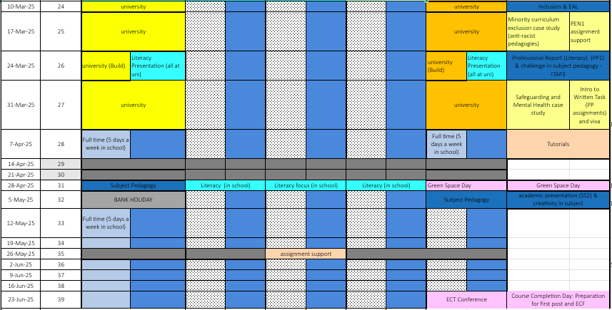
Secondary Calendar 24/25

Slide 41
Timetable Escalation
Timetable Escalation: 80% requirement
w/c 7th April: 5 days in school (experience of 16-hour timetable)
w/c 12th May: 5 days a week in school teaching 16-hour timetable
16 hours per week of teaching can include:
•Teaching other subjects
•Team teaching
•Small group teaching
•Interventions
•1-1 support
•Extra-curricular activity
Trainees must be planning the above.

Slide 42
INTERVIEWS and NEED analysis
Emily Davis
March 2025
Every child in every classroom deserves a great teacher every day.

Slide 43
Informing Interview Candidates of Needs Identified
During the interview process, we ask that you highlight any needs identified.
This can be relating to any issues with Fundamental Skills or other aspects such as becoming more familiar with phonics or brushing up on their knowledge of safeguarding.
We have added a new prompt to the Qualtrics form you complete after conducting the interview where we ask if you’ve informed the candidate of these identified needs
This is because we’ve found that some trainees who were recruited through partners were beginning the course without knowledge of these areas for development.
Any questions about this, please email:
Emily Davies (primary) – emily.c.davies@warwick.ac.uk or
Vikki Armeson (secondary) - V.S.Armeson@warwick.ac.uk

Slide 44
Professional Dialogue/Viva
What is it?
Final PGCE assessment
50% of the Professional Practice Module
30-minute dialogue with ULM (online/recorded for moderation)
Questions based on the module learning outcomes – coaching style dialogue
LO1 Demonstrate professional knowledge of the ITE curriculum in the age phase for which they are training.
LO3 Deal with complex issues, both systematically and creatively, make sound evidence-based judgements in the absence of complete data, and communicate their conclusions clearly to specialist and non-specialist audiences.
LO4 Demonstrate self-direction and originality in tackling and solving school learning environment-based problems, and act autonomously in planning and implementing teaching at a professional level.
LO5 Understand how to further advance their professional knowledge and understanding, and to develop new skills to a high level in the profession.
LO6 Understand how teachers are key role models, who can influence the attitudes, values and behaviours of their students
LO7 Affect and improve the wellbeing, motivation and behaviour of pupils in school and influence pupils’ resilience and beliefs about their ability to succeed.
LO8 Demonstrate how effective teaching can transform pupils’ knowledge, capabilities and beliefs about learning.
LO9 Make valuable contributions to the wider life of the school in a broad range of ways; including by supporting and developing effective professional relationships with colleagues.

Slide 45
Professional Dialogue/Viva
How can you help?
Have those professionally reflective conversations with your trainee(s);
encourage their professional voice and confidence to speak with authority about their specific examples of their practice – talk like a teacher
Encourage them to explain the links to the evidence base (literature/theory) for the issue under discussion
Ensure they have access to a quiet, private space for the dialogue/viva, with wifi coverage (or work from home)
Create ‘space’ before/after the Dialogue/Viva.

Slide 46

QUESTIONS
AND DISCUSSION

