Slide 1

PGCE
Secondary
Centre for
Teacher Education
EXCELLENT TEACHERS, NEED EXCELLENT TEACHERS

Slide 2

What to expect this evening
Introductions
CTE and PGCE in general
Secondary specific information and examples
Q&A

Slide 3
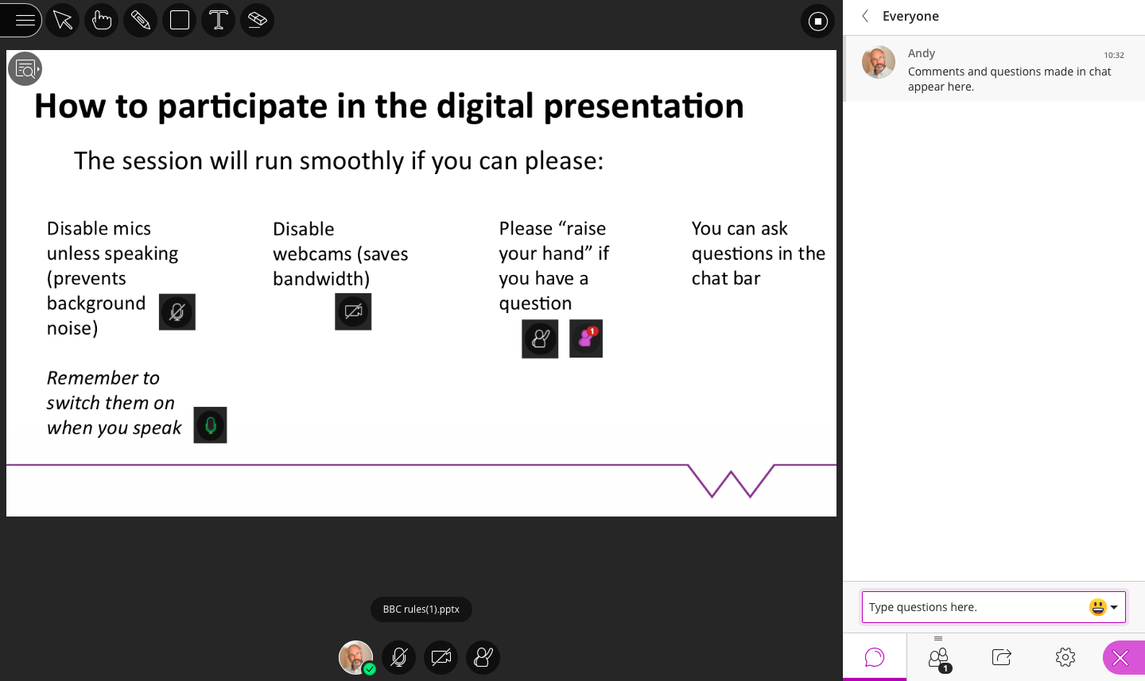

Slide 4
Introduce yourself
It’s great to have you in this Webinar;
We’d like to know you a little better;
Please introduce yourself by adding a comment to the chat box on the right hand side of this screen;
Say your first name, where you are from and in a short phrase or sentence, what you are interested in;
You can use the comment box at any time to ask a question, but as with any online forum, be cautious about asking anything sensitive. Should you have anything personal that you would like to discuss with us, we encourage you to contact us by email on CTE.admissions@warwick.ac.uk

Slide 5
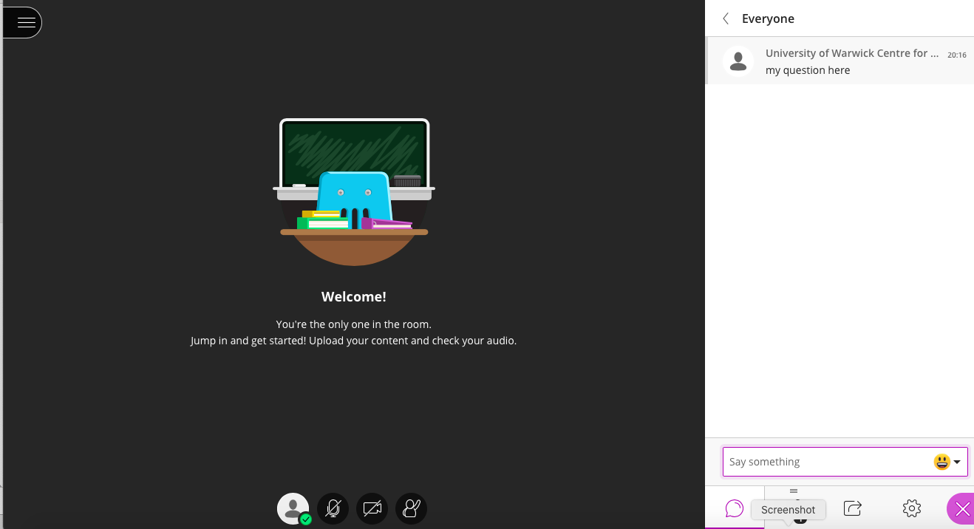
Please post any comments & questions into the chat box

Slide 6

Why Warwick?
The Warwick Teacher Values
Our training is built on three core values for ourselves and the teachers who train with us:
Social Justice
Intellectual curiosity
Creativity
“Studying at Warwick gave me a solid foundation for my career as a teacher. Some great lectures, visits and guest speakers provided some useful information to help me on my way. I would definitely recommend Warwick.”
Yasser, PGCE Alumnus
Notes:
Warwick will give you the skills to become the best teacher you can be
Employment rate is very high at 98%, our trainees are ‘sought after’
We are a Russell Group university and are committed to maintaining the very best research and have an outstanding teaching and learning experience

Slide 7



Why Warwick?
Rated Outstanding by OFSTED in the primary and secondary phase
“The success of the programme is a testament to everyone’s passion for what they do for the students and the pupils they serve.”
98%
OF OUR TRAINEES ARE IN EMPLOYMENT WITHIN A FEW MONTHS OF GRADUATION
Notes:
Quotes from our examiners, and OFSTED ratings

Slide 8
Routes into Teaching
UNIVERSITY-LED
You can make up to three choices on UCAS. This can be a mix of University and school-led routes.
CORE
SCHOOL-LED
SCHOOL DIRECT
SCHOOL-LED
SCHOOL DIRECT
SALARIED
TRAINING
Notes:
Brief overview to explain the routes

Slide 9

Entry Requirements
Graduate/about to graduate, with a 2:2 or above honours degree
Grade C/4-9 in GCSE English Language and Mathematics
Equivalent qualifications may be considered
Enhanced DBS check
We recommend that you have visited a couple of schools before your application or interview as this will really help you, though this is not essential
Before training begins: Where possible, we recommend you gain as much experience in UK schools as possible
Notes:
Briefly discuss the entry requirements

Slide 10

PGCE Secondary
(Core & Secondary School Direct)
• Full time course
• Taking one full academic year
• Preparation for employment in September
University-Led (Core)
Apply to The University of Warwick
11-18 years
School-Led (School Direct)
Apply direct to school.
Run in partnership with Warwick
11-16 years

Slide 11

What makes Warwick different?
Training founded on Warwick Teacher Values
Outstanding support from Teaching Fellows (Experienced ex-teachers)
Very strong partnership with schools
Co-constructed, co-delivered course
High level of trainee satisfaction
Long school placements
80% of the year spent in school
PGCE = 90 CATS academic credit towards our MA in Professional Education
Notes:
Why is PGCE secondary at Warwick better than any other PGCE provider?

Slide 12
PGCE Course Structure
Subject Studies
Subject seminars and workshops
Subject Hubs of Excellence
Academic Assignments
Professional Enquiry
Teaching
Planning
Behaviour
Assessment
Safeguarding
Reflection
Academic Assignments
Professional Practice
School Practice (Placement)
Observation
Visits from University TF
Half-termly Assessment
Portfolio (PDP)
PGCE (90 CATS)
MA (180 CATS)

Slide 13

Placements: University-Led (Core)
Two extended Professional Practice placements in partner schools (one term and two terms respectively)
Contrasting settings to provide a varied and balanced experience of teaching in different settings
Try to take account of personal circumstances when placing trainees, to minimise commute to an hour
Five day placement in a Primary school
Optional 4-day placement in an alternative educational setting, e.g. special school

Slide 14

Placements: School-Led (School Direct Training & Salaried)
Extended Professional Practice placement in one main school or “Base School”
Additional placement (half a term) in contrasting school
Five day placement in a Primary school
Varied experience of teaching in different settings
Contribute significantly to life at your “Base School”
If you choose to follow the salaried route you may have to plan and assess classes independently

Slide 15

Our courses for 20/21
Core and School Direct
Art and Design
Biology
Chemistry
Computer Science
Drama
English
Geography
History
Mathematics
Modern Foreign Languages
Music
Physics
Physical Education
Religious Education
Notes:
We offer
14 subjects across our University-led and School-led programmes.
For 19/20 entry the following will not be available: Physics with Maths, English with Drama,

Slide 16

Subject Knowledge Enhancement
Info on the DfE website
Courses from 8-28 weeks long
Funded by DfE in eligible subjects
May be eligible for a tax-free SKE training bursary of up to £5,600 (depending on the course length)
Delivery varied:
Online
Face-to-face
Blended
Notes:
A Subject Knowledge Enhancement (SKE) programme is ideal for applicants who may not have enough specific subject knowledge to begin their chosen PGCE. It is designed to help you gain in-depth knowledge needed to train in your chosen subject of Biology, Chemistry, Computing, Design and Technology, English, Geography, Languages, Mathematics or Physics. NEW: English. NEW 8-week SKE in RE.
Ensure you state in your UCAS application that you are interested in doing an SKE.
DfE website: https://getintoteaching.education.gov.uk/subject-knowledge-enhancement-ske-courses
Information can be found on our website.
NOTE: trainees may only do an SKE course in their training subject. i.e. if training in “physics” they may not do SKE to support a weaker science. The only exception is MFL, in which a secondary language may also be studied.

Slide 17
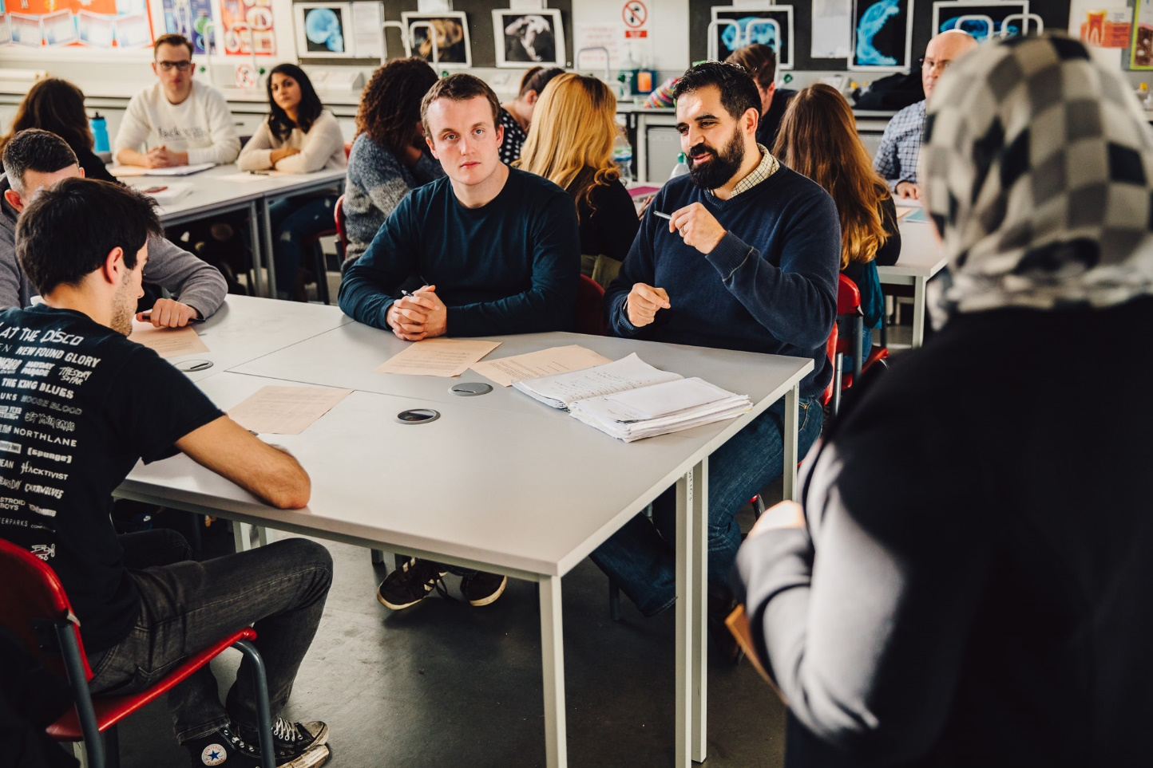
Fees
Full-time Home and EU tuition fee for studying a PGCE 2020/21 is £9,250
School Direct Salaried fee is £2,000
The full-time International fee is £21,060
Additional Costs
Travel Expenses
Books – can use library
Materials - recommend laptop/tablet
Printing – resources, academic
Notes:
Home and EU students can apply to the Student Loans Company for a tuition fee loan to cover the cost of the fees.
Travel
Trainees are required to pay for their travel to and from their placement schools either using private and public transport. You will need to be prepared for the possibility of extra travelling time to and from your schools – possibly over an hour by car or significantly longer by public transport, although we make every reasonable effort to minimise your journey times.
Books
Books are recommended but there is no requirement to purchase specific texts and you have access to the University of Warwick library.
Materials
You will need writing materials. Ideally, you will need a laptop or tablet: you will certainly need access to a PC of some kind.

Slide 18
Scholarships and Bursaries
Subject | Early Career Payment* | Scholarship | Trainee with 1st/PhD | 2:1/Masters | 2:2
Chemistry, Languages, Mathematics, Physics | £6,000 | £28,000 | £26,000 | £26,000 | £26,000
Computing | - | £28,000 | £26,000 | £26,000 | £26,000
Biology | - | - | £26,000 | £26,000 | £26,000
Geography | - | £17,000 | £15,000 | £15,000 | £15,000
English | - | - | £12,000 | £12,000 | £12,000
Art & Design, History, Music, Religious Education | - | - | £9,000 | £9,000 | £9,000
Correct for 20/21
You could receive £32k (or £34k) in total - £26k as a tax-free bursary (or £28k scholarship) with additional payments of £6k after tax once in teaching. You'll need to have completed a non-salaried teacher training course and received a bursary or scholarship in the academic year 2020/21. You will receive three additional early-career payments of £2k each in your second, third and fourth years of teaching. Enhancements to these payments (£1k extra per year) are available if you teach in specified areas in England. You must have taught in a state-funded school in England since completing your teacher training course. T&Cs apply.

Slide 19

Scholarship Eligibility
Have at least a 2:1 degree or above
Can apply with a 2:2 but need evidence of significant relevant experience
Scholarships are awarded in place of a bursary
Unsuccessful scholarship applicants still receive the standard bursary
Notes:
Eligibility
To be eligible for a scholarship, you should have at least a 2:1 degree or above and want to teach chemistry, computing, geography, languages, maths or physics. You can still apply if you have a 2:2, but you’ll need to provide evidence of significant relevant experience. Scholarships are awarded in place of a bursary.
If you’re not successful in your application for a scholarship, and secured a place on a qualifying teacher training course in England you’ll still receive the standard bursary – find out more about bursaries.

Slide 20

Career Progression
Teaching and Learning Responsibilities
Head of Department, Head of Year
Pastoral role, SEN, safeguarding, mentoring
Lead Practitioner
Specialist Leader of Education
Management e.g. Assistant Head, Deputy Head, Head Teacher
International Schools
Notes:
Moving away from teaching
Education lecturing, school inspection, advisory or consultancy roles, initial teacher training, administration in local education authorities (LEAs) and examination boards
Museums, art galleries and zoos employ teachers
Self-employment, private tutoring, writing educational materials

Slide 21

Live Chat events
To find out more about teacher training at Warwick, we are offering several opportunities to engage with us from a distance, digitally.
Stay up to date by visiting the CTE website and clicking on the Live Chat button, or by using this link
warwick.ac.uk/fac/soc/cte/about/news-and-events/live-chats

Slide 22

International Qualifications
Applicants with International qualifications are advised to contact NARIC in the first instance. NARIC are a designated United Kingdom national agency for the recognition and comparison of International qualifications and skills.
For more information about NARIC please go to; https://naric.org.uk/naric/
It is also useful to look at the following link before applying; https://www2.warwick.ac.uk/fac/ soc/cte/thinking-about-being-a-teacher/entry-requirements/international
Notes:
NARIC is a good first place to start but also mention that NARIC doesn’t give complete clarification, so it will tell an enquirer that their international degree is equivalent to a UK Honours degree but won’t give a classification for that degree.

Slide 23
Thank you
for joining us today
Something else you wanted to ask? If it’s personal and you would like to discuss it with us privately, please email us on CTE.admissions@warwick.ac.uk and we will ensure a member of CTE comes back to you.

