Slide 1

The briefing for International Mentors will begin at 12.30 BST
Penny Ottewill - Secondary
Anna Donnelly – Primary

Slide 2


Session Outcomes:
To be able to explain the purpose and process of the following documentation; which all support mentoring at the University of Warwick in 2024 / 2025:
To be able to access and navigate around the Mentor Development Programme (MDP)
The Mentoring Agreement
The mentoring records (ICON)
Collaborative Assessments and Review (CAP)
Professional Practice Units & ITAPs
Mentor Development Programme

Slide 3
A busy and positive start:
Live Sessions so far:
The context of International
Education
Safeguarding
Learning Theory
History of Education in England
Developing Teacher identity
Character Education
Reflective practice
Child Development
Being a mentee
Asynchronous Material so far:
Axia Platform
Observing lessons
Planning preparation
Subject Knowledge audits
Academic Writing
Fundamental Skills
Upcoming live sessions in September and October
Professional Enquiry
Curriculums
Adaptive Teaching
ITaPs
Behaviour to learn
Preparation for teaching ad learning
Secondary in Subject
What it means to be a subject teacher
Issues in Subject
Primary
Spoken Language
Developing Spoken Language
Reading Pedagogies
Focus for September/October
Settling in tutorials and tripartites
Settling into the course
ITaP 1 and 2

Slide 4
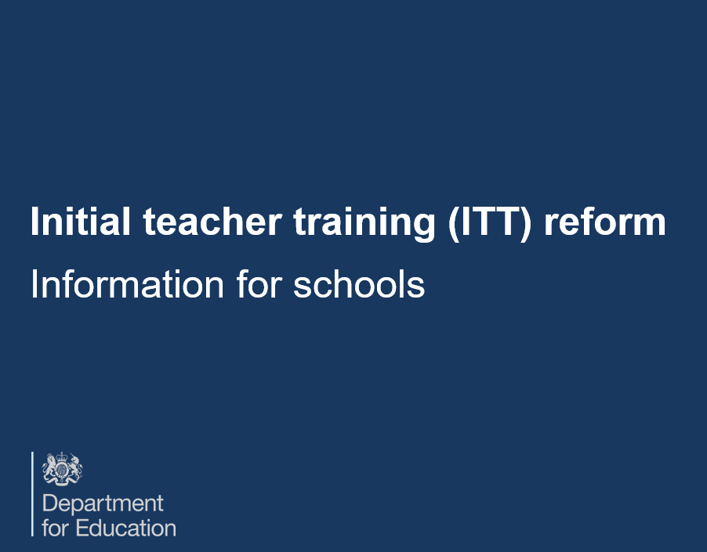
National Mentoring Expectations.
From September 2024 onwards - the new quality requirements should ensure that every trainee receives an entitlement of 1.5 hours per week of mentoring support.

Slide 5
National Mentoring Expectations.
Taken directly from DfE guidance for IQTS Programmes (Feb ‘24)
Mentor training prepares mentors for their role in guiding and supporting trainees throughout their IQTS programme.
They have expertise in evidence-based subject or phase-specific approaches to teaching and that they are allocated to trainees as appropriate to their subject or phase needs.
Mentors receive enough time to attend the required training and discharge the mentoring entitlements according to the minimum set out in these iQTS criteria

Slide 6
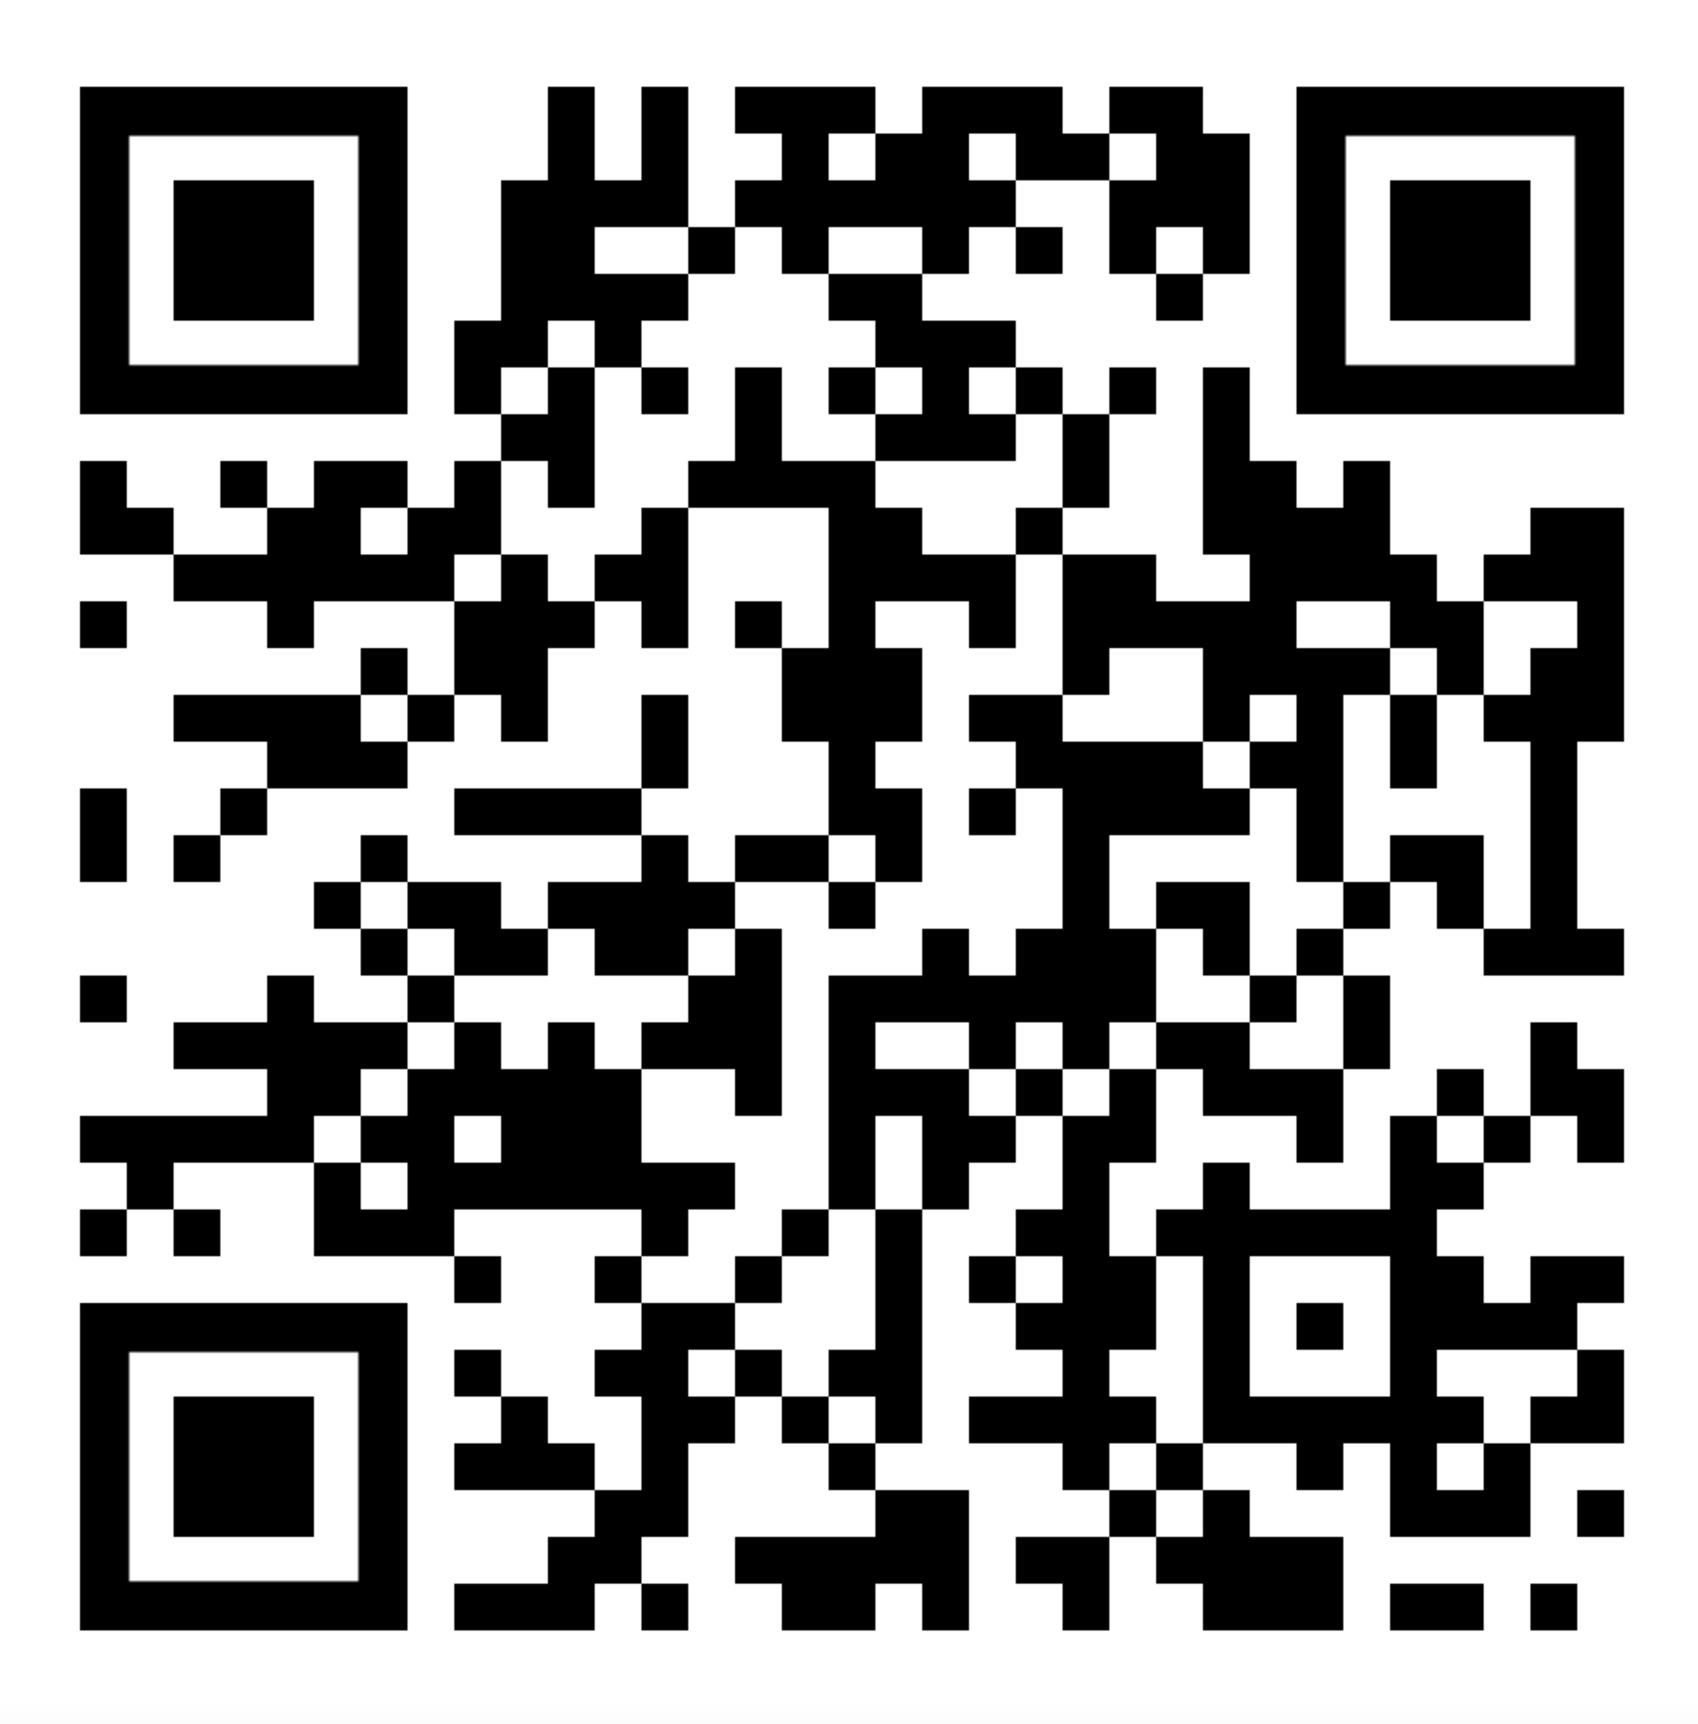
Our response: To ensure that we meet the DfE’s requirements for a ‘professional network of well trained and expert mentors’, we have developed a flexible suite of Tiers and Units to support the support your mentor development.
user friendly – with a mix of asynch, face to face, online workshops and in school support. We have embedded the existing mentoring requirements (briefings, conference, school visits etc.) into our programme. Tier 3 is tailored towards individual mentor development. ​
enables mentors to join a professional community of practice to share ideas, resources, and experiences.

Slide 7
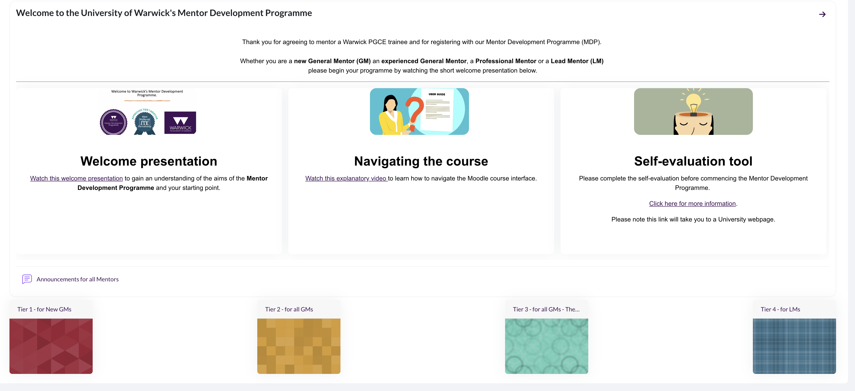

Slide 8




How CTE’s principles of assessment support our mentoring approach.
Improvement: improve not prove
Trainee Agency: trainee-led instructional coaching approach – trainees are an active part of the process
Supportive: identify trainees who are not on track to achieve the TS by the end of programme to enable intervention and support
Dialogic: an entitlement to hold dialogic conversations with expert colleagues (and observe expert colleagues).
Clarity: shared expectation of expected progress AND of important principles e.g. WTV, expectations of support.
Purposeful - streamlined to ensure that assessment contributes to progress with a minimum of workload

Slide 9
Warwick’s Mentoring Model based on Instructional Coaching (Knight, 2013)
Cycle to be repeated as new target set or target is adjusted to meet the needs of the trainee.
Analyse New / Current Reality
Set targets
Identify and explain teaching strategies – co-construct targets/goals
Provide support until targets are met (mentorship)

Slide 10
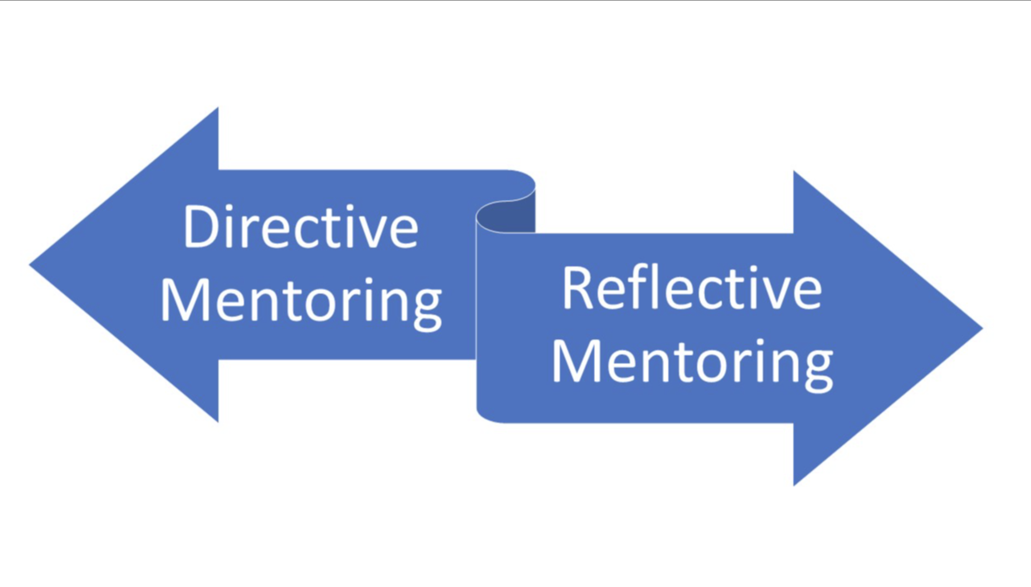
The level of support is matched to the trainees’ level of proficiency – working on a continuum of support (directive to reflective) and will involve the mentor asking questions and mentee discussing a range opportunities for observation, modelling, co-planning, data collection and most importantly the use of dialogue to support development.

Slide 11
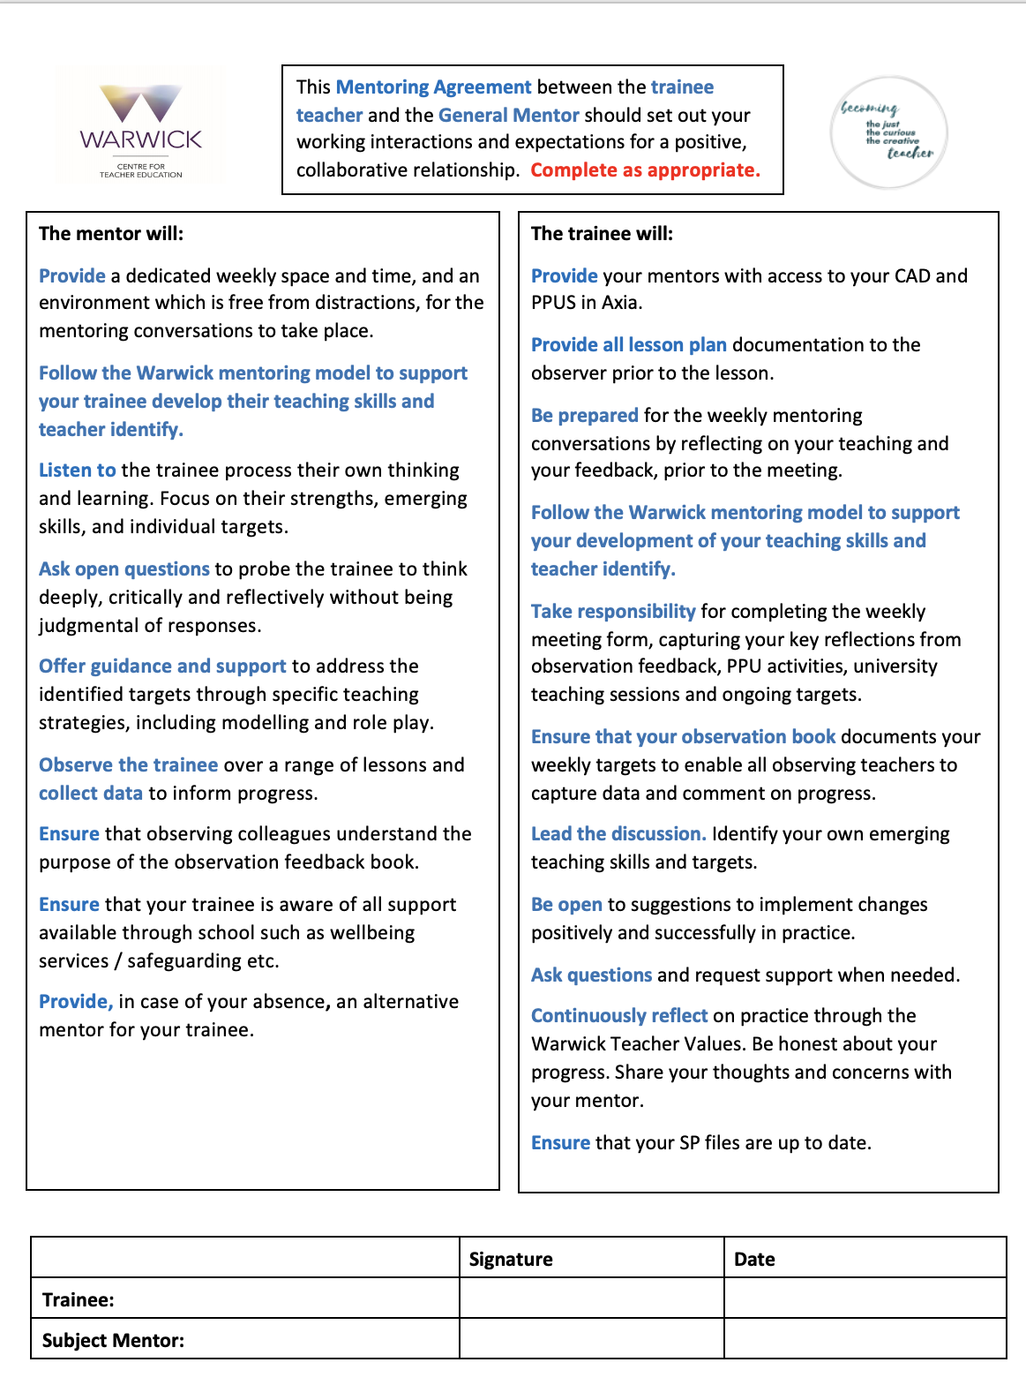
Your Mentoring Agreement:
Should be completed, with your trainee, in the first or second meeting.
Provides both you and your trainee with a shared understanding of the responsibilities and boundaries of your relationship
Should be signed by you and your trainee - both keep a copy for reference.

Slide 12
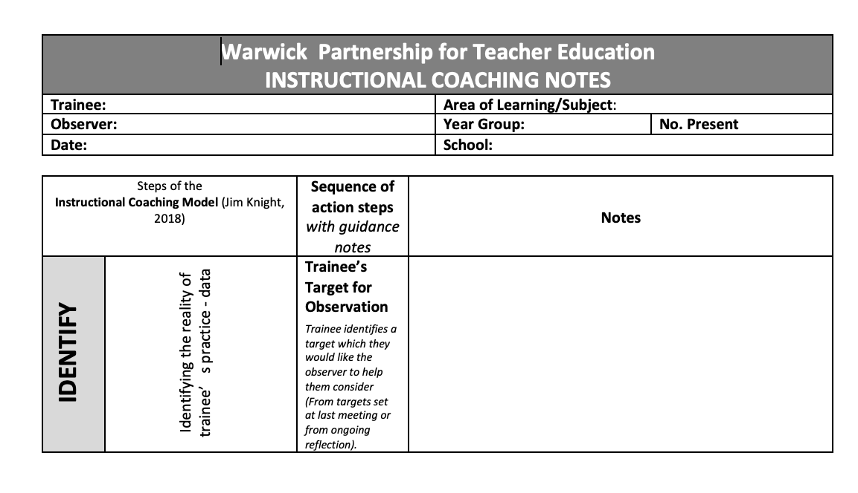
Mentoring Notes (ICON) ​
Should be completed together with your trainee and within the mentoring meeting.
Provides both you and your trainee with a shared understanding the trainee’s current reality, reflections and ongoing targets.
Needs to be uploaded to Axia by the trainee and signed off by you the mentor.
Notes:
Place emphasis on mentoring environment
Importance of revisiting this at the beginning of each half term – amend if necessary.

Slide 13
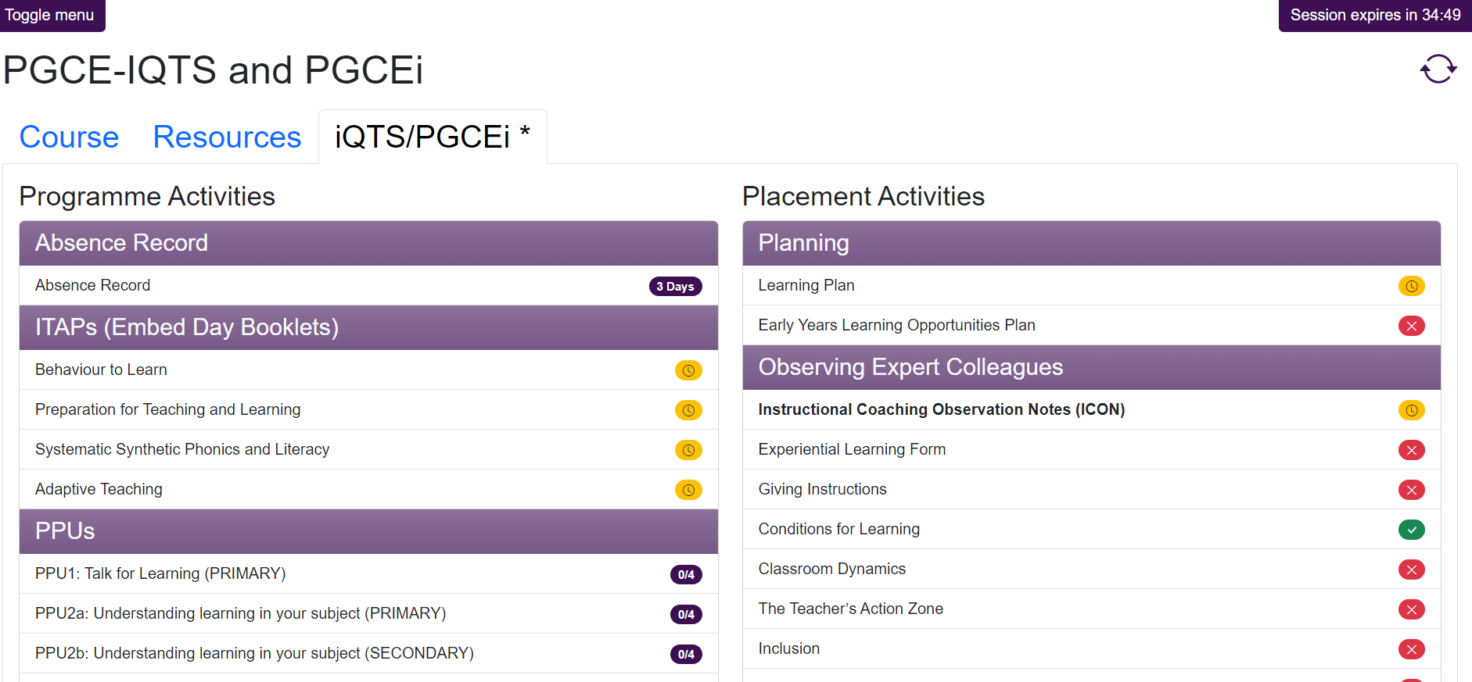

Slide 14
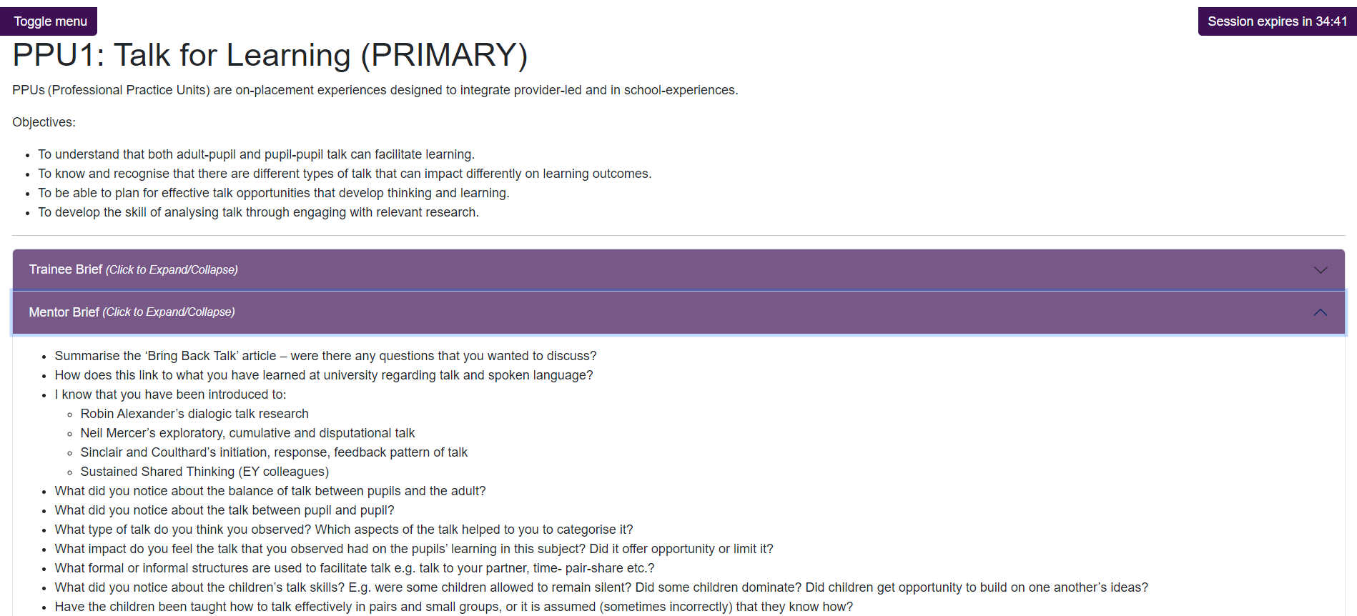

Slide 15
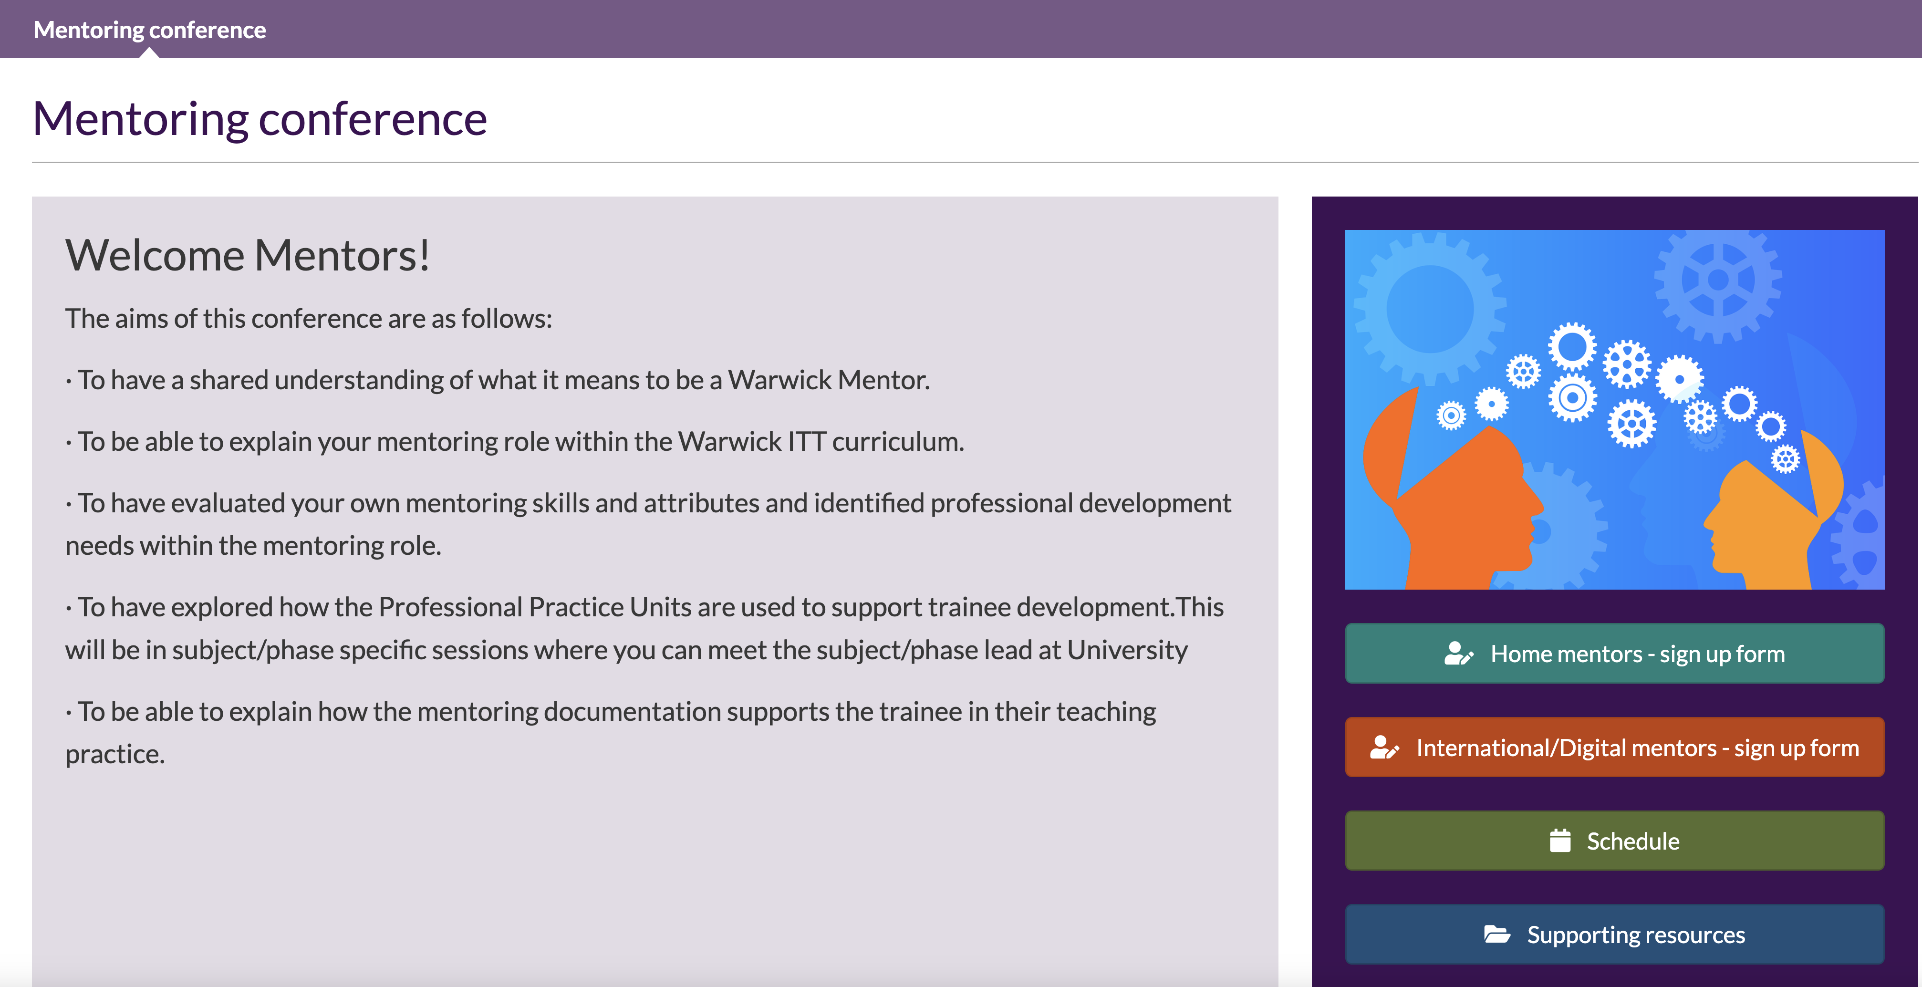

Slide 16

What else do you still need to know?

Slide 17
