Slide 1

The workplace: glassed and gendered?
Dr Kate Carruthers Thomas, Birmingham City University
Warwick University
9 April 2019

Slide 2
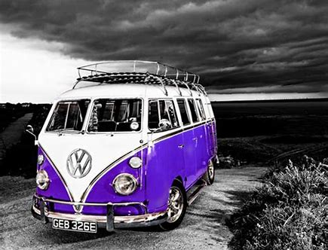
the g word tour
www.thegword2017.wordpress.com
#gwordtour
#gendersatwork
#gettinggraphic

Slide 3
the research:
Gender(s) At Work
(2016-2018)
explores:
how gender (and intersectional) factors shape workplace experiences and career trajectories within a post-1992 UK university
implications for the idea of ‘career’ as a linear, uninterrupted, gender-neutral trajectory
implications for the Athena SWAN Charter and the university in addressing/redressing gender inequality

Slide 4
the research:
Gender(s) At Work
(2016-2018)
‘institutional research (IR)’? – ie: conducted within an educational organisation to inform decision-making, planning and effectiveness
IR typically seeks a quick turnaround and clear simple answers, is not underpinned by theoretical perspectives
Gender(s) At Work aimed to increase corporate intelligence about gender equality and contribute to the university’s Athena SWAN gender equality agenda
but distinctive: 18 month duration, qualitative data (interviews and visual mapping); feminist geographic analytical framework, findings reported externally

Slide 5
sample
50 self-selecting participants:
  23 female
  16 male
  1 gender non-binary
  academic/professional roles
  across organisational hierarchy

Slide 6
methods
1. narrative enquiry
potted career histories
common question schedule
experiences of working at the university and sector more widely
participants’ perceptions of the influence of gender on those experiences/trajectories
participant verification
why narrative?
experiences as expressed in lived and told stories of individuals and relates to the singular and particular within a social context (Creswell 2007)
accommodating complexity…revealing ambiguity (Bathmaker 2010, p2)
space as a simultanaeity of stories-so-far … place is a collection of those
stories (Massey, 2005, p9)

Slide 7
methods
2. organisational mapping
mapping sheet
common shapes – or freedom to create own
‘which best matches your perception of the university’
‘place yourself in relation to the shape’
changes/annotation allowed.
why mapping?
Participant-generated visual materials are particularly helpful in exploring the taken-for-granted things in their research participants’
lives …(Rose 2014, p. 27)
space as social relations shaped by power (Massey 2005, p9)

Slide 8
spatial storytelling
In Gender(s) at Work I use spatial storytelling to map and report stories beyond dominant and exclusionary narratives, to uncover spaces between … to foreground relationships between spaces and power.
(Carruthers Thomas, 2019)
revealing spaces between organisational rhetoric/lived experience

Slide 9
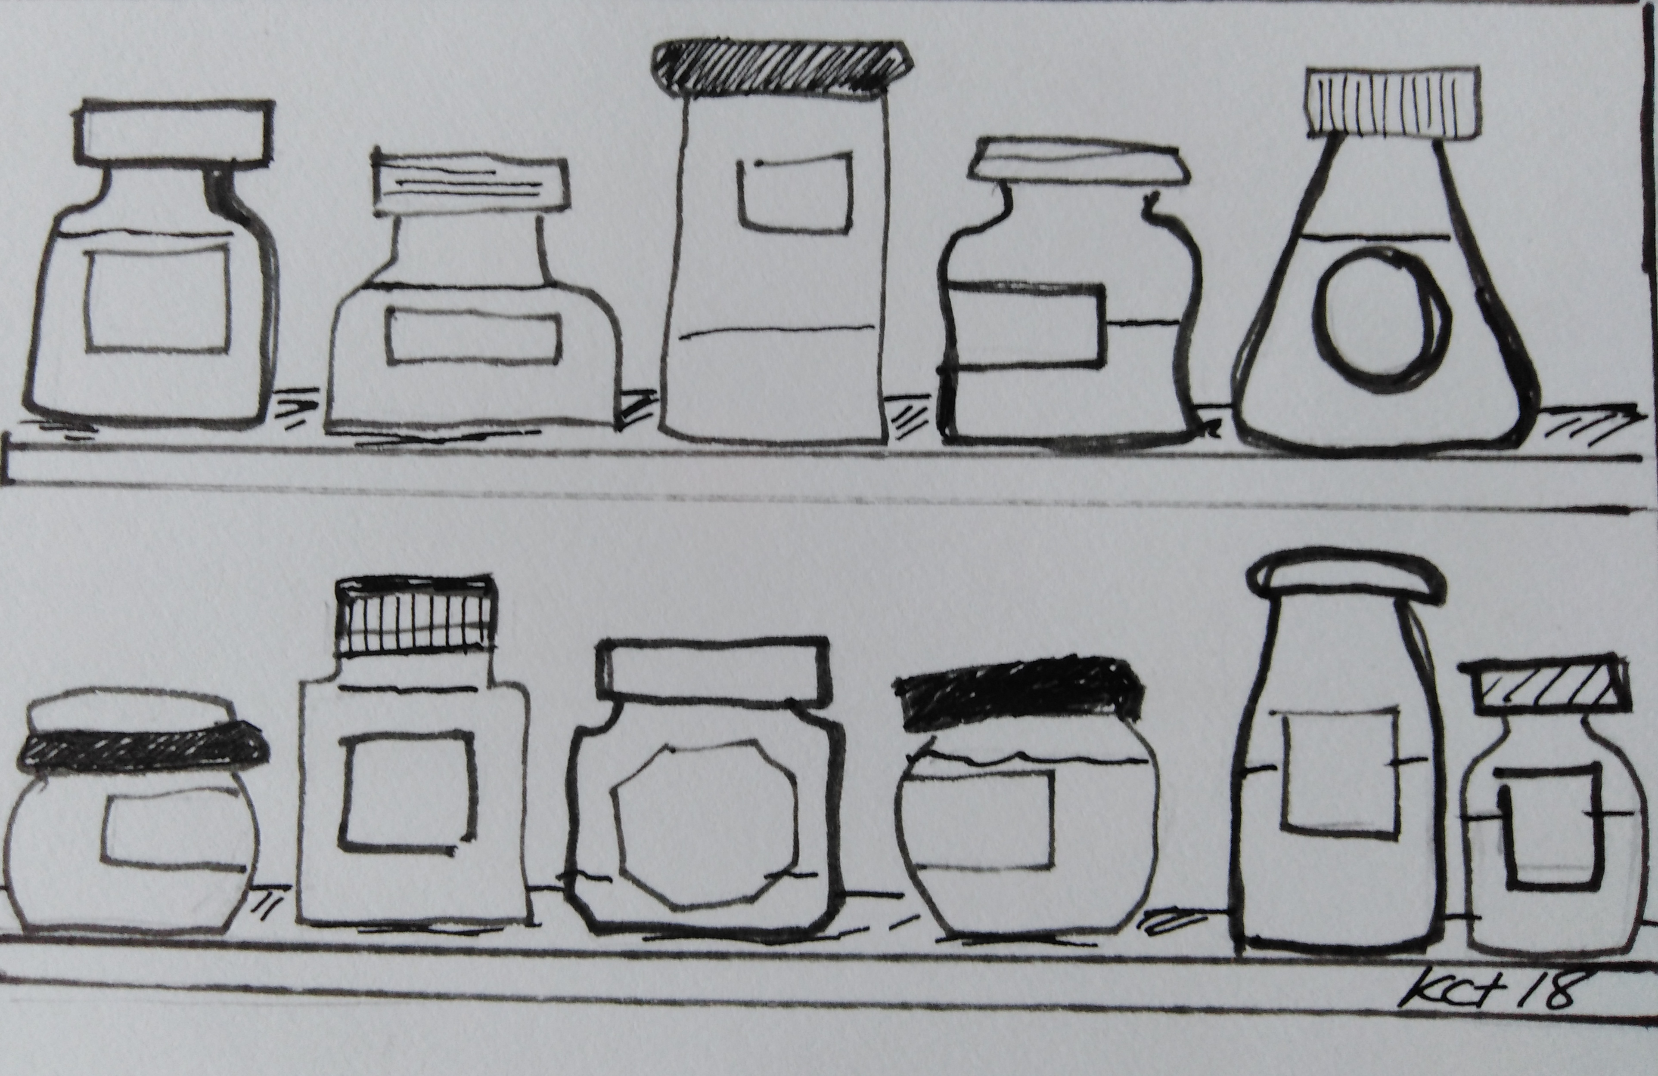
findings

Slide 10

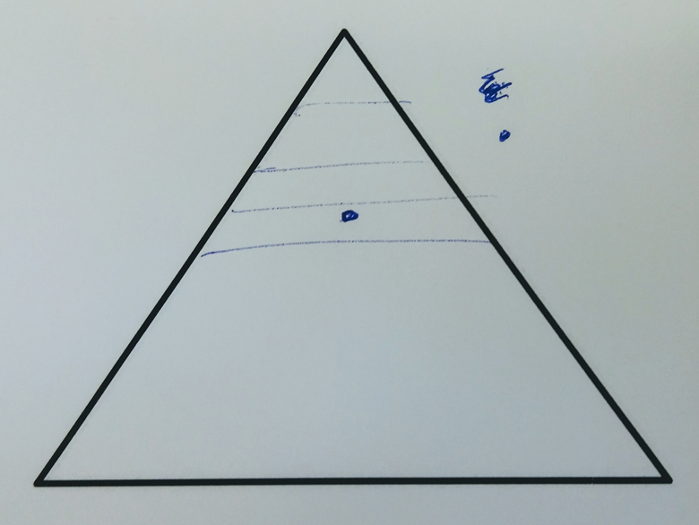
Story A
maternity – interruption
flexible working – a nuisance
always running to catch up
I’m instantly drawn to a hierarchical structure because I’m a central service and I report up to the top floor, it’s literally like that in this building. And I would say that I’m probably here in terms of structure. I’m probably here in terms of what I’m being asked to do. When I am representing the University outside of the building, people interact with me kind of up here. Internally, I don’t even get to go to management forum, so I’m down here’

Slide 11

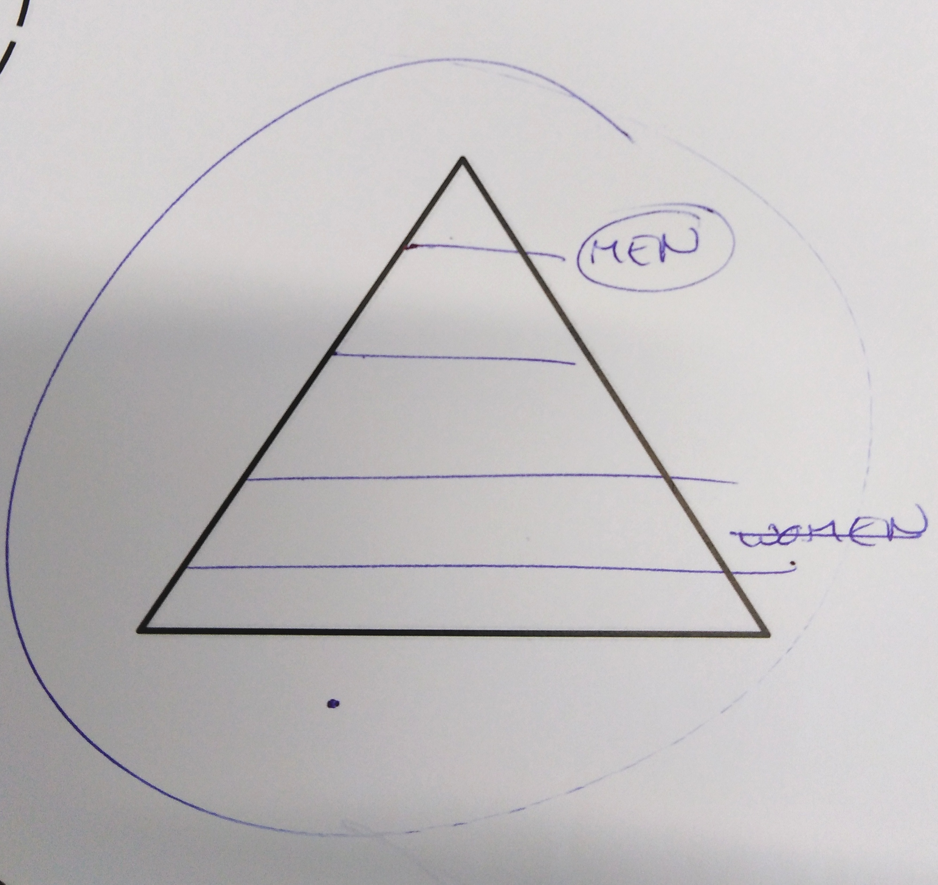
Story B
further ahead than I should be at this point in my career
facing a career crossroads
uncomfortable with particular ‘masculine’ behaviours
It is very hierarchically organised. In an ideal university the students would be at the top. My role is somewhere in the middle. But me, who I am, what I do, my hopes, my dreams, my aspirations, that is not interesting or important to anybody. I feel relatively powerless to affect change in any meaningful way in my institution.

Slide 12

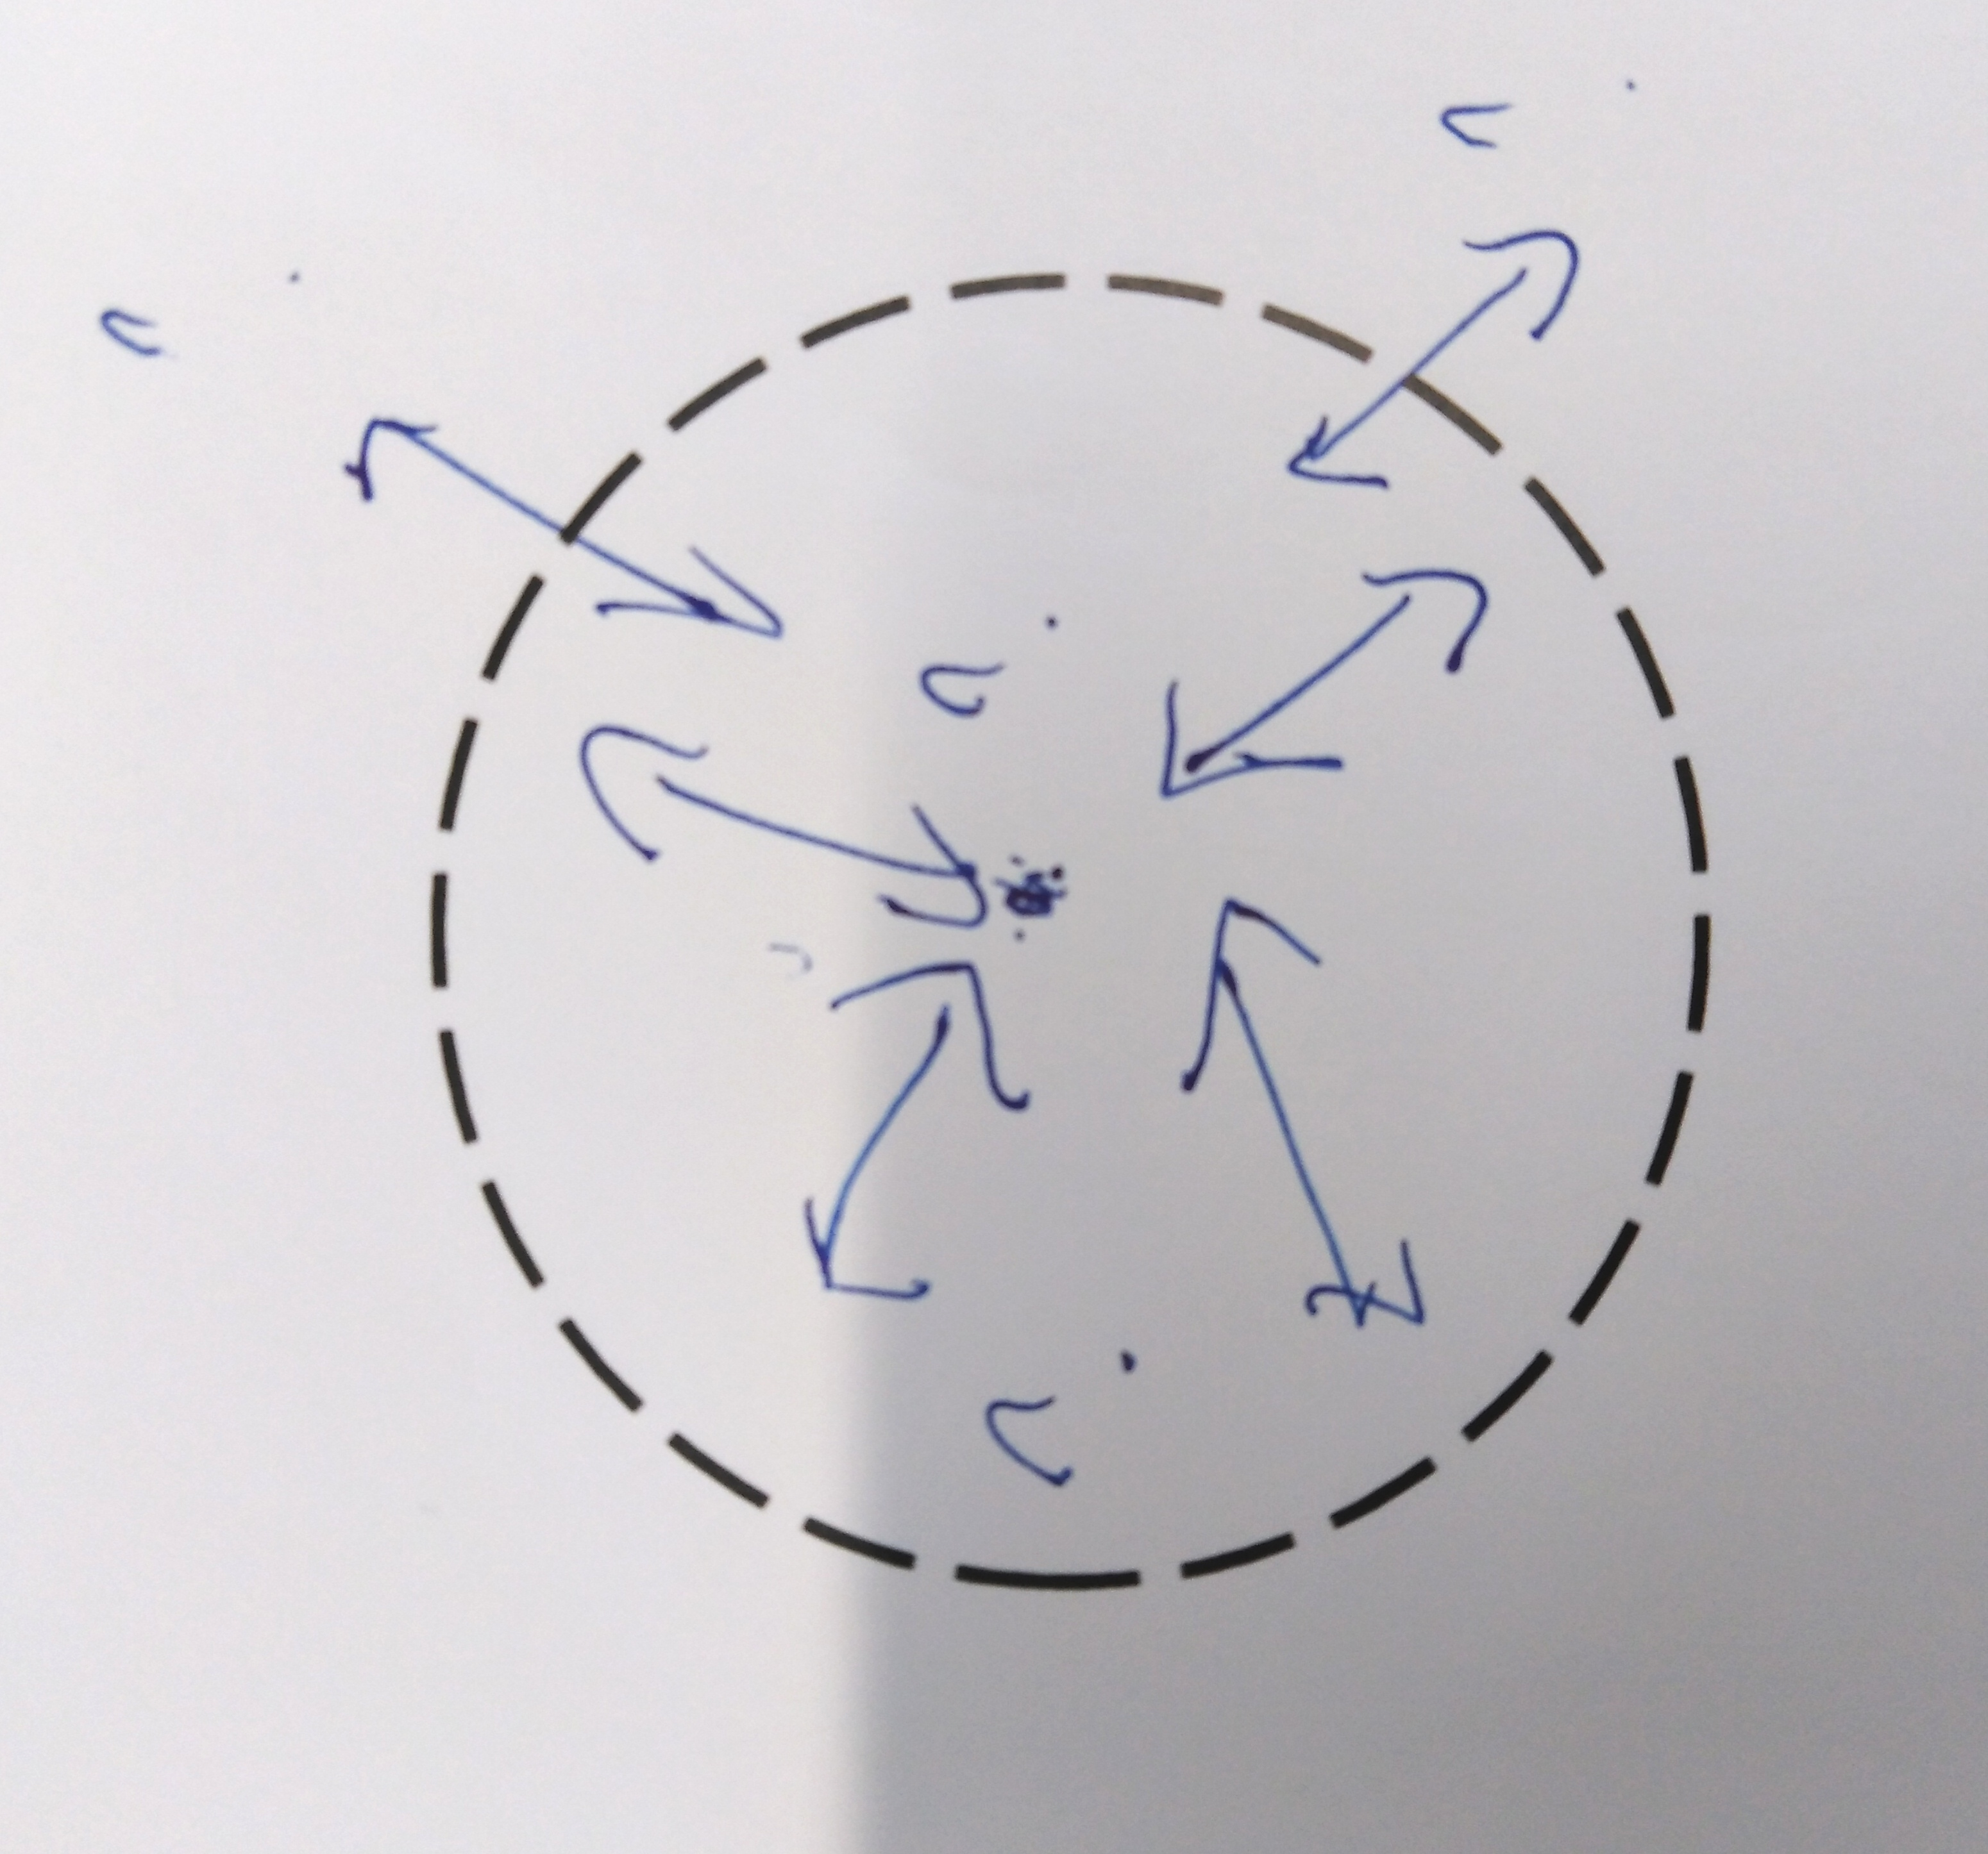
Story C
a zig-zag route
the feminist police
am I willing to compromise who I am?
I'm going to go for the circle, because the way I see academia is as a conglomerate: as a collegiate activity. I would place myself, I think, at the centre of that - not because I think I'm the centre of everything - but the way I interact with people is obviously from me outwards, whether that's students, or colleagues, or line managers, or people I line-manage.

Slide 13
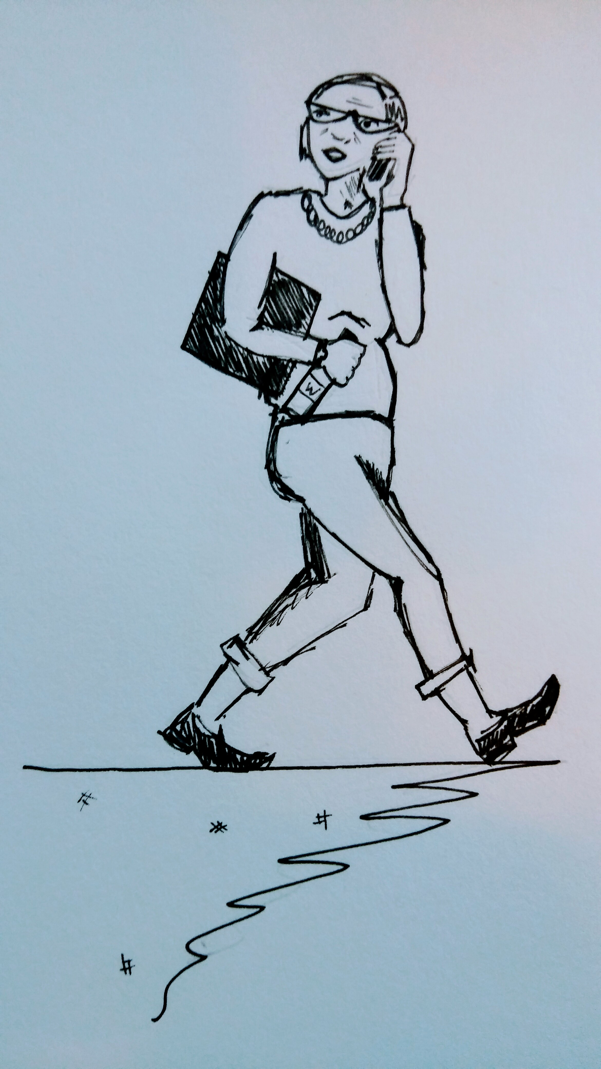
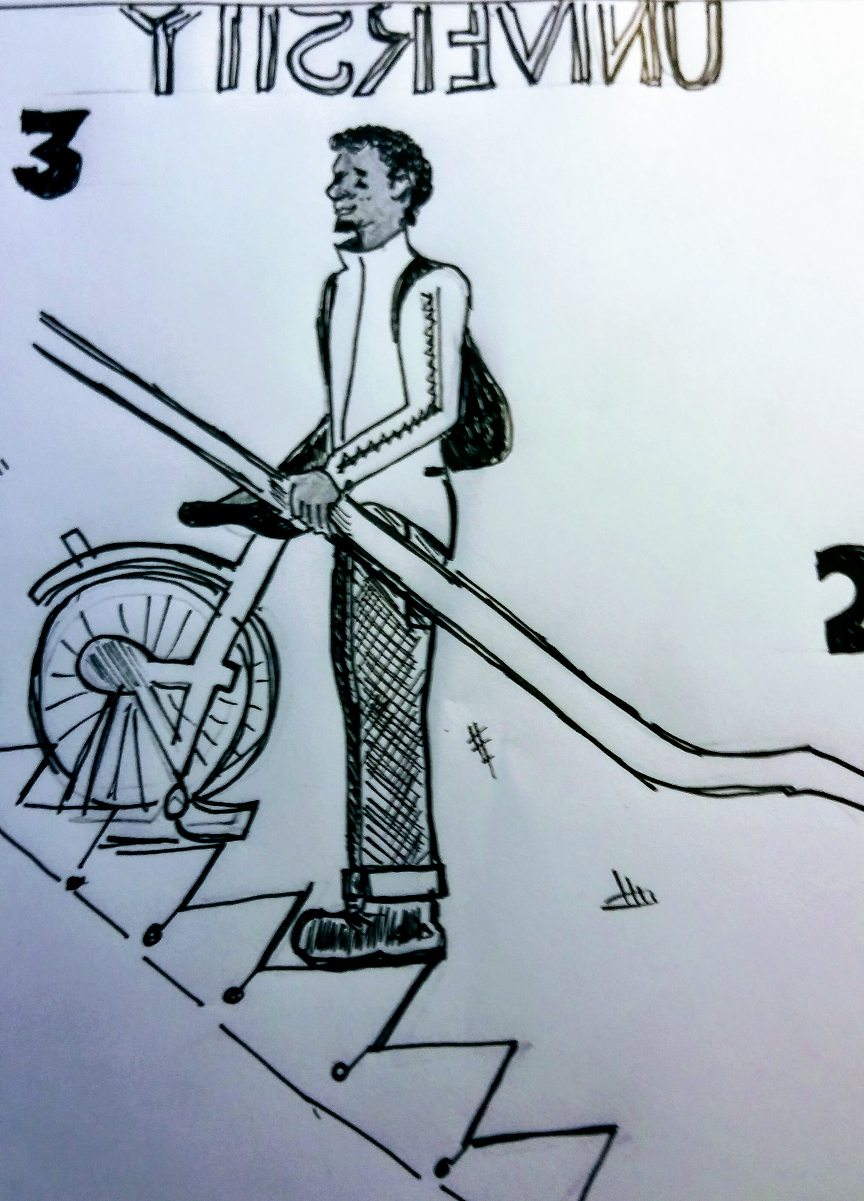
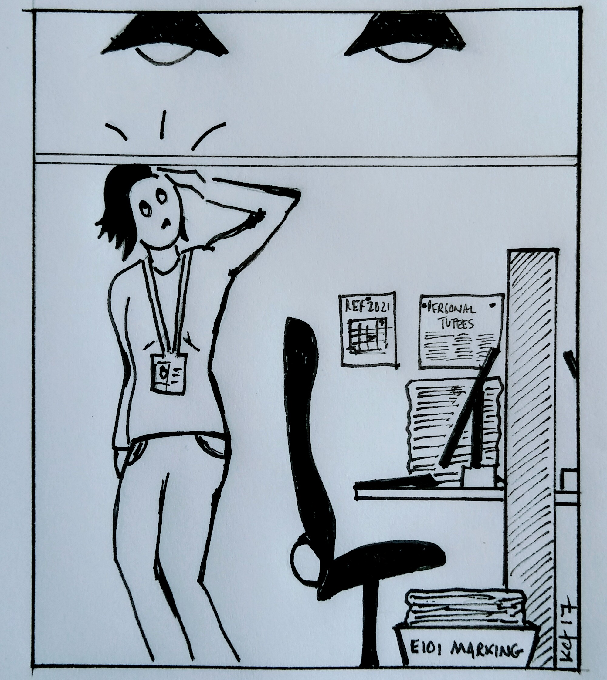
? career archetypes: glass ceiling glass escalator glass cliff
(Bruckmüller et al 2014; Williams 2013; Ryan and Haslam 2005; Budig 2002 inter alia).
Notes:
career obstacles, risks, constraints and privileges frequently characterised by archetypal (and architectural) phenomena: the glass ceiling, the glass escalator and the glass cliff

Slide 14
the gword tour
Gender(s) At Work
  Research Presentation
  Mapping Career Workshop
  ‘Glass’ Research Poem
Getting Graphic
  Presentation:The Accidental Cartoonist
  Getting Graphic Workshop
  My Brilliant Career? An Investigation

Slide 15
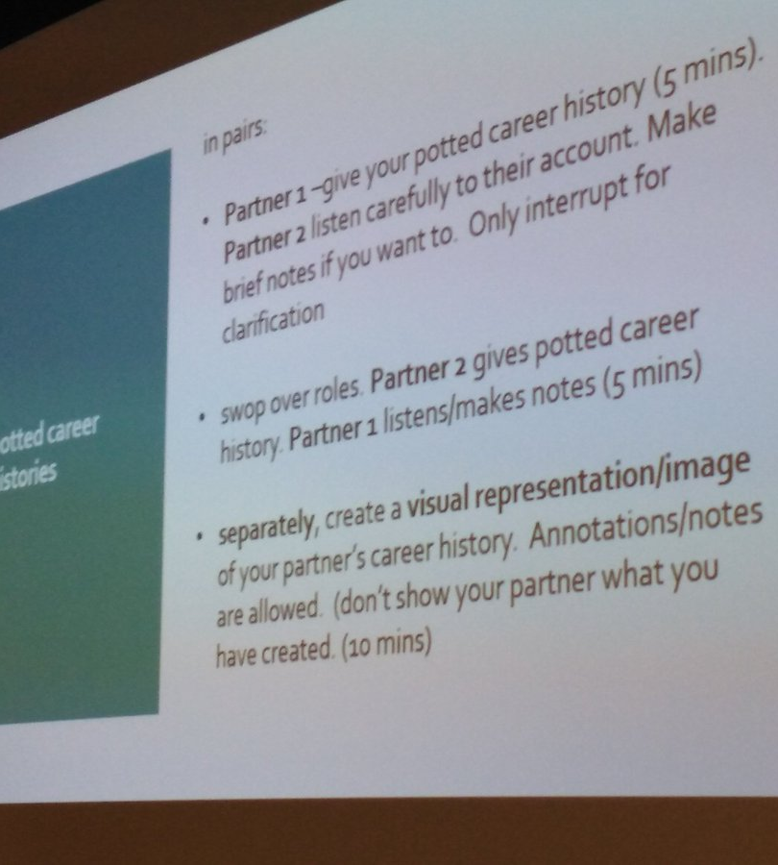
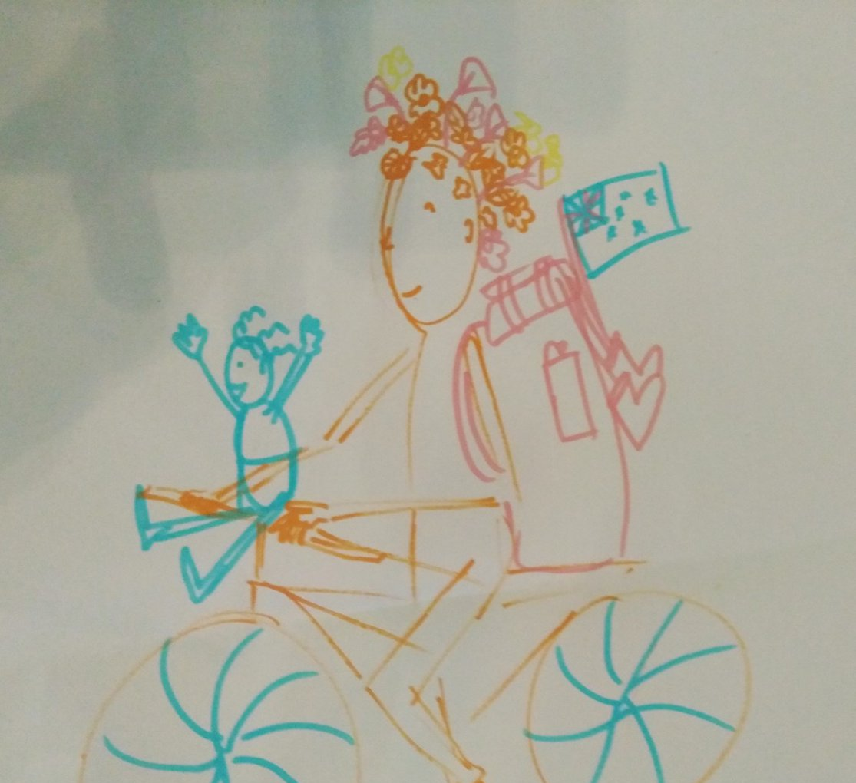
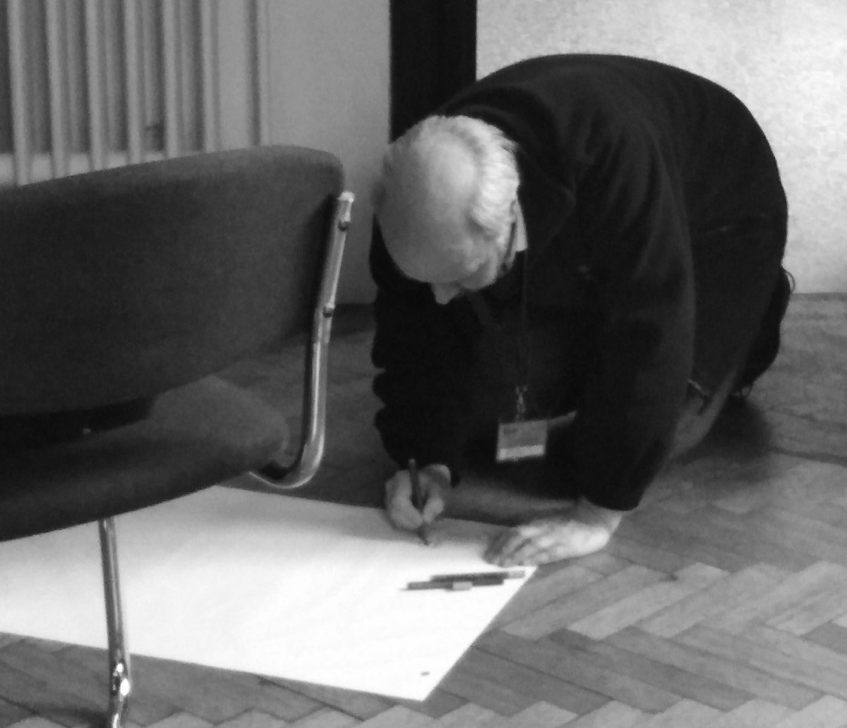
MAPPING CAREER WORKSHOP

Slide 16
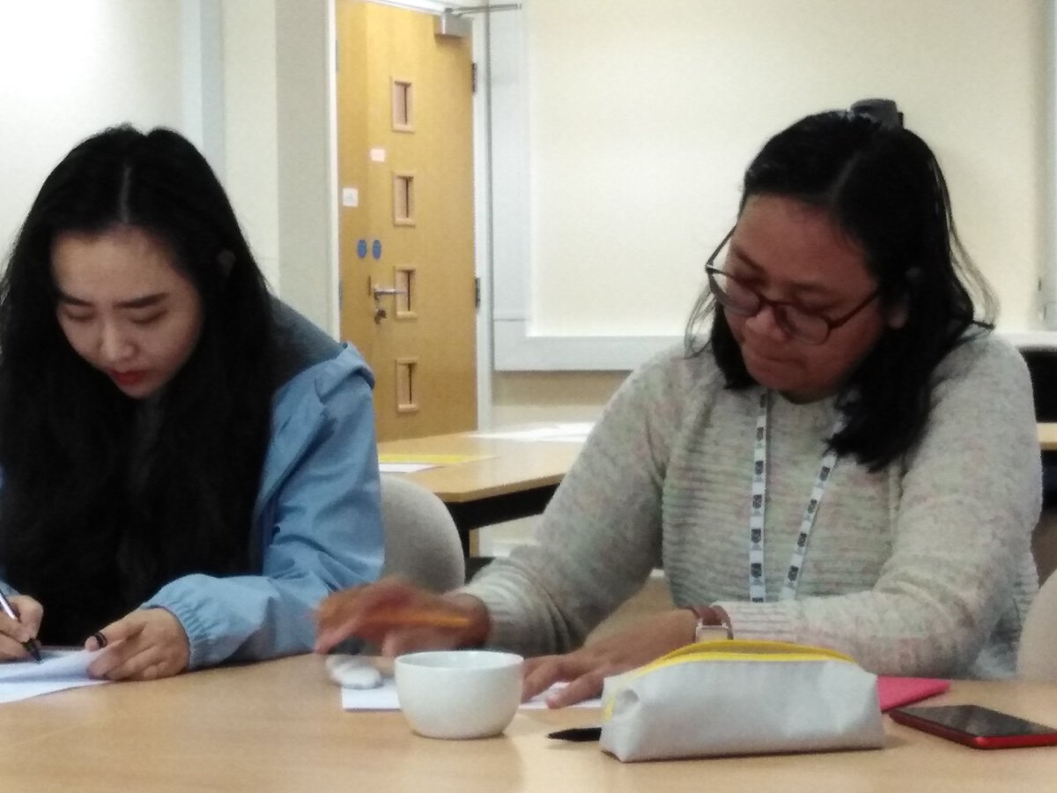
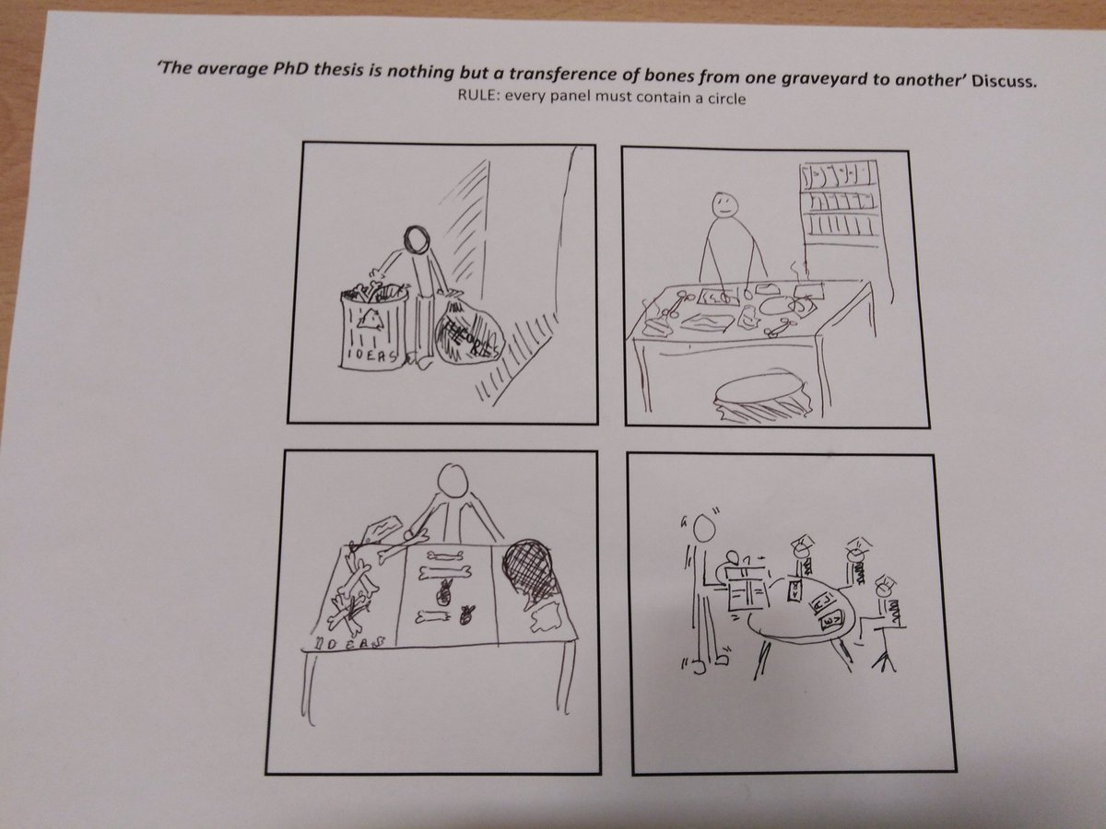
GETTING GRAPHIC WORKSHOP

Slide 17
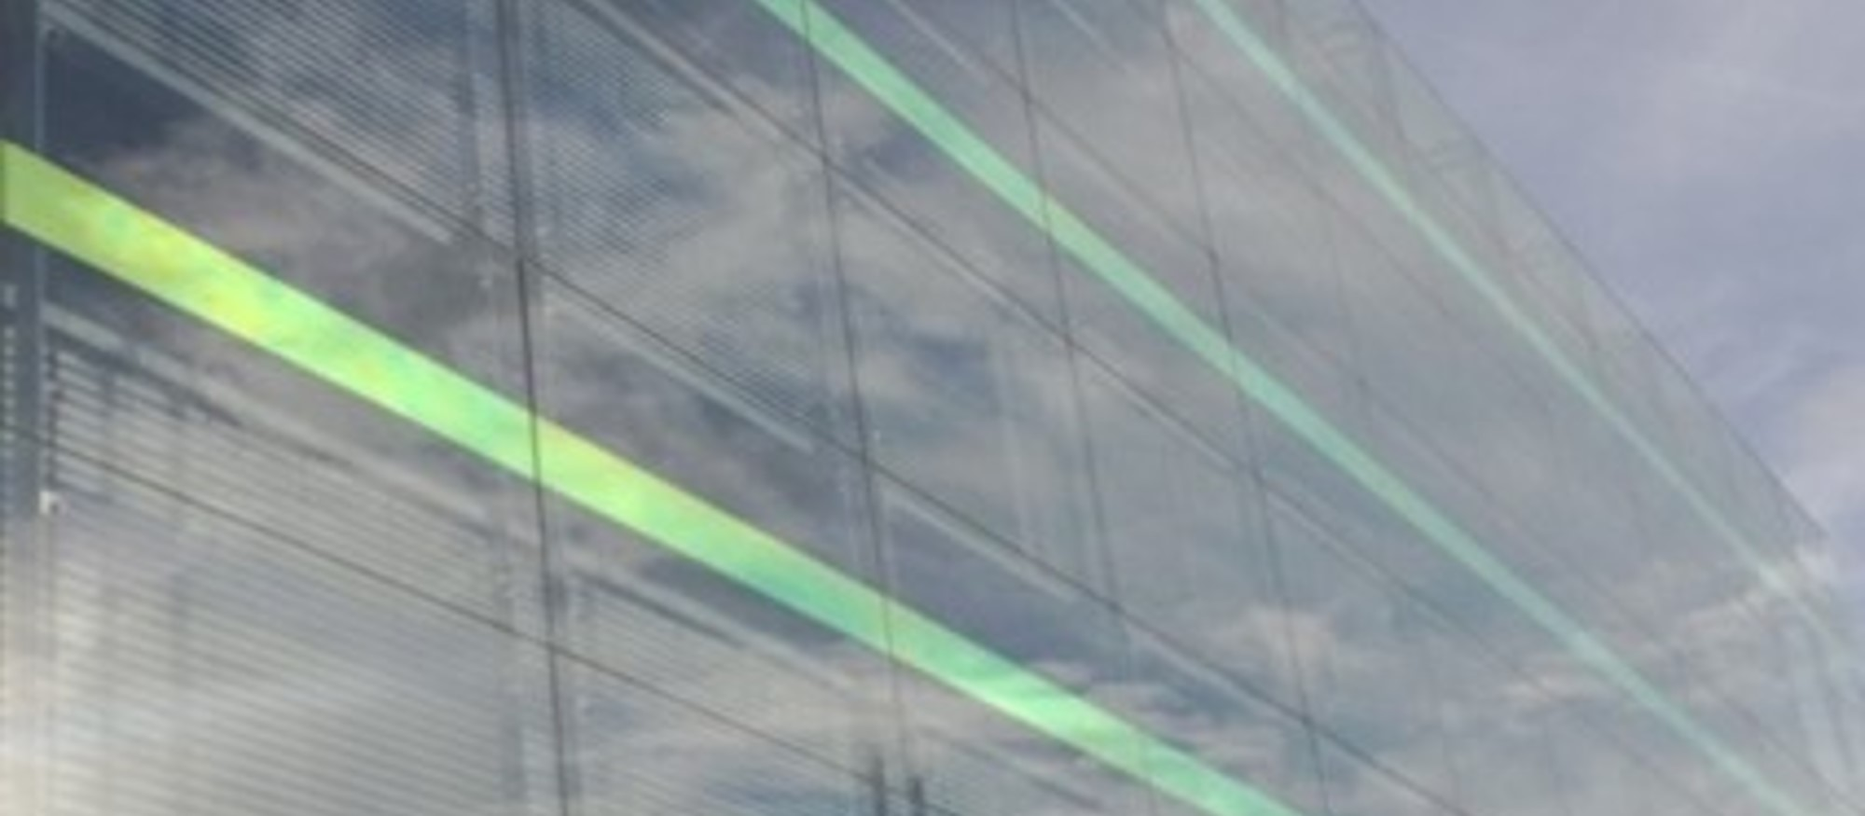
glass
a research poem

Slide 18
ceiling (ii)
She said – get the kids to university first, then we’ll talk about a PhD.
He said – you look great in that dress.
She said - I can’t say with any certainty we’ll advertise – keep an eye on the press.
I said – I’ve been doing the job anyway …
He said – I’m always impressed by your student evaluations – they love you!
I said – I want to progress.
She said – right now you’re not ready.
He said – I think you’re the best.
I said –forget it.

Slide 19
cliff (ii)
Even now, even now in my meetings
I’m still faced with wall to wall suits
and I still hear my colleagues repeating
the proposals I tried to get through
weeks ago. Great idea! If I’m Chair
their language is muted,
I know they just wouldn’t dare
talk the way they do to each other
when the ‘feminist police’ are not there.
I wanted this job. I’m ambitious.
I’ve waited a very long time.
Opportunities like this are quite precious
but up here I can see there are lines
to be crossed. If I cross them
will my foothold crumble
or will I achieve greater height,
but as someone I don’t want to become?
and if so, was the climb worth the fight?

Slide 20
discussion

Slide 21
gender, work and career in HE
lived experiences of the higher education workplace are complex and gendered
staff continue to negotiate paid workload and career within the continuing constraints of social roles constructed ‘masculine’ and ‘feminine’
but
career pipeline/trajectory/ladder … aligned to male-defined constructions of work and career success … continue to dominate organisational research and practice (Bilimoria et al. 2008, p.727)
and
silent on structural factors and their positive/negative effects
supporting
the idealized worker is one that is available 24/7 without ties or responsibilities that will hinder her or his productive capacities. She or he is unencumbered and on-call, even if not ‘at work’ (Lynch, 2010, p.57)

Slide 22
implications for Athena SWAN?
AS works within academic ‘career’ norms – metrics-driven (REF/TEF), valuing particular types of productivity, no time to lose, early-mid- late career-stages – evidence of gendered disadvantage (Yarrow 2018).
focus on ‘leaky pipeline’, enabling measures to advance gender equality/career progression: maternity and flexible working, career development, organisational culture, attention to intersectionality
but
spaces between organisational rhetoric/lived experience
‘institutional speech acts … do not go beyond pluralist understandings of diversity and are non-performative in the sense that they fail to deliver what they have promised’ (Ahmed 2006, p.764)
how can we mitigate the risk of Athena SWAN being ‘an institutional speech act’?

Slide 23
thank you
Kate Carruthers Thomas
kate.thomas@bcu.ac.uk
@drkcarrutherst
www.thegword2017.wordpress.com

Slide 24
references
Bathmaker, A.-M. (2010). Introduction. In A.-M. Bathmaker and P. Hartnett (Eds.), Exploring learning, identity and power through life history and narrative research (pp. 1–10). London, UK: Routledge.
Bilimoria, D., O'Neil, D. A., Hopkins, M. M., & Murphy, V. (2010). Gender in the management education classroom: A collaborative learning journey. Journal of Management Education, 34(6), 848–873.
Bruckmüller, S., Ryan, M. K., Rink, F. & Haslam, S. A.: Beyond the glass ceiling: The glass cliff and its lessons for organizational policy. In: Social Issues Policy Review 8 (2014), S. 202–232.
Budig, M., Male Advantage and the Gender Composition of Jobs: Who Rides the Glass Escalator? In: Social Problems 49, No. 2 (2002), S. 258–277.
Carruthers Thomas, K., (2019) ‘Gender as a Geography of Power’ in G. Crimmins (ed). Resisting Sexism in the Academy: Higher Education, Gender and Intersectionality. Basingstoke: Palgrave Macmillan.
Creswell, J. W. (2007). Qualitative inquiry and research design: choosing among five approaches. Thousand Oaks, CA: Sage.
Massey, D. (2005). For space. London, UK: Sage.
Rose, G. (2014). On the relation between ‘visual research methods’ and contemporary visual culture. The Sociological Review, 62, 24–46.
Ryan, M.K. & Haslam, S. A.: The Glass Cliff: Evidence that Women are Over-Represented in Precarious Leadership Positions. In: British Journal of Management, Vol. 16 (2005), S. 81–90.
Williams. M.: The Glass Escalator, Revisited. Gender Inequality in Neoliberal Times. In: Gender & Society Vol. 27. No.5 (2013), S. 609–629.

