Slide 1

Comparing approaches to Early Years Teaching
Kirsty Weeks 2019
Notes:
Make a few notes for me about your experience in this background why chose it what intentions future
Today nothing too taxiing some time for you to do some small group discussion

Slide 2

Families philosophies of how to raise and educate their children vary immensely and often change over time.
Think about families you know.
What might influence their philosophy?
When a child spends time outside the home what factors are at play?
Are there common threads in the type of early education children receive?

Slide 3
Since 2008 there has been an Early Years Statutory Framework
This means it must be delivered by maintained schools, non-maintained schools, independent schools and all providers on the Early Years Register in England - this includes childminders, children’s centres, pre-schools and nurseries.
It comprises a set of welfare requirements and a set of Learning and Development requirements.
Notes:
It was controversial from start whilst maintained sector had been used to many such things new to idep and child minders and amount of perscription and paperwork was often overwhelming in fact the numbers of childminders dropped significantly after

Slide 4

The EYFS framework is often referred to as a political centred approach
In fact what you see in the documentation and in settings themselves is practice which is often a mixture of a range of approaches.
Let’s have a look at a number of these approaches to Early Education.

Slide 5
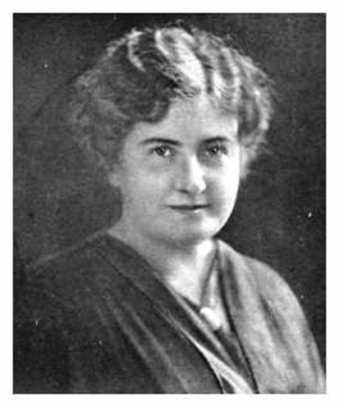
Montessori
Maria Montessori was born in Italy in 1870. She studied Medicine at the University of Rome.
Montessori is an approach to education based upon the principle that schooling should work with the nature of the child instead of against it. Therefore, education should be based upon scientific study of the child and a resulting understanding of the processes of development and learning.
Notes:
Learning by doing was quite revolutionary in her day. She fled Italy because she was a free thinker and so enemy of Mussolini.

Slide 6
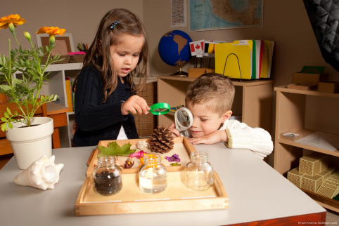
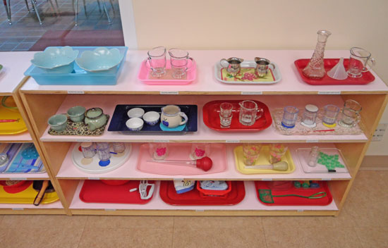
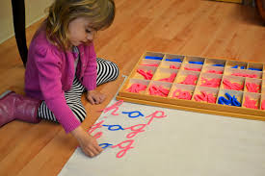
The teacher presents lessons to individuals rather than classes.
Children learn through practising tasks rather than listening to facts.
It has an emphasis on self-discipline.
Materials in the classroom are carefully designed and displayed.
It is systematic and carefully sequenced.
It is based on the principle of freedom of choice rather than set times for activities.
clip
Notes:
8.15-13.46 18.30-24.25 schools world Montessori.

Slide 7

Why do you think this method is popular amongst the middle class in the UK?
Why do you think this system wasn’t as popular in the state sector?
Can an approach which was devised 100 years ago meet the needs of today’s children?
What aspects of this have you seen in practice?

Slide 8
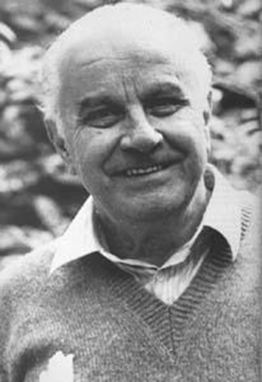
The Reggio Emilia Approach
Reggio Emilia is a prosperous town in
Northern Italy.
It is also an approach founded by Loris Malaguzzi who set up his first school in 1945.
At the heart of his system is the powerful image of the child. Reggio educators do not see children as empty vessels that require filling with facts. Rather they see children as full of potential, competent and capable of building their own theories.

Slide 9
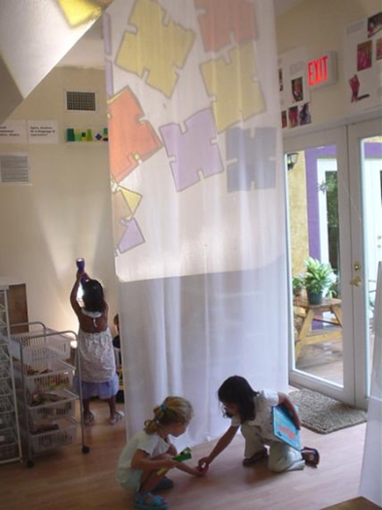
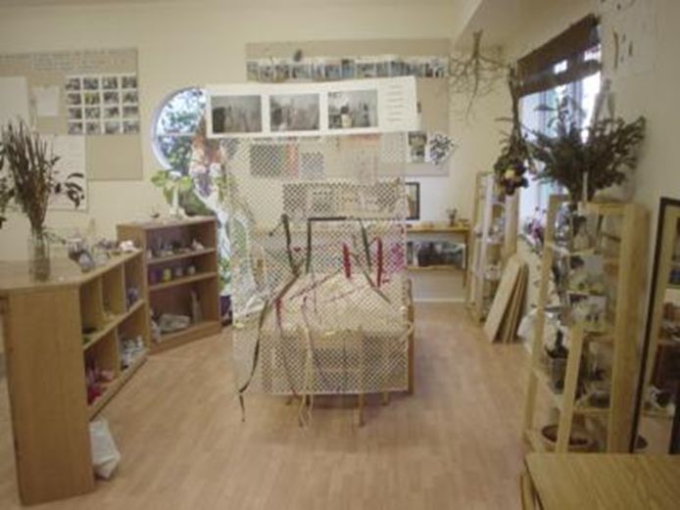
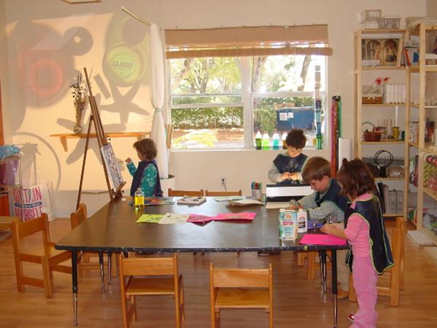
Children must have some control over the direction of their learning.
Children must be able to learn through experiences of touching, moving, listening, seeing and hearing.
The environment is warm and calm featuring wood, glass, and muted colours.
The teacher is the partner, nurturer, guide and researcher. Facilitators not instructors. The parent is a partner. No formal curriculum.
TASK : What aspect would you explore further?
clip
Notes:
You tube cnn news report 2.00-7.06

Slide 10
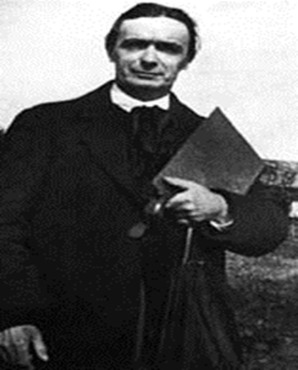
Waldorf/Steiner approach
Developed by Rudolf Steiner in1919, Waldorf Education distinguishes three broad stages in child development, each lasting seven years. The early years education focuses on providing practical hands on activities that encourage creative play.
In the UK there have been criticisms of the science education in the Steiner Academies, particularly in relation to promoting homeopathy and ideas about spirits.
He believed in 7 teaching methods that used imagination: drama, exploration, storytelling, routine, arts, discussion, empathy.
Notes:
5.21 – 9.30 a window into waldorf

Slide 11

What are the advantages/disadvantages of
sheltering the children from modern outside influences?
Clip

Slide 12
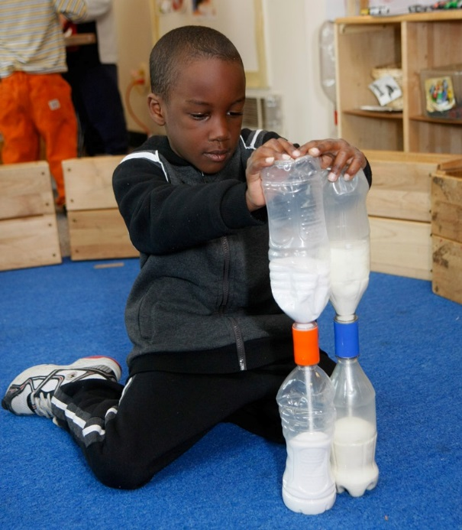
High Scope
The High Scope philosophy is, in part, based on the work of Piaget and Bronfenbrenner. (see theory ppt)
In a High Scope school, different areas of the classroom are designated for different activities, for example water play, reading, sand play, art, writing, dramatic play, etc.
Children are intended to be able to access all facilities independently and be able to take some responsibility for use of these areas.
Notes:
Look at the day popular in USA.

Slide 13
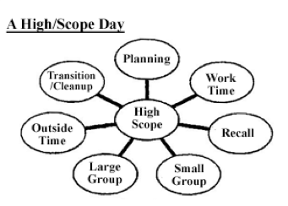
An important part of the approach is the plan-do-review sequence. Children first plan what materials they want to work with and what they want to do (this can be done formally or informally in small groups). Only once they have made a plan, however vague, of what they want to do can they go and do it. Then, after this choice worktime, the children discuss what they have been doing and whether it was successful.

Slide 14
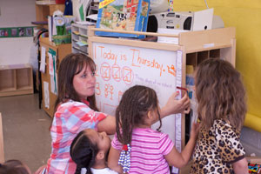
Even when activities are planned by adults around specific concepts, adults encourage children's initiatives and choices. In play situations, adults follow children's lead. While teachers may look for opportunities to gently challenge children by introducing a new idea or appropriate vocabulary, they stay within the context of the children's play goals.
HighScope has neither a directive nor an “anything-goes” atmosphere. Instead, HighScope promotes a supportive climate in which adults and children are partners throughout the day.
TASK: Discuss the differences and similarities between this and other approaches we have seen today.
Clip
Notes:
Planning time bears.

Slide 15
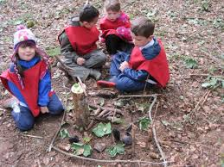
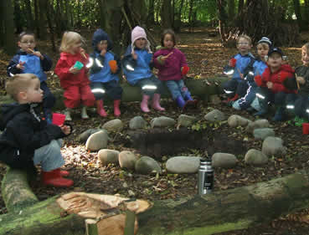
Forest Schools
clip
A history of Forest Schools can begin with the original concept of Forest Schools in Sweden. Forest Schools was implemented here in the 1950’s and it has since extended throughout the world.
A study done in Sweden over a 13 month period found that children located in urban environments were much less happy than those attending forest school kindergarten in a countryside environment. The children who had the forest school opportunity were in a pleasant, fun, natural and relaxing environment. These children were arriving at school with stronger social skills, high capacity to work in groups and seemed to have high self-esteem and confidence in their own abilities.
Notes:
Clip 0 to 7.40.

Slide 16

How has this overview today helped you to develop as a teacher?

