Slide 1
Mathematical Mindsets
Mark Harris
m.o.harris@warwick.ac.uk

Slide 2
Research
Boaler, J (2016) Mathematical Mindets
Drury, H (2015) Mastering Mathematics
(2013) Attitudes Towards Maths. National Numeracy (online), available at: www.nationalnumeracy.org.uk [accessed 31 August 2015]
Education Endowment Foundation Toolkit – Setting and Streaming

Slide 3
Objectives
To understand the importance of a Mathematical Mindset
To identify strategies to develop a Mathematical Mindset
To begin to reflect on the kind of teacher of Maths that you want to be

Slide 4
Teaching Standards
TS 3 Demonstrate Good Subject and Curriculum Knowledge
TS3a: Have a secure knowledge of the relevant subject/s and curriculum areas, foster and maintain pupils’ interest in the subject and address misunderstandings
TS3b: Demonstrate a critical understanding of developments in the subject and curriculum areas, and promote the value of scholarship
TS3d: If teaching early mathematics, demonstrate a clear understanding of appropriate teaching strategies.
(n.b. early mathematics refers to mathematics taught in both the early years and primary age phases)

Slide 5

Discuss
What are you like at maths?
What made you come to this conclusion?

Slide 6

Maths Brain
Brain ‘plasticity’
New learning – Synapse fires
‘The Knowledge’
Hippocampus
Therefore, all students can achieve at the highest level of maths.

Slide 7
Mindsets
Growth Mindset
Believe that effort creates success
Believe that skills and ability can be increased over time
View mistakes as an opportunity to develop
Are resilient
Think about how they learn
Fixed Mindset
Believe that you either have ability or do not
Are reluctant to take on challenges
Are worried about making mistakes
Prefer to stay in their comfort zone
Think it is important to seem intelligent in front of others

Slide 8
Subject Knowledge Test
X | 8 | 2 | ½ | 5 | ¼ | 10 | 4
6
3
7
9
4
5
12
Once you have completed the grid, discuss:
What was your starting point? Why?
What order did you complete the grid in? Why?
What is the correct way to complete this grid?

Slide 9
Subject Knowledge Test
X | 8 | 2 | ½ | 5 | ¼ | 10 | 4
6 |  | 12
3 |  | 6
7 |  | 14
9 |  | 18
4 |  | 8
5 |  | 10
12 |  | 24

Slide 10
Subject Knowledge Test
X | 8 | 2 | ½ | 5 | ¼ | 10 | 4
6 |  | 12 |  |  |  |  | 24
3 |  | 6 |  |  |  |  | 12
7 |  | 14 |  |  |  |  | 28
9 |  | 18 |  |  |  |  | 36
4 |  | 8 |  |  |  |  | 16
5 |  | 10 |  |  |  |  | 20
12 |  | 24 |  |  |  |  | 48

Slide 11
Subject Knowledge Test
X | 8 | 2 | ½ | 5 | ¼ | 10 | 4
6 | 48 | 12 |  |  |  |  | 24
3 | 24 | 6 |  |  |  |  | 12
7 | 56 | 14 |  |  |  |  | 28
9 | 72 | 18 |  |  |  |  | 36
4 | 32 | 8 |  |  |  |  | 16
5 | 40 | 10 |  |  |  |  | 20
12 | 96 | 24 |  |  |  |  | 48

Slide 12
Subject Knowledge Test
X | 8 | 2 | ½ | 5 | ¼ | 10 | 4
6 | 48 | 12 |  |  |  | 60 | 24
3 | 24 | 6 |  |  |  | 30 | 12
7 | 56 | 14 |  |  |  | 70 | 28
9 | 72 | 18 |  |  |  | 90 | 36
4 | 32 | 8 |  |  |  | 40 | 16
5 | 40 | 10 |  |  |  | 50 | 20
12 | 96 | 24 |  |  |  | 120 | 48

Slide 13
Subject Knowledge Test
X | 8 | 2 | ½ | 5 | ¼ | 10 | 4
6 | 48 | 12 |  | 30 |  | 60 | 24
3 | 24 | 6 |  | 15 |  | 30 | 12
7 | 56 | 14 |  | 35 |  | 70 | 28
9 | 72 | 18 |  | 45 |  | 90 | 36
4 | 32 | 8 |  | 20 |  | 40 | 16
5 | 40 | 10 |  | 25 |  | 50 | 20
12 | 96 | 24 |  | 60 |  | 120 | 48

Slide 14
Subject Knowledge Test
X | 8 | 2 | ½ | 5 | ¼ | 10 | 4
6 | 48 | 12 | 3 | 30 |  | 60 | 24
3 | 24 | 6 | 1.5 | 15 |  | 30 | 12
7 | 56 | 14 | 3.5 | 35 |  | 70 | 28
9 | 72 | 18 | 4.5 | 45 |  | 90 | 36
4 | 32 | 8 | 2 | 20 |  | 40 | 16
5 | 40 | 10 | 2.5 | 25 |  | 50 | 20
12 | 96 | 24 | 6 | 60 |  | 120 | 48

Slide 15
Subject Knowledge Test
X | 8 | 2 | ½ | 5 | ¼ | 10 | 4
6 | 48 | 12 | 3 | 30 | 1.5 | 60 | 24
3 | 24 | 6 | 1.5 | 15 | 0.75 | 30 | 12
7 | 56 | 14 | 3.5 | 35 | 1.75 | 70 | 28
9 | 72 | 18 | 4.5 | 45 | 2.25 | 90 | 36
4 | 32 | 8 | 2 | 20 | 1 | 40 | 16
5 | 40 | 10 | 2.5 | 25 | 1.25 | 50 | 20
12 | 96 | 24 | 6 | 60 | 3 | 120 | 48

Slide 16
Causes of Negativity
Bad experiences of Maths: Students are often not confident in their understanding of basic concepts and they also don’t see the everyday relevance or value of maths. Many have bad memories of school maths and this continues to influence how they feel about maths throughout their adult lives.
“Negative Memories of School
Maths Still Affect me”.
Source: Challenge Pilot participant data, 2013
25%

Slide 17
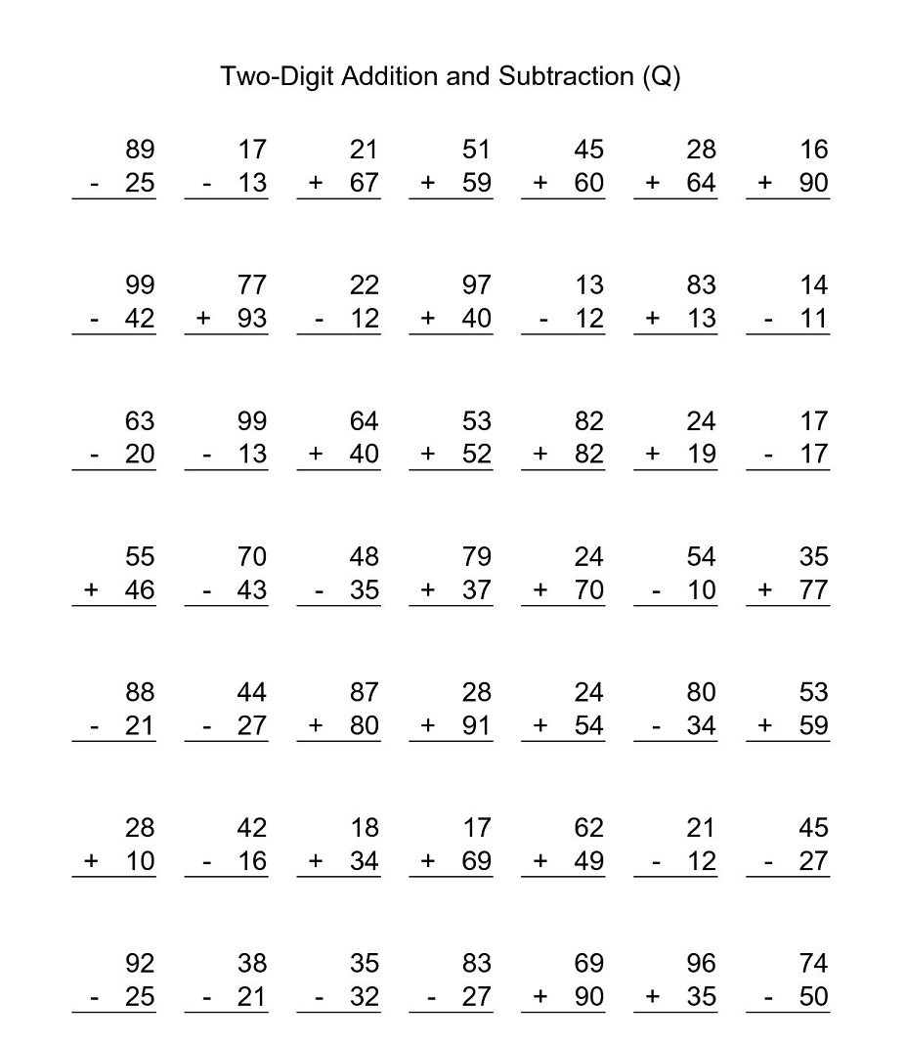
Causes of Negativity
How do you feel when you see this worksheet?
Mindful practice vs Mindless practice?

Slide 18
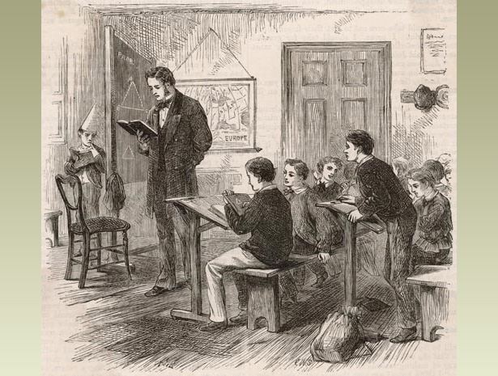
Victorian Maths
Focus on number work
Children learnt number facts by rote
Children sat separately or in rows
Talking was discouraged

Slide 19
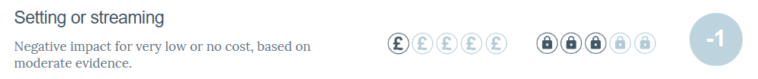
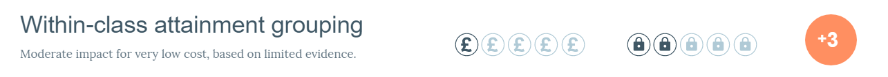
No Labels
What are the benefits/disadvantages to setting children based on ability in maths?
Education Endowment Foundation

Slide 20
Pre-task
Five Principles of Extraordinary Maths Teaching (Dan Finkel, Tedx Talks, 2016)
Start with a question
Students need time to struggle
Teacher is not the answer key
Say ‘yes’ to your students’ ideas
Play!

Slide 21
Effective Maths Teachers
Talk to a partner and identify the key features of effective Maths teachers you have known.
You might also want to list features to be avoided at all costs!

Slide 22
Developing Positive Attitudes
How do we develop positive attitudes towards mathematics and learning mathematics?
  Use a wide range of tasks and resources
  Enthusiastic teachers, with a ‘can do’ positive attitude
  Plenty of opportunities for students to experience success
  Hands-on approaches to learning
  Use real-life examples and explore links with other subjects
  Offer positive role models of mathematicians
  Maths Clubs – e.g. older students mentoring younger students
  Share learning with parents (e.g. maths evenings to encourage positive attitudes amongst parents)
  ‘Make it enjoyable’: maths challenges, competitions, puzzles, celebrate achievements
  Source: NRICH (2011) Engaging Students, Developing Confidence, Promoting Independence

Slide 23
Developing Positive Attitudes
How do we develop confident learners who are able to work independently and willing to take risks?
  Acknowledge all contributions positively, encourage learning from mistakes, welcome wrong answers as the springboard to new understanding
  Use positive language
  Encourage independent and small group research
  Value different approaches to solving problems
  Source: NRICH (2011) Engaging Students, Developing Confidence, Promoting Independence

Slide 24
A Mathematical Classroom
Jo Boaler: Mathematical classrooms are places where students:
Develop an inquiry relationship within mathematics, approaching maths with curiosity, courage, confidence and intuition;
Talk to each other and the teachers about ideas;
Work on mathematics tasks that can be solved in different ways and/or with different solutions;
Work on mathematics tasks with a low entry point but very high ceiling;
Work on mathematics tasks that are complex, involve one or more method or area of mathematics
Are given growth mindset messages at all times
Are assessed formatively – to inform learning – not summatively to give a rank with their peers.

Slide 25
A Mathematical Classroom
Jo Boaler: Mathematical classrooms are places where students believe:
Everyone can do well in maths;
Mathematics problems can be solved with many different insights and methods;
Mistakes are valuable, they encourage brain growth and learning;
Mathematics will help them in their lives.

Slide 26
Advice for Parents
Boaler gives the following advice for parents:
Encourage children to play maths puzzles and games.
Always be encouraging and never tell kids they are wrong when they are working on maths problems.
Never associate maths with speed.
Never share with your child the idea that you were bad at maths at school or you dislike it – especially if you are a mother.
Encourage number sense
Encourage a growth mindset

Slide 27
Maths Audit
Maths General → Maths Audit 1
Can be located at:
  https://moodle.warwick.ac.uk/mod/quiz/view.php?id=715439
  Don’t panic!
Initial audit helps identify any gaps in subject knowledge.
Mixed ability cohort with a range of backgrounds – take advantage of this throughout the year

Slide 28
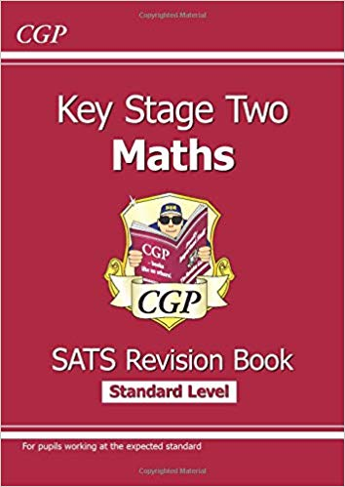
Recommended books to develop your subject knowledge
Mathematics Explained for Primary Teachers
Derek Haylock ISBN: 9781526455840
Understanding Mathematics for Young Children (useful for KS 1 placement)
Derek Haylock and Anne Cockburn
ISBN: 9781446248669
Children’s Errors in Mathematics
Alice Hansen ISBN: 9781446274439
Transforming Primary Mathematics
Mike Askew ISBN: 9780415607025
CGP Maths (Key stage or individual year group)
    ISBN: 978-1782944195

Slide 29
FREE ATM Student e-Membership
Trainee Teachers can now join ATM for the 2019/2020 academic year free of charge. Each application will be funded courtesy of the Alan Bell Endowment to support trainee teachers.
Benefits include:
  Online access to the latest journal as well as the complete library of past MT journal articles.
  Access to the growing member only resources area
  Joining Offer - free downloadable resource pack
  25% discount on ATM publications
  Significant discounts on the ATM Annual Conference
  CPD Opportunities
  Access to local branches and networking
  Professional support and enrichment by being part of the ATM Community
Students can apply individually by going to: www.atm.org.uk/Join/Student

Slide 30
Useful Websites
https://www.ncetm.org.uk/
National Centre for Excellence in Teaching Mathematics
http://nrich.maths.org/frontpage
NRICH
http://www.nationalstemcentre.org.uk/
National STEM Centre
http://www.m-a.org.uk/jsp/index.jsp
The Mathematical Association

