Slide 1

Teacher professionalism and the development of professional wisdom
19/20

Slide 2
Objectives
Understand what it means to be a ‘professional’
To understand the importance of professionalism to the teacher/trainee teacher role
Develop an understanding of the importance of the Preamble and Part Two of the Teachers’ Standards helping professionals
To begin to develop professional wisdom and an understanding of the moral role of the teacher through the critical reflection on ethical dilemmas in practice

Slide 3
Teacher professionalism
This is a professional course.
You are not ‘students’; we call you ‘trainees’.
To be successful, you will need to behave as a ‘professional’ when in University, school and wider society.

Slide 4
Government and Ofsted view
Teachers’ Standards
Preamble
Teachers make the education of their pupils their first concern, and are accountable for achieving the highest possible standards in work and conduct. Teachers act with honesty and integrity; have strong subject knowledge, keep their knowledge and skills as teachers up-to-date and are self-critical; forge positive professional relationships; and work with parents in the best interests of their pupils.

Slide 5
Teacher standards: Part 2
A teacher is expected to demonstrate consistently high standards of personal and professional conduct.

Slide 6
Part 2: Teachers uphold public trust in the profession and maintain high standards of ethics and behaviour, within and outside school, by:
treating pupils with dignity, building relationships rooted in mutual respect, and at all times observing proper boundaries appropriate to a teacher’s professional position
having regard for the need to safeguard pupils’ well-being, in accordance with statutory provisions.
showing tolerance of and respect for the rights of others.
not undermining fundamental British values, including democracy, the rule of law, individual liberty and mutual respect, and tolerance of those with different faiths and beliefs.
ensuring that personal beliefs are not expressed in ways which exploit pupils’ vulnerability or might lead them to break the law.
Teachers must have proper and professional regard for the ethos, policies and practices of the school in which they teach, and maintain high standards in their own attendance and punctuality.
Teachers must have an understanding of, and always act within, the statutory frameworks which set out their professional duties and responsibilities.

Slide 7
Let’s look in more detail
1. Relationships and boundaries
2. Engagement
3. Accountable, up-to-date and self-critical
4. Integrity and Ethics
5. Tolerance, respect and professional regard (Intellectual ambiguity and unease)

Slide 8
1. Relationships and boundaries

Slide 9

Professional appearance
Pre-empt: Think about how you choose to present yourself and the impression this gives
Show initiative: If you are new to the school, speak to mentor about dress code - schools will expect appropriate and smart dress
Find out about expectations for PE lessons etc. Can you wear your PE kit all day? Should you change beforehand? Role-model sensible choice of clothes and footwear for the children you teach.

Slide 10

Building Relationships
…how can you build relationships in school?
…offering to help/ make a cup of tea
…be proactive, show an interest, ask questions.
…saying hello/smiling.
…saying thank you when someone does something to help you
…be part of the team…join in with the extras in school
Can you think of any other ways to develop positive relationships with colleagues?
Why is it important to develop relationships outside your own year group?

Slide 11
Building Relationships
“..on placement I made a real effort to make myself known across the whole school from reception to year 6, and I feel this has had a great impact on my experience and has made me feel even more so like a teacher. I was respected by the whole school as a member of staff...it also opened doors for opportunities to observe outstanding practice that I could then adapt and implement in my own teaching.”

Slide 12
2. Engagement

Slide 13


Slide 14

Engagement
…contribute to forums…appropriately – be mindful of the feelings of others
…actively participate in sessions – contribute to discussions
…respectful use of laptops
…engage with and support each other.
…phrase things professionally
…complete evaluations
…phones away unless an emergency
…be willing to work with different people
…attendance and punctuality

Slide 15



Slide 16
3. Accountable, up-to-date and self-critical

Slide 17
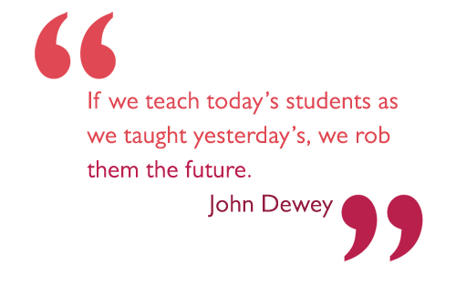
Notes:
up-to-date

Slide 18
Accountable and self-critical
Take responsibility for your own professional development (with support)
Be open to feedback
See feedback as constructive
Proactively seek support

Slide 19
Reflective practice
You will develop the skills to critically reflect throughout your training and career;
It is important to take the time to critically reflect on:
  your progress
  your classroom practice
  relevant literature and theory
  your learning from your university-based training AND
  what you observe/experience on your school placements

Slide 20
4. Professional Integrity and Ethics

Slide 21
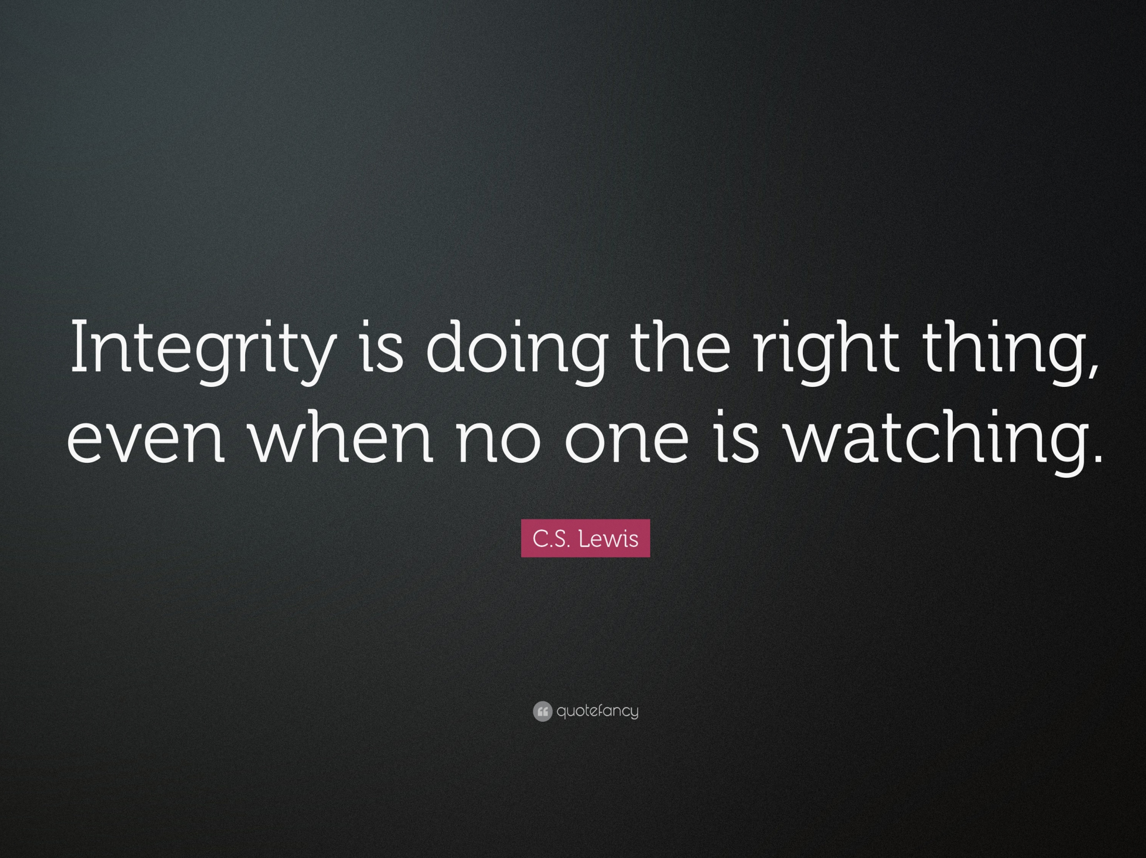

Slide 22
The need for professional wisdom
“The professions enjoy a unique and privileged place in the public eye. They are relied upon for moral probity, diligence, fairness and resolve, frequently in complicated circumstances and often in the face of conflicting demands. Professional
people are expected to do the right thing; and they are expected to do the right thing both for individuals – be they clients, customers, patients, pupils, victims of crime or enemy combatants – and for society at large.”
(Jubilee Centre, 2016)

Slide 23
You don’t want to become just like a load of robots that just follow procedures and protocol and rules, each situation is different and you need to develop the skills to make judgements…
Experienced Teacher – quote from Jubilee Centre for Character and Virtues (2015)
The Good Teacher report

Slide 24
Systematic/Reflective Case Debriefing
Method (Adapted from Freeman, 1999)
Note down your first reaction to this scenario. Is this an ethical issue? Does anything need to happen about it? Why/Why not?

Slide 25
Scenario 1 – social media
Laura is a trainee teacher who has recently started her complementary placement at a local school. She posts the following message to a private Facebook group of family and friends…

Slide 26
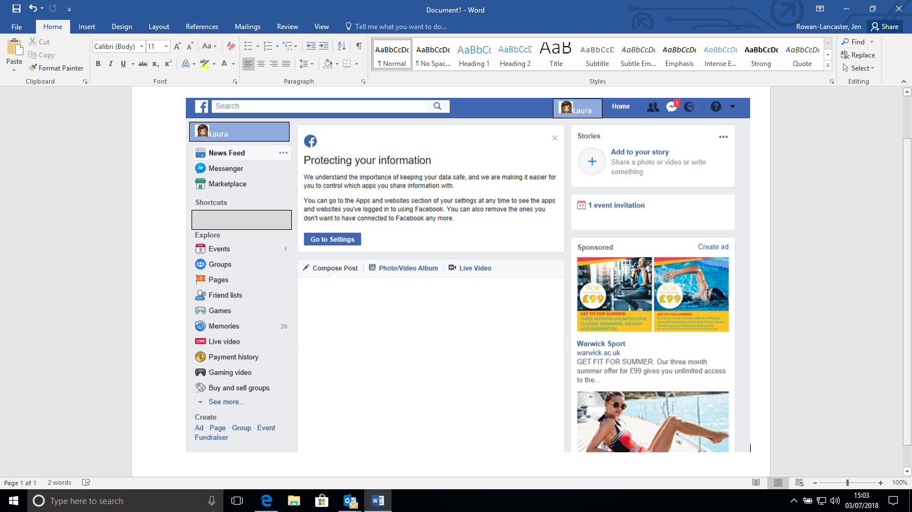


I can’t believe how much extra work I have to do at my complementary school compared to all my other teacher friends, it seems so unfair . I’m really not enjoying my time there at all and hardly anyone has made any effort to make me feel welcome. I can’t even remember what it feels like to have a social life and no one even seems to appreciate how hard I am working. Counting down the days until the end of term…

Slide 27
Systematic/Reflective Case Debriefing
Method (Adapted from Freeman, 1999)
Note down your first reaction to this scenario. Is this an ethical issue? Does anything need to happen about it? Why/Why not?
2. Identify all the stakeholders who are involved/could potentially be affected.
3. Identify the issues that make each of the stakeholders care about how this is resolved.
4. Generate possible solutions without judging their practicality or worthiness. There are likely to be a variety of acceptable ways to resolve a dilemma.

Slide 28
Case Study 1: the actual viewpoints of some of those involved…
Do their opinions affect your own views on the situation and the solutions you have generated?

Slide 29
I don’t see why it is a problem that I posted a comment about my school experience on Facebook. I didn’t name the school and I have changed all my privacy settings so that only my friends can see what I have written and I have even amended my name so it is harder for people to search for me. I was feeling upset after a hard week at my new school so putting a post on social media was a way of me having a bit of a moan so people I hadn’t seen for a while would understand that I was having a bit of a tough time…
Laura – School Direct PGCE student

Slide 30
The university were very disappointed to find out that Laura had made disparaging remarks about her complementary placement school on social media. Irrespective of privacy settings, students are informed right at the start of the year that they must be very cautious about what they choose to post. Embarking on a career as a teacher means that even as a trainee, students have professional responsibilities that must be upheld both in and out of school.
Prof Des Hewitt, Head of
Primary Teacher Education, CTE

Slide 31
We were very upset to be informed that Laura had written some unfavourable comments on social media about our school and the experience she has had with us this term. If she was feeling unhappy or required additional support to help her manage her workload, she should have spoken to myself, her mentor or another senior leader to enable us to rectify the situation rather than choosing to air her views on Facebook. Although she did not specifically name the school, it would not be difficult to find out where she currently was on placement so therefore her actions could have caused damage to the school’s reputation.
Mrs J. Brown, Headteacher

Slide 32

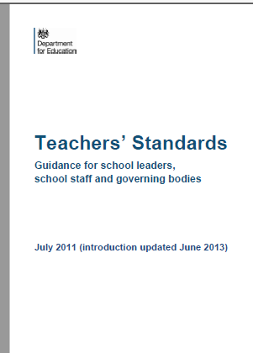
5.Taking all things into consideration, what would be the most appropriate resolution(s) that meets the professional expectations and ethical code stipulated in the Teachers’ Standards? Justify your decision.

Slide 33
Learning Points
What would you suggest Laura should have done differently?
What is the most effective way of addressing a concern that arises whilst on placement? What procedures should you follow? Who should you go to for support?
What changes do you need to make to your use of social media now you are on a professional course?
Further reading: https://neu.org.uk/advice-and-resources/trainee-advice/social-media

Slide 34
5. Tolerance, respect and professional regard
(Intellectual ambiguity and unease)

Slide 35


Slide 36
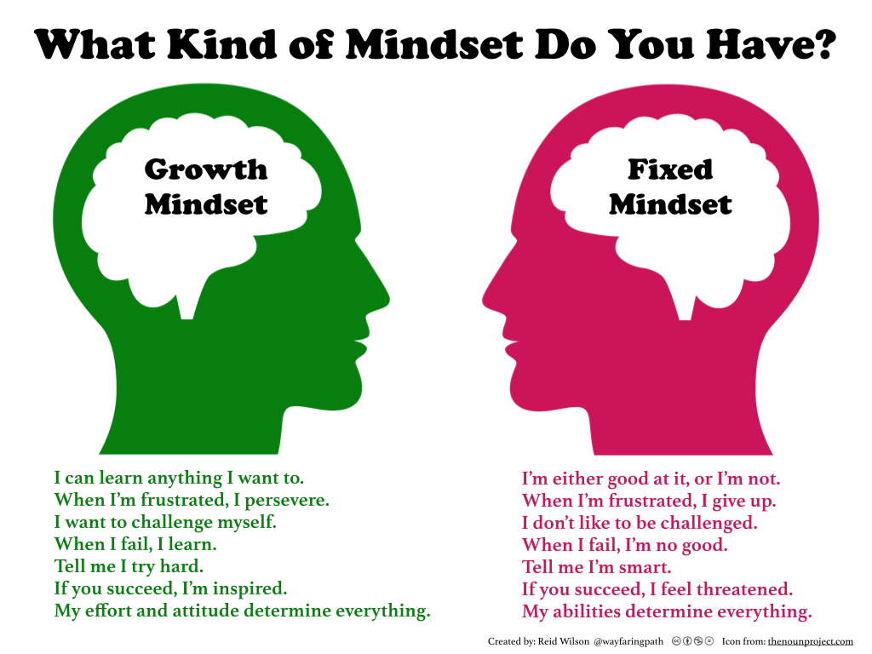
http://carriekepple.com/2015/04/24/growth-mindset-vs-fixed-mindset-which-do-you-have/

Slide 37
Scenario 2
Following lesson observation feedback, Richard became very upset and refused to sign or accept the lesson observation proforma.

Slide 38
Systematic/Reflective Case Debriefing
Method (Adapted from Freeman, 1999)
Note down your first reaction to this scenario. Is this an ethical issue? Does anything need to happen about it? Why/Why not?
2. Identify all the stakeholders who are involved/could potentially be affected.
3. Identify the issues that make the stakeholders care about how this is resolved.
4. Generate possible solutions without judging their practicality or worthiness. There are likely to be a variety of acceptable ways to resolve a dilemma.
5. Taking all things into consideration, what would be the most appropriate, ethical resolution(s)?

Slide 39
Gauging the viewpoints of those involved…
Here are the views of 3 key stakeholders involved in this scenario.
Does finding out about their opinions affect your own views on the situation and the possible solutions you have generated?

Slide 40
I spent two full days preparing for this one lesson and deserved for the grade and feedback to be much better. This is a lower grade than my previous observations and I didn’t want it in my folder because it made things look like I was going backwards.
Richard – School Direct PGCE student

Slide 41
I was shocked by Richard's reaction but did understand that he was disappointed. I think he reacted this way because he cared so much and wanted to do a great job. There was no point addressing his reaction at that time but his inability to engage in the feedback conversation did give me cause for concern.
Sally Hewitt, Link Tutor, CTE

Slide 42
5.Taking all things into consideration, what would be the most appropriate resolution(s) that meets the professional expectations and ethical code stipulated in the Teachers’ Standards? Justify your decision.
Notes:
Ask trainees to think about how they will

Slide 43
Learning Points
How could Richard have handled this situation differently?
If you find yourself in this position, what strategies could you use?
What could you do if you disagree with feedback from a colleague?
How can you get the most out of feedback?

Slide 44
Plenary
What have you learnt about professional wisdom and the importance of the professional expectations of teachers?
What are you going to take away from this session?
How will you ensure you make a positive first impression during your first week in school?

