Slide 1

Phonics:
Developing your Subject Knowledge (TS3.d)
Jo Dobb

Slide 2
The NC English - Glossary
R A G rate for September:
  Red = I don’t understand what this term means
  Amber = I understand this but I am not confident
  Green = I can explain this term to someone else
Upload to your e-PDP (edit in December and March/April)
Keep in your school file whilst on placement if you choose to

Slide 3
Objectives for this session
For you to:
know and understand some technical vocabulary
be able to count phonemes in words
begin to recognise how progression is mapped and supported
understand the place of phonics in the reading and writing process

Slide 4
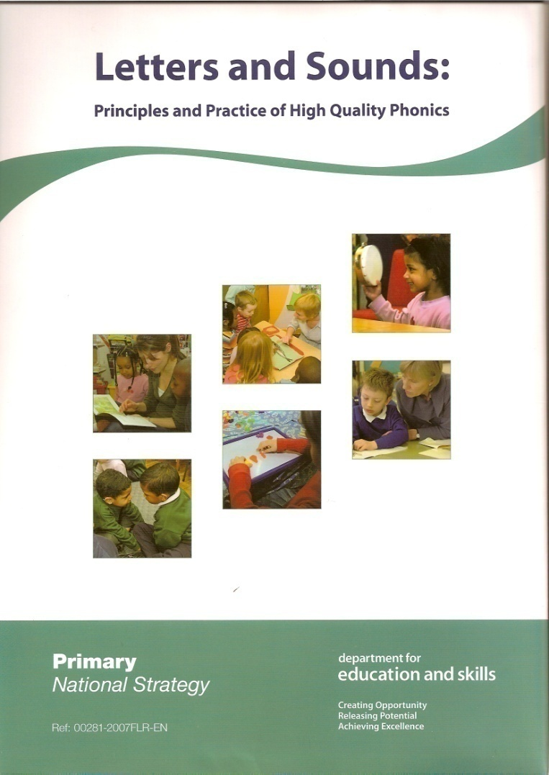
…and introduce you to one SSP programme for teaching

Slide 5
Today’s session is focusing on one dimension of this model…
Language
Comprehension
processes
Word
Recognition
process
Word
Recognition
process
good
poor
good
poor
Language
Comprehension
processes

Slide 6
Further Reading
The Rose Report-An Independent Review of Reading 2006
Phonics - Practice, Research and Policy
by Maureen Lewis and Sue Ellis
Teaching Synthetic Phonics
by Rhona Johnson and Joyce Watson
Stythetic Phonics and Learning to Read: A cross-language perspective by Usha Goswami
Pub: Educational Psychology in Pracice, Vol 21, No.4,Dec 2005, pp273-88

Slide 7
Programmes & Resources
Whichever programme or resource
teachers use, exciting and appealing books
which play with sound, rhyme and rhythm
will remain a key element of a rich and
effective literacy environment.

Slide 8

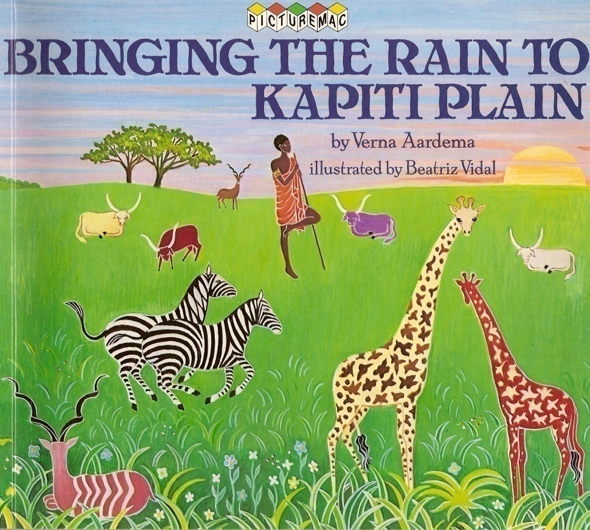
Books like these…
links with NF theme of
the water cycle

Slide 9


Books like these…

Slide 10
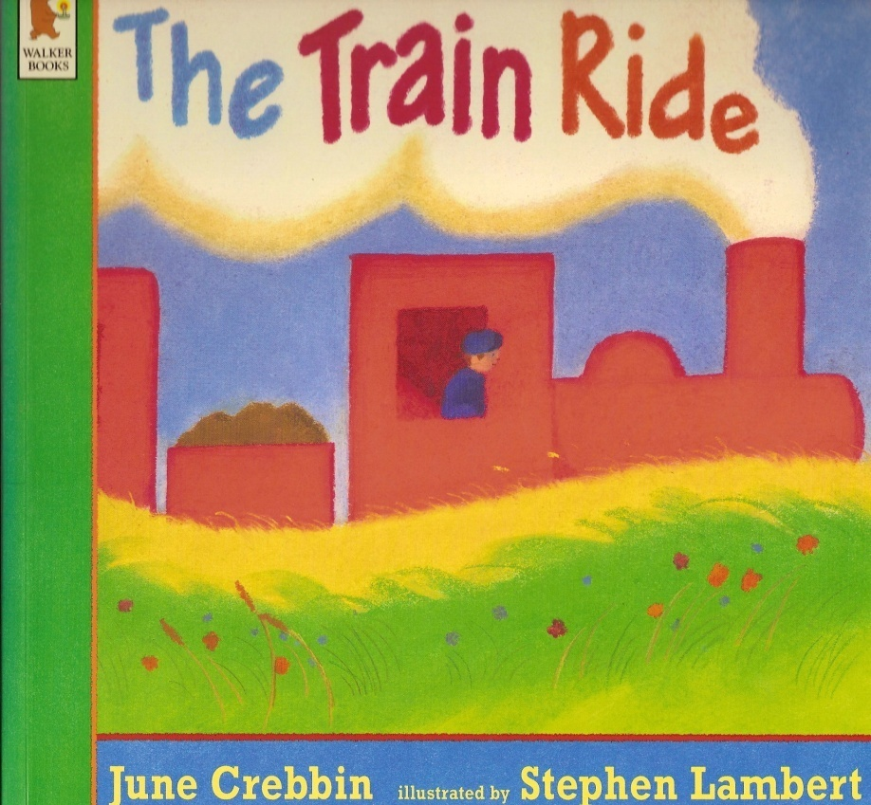

Books like these…
Use alongside
NF – focus on
camouflage

Slide 11


and for older children…
Don’t underestimate the value
of sharing strongly rhythmical
texts with older children too…

Slide 12
Please…
don’t look any further in your hand-outs or copies of slides…

Slide 13
Reading:
…and once you recognised the letters in those ‘chunks’ you gave them a sound
…and then you combined those sounds to pronounce a word.
This is called blending.

Slide 14
Spelling
You listened to the word and broke it up
in your head into individual sounds…
This is called segmenting
…and then matched the most likely letter to each sound.
Research shows that children
who can segment make faster
progress with early reading
and writing than those who
cannot.

Slide 15
Phonics at a glance:
Phonics is
The reversible
skills of
segmentation
and blending
+
Knowledge of
the alphabetic
code

Slide 16
Daily, discrete phonic work is a priority for swift, early reading development
Language
Comprehension
processes
Good decoding skills
will help children
to operate here…
Word
Recognition
process
Word
Recognition
process
good
poor
good
poor
Language
Comprehension
processes

Slide 17
A ‘Simple View of Reading’
The process of phonics acquisition is time-limited whereas the development of comprehension is a lifelong activity.
So we need an early emphasis on word recognition and decoding…and ‘phonics’ as a first-call strategy in early reading.

Slide 18
Next, some activities…
What is the definition of a phoneme…?
...and a helpful way to determine if you are enunciating a ‘new’ one...
Also... a word about vowels and consonants...

Slide 19
Enunciation…
Let’s practise some consonant sounds:
f | l | m | n | r | s | v | z | sh | th (thin)
b | c | d | g | ch | j | p | t | w | y

Slide 20
Next, some activities…
Phoneme Count

Slide 21
Door bells: demonstration
f i n b r i dge
. . . . . . ___
c a tch s l augh t er
. . __ . . __ . __

Slide 22
Next, some activities…
Sound buttons

Slide 23
Now let’s check some terminology:
phoneme
grapheme
segmenting
blending
consecutive consonants
digraph
trigraph

Slide 24
Terminology…
Consonant digraph
Vowel digraph
Split digraph

Slide 25
The split digraph: ie
ie representing the long vowel sound
commonly comes at the end of a word
e.g. pie; tie;
Write ‘pie’ on your
whiteboard

Slide 26
The split digraph
Apart from the plural form (ties) and past tense
(tied) it isn’t common to find ie in the medial
position in English spellings.
Instead, the vowels are ‘split’ – but still working
together to create the long vowel sound:
time not tiem; fine not fien

Slide 27
More split digraphs…
ae sane; made; gate;
ee will be seen in medial position
oe lobe; cone; home;
ue tune; tube;

Slide 28
Which of these words contain a split digraph?
Phase 5 teaching: the split digraph
time made
spike have
come hope
some tune
Notes:
A misunderstanding: have, come, some, are not split-digraphs

Slide 29
A bit more subject knowledge
There are about 44 phonemes in the English language
– but only 26 letters in the alphabet to represent them.
We therefore need to use letters in different combinations
to represent the full range of sounds.
There are approximately 140 letter combinations for us to
draw upon. (See HO)

Slide 30
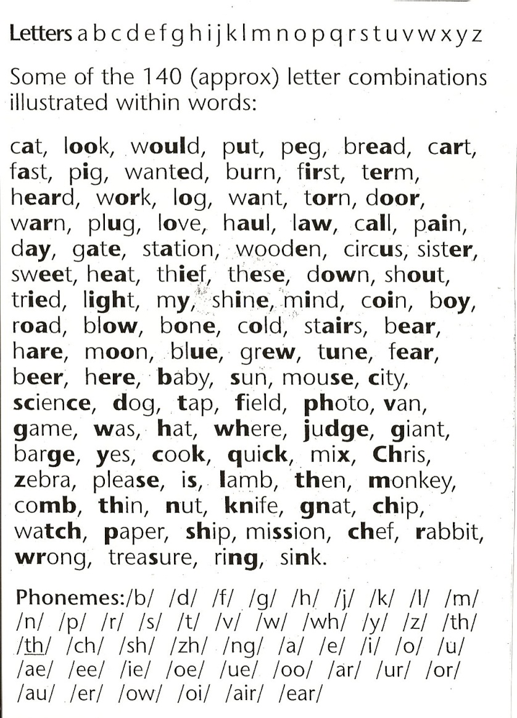
Letters & phonemes: the alphabetic code
English does not
have single
sound-symbol
correspondence

Slide 31
Consonant phonemes
Most consonant phonemes
have one highly frequent
representation.
e.g. m is more common
than mb or mm for
encoding the /m/
phoneme

Slide 32
Vowel phonemes
Short vowels
Long vowels
One spelling of
each of the
remaining
long vowel
phonemes

Slide 33
Three Key principles:
A phoneme can be represented by one or more letters
/b/ /sh/ /igh/
The same phoneme can be represented / spelled in more than one way
rain may lake
The same spelling may represent more than one phoneme
mean deaf great

Slide 34
An important point of practice
You must routinely, during teaching, distinguish
between letter names and letter sounds…
…sounds for decoding (reading)
…letter names for encoding (spelling)
Model this and then encourage and expect your
children to do the same within KS1 especially!

Slide 35
Important points to note:
Teachers’ subject knowledge is crucial to learners’ progress.
Teaching is structured, systematic and based on ongoing assessments.
Phonics teaching is daily with new learning in each lesson as well as previous learning revisited.
Effective phonics teaching leaves no one behind. Quick intervention for catch –up and keep up.
Effective phonics teaching includes a focus on reading and writing ‘tricky words’
Polysyllabic words should be included from Phase 3
Decodable books should be used within Phonics and reading lessons.

Slide 36
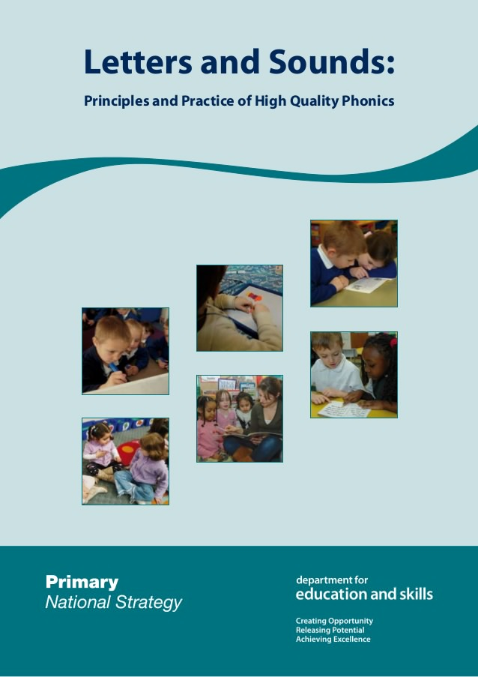
Part 2: The sequence – 6 phases

Slide 37
Phase 1
developing good phonological awareness
an ability to distinguish between sounds
an ability to ‘tune in’ to rhyme, rhythm and alliteration; a sensitivity to syllable units; onset and rime
Duration
This period falls within the developmental stages
from Nursery onwards.
This phase is the foundation of
Literacy learning

Slide 38
Phase 1 – 7 strands
General sound discrimination – environmental
General sound discrimination – instrumental
General sound discrimination – body percussion
Rhythm and rhyme
Alliteration
Voice sounds
Oral blending and segmenting

Slide 39
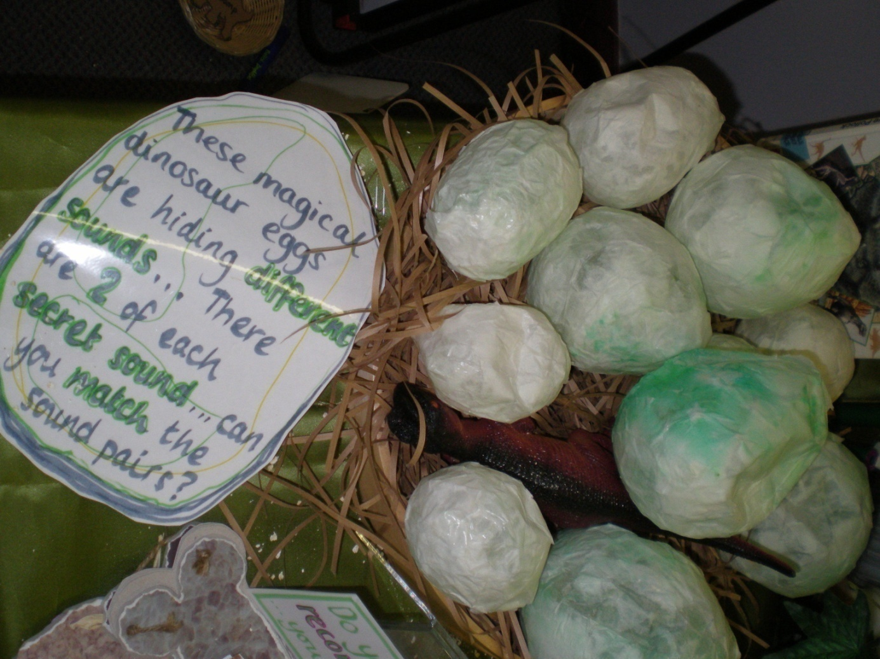
Phase 1 - sound discrimination
‘Playful
opportunities
to share and
enjoy the sounds
of the language’

Slide 40
Phase 2 - Duration: up to 6 weeks
– introduce 19 grapheme-phoneme correspondences
This will provide children with knowledge of a small
selection of common consonants and vowels
enabling them to blend and segment simple CVC
words: s/a/t p/i/n

Slide 41
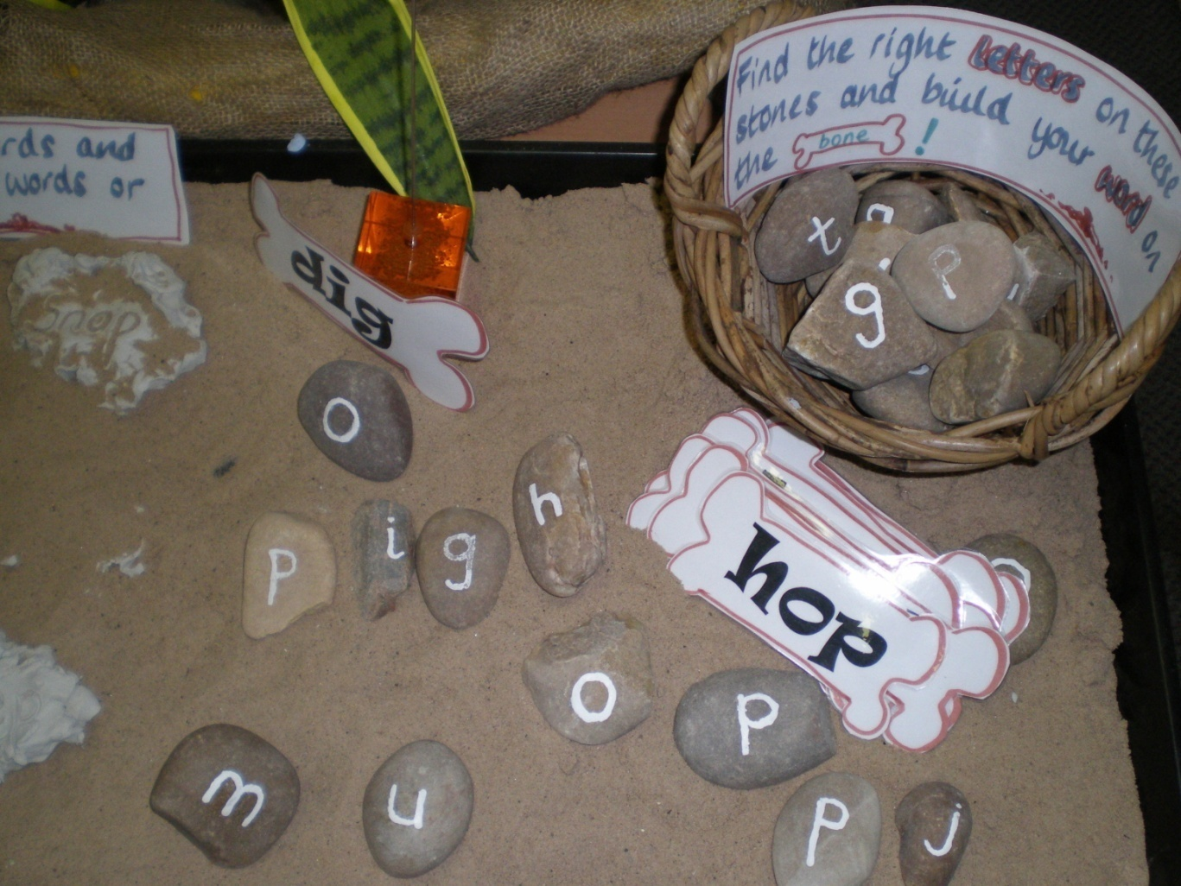
Phase 2

Slide 42
Phase 3 - Duration: up to 12 weeks
– introduces another 25 graphemes so children know one GPC for each of the 43 phonemes including one representation of each of the long vowel phonemes
children link sounds to letters, naming and sounding the letters of the alphabet
- hear and say sounds in the order in which they occur in the word initial, medial and final phonemes

Slide 43
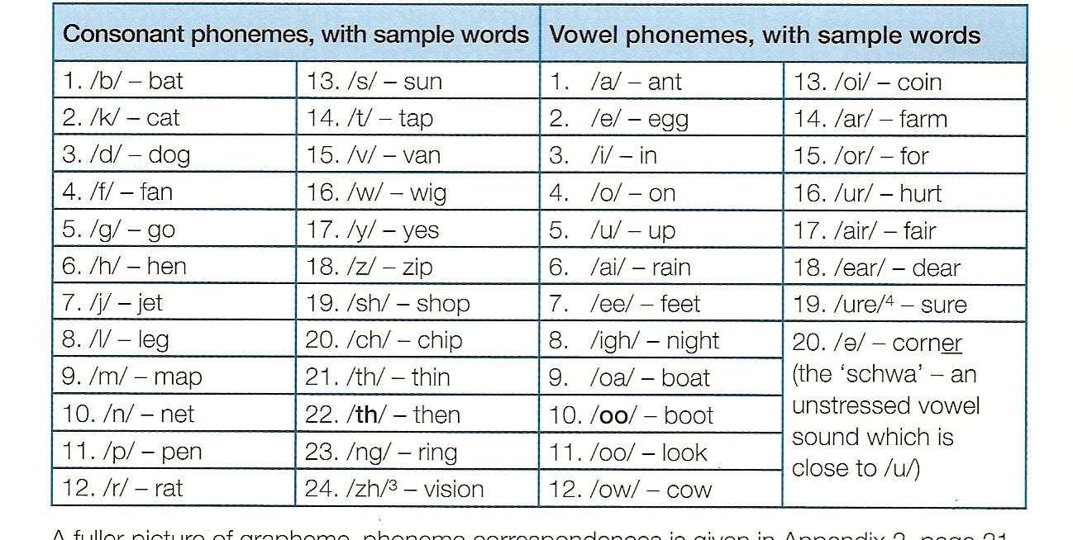
Phase 3
Children will know the most common representation of each consonant
phoneme and one representation of each of the vowel phonemes.
At this point, children
can encode the sounds
in any words they
want to write…

Slide 44
Phase 4 - Duration: 4-6 weeks
no new GPCs
teaching children to read and spell words with
consecutive consonants c/r/i/s/p
children are able to blend and segment adjacent
consonants in words and apply this skill when reading unfamiliar texts and when spelling.

Slide 45
Phase 5 - Duration: throughout Y1
- additional GPCs – ie alternative ways of pronouncing the graphemes and spelling the phonemes already taught jam/giant/bridge
- alternative ways of pronouncing the graphemes and spelling phonemes corresponding to long vowel phonemes
children will read and spell phonically decodable 2 and 3-syllable words.
phonic skills will be prime approach in reading and spelling of unfamiliar words.

Slide 46
Phase 5 words from 2017 reading check
tay
zued
meve
splue
feast
shape
groups
straw
person
model
reptiles
Can they smoothly blend to read these words?
Split digraph
Can our children in Year 1 identify the phonemes in these words?
Alternative GPCs

Slide 47
Phase 6 - Duration: throughout Y2
The spelling programme
Teaching children to develop their skill and automaticity in reading and spelling to create an ever-increasing capacity to attend to reading for meaning.
- Children apply phonic skills to recognise and spell an increasing number of complex words.

Slide 48
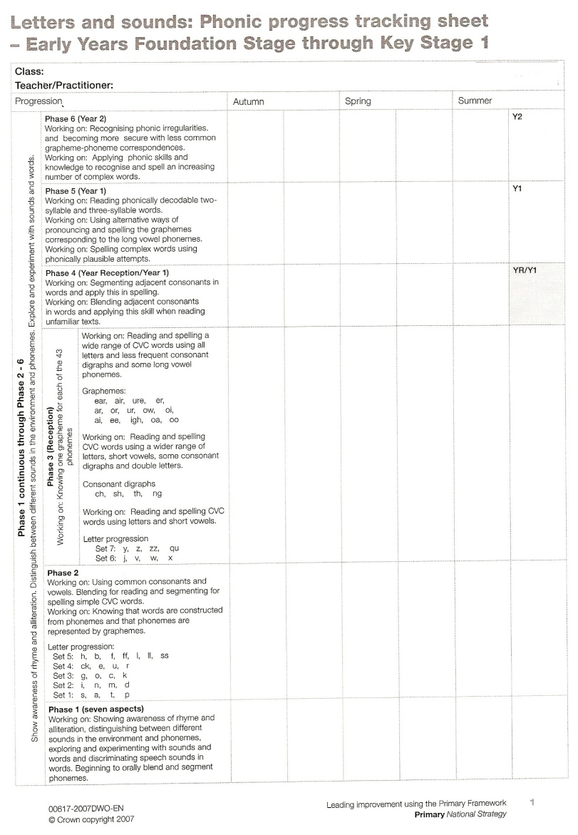
Record sheet showing 6 phases
Theory into practice:
Let’s watch some
video clips which
exemplify teaching
and learning at the
different Phases.
Use the grid to track
progression from Phase 1
to Phase 6

Slide 49
Ongoing difficulties
Children not making expected progress will
exhibit 3 typical weaknesses:
an inability to segment
poor vowel choices
poor memory for rapid recall of spellings of high frequency words
Poor sound discrimination

Slide 50
Subject knowledge
A test of what you now know…

Slide 51
Useful website for games and activities linked to L&S phases:
www.phonicsplay.co.uk
select ‘Free Phonics Play’ button and
experiment with the online games.

Slide 52
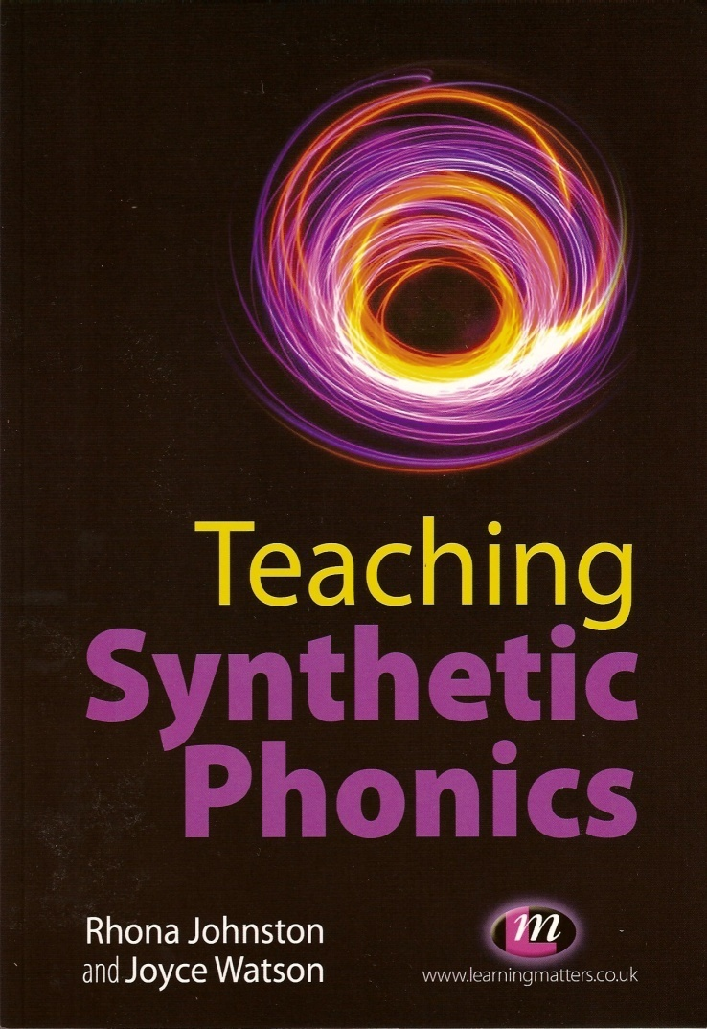
Teaching a synthetic phonics lesson
Exemplification of how to
plan a synthetic phonics
lesson at different Phases –
using Letters and Sounds can
be found in chapters 6 and 7
of this book.

Slide 53
Remember!!!
Phonics will only get you so far…
We turned up late but we waited for Zap while he jumped around.

Slide 54
Phonics will only get you so far…
We turnd up late but we waitid for Zap while he
jumpt around.
  Phonics is one part of early reading; a love of reading, together with fluency and comprehension must be skilfully enabled and developed, over time, if children are to progress as competent and engaged readers who read independently and for pleasure…

