Slide 1
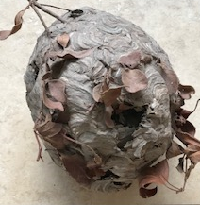
Working Scientifically 1: Observation
Tutor:
Sally Spicer
S.L.Spicer@warwick.ac.uk

Slide 2
Research
Archer L. Osborne, J. Dewitt, J., Dillon, J., Wong, B. and Willis, B. (2013) ASPIRES Young people and career aspirations 10-14. London: King’s College London
Maule L. and Featonby D. (2016) Fifty Shades of Muddy Green Issue 35 : Science in School http://www.scienceinschool.org/content/fifty-shades-muddy-green
Mepsted J. (2018) Supporting the teaching and assessment of working scientifically; Primary Science; special issue TAPS
Ofsted (2015) Improving science with the Lab 13 project: Irchester Community Primary

Slide 3
Teachers’ Standards
TS 1 – 8 all apply to teaching science, a core subject
TS 1 High expectations that inspire, motivate and challenge pupils
TS 3 Good subject knowledge and curriculum knowledge
TS4 Plan and teach well-structured lessons
TS 5 Adapt teaching to respond to strengths and needs of all pupils

Slide 4
Session Overview
To know and understand:
Importance of practical scientific enquiry
Working scientifically: types of enquiry
Observations and asking questions

Slide 5

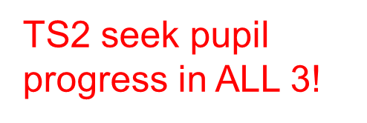
Importance of practical scientific enquiry
Developing Enquiry Skills (NC = WS)
Use methods /strategies of scientists to find answers
2) Conceptual Knowledge and Understanding
Learn about important ‘big’ science ideas
Understand the world around
Develop learning skills they will need throughout life ...
3) Developing Social Skills and Positive Attitudes
Develop positive attitudes:
Curiosity, awe and wonder, co-operation …

Slide 6
NC Science 2014 KS1 & 2
Working scientifically
…to understand how science can be used to explain what is occurring, predict how things will behave, and analyse causes.
... specifies the understanding of the nature, processes and methods of science for each year group. It should not be taught as a separate strand.

Slide 7
National Curriculum 2014 Working Scientifically
KS1 | Lower KS2 | Upper KS2
simple tests simple equipment | simple practical enquiries, comparative and fair tests range of equipment … data loggers, thermometers Accurate measurements, standard units | planning different types of scientific enquiries recognising and controlling variables where necessary measurements, range of scientific equipment, increasing accuracy and precision, repeat readings when appropriate
use observations and ideas to suggest answers to questions | use results to draw simple conclusions, make predictions for new values, suggest improvements, raise further questions | use test results to make predictions to set up further comparative and fair tests
 | Use straightforward scientific evidence…to support findings | Identify scientific evidence used to support or refute ideas or arguments

Slide 8
“Science without practical is like swimming without water” (SCORE 2009)
Explore
Report
Discuss
Question
http://www.score- education.org/media/3674/primary.pdf

Slide 9
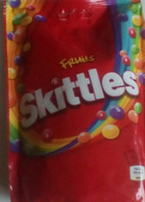
Working Scientifically: Skittles!
Explore Skittles - arrange 3 – 5 Skittles on a paper plate or in a petri dish placed on white paper
Predict: what will happen when you add water?
Observe -what happens?
Discuss – can you explain what you observe? How many different questions can you come up with? What if? …. When would …? How might … ? Why is..? Where could…?
Report findings/explanations; what could you explore next
What skills might be developing?
Misconceptions?
SEND

Slide 10
Aspects of science enquiry
Skills: choosing and using ‘scientific’ equipment (eg measuring temperature, using hand lens, measuring distance or time taken)
Observations: Using 5 senses, using aids, classifying (eg grouping, sorting, pattern seeking)
Illustrations: Focussed activity to demonstrate a particular science idea
Investigations: Learning methods & strategies for finding out science ideas

Slide 11
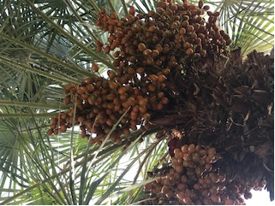
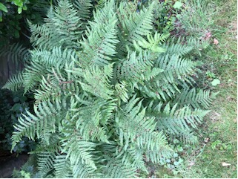
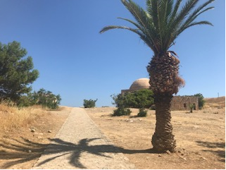
Types of enquiry
‘working scientifically’ … so that pupils learn to use a variety of approaches to answer relevant scientific questions.
Types of scientific enquiry should include:
observing over time
pattern seeking
identifying, classifying and grouping
comparative and fair testing (controlled investigations)
researching using secondary sources.
Pupils should seek answers to questions through collecting, analysing and presenting data.

Slide 12
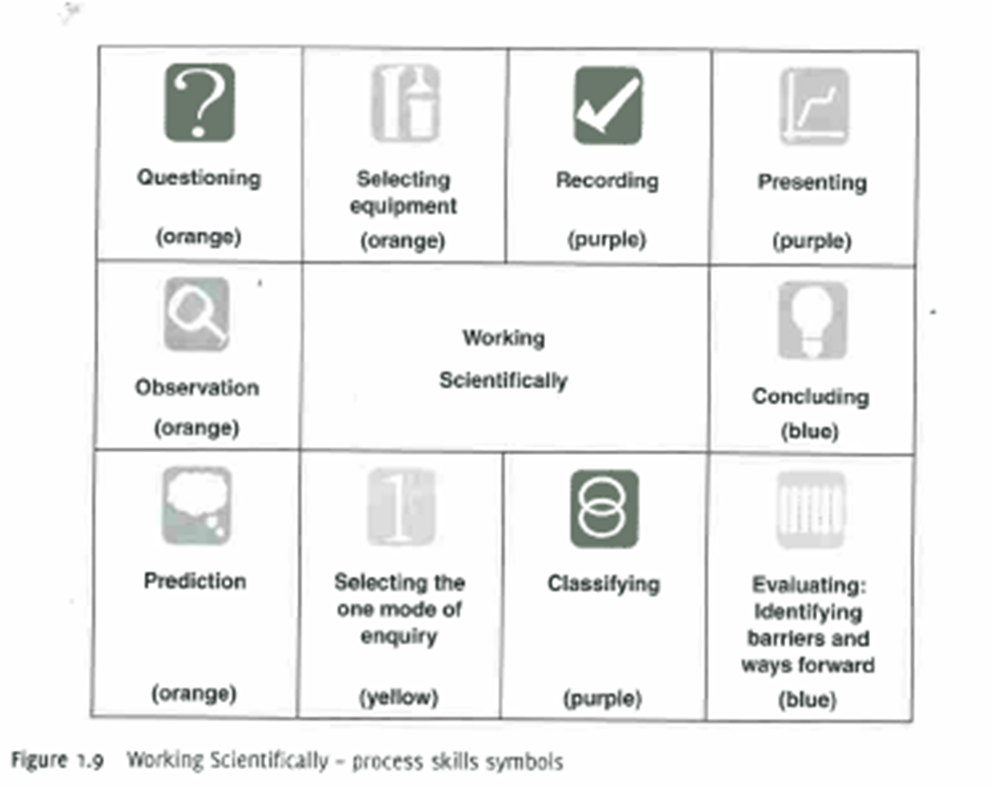
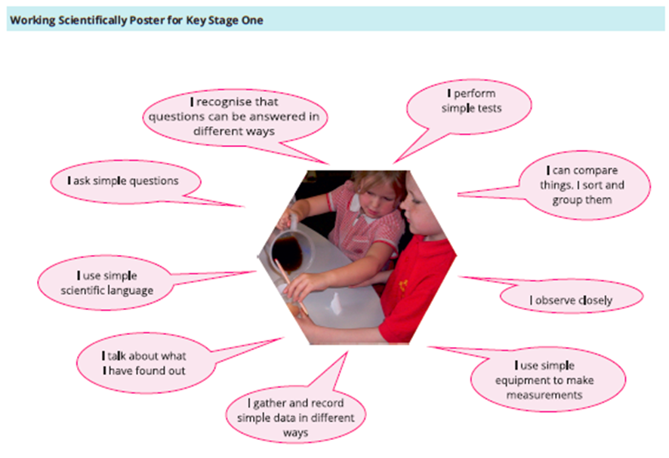


Slide 14
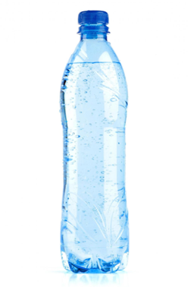


Developing Observational Skills
Circuit of Activities – explore using the prompts at the tables
Feely bags / boxes
Leaves
Liquids
Sealed containers
RSPCA photo cards
Focus frame & graphic organiser supported observation
What senses and skills have you used? How? Do you have any more questions you would like to ask? How could you find out the answers? How might you record your observations?
CLEAPSS

Slide 15
Scientific Knowledge & Understanding
Pupils should be taught to use … practical scientific methods, processes and skills through the teaching of the programme of study content:
Links from observation circuit to the NC (2014) for science:
Year 1 Plants; Animals, Including humans
Year 1 Everyday materials
Year 4 Living things and their habitats; Animals, Including humans
Year 4 Sound
Year 6 Living things and their habitats

Slide 16

Asking Science Questions
Children need encouraging to continue asking questions (post EYFS)
Need teaching to identify questions that can/ cannot be investigated
Questions to investigate generated after first hand observational experience often better
Scaffold: question words, model; develop in pairs from observations, use sorting grid
Roden & Archer 2014
Bloom’s revised Taxonomy
Questions
I can investigate now | I can’t investigate now
? | ?

Slide 17
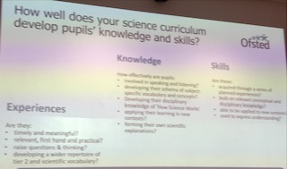
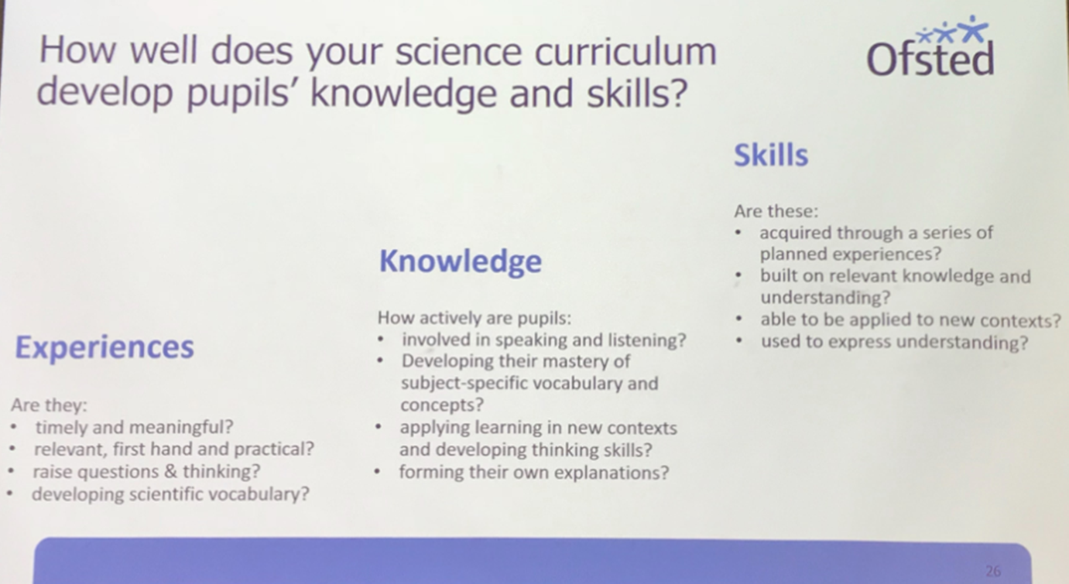
Ofsted July 2019
Ofsted July 2018

Slide 18
National Curriculum 2014 Working Scientifically
KS1 | Lower KS2 | Upper KS2
Asking simple questions Observing closely use observations and ideas to suggest answers to questions | Asking relevant questions Making systematic and careful observations ...taking accurate measurements ... use results to draw simple conclusions ... raise further questions | Planning different types of scientific enquiries to answer questions Taking measurements ... with increasing accuracy and precision ... Reporting and presenting findings from enquiries ...
Gathering and recording data to help in answering questions | Use straightforward scientific evidence…to answer questions or support findings | Identify scientific evidence used to support or refute ideas or arguments

Slide 19
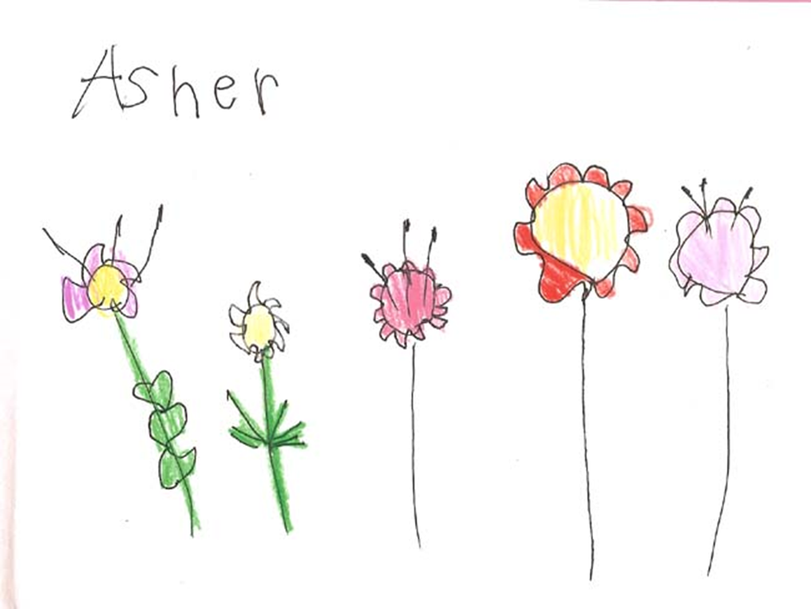
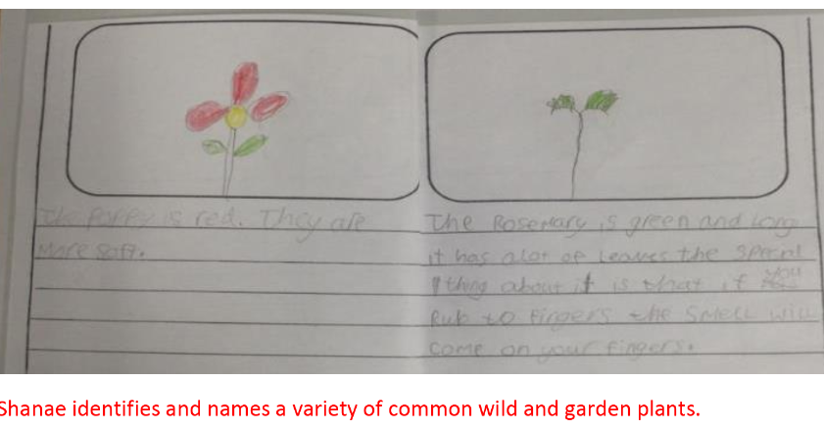
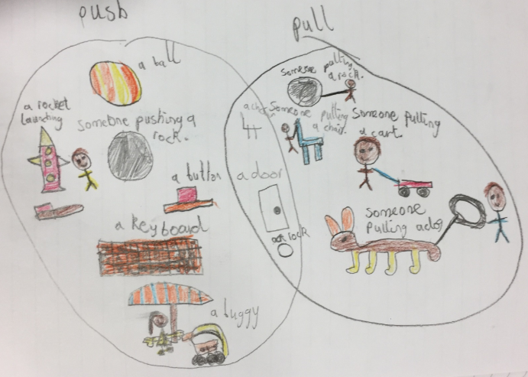

Slide 20
Investigating Magnets
Task 1
Explore the collection of magnets (5 mins)
Which objects are attracted to the magnet?
What properties do they have in common?
Task 2
Which is the strongest magnet?
Devise a test to find out exactly how strong each magnet is? Does the size, shape, colour or any other factor affect how strong the magnet is?
What other tests are there? Groups share ideas

Slide 21
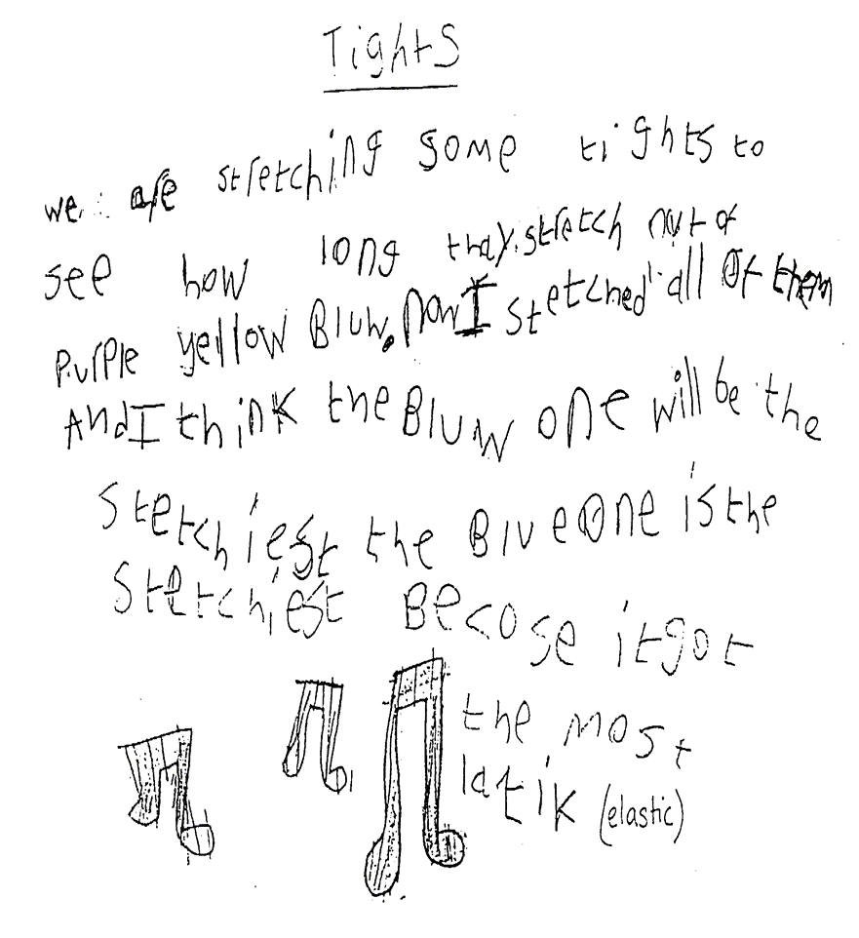
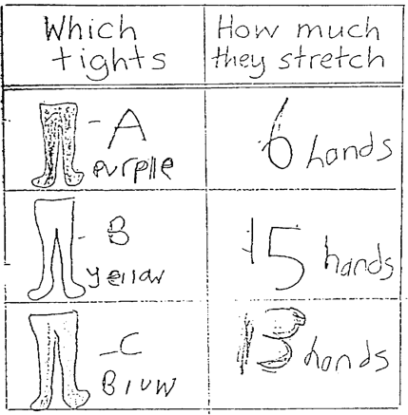
Comparative testing KS1 -tights

Slide 22
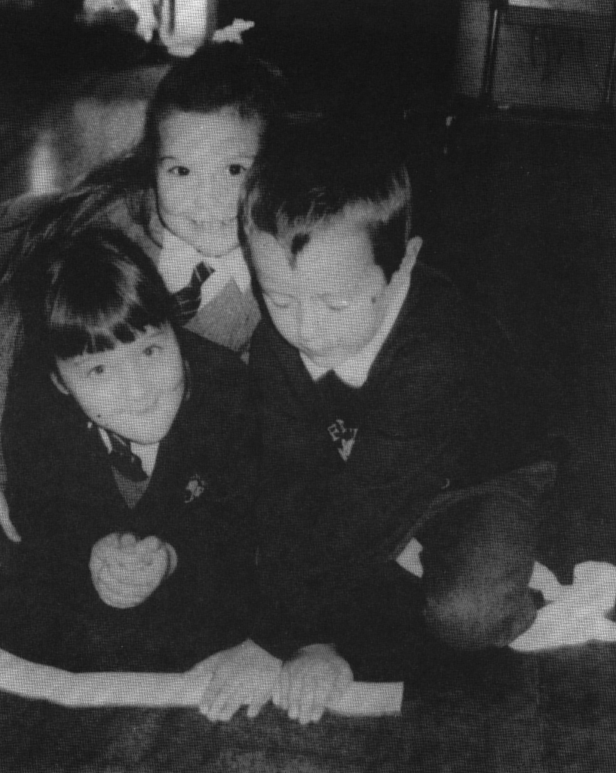
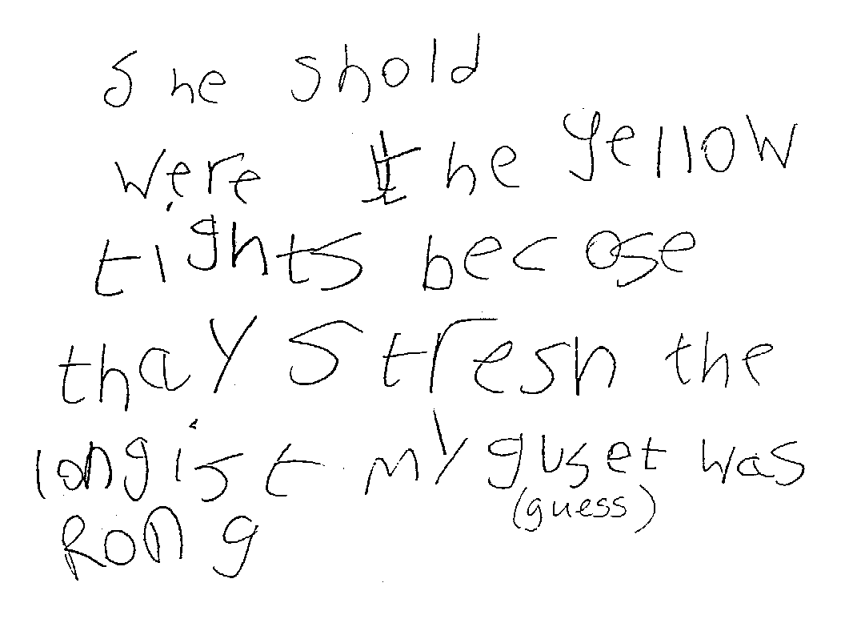
Investigating tights

Slide 23
Observation-Creative and Cross curricular
My Thoughts About Being Blind
I see with my ears.
I hear the leaves in the tall trees, whispering in the night.
I hear the sea, dark and deep, and the splash of the dolphin’s leap.
I hear the flames crackling and the window frames rattling in the wind.
I see with my ears.
I see with my nose.
I smell the blossoms pearly-grey and hay new mown.
I smell the ploughed earth, cows in the byre, the smoky fire.
I smell Grandpa’s pipe, Gran’s lavender room and Mum’s faint perfume.
I see with my nose.
I see with my mouth.
I taste the strong black coffee and the thick brown toffee between my teeth.
I taste the yellow of the lemon, the green of the melon and the red of the tomato.
I taste the orange of the carrot, the purple of the plum, the gold of the sun on my face.
I see with my mouth.
I see with my hands.
I feel the sharp edges, slippery floors, smooth ledges.
I feel lemonade in cold canisters, hard wooden banisters.
I feel hands to hold, arms on shoulders, faces to touch.
I see with my hands.
Originally written in Braille by Ruth Hardcastle aged 11

Slide 24

Developing the right attitudes through practical science takes time!
‘An attitude of willingness to take account of evidence does not result from a single activity or even several activities … They are ‘caught’ rather than ‘taught’ ... an example of the behaviour in practice is a key action teachers can take. … reinforcing positive attitudes; and discussing attitude related behaviour.’
(Harlen & Qualter 2009 cited Harlen, W. 2011 p6 ASE Guide to primary science education)
“ …science has not been taught frequently enough for enquiry skills to be developed. The expectation is that science should be taught weekly though no minimum time will be quoted.”
Brian Cartwright on Maintaining Curiosity, at NSLC, 21.11.13
ASPIRES report (2013)

Slide 25
Plenary
Trainees should have a better knowledge and understanding of:
Importance of practical scientific enquiry
Working scientifically: types of enquiry
Observation and asking questions

Slide 26
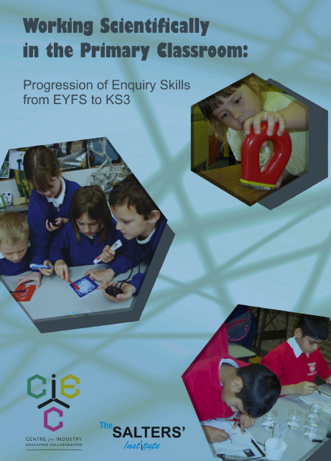
Useful resources
ASE (Association for Science Education)
http://www.ase.org.uk/home/
PLAN https://www.ase.org.uk/resources/primary/plan/
PSTT (Primary Science Teaching Trust) https://pstt.org.uk/resources
CIEC Working Scientifically in the primary classroom: Progression of Enquiry Skills from EYFS to KS3 www.ciec.org.uk
Practical work in primary science (SCORE 2009) free booklet
http://www.score-education.org/media/3674/primary.pdf
A framework for practical science (SCORE 2009)
http://www.score-education.org/media/3662/framework.pdf

Slide 27
Bibliography
Bianchi, L., Feasey, R. (2011) Science Beyond the Classroom Boundaries. For 3 – 5 year olds. McGraw Hill.
Department for Education (2014) Statutory Framework for the Early Years Foundation Stage Setting the standards for learning, development and care for children from birth to five
Department for Education (2013) National Curriculum in England: science programmes of study
Department for Education (2013) The national curriculum in England; framework document: for teaching 1 September 2014 to 31 August 2015
Department for Education (2013) Teachers’ Standards
Dunne, M. and Peacock, A. (2015) 2nd Edition; Primary Science: A Guide to Teaching Practice; SAGE
Harlen, W. ed (2010) ASE Guide to Primary Science Education. New Edition. ASE Hatfield.
Howe, A., Davies, D., McMahon, K., Towler, L., Collier, C., Scott, T. ( 2009) 2nd ed Science 5 – 11. A Guide for Teachers. Routledge. London.

Slide 28
Bibliography cont.
Lakin, L. (2013) Developing independent Learning in Science. Practical ideas and activities for 7-12 year olds Open University Press.
Ofsted (2013) Maintaining Curiosity A survey into science education in schools; No. 130135
Ofsted (2013) Report Summary; Maintaining Curiosity A survey into science education in schools; No. 130135
Osborne, J., Simon, S., & Collins, S. (2003) Attitudes towards science: a review of the literature and its implications. International Journal of Science Education. 25 (9), 1049 – 1079
Roden, J. and Archer, J. (2014) Primary Science For Trainee Teachers; SAGE
Wilson, H., Mant, J. 2011 What makes an exemplary teacher of science? The pupils’ perspective. School Science Review. Vol 93:342 ASE Hatfield. Herts. http://www.ase.org.uk/home/

