Slide 1

English – Introductory session
Literature at the heart of English…
Jo Dobb
j.dobb@warwick.ac.uk
Avon building WA 0.05c

Slide 2
Programme Outline
Creating your ‘Toolkit’
Research-based approaches
SK alongside practical ideas
Text-based – Literature at the heart of English…
Focus on Phonics
KS1 and KS2
Tasks to support and develop your understanding and expertise
Tutor: Jo Dobb

Slide 3
Programme Outline
Session Number | Session Focus
1 | Phonics
2 | Shared Reading
3 | Shared Writing
4 | Guided Reading
5 | Grammar SK
6 | Grammar
7 | Spoken Language
8 | Non-Fiction
9 | English as an Additional Language (EAL) SST
10 | Developing Comprehension
Session materials are found in Moodle under the ‘English Sessions’ tile.

Slide 4
Professional Subject Associations Useful Websites
The UK Literacy Association (UKLA)
www.ukla.org
National Association for the Teaching of English (NATE)
www.nate.org.uk
Websites:
booksforkeeps.co.uk
www.literacytrust.org.uk
www.lovereading4kids.co.uk
www.literacyshed.com

Slide 5
The Statutory Curricula for English
The National Curriculum
‘Spoken Language’
Reading has 2 dimensions:
Word Reading
Comprehension (listening and reading)
Emphasis on reading for pleasure
Writing has 2 dimensions:
Transcription (spelling and handwriting)
Composition (articulating ideas and structuring them into speech and writing)
Statutory Appendices:
Non-Statutory Glossary
The EYFS
Prime Area of Learning:
Communication and Language
Specific Area of Learning:
Literacy

Slide 6
PHONICS, PHONICS, PHONICS…
National Priority
No-notice Inspection
First-call strategy
Schools under scrutiny
Variation in school approaches – same key principles
Intervention at KS2
Application across the Curriculum

Slide 7
The School-Based Task
Full details on Moodle > English General > SBTs and Resources for School Placement https://moodle.warwick.ac.uk/mod/page/view.php?id=716418
On each placement as applicable: Find out about the Phonics scheme used by the school, spend time finding out about how the teachers plan and assess Phonics (look through and engage with their planning) and find out which resources are available to you. Arrange to observe a Phonics lesson (see optional ‘observation checklist’ attached below to support you) For a genre of children’s literature that you are less familiar with (initially, see your targets identified at interview) identify three new titles/authors that your teacher recommends Optional challenge task: choose one text to add to ‘The Book Place’ This challenge task is optional but it will really support your fellow trainees in developing their knowledge of children’s literature as well as your own; the CTE Book Place resource will only be as good as you help to make it! | When you are in KS2: Plan, teach and assess pupils in Phonics for a minimum of 1 week (or equivalent) You can teach a small intervention group in your own class or arrange to visit a KS1/Reception class – please organise this for early on in your placement - see Moodle (English General Tile > SBTs and resources for school placement) for more guidance on how to approach and organise this. You can find a Phonics planning pro-forma attached below. Additional resources to support your planning can be found on Moodle: English General Tile > SBTs and resources for school placement ***** At the end of your placement, you can upload a copy of your planning to your e-PDP as this will be good evidence of your developing Subject Knowledge. | When you are in KS1: Plan, teach and assess pupils in Phonics for a minimum of 3 weeks This should be with the whole class You should have at least one formal observation (two is advisable: one early on to give you some formative feedback to support your progress and another towards the end of your teaching to support an accurate grading against TS3.d) The pro-forma for a formal observation, to be completed by your mentor or class teacher can be found attached below. Assess a child in Phonics Write a profile of the child which is diagnostic and which sets next steps for planning and teaching. Please see the attached prompt sheet and format for recording below ‘Assessing a child in Phonics’. ***** At the end of your placement, you can upload a copy of your planning, observation and the Assessing a child in Phonics page to your e-PDP as this will be good evidence of your developing Subject Knowledge as well of your progress towards TS6.

Slide 8
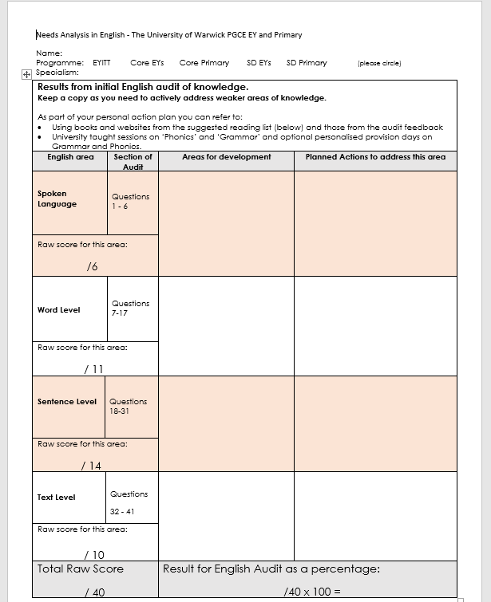
The Initial English Audit
Not a test!
Supports targeted actions = progress for you and your pupils!
Repeated at the end of the year
What to do:
Lets have a look!
https://moodle.warwick.ac.uk/course/view.php?id=32159#section-4
Complete the online audit
Complete the Needs Analysis form and action plan
Email me a COPY of your Action Plan by 13.09.19 (your first English session)
Upload a copy to your e-PDP – the Subject knowledge page
Add all info to your training plan

