Slide 1
Developing Reflective Practice
Primary/EY School Direct
August 2019

Slide 2
Objectives
To:
promote personal reflection;
develop your understanding of ‘reflective practice’ and its centrality to professionalism;
understand the purpose of ‘reflective practice’ and its importance to ITE trainees;

Slide 3
Teachers’ Standards
Preamble
Teachers make the education of their pupils their first concern, and are accountable for achieving the highest possible standards in work and conduct. Teachers act with honesty and integrity; have strong subject knowledge, keep their knowledge and skills as teachers up-to-date and are self-critical; forge positive professional relationships; and work with parents in the best interests of their pupils.
TS 4: reflect systematically on the effectiveness of lessons and approaches to teaching
TS 8: take responsibility for improving teaching through appropriate professional development, responding to advice and feedback from colleagues
Notes:
Emphasise the importance of reflective practice in the teaching profession

Slide 4
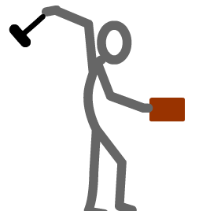
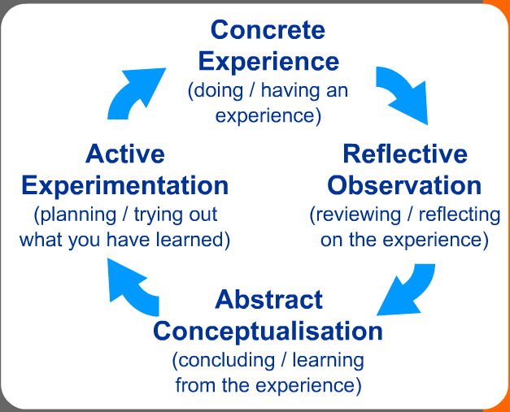
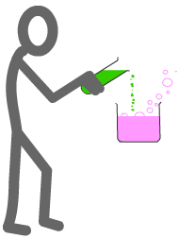
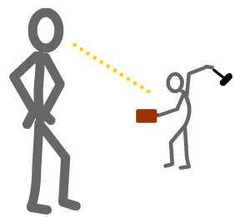
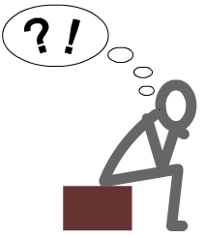
A. Kolb’s Learning Cycle
http://www.ldu.leeds.ac.uk/ldu/sddu_multimedia/kolb/kolb_flash.htm
Notes:
The 3 definitions are included for the purpose of feedback discussion for you to use/not use as you see fit.

Slide 5
B. Reflection according to Bolton (2006)
‘Reflection is an in-depth consideration of events or situations: the people involved, what they experienced, and how they felt about it. This involves reviewing or re-living the experience to bring it into focus, and replying from diverse points of view. Seemingly innocent details might prove to be key; seemingly vital details may be irrelevant’ (Bolton, 2010, p. xvix)
Reflection is a state of mind, an ongoing constituent of practice, not a technique, or curriculum element. Reflective Practice can enable practitioners to learn from experience about themselves, their work, and the way they relate to home and work, significant others and wider society and culture. It gives strategies to bring things out into the open, and frame appropriate and searching questions never asked before. It can provide relatively safe and confidential ways to explore and express experiences otherwise difficult to communicate. It challenges assumptions, ideological illusions, damaging social and cultural biases, inequalities, and questions personal behaviours which perhaps silence the voices of others or otherwise marginalise them. (Bolton, 2006, pp.3)

Slide 6
C. Reflection according to Schon (1991)
“When we reflect, we consider deeply something which we might not otherwise have given much thought to. This helps us to learn. Reflection is concerned with consciously looking at and thinking about our experiences, actions, feelings and responses and then interpreting or analysing them in order to learn from them (Boud et al., 1994; Atkins and Murphy, 1994). Typically we do this by asking ourselves questions about what we did, how we did it and what we learnt from doing it. Schön (1991) distinguishes between reflection-on-action and reflection-in-action in the following way: Reflection-in-action is concerned with practising critically. So, a physiotherapy student working with a client on an exercise programme is making decisions about the suitability of particular exercises, which exercise to do next and judging the success of each exercise at the same time as they are conducting the activity. Reflection-on-action on the other hand, occurs after the activity has taken place when you are thinking about what you (and others) did, judging how successful you were and whether any changes to what you did could have resulted in different outcomes.
http://www.learningdevelopment.plymouth.ac.uk/LDstudyguides/pdf/11Reflection.pdf

Slide 7
Reflexivity: What is it?
Reflexivity is concerned with reflection upon the self within teaching (Warin et al., 2006, p.242)
“Ashmore (1989) outlines the many uses and meanings of 'reflexive'. Included in these are reflexivity as self-reference, reflexivity as self-awareness and…..Many writers take the meaning from its Latin derived dictionary definition: to turn back on oneself (Bourdieu & Wacquant, 1992; Lawson, 1985; Steier, 1991). This is interpreted to mean that people have to think about their own concepts and what they bring to any situation. (Matthews and Jessel, 1998)
In contrast to the view that people can be objective, reflexivity argues that we have a social and intellectual unconscious—and consciousness—that we bring to any situation.‘….to find a way of standing outside the self….it enables becoming aware of the limits of our own knowledge of how our own behaviour is complicit in forming organisational practices which for example, marginalise groups or exclude individuals. Reflexivity uses strategies such as internal dialogue to make aspects of the self strange. It requires being able to stay with personal uncertainty, critically informed curiosity and flexibility to find ways of changing deeply held ways of being: a complex, highly responsible social and political activity.’ (Bolton, 2010, p. xvix)
Notes:
Now trainees have a grasp of reflection and reflective practice, develop this to consider the concept of ‘reflexivity’.
Ask trainees to read the above quotes and to try to articulate the difference.
Could use ‘Think, Pair, Share’ here.
Illustrate this with the quote on the next slide.

Slide 8
Definitions of ‘reflection, reflective practice, reflexivity…
Similarities
Differences
Notes:
For the self-study task, trainees will have considered 1 of 3 definitions of reflection – understanding that definitions vary, that knowledge is contested is a feature of work at Master’s level – we will revisit this is when we look at the PGCE assignment.
Group students in groups of 3 with one of each definition (A,B,C). Students to share each definition and consider the similarities and differences.

Slide 9
Reflection or Reflexivity?
“I just do not get on with my classes. They do not respect me and I cannot seem to establish my authority. The school-based tutor has suggested that I sit and work with a group of pupils during some lessons and talk to them to see how they are feeling.... When I worked with the pupils I realised how boring they found much of the work, and that they did not respect teachers who were not interested in them. I realised that they did respect, and responded to, some of the teachers, but that the teacher has to earn respect. I have begun to realise that I had been brought up to believe that the young should automatically respect their elders, and that pupils should therefore obey teachers. It is painful for me to realise that this is not the case, and that I will have to earn their respect. Even more, through talking to the pupils, I realise that I have to respect them and that this is part of the process. I thought I did, and still think I do, but perhaps I am just not communicating it to them. I think that these are the areas I am going to have to work on to improve my discipline.”
(Matthews and Jessel, 1998, p. 233-234)
Notes:
Quote from a PGCE student.
Read, discuss with a partner: is this reflective or reflexive practice?

Slide 10
Purposes of Reflective Practice (Theory to Practice)? TTYP
Notes:
Purposes of Reflection
As a group make a list of purposes of reflective practice (in it’s broadest sense – all definitions discussed)
One group shares – tick of if you have on your list….any more?
Scribe purposes on the slide.
Typical responses might be: to learn from our mistakes; to improve our teaching, to improve children’s learning, to allow us to reconsider our practical approaches against theory, to involve others in our professional development, to encourage us to consider taken-for-granted assumptions….etc.

Slide 11
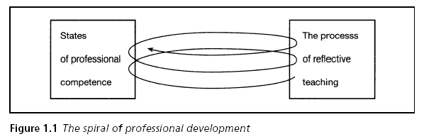
Pollard, 2005, p.5
Notes:
For those that like an image, this is Pollard’s view of the purpose of reflective teaching i.e. to improve professional competence,

Slide 12
Levels of reflection
1. Descriptive writing: writing that is not considered to show evidence of reflection: it is a description with no discussion beyond description.
2. Descriptive reflection: There is a description of events. The possibility of alternative viewpoints is accepted but most reflection is from one perspective.
3. Dialogic reflection: the work demonstrates ‘a “stepping back” from events and actions leading to a different level of mulling about discourse with self and exploring the discourse of events and actions’. There is a recognition that different qualities of judgement and alternative explanations may exist for the same material. The reflection is analytical or integrative, though may reveal inconsistency.
4. Critical reflection: ‘Demonstrates an awareness that actions and events are not only located within and explicable by multiple perspectives, but are located in and influenced by multiple historical and socio-political contexts’
Moon (2006) p.40-41
Notes:
Another way of conceptualising reflection is to consider the depth of reflection. Moon conceptualises 4 levels.
Briefly introduce these
It isn’t really important whether they correctly identify the level of reflection in the examples provided, different interpretations are indeed possible. However the activity does encourage them to consider the concept of reflection a little more deeply/from other perspectives.

Slide 13
Reflective practice and your ePDP
Remember – the WADs contain learning questions to support your reflections.
Notes:
Sally introduced WADs the day before.
Get a folder with WADs and training plan.

Slide 14
e-PDP
Online portfolio
Mahara
Will be introduced tomorrow
Add link to share template briefly
Notes:
Share the e-PDP with trainees – show them Reflection Points – Abi will go through this tomorrow.

Slide 15
Using the WADs to support your reflections
Examples of learning questions (TS5)
How does your planning take account of different needs and strengths of learners?
How does your planning refer to individual and group learning needs?
What differentiation strategies have you found to be most effective and why?
How do you know if your differentiation strategies have been effective?
Notes:
Get WADs out. Turn to TS5 – ePDP – WADs support the ePDP

Slide 16
Learning questions and your ePDP
Use these questions during your University sessions and at other times throughout your training year.
Your responses to these questions will provide evidence of your developing professional knowledge, skills and understanding during your training year.
Consider how you can apply models of reflection to your experiences e.g. Kolb, Moon, Schon, Bolton’s ‘reflective’ vs ‘reflexive’ practice as part of your ePDP

Slide 17
Sources of evidence of progress against the Standards
Children’s work
Lesson evaluations
Lesson observations
Planning
Assessment and marking

Slide 18
Reflection points
RP1 – by the end of the October half term
RP2 – By the end of Christmas holidays
RP3 – By the end of the Easter holidays
RP4 – 22nd June 2019

Slide 19
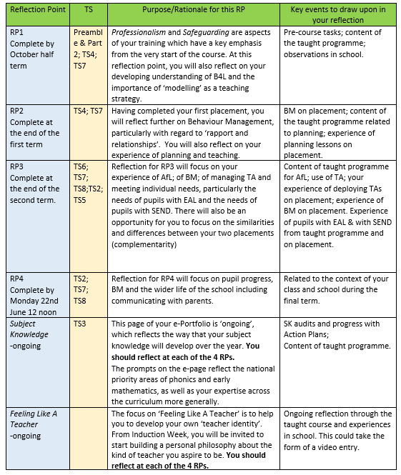
Notes:
Pass copies around at beginning
Assessed at H-Level and monitored throughout the year by personal tutors.

Slide 20
Next steps
Complete the first page of your e-PDP with your own details once you are set up (Thursday)
In the coming weeks begin completing your reflections for RP1
Feeling like a teacher
This is assessed as H Level
Notes:
Talk to them about e-PDP and Mahara – Mahara is the platform/tool – the e-PDP is the Professional Development Portfolio.

Slide 21
References
Bolton, G. (2010) Reflective Practice (third edition) London: Sage
Kolb, D. (1984) cited in Leeds University available online at:
http://www.ldu.leeds.ac.uk/ldu/sddu_multimedia/kolb/kolb_flash.htm
accessed 24.7.13
Matthews, B. & Jessel, J. (1998) Reflective and Reflexive Practice in Initial Teacher Education: a critical case study Teaching in Higher Education, 3:2, 231-243
Moon, J. Learning Journals A handbook for Reflective Practice and Professional Development (second edition) London: Routledge
Pollard, A. (2005) Reflective Teaching (third edition) London: Continuum
Schon, D. (1991) cited in Plymouth University available online at: http://www.learningdevelopment.plymouth.ac.uk/LDstudyguides/pdf/11Reflection.pdf accessed 24.7.13
Warin, J., Maddock, M., Pell, A. and Hargreaves, (2006) L. Resolving identity dissonance through reflective and reflexive practice in teaching Reflective Practice 7: 2 pp. 233–245

Slide 22
We learn not from doing, but by thinking about what we do. Anon.
Notes:
Ask trainees to reflect on the comment. You might use the ‘Think, pair, share’ strategy.

