Slide 1
Mathematical Mindsets
Sally Hewitt
Mark Harris (m.o.harris@warwick.ac.uk)
Notes:
https://vimeo.com/245472639
https://vimeo.com/241875015

Slide 2
Research
Boaler, J (2016) Mathematical Mindets
Drury, H (2015) Mastering Mathematics
(2013) Attitudes Towards Maths. National Numeracy (online), available at: www.nationalnumeracy.org.uk [accessed 31 August 2015]
Education Endowment Foundation Toolkit – Setting and Streaming

Slide 3
Objectives
To understand the importance of a Mathematical Mindset
To identify strategies to develop a Mathematical Mindset
To begin to reflect on the kind of teacher of Maths that you want to be

Slide 4
Teaching Standards
TS 3 Demonstrate Good Subject and Curriculum Knowledge
TS3a: Have a secure knowledge of the relevant subject/s and curriculum areas, foster and maintain pupils’ interest in the subject and address misunderstandings
TS3b: Demonstrate a critical understanding of developments in the subject and curriculum areas, and promote the value of scholarship
TS3d: If teaching early mathematics, demonstrate a clear understanding of appropriate teaching strategies.
(n.b. early mathematics refers to mathematics taught in both the early years and primary age phases)

Slide 5

Discuss
What are you like at maths?
What made you come to this conclusion?
Notes:
How many trainees have the idea that they can’t do maths?
How did you come to this conclusion? Why do you think this?

Slide 6
Causes of Negativity
Bad experiences of Maths: Students are often not confident in their understanding of basic concepts and they also don’t see the everyday relevance or value of maths. Many have bad memories of school maths and this continues to influence how they feel about maths throughout their adult lives.
“Negative Memories of School Maths Still Affect me”.
Source: Challenge Pilot participant data, 2013
25%

Slide 7
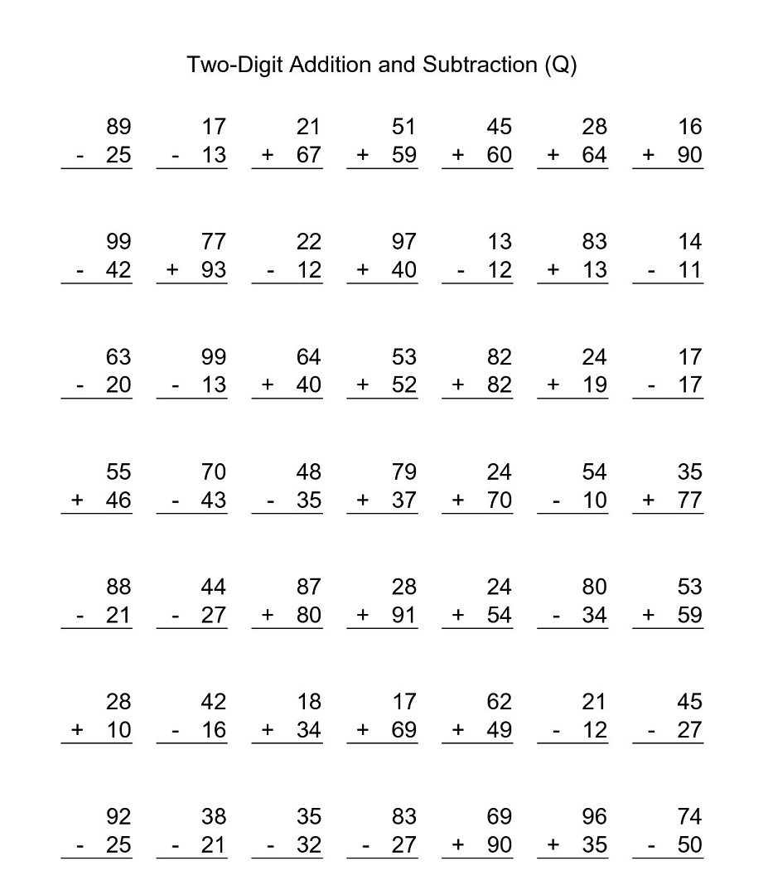
Causes of Negativity
How do you feel when you see this worksheet?
Mindful practice vs Mindless practice?
Notes:
Discuss the development of a fixed mindset by giving children a worksheet similar to this:
Boredom
Can/can’t do it
Is getting the answer important or how they get the answer?
How many questions does a child need to answer to know if they can/can’t do something?
Range of questions included that may use different strategies to answer.
Mindful practice – carefully selected questions that have progression and develop key skills.
Mindless practice – answering many randomly created questions that have no clear progression.

Slide 8
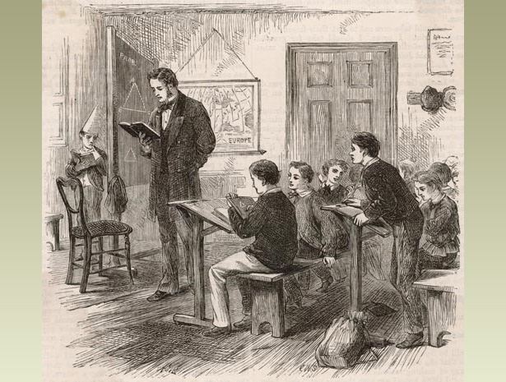
Victorian Maths
Focus on number work
Children learnt number facts by rote
Children sat separately or in rows
Talking was discouraged
Notes:
How many trainees experienced maths lessons like this?

Slide 9
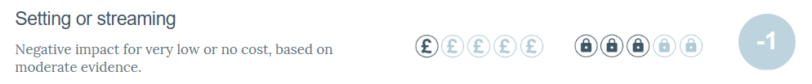
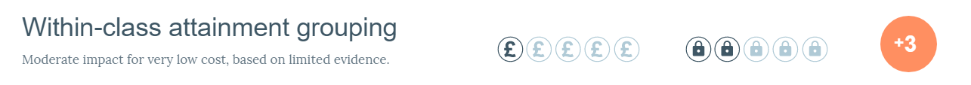
No Labels
What are the benefits/disadvantages to setting children based on ability in maths?
Education Endowment Foundation
Notes:
Low attaining learners who are set or streamed fall behind by 1 or 2 months per year, on average, when compared with the progress of similar students in classes with mixed ability groups. It appears likely that routine setting or streaming arrangements undermine low attainers’ confidence and discourage the belief that attainment can be improved through effort. Research also suggests that ability grouping can have a longer term negative effect on the attitudes and engagement of low attaining pupils.
In contrast, studies show that higher attaining learners make between 1 and 2 additional months' progress when set or streamed compared to when taught in mixed ability groups. This is unsurprising: studies of targeted interventions for pupils identified as "gifted and talented" show that they benefit from a range of different kinds of grouping, including pull-out classes, accelerated classes and promotion (where high attaining pupils move up a year). However, research into gifted and talented schemes rarely records the impact of the schemes on the students not identified as gifted and talented, who are more likely to be from disadvantaged backgrounds. It is possible that, as with setting and streaming, those not identified as gifted and talented experience a negative impact.
Though the average impact of setting or streaming on low attaining pupils is negative, evidence suggests that certain types of grouping are more effective than others. Some studies have shown that reducing the size of the lowest attaining groups and assigning high-performing teachers to these groups can be effective, as can providing additional targeted catch up support
One of the challenges of attainment grouping is ensuring that pupils are correctly allocated to groups. Some studies from the UK suggest that misallocation is a particular problem for pupils from disadvantaged backgrounds, who are at greater risk of misallocation to lower attaining groups, and the negative impact which can accompany this.
What should I consider?
Before you implement this strategy in your learning environment, consider the following:
How will you decide which subjects or activities are grouped by current level of attainment and which are not?
How will you ensure that all pupils receive high quality teaching when different groups are doing different tasks or require different teaching strategies?
How will you minimise the risk of allocating pupils to the wrong group? Have you assessed whether your grouping criteria could disadvantage certain pupils? For younger children, have you taken their relative age within the year group into account?
How flexible are your grouping arrangements? Pupils progress at different rates so regular monitoring and assessment is important to minimise misallocation and ensure challenge for all pupils.
How will you monitor the impact of grouping on pupils’ engagement and attitudes to learning, particularly for lower attaining pupils?

Slide 10
Mindsets
Growth Mindset
Believe that effort creates success
Believe that skills and ability can be increased over time
View mistakes as an opportunity to develop
Are resilient
Think about how they learn
Fixed Mindset
Believe that you either have ability or do not
Are reluctant to take on challenges
Are worried about making mistakes
Prefer to stay in their comfort zone
Think it is important to seem intelligent in front of others

Slide 11

Maths Brain
Brain ‘plasticity’
New learning – Synapse fires
‘The Knowledge’
Hippocampus
Therefore, all students can achieve at the highest level of maths.
Notes:
Brain plasticity – the brain has the ability to grow. Neuroplasticity – ability for the brain to change and rewire itself
New synapses are described as ‘footprints in the sand’ – can become if travelled a lot or be washed away.
Research by Moser et al (2011) found that synapses fire more when mistakes happen.
Brain is losing/gaining connections all the time.
Tab Cab drivers have to learn to pass ‘The Knowledge’ test. Need to learn (within 6 mile radius of Charing Cross):
320 routes
25,000 streets
20,000 landmarks (clubs, hospitals, hotels, theatres, embassies, stations and historic buildings. )
Hippocampus – part of the brain. A black cab driver’s hippocampus grows whilst training and working as a cabbie. Researchers have found that the hippocampus shrinks when a black cab driver retires. Researchers have also found that the hippocampus of a London bus driver is smaller – why? They only have to memorise set routes.
People believe that there is a ‘maths brain’ – that people are either born to be good or bad at mathematics. This is a myth.
Therefore, need to challenge traditional thinking towards maths – especially grouping/setting children in groups.

Slide 12
Subject Knowledge Test
X | 8 | 2 | ½ | 5 | ¼ | 10 | 4
6
3
7
9
4
5
12
Once you have completed the grid, discuss:
What was your starting point? Why?
What order did you complete the grid in? Why?
What is the correct way to complete this grid?
Notes:
Once the trainees have completed the grid, share the questions with them.
Get the trainees to realise that mathematical thinking is about looking at a problem and finding the most effective, or efficient, way of solving it rather than simply following a process which had ‘worked’ previously.

Slide 13
Subject Knowledge Test
X | 8 | 2 | ½ | 5 | ¼ | 10 | 4
6 |  | 12
3 |  | 6
7 |  | 14
9 |  | 18
4 |  | 8
5 |  | 10
12 |  | 24

Slide 14
Subject Knowledge Test
X | 8 | 2 | ½ | 5 | ¼ | 10 | 4
6 |  | 12 |  |  |  |  | 24
3 |  | 6 |  |  |  |  | 12
7 |  | 14 |  |  |  |  | 28
9 |  | 18 |  |  |  |  | 36
4 |  | 8 |  |  |  |  | 16
5 |  | 10 |  |  |  |  | 20
12 |  | 24 |  |  |  |  | 48

Slide 15
Subject Knowledge Test
X | 8 | 2 | ½ | 5 | ¼ | 10 | 4
6 | 48 | 12 |  |  |  |  | 24
3 | 24 | 6 |  |  |  |  | 12
7 | 56 | 14 |  |  |  |  | 28
9 | 72 | 18 |  |  |  |  | 36
4 | 32 | 8 |  |  |  |  | 16
5 | 40 | 10 |  |  |  |  | 20
12 | 96 | 24 |  |  |  |  | 48

Slide 16
Subject Knowledge Test
X | 8 | 2 | ½ | 5 | ¼ | 10 | 4
6 | 48 | 12 |  |  |  | 60 | 24
3 | 24 | 6 |  |  |  | 30 | 12
7 | 56 | 14 |  |  |  | 70 | 28
9 | 72 | 18 |  |  |  | 90 | 36
4 | 32 | 8 |  |  |  | 40 | 16
5 | 40 | 10 |  |  |  | 50 | 20
12 | 96 | 24 |  |  |  | 120 | 48

Slide 17
Subject Knowledge Test
X | 8 | 2 | ½ | 5 | ¼ | 10 | 4
6 | 48 | 12 |  | 30 |  | 60 | 24
3 | 24 | 6 |  | 15 |  | 30 | 12
7 | 56 | 14 |  | 35 |  | 70 | 28
9 | 72 | 18 |  | 45 |  | 90 | 36
4 | 32 | 8 |  | 20 |  | 40 | 16
5 | 40 | 10 |  | 25 |  | 50 | 20
12 | 96 | 24 |  | 60 |  | 120 | 48

Slide 18
Subject Knowledge Test
X | 8 | 2 | ½ | 5 | ¼ | 10 | 4
6 | 48 | 12 | 3 | 30 |  | 60 | 24
3 | 24 | 6 | 1.5 | 15 |  | 30 | 12
7 | 56 | 14 | 3.5 | 35 |  | 70 | 28
9 | 72 | 18 | 4.5 | 45 |  | 90 | 36
4 | 32 | 8 | 2 | 20 |  | 40 | 16
5 | 40 | 10 | 2.5 | 25 |  | 50 | 20
12 | 96 | 24 | 6 | 60 |  | 120 | 48

Slide 19
Subject Knowledge Test
X | 8 | 2 | ½ | 5 | ¼ | 10 | 4
6 | 48 | 12 | 3 | 30 | 1.5 | 60 | 24
3 | 24 | 6 | 1.5 | 15 | 0.75 | 30 | 12
7 | 56 | 14 | 3.5 | 35 | 1.75 | 70 | 28
9 | 72 | 18 | 4.5 | 45 | 2.25 | 90 | 36
4 | 32 | 8 | 2 | 20 | 1 | 40 | 16
5 | 40 | 10 | 2.5 | 25 | 1.25 | 50 | 20
12 | 96 | 24 | 6 | 60 | 3 | 120 | 48
Notes:
What does this activity teach you in what’s important to teach children?
How were you influenced by your own experiences in school when completing this grid?

Slide 20
Great Maths Teaching
Talk as a table and identify the key features of effective Maths teaching. Record your ideas and be prepared to share!
Draw on your own experiences and consider the key messages from the pre-session task.

Slide 21
Pre-Session Task
Five Principles of Extraordinary Maths Teaching (Dan Finkel, Tedx Talks, 2016)
Start with a question
Students need time to struggle
Teacher is not the answer key
Say ‘yes’ to your students’ ideas
Play!
Notes:
Opportunity for trainees to discuss and share their thoughts regarding the pre-task set before today’s lecture. Do they agree? Disagree?
"Not knowing is not failure, it's the first step to understanding"

Slide 22
Developing Positive Attitudes
How do we develop positive attitudes towards mathematics and learning mathematics?
Use a wide range of tasks and resources
Enthusiastic teachers, with a ‘can do’ positive attitude
Plenty of opportunities for students to experience success
Hands-on approaches to learning
Use real-life examples and explore links with other subjects
Offer positive role models of mathematicians
Maths Clubs – e.g. older students mentoring younger students
Share learning with parents (e.g. maths evenings to encourage positive attitudes amongst parents)
‘Make it enjoyable’: maths challenges, competitions, puzzles, celebrate achievements
Source: NRICH (2011) Engaging Students, Developing Confidence, Promoting Independence

Slide 23
Developing Positive Attitudes
How do we develop confident learners who are able to work independently and willing to take risks?
Acknowledge all contributions positively, encourage learning from mistakes, welcome wrong answers as the springboard to new understanding
Use positive language
Encourage independent and small group research
Value different approaches to solving problems
Source: NRICH (2011) Engaging Students, Developing Confidence, Promoting Independence

Slide 24
A Mathematical Classroom
Jo Boaler: Mathematical classrooms are places where students:
Develop an inquiry relationship within mathematics, approaching maths with curiosity, courage, confidence and intuition;
Talk to each other and the teachers about ideas;
Work on mathematics tasks that can be solved in different ways and/or with different solutions;
Work on mathematics tasks with a low entry point but very high ceiling;
Work on mathematics tasks that are complex, involve one or more method or area of mathematics
Are given growth mindset messages at all times
Are assessed formatively – to inform learning – not summatively to give a rank with their peers.

Slide 25
A Mathematical Classroom
Jo Boaler: Mathematical classrooms are places where students believe:
Everyone can do well in maths;
Mathematics problems can be solved with many different insights and methods;
Mistakes are valuable, they encourage brain growth and learning;
Mathematics will help them in their lives.

Slide 26
Maths Audit
Maths General → Maths Audit 1
Can be located at:
https://moodle.warwick.ac.uk/mod/quiz/view.php?id=715439
Don’t panic!
Initial audit helps identify any gaps in subject knowledge.
Mixed ability cohort with a range of backgrounds – take advantage of this throughout the year
Notes:
Complete by Friday 13th Sept

Slide 27

Recommended books to develop your subject knowledge
Mathematics Explained for Primary Teachers Derek Haylock ISBN: 9781526455840
Understanding Mathematics for Young Children (useful for KS 1 placement)
Derek Haylock and Anne Cockburn
ISBN: 9781446248669
Children’s Errors in Mathematics Alice Hansen ISBN: 9781446274439
Transforming Primary Mathematics
Mike Askew ISBN: 9780415607025
CGP Maths (Key stage or individual year group)
ISBN: 978-1782944195

Slide 28
Useful Websites
https://www.ncetm.org.uk/
National Centre for Excellence in Teaching Mathematics
http://nrich.maths.org/frontpage
NRICH
http://www.nationalstemcentre.org.uk/
National STEM Centre
http://www.m-a.org.uk/jsp/index.jsp
The Mathematical Association

