Slide 1

Teacher professionalism and the development of professional wisdom
School Direct 19/20

Slide 2
Objectives
Understand what it means to be a ‘professional’
To understand the importance of professionalism to the teacher/trainee teacher role
Develop an understanding of the importance of the Preamble and Part Two of the Teachers’ Standards helping professionals
To begin to develop professional wisdom and an understanding of the moral role of the teacher through the critical reflection on ethical dilemmas in practice

Slide 3
Teacher professionalism
This is a professional course.
You are not ‘students’; we call you ‘trainees’.
To be successful, you will need to behave as a ‘professional’ when in University, school and wider society.
Notes:
However, we’re working on the principle that the journey has already commenced and you ‘are already’ the teacher. Our expectations are based on this principle due to the short duration of your education/training.

Slide 4
Government and Ofsted view
Teachers’ Standards
Preamble
Teachers make the education of their pupils their first concern, and are accountable for achieving the highest possible standards in work and conduct. Teachers act with honesty and integrity; have strong subject knowledge, keep their knowledge and skills as teachers up-to-date and are self-critical; forge positive professional relationships; and work with parents in the best interests of their pupils.
Notes:
As each issue is identified add to a menu for the lecture: (need a partner to scribe (neatly) on the flipchart)
pupils their first concern:
You may be used to being in university – where the university had your progress as a central concern and here on the PGCE, your progress is our central concern BUT when you go into school on placement, what is a school’s primary responsibility/priority?
Accountable – you will be in a position of responsibility (for pupil progress)
Pre-reading – traines to read beforehand.
Pupils their first concern:
Accountability .Links to being a professional: taking responsibility for your own actions and your own professional development;

Slide 5
Teacher standards: Part 2
A teacher is expected to demonstrate consistently high standards of personal and professional conduct.
Notes:
In school you are there to learn and schools are prepared to support you with learning to plan, manage behaviour, develop your teaching techniques. They don’t expect you to be able to do this straight away, or be brilliant straight away!
BUT: schools will expect you to act professionally from day 1.
What do you think this means?

Slide 6
Part 2: Teachers uphold public trust in the profession and maintain high standards of ethics and behaviour, within and outside school, by:
treating pupils with dignity, building relationships rooted in mutual respect, and at all times observing proper boundaries appropriate to a teacher’s professional position
having regard for the need to safeguard pupils’ well-being, in accordance with statutory provisions.
showing tolerance of and respect for the rights of others.
not undermining fundamental British values, including democracy, the rule of law, individual liberty and mutual respect, and tolerance of those with different faiths and beliefs.
ensuring that personal beliefs are not expressed in ways which exploit pupils’ vulnerability or might lead them to break the law.
Teachers must have proper and professional regard for the ethos, policies and practices of the school in which they teach, and maintain high standards in their own attendance and punctuality.
Teachers must have an understanding of, and always act within, the statutory frameworks which set out their professional duties and responsibilities.
Notes:
Blue = separate lectures so not addressing in this lecture

Slide 7
Let’s look in more detail….
1. Relationships and boundaries
2. Engagement including Attendance and punctuality
3. Accountable, up-to-date and self-critical
4. Professional ethics – including how to respond to ethical dilemmas linked to professional unease, integrity, tolerance and respect

Slide 8
1. Relationships and boundaries

Slide 9

Professional appearance
Pre-empt: Think about how you choose to present yourself and the impression this gives
Show initiative: If you are new to the school, speak to mentor about dress code - schools will expect appropriate and smart dress
Find out about expectations for PE lessons etc. Can you wear your PE kit all day? Should you change beforehand? Role-model sensible choice of clothes and footwear for the children you teach.

Slide 10

Building Relationships
…how can you build relationships in school?
…offering to help/ make a cup of tea
…be proactive, show an interest, ask questions.
…saying hello/smiling.
…saying thank you when someone does something to help you
…be part of the team…join in with the extras in school
Can you think of any other ways to develop positive relationships with colleagues?
Why is it important to develop relationships outside your own year group?
Notes:
Engaging in the whole life of the school bad example e.g. E.g. school inspection, trainee did nothing to support staff, marked her own books and left res of staff stayed late. After all over, Head put on a buffet as a thank you to staff , and this trainee was the first to the table at the buffet….staff noted this and didn’t think it was appropriate. She also complained that she hadn’t had a Mentor meeting….!

Slide 11
Building Relationships
“..on placement I made a real effort to make myself known across the whole school from reception to year 6, and I feel this has had a great impact on my experience and has made me feel even more so like a teacher. I was respected by the whole school as a member of staff...it also opened doors for opportunities to observe outstanding practice that I could then adapt and implement in my own teaching.”

Slide 12
2. Engagement
Notes:
Some aspects of engagement were included in those tips about building relationships in schools…
But what about engaging in the university?

Slide 13

Notes:
Engagement – expectations that trainees engage in:
- university taught sessions - participation – active learning
CPD
Contribute to evaluations
Engage with and support each other
Engaging in the whole life of the school bad example e.g. E.g. school inspection, trainee did nothing to support staff, marked her own books and left res of staff stayed late. After all over, Head put on a buffet as a thank you to staff , and this trainee was the first to the table at the buffet….staff noted this and didn’t think it was appropriate. She also complained that she hadn’t had a Mentor meeting….!
Good example to contrast – one of the 1st things Menotr says is…they are a brilliant trainee , they’ve helped with this…. (add to this)

Slide 14

Notes:
Open-mindedness (Dewey 1933)
You will all join the course with ideas about what a good education is, what is right, what you like, believe etc.
Be prepared to be challenged! You will see so many different ways of doing the same thing, see new approaches,

Slide 15
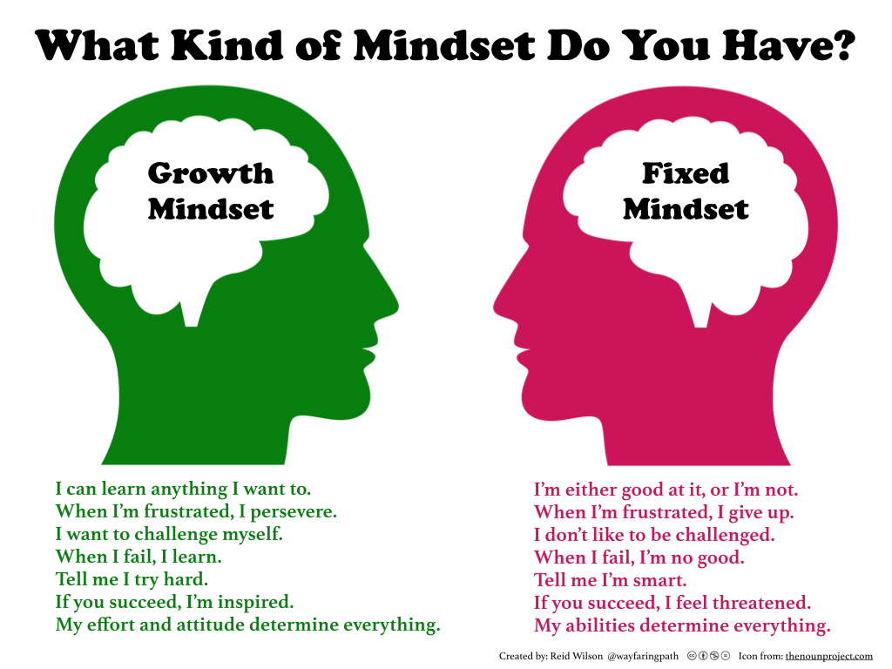
http://carriekepple.com/2015/04/24/growth-mindset-vs-fixed-mindset-which-do-you-have/

Slide 16

Engagement
…contribute to forums…appropriately – be mindful of the feelings of others
…actively participate in sessions – contribute to discussions
…respectful use of laptops
…engage with and support each other.
…phrase things professionally
…complete evaluations
…phones away unless an emergency
…be willing to work with different people
…attendance and punctuality

Slide 17



Slide 18
Attendance and Punctuality
Follow procedures for unavoidable absence - see handbook for details.
Complete online form on Moodle
Email personal tutor and Julie if you need to have an unavoidable absence
Keep mentor informed of any university absences
Medical appointments should not be arranged on university days unless an emergency
Notes:
80% attendance

Slide 19
3. Accountable, up-to-date and self-critical

Slide 20
Accountable and self-critical
Take responsibility for your own professional development (with support)
Be open to feedback
See feedback as constructive
Proactively seek support

Slide 21
Reflective practice
You will develop the skills to critically reflect throughout your training and career;
It is important to take the time to critically reflect on:
  your progress
  your classroom practice
  relevant literature and theory
  your learning from your university-based training AND
  what you observe/experience on your school placements
Notes:
More about this later…..

Slide 22
4. Professional Ethics
Notes:
Integrity is the quality of being honest and having strong moral principles; moral uprightness. It is generally a personal choice to hold oneself to consistent moral andethical standards. In ethics, integrity is regarded by many people as the honesty and truthfulness or accuracy of one's actions. (Wikipedia, the free encyclopedia
)

Slide 23
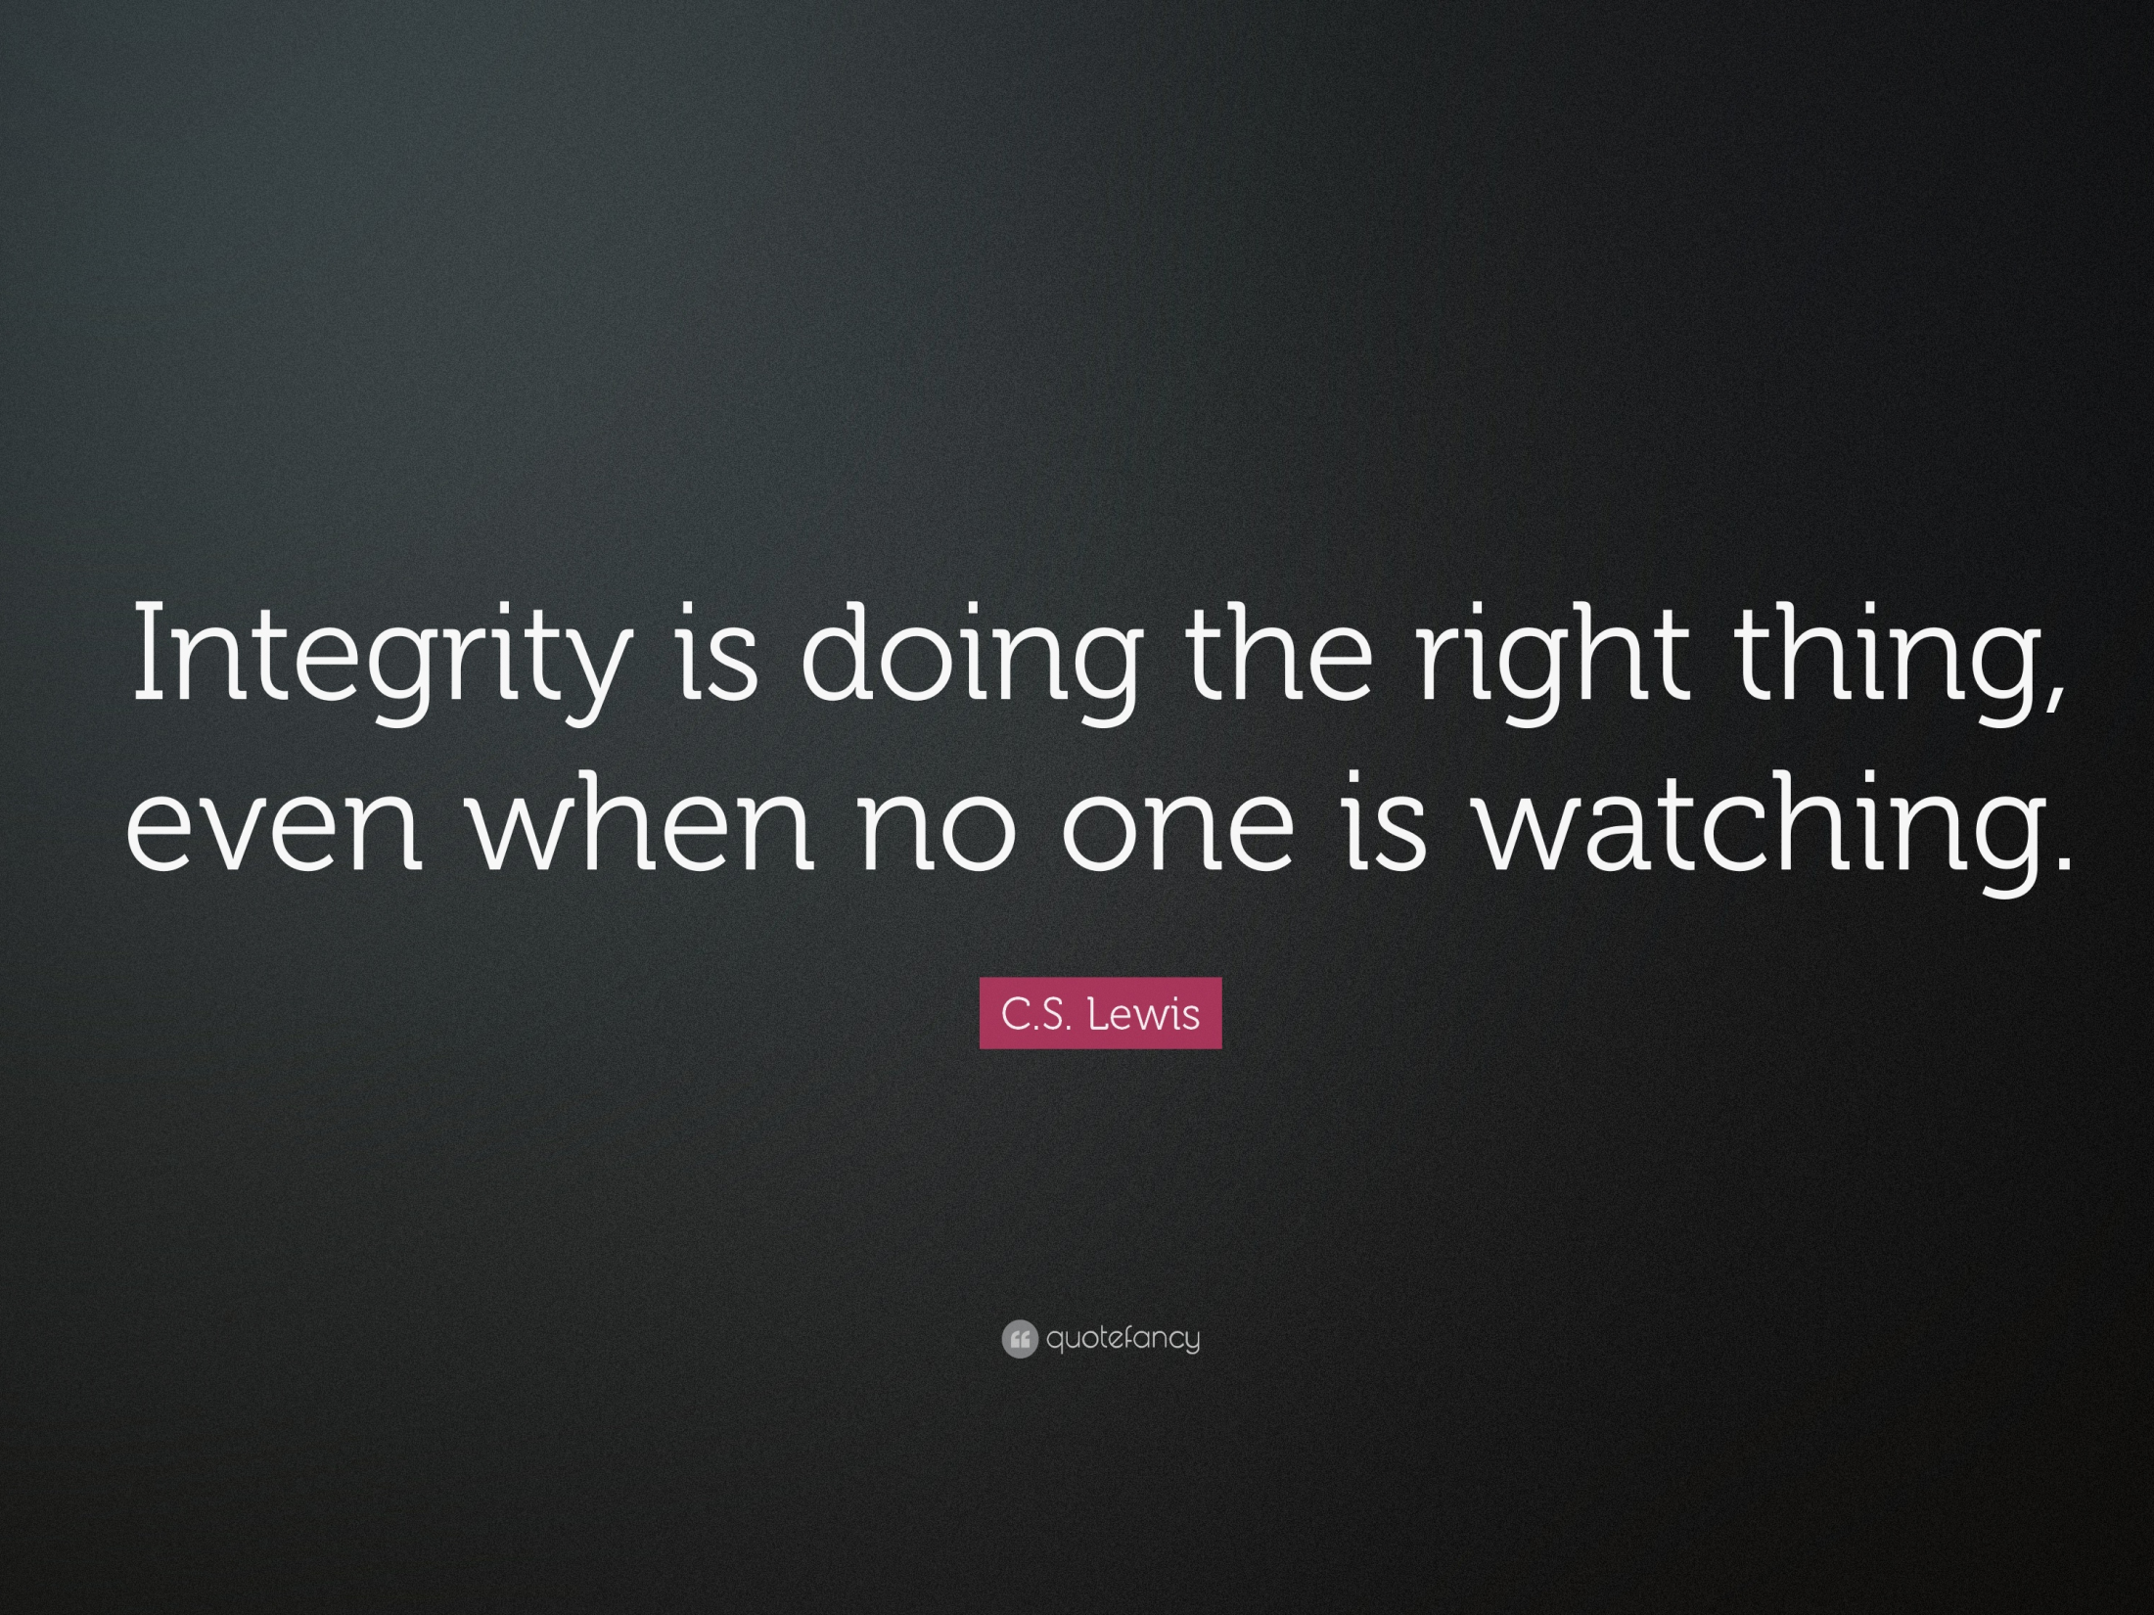

Slide 24
The need for professional wisdom
“The professions enjoy a unique and privileged place in the public eye. They are relied upon for moral probity, diligence, fairness and resolve, frequently in complicated circumstances and often in the face of conflicting demands. Professional
people are expected to do the right thing; and they are expected to do the right thing both for individuals – be they clients, customers, patients, pupils, victims of crime or enemy combatants – and for society at large.”
(Jubilee Centre, 2016)

Slide 25
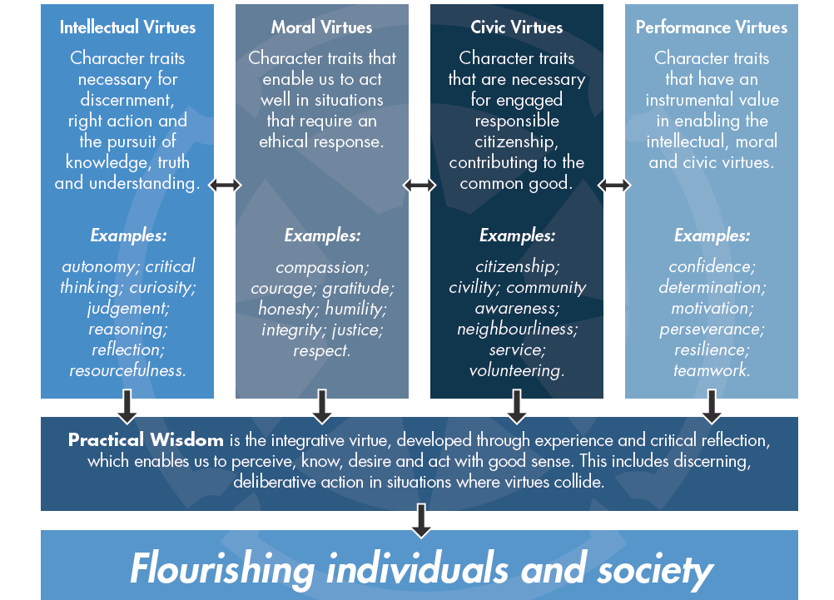
Notes:
Relate back to Jubilee Centre for Character and Virtues framework introduced in earlier workshop

Slide 26
You don’t want to become just like a load of robots that just follow procedures and protocol and rules, each situation is different and you need to develop the skills to make judgements…
Experienced Teacher – quote from Jubilee Centre for Character and Virtues (2015)
The Good Teacher report
To support the development of your professional wisdom, we will be reflecting on a range of real-life ethical dilemmas that student teachers and experienced teachers have encountered throughout your PGCE year.

Slide 27
Scenario 1 – social media
Laura is a trainee teacher who has recently started her complementary placement at a local school. She posts the following message to a private Facebook group of family and friends…

Slide 28
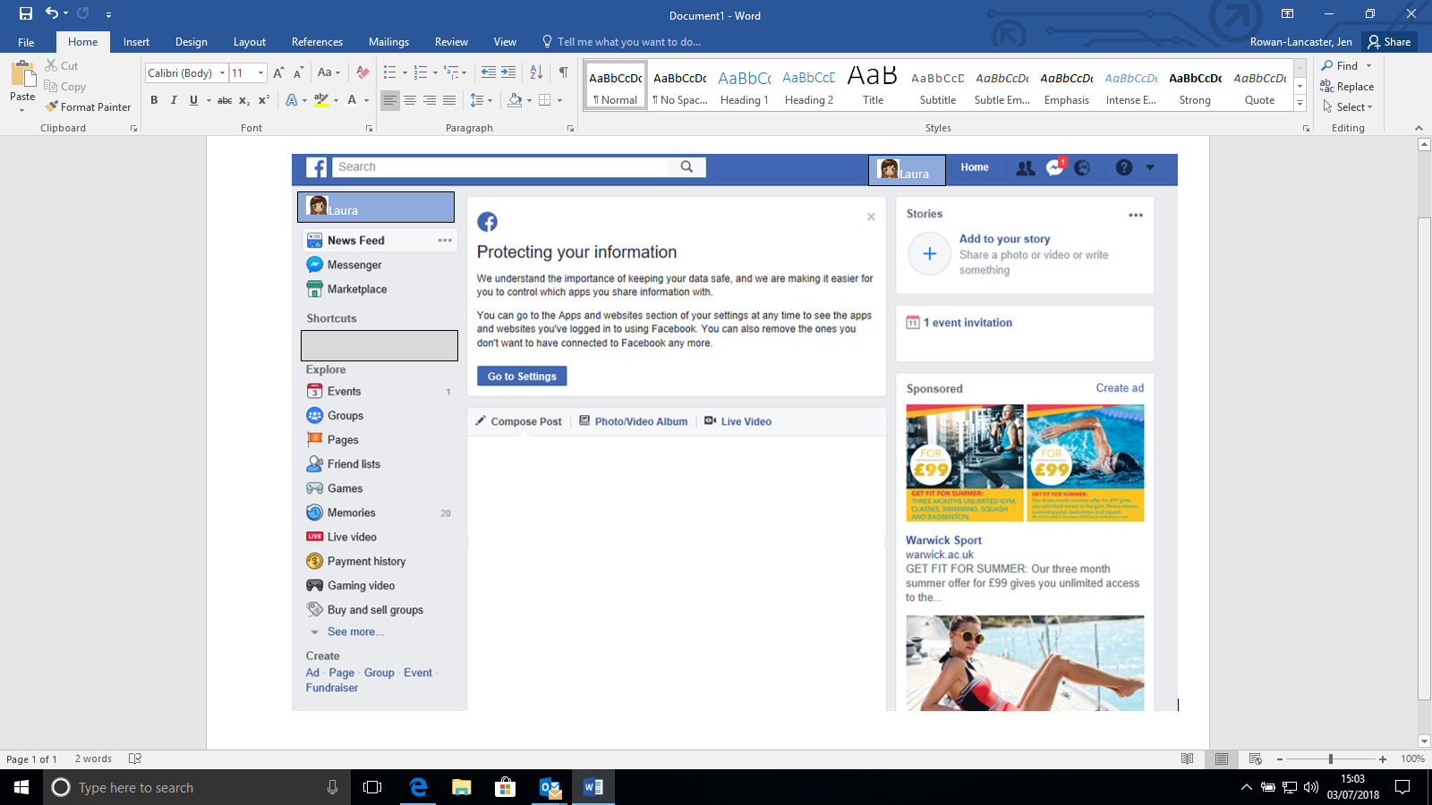


I can’t believe how much extra work I have to do at my complementary school compared to all my other teacher friends, it seems so unfair . I’m really not enjoying my time there at all and hardly anyone has made any effort to make me feel welcome. I can’t even remember what it feels like to have a social life and no one even seems to appreciate how hard I am working. Counting down the days until the end of term…

Slide 29
Systematic/Reflective Case Debriefing
Method (Adapted from Freeman, 1999)
1. Write down your first reaction to this scenario. Is this an ethical issue? Does anything need to happen about it? Why/Why not?

Slide 30
2. Identify all the stakeholders who are involved/could potentially be affected by this incident.
3. Identify the issues that make the stakeholders care about how this is resolved.

Slide 31
4. Brainstorm solutions
Generate possible solutions without judging their practicality or worthiness. There are likely to be a variety of acceptable ways to resolve a dilemma. Explore the possibilities and consider unconventional options.

Slide 32
Gauging the viewpoints of those involved…
Here are the views of 3 key stakeholders involved in this scenario.
Does finding out about their opinions affect your own views on the situation and the possible solutions you have generated?

Slide 33
I don’t see why it is a problem that I posted a comment about my school experience on Facebook. I didn’t name the school and I have changed all my privacy settings so that only my friends can see what I have written and I have even amended my name so it is harder for people to search for me. I was feeling upset after a hard week at my new school so putting a post on social media was a way of me having a bit of a moan so people I hadn’t seen for a while would understand that I was having a bit of a tough time…
Laura – School Direct PGCE student

Slide 34
The university were very disappointed to find out that Laura had made disparaging remarks about her complementary placement school on social media. Irrespective of privacy settings, students are informed right at the start of the year that they must be very cautious about what they choose to post. Embarking on a career as a teacher means that even as a trainee, students have professional responsibilities that must be upheld both in and out of school.
Prof Des Hewitt, Head of
Primary Teacher Education, CTE

Slide 35
We were very upset to be informed that Laura had written some unfavourable comments on social media about our school and the experience she has had with us this term. If she was feeling unhappy or required additional support to help her manage her workload, she should have spoken to myself, her mentor or another senior leader to enable us to rectify the situation rather than choosing to air her views on Facebook. Although she did not specifically name the school, it would not be difficult to find out where she currently was on placement so therefore her actions could have caused damage to the school’s reputation.
Mrs J. Brown, Headteacher

Slide 36

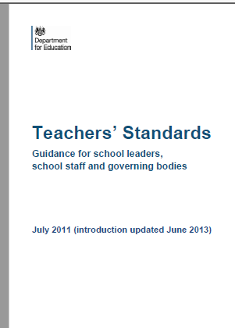
5.Taking all things into consideration, what would be the most appropriate resolution(s) that meets the professional expectations and ethical code stipulated in the Teachers’ Standards? Justify your decision.

Slide 37
Learning Points
What would you suggest Laura should have done differently?
What is the most effective way of addressing a concern that arises whilst on placement? What procedures should you follow? Who should you go to for support?
What changes do you need to make to your use of social media now you are on a professional course?
Further reading: https://neu.org.uk/advice-and-resources/trainee-advice/social-media

Slide 38
Scenario 2: Being open to feedback.

Slide 39
Scenario 2
Following lesson observation feedback, Richard became very upset and refused to sign or accept the lesson observation proforma.

Slide 40
Systematic/Reflective Case Debriefing
Method (Adapted from Freeman, 1999)
1. Write down your first reaction to this scenario. Is this an ethical issue? Does anything need to happen about it? Why/Why not?

Slide 41
2. Identify all the stakeholders who are involved/could potentially be affected by this incident.
3. Identify the issues that make the stakeholders care about how this is resolved.

Slide 42
4. Brainstorm solutions
Generate possible solutions without judging their practicality or worthiness. There are likely to be a variety of acceptable ways to resolve a dilemma. Explore the possibilities and consider unconventional options.

Slide 43
Gauging the viewpoints of those involved…
Here are the views of 3 key stakeholders involved in this scenario.
Does finding out about their opinions affect your own views on the situation and the possible solutions you have generated?

Slide 44
I spent two full days preparing for this one lesson and deserved for the grade and feedback to be much better. This is a lower grade than my previous observations and I didn’t want it in my folder because it made things look like I was going backwards.
Richard – School Direct PGCE student

Slide 45
I was shocked by Richard's reaction but did understand that he was disappointed. I think he reacted this way because he cared so much and wanted to do a great job. There was no point addressing his reaction at that time but his inability to engage in the feedback conversation did give me cause for concern.
Sally Hewitt, Link Tutor, CTE

Slide 46
5.Taking all things into consideration, what would be the most appropriate resolution(s) that meets the professional expectations and ethical code stipulated in the Teachers’ Standards? Justify your decision.
Notes:
Ask trainees to think about how they will

Slide 47
Learning Points
How could Richard have handled this situation differently?
If you find yourself in this position, what strategies could you use?
What could you do if you disagree with feedback from a colleague?
How can you get the most out of feedback?

Slide 48
Plenary
What have you learnt about professional wisdom and the importance of the professional expectations of teachers?
What are you going to take away from this session?
How will you ensure you make a positive first impression during your first week in school?
Notes:
For those that have been a TA – how will you establish yourself in the new role?

