Slide 1
Research What you Teach,
Teach What you Research the Personal and Professional Journey of a Teacher-Researcher
Prof Des Hewitt
Centre for Teacher Education
d.m.hewitt@warwick.ac.uk

Slide 2
My First day as an NQT
‘Adil,…sir
Robert,… sir
Qasar……
Where’s Qasar?
Sir he’s sitting over there, but he can’t speak English…
Ok, then…..’

Slide 3
Overview
1990 SEN
1991 MA
1992 PGCE
2004 Ph.D
2009 NTF
2011 Prof
2017 Prof

Slide 4
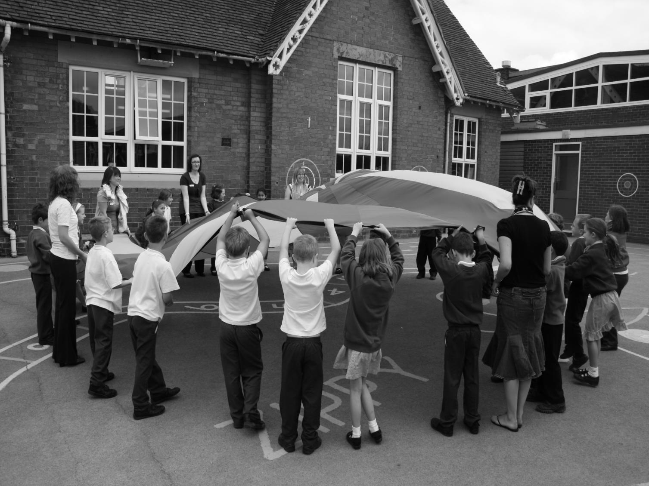


Minna Uitto
University of Oulu
Finland
‘Teacher Memories’
ECER 2011, Berlin
Prof. Des Hewitt
University of Derby
England

Slide 5
Teacher Memories
Poll
Think of a primary teacher who taught you from your own school days
What is memorable about this teacher?
  They were funny;
  They were passionate about teaching;
  They had a fantastic knowledge of teaching;
  They helped you through a difficult time
Notes:
11:45-12:00
Trainees may respond with the following:
The key factors listed in the training were: poverty, impact of poor family relationships, poor quality housing, homelessness, non-maternal care, academic pressures, bullying, poor school climate, strict behaviour policies
Trainees will probably respond that a school climate should be nurturing, supportive, good at listening, quality pastoral care etc…
Dominance, Contingent approval, Psychological control, Behavioural control (rules and consequences ), Surveillance of children
Self-concept: poor self esteem can impact on many aspects of a child’s emotional wellbeing. Poor self-esteem can also lead to poor self-efficacy whereby pupils may loss faith in their own abilities which, in a school context, could impact on their academic progress.
Supporting children in developing resilience could look like: nurturing school climate, trusting relationships with adults and peers, a school that uses a Growth Mindset approach to learning and personal wellbeing

Slide 6

“Schools and colleges (should) become research-rich environments in which to work.
It also requires that teacher researchers and the wider research community work in partnership, rather than in separate and sometimes competing universes.”

Slide 8
In a research-rich, self-improving education system:
Every learner is entitled to teaching that is informed by the latest relevant research.
Every teacher is entitled to work in a research-rich environment that supports the development of their research literacy, and offers access to facilities and resources (both on-site and online) that support sustained engagement with and in research.

Slide 9
Different ways of seeing schools
Great schools
Dictate method according to a successful formula
Teaching
Prescribed approach in a culture of performativity
Learning
As an act of compliance
Great teachers
Great learners
Great schools

Slide 10
How and what should we teach?
Prescribed curriculum: is to be likened to the totalitarian control of art
Agricultural research: conducting field trials through randomized sampling in order to maximize yield;
Teacher-Researcher: researching teaching for personal, professional and political purposes; more than just consumers of research; sometimes collaborators in research.

Slide 11
‘It is teachers who will change the world of the school by understanding it’
Stenhouse, L. and Rudduck, J., 1985. Research as a basis for teaching: Readings from the work of Lawrence Stenhouse. Heinemann

Slide 12
The Teacher-Researcher
How do pupils support their own learning through self-support learning strategies in English?
A investigation in four schools over four years through classroom observation, teacher and pupil interviews
Hewitt, D., 2008. Understanding effective learning: strategies for the classroom. McGraw-Hill Education (UK).

Slide 13
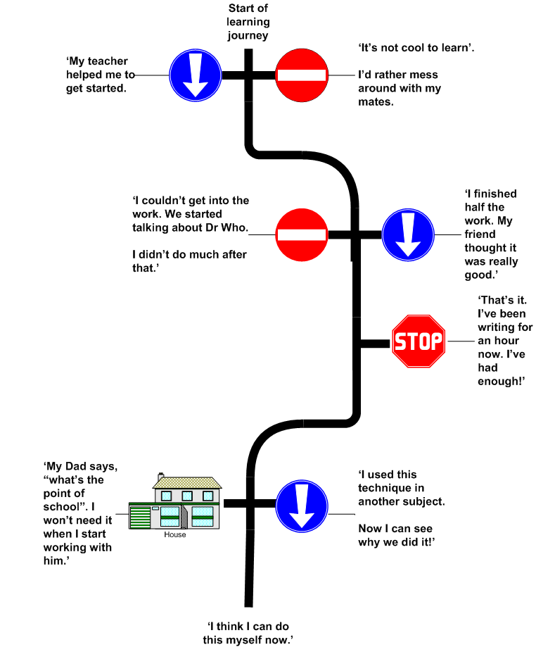
Understanding the learning journeys of your pupils
Can you spot one of your pupils?

Slide 14
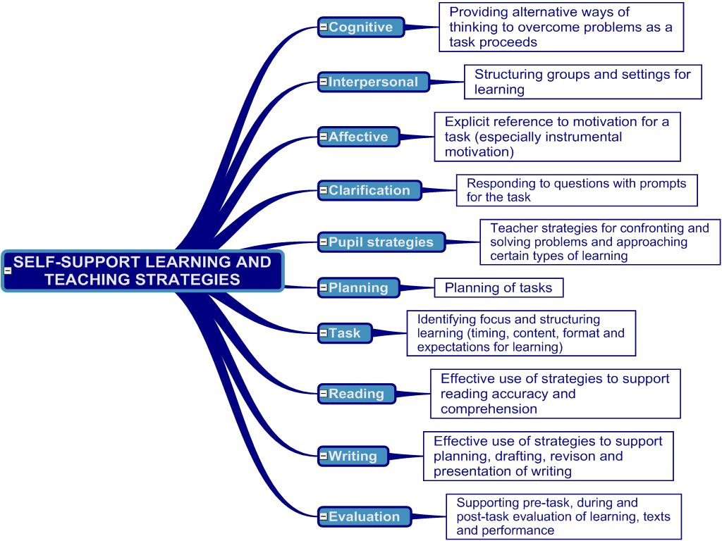

Slide 15
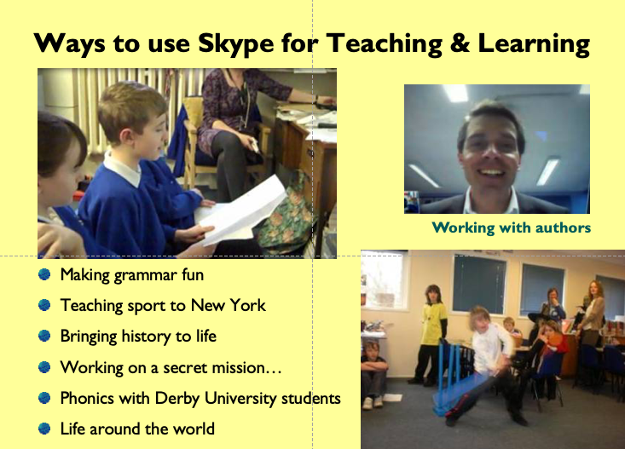
Research and the curriculum

Slide 16
The future of education
‘If we want the best for pupils, we need the best for teachers.’
‘The importance of values, motivation, agency and empowerment for all learners – including teachers’

Slide 17
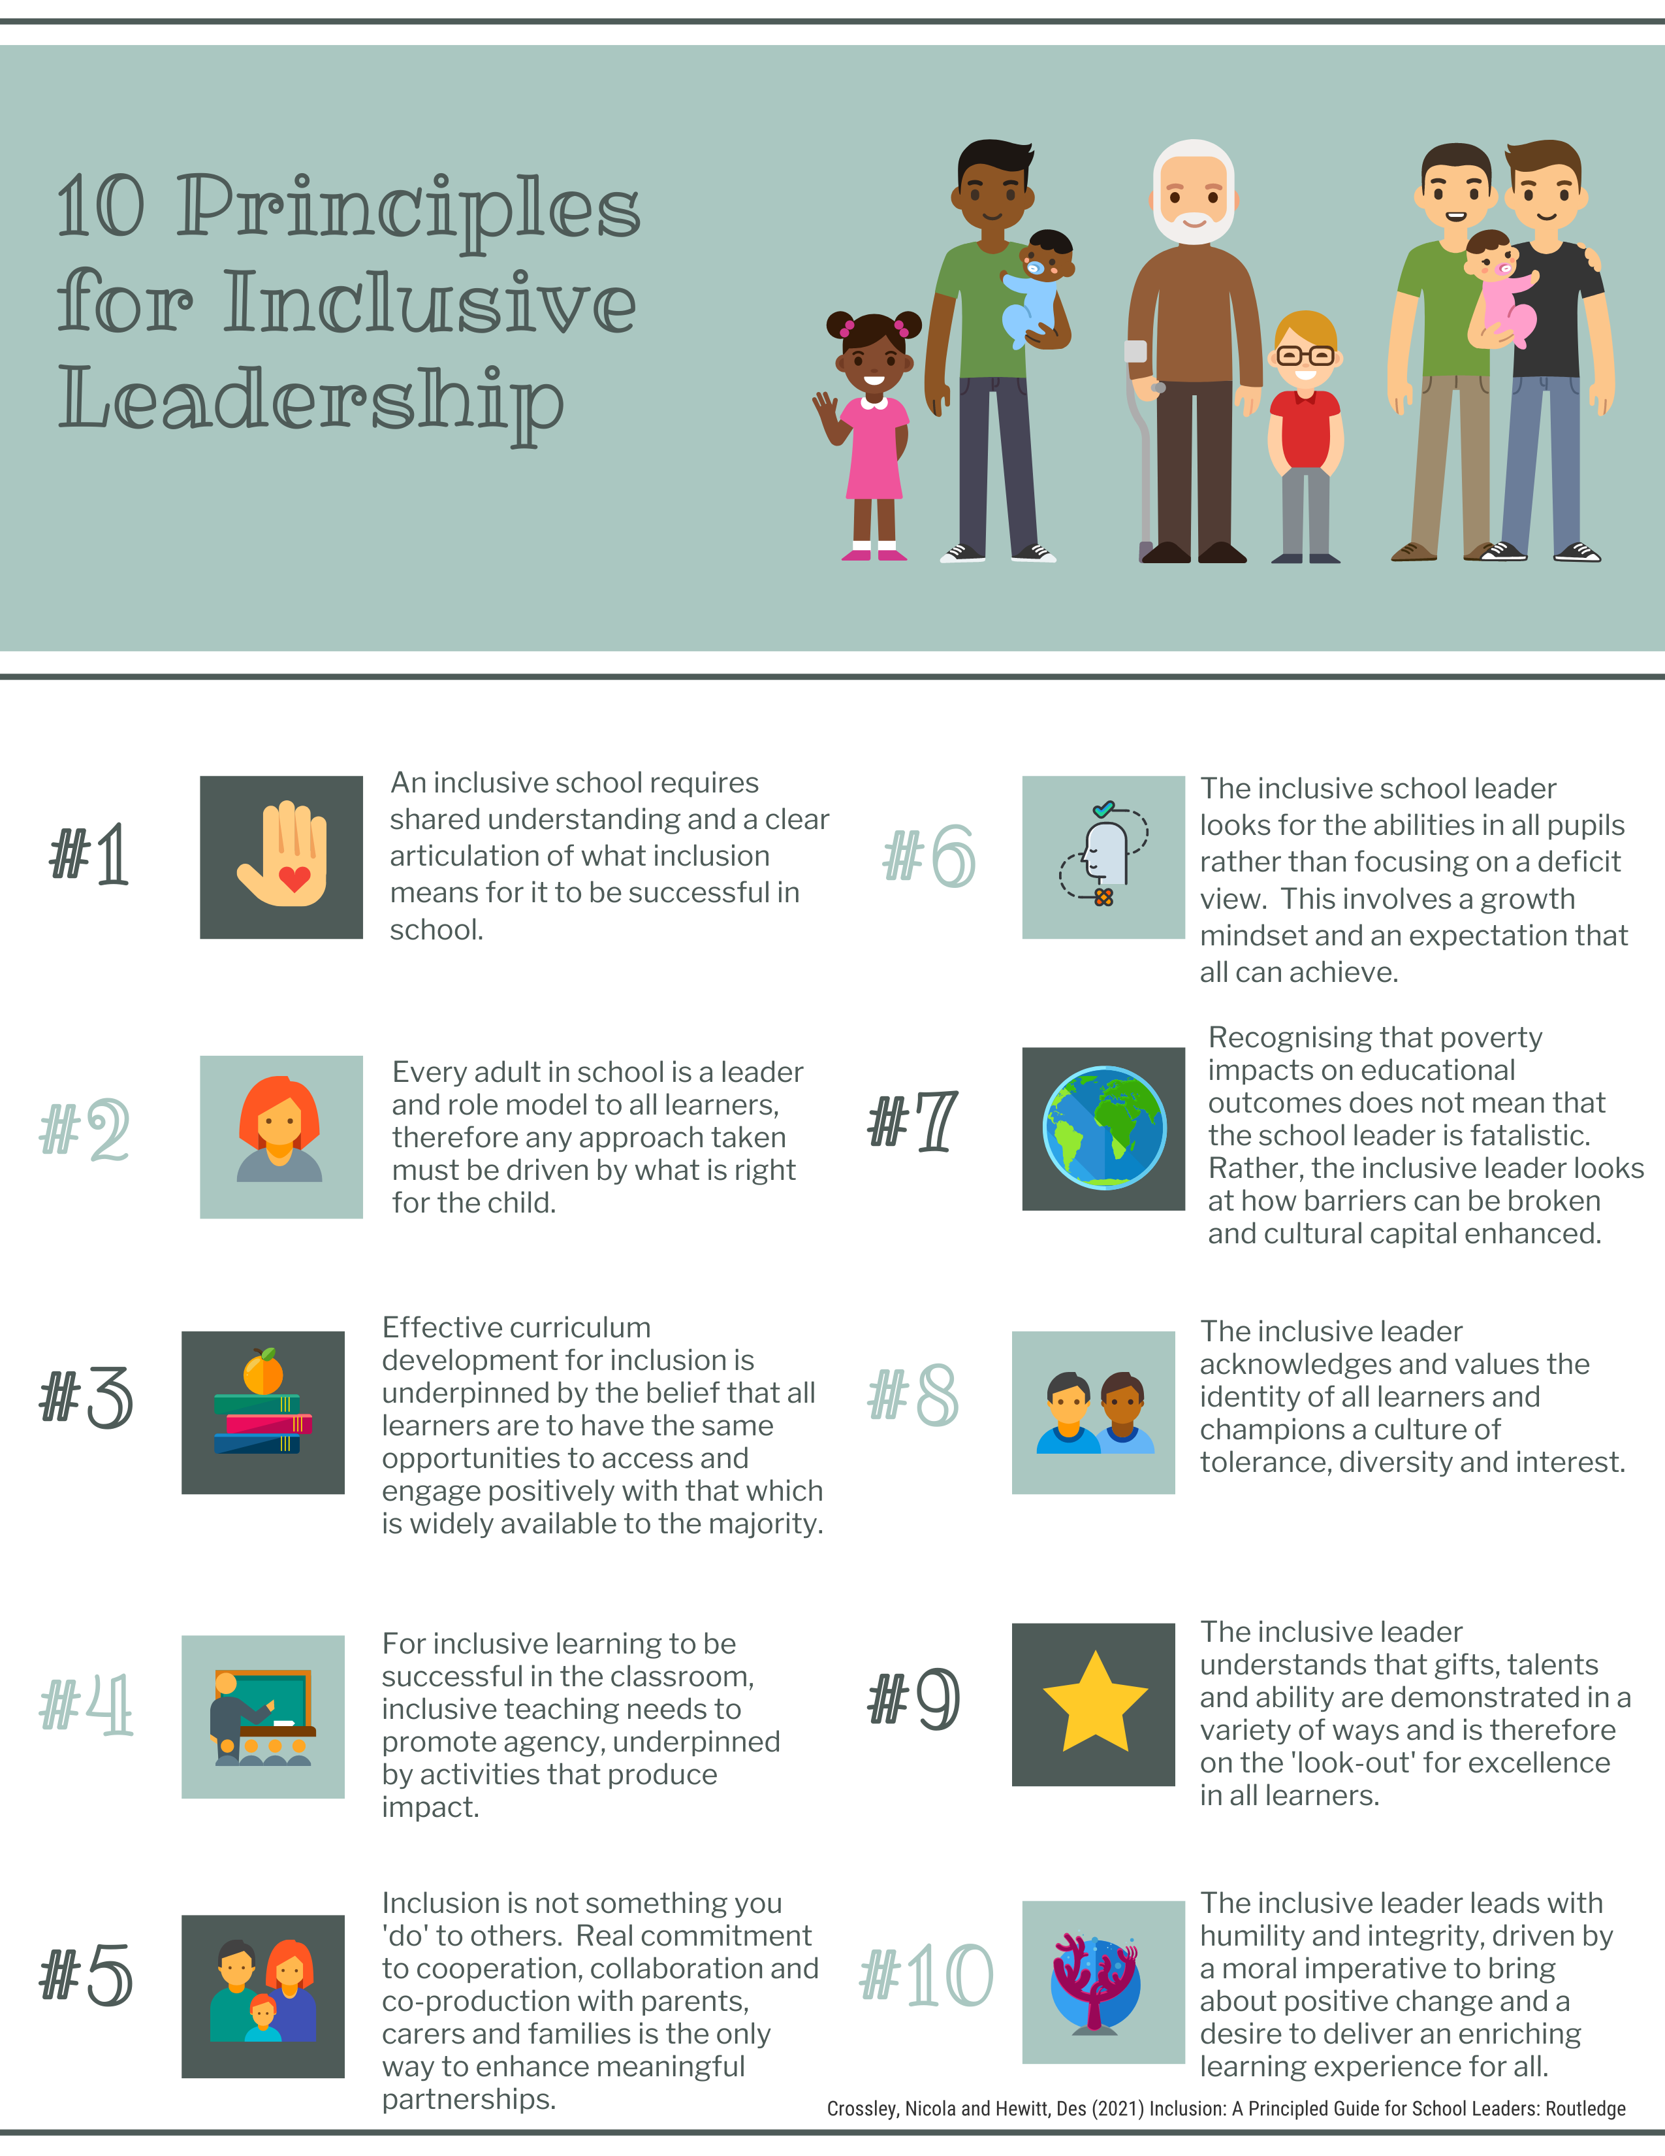

Crossley, N., & Hewitt, D. (2021)
Inclusion: A Principled guide for school leaders.
Routledge
What are the most important features for you?
10 mins discussion
When you come back into the main room, complete the poll

Slide 18
The benefits: research teaching and teach research
Cognitive: helps you learn about learning, teaching and assessment;
Social: connects you with others
Affective: recharges your batteries
Moral: allows you to realise your values
Professional: responsibility to contribute to the wider professional community
Pragmatic: research is not a ‘bolt on’ to teaching

Slide 19



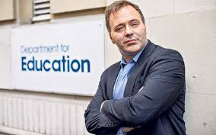




Slide 20
Who controls knowledge?
Personal and institutional
Power:
Control:
Status:
Competing networks of constantly changing influence, discourse and relevance
International: OECD, US, Aus., NZ
National: govt., EEF, Think Tanks, Charities
Regional: Teaching School Hubs, research schools, some Universities
Local: MATs, LAs

Slide 21
So what…. Next steps
Join a professional learning community (Royal College of Teaching)
Work with your local University (CTE/ Warwick!)
Join a subject association (NATE, NALDIC, NASEN)
Opportunities through your Union
Make it happen in your school/ MAT
Extend your studies: MA, Ph.D, Ed.D

Slide 22
Research
Hewitt, D. (2018): Evaluation of a School Direct ITT Hub (2018). ECER Conference, Bolzano, Italy
Hewitt, D. and McCormack, L. (2017): Teacher Well-being in Initial Teacher Education. ECER Conference, Copenhagen
Hewitt, D and Barta, S. (2013): Academic Integrity and cheating in University.
Hewitt, D. and Kimmelman, N. (2012): Learning spaces. ECER Conference, Cadiz
Hewitt, D. and Uitto, M. (2011): Teacher memories. ECER Conference, Berlin
Hewitt, D. (2010): Impact assessment in Teacher Education. ECER Conference, Helsinki
Hallam, J. & Hewitt, D. (2009): Children’s conception of art in school. Art in Education Journal
Hewitt, D & Cuthbert, K. (2006): Education and nursing: interprofessional education

Slide 23
“Growing your curiosity for learning and excitement for teaching”

