Slide 1
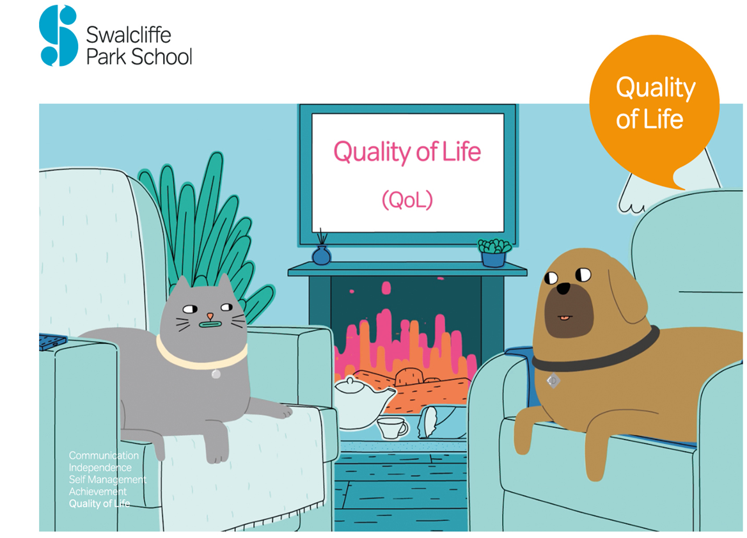
An action research
perspective from a specialist school
‘Research In Action’ Friday 10th Dec 2021

Slide 2
Kiran Hingorani
CEO Swalcliffe Park School
khingorani@swalcliffepark.co.uk
Trained as a secondary school teacher: Science
Specialist school: Cerebral Palsy
Specialist School: Speech Language and Communication
8 years out: Italy: Sri Lanka: Tanzania: Global charity
Specialist School: Autism

Slide 3
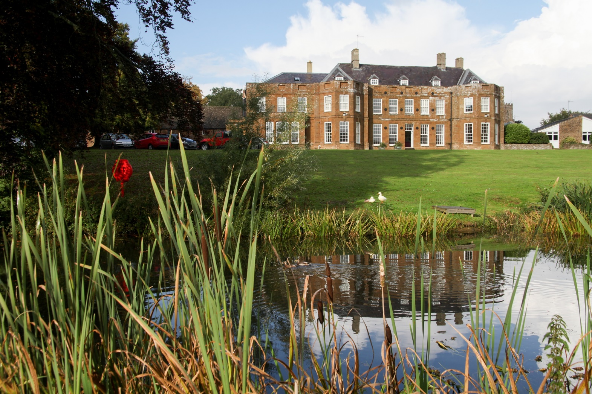
Our school

Slide 4
Boys aged 10-19 on the autism spectrum
Broadly average cognitive ability
Residential and day
20 LAs
Non-maintained Charitable Incorporated Organisation (CIO)
Our students (70)

Slide 5
Teachers: 19
Executive team: 3
Learning Support Assistants: 18
Speech and Language therapists: 3
QoL: 4
Clinical Psychologists and assistants:2+2
Occupational Therapists:3
Residential Care Workers:18
Medical: 2
Support services 17
Our staff (91)

Slide 6
Research influences on our ethos, culture and practice
Start with ‘Why’: Simon Sinek: Marketing Consultant
Highly Reliable Organisations and Schools: David Reynolds : Newcastle University
Family systems: Emily Bishop UBC, Vancouver
Quality of Life: Robert Schalock: Hastings College, Nebraska
Quality of Life in Autism (QoLA): Valsemma Eapen UNSW, Sydney

Slide 7
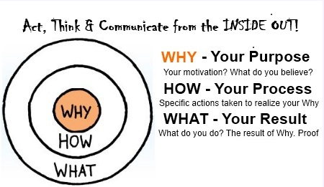
Introducing Simon, straight away…no messing about!
Simon Sinek
‘The Golden Circles’
Start with ‘Why’

Slide 8
Presentation =
Evidence
Data
Statistics
119,000,000

Slide 9

Google results for…
Why is NUFC important?

Slide 10
Presentation =
Evidence
Data
Statistics
119,000,000
387,000,000

Slide 11

Google results for….
Why is beer important?

Slide 12
119,000,000
387,000,000
8,390,000,000
Presentation =
Evidence
Data
Statistics

Slide 13

Google results for……..
Why is climate change important?

Slide 14
Keynote =
Evidence
Data
Statistics
10,730,000,000

Slide 15
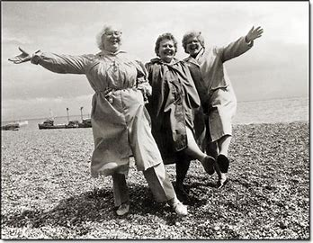
And the answer is…..
QoL!!

Slide 16

So...
‘Quality of Life’
eh?
Forbes
Sep 4, 2013,09:21am EDT
Quality Of Life: Everyone Wants It, But What Is It?
IESE Business School
Contributor
Leadership Strategy
We share global insights and research.

Slide 17
How does this fit with
‘Why’ ?
We will talk about definitions later but it’s important to set the context first…..to establish our
‘Why’?

Slide 18
Risk factors for poor QoL in students?
What it is important to live a happy life?
Parents with poor mental health
Homelessness
Looked After Children
Teenage pregnancy
Victims of abuse
Gang membership
SEND
Long term illness
LGBTQ+
Poverty
ONS lit review of recent research: Oct 2020

Slide 19
Some more numbers to consider…..
There are around 700,000 people in the UK on the autism spectrum
If you include their families, autism is part of daily life for 2.8 million people

Slide 20
If you bump into Emily over the holidays, she might want to chat about…
Emily would want us to consider her ‘family systems’ model and how…..each child needs to be considered as an interconnected part of their family…
So how do we hear family voices on their QoL?
Emily Gardiner: UBC Vancouver

Slide 21
Unfortunately, research tells us that……..
Family Voice
Families with children who have SEND report lower QoL compared to those with typically developing children
Families with autistic children report lower QoL compared to those with other SEND…
Behaviour/ isolation/exhaustion/ housing/ food/ family dynamics/ employment/ fuel/ money/ Covid/ Christmas…….

Slide 22
A helpful way to think about QoL:
If we can define it…we can measure it
Personal
Dynamic
Multi-dimensional
Environmental

Slide 23
Quality of Life Model
Here’s Robert……
Schalock
Hastings College,
Nebraska
Factor
Domain
Exemplary Indicators
Independence
Personal Development
Personal skills / adaptive behaviour
Self-Determination
Choices / decisions / autonomy / control
Social Participation
Interpersonal
Relationships
Social networks
Friendships
Social activities
Social inclusion
Involvement in community
Community roles
Rights
Equal opportunities
Respectful treatment
Legal access & due process
Well-being
Emotional well-being
Safety & security
Positive experiences / success
Physical well-being
Health & nutritional status
Recreation / physical exercise
Material well-being
Income / possessions

Slide 24
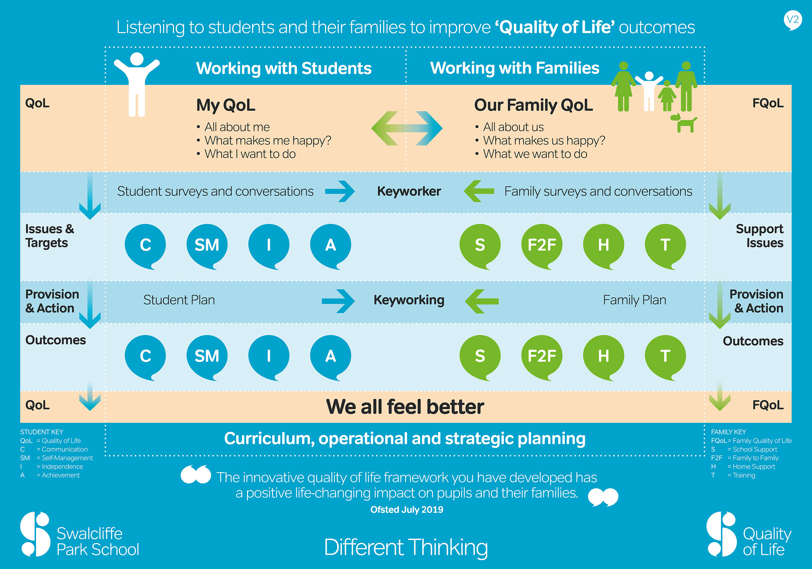
Our QoL
Framework
Why
How
What

Slide 25
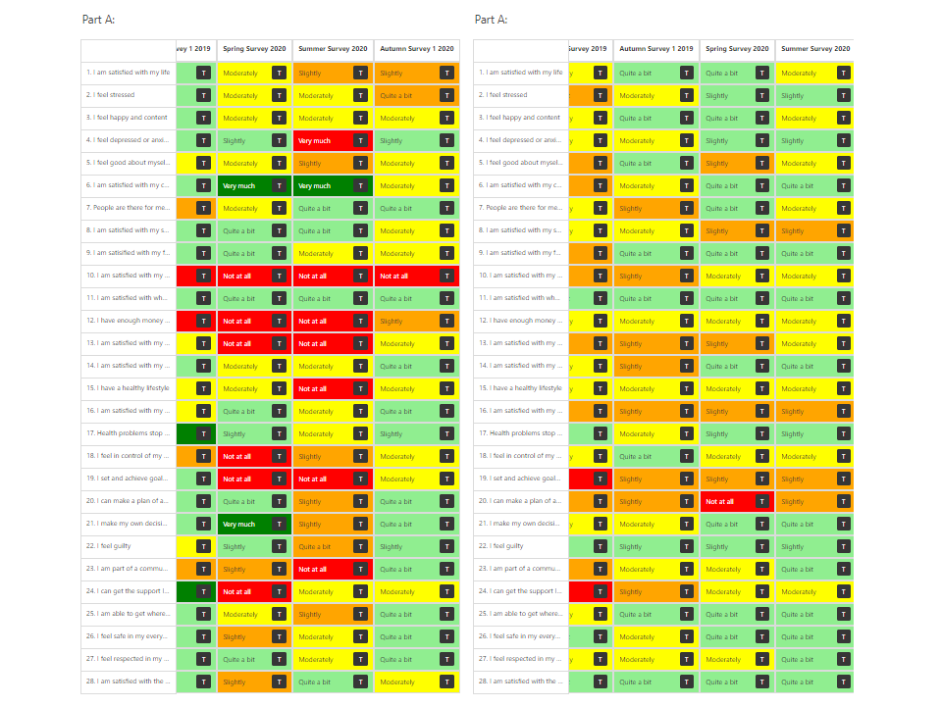

Slide 26
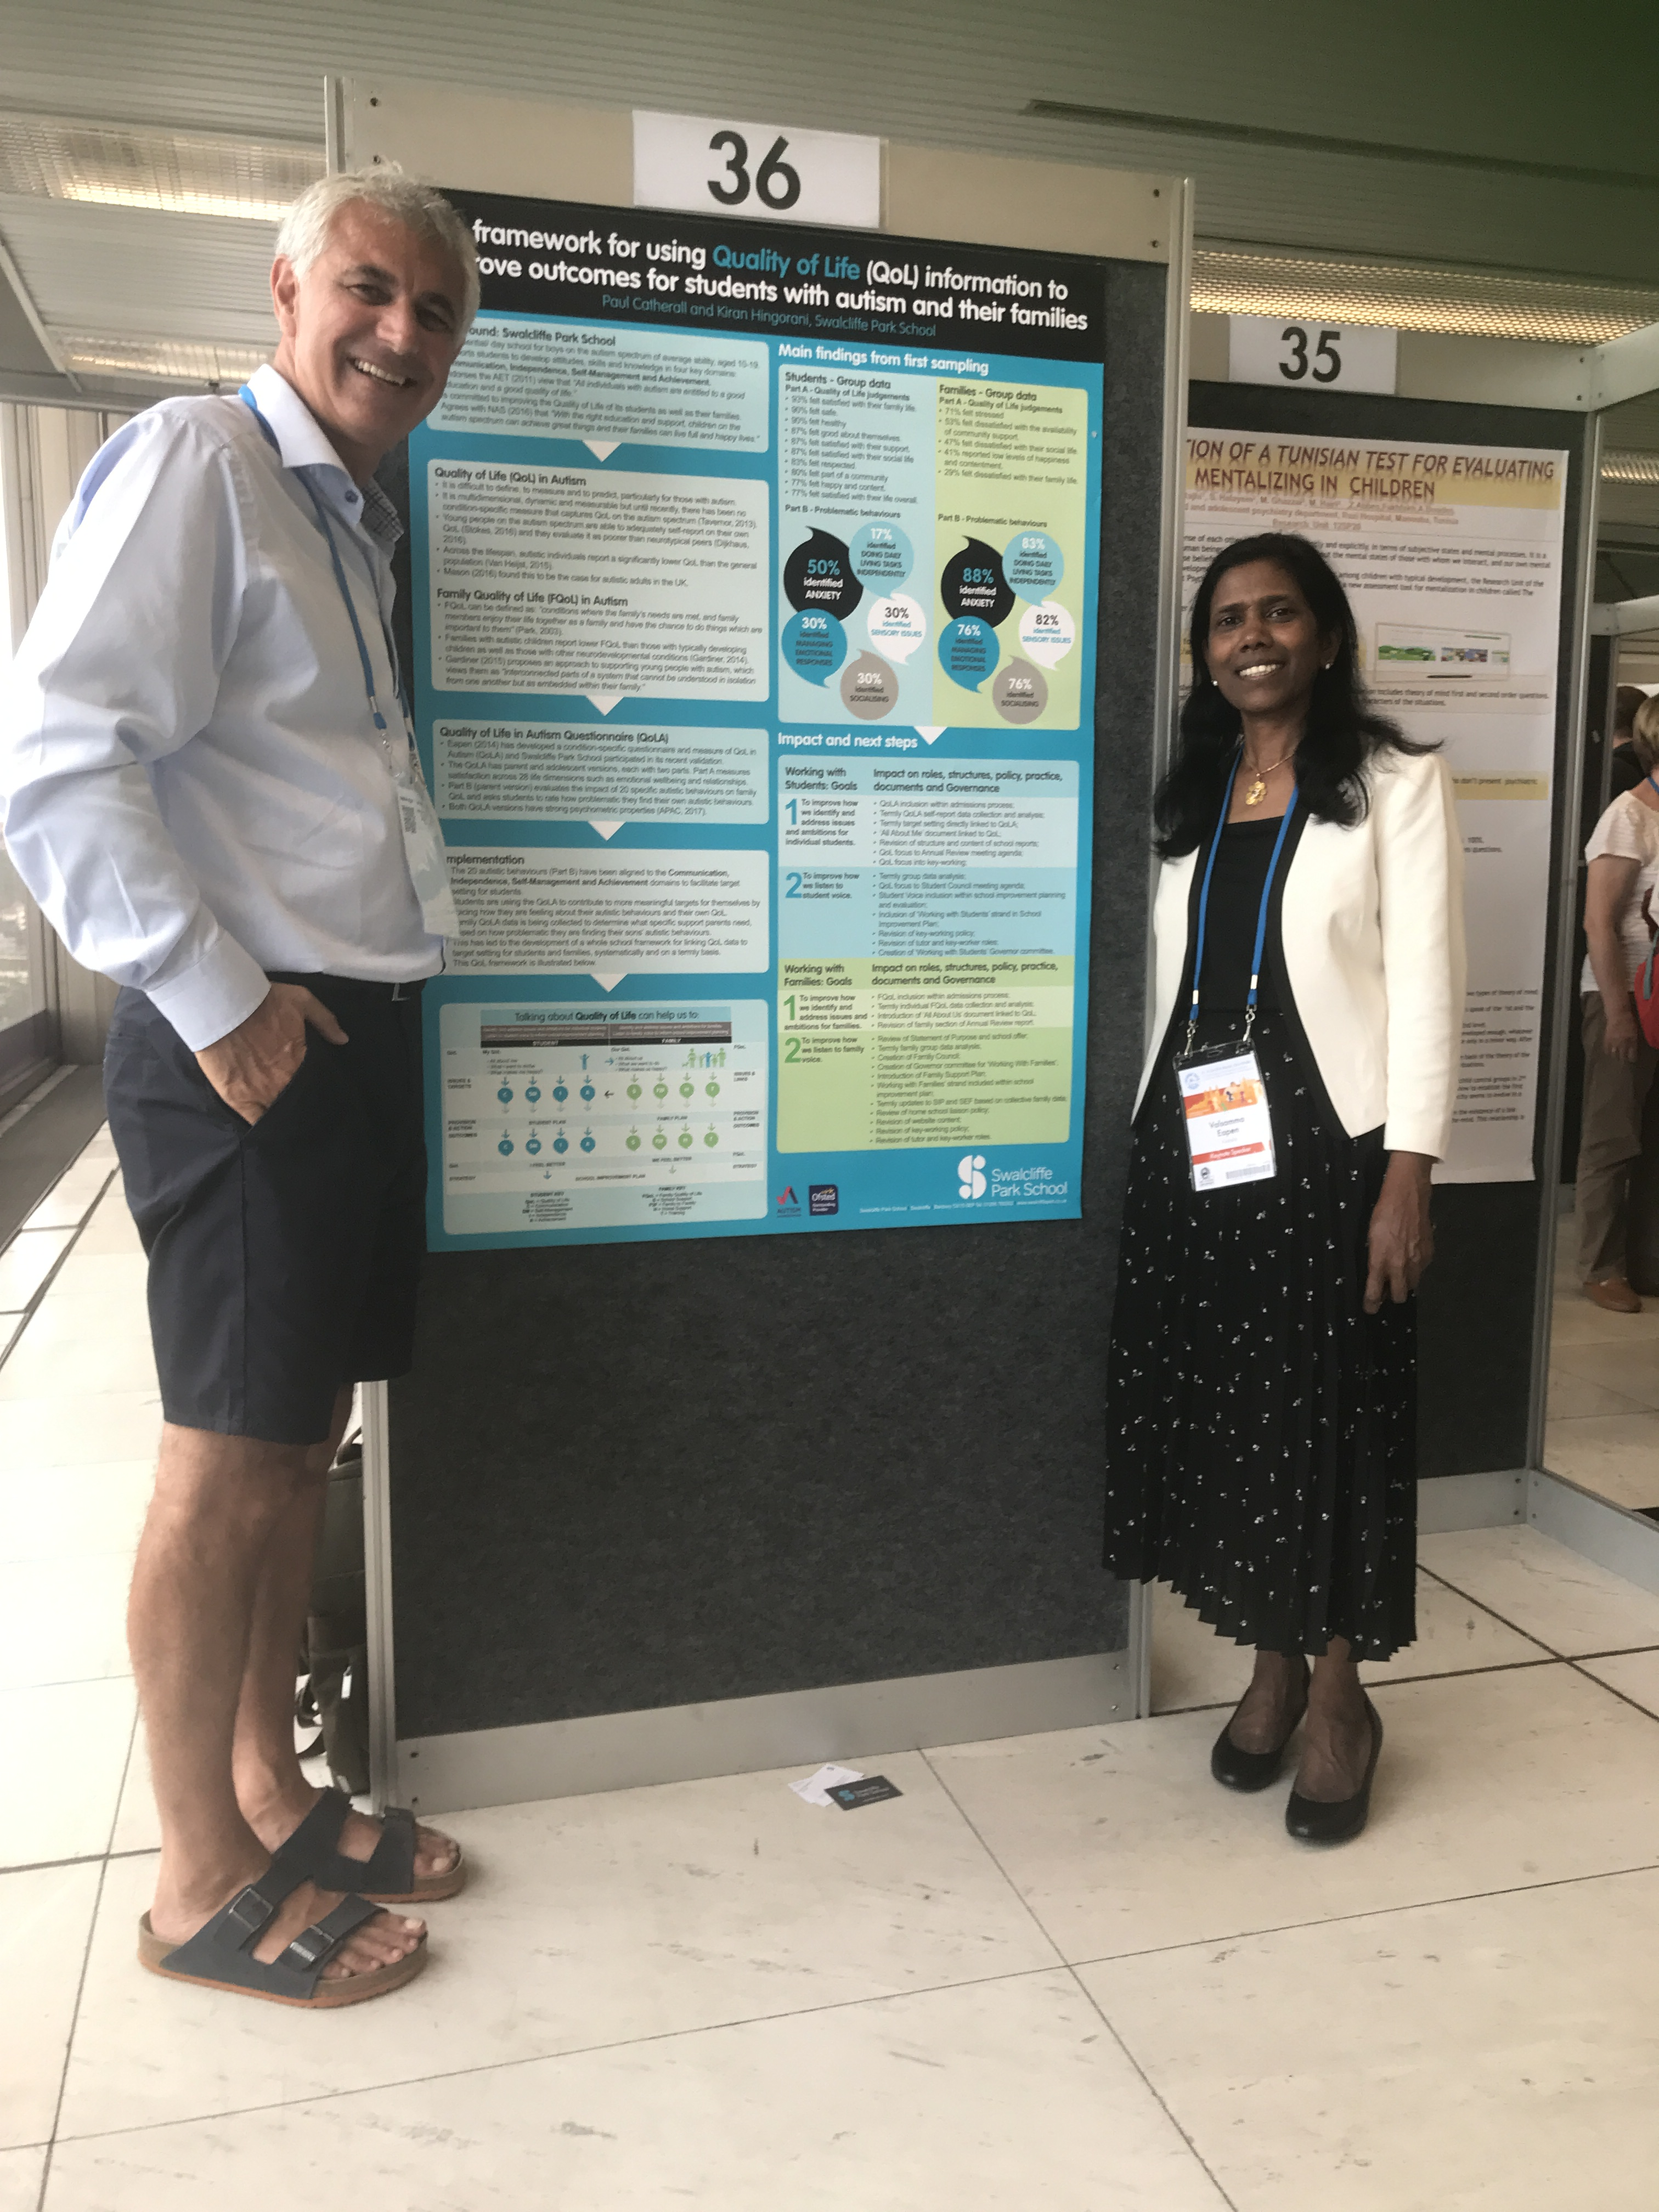
Hey look ……it’s Valsa !!
Prof Valsemma Eapen
UNSW

Slide 27

School based action research
Quality of Life
Transitions into school
Safeguarding
SaLT and English
Transitions into school

Slide 28

Keyworking is at the heart of everything we do

Slide 29

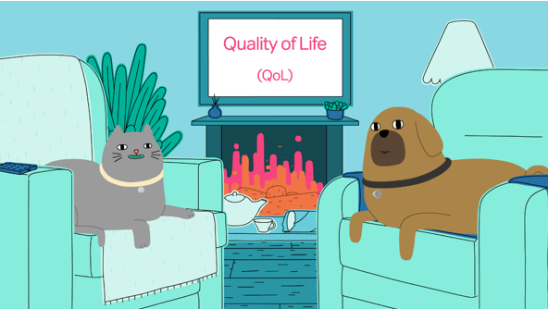
Action research around Keyworking
https://bit.ly/HowKeyworkingcanimproveyourQoL
https://bit.ly/ReflectionsonKeyworking

Slide 30
So…in conclusion…
School-based action research helps us to…
Improve aspects of practice we feel are most important
Review our curriculum, operational and strategic planning
Help us demonstrate what success looks like for individual students and their families and us a whole school

Slide 31

For more information please go to the ‘Quality of Life’ section of our website www.swalcliffepark.co.uk
or call Kiran on 07813 465922
qol@swalcliffepark.co.uk
I look forward to hearing from you
Swalcliffe Park School
Swalcliffe, Banbury
Oxfordshire OX15 5EP
01295 780302
qol@swalcliffepark.co.uk
swalcliffepark.co.uk
CIO Registered Charity No. 1173113
DofE Approved Non-Maintained No. 931/7007

