Slide 1
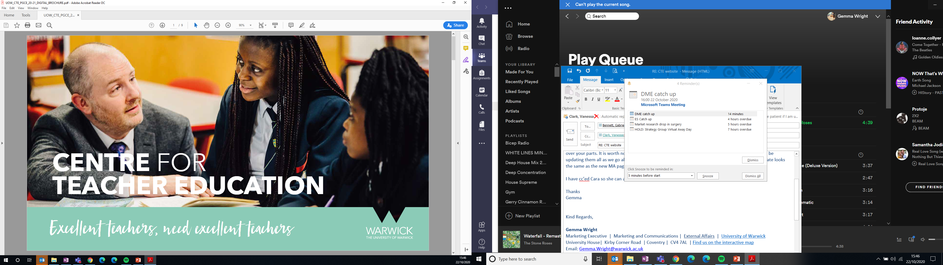
Teacher Workload and wellbeing – It’s all about YOU
Dr Deborah Roberts and Georgina Newton

Slide 2
Outline
You will engage with recent research on workload and retention and understand the resultant policy changes.
You will reflect upon national recommendations for wellbeing and workload in schools, conduct some mini-research and be empowered to frame appropriate questions that you’d ask in an interview or a mentor meeting.

Slide 3

Research Summary:
Action Research – workload reform for trainee teachers
Workload reform in schools
Review of trainee workload in CTE (Uni and School)
Research: longitudinal focus groups to evaluate and listen
Notes:
DR talk through own research

Slide 4
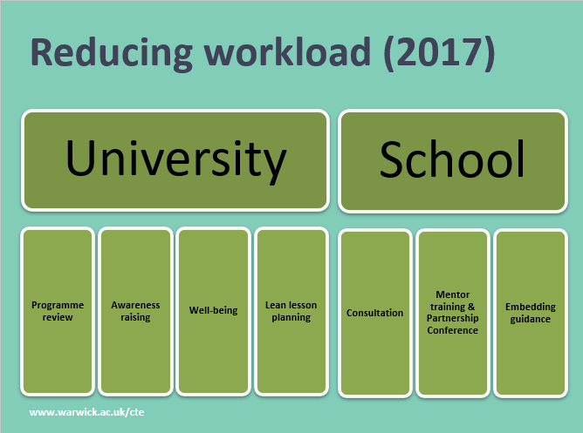
Research Summary:
Action Research – workload reform for trainee teachers
Workload reform in schools
Review of trainee workload in CTE (Uni and School)
Research: longitudinal focus groups to evaluate and listen
Notes:
DR talk through own research

Slide 5
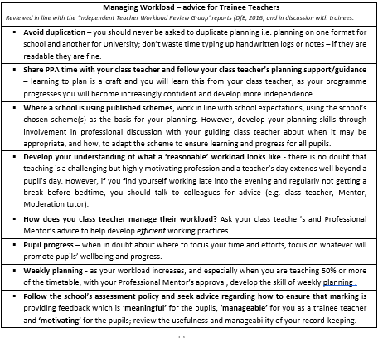
Research Summary:
Action Research – workload reform for trainee teachers
Workload reform in schools
Review of trainee workload in CTE (Uni and School)
Research: longitudinal focus groups to evaluate and listen
Notes:
DR talk through own research

Slide 6
Research Summary:
Why do teachers quit and what could we do to keep them?
Decisions are made in the "affective" domain, so what it feels like to be a teacher is very important
Appreciation, relationships with colleagues and workload considerations are key
When teachers know they are trusted and valued they enjoy the job more and are more likely to stay
Notes:
GN talk through own research
Healthy and engaged employees, together with a strong workplace culture, are the secret sauce for business success.

Slide 7
Research Summary:
Why do teachers quit and what could we do to keep them?
Decisions are made in the "affective" domain, so what it feels like to be a teacher is very important
Appreciation, relationships with colleagues and workload considerations are key
When teachers know they are trusted and valued they enjoy the job more and are more likely to stay

Slide 8
Research Summary:
Why do teachers quit and what could we do to keep them?
Decisions are made in the "affective" domain, so what it feels like to be a teacher is very important
Appreciation, relationships with colleagues and workload considerations are key
When teachers know they are trusted and valued they enjoy the job more and are more likely to stay

Slide 9
Research Summary:
Why do teachers quit and what could we do to keep them?
Decisions are made in the "affective" domain, so what it feels like to be a teacher is very important
Appreciation, relationships with colleagues and workload considerations are key
When teachers know they are trusted and valued they enjoy the job more and are more likely to stay

Slide 10

Research Summary:
Why do teachers quit and what could we do to keep them?
Decisions are made in the "affective" domain, so what it feels like to be a teacher is very important
Appreciation, relationships with colleagues and workload considerations are key
When teachers know they are trusted and valued they enjoy the job more and are more likely to stay

Slide 11



Progress so far
Notes:
GN
Have you seen this before? Has school signed up?
What are the key points for you?
Poll…. GN organise in BBC to find out trainees’ opinions on what’s important.
What can the DfE do to support wellbeing?

Slide 12

Progress so far
Notes:
And it’s not just DfE
What should Ofsted do?

Slide 13

Progress so far

Slide 14

Research in Action
In groups of 3
What have you experienced?
  How has your wellbeing been supported on placement?
    Flexibility?
    Agency?
    Workload?
    Behaviour culture?
    Communication?
    Measuring wellbeing?
    Understanding your own wellbeing?
What will you be looking for in your new workplace?
  What key points are important to discuss?
  How would you plan to talk to your mentor about this? What questions would you ask?
Can you frame 2 questions that you’d ask in an interview?
Notes:
DR:
Random Groups
10/15 mins: 3 mins each to talk ininterrupted
Then 3 mins to monitor Stormboard
https://stormboard.com/invite/1660008/soar2493

Slide 15
Reflections and questions
Notes:
What are reasonable expectations of workload and working hours in a professional life?

