Slide 1
E-safety – for teachers
Mark Harris

Slide 2
Teachers’ Standards
Preamble
Teachers make the education of their pupils their first concern, and are accountable for achieving the highest possible standards in work and conduct. Teachers act with honesty and integrity; have strong subject knowledge, keep their knowledge and skills as teachers up-to-date and are self-critical; forge positive professional relationships; and work with parents in the best interests of their pupils.

Slide 3
Part Two
A teacher is expected to demonstrate consistently high standards of personal and professional conduct.
• Teachers uphold public trust in the profession and maintain high standards of ethics and behaviour, within and outside school, by:
  treating pupils with dignity, building relationships rooted in mutual respect, and at all times observing proper boundaries appropriate to a teacher’s professional position
  having regard for the need to safeguard pupils’ well-being, in accordance with statutory provisions
• Teachers must have proper and professional regard for the ethos, policies and practices of the school in which they teach, and maintain high standards in their own attendance and punctuality.
• Teachers must have an understanding of, and always act within, the statutory frameworks which set out their professional duties and responsibilities.

Slide 4
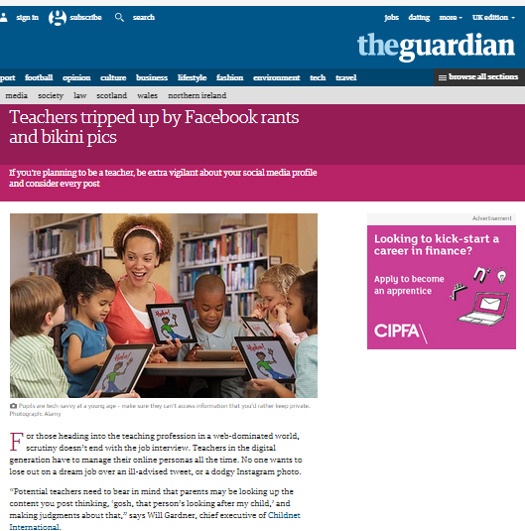

Slide 5
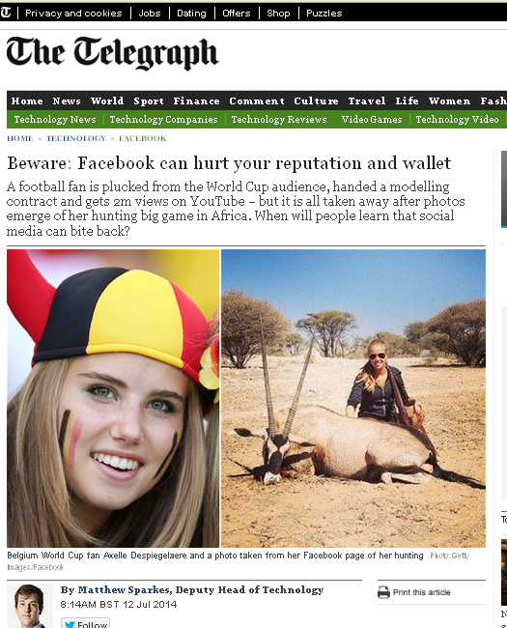

Slide 6
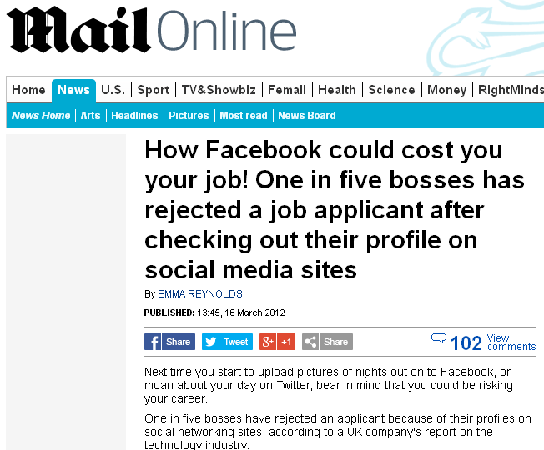

Slide 7
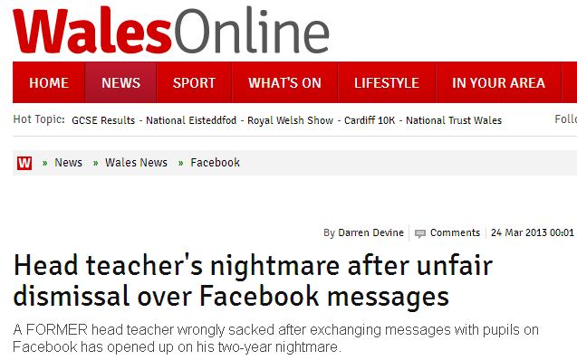

Slide 8
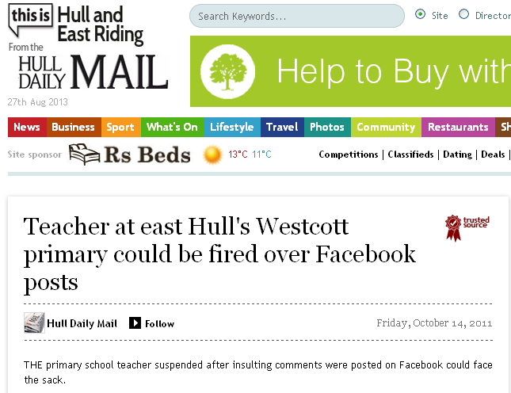

Slide 9
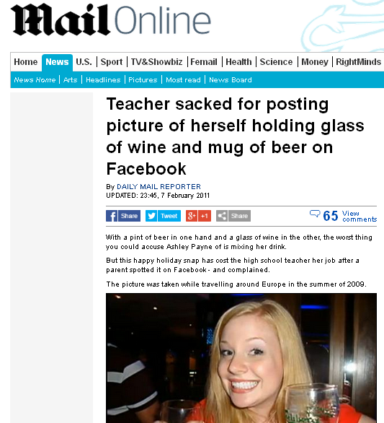

Slide 10
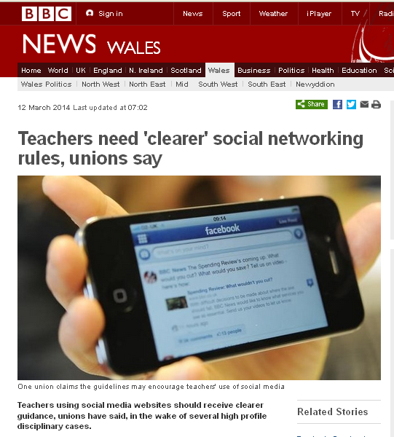

Slide 11
UK Safer Internet Centre
“While there are instances of pupils setting up fake social media accounts in a teacher’s name, the majority of problems are the result of teaching staff themselves behaving inappropriately. More often than not it’s a failure of basic common sense on the part of professionals.”

Slide 12
Protect children.
Protect yourself.

Slide 13

Protect yourself - now
#protectyourself
Are your privacy settings adequate?
Choose an appropriate profile picture.
Make sure your photos and details are only for the consumption of people you trust.
Regularly check your profile to ensure it is free from inappropriate comments and/or images.
Check any information you’ve posted - make sure that information can’t be used against you.
‘Untag’ yourself from photos on friends’ pages if they could be considered inappropriate.

Slide 14
How can I continue to protect my professional reputation?
Always think before making any posts, status updates or having discussions regarding the school, its staff, pupils or parents.
Comments made public could be taken out of context and could be very damaging.
Think about the language you use – abrupt or inappropriate comments, even if they are made in jest, may lead to complaints.
Anything that is put online is potentially public and permanent.
Childnet International (2011)
Notes:
If in doubt, don't put it up!
Do not post anything that could be construed as defamatory or discriminatory against others.
Employers increasingly use social media to look at candidates before or after a job interview. If you would not want your employer to see something, take it down!
Any post can be potentially quoted by the media
Do not get involved in online arguments - they can escalate quickly!

Slide 15
Remember,
...you can tell what content relates to you, and what is about someone else with the same name, but other people can’t necessarily do so.
Your strategy is therefore two-fold:
To remove or hide anything unprofessional or off-putting that does relate to you.
To make clear what doesn’t relate to you.

Slide 16
Suggestion ...
Remove your family name from your social media profiles, use a middle name or one you’ve always wanted!

Slide 17



Protect yourself – on placement
#protectyourself
Be proactive* - familiarize yourself with the E-Safety, Whistle-blowing and Acceptable Use policies.
Pupils will be curious about a new teacher and may well Google you or try to find you on Facebook.
Protect network passwords.
Set your tweets to private so you can control who follows you.
Google yourself – you may be surprised!
Be aware of your digital footprint.
*TS Part Two - professional regard for the ethos, policies and practices of the school
Notes:
Digital footprint: Retweeting can be seen as a sign of endorsement. This may be inappropriate in some circumstances
When joining being added to a Facebook group, always check whether it is Public, Closed (where anyone can see the members of the group but not the discussion) or Secret (where neither the members or the discussion are visible)
Twitter is a much more public forum than Facebook.

Slide 18
Don’t share any contact details with pupils or parents . . .
for ANY reason.
Be VERY cautious of being ‘friends’ with staff.

Slide 19
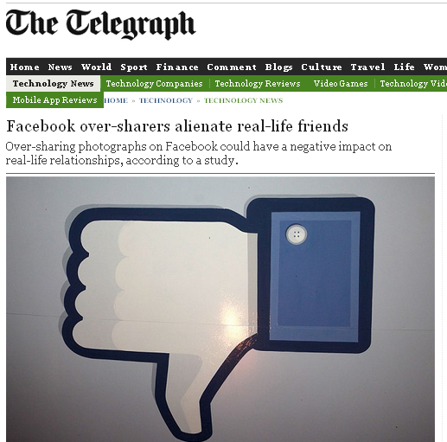
Facebook group
Be considerate;
  Of pupils and parents.
  Of your peers;
  Of staff;
Be careful.

Slide 20
Useful links
Social Networking: A guide for Trainee Teachers and NQTs
http://www.childnet.com/ufiles/Social-networking.pdf
UK Safer Internet Centre
http://www.saferinternet.org.uk/
CEOP ThinkUknow
https://www.thinkuknow.co.uk/
New Teachers TES
http://newteachers.tes.co.uk/content/dont-let-facebook-harm-your-career
NASUWT
http://www.nasuwt.org.uk/InformationandAdvice/Professionalissues/SocialNetworking/NASUWT_007513
Child Exploitation and Online Protection - NCA
http://ceop.police.uk/

Slide 21
Maths Pre-Task
In preparation for the maths lecture on Tuesday 3rd September, please watch a short TedX talk by Dan Finkel on the ‘Five Principles of Extraordinary Maths Teaching’.

