Slide 1
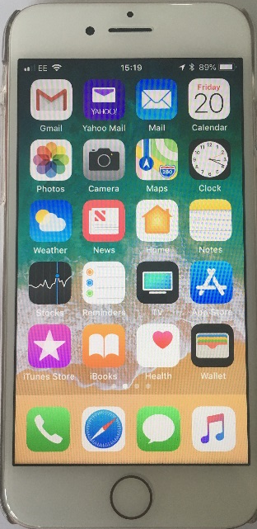
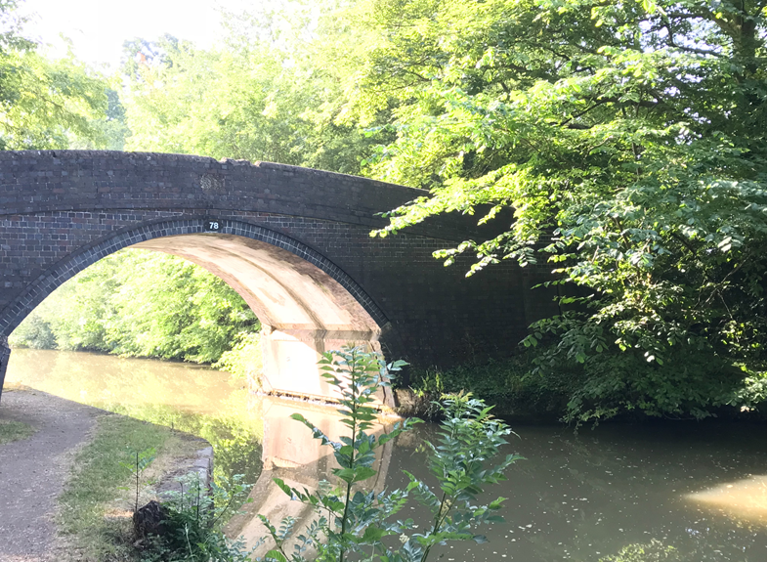
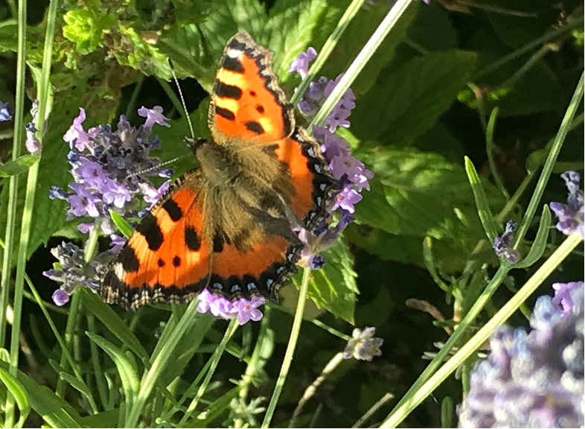
Introduction to Science
Sally Spicer
2019/20
S.L.Spicer@warwick.ac.uk

Slide 2
Research
Archer L. Osborne, J. Dewitt, J., Dillon, J., Wong, B. and Willis, B. (2013) ASPIRES Young people and career aspirations 10-14. London: King’s College London http://www.kcl.ac.uk/sspp/departments/education/research/aspires/aspires-final-report-december-2013.pdf
DeWitt, J., Archer, L. & Mau, A. (2016) Dimensions of science capital: exploring its potential for understanding students’ science participation; International Journal of Science Education; 38 (16); 2431-2449
Noble, M-A. & Tippett, C.D. (2015) Dr. Blasto: Five to six
year-old students’ portrayal of a fictional science villain JES; 9: 10-22
Ofsted (2015) Improving science with the Lab 13 project: Irchester Community Primary

Slide 3
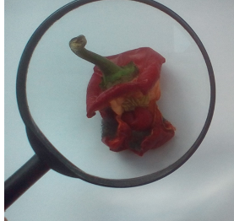
Overview of Course Aims
  Provide knowledge and understanding for starting to teach EY/National Curriculum science safely, competently and confidently
  Prepare you to become caring, imaginative, proficient, and effective teachers of science
  Develop the teaching skills to be able to plan, teach, manage and assess science in a primary /EY setting
  Develop your own knowledge and understanding of important scientific ideas
  To develop your critical thinking and reflective practitioner skills

Slide 4
Teachers’ Standards
TS 1 – 8 all apply to teaching science, a core subject
TS 3 Demonstrate good subject and curriculum knowledge
have a secure knowledge of the relevant subject(s) and curriculum areas, foster and maintain pupils’ interest in the subject … address misunderstandings
demonstrate a critical understanding of developments in the subject and curriculum areas, and promote the value of scholarship
demonstrate an understanding of and take responsibility for promoting high standards of literacy, articulacy and the correct use of standard English, whatever the teacher’s specialist subject

Slide 5
Session Objectives
Trainees should:
Have an overview of the EY framework and primary NC for science in England
Consider some cross curricular links
Understand the term ‘science capital’
Be aware of the big ideas of science
Know the importance of teaching science

Slide 6

What is a Scientist?
What does a scientist look like?
You have 2 minutes to draw your version of a scientist at work

Slide 7
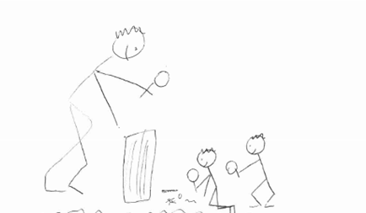
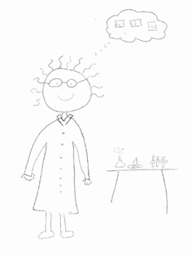
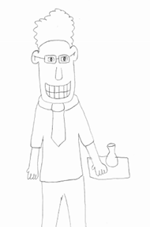
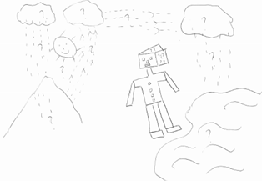

Previous Trainees’ Views
Brian Cartwright (former national lead for science with Ofsted) 21.11.13

Slide 8
Science Villain!
Noble, M-A. & Tippett, C.D. JES(9) Summer 2015
http://www.ase.org.uk/journals/
Journal of Emergent Science

Slide 9
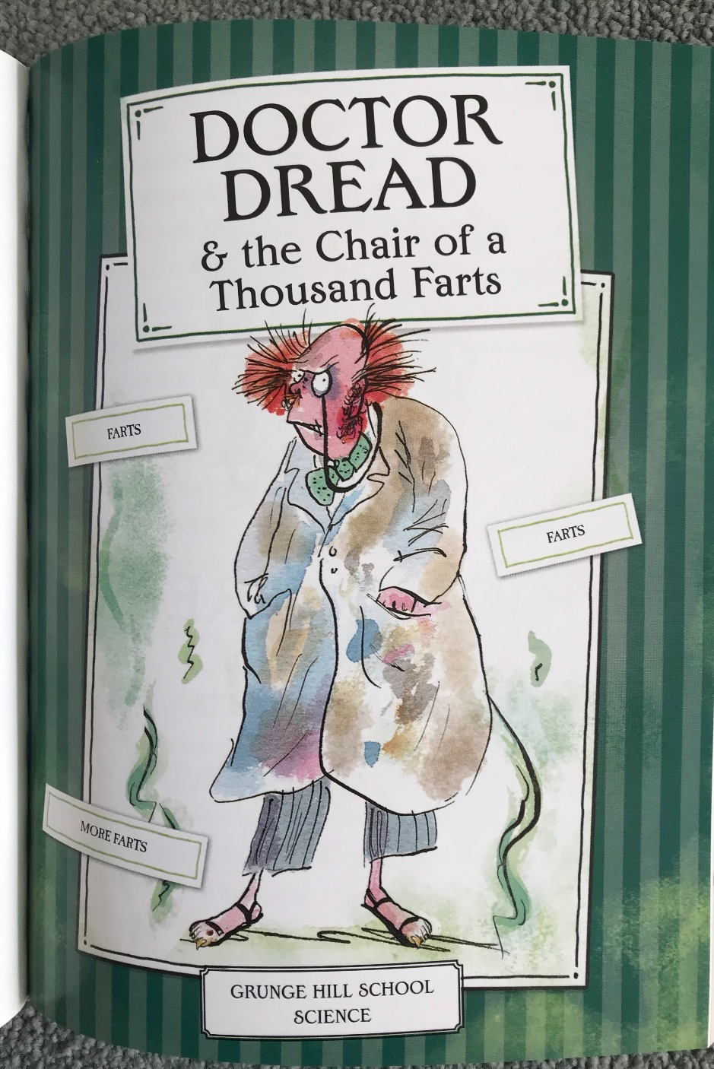


Slide 10
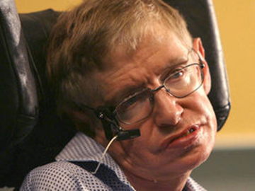
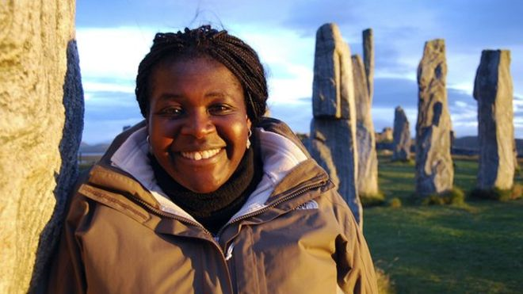
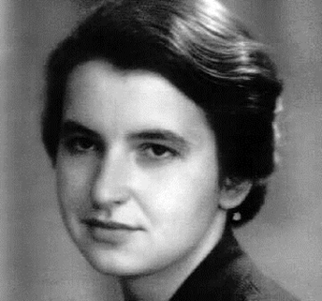
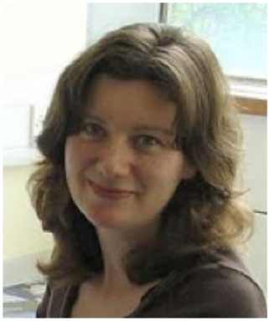
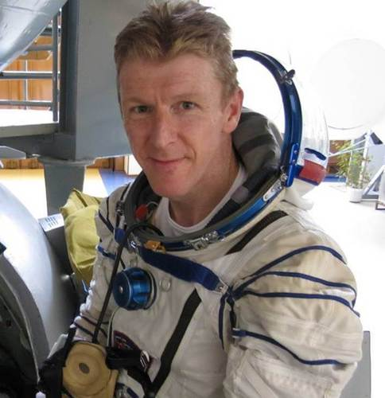
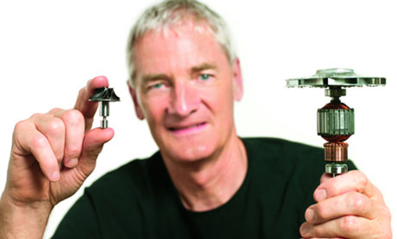
Some famous (or not) scientists
Potential role models

Slide 11
Aims of primary / early science
‘… for understanding the world... Science has changed our lives and is vital to the world’s future prosperity …’ (NC 2014)
Make sense of the world around us Equip ourselves with vital life skills .. Make informed decisions as scientifically literate members of society (Harlen, 2011 cited in ASE Guide to Primary Science Education 2018)

Slide 12
The importance of early science
“We need to give children a clearer idea of the importance of science to our lives and what career choices science might lead us to” Brian Cartwright at NSLC, 21.11.13
Most 10 – 14 year olds do not aspire to become scientists. A child age 10 who does not aspire to science is highly unlikely to by age 14 (Archer et al. 2013; ASPIRES)
Practice: improvements in science contributed in a substantial way to the overall improvements in the school and the school’s overall effectiveness (Ofsted 2015 Improving science with the Lab 13 project: Irchester Community Primary)
Context for learning
OFSTED – broad and balanced curriculum; quality of education
Adding Science Capital

Slide 13
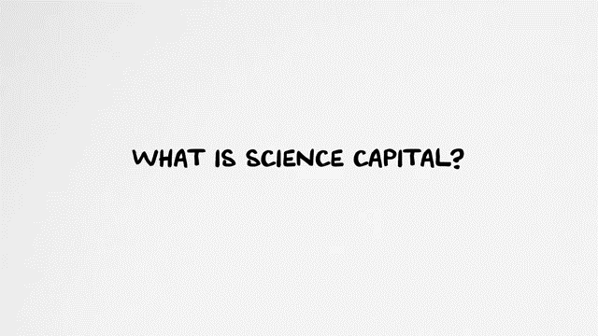
Science Capital
  https://www.youtube.com/watch?v=A0t70bwPD6Y

Slide 14
The importance of the EY/primary teacher
Teachers …major impact on pupil’s enjoyment of a subject “Research evidence …it is the teacher variables that are the most significant factor determining (positive) attitude, not curriculum factors” (Wilson & Mant. 2011)
…guiding children to make sense of their physical world… opportunities to explore, observe and find out... through planned, purposeful play ... adult-led and child-initiated active learning; creating and thinking critically (EYSF 2014)
Essential pupils experience inspiring science ... Value and place of science in their lives (Wellcome Trust 2014)
Relevant, inspiring, creative, engaging (Serrett, N. & Earle S. (2018) ASE Guide to Primary Science Education)

Slide 15
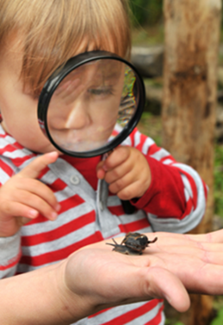
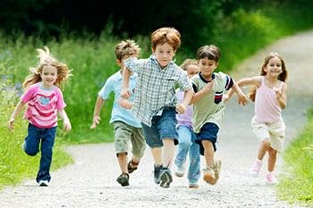
Early Years Statutory Framework
Overarching principles
• every child is unique
• learn... through positive relationships;
• enabling environments
• develop and learn in different ways and at different rates.
3 areas crucial for igniting children’s curiosity and enthusiasm for learning: C&L, PD, PSED
4 specific areas: literacy, maths, UtW, A&D

Slide 16
Early Learning Goals
Understanding the world
People and communities: children talk about … their own lives ... They know about similarities and differences between themselves and others, and among families, communities and traditions.
The world: children know about similarities and differences in relation to places, objects, materials and living things. They talk about the features of their own immediate environment and how environments might vary ... They make observations of animals and plants and explain why some things occur, and talk about changes.
Technology: children recognise that a range of technology is used in places such as homes and schools. They select and use technology for particular purposes.

Slide 17
ELG Pilot: September 2018
25 schools; address language & social skills; reduce teachers’ workload
ELG The Natural World
- Explore the natural world around them, making observations and drawing pictures of animals and plants;
- Know some similarities and differences between the natural world around them and contrasting environments, drawing on their experiences and what has been read in class;
- Understand the effect of the changing seasons on the natural world around them.

Slide 18
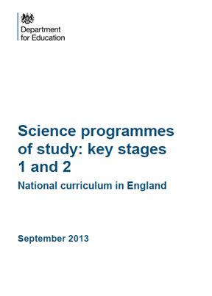
Primary NC Science 2014 KS1 & 2
Aims
develop scientific knowledge and conceptual understanding
develop understanding of the nature, processes and methods of science
equipped with scientific knowledge required to understand the uses and implications of science, today and for the future
Purpose of study
…foundations for understanding the world through ... biology, chemistry and physics.
recognise power of rational explanation...develop sense of excitement and curiosity about natural phenomena ...
British Values

Slide 19
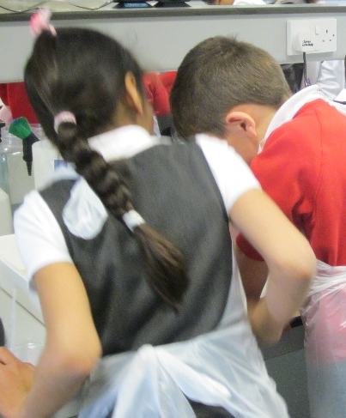
Primary NC Science 2014 KS1 & 2
Principal focus of science teaching in KS1:
enable to experience and observe phenomena, looking more closely at the natural and humanly-constructed world around them
encouraged to be curious and ask questions about what they notice
Most of the learning about science should be done through the use of first-hand practical experiences..
Learning theory: Constructivism, Social Constructivism and Social Learning

Slide 20
National Curriculum Theme | Year
Plants | 1, 2, 3
Animals, including humans | all
Living things and their habitats | 2, 4, 5, 6
Materials: Everyday & Uses Rocks States of matter Properties & changes … | 1, 2 3 4 5
Light | 3, 6
Forces and magnets | 3, 5
Electricity | 4, 6
Seasonal changes | 1
Sound | 4
Earth and space | 5
Evolution and inheritance | 6

Slide 21

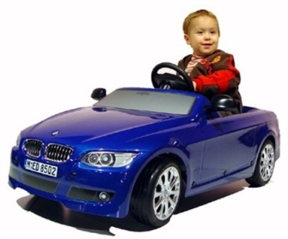

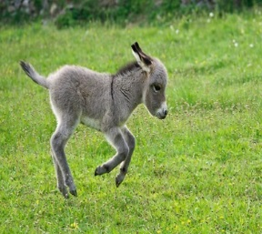
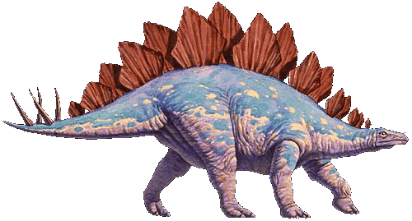

The Big Ideas of Science
All material in the universe is made up of very small particles
Objects can affect other objects at a distance
Changing an object’s movement requires a net force acting on it
Total amount of energy stays the same, but can be transformed
Composition of Earth, its atmosphere and processes within them shape its surface and climate
Solar system is a very small part of 1 of millions of galaxies
Organisms are organised on a cellular basis
Organisms require energy and materials; often dependant on / in competition with other organisms
Genetic information is passed down generations
Diversity of organisms, living or extinct result from evolution
Harlen W. (2010) Big Ideas of Science

Slide 22
National Curriculum Theme | Year | Big Ideas
Plants | 1, 2, 3 | 7, 8
Animals, including humans | all | 7, 8, 9, 10
Living things and their habitats | 2, 4, 5, 6 | 7, 8, 10
Everyday materials; Uses... Rocks States of matter Properties & changes … | 1, 2 3 4 5 | 1, 5
Light | 3, 6 | 4, 6
Forces and magnets | 3, 5 | 2, 3
Electricity | 4, 6 | 4
Seasonal changes | 1 | 8
Sound | 4 | 1, 4
Earth and space | 5 | 1, 2, 6
Evolution and inheritance | 6 | 9, 10

Slide 23
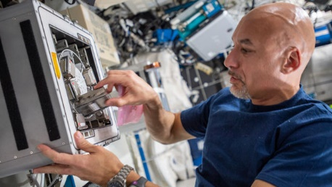
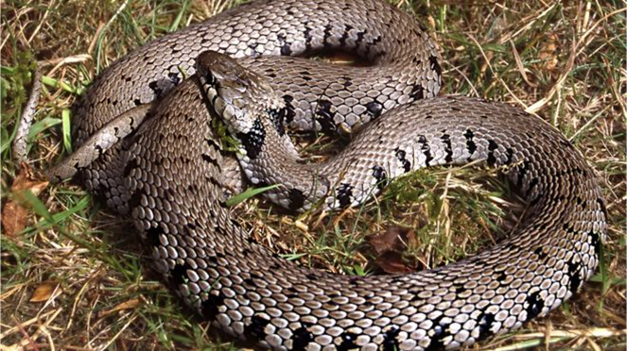
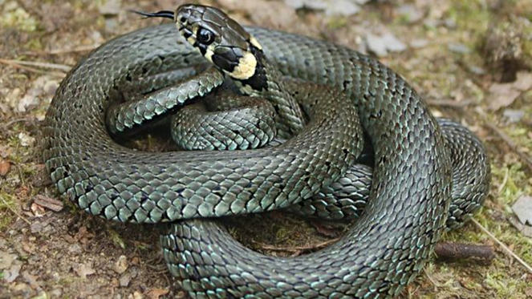
Current / recent science examples
Moon mining kit ready for space station tests ESA UK 5 August 2019
New UK grass snake identified
BBC News 7 August 2017
ESA astronaut Luca Parmitano
https://www.esa.int/ESA_in_your_country/United_Kingdom/Moon_mining_kit_ready_for_space_station_tests
Barred grass snake, Natrix helvetica
Common or eastern grass snake, Natrix natrix
https://www.bbc.co.uk/news/uk-40853286

Slide 24
Working with Big Ideas of Science Education (2015)
Pedagogy
Scientists (learners) start from their existing ideas
New experience raises a question
Develop ideas through inquiry – scientific investigation
Taught: skills, complex abstract ideas

Slide 25

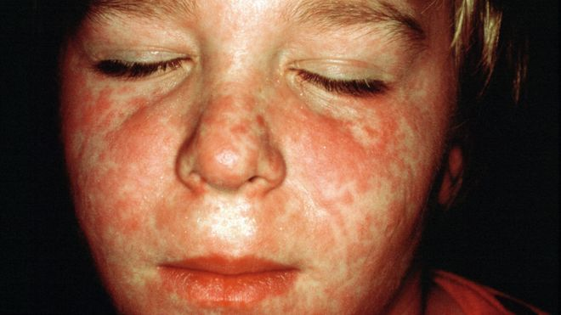
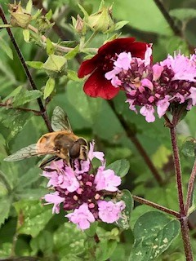
The Big Ideas About Science
Science assumes that for every effect is 1 or more causes
Scientific explanations, theories and models are those that best fit the facts known at a particular time
Knowledge produced by science is used in some technologies to create products to serve human ends
Applications of science often have ethical, social, economic and political implications
Harlen W. (2010) Big Ideas of Science

Slide 26
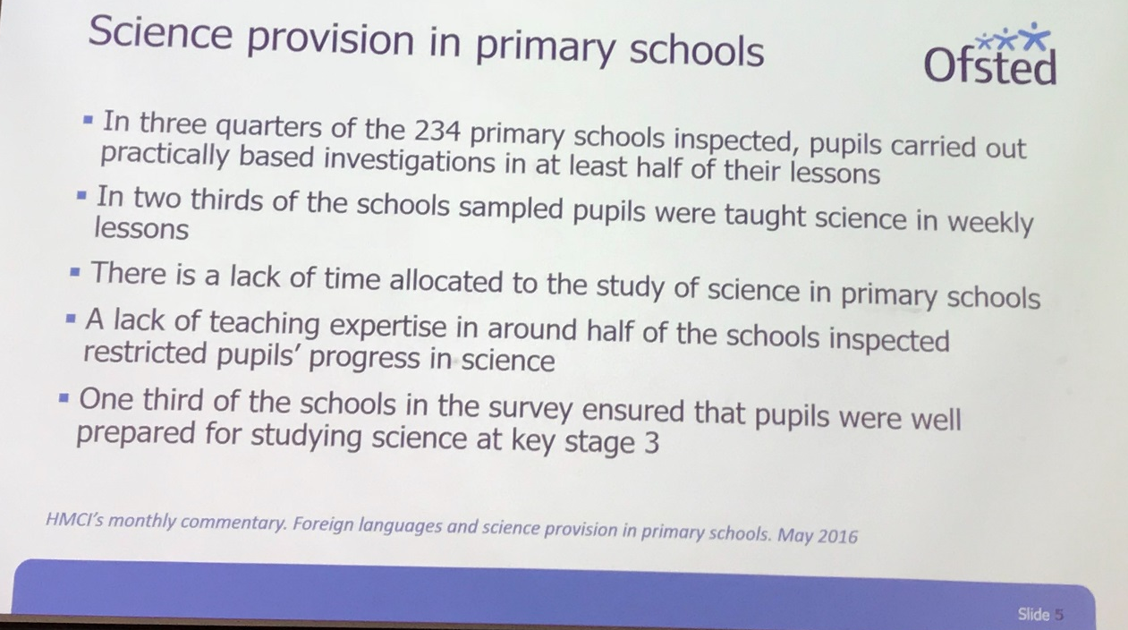
OFSTED view
Maintaining Curiosity Key Finding Teachers who coupled good literacy teaching with interesting and imaginative science contexts helped pupils make good progress in both subjects. Ofsted (2013)
Average 1.4 hrs (1hr 24)/ week
58% classes less than 2 hrs
Wellcome Trust (2017)

Slide 27
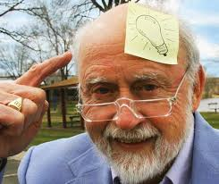
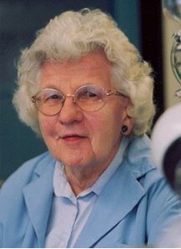
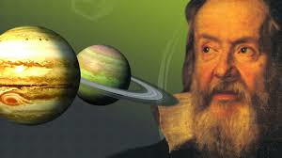
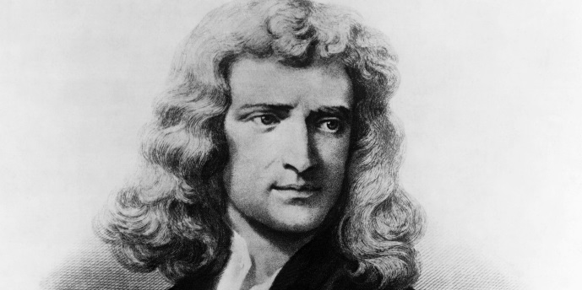
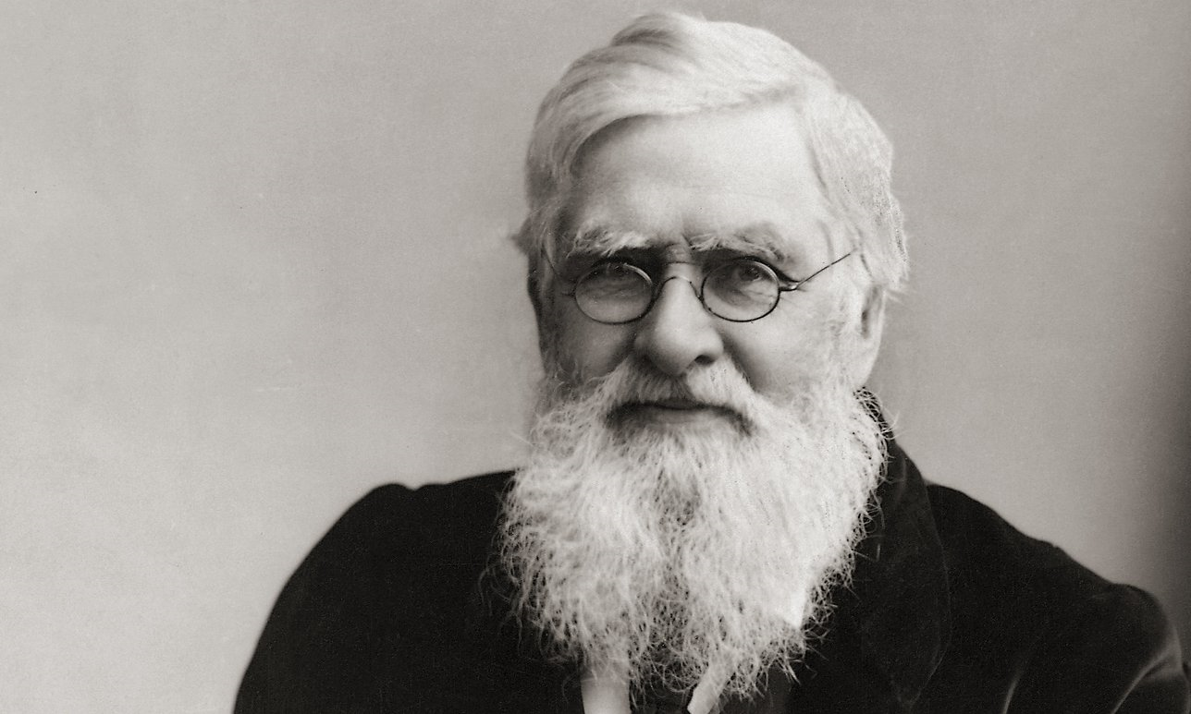
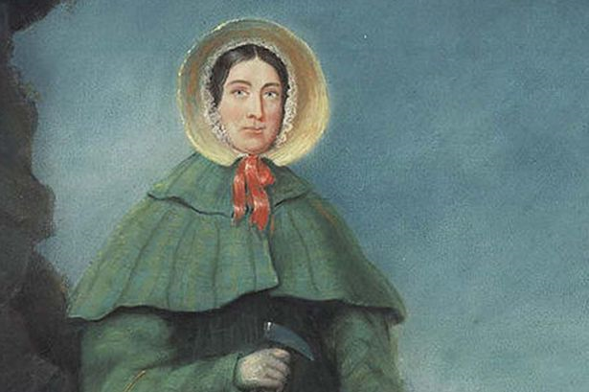
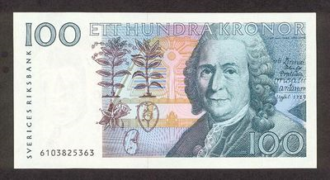
Who are they?

Slide 28
Biographies examples to consider
Name | NC | Key information
John Dunlop | Y2 Uses of everyday materials | Pneumatic tyres
Charles Macintosh | Y2 Uses of everyday materials | Waterproof fabrics
John McAdam | Y2 Uses of everyday materials | Road building - tarmac
David Attenborough | Y5 Living things and their habitats | Naturalist
Jane Goodall | Y5 Living things and their habitats | Animal behaviourist
Spencer Silver | Y5 Properties and changes of materials | Sticky note glue
Ruth Benerito | Y5 Properties and changes of materials | Wrinkle-free cotton
Ptolemy, Alhazen, Copernicus | Y5 Earth and space | Model of the solar system
Galileo Galilei, Isaac Newton | Y5 Forces | Theory of gravitation
Carl Linnaeus | Y6 Living things and their habitats | Classification
Mary Anning; Charles Darwin, Alfred Wallace | Y6 Evolution and inheritance | Fossils; theory of evolution

Slide 29
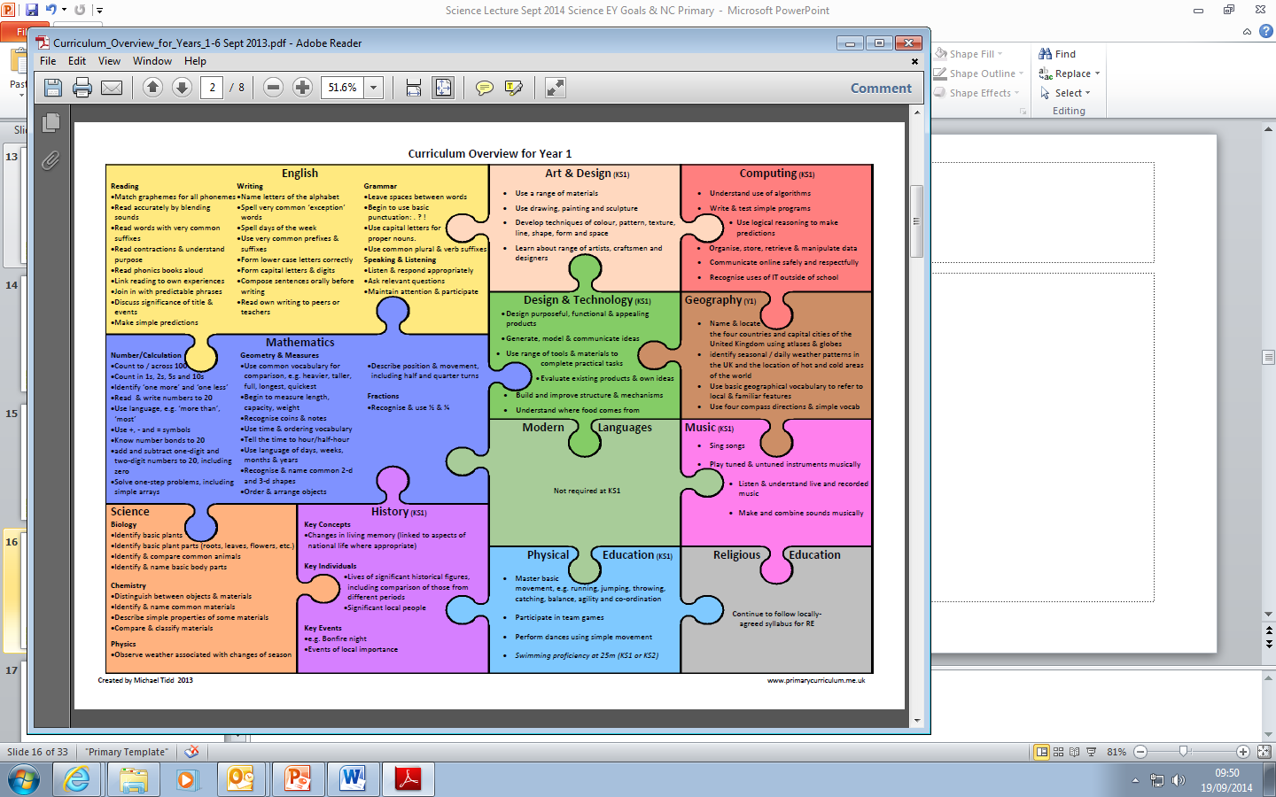
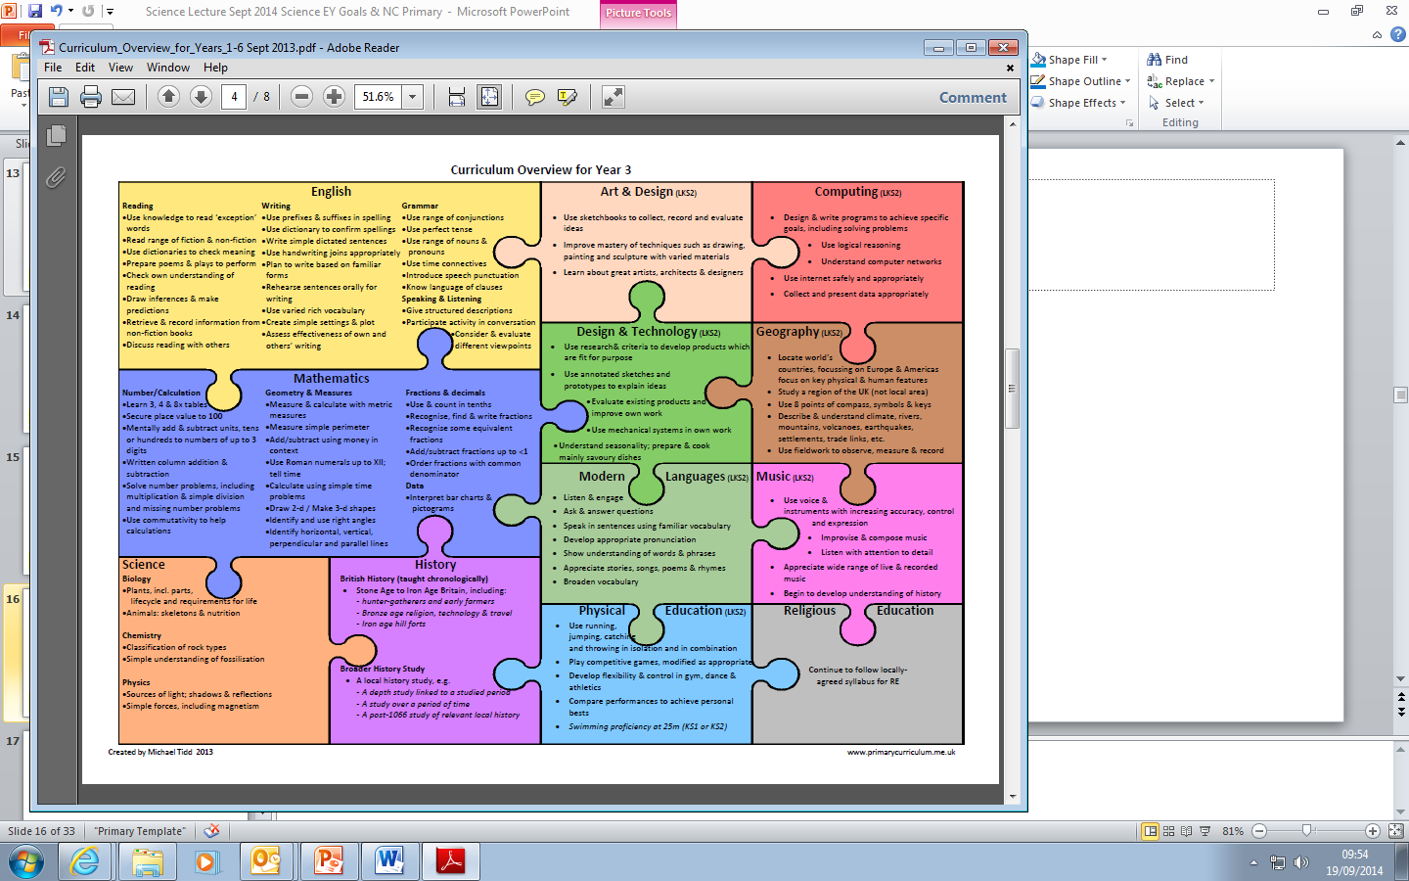
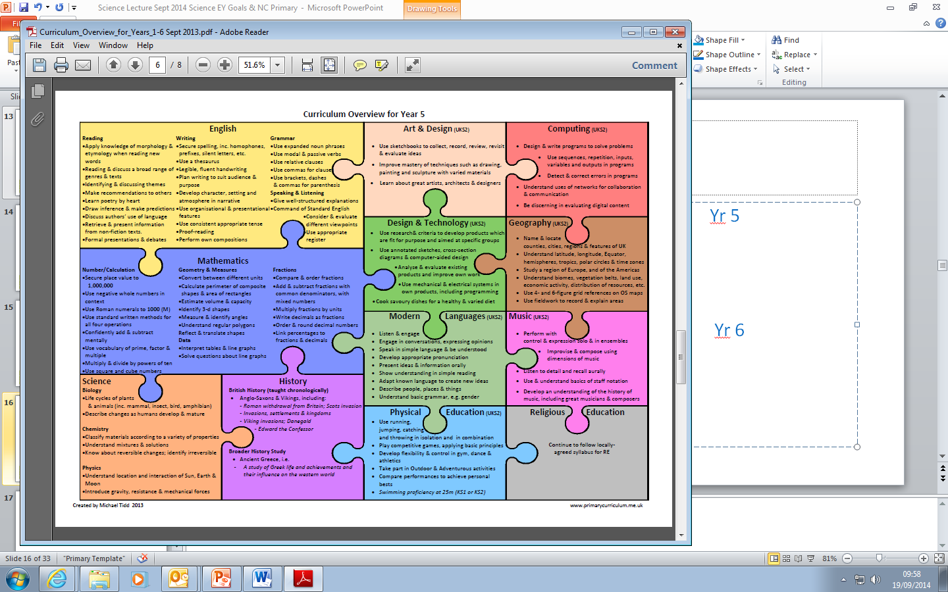
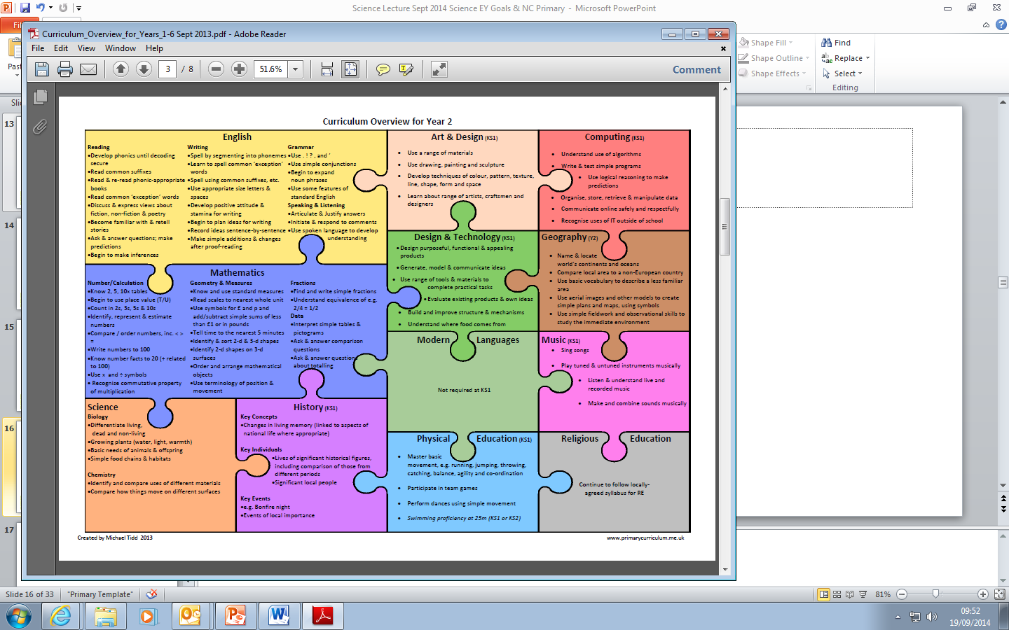
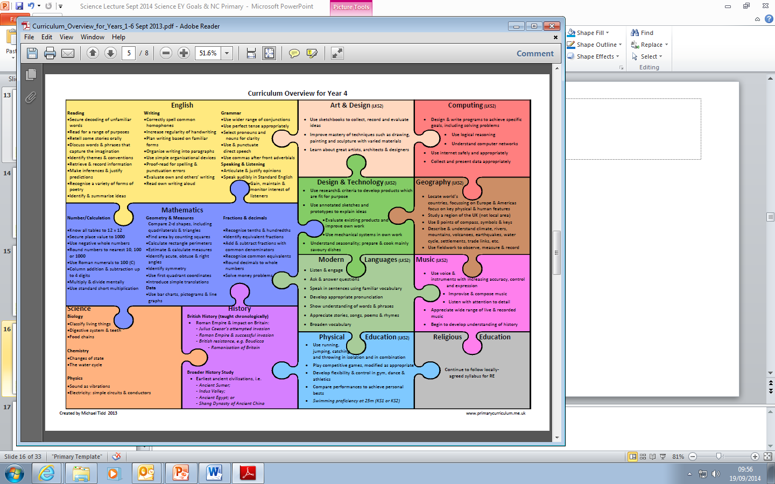
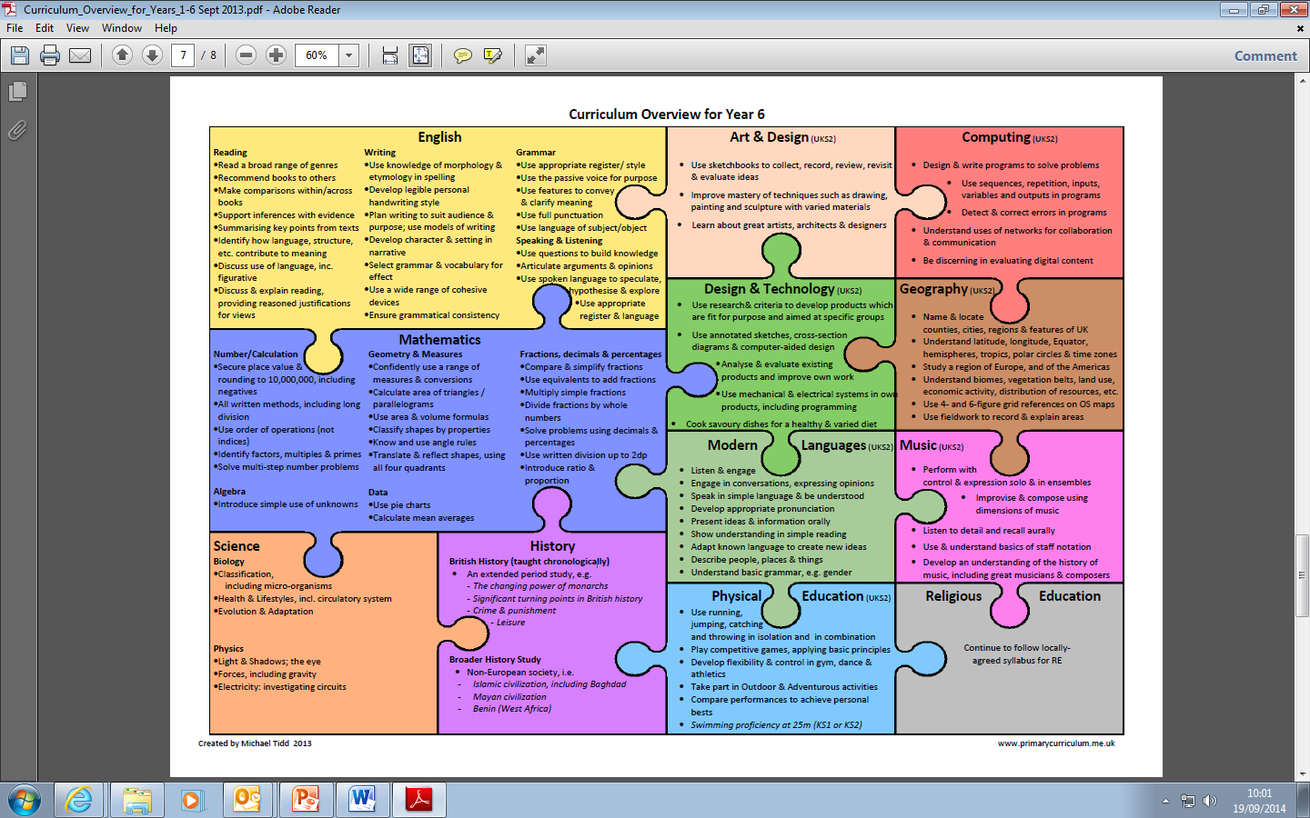

Slide 30
Bibliography
Davis, K. (2016) Promoting sustainability in science education programmes: Becoming aware of gender stereotyping and improving practice Science Teacher Education 76; 11-20, ASE
DfE (2014) Statutory framework for the early years foundation stage Setting the standards for learning, development and care for children from birth to five
DfE (2013) Science programmes of study: key stages 1 and 2 National curriculum in England DFE-00182-2013
Harlen W., (ed) (2010) Principles and big ideas of science education, Association for Science Education, http://www.ase.org.uk/resources/big-ideas/
Harlen W., (ed) (2015) Working with Big Ideas of Science Education; IAP
Ofsted (2013) Maintaining curiosity in science No. 130135
Penner, A.M. (2015) ‘Gender inequality in science’, Science, (347), 234
Serrett, N. & Earle S. (2018) ASE Guide to Primary Science Education
Tidd M. (2013) Overview of the Primary Curriculum Based on National Curriculum published in September 2013 http://michaelt1979.files.wordpress.com/2013/09/curriculum-overview-for-years-1-6.pdf
Wellcome Trust (2017) ‘State of the nation’ report of UK primary science education; London
Wellcome Trust (2014) Primary science: is it missing out? London
Wilson, H. & Mant, J. (2011) SSR; 93: 115-119

