Slide 1
IT Services
Training Team
IT Services Induction for
New Students
Notes:
First welcome to the university and congratulations for getting here!
I’m from the IT training team and I’m here today to briefly explain some of the services available to you during you time at Warwick.

Slide 2
Registration
Login name and password
    warwick.ac.uk/passwords
  The Campus Data Network
  Email
  Wireless network service
  Access to Warwick’s Intranet MyWarwick and
    Start.Warwick
      My Warwick Admin Systems
    MyFiles
    Library Resources
Notes:
Once you have enrolled online you can register for an IT Services Login name and password.
Username = (u)ID number
Password of you choice (set up security questions when first login/do not disclose to anyone)
Will give you access too…
The Campus Data Network In Open Access Work areas.
Email – will explain in a minute
Wireless networks – hotspot-secure and resnet-secure
MY Warwick – student homepage
People Search
Exam Timetables
Student Records
Printer credits
Start. Warwick – homepage you can personalise
MyFiles – access files at home
Library Resources - online journals and articles (for the actual ;library on campus need card to access)

Slide 3
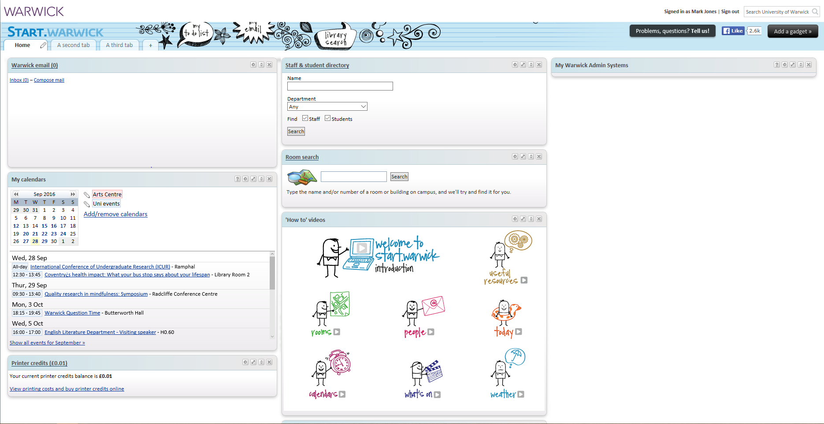
Notes:
Here’s an example of Start.warwick in case you don’t have time to click on the link in the slide above!

Slide 4
IT Services
The Campus Data Network
  Microsoft Office 2013
  Specialist Applications – Software Centre
Internet Access
  Open Access Areas / Hubs
  Student Residences
  Wireless Network
    Hotspot Secure, Resnet Secure
Home Use Licences
  warwick.ac.uk/software
Privately-owned systems support
Notes:
The campus data network can be accessed from open access areas
Most computers are windows 7 with office 2013
In Windows 7, go to Start>All Programs> software centre
In addition to the Campus Data Network, Access to the Internet is available from:
Student Residences - resnet
Wireless everywhere on campus – hotspot secure
Home use Software
Free and discounted software on uni webpages e.g. SPSS, mathtype and office 2016
Help is available for personally owned machines - Free to resident students, £30 for non-residents (lasts the year)
Contact Help Desk for further info

Slide 5
Email
    Student email - Microsoft Office 365 service
    Official University email address, e.g.
      G.M.Jones@warwick.ac.uk
    Logging in to your email account
      MyWarwick (webmail.warwick.ac.uk )
Notes:
Access to web-based Microsoft Office 365 mail system.
MY WARWICK email link
Log in directly at webmail.warwick.ac.uk
Allocated email address initial.surname@warwick.ac.uk
Always give this email out within the university
All official email will be sent to your IT Services account. If you forward your mail to another account you must still check it regularly to ensure that it does not exceed the quota.

Slide 6
Regulations & Policies
University Regulations
  warwick.ac.uk/its/policies
  Regulations for Computer Use
  JANET acceptable use
  Code of conduct for use of public computer work areas
  ResNet Acceptable Use Policy
  Anti-Virus Policy
Health & Safety
Information Security
  e.g. Data Protection
  warwick.ac.uk/gov/informationsecurity
Notes:
By enrolling at the university you are agreeing to abide by the universities regulaties ond policies when using the universotues computing facilities
Regulations for computer use
Code of conduct
Joint academic network policies (JANET)
Anti virus
Don’t do anything you wouldn’t want anyone else to see. Campus and in student residences.
See ITs policies for more info
Health and Safety..
Make sure you work station is safe and your not causing yourself any harm and theres no trip hazards etc. about. Report if there are
Information Security
See the Information Security site for guidance.

Slide 7
Saving your Work
Save your work frequently
Ideally save to the H (Home): drive at Warwick
  Regularly backed up by IT Services
  Accessible via MyFiles link on MyWarwick
Make backup copies
DO NOT SAVE TO THE HARD DRIVE
Notes:
Save frequently!!!
Save to H drive on university computers (one with username) – backed up by IT and we be on any computer you login to
Access at home through my files (on homepage)
Back up any important work –memory stick!
MOST IMPORTANT – do not save to actual computer – will be deleted when you log out!

Slide 8
Training
Free courses for students
Qualifications
  Microsoft Office Specialist (MOS)
warwick.ac.uk/itstraining
Notes:
Free courses, can help with your studies
All Microsoft programme
Word assignment and dissertation formatting help
Endnote referencing
Photoshop, Nvivio
Also offer Microsoft office specialist qualifications for free – self study and look great on a CV

Slide 9
Printing
Laser Printers in Open Access Work Areas (Most provide colour and A3 printing)
Print over wireless network
  warwick.ac.uk/wirelessprint
Paying
  Pre-paid credit scheme
    Online with a credit or debit card from warwick.ac.uk/printercredits or via Start.warwick
Notes:
Look at IT instructions for printing!
Networked printers are KYOCERA – huge! Print to anything Kyocera scan card > pull print and select
print wirelessly from your own laptop too via the go/wirelessprint website.
Need to put money on card for printing – IT website
5p single side B&W (increases with size and colour)
If you run out of money your print will continue and you’ll go into debt (need to pay off to graduate)

Slide 10
Contact IT Services
For help, contact the Help Desk
    Visit the IT Services Drop-In Centre located on the first floor of the Library
    Phone (024 765)73737
    Online Self Service warwick.ac.uk/itshelpdesk
  For ResNet enquiries, phone ext 75000
  For information, visit IT Services web site warwick.ac.uk/itservices
Notes:
Contacting IT…
Call helpdesk
Library drop in (Opening Times: 8:30 am to 5:30pm, Mon – Fri)
Online form
Residences call 75000
Emails and notes on it services homepage if there's any news etc.
Should also have info and memory stick in room if in student accomodation.
Thank you for your time – Any questions???

