Slide 1

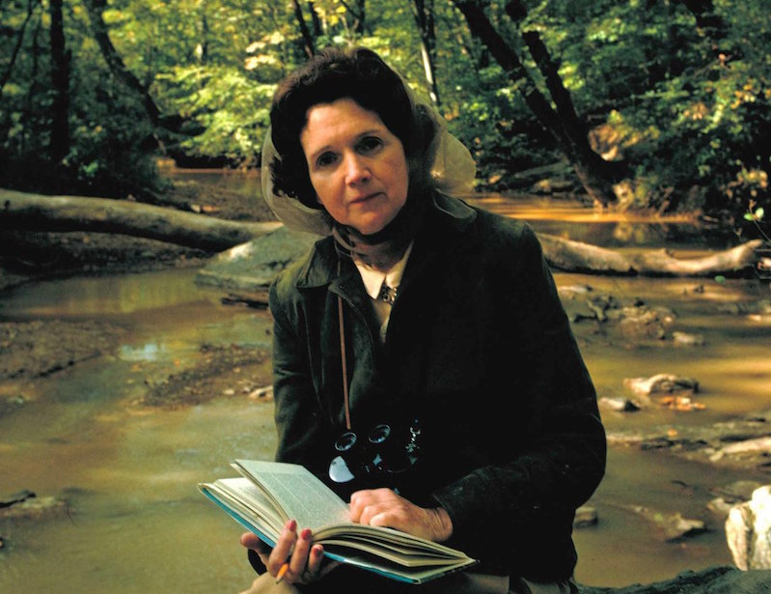
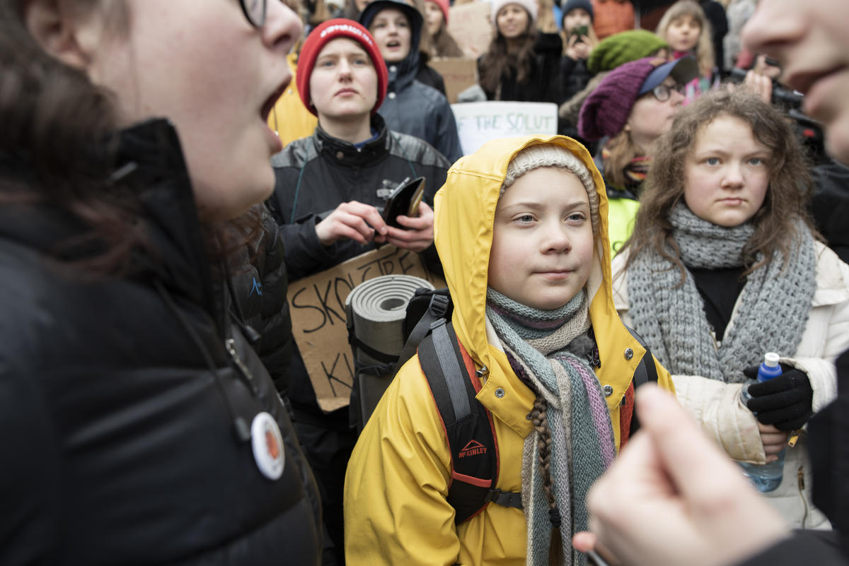
Climate, Environment and Curriculum
What does the government want young people to learn about climate change and the environment?
William Scott
University of Bath, Department of Education
National Association for Environmental Education
NAEE – National Association for Environmental Education (UK) Charity No. 1166502

Slide 2
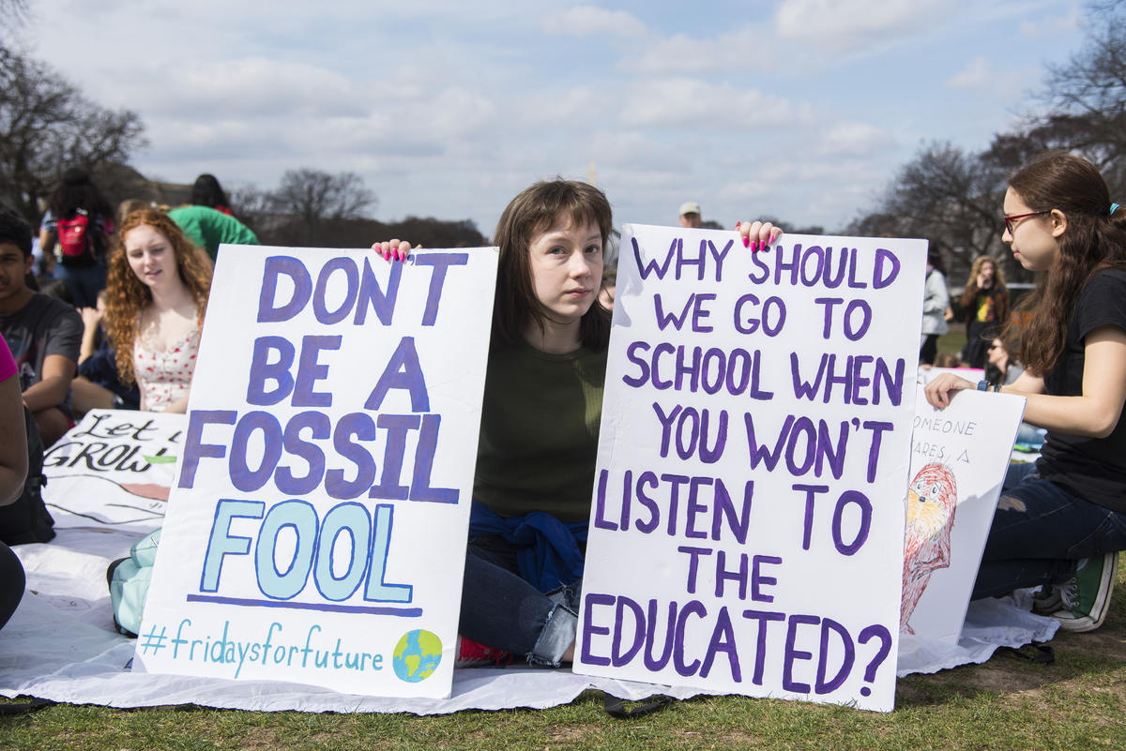
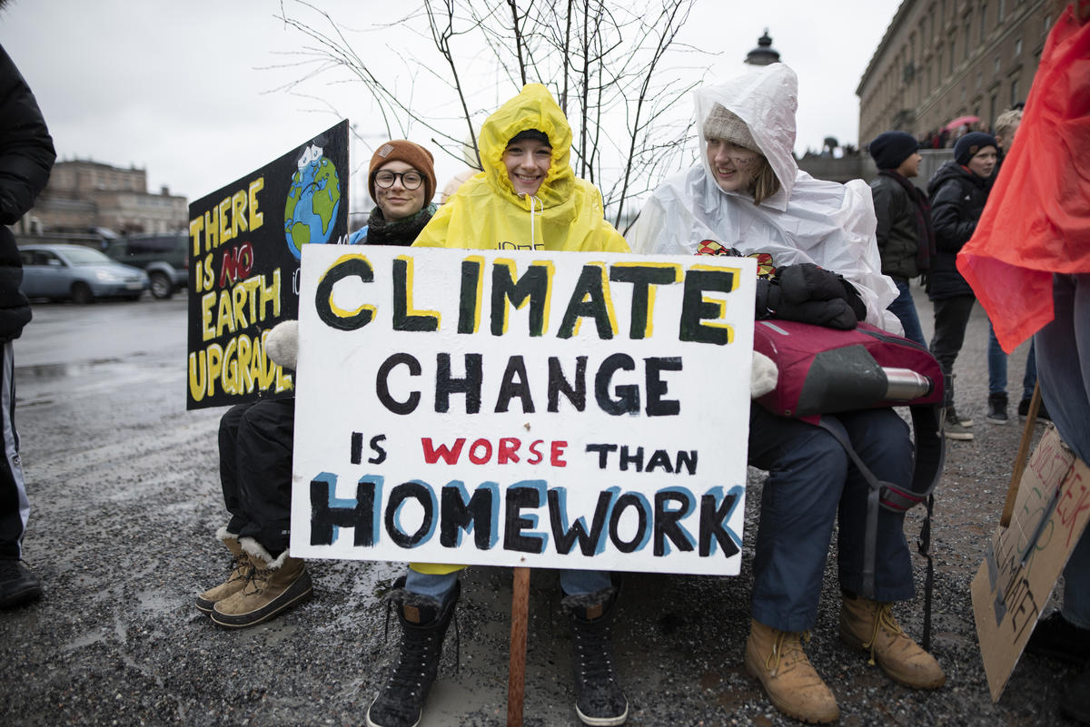

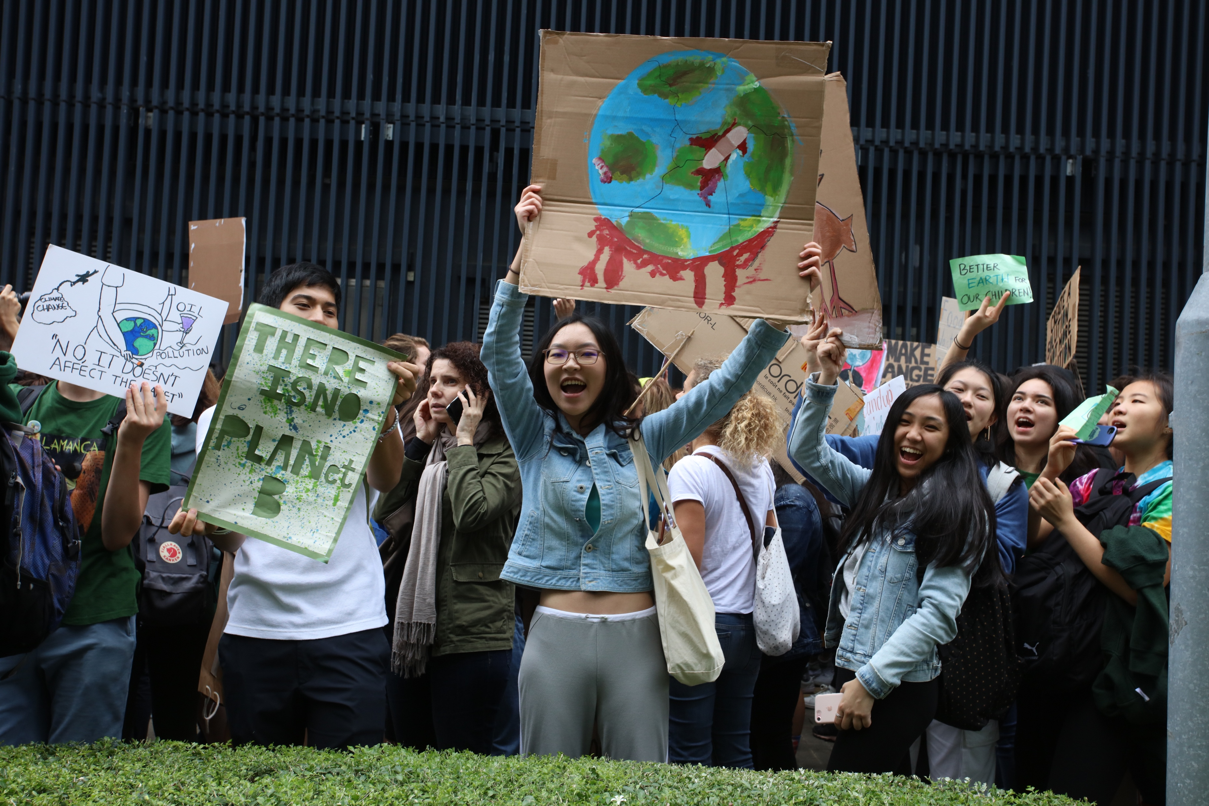
Climate, Environment and Curriculum
NAEE – National Association for Environmental Education (UK) Charity No. 1166502 naee.org.uk info@naee.org.uk

Slide 3
Climate, Environment and Curriculum
What should we be teaching about climate and the environment?
Greta Thunberg:
“You have stolen my dreams and my childhood with your empty words. And yet I’m one of the lucky ones.”
“People are suffering. People are dying. Entire ecosystems are collapsing. We are in the beginning of a mass extinction. And all you can talk about is money and fairy tales of eternal economic growth.”
NAEE – National Association for Environmental Education (UK) Charity No. 1166502

Slide 4

Climate, Environment and Curriculum
“For the first time in the history of the world, every human being is now subjected to contact with dangerous chemicals from the moment of conception until death.”
Silent Spring
“The most important legacy of Silent Spring was a new public awareness that nature was vulnerable to human intervention.”
US Natural Resources Defense Council
NAEE – National Association for Environmental Education (UK) Charity No. 1166502

Slide 5
Climate, Environment and Curriculum
The 1960s saw the first attempts to put environmental issues into the curriculum.
Through the 1970s and early 1980s environmental education grew both in the UK and internationally
There was curriculum and course development in schools
NGOs supported this work as did school inspectors and LEAs
Exam courses at 16 and 18 in environmental science and environmental studies were developed
The national curriculum brought all this to an end.
NAEE – National Association for Environmental Education (UK) Charity No. 1166502

Slide 6
Climate, Environment and Curriculum
International developments:
The Brundtland Commission on Environment and Development was set up by the UN (1988)
The 1st IPCC report on climate change (1990)
A second World Conservation strategy (1991)
A World Summit on environment and development in Rio (1992)
Agreement on the Millenniun Development Goals (2000)
Turning of attention to sustainable development and a second Earth Summit (2002)
NAEE – National Association for Environmental Education (UK) Charity No. 1166502

Slide 7
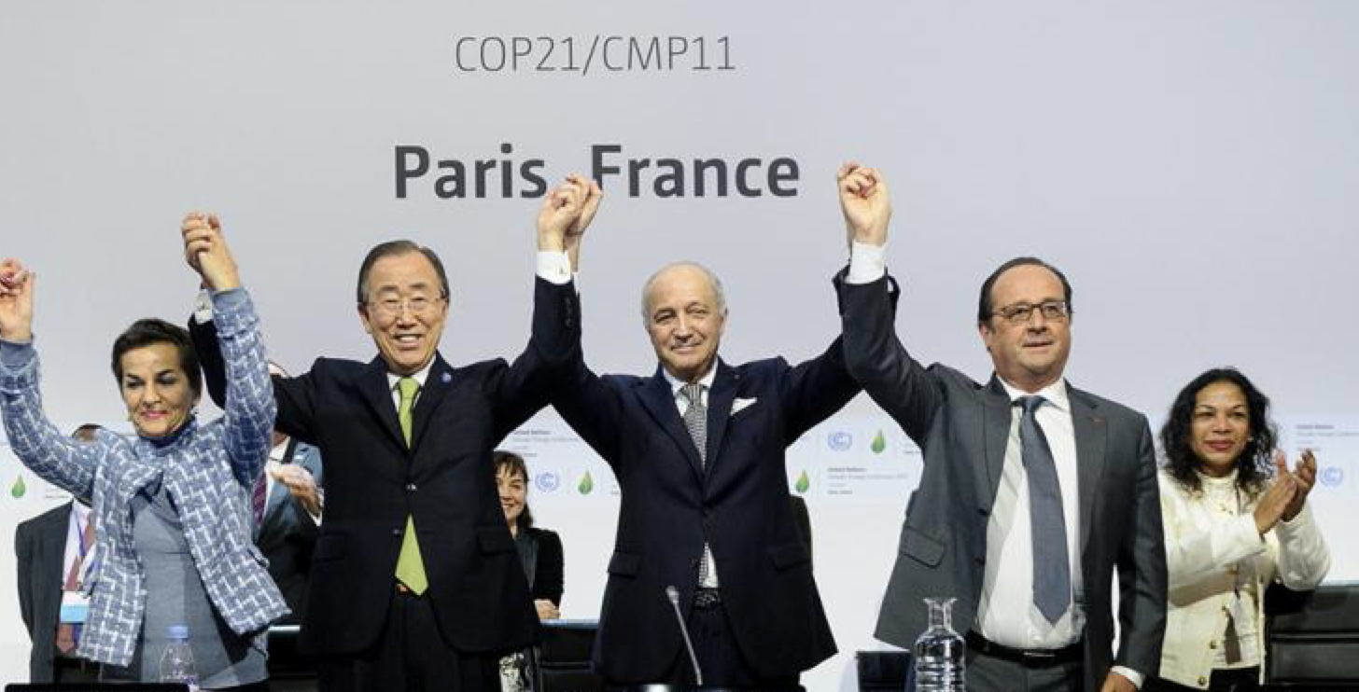
Climate, Environment and Curriculum
Since then, and to cut a very long story short, we have seen:
climate and carbon dominate international concerns
the Paris Agreement
the call for net zero carbon by 2050
17 Sustainable Development Goals (SDG) agreed with 165 targets
Progress made in meeting some of the goals
NAEE – National Association for Environmental Education (UK) Charity No. 1166502

Slide 8

NAEE – National Association for Environmental Education (UK) Charity No. 1166502

Slide 9
Climate, Environment and Curriculum
The Department for Education has never been keen on environmental education – or other “adjectival educations”.
It still isn’t for a variety of reasons.
Anyway, DfE says that environmental issues are already embedded within the national curriculum.
This is true – up to a point.
NAEE – National Association for Environmental Education (UK) Charity No. 1166502 naee.org.uk info@naee.org.uk

Slide 10
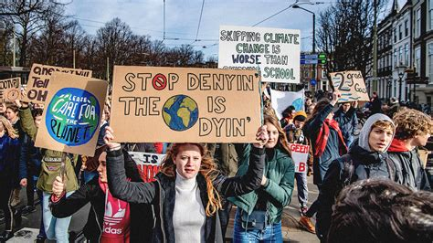
Climate, Environment and Curriculum
“Teaching about climate change needs to cover a number aspects, including causes, consequences and mitigations. These are all covered in the current National Curriculum.
This includes studying climates and climate zones in Key Stages 2 and 3 geography, alongside the greenhouse effect and evidence for other anthropogenic causes of climate change in Key Stages 3 and 4 science.
Rt Hon Nick Gibb MP
Minister of State for School Standards, replying to Michael Gove MP following a constituent’s letter; April 2020.
NAEE – National Association for Environmental Education (UK) Charity No. 1166502

Slide 11
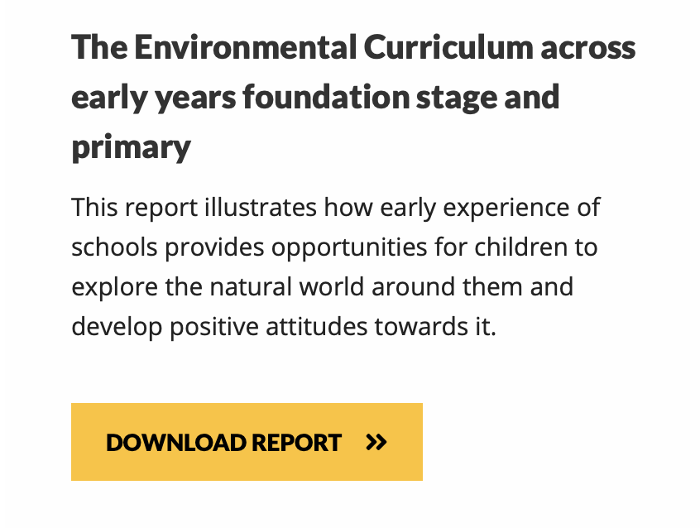
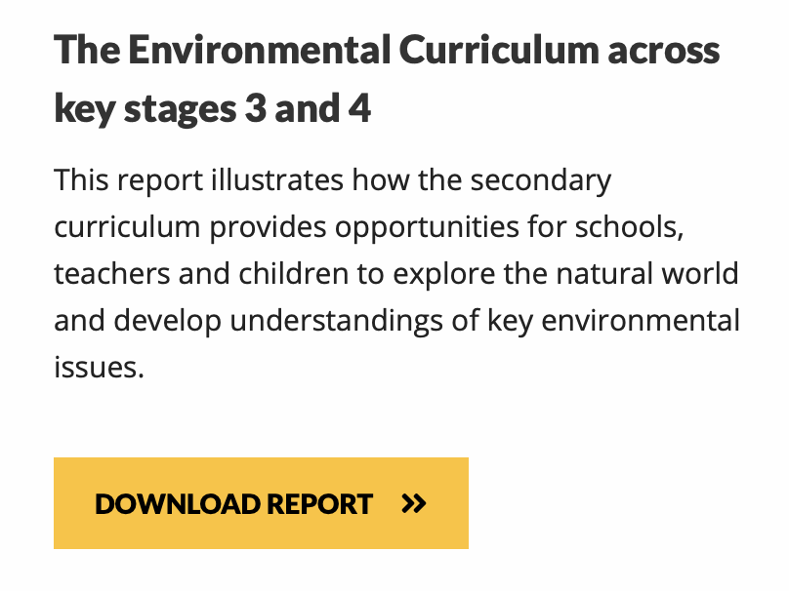
Climate, Environment and Curriculum
naee.org.uk/latest-report-from-naee
NAEE – National Association for Environmental Education (UK) Charity No. 1166502

Slide 12
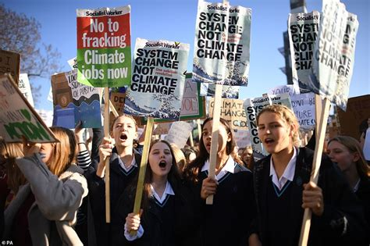
Climate, Environment and Curriculum
“Although the government shares young people’s concern about climate change, we don’t think it should be at the expense of a child’s education because what we want is for the next generation to be as well educated as possible to tackle these kinds of problem, and you don’t do that by missing out on an education.”
Rt Hon Nick Gibb MP
Minister of State for School Standards, speaking on Radio 4 on 25th September 2019 about the Friday climate strikes.
NAEE – National Association for Environmental Education (UK) Charity No. 1166502 naee.org.uk info@naee.org.uk

Slide 13
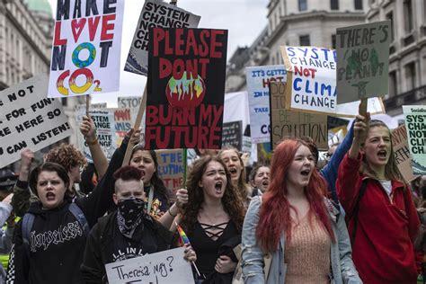
Climate, Environment and Curriculum
"Children feel very passionately about it. In school we’ve debated it. They have a climate-change afterschool club that they can choose to join. It’s something that we’ve woven into the curriculum.”
“I see it as parents wanting to educate their children about their democratic right, so it’s part of the British values lessons. It’s a very good way of them doing that. I think it’s very positive that they are doing that.”
Sue Harte
Head of John Stainer Primary School, Brockley
Quoted in The Times in September 2019 explaining why she went with the school council on a climate strike.
NAEE – National Association for Environmental Education (UK) Charity No. 1166502 naee.org.uk info@naee.org.uk

Slide 14
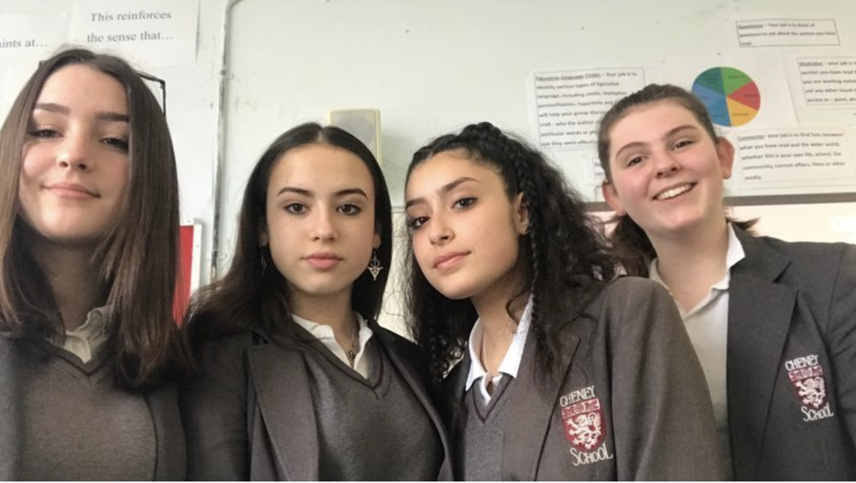
Climate, Environment and Curriculum
"We are four 15 year old school students who are deeply concerned about the damage we’re doing to our planet and how it will affect our futures. Climate change is the biggest issue of our time. It must be a part of our education if our generation is to understand it and help us to combat its effects.
We’ve barely learned about the climate crisis at school, even though it’s supposed to be part of geography and science. If young people like us are going to have any kind of future, the climate emergency must be a central, core part of our compulsory curriculum.”
Izzy Lewis
Kamila Chamcham
Rasha Alsouleman
Lucy Gibbons
Cheney School, Oxford; May 2019
NAEE – National Association for Environmental Education (UK) Charity No. 1166502

Slide 15
Climate, Environment and Curriculum
UKSCN – the UK Student Climate Network organised monthly student protests inspired by Greta Thunberg’s #FridaysforFuture movement
“We are a group of mostly under 18s taking to the streets to protest the government’s lack of action on the Climate Crisis.”
“We are mobilising unprecedented numbers of students to create a strong movement and send a message that we are tired of being ignored.”
NAEE – National Association for Environmental Education (UK) Charity No. 1166502

Slide 16


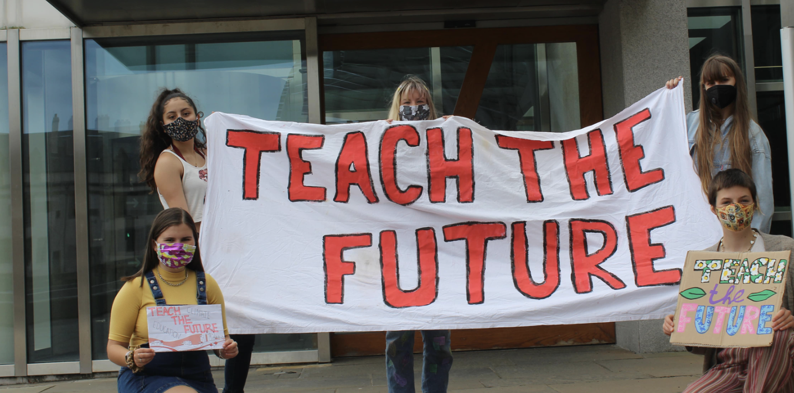


Climate, Environment and Curriculum
teachthefuture.uk
NAEE – National Association for Environmental Education (UK) Charity No. 1166502

Slide 17

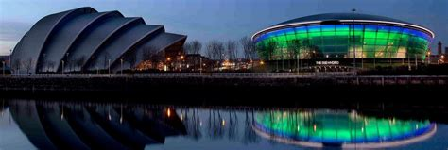
Climate, Environment and Curriculum
Education featured strongly at COP26 with ministers meeting student campaigners.
In one session, the permanent secretary at the DfE (and other civil servants) were taught about climate change by students from Teach the Future and SOS-UK.
DfE made a number of pledges.
Education Secretary, the Rt Hon Nadhim Zahawi MP:
“The UK is committed to become a world leader in sustainability right across the education system by engaging young people and bringing them on our journey towards net zero and a green future.”
NAEE – National Association for Environmental Education (UK) Charity No. 1166502

Slide 18

Climate, Environment and Curriculum
The DfE’s draft strategy proposes these action areas:
Climate Education
Green Skills and Careers
The Education Estate
Operations and Supply Chains
Education Secretary, the Rt Hon Nadhim Zahawi MP :
“Education is critical to fighting climate change. We have both the responsibility and privilege of educating and preparing young people for a changing world – ensuring they are equipped with the right knowledge, understanding and skills to meet their biggest challenge head on.”
NAEE – National Association for Environmental Education (UK) Charity No. 1166502

Slide 19
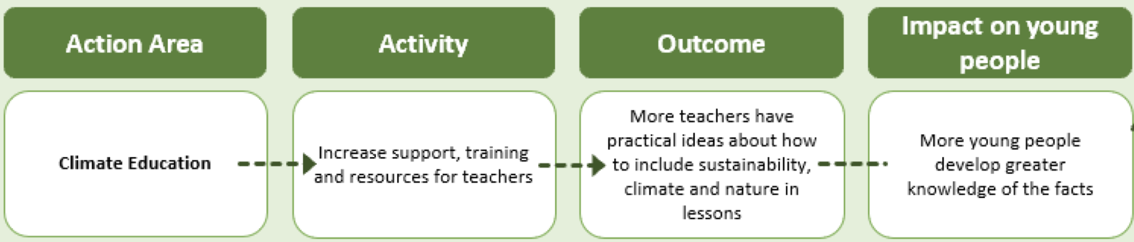

Climate, Environment and Curriculum
The draft strategy says this about climate education and green skills:
NAEE – National Association for Environmental Education (UK) Charity No. 1166502

Slide 20
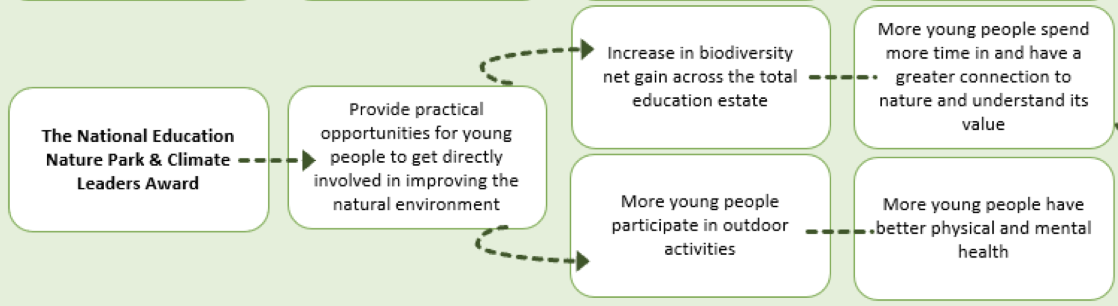
Climate, Environment and Curriculum
The draft strategy proposes to set up nature parks and a climate leaders award.
NAEE – National Association for Environmental Education (UK) Charity No. 1166502

Slide 21
Climate, Environment and Curriculum
The draft strategy confirms that teaching about climate change is not a political issue and so schools do not need to give views of climate change deniers.
However, where discussions about climate change transition touch upon issues such as social and economic reform, this should be handled in line with schools’ normal duties on political impartiality – ie, there’s a need for balance.
Schools are also directed not to encourage pupils to join campaigning groups, or take part in protests.
They are not, however, instructed to actively discourage pupils from taking this path.
NAEE – National Association for Environmental Education (UK) Charity No. 1166502

Slide 22
Climate, Environment and Curriculum
DfE draft strategy: what do critics say?
No change to the curriculum is proposed
There’s not enough depth to studies
All subjects should be involved
Not enough focus on nature and biodiversity
Not enough emphasis on the role of school leadership & governors
Pupil engagement is downplayed and critical thinking is ignored
A focus on social change and values and attitudes is needed
The shift to net-zero in schools is too slow
There’s no new money
NAEE – National Association for Environmental Education (UK) Charity No. 1166502

Slide 23

Climate, Environment and Curriculum
NAEE is a charity that was formed in the 1960s.
Its purpose is to support environmental education within schools and teacher education through:
providing resources, information and ideas for teachers
financial support for pupils to visit outdoor education centres
collaboration with organisations with related aims
NAEE has: a termly journal and an informative website
Membership is free to students: naee.org.uk/join-naee
NAEE – National Association for Environmental Education (UK) Charity No. 1166502

