Slide 1
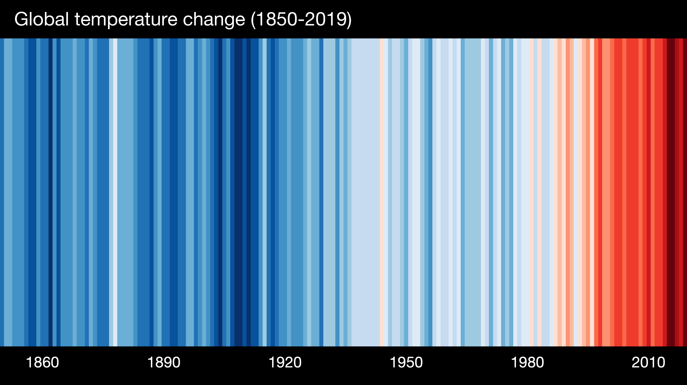
What has been happening from 1850 to 2019?

Slide 2


Slide 3
WELCOME Professor Kate Ireland
https://echo360.org.uk/media/4a1b60f7-6411-4bbd-a457-f7951ce500d7/public

Slide 4
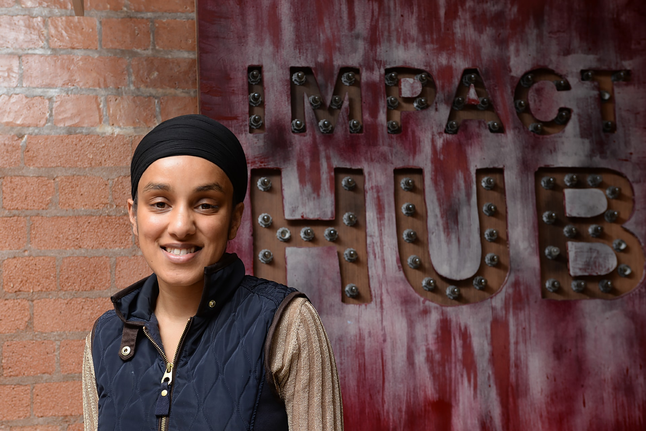
What does climate change mean to you?

Slide 5
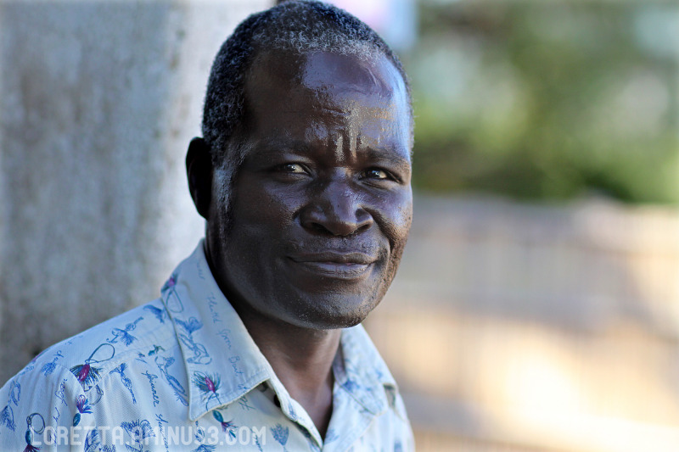
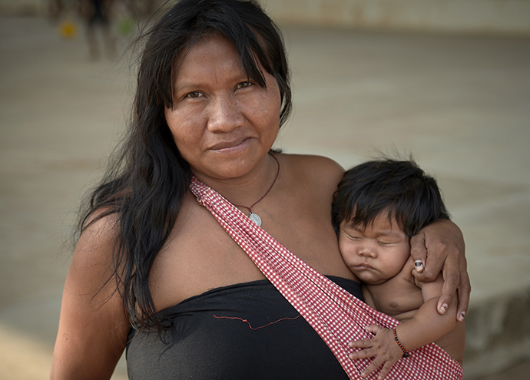
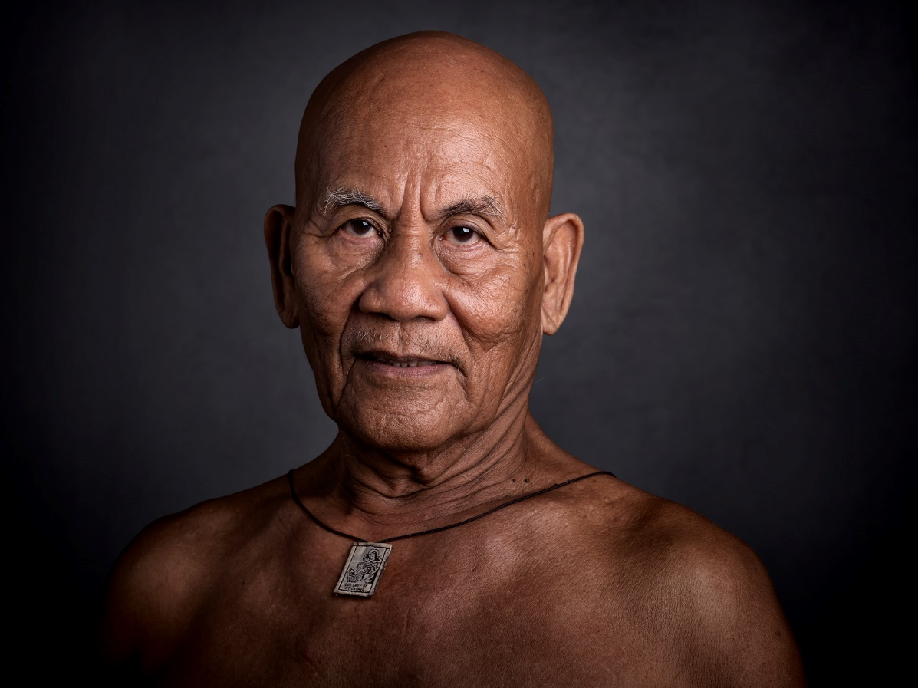

Slide 6
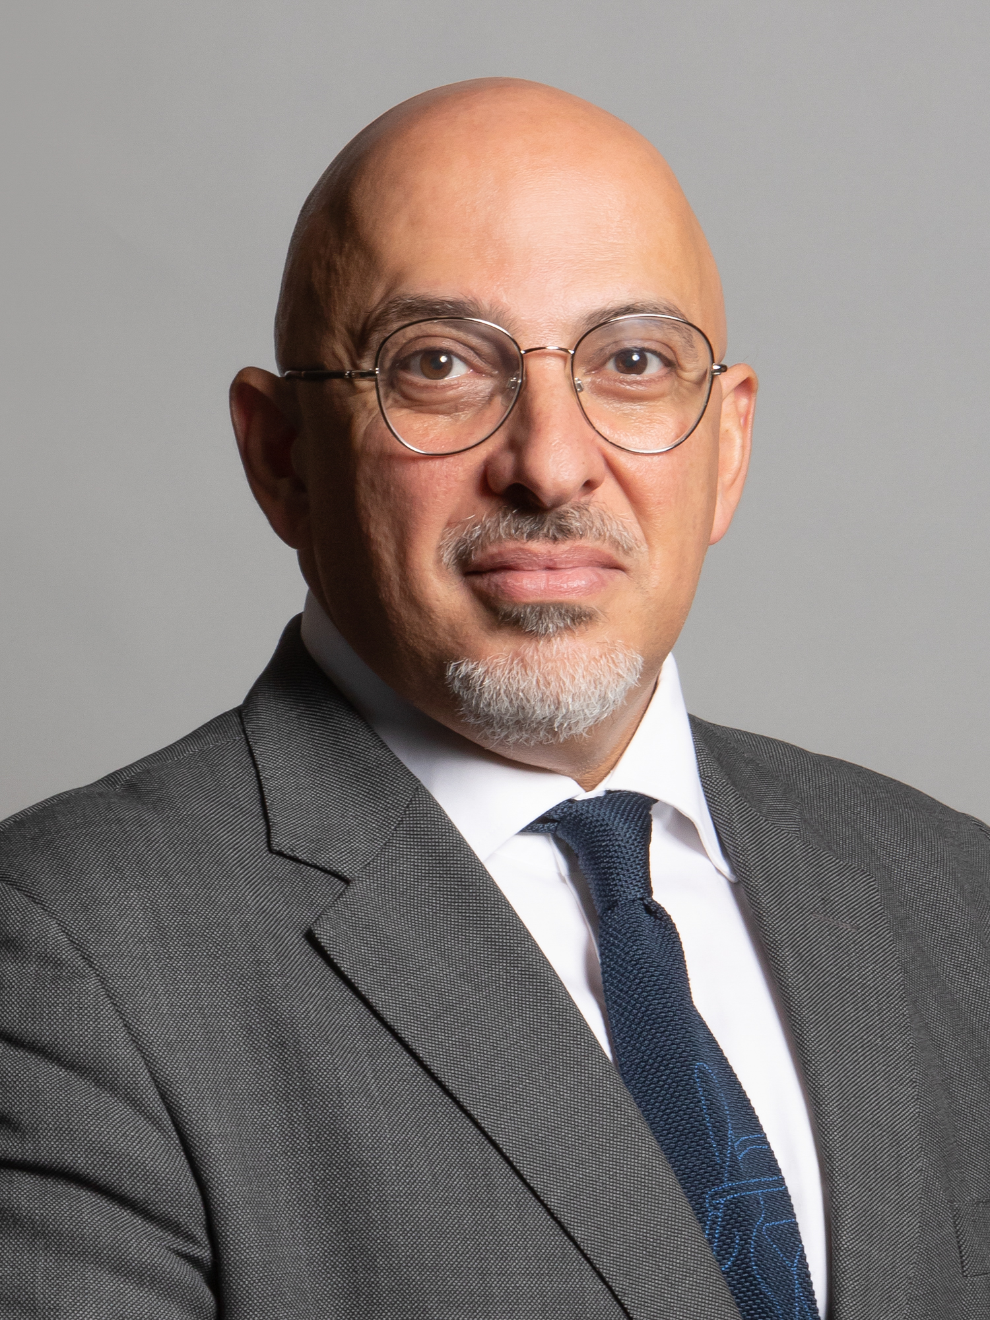
“We want to deliver a better, safer, greener world for future generations of young people and education is one of our key weapons in the fight against climate change.”
Nadhim Zahawi

Slide 7
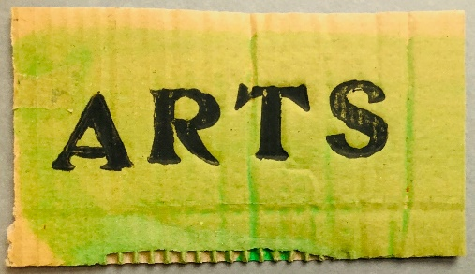
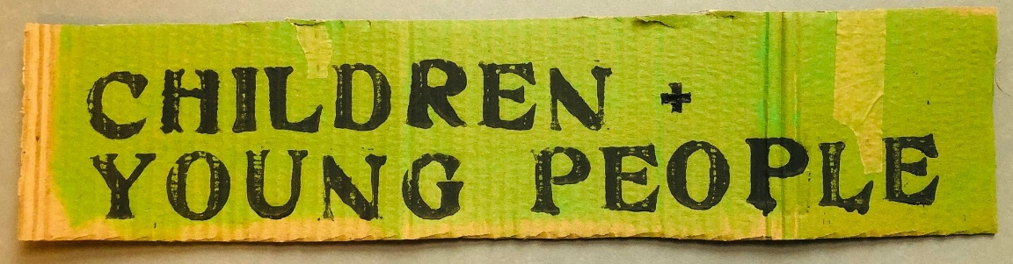
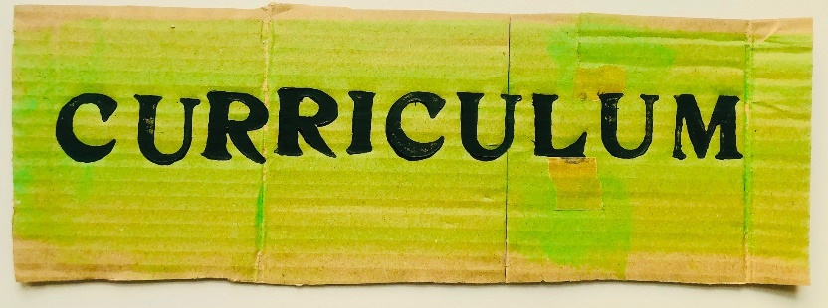
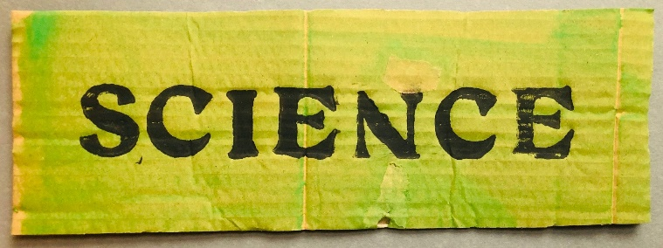

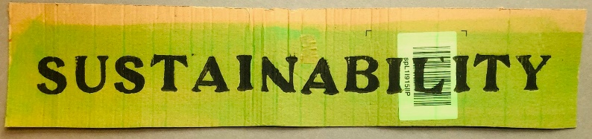
A collection of digital resources grouped into 6 zones

Slide 8

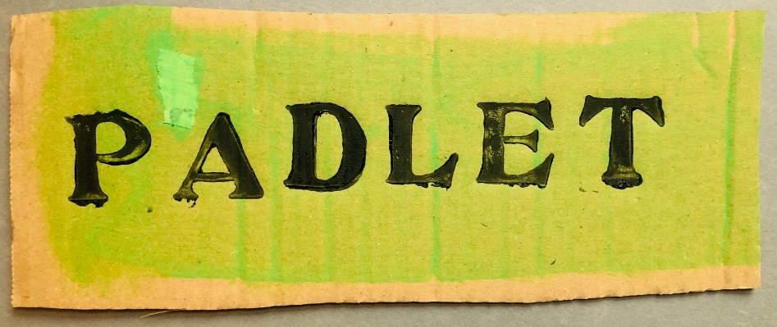
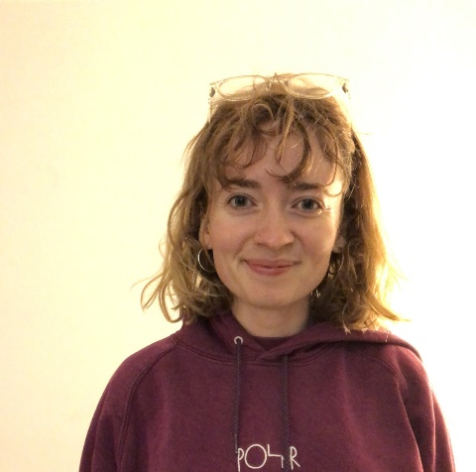
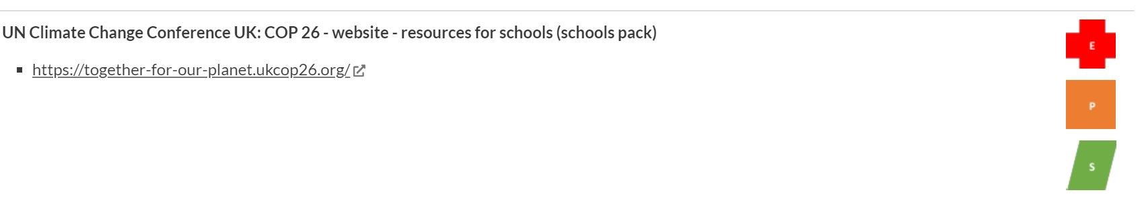
Sophie Thorpe
A curriculum for a hot planet
11 am, repeated at 11.30 am and 12 noon

Slide 9
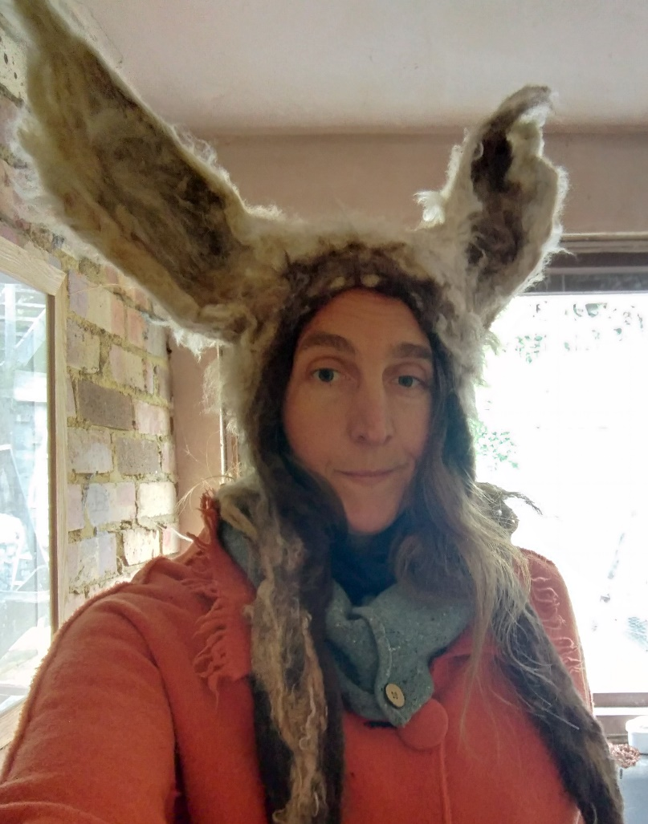
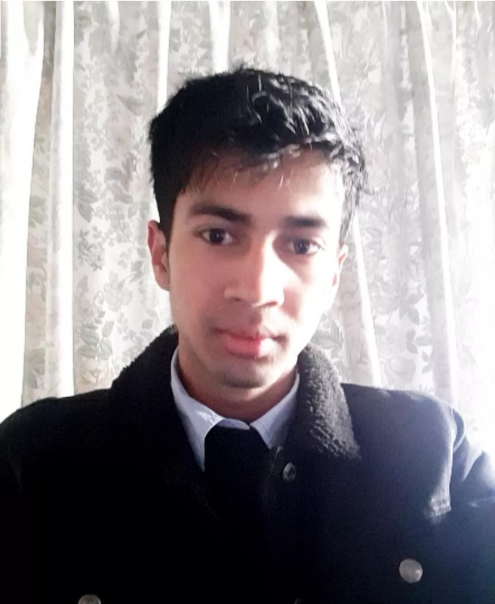
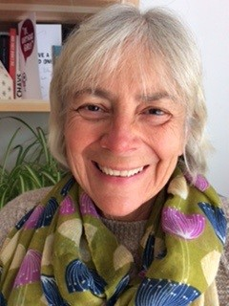
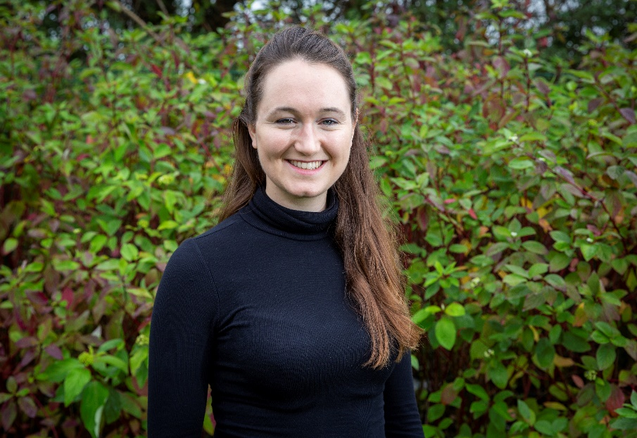

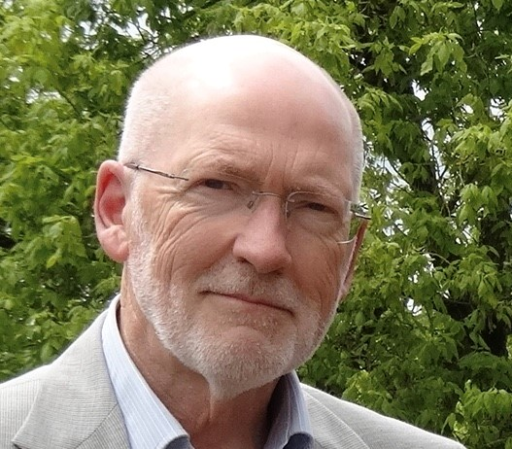

Slide 10
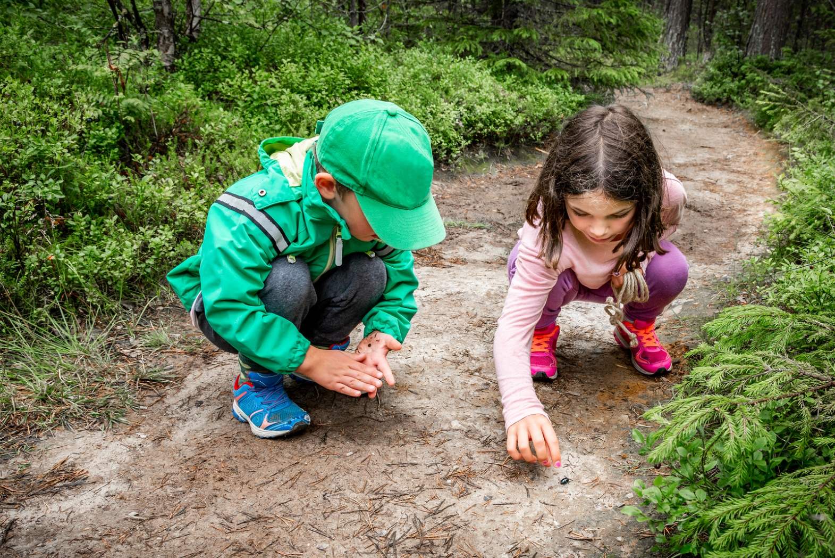
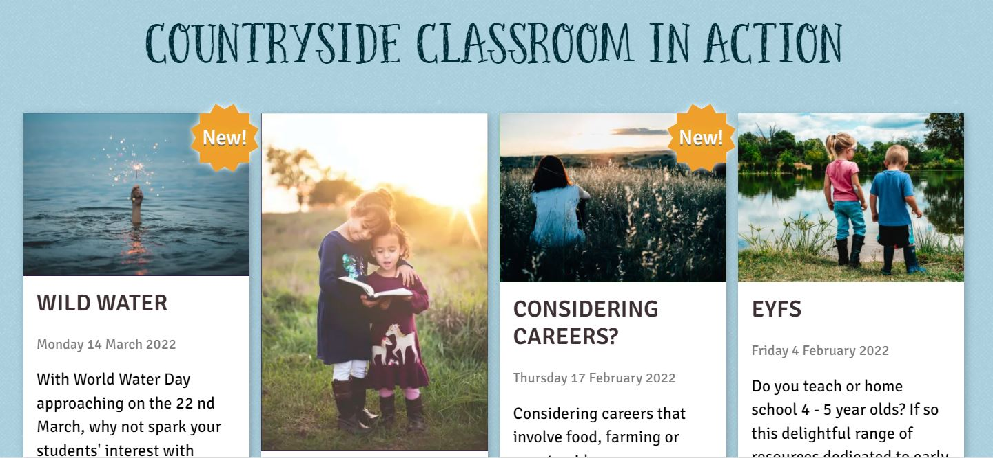


Slide 11
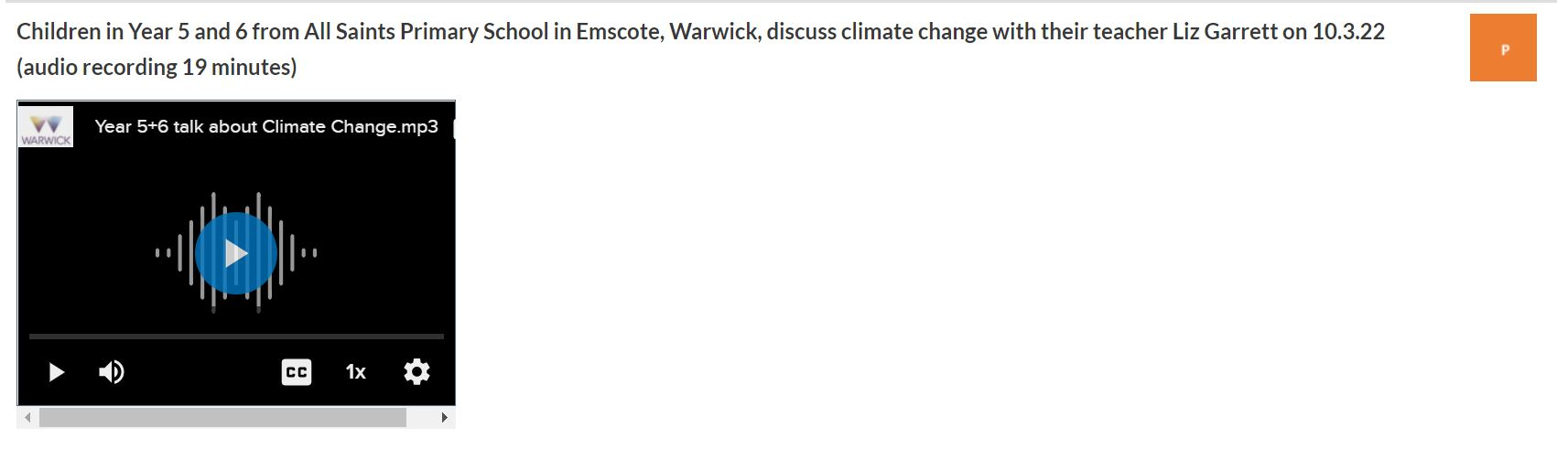
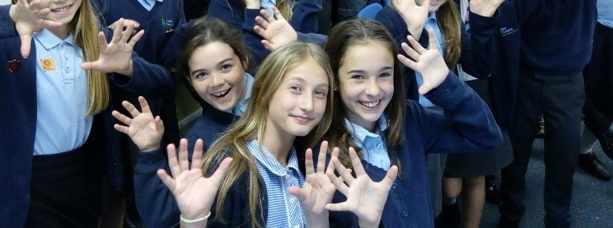

Slide 12



Slide 13


Slide 14

Cameras and Mics on please!
Share your perspective
Signpost group members to resources

Slide 15



Read DfE Draft Strategy on Climate and Sustainability – made notes in relation to KS2
(Gov + UN)
Listened to podcast on talking with children about Climate Change
Bullet points of key issues
(Children + Young People)
Listened Marilyn Hull discuss
the basic science, took part in discussion and deepened my understanding of the facts and archived weblinks (Science)

Slide 16
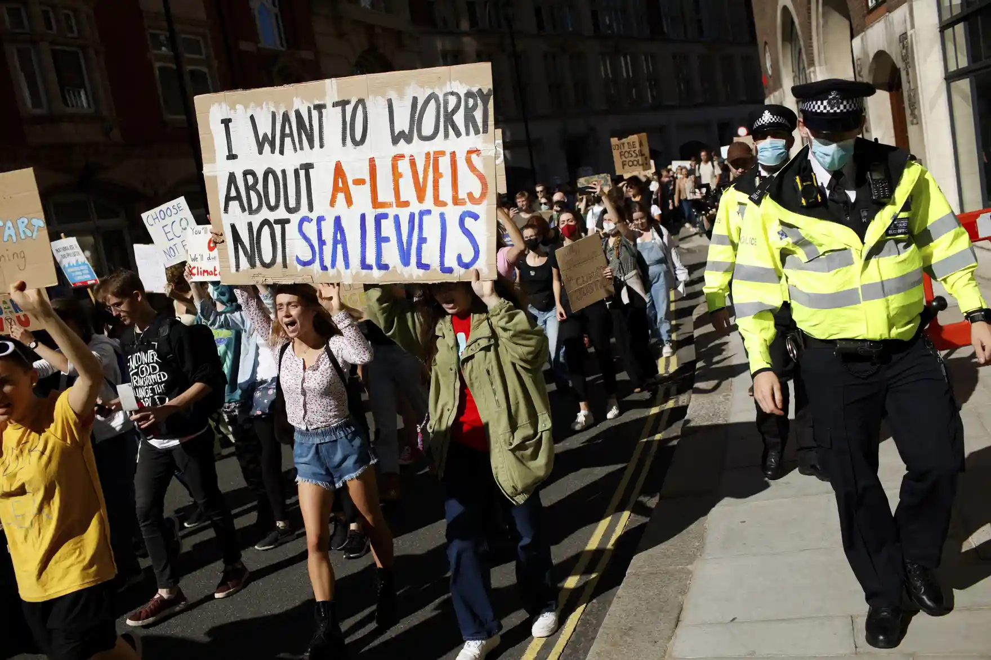

Slide 17
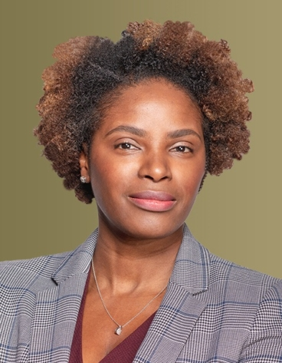
“To compel the kind of action that will move the needle on mitigating the climate crisis, we need a climate literate, conscious, and empowered society that understands what’s at stake, is motivated to pressure policy makers and CEOs to change their practices, and can envision a new future for all of us.”
Chirlie Felix, Teach for All

Slide 18


Please keep in touch!
Start: Microsoft Form
End: Microsoft Form

Slide 19
Please go to your first group meeting now!

