Slide 1
Climate Emergency – the facts, and what to do about them
‘Green Space’
Friday March 25th 2022
Marilyn Hull marilynhull@yahoo.co.uk

Slide 2
Perspectives
I come at this mainly from the point of view of activism. I’ve been involved in climate campaigning - especially fossil fuels disinvestment - since 2013.
In this huge topic what are some of the emergent threads?
How as individuals are we responding, but also what kinds of conversations about climate are we having as educators with children and young people?

Slide 3
Short film: Climate change, the facts
We’ll watch a couple of minutes of a short film (there’s a longer version if you’re interested) which graphically describes the problem. It includes interviews with some leading scientists, including James Hansen, whose 1988 Congressional statement was a landmark moment in the recognition of the seriousness of the issue.
One line of questions you might want to pick up is why politicians and others have been so ineffective in heeding scientific advice and taking action.

Slide 4
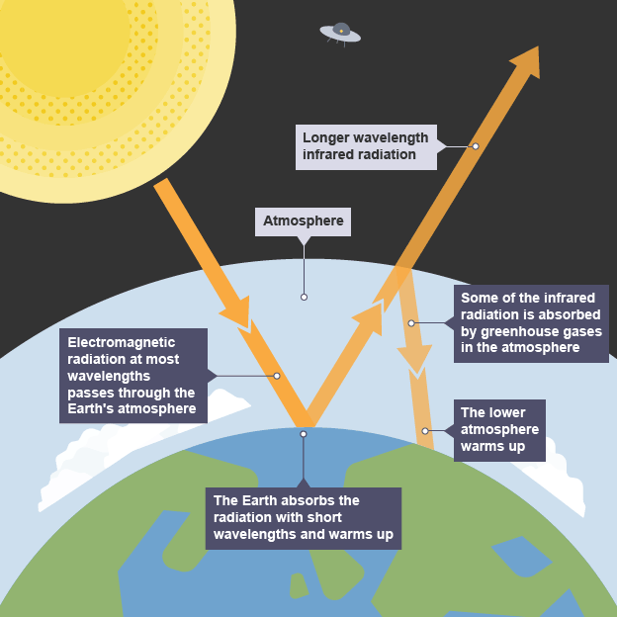
The greenhouse gases – mainly carbon dioxide, methane and water vapour - allow some of the infrared radiation to be re-absorbed (down arrow on right). Over hundreds of thousands of years this has created the warm atmosphere in which life as we know it, including human life, has been able to develop. The problem now is that there is too great an increase in these gases for effective absorption to occur. The planet is overheating.

Slide 5
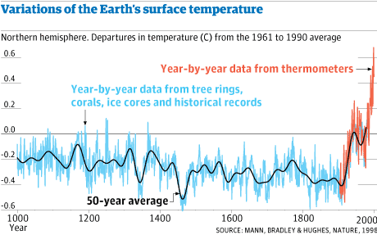
The famous ‘hockey stick’ graph summarises pre-written evidence (in blue here) based mainly on tree rings and ice structures together with data collected from late 19 century (in red). It’s also interesting because it was the subject of an infamous attempt to discredit its authors in an organised campaign of misinformation by the pro fossil-fuel lobby. The fact that this took place just before the 2009 COP15 in Copenhagen – a disastrous failure – is claimed by many environmentalists to have set back climate action a decade. Watch the brilliant TV film ‘The Trick’ about this and for a sense of truly inspiring scientific integrity!

Slide 6
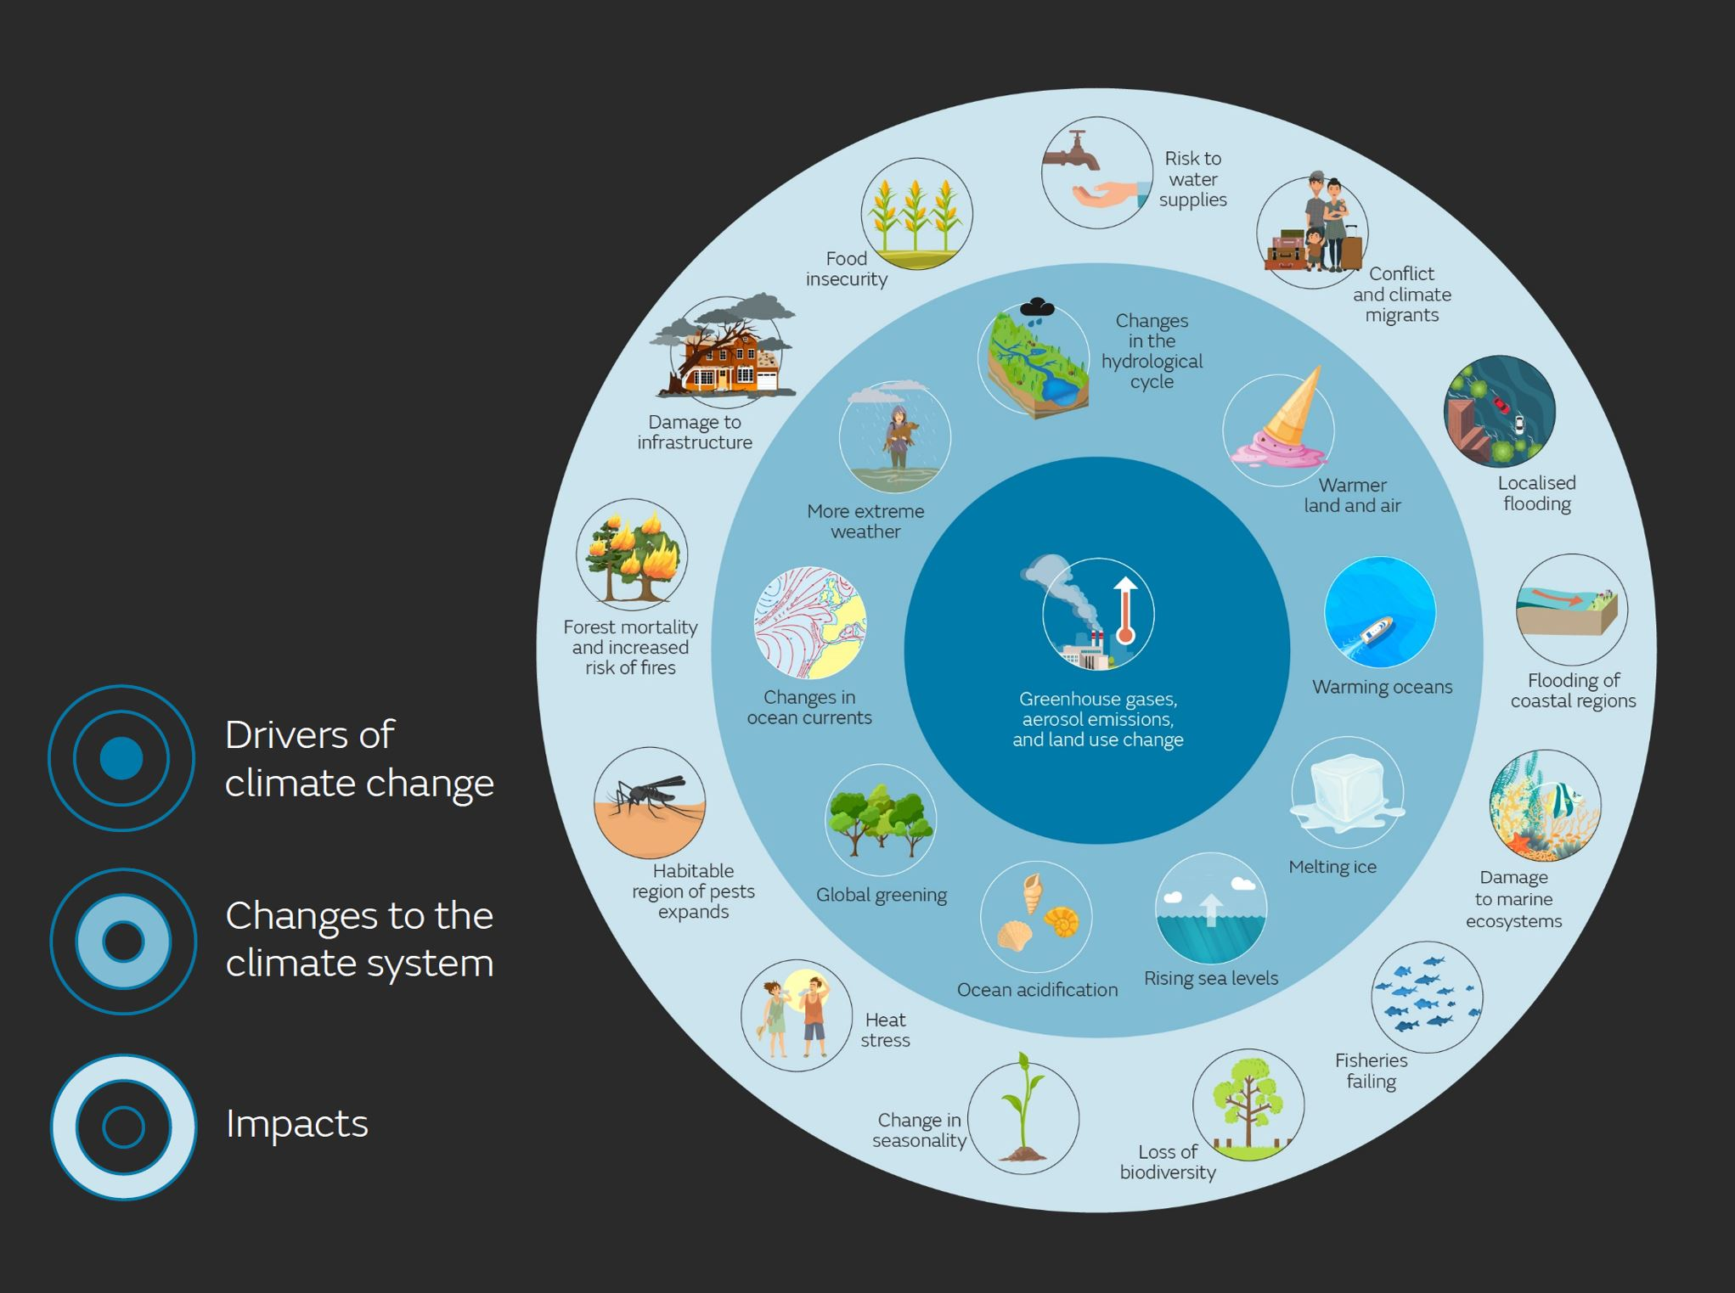
Where we’re at (more or less) now

Slide 7
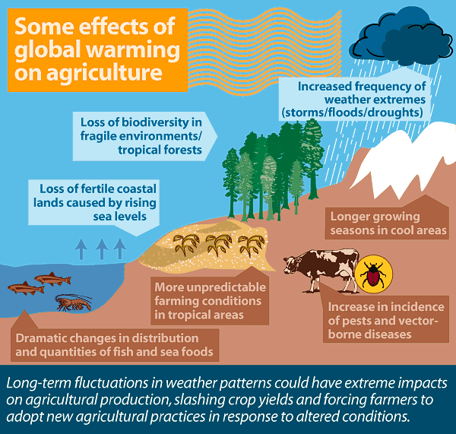

Slide 8
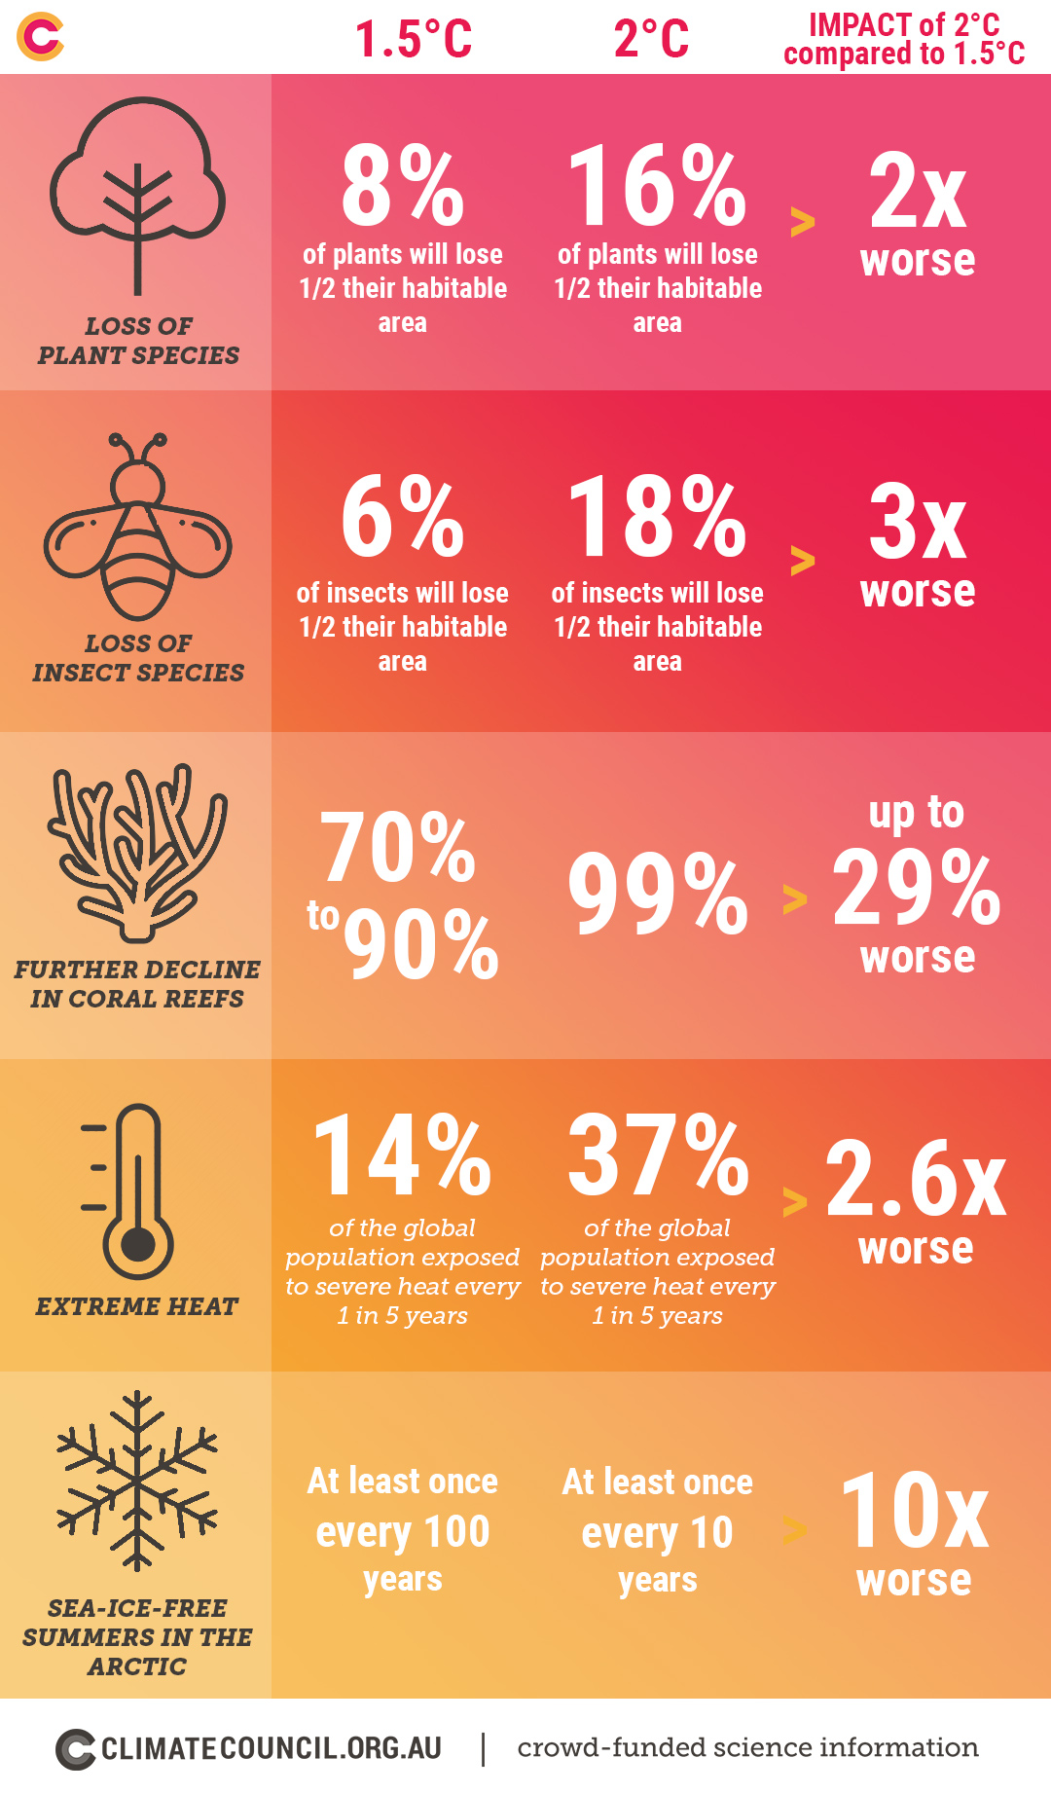
Consequences of 2 degrees of warming

Slide 9
At 2 degrees global warming
Around 65 million more people are exposed to exceptional heatwaves
Disappearance of Arctic sea ice
10 million more people flooded by rising coastal waters
Rapid decline of world food supplies
99% coral reefs disappear
6 million square kilometres of permafrost will melt across the Arctic

Slide 10
At 2 degrees
What would this mean for UK?
Hotter, drier summers, drought, fires
Warmer, wetter winters, flooding
Sea level rise – some coastal collapse, low lying areas submerged
Tropical diseases spreading to UK
Food shortage from failures of staple crops
Huge refugee crisis/political instability

Slide 11
Consequences of 3 degrees warming
Planet hotter than at any time in last 3 million years
Almost all mountain glaciers gone
About one third of earth’s land surface subject to unliveable heatwaves
Sahara desert spreads into Europe
Sea level rise could be as high as 2metres by end of century
Staple food crops fail, mass famines, millions are made homeless, refugee crises, unrest, war

Slide 12
Consequences of 4 degrees warming
Worst mass extinction since dinosaurs (scientists already describe us as living now through the sixth mass extinction; this is described as the ecological emergency which is running in parallel with the climate emergency and of course is completely interrelated)
Escalating heat takes us quickly to 5 and 6 degrees of warming
Human civilisation as we have known it is basically over

Slide 13
Adaptation and mitigation
Adaptation – adapting to life in a changing climate – involves adjusting to actual or expected future climate.
In the absence of effective government and international leadership, communities around the world have been and are endlessly inventive in adapting to the challenges of changing weather patterns. Sometimes governments and international organisations have been proactive in supporting initiatives eg expansion of flood defences in UK.
Mitigation – reducing climate impacts – requires reducing the flow of heat-trapping greenhouse gases into the atmosphere.
This involves reducing the burning of fossil fuels (coal, oil, gas) as fast as possible, and doing everything to increase the efficacy of carbon ‘sinks’. It doesn’t take much imagination to look around and see that efforts by governments to do this have been woefully inadequate as, despite widespread agreement around targets (see Paris COP 2015) the increase in atmospheric carbon continues to rise steadily.
https://climate.nasa.gov/solutions/adaptation-mitigation/

Slide 14
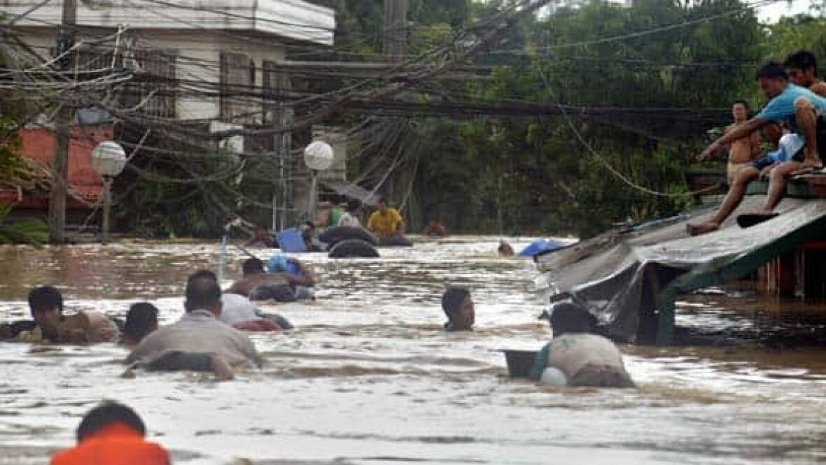
Adapting to climate change

Slide 15
Case study: Pasig city, Philippines
In 2009 Typhoon Ondoy struck the Philippines and displaced hundreds of thousands of people.
People living in ‘informal settlements’ in Pasig City in Manila not only lost their homes but were told by the government that they would have to relocate because future storms would only get worse.
Many people wanted to stay, close to where they’d raised their families and where their jobs were. So they worked with local stakeholders, the government, and international partners to develop a plan for climate adaptation

Slide 16
The community members selected a part of the embankment to reduce the risk of flooding.
They erected buildings with stronger materials that could resist winds and flooding.
They strategically placed key infrastructure in more protected sites.
Results:
Many, not all, residents were rehoused in a more resilient position.
The project provided a model for other communities to follow.

Slide 17
Mitigating climate change
The world is now at around 418 ppm (parts per million carbon dioxide in the atmosphere). Prior to the Industrial Revolution this figure was around 280ppm.
The scientific consensus is that we have gone too far to return to the pre-industrial balanced atmosphere that supported the successful evolution of the human species.
The goal now is to mitigate the effects through, for example, the expansion of sustainable technologies such as solar and wind power; the development of alternative technologies, changing people’s behaviour around consumption and travel etc

Slide 18
Who is responsible for making change happen? Well, everyone? Whilst individual behavioural change is vital (at least because it involves change of mindset) the scale of adjustments needed requires massive action by governments, ‘prompted’ of course by all of us:
Public information as to nature, speed & scale of changes needed and making it easier for people to consume (food, clothes, travel) more sustainably
Create structure for fair, secure, sustainable low-carbon world by:- Cutting fossil fuel subsidies & high-carbon use incentives
Introducing incentives for low carbon use eg home insulation & heat pumps, electric vehicles
Encourage private investment by investing in infrastructure & training for green economy & new green industries
Setting regulatory framework to require businesses to adopt sustainable business models, including agriculture

Slide 19
The most important thing of all: Leave fossil fuels (oil, coal, gas) in the ground
There are so many actions we can and must take but the core of it remains a full scale assault on the fossil fuel industry
Individual lifestyle choices will help: using a green energy supplier, turning the heating down or off, walking, cycling, using public transport
Really effective and NO COST is writing often to your MP on issues of climate and the environment. It takes just a few minutes to email.
Search ‘write to them’ and everything you need is online. MPs are required to reply and they do take notice of the numbers as well as the subject they’re being contacted about https://www.writetothem.com/

Slide 20
The pedagogical problem
How do we teach subjects about which we may feel emotionally vulnerable, and fear our pupils will be vulnerable too?
Question…. Are there other areas of the curriculum which you find uncomfortable and would rather avoid? What did you learn - or not learn - as a student from teachers who had the same problem?

Slide 21
Reasons to be cheerful
Adapating and mitigating – as individuals make changes to their lives they tend to spread the good news! As the philosopher said, one virtuous act tends to lead to others.
Economics – the affordability of new technologies is rapidly falling which means we are in the midst of a great expansion. Done well, this should lead to many developing countries ‘leapfrogging’ the dirty development phase of the old industrial revolution involving fossil fuels
The low cost of renewables is putting pressure on fossil fuel companies who are seeing a steady drift of investors away from them. Campaigners often focus on fossil fuel divestment as the fastest and most urgent path to preventing climate disaster
Carbon capture and storage – CCS – promising but at present not scaleable. It’s a reason for hope but cannot be argued by politicians as a reason for not acting now because the technology isn’t there yet.
Human ingenuity and determination to solve problems is amazing and inspiring –stories abound. Listen, for example, to ’39 ways to save the planet’: https://www.bbc.co.uk/programmes/m000qwt3
A new respect; a new sense of interconnectedness between human beings and our environment? In the words of the song, the sense that ‘You don’t know what you’ve got till it’s gone’ is a wake-up for so many people to recognise and protect the extraordinary beauty of our planet.

Slide 22
Back to the Nature Table?
Climate change and the global ecological emergency are not easy subjects to teach.
Because teachers are supposed to be inspiring!
A very long time ago every primary classroom had a nature table. Onto this eager children would place conkers, and funny looking stones, and feathers, and twigs. Then quite often the teacher would gather everyone around to admire and chat about these things.
Now I remember this well. I can’t say I think the seven year old me learnt much, but there is a lesson here. Which is: in every which way possible maybe the job of teachers right now is to help children fall in love with the world around them again.

