Slide 1
Supporting New Arrival and Advanced EAL learners
Warwick University- January 17th 2022
Amanda Millican EAL Advisory Teacher
Notes:
I work as an advisory teacher in both Solihull and Coventry.

Slide 2
Aims
  Explore the difference between New Arrival EAL learners and more Advanced EAL learners
  Offer practical advice on strategies and resources which encourage academic language development for EAL Learners:
          Making the academic language of the classroom comprehensible
          Scaffolding the production of the academic language in the classroom
          Supporting the building up of vocabulary

Slide 3
Why increase in demand for advice on supporting EAL learners
1.6 million recorded as having a first language known or believed to be other than English (Census January 2021)
41% of teachers now work in English schools in multilingual settings (OECD Teaching and Learning survey)
School closures have had a greater negative impact on learning for pupils using EAL (NFER survey 2021)
UKRS,ARAP, Operation Warm Welcome programmes have increased the amount of EAL learners in schools recently
Notes:
1,608,270 pupils recorded as having EAL (CENSUS –January 2021) 1 in 5 pupils (19.3%)

Slide 4
DfE Definition of EAL learner
"A pupil is recorded as having English as an additional language if she/he is exposed to a language at home that is known or believed to be other than English. It is not a measure of English language proficiency or a good proxy for recent immigration."
(DfE- English proficiency of pupils with English as an additional language February 2020)
Notes:
1. The percentage of pupils with EAL in all state-funded schools in England is:
a.19
b. 22
c. 27
2. The Number of pupils with EAL is:
a. 1.6 million
b. 2 million
c. 1.2 million
3. The most widely spoken language in English state-funded schools after English is:
a. Punjabi
b. Polish
c. Urdu

Slide 5
Fluency in social language can be mistaken for fluency in academic language and therefore a pupil’s needs can be overlooked
Differences between English Language Proficiencies of our EAL learners
BICS – Basic Interpersonal Communication Skills
CALP – Cognitive Academic Language Proficiency

Slide 6
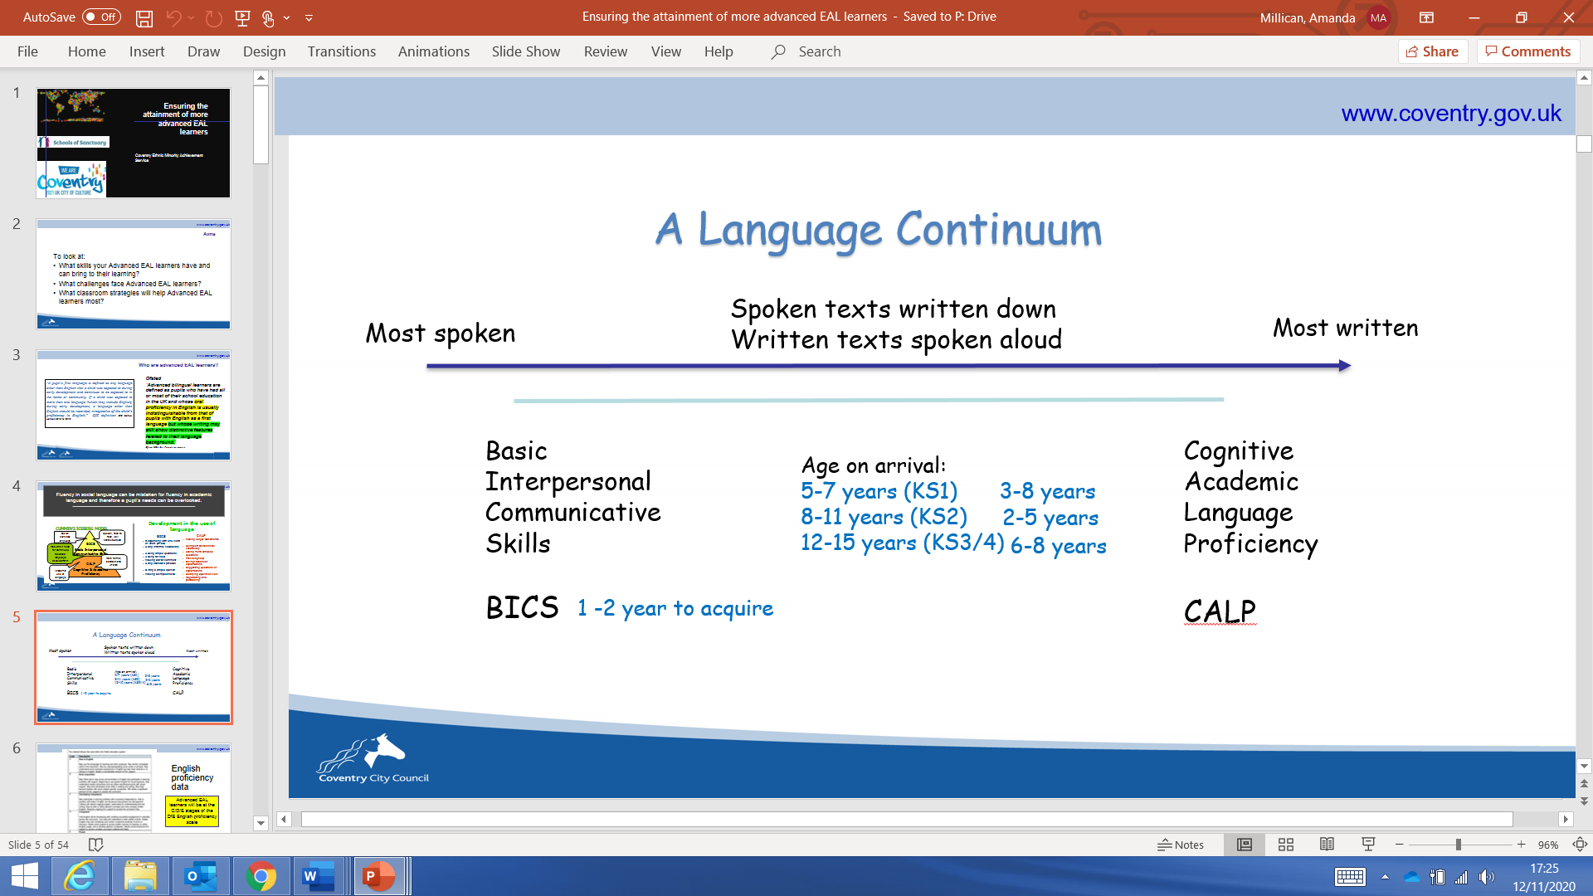

Slide 7
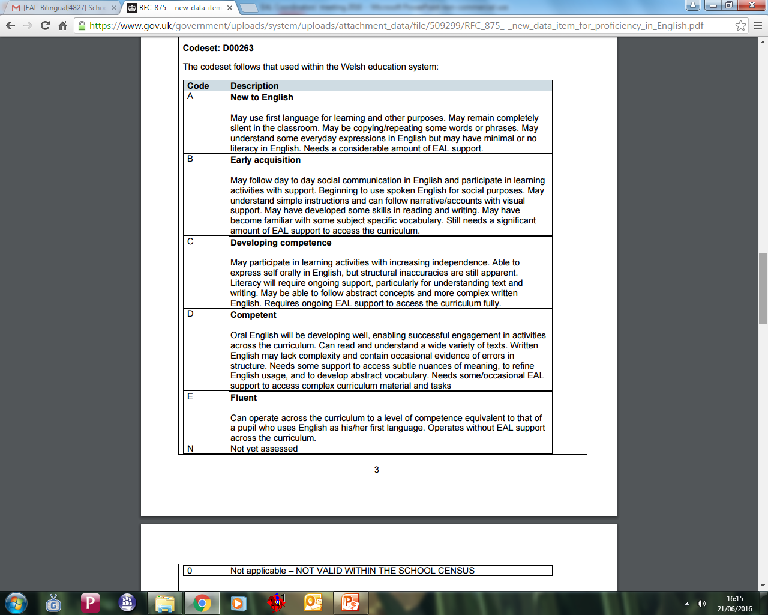
English proficiency data
New Arrival EAL learners will be at the A/B stages of the DfE English proficiency scale
Advanced EAL learners will be at the C/D/E stages of the DfE English proficiency scale
Notes:
New Arrivals and Advanced EAL learners will need support to access the curriculum:
They will need language scaffolds so that they can access the content of the lesson and depending on the level of the learner, will depend on the degree of scaffolding.

Slide 8
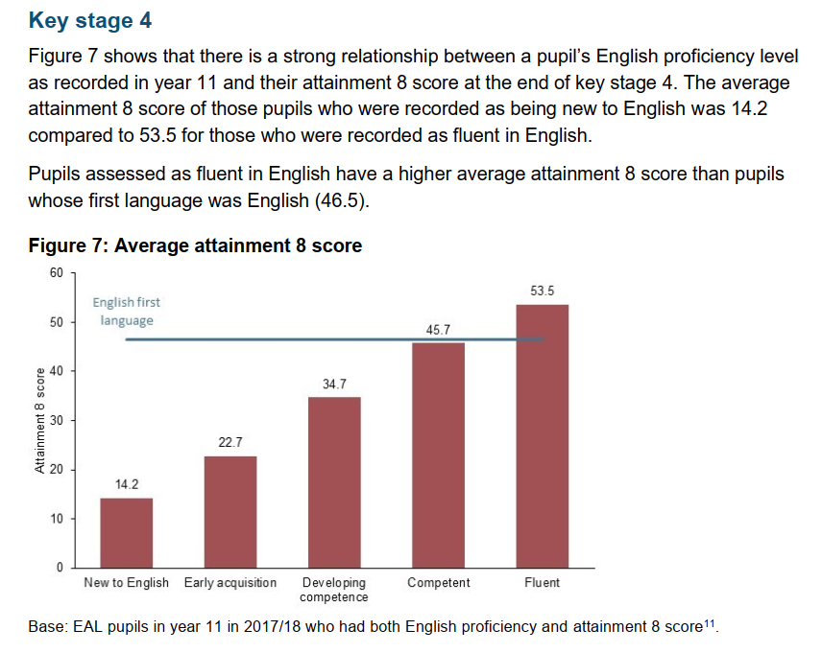
Links between English Proficiency and Attainment
What are the implications for EAL students who are DfE level C – Developing Competence?
“English Proficiency of pupils with English as an additional language Ad hoc Notice”, February, 2020, DfE
Notes:
Strand and Hessel 2018 - carried out some research looking at similar data to this – but that had been collected from Local Authorities. Their research suggested a strong link between English proficiency and academic attainment. Eal pupils with different levels of proficiency - varying levels of achievement. The greater the English proficiency - the greater the achievement – indicates strong link between English proficiency and educational achievement.
What are the implications for EAL students who are grade C – developing competence? - In danger or underperforming. Strong relationship between English proficiency level and the likelihood of them reaching age related expectations. This shows the need to develop academic language – at grade C they are able to communicate socially and access some curriculum content but unless they can make use of academic language and structure their writing correctly and in an appropriate register they will not meet their potential .

Slide 9
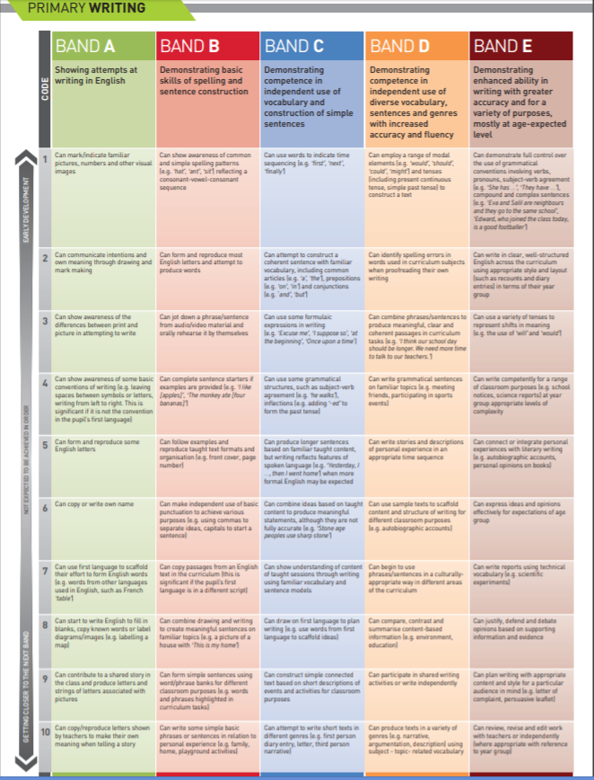
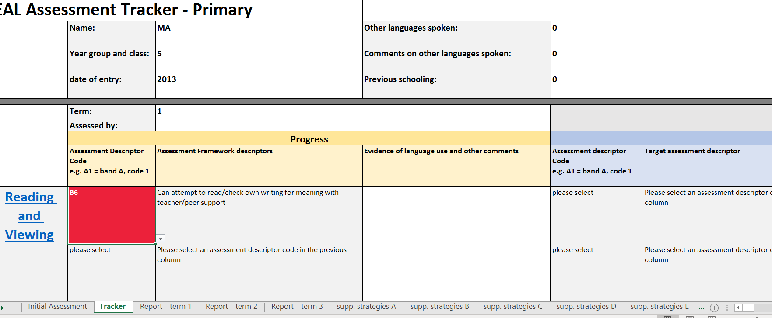
Importance of tracking progress of English proficiency
/The Bell Foundation Assessment scale
https://www.bell-foundation.org.uk/eal-programme/eal-assessment-framework
Notes:
AM Training opportunity- January 12th 2021- Assessing, Progress tracking and Target setting.

Slide 10
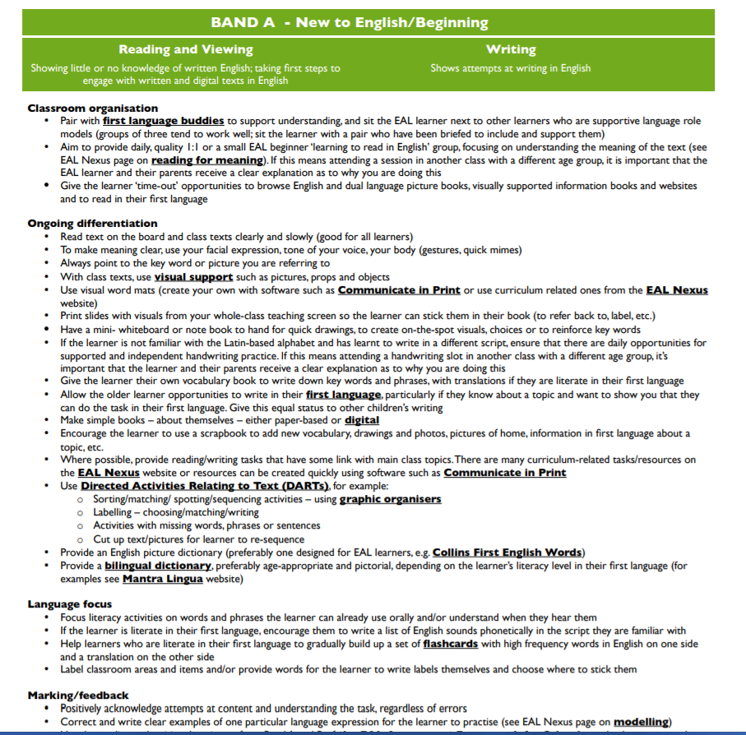
Support Strategies linked to tracker
Strategies to support
Listening, speaking, reading and writing
Strategies to support the 5 DfE levels
Covering the following areas:
  Classroom organisation
  Ongoing differentiation
  Language focus
  Marking/feedback
  Communication with home
e.g. Communication with home
Give parents useful websites for EAL such as the British Council’s Learn English Kids, which has plenty of audio-visual stories with clear text, and BBC bitesize KS1 , which has grammar exercises for EAL learners
Notes:
AM
Published in 2017
Divided by band and then oracy and literacy skills
Covering 5 different support areas

Slide 11

Caio- Year 7
EAL New Arrival DfE level A/B
UK Arrival: October 2020
Country of Origin: Brazil
Came with his parents and older sister. Parents work full-time.
First/Home language Portuguese
Age related Literacy in Portuguese.
Very shy and initially refusing to speak in English. Enjoys and is good at football
Full primary education in Brazil- unable to contact previous school
What were Caio’s assets as a newly arrived EAL learner?
What challenges did he face?
Notes:
Place in the Chat: What assets will Caio bring to his EAL learning
What challenges will he have?

Slide 12

Amina - Year 9
Advanced EAL Learner
DfE level C
UK arrival: June 2018
Country of origin: Syria but
lived in Lebanon for 3 years
Family are part of VPRS project
Refugee Status
First/Home Language: Arabic
Some basic literacy in Arabic
but unable to read fluently
Some schooling in the Lebanon- unable to obtain specific information
Outgoing and friendly, her older brother has special needs and so she translates for the family.
What were Amina’s assets as an advanced EAL learner?
What challenges did she face?
Notes:
Place in the Chat: What assets will Amina bring to her EAL learning
What challenges will he have?

Slide 13

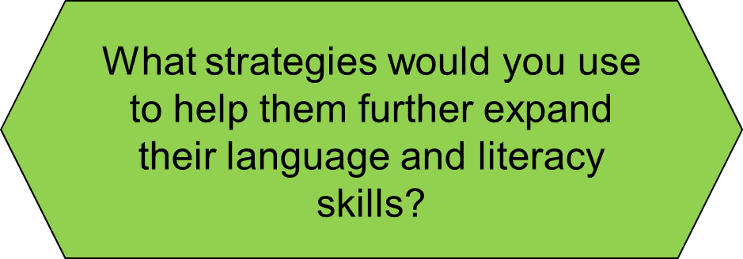

EAL New Arrival and more Advanced EAL learner
Caio Year 7 | Caio has previous literacy in Portuguese Family value the importance of education Good at football | Parents work full-time and unable to support Limited access to resources at home: no lap-top/limited wi-fi Reluctant to speak in class and to adults
Amina Year 9 | Very determined to help herself some literacy in Arabic Outgoing personality able to make friends easily and to acquire BICS. | Understanding academic language Missed education in Syria/Lebanon Constructing complex sentences Lack of vocabulary in English In low ability sets with restricted language models Understanding and answering assessment questions Understanding logging onto Teams
Notes:
Go to chat

Slide 14
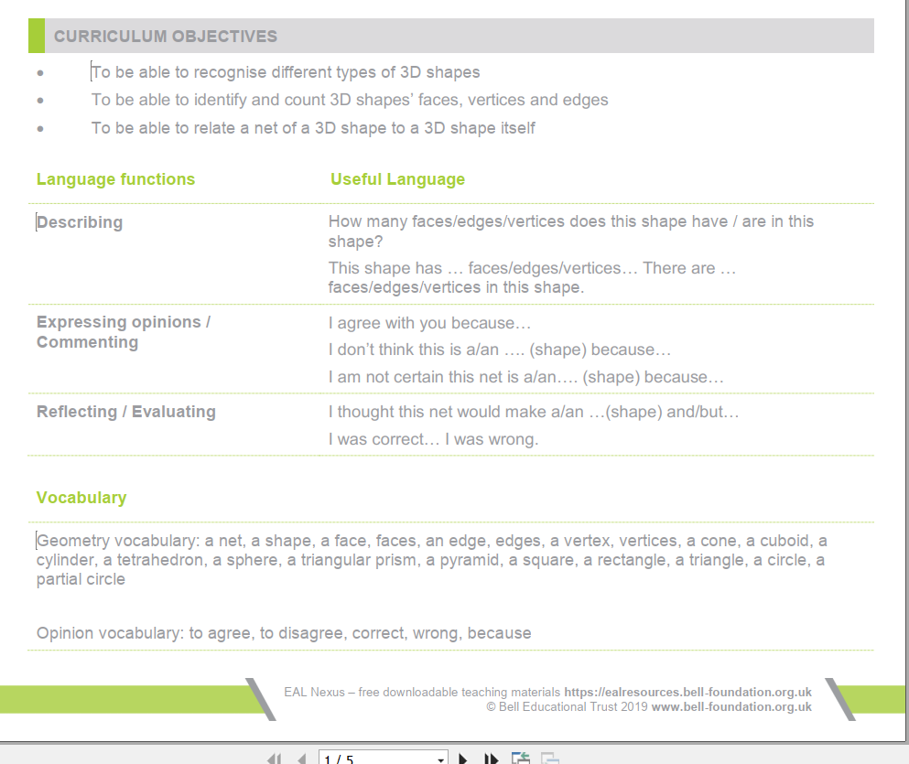
Identifying the language challenges; planning for language development
Identify the language functions for the lessons/series of lessons
Establish the language structures needed to carry out the functions for pupils to both understand and produce
Identify subject specific vocabulary and key content vocabulary
https://www.bell-foundation.org.uk/resources/detail/3d-shapes/
Notes:
The Bell Foundation EAL Nexus resources- Teachers Notes

Slide 15

Making the academic language of the mainstream classroom understandable
Notes:
Learners with EAL have a dual task at school: to learn English (language) and to learn through English. For this reason, EAL teaching aims to teach English using the mainstream curriculum as the context.
Specific teaching strategies and resources are therefore necessary to make the language of the curriculum accessible to learners who use EAL

Slide 16
How could you adapt instructions/questions for pupils using EAL?
I want you to open your books and spend the next quarter of an hour doing Exercise 3 on page 62 in silence.
New Arrivals
Instructions need to be graded\\d
Avoid sentence headers/colloquial terms
Decide on and use consistently short repetetive language structures for classroom instructions
Slow down and repeat instructions
Consider position of EAL learner
Support with key visuals/body language
Ask closed, either/or questions to provide model language in question
Advanced EAL learners
Will understand sentence headers, ‘What I want you to do is…’
Will understand vague language and sentence fillers ‘um…let’s see, ‘sort of’
Clarify classroom procedure-point to the key visual indicating different forms of classroom practice
Place timer on the board 15:00
Modelling/rehearsing how to answer the first question
Use open questions to encourage higher order language (justifying, clarifying, describing)

Slide 17
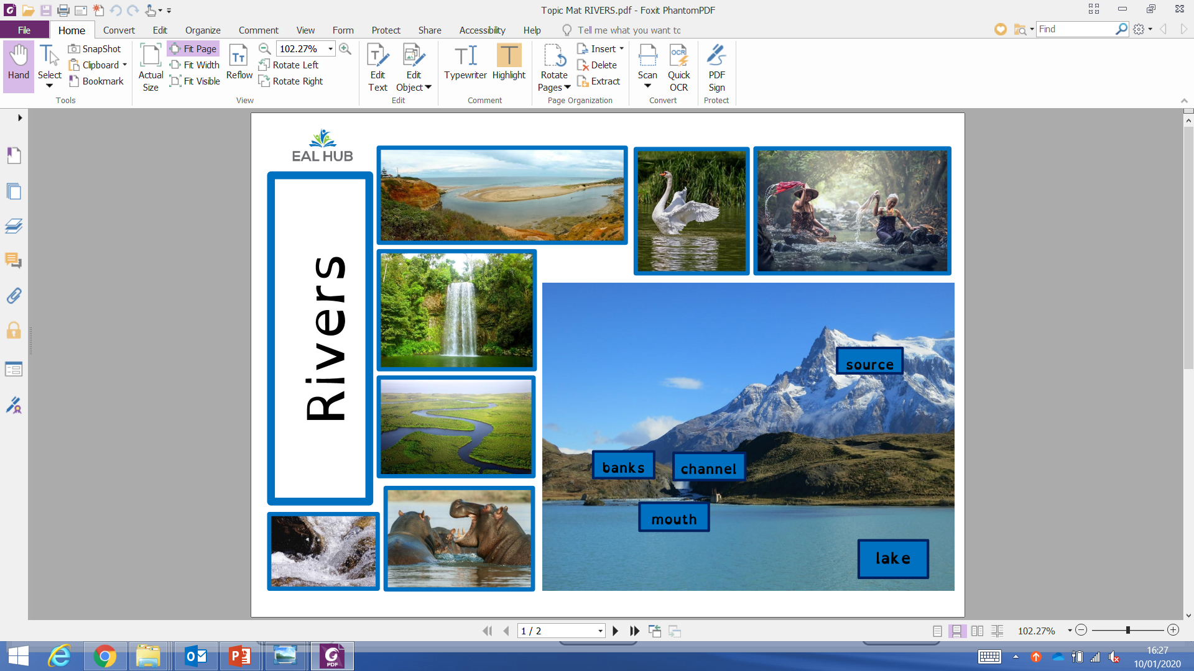
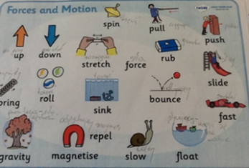
Pre-visiting- key vocabulary and language structures
Identify key vocabulary & sentence structures in planning
model it in context;
link with visuals;
draw attention to it and use it in other contexts;
encourage learners to listen out for language and circle/highlight;
display it;
provide opportunities to practise it.
Where possible, support children in making connections to similar vocabulary in their first language.
Notes:
AM
Vocabulary is one of the key language features for EAL learners and will be the starting point for many children new to English. Enabling these children to develop an understanding of new vocabulary is a process that occurs over time and requires numerous encounters. To teach new vocabulary, teachers will need to:

Slide 18
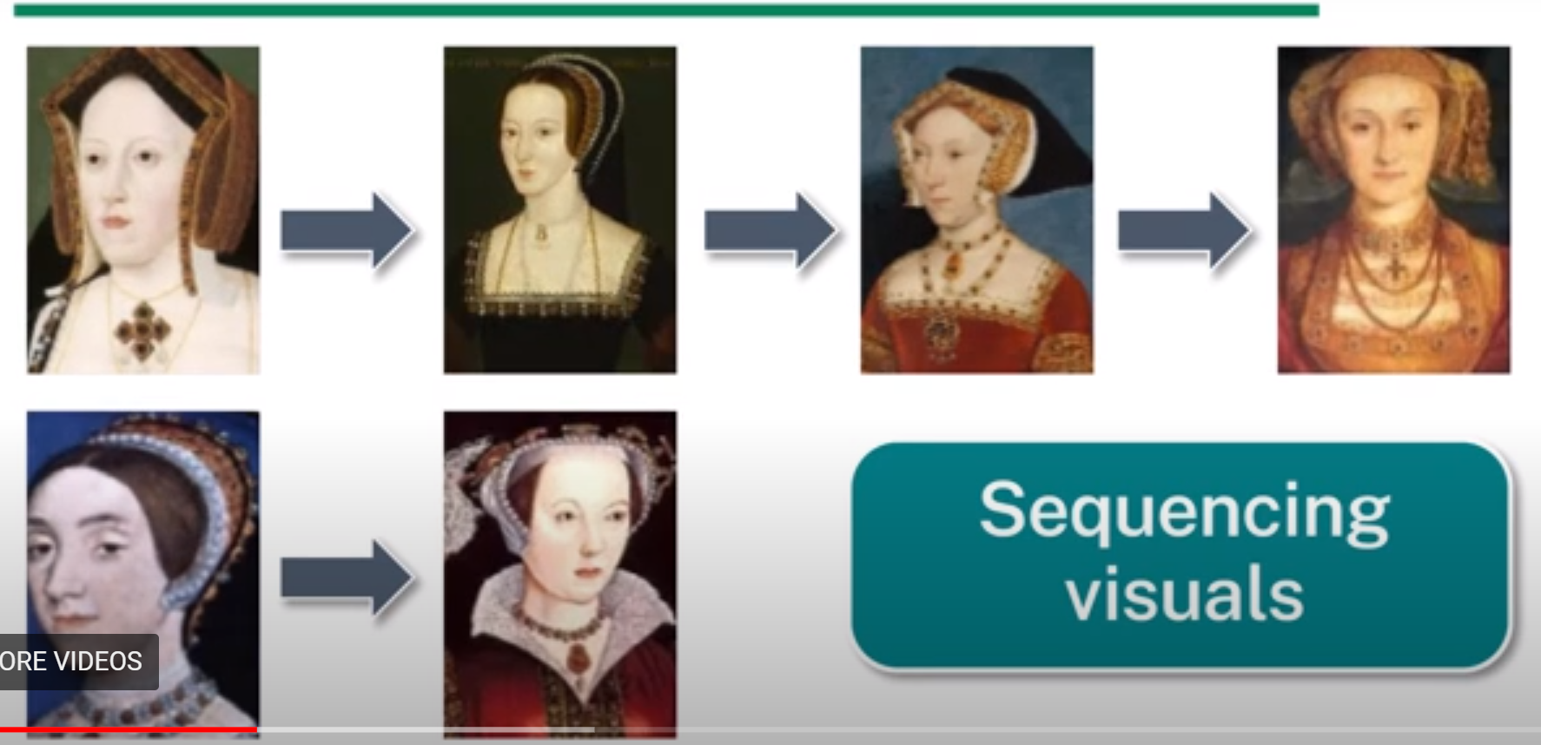
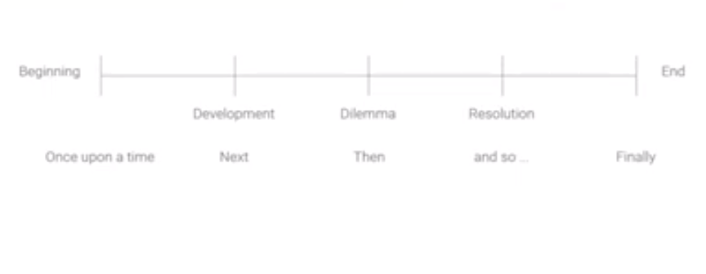

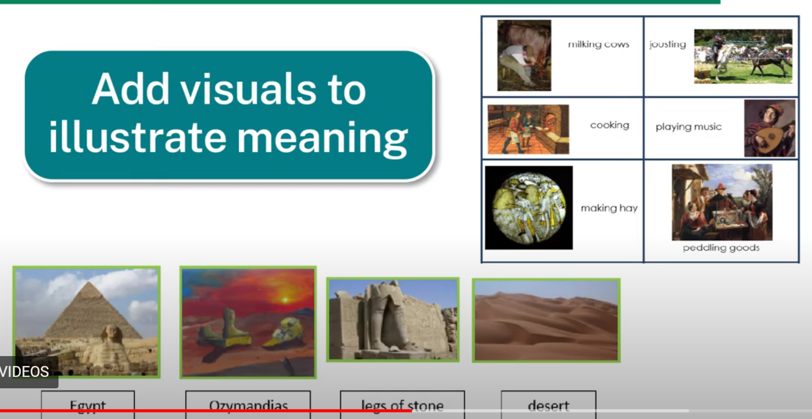
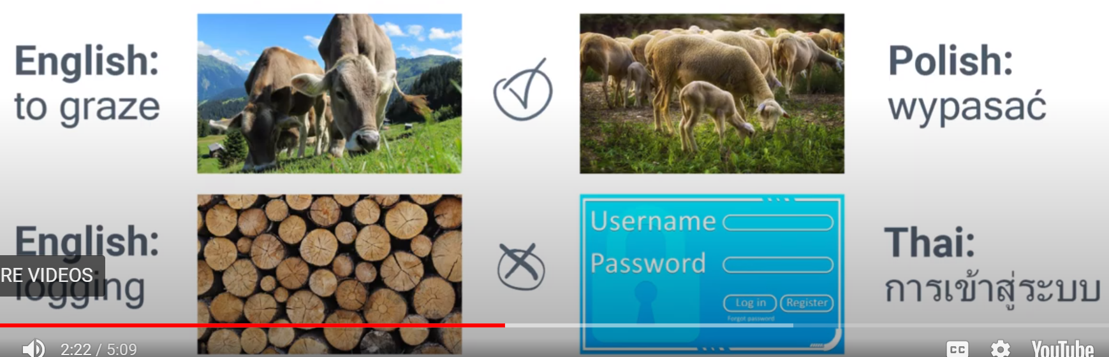
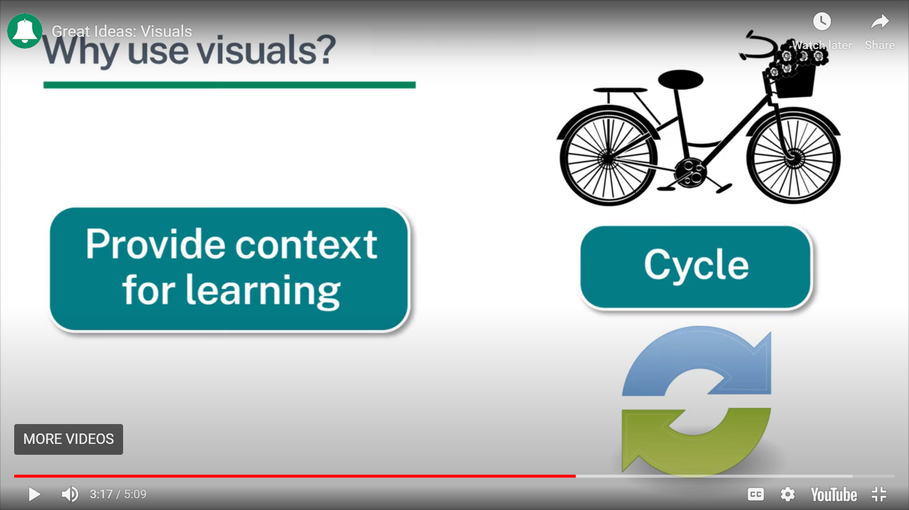
Scaffolding Understanding- Key Visuals
Key visuals and Graphic organisers
Enable learners to demonstrate what they understand
Illustrate meaning immediately
Clarify meaning
Provide a clear context for words used in the classroom
Notes:
Why use visuals: https://www.bell-foundation.org.uk/eal-programme/guidance/effective-teaching-of-eal-learners/great-ideas/visuals/
-remove the language barrier
-Illustrate meaning immediately (EAL Nexus- History lesson on Tudors and English lesson on the poem Ozymandias)
-clarify meaning with image searches on Google Images
-provide a clear context for vocabulary used in the classroom

Slide 19
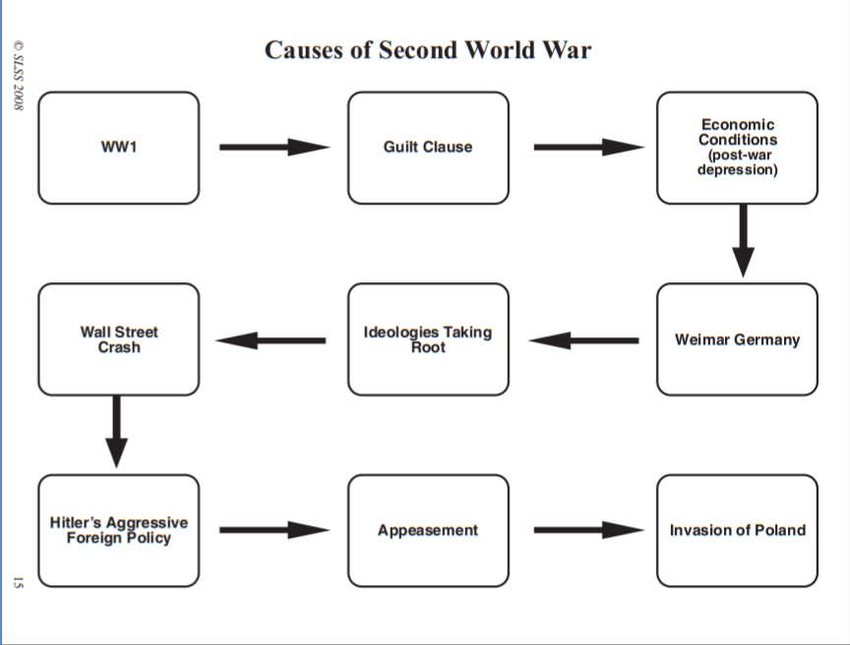
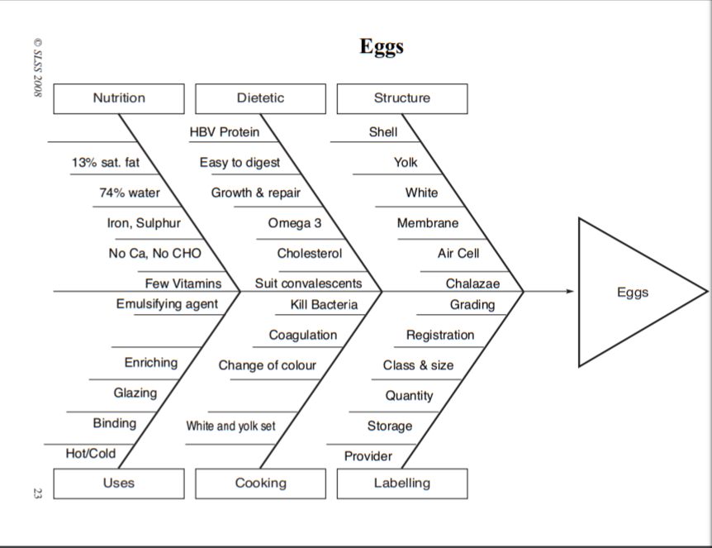
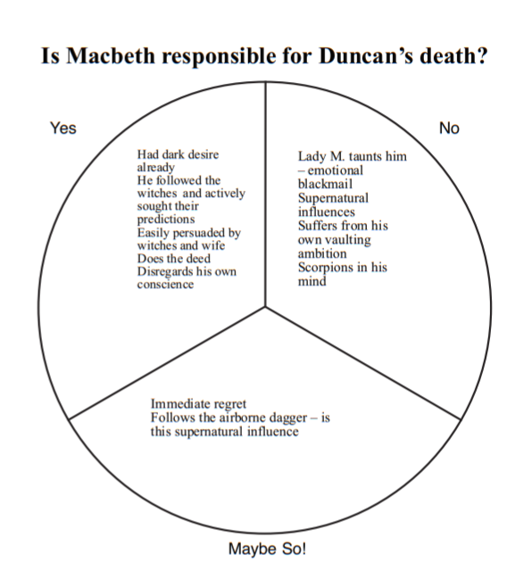
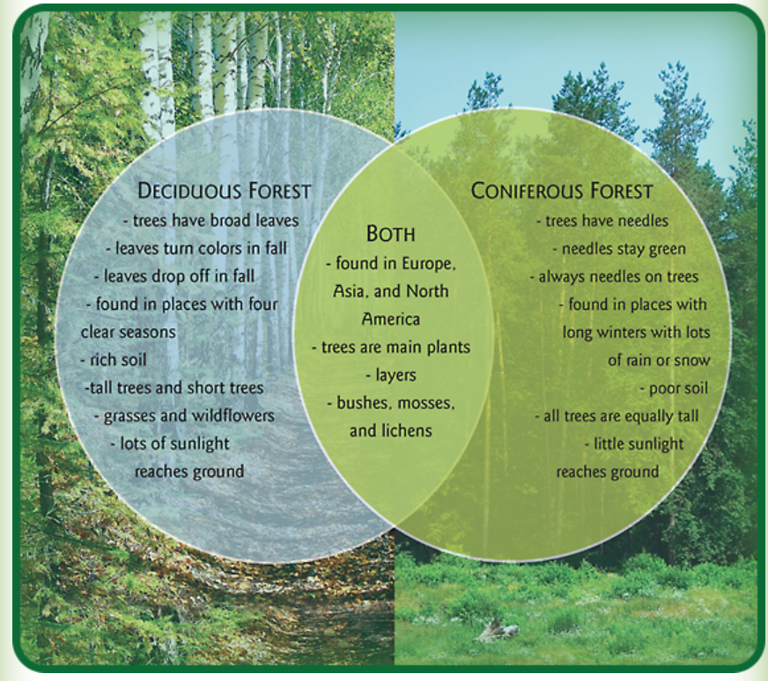
Scaffolding Understanding- Key visuals and Graphic Organisers
Notes:
A graphic organiser is a way to:
allow EAL learners to see the relationship between different ideas (makes the content more understandable)
To understand more complicated language structures – full lesson content is made accessible to EAL learners
Allow them to organise their thoughts before speaking and writing
First language can be included/ they can translate themselves

Slide 20


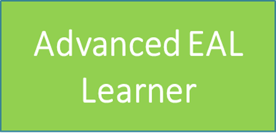
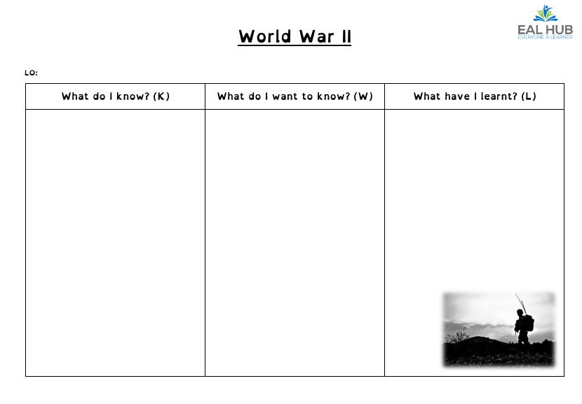
Scaffolding Reading for Understanding
Pre-visit texts/key vocabulary before the lesson
Find out where the gaps are and help learners fill them (KWL charts)
Use KWL grids to activate prior learning
Notes:
KWL charts are an effective strategy to build background and to check prior learning and should be used at the beginning of a lesson or topic.

Slide 21

Predicting from the Title, First Sentence, key words or video clip
Before
“There is no lake at Camp Green Lake.”
Key words
Dry wasteland shrivelled
Rattlesnakes scorpions camper
What do you think this book will be about?
Notes:
Use first language by translating the key words or asking EAL learners to do this themselves.
Be aware of Cultural Capital
Writing predictions in L1 –New Arrival

Slide 22



Shadow reading for fluency
During Reading
Give pupils a section of the text
Pupils listen to the text read aloud, with appropriate pauses and expression.
Then pupils have chance to repeat it (copying pronunciation, stress and intonation patterns.)
EAL New Arrival
Notes:
Good for:
Being able to recognise stress and intonation patterns are part of learning to listen accurately
Encourages fluency
Paired reading or reading aloud with a whole class.
Use visualisers in whole class reading

Slide 23

Margin questions
What do you expect to find out in this text?
If you drew this what would it show?
Storm hits Brighton
Yesterday’s devastating storms have left a path of destruction across Brighton. The storm began in the early hours of yesterday morning. Winds of up to 140kms an hour wreaked havoc across the coastal area, they killed one man, blacked out almost 200,000 homes, left two swimmers missing at sea, cut roads and rail lines, and damaged buildings.
A passenger in a car died when a tree fell on his car. Emergency service workers took nearly an hour to rescue the driver. The Emergency Services took around 4,800 calls as rescue personnel worked into the night. City streets became wind tunnels and many streets became impassable. Wild winds ripped off roofs and uprooted trees. In the west of the city 12,000 homes were left without power, while the wind wrenched roofs from houses and ripped yachts from moorings.
The winds finally abated at about 9pm.
What other words could you use? Look at the rest of the sentence
What does this tell you about the storm?
How could you work out the meaning of these words?
Imagine you are in a wind tunnel. What does it feel like?
What kind of movement is wrenching and ripping?
Notes:
focus learners’ attention on particular parts of a text;
model the types of questions that effective readers ask when they are reading a text;
focus on the key skills of reading such as: predicting, summarising, clarifying, questioning, hypothesising etc.;
scaffold this process by placing questions around a text and directly point the questions to where a learner can find the answer.

Slide 24
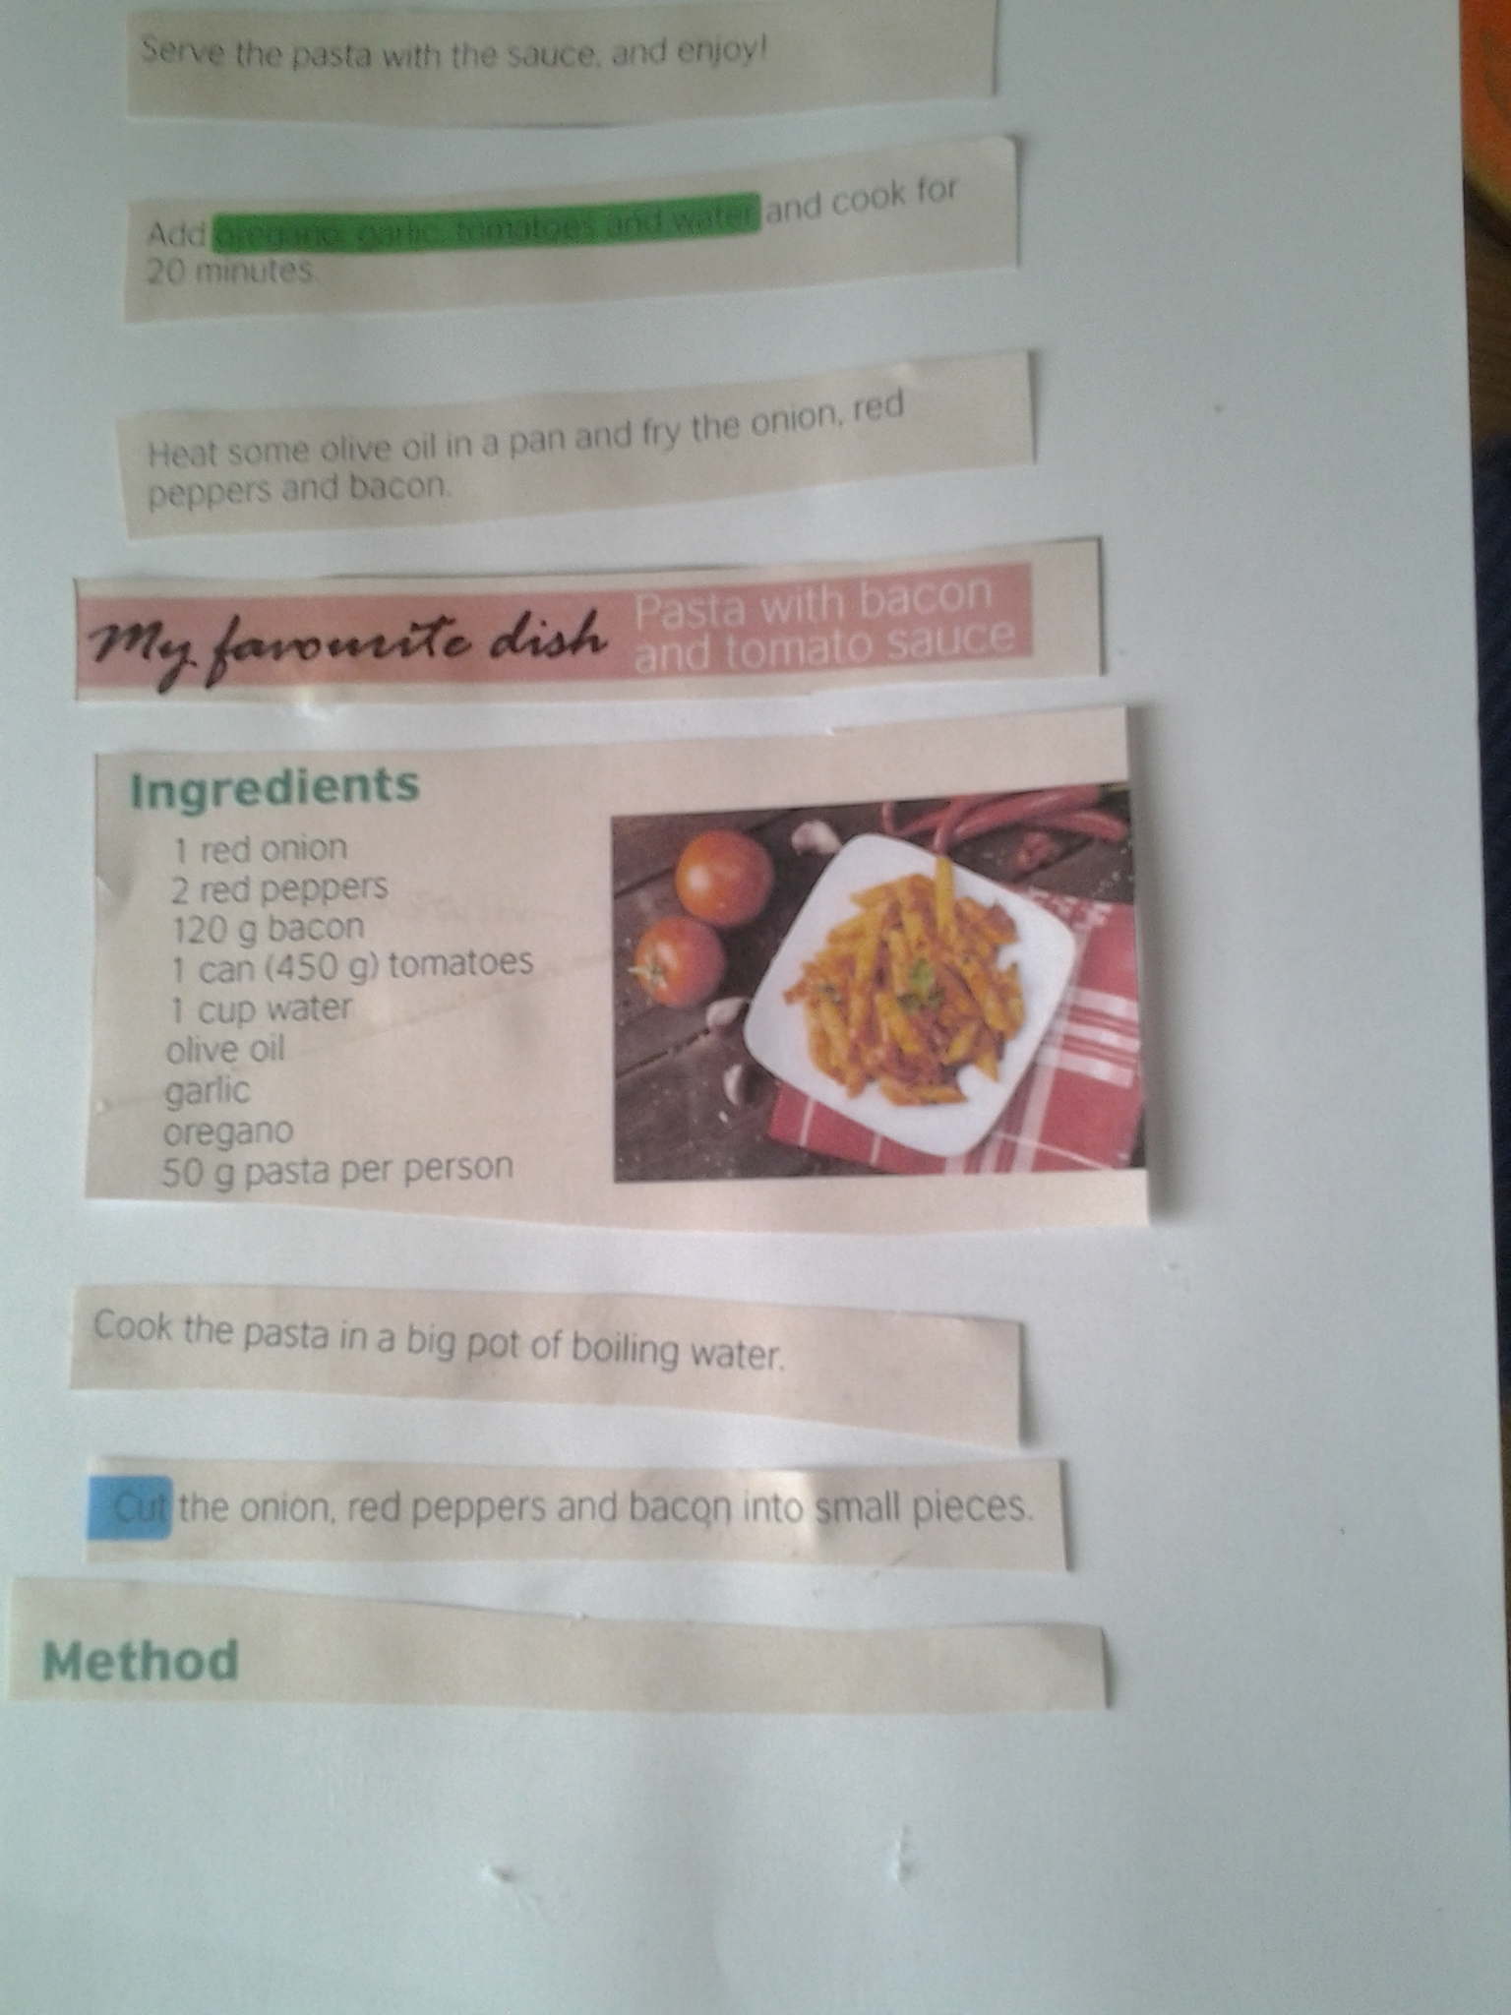
Reading for a purpose - Jigsaw Reading
During
Cut a text into paragraphs or sentences
Students must put the text into the correct order
Explain choices- assess summarising skills
Good for text cohesion, reference words and conjunctions
EAL New Arrival
Notes:
Jigsaw reading example
Text in photo taken from https://learnenglishteens.britishcouncil.org/skills/writing/elementary-a2-writing/recipe
This strategy is effective for a number of reasons.
It clarifies the knowledge that learners have about a subject or topic.
It is a good strategy to use for correct sentence construction.
It can be used to improve grammar by looking at grammatical rules. E.g. the location of connectives etc.
Most EAL learners, no matter what proficiency, enjoy the challenge of reforming sentences.

Slide 25

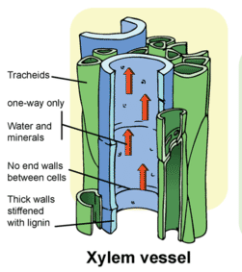
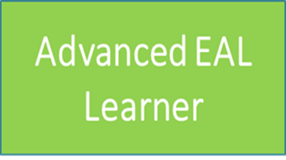
DARTs- Cloze activity
EAL New Arrival
What tense are the verbs in and why?
Xylem is the transport tissue in plants that _________ water and minerals from the roots up the plant stem and into the leaves. It ____ also important for __________ the plant. Xylem cells ___ ________ to their role as they _____ their end walls to form a continuous hollow tube to ______ the volume of the transport. Lignin is a substance which they _______, and this helps to _______ the plant.
Key words
is, strengthen, supporting, contain, carries, maximise, are adapted, lose,
Notes:
Modified DARTs activity- not to test pupils but to practise language.
Activity- focus on verbs in a text.
Use of present tense verbs in Science to indicate something is generally true, habitual and permanent.
Vanishing cloze works well and practices oral rehearsal

Slide 26
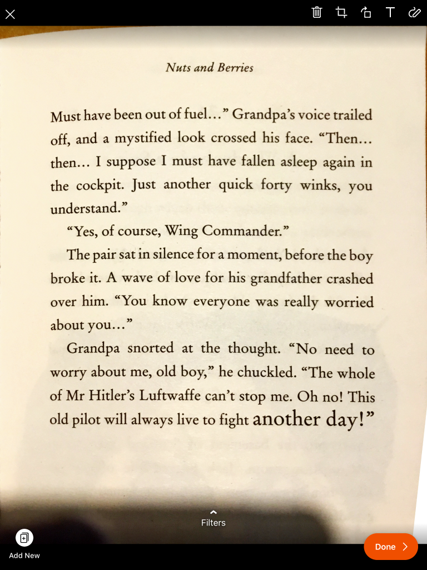
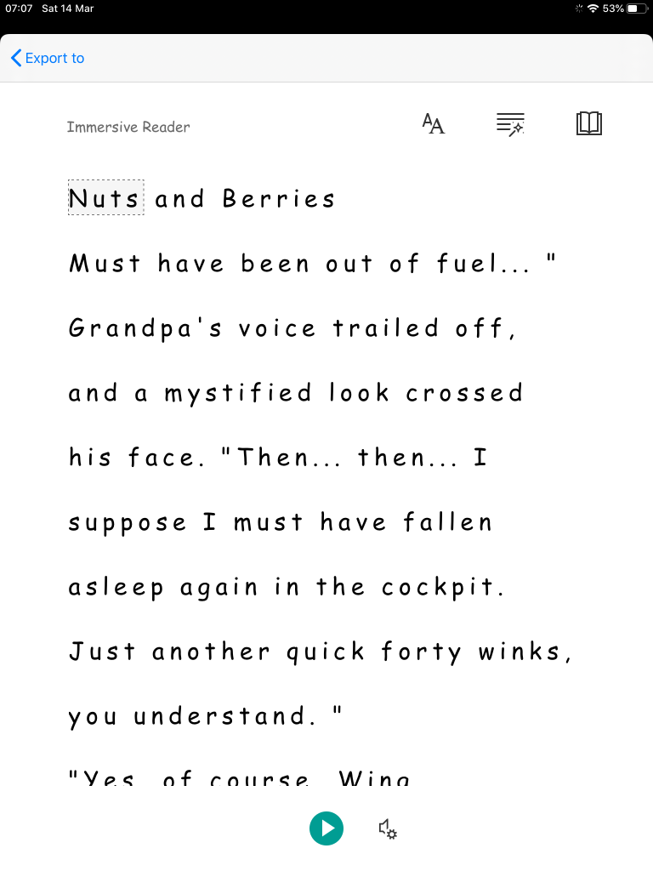
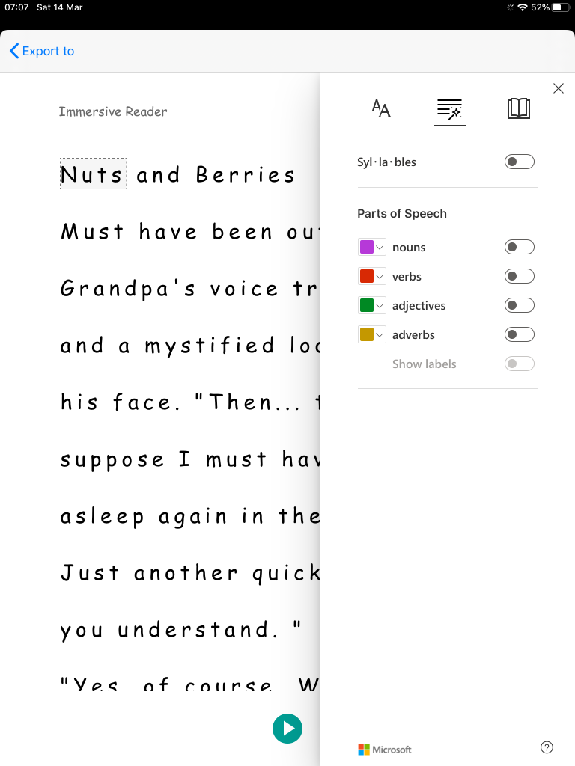

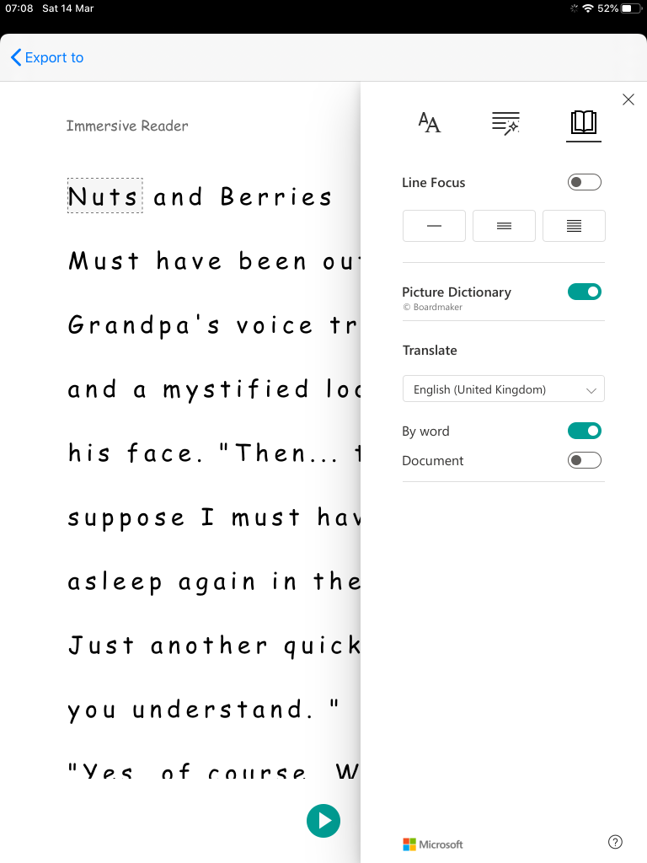

Scaffolding Reading Using Microsoft LeNS Immersive Reader on the ipad
cloze
This Photo by Unknown Author is licensed under CC BY-SA-NC
Translation
Notes:
Using Office Lens can be really beneficial to EAL learners in your classrooms.
I have used it on a number of occasions for example in a Year 11 (15 – 16 year olds) English class. The class were reading Jekyll and Hyde and through using the translation tool an Urdu speaking New Arrival EAL learner was able to comprehend the text and answer questions that were being asked to the whole class

Slide 27
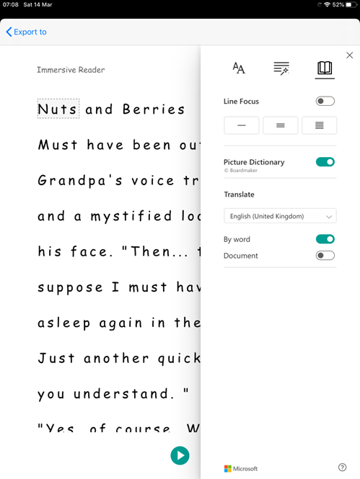
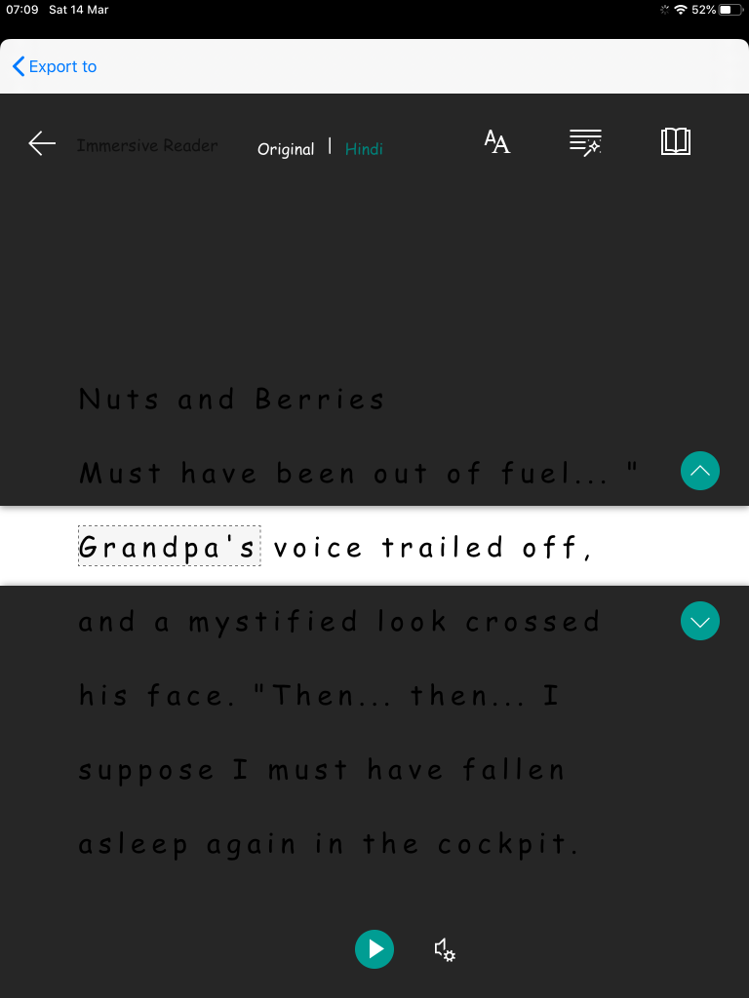
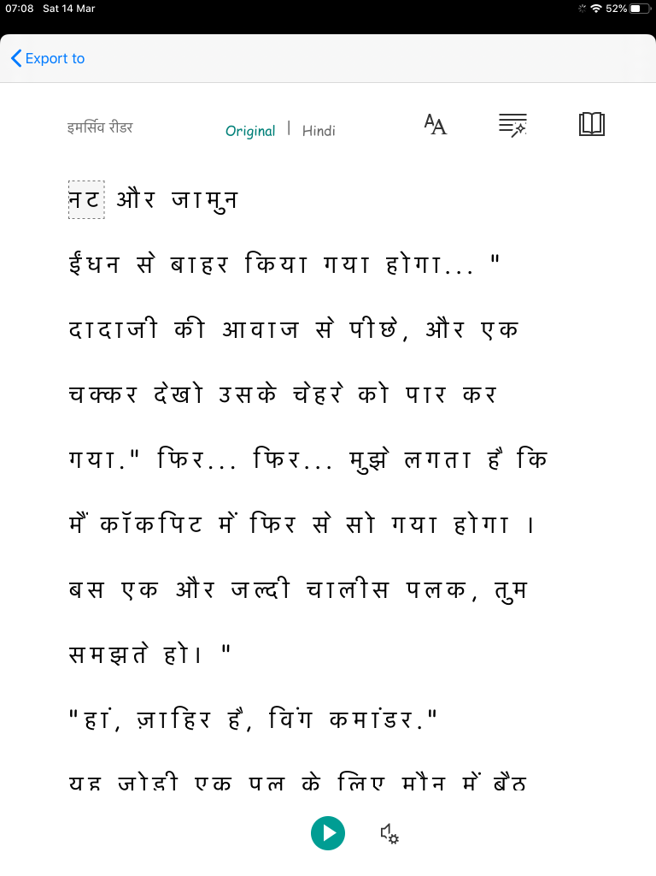






This Photo by Unknown Author is licensed under CC BY-SA-NC
Notes:
When you click on the book icon in the top right hand corner (photo above), you are given more options. For instance you can select to focus on different parts of the text. The images below show how you can focus on: single lines, 3 lines and whole paragraphs. This is a particularly helpful function for beginner EAL learners who may be at the early stages of learning to read. By focusing on specific lines as they read, learners do not get distracted.

Slide 28


Key Vocabulary-Never Heard the Word Grid/Dual language glossaries
Ref: Impact Wales
Notes:
Choice of vocabulary
Tier 1: Everyday language used in conversation
Tier 2: Cross curricular, high utility vocab found in many contexts (abstract)
Tier 3: Domain/curriculum specific (context)
Never Heard the word grids
Never heard before-Use dictionary
Heard it before but don’t know what it means-Use dictionary
Heard it before and know what it means-Write the definition
Can I use it correctly in a sentence?

Slide 29

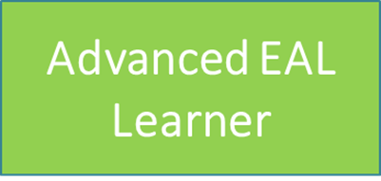
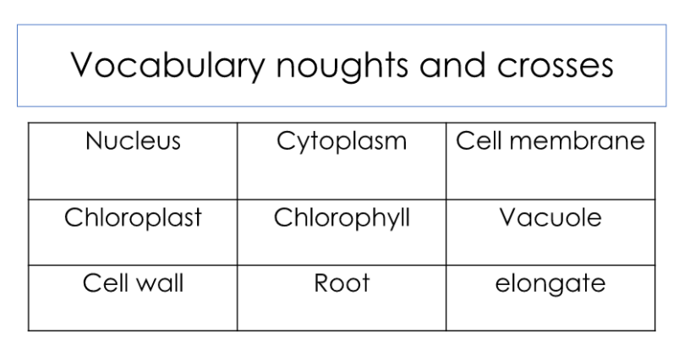
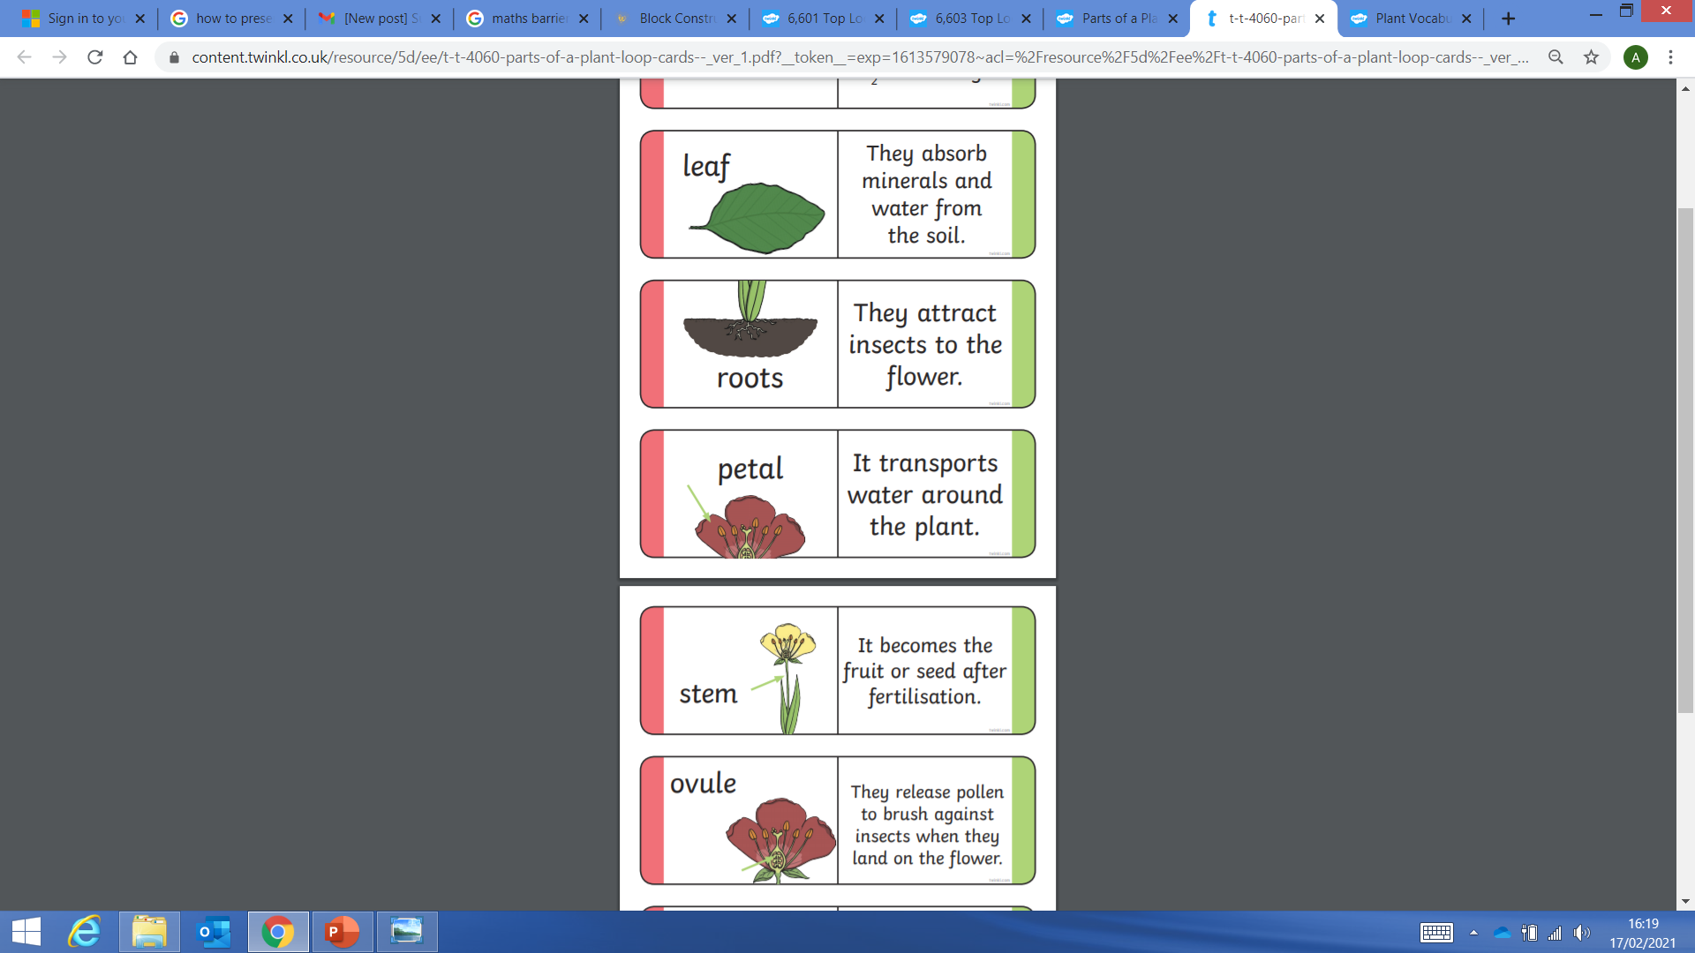

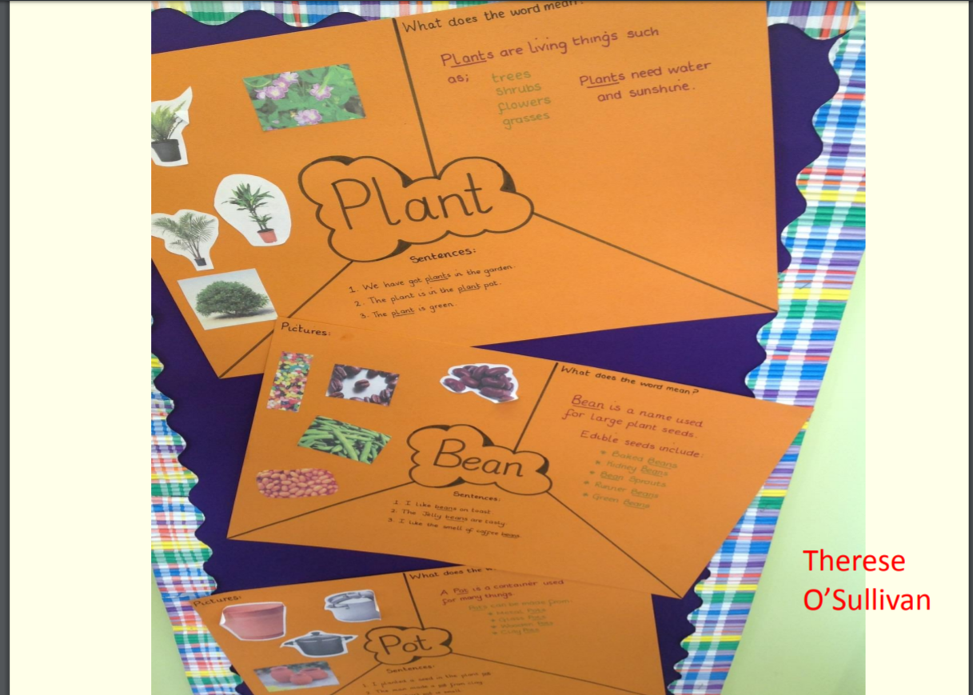
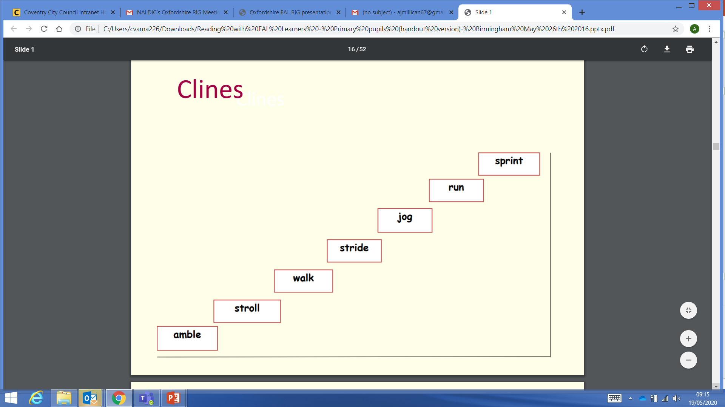
Developing academic Vocabulary
Loop activities
Os and Xs
Bingo
Odd one out
Tasks developing idioms/Clines/
Synonyms/antonyms
Notes:
Encourage personal glossaries (dual language where appropriate)
Determine the role function the word plays in the sentence.
Identify any context clues which might help define the word.
Play vocabulary games such as Jenga and Bingo to consolidate vocabulary; matching words and definitions.
Specifically teach learners how to make effective use of dictionaries, spellchecks, thesauri.
Include tasks to develop synonyms, collocations, phrasal verbs idioms and clines.

Slide 30



Vocabulary extension- Summary Bullseye
Gaunt, A and Stott A, Transform Teaching and Learning Through Talk.
The Oracy Imperative.
policeman
 | Tally | Total
5 point word
3 point word
1 point word
Overall total
died
emotions
neighbour
autism
curious
incident
lies
interview
fork
father
Notes:
Identify 15 words of varying levels of difficulty or familiarity to your pupils
Working in pairs pupils summarise what they have been learning e.g. providing a summary explanation of the plot of the book so far.
The speakers aim is to use as much of the target language as possible in their summary, their partner listens and ticks off the words as they use them and then swap over. Each get a score at the end of the task.

Slide 31


Scaffolding production of language in the mainstream classroom
speaking and writing support

Slide 32
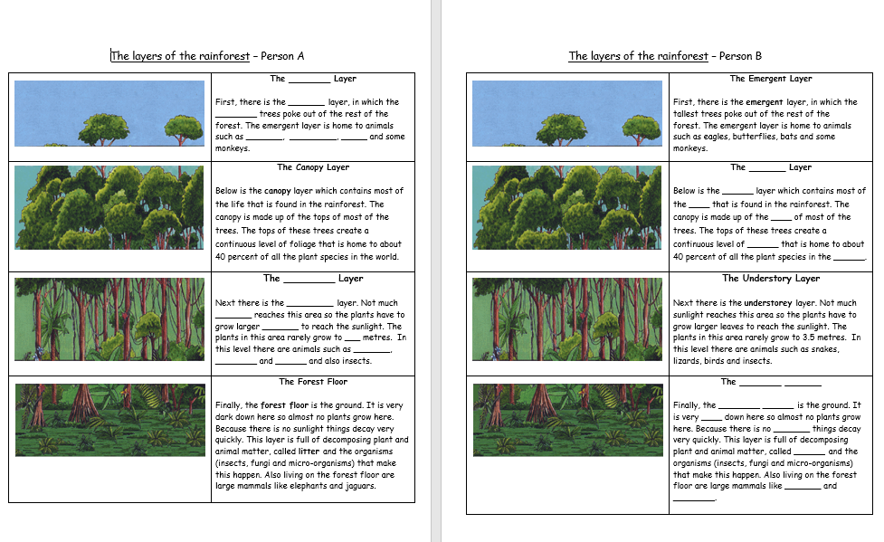
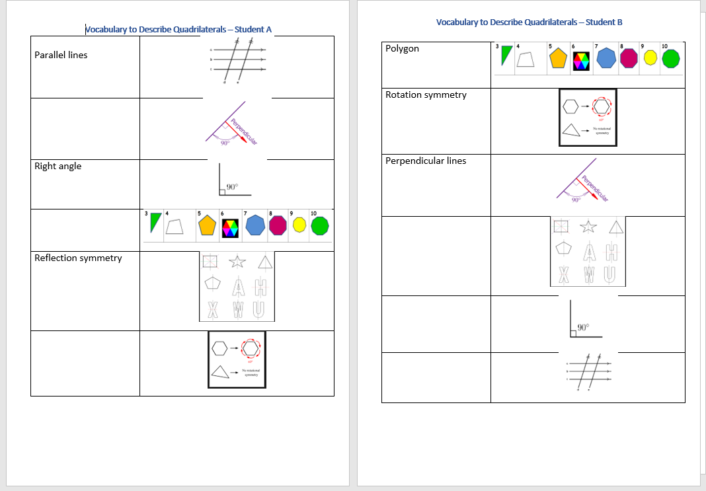
Barrier Games- rehearsing academic language
EAL New Arrival
Notes:
What are barrier games?
Barrier games are a specific form of an information gap activity. Information gap activities are communicative activities for two or more learners, where Learner A has information that Learner B needs, and vice versa.
Examples of activities
Barrier games are very flexible and can be used with any age-group, in any subject and with learners at any level of English language proficiency. Activities include, for example:
1. Completing a timeline:
One example is Learners A and B are each given different biographical information about Charles Dickens, and identical timelines to complete. They have to ask each other questions in order to fill in their timelines.
2. Guess the 3-D shape:
Learner A chooses a 3-D shape from a set that Learner B cannot see and describes it to Learner B who has to guess what it is. ‘It has eight vertices and six faces. The faces are all equal in size.’ When Learner B has guessed correctly the roles are reversed. This gives an opportunity for both learners to practise using mathematical language in a real context.
Why are barrier games a Great Idea for EAL learners?
Barrier games can encourage learners to develop speaking and listening skills within the context of a curriculum topic and are a great way of providing an opportunity for purposeful communication with learners who can provide good models of English, as recommended by research
They support learners with the development of strategies for communication: rewording, requesting clarification, questioning, giving and following simple clear instructions (explaining), clarifying or describing.
Barrier games are an excellent way of reinforcing newly-acquired language and giving the learner an opportunity to practise subject-specific target language in a real context. They are motivating and provide a sense of achievement.
The theoretical base for placing EAL learners in a situation where they have a genuine need to speak in order to complete a task, as is the case with a barrier game. Barrier games can also provide an opportunity for exploratory talk used to solve problems collaboratively, as recommended by researchers like Robin Alexander and Gordan Wells.

Slide 33
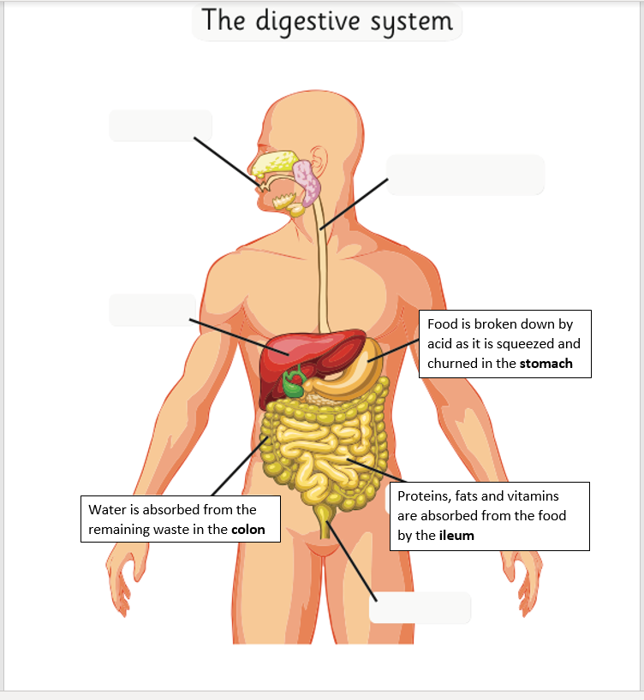
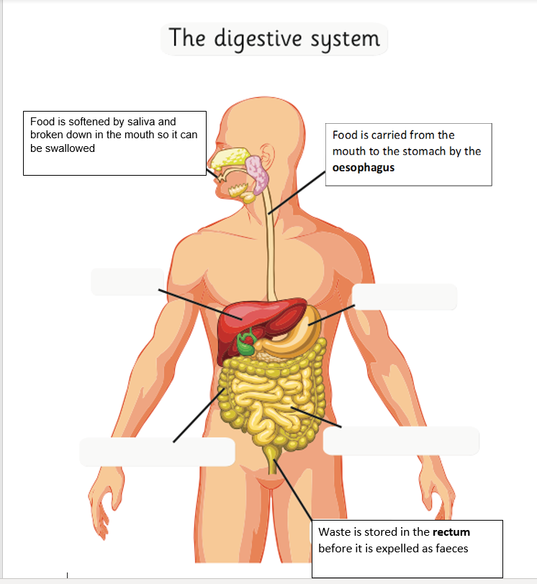
Barrier game with an academic language focus
What are the language functions?
What language structures are being practised?
Notes:
Language functions: reporting, describing
Language structures: present tense

Slide 34
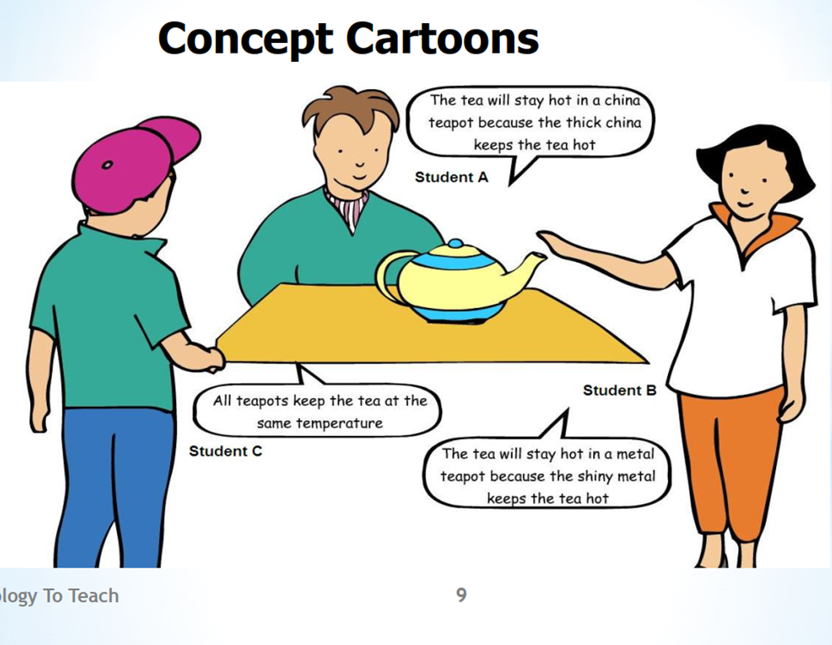
Talk as a Process- Exploratory Talk
Exploratory Talk
Allows learners to:
explore and clarify concepts;
try out a line of thought, through questioning, hypothesizing, making logical deductions, and responding to others’ ideas.
Pauline Gibbons Scaffolding Language scaffolding Learning
Naylor, S. and Keogh, B 2010 Concept Cartoons in Science Education.
Notes:
Exploratory Talk- Using Concept Cartoons to facilitate group discussion
Exploratory enables an EAL learner to listen to others’ ideas and explore their own in a safe small-group situation where they feel at ease to experiment with language.
They share relevant knowledge, offer opinions and seek them from each other. Ideas and suggestions may be challenged, but challenges are justified with reasons.
Naylor, S. and Keogh, B 2010 Concept Cartoons in Science Education.

Slide 35

Should children be allowed to work in factories like they did in 19th century Britain? - Year 7 History - Exploratory Talk
What kind of factory is boy working in?
What kinds of dangers can you see?
Speaking Scaffolds for New Arrival EAL learners
I think it is a _____ factory.
The boys are probably_____ years old
The dangers I can see are…
How old do you think he is?
Notes:
Picture of child workers in 19th century and “Talking Point” question for students to discuss
Photo may help to make the starter “concrete” for the students so they can use their prior knowledge
Relating question to today may allow students to talk about own ideas / experience
The teacher can then build on what they know when moving the discussion to working conditions in 19th century

Slide 36
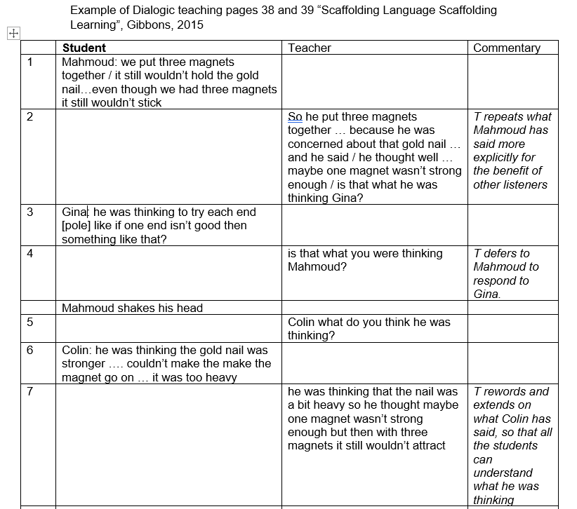

Bridging Talk/Dialogic Talk
Re-casting
Meaning
“co-constructed” through dialogue
Deferring to the student
Extending and modelling academic language
Notes:
Dialogic Talk in the classroom (type of Bridging talk)-Teacher talk is essential for scaffolding language development and guiding an EAL learners’ thinking forward
Teacher extends pupil responses by:
Asking why questions to encourage pupils to reason and reflect
Listening to what pupils are saying(not only for the ‘pre-scripted’ answers) and responding accordingly
checking on pupils’ reasoning and providing a model response for tackling more complex problems.
Good for EAL as:
Gives pupils time to think
Encourages learners to explain how they have solved a problem
Responses are recasted sympathetically
Encourages literate talk: Bridging talk which will in turn be a rehearsal for their writing.

Slide 37
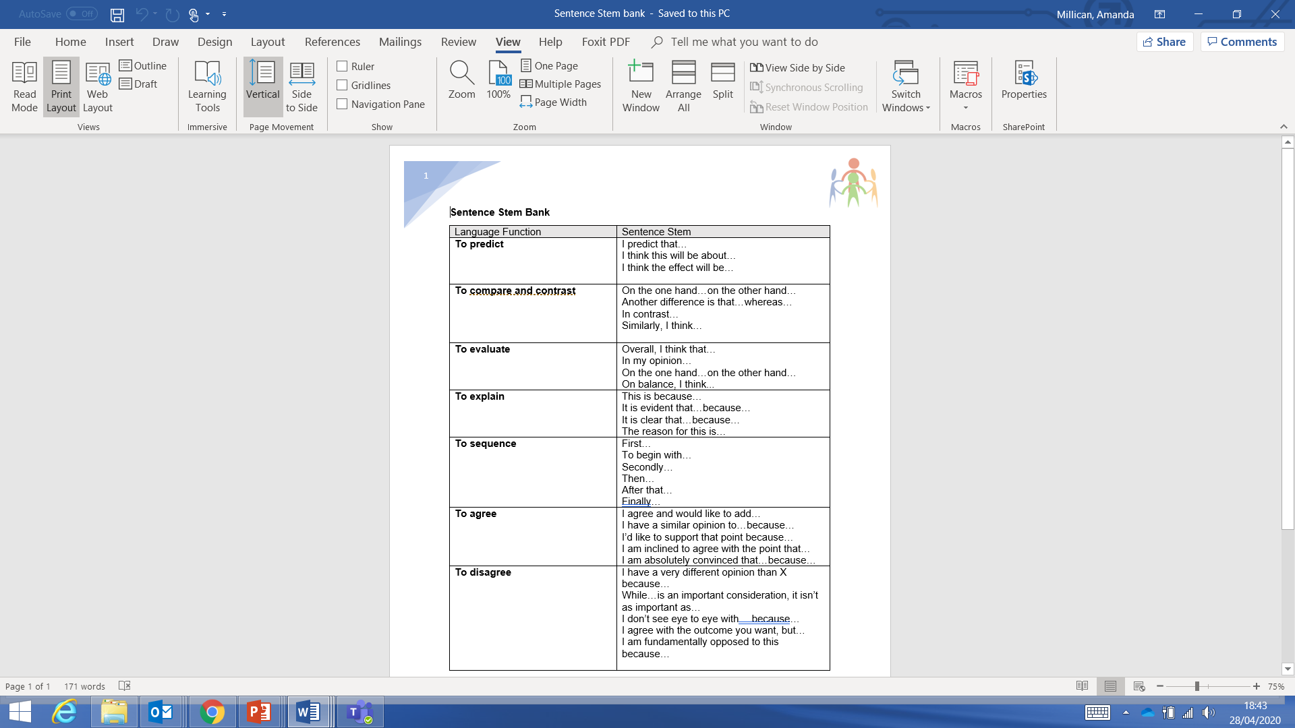
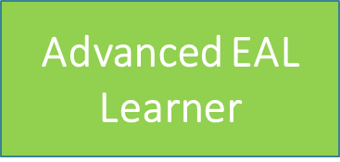
Promoting formal language with displayed sentence stems.
What would be the most useful sentence stems for your learners?
Notes:
Can issue the students with a support sheet with sentence stems like the ones mentioned in dialogic talk activity – to prompt the students to use more academic language – can also have those students who are observing - looking for particular examples being used by the students who are having the socratic discussion.

Slide 38
Writing support - A sequence for teaching writing
Steps 1-4
Teach through DialogicTalk
1. Develop the topic
Becoming familiar with the genre/text type
Oral rehearsal
EAL support
Talk opportunities, including first language; visual prompts. Draw on first-hand experience and Consider different Cultural Capital. Build up vocabulary and language structures of the genre.
2. Model and deconstruct the genre
Read together: Read examples of similar genres and talk about how they are structured and examine their language features. Collaborative activities with a language focus. Oral rehearsal
3. Joint construction
Writing together
Teacher scribing, guided writing
Teacher demonstration of writing process considering content and language. Co-construct writing through contributions, making mistakes and experimenting with language structures and using vocabulary banks.
4. Independent writing
Identify and celebrate success
Scaffold through writing frames, sentence starters, substitution tables: refer to the writing models in Stages 2 and 3. Peer review.
Notes:
Diagram based on p.7 of Raising Boys’ Achievements in Writing (September 2004). Used with kind
permission of the UKLA (United Kingdom Literary Association).
The Writing Process or sequence is part of the process of developing thinking skills so that pupils can reflect on their language choices.
A focus writing genre is introduced, modelled and practised in 4 stages. The last stage being independent writing
It is important that the process is not linear and each stage can be revisited

Slide 39



Wallpapering – Building the Field-Google Jam Board- Step 1
  Groups note down one thing they know about a topic on a post it note.
  One person from each group puts the group’s notes on the walls around the class
  Pupils walk around, read and evaluate comments.
  They comment on what they agreed/disagreed on as a class activity.
Notes:
Focus on Setting the scene and building the field- Cultural Capital
Ref:Gibbons, P (2009) English Learners: Academic Literacy and Thinking. Learning in the Challenge Zone. Heinemann. Portsmouth.
Focus on the talking that takes place during this collaborative activity. Pupils are sharing their knowledge and ‘developing their knowledge of the topic through collaboration with others and exploratory talk.
This is a particularly effective strategy to use with New to English students who might be lacking in content knowledge / confidence in sharing their ideas. It allows them to build knowledge of the particular area being studied in a non threatening way.

Slide 40
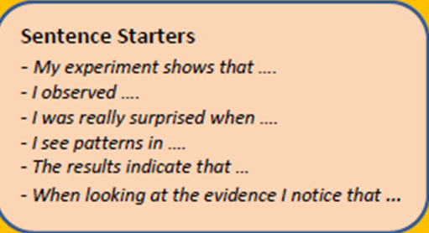
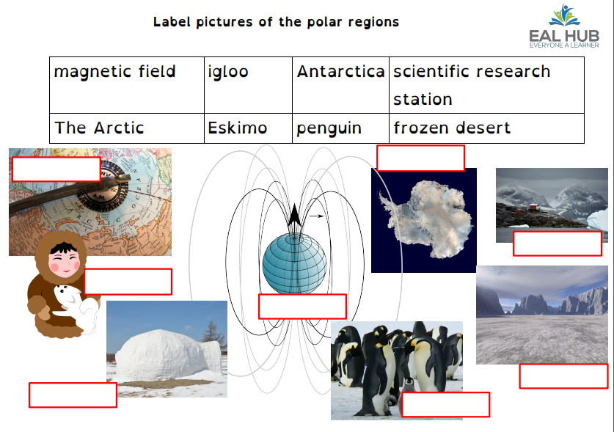
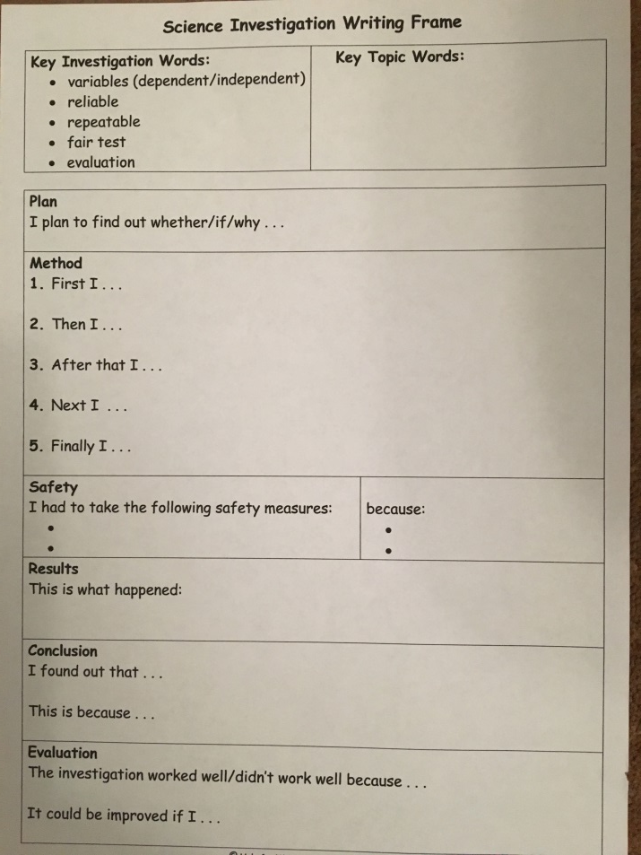
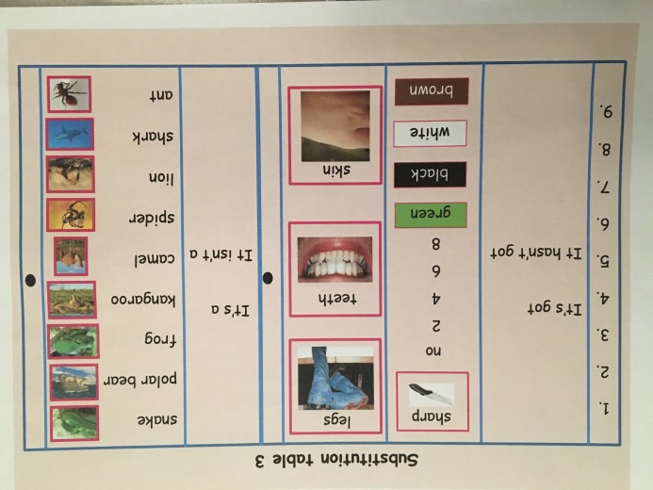
Scaffolding Writing
Encouage writing in first language;
scaffold writing through
  substitution tables;
  matching sentence halves
  cloze
use labelling activities;
provide writing frames with sentence starters for longer pieces of writing;
orally rehearse sentences;
Notes:
AM Sentence and Text Scaffolding
Substitution tables
Gap-fills
Sentence starters

Slide 41
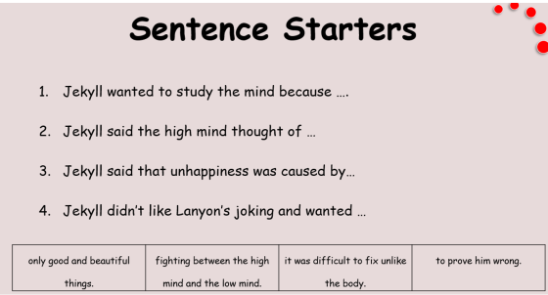
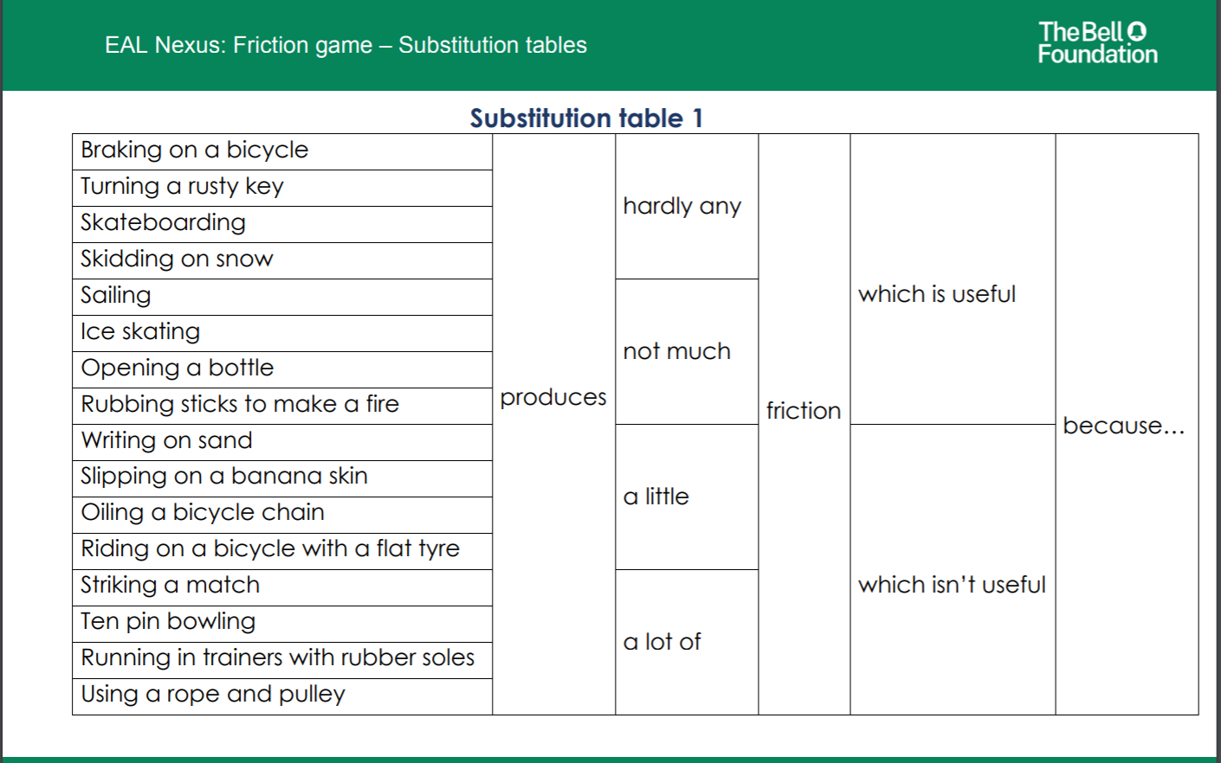

Substitution Tables/ Top and tail sentences
Tropical rainforests cover rainforest in the world.
The Amazon is the largest from rainforests.
25% of modern medicines come from 7% of the earth.
EAL in the Daylight J. Bifield
Notes:
What are substitution tables?
A substitution table is when a teacher provides a table giving model sentences with a range of choices for learners to select from, using a set pattern. It is a very useful scaffolding resource which extends the speaking or writing skills of EAL learners and can be used as a reinforcement of newly-acquired language.
Substitution tables can be used:
To scaffold talk
To scaffold writing
To support development of a particular grammatical feature

Slide 42

Scaffolding answering an Exam question- Year 11 English
Advanced EAL Learner

Slide 43



Step 2-Modelling and Deconstruction activity - Dictogloss
The teacher reads a short text on a familiar topic at normal speed.
The learners listen and take notes.
The teacher repeats the reading, after writing new subject vocabulary on the board to help newer EAL learners.
The learners form pairs and share their notes.
The teacher reads the text a final time at normal speed.
The learner pairs form fours to produce a final written version of the text. The aim is to get as close to the original as possible.
Provides a context for talking with pupils about language.
Combines speaking, listening reading and writing
Provides models of academic language
Notes:
Why is dictogloss a Great Idea for EAL learners?
Dictogloss works really well in mixed ability classes. It is a very effective language learning tool as it requires learners to listen, talk, collaborate, take notes, redraft and present orally. Dictogloss actively encourages learners to communicate for a meaningful purpose. It also draws the learners’ attention to key features of English that is slightly above their usual language level.
Dictogloss is also an excellent way of modelling academic language which EAL learners need to develop in order to reach their potential
Examples of activities
Dictogloss can be used in all curriculum areas and at all from New to English to Fluent. It is suitable for use with learners aged eight and above.
1. Exam practice:
Dictogloss can be useful to provide EAL learners with model answers to exam questions that require a more extended response, for example describing a graph in science or economics. Prepare the lesson by writing or sourcing a model answer. Give the students a GCSE question which involves describing what is shown by a graph and display the graph. Then use the model answer as a dictogloss text as described above.
2. Introducing a genre:
It is also a useful way to model how to write in a particular genre. E.g. An Inspector Calls JB Priestly dictogloss models biographical writing. Going through the final written version at the end gives an opportunity to point out key features of the text and frequent phrases used in that genre.
3. Academic language:
Dictogloss is perfect for encouraging learners to use academic language by introducing more advanced language patterns that they may not yet comfortably use in their own writing. For example, use dictogloss to provide a model introduction to a literature essay – a form of academic writing that many learners find challenging.

Slide 44

Modelling the writing process - Step 3
Teacher models writing process including thought process
Allows for contributions and discussion about language
Refers back to checklist of language features of written genre (persuasive text)
Imitates recasting of language through dialogic talk
Ensuring the Attainment of advanced learners of English - National Strategies – Secondary
https://webarchive.nationalarchives.gov.uk/20110202101215/https://nationalstrategies.standards.dcsf.gov.uk/node/187758
Notes:
Co-Construction of written texts
Teacher models the process by writing in front of the class and ‘thinking aloud’ (Now what should I put next?)
allowing for discussion about language and how the text is constructed. It includes making changes.
Defining the conventions of the text type - agreeing a check list (toolkit) of the features which is a scaffold.
Demonstrates how to compose sentences with specific language features e.g. subordination for time and reason
A written process which imitates the recasting process of oral language development.

Slide 45
Possible answers…
Caio Year 7 | Caio has previous literacy in Portuguese Family value the importance of education Good at football | Parents work full-time and unable to support Limited access to resources at home: no lap-top/limited wi-fi Reluctant to speak in class and to adults | Placing in sets to reflect ability rather than Eng lang proficiency Pre-reading strategies rich in key visuals(send home packs during lockdown) PPT recordings shadow reading/Microsoft Lens for translation into Portuguese Writing in L1 Speaking frames/Substitution tables Top/tail sentences/Labelling Paired reading – Portuguese speaker/ Talking 3s
Amina Year 9 | Very determined to help herself some literacy in Arabic Outgoing personality able to make friends easily and to acquire BICS. | Understanding academic language Missed education in Syria/Lebanon Constructing complex sentences Lack of vocabulary in English In low ability sets with restricted language models Understanding and answering assessment questions Understanding logging onto Teams | Pre-visiting vocabulary in context Exploratory/Dialogic Talk Never heard the word grids Paired reading/jigsaw reading/margin questions Providing model answers/Co-construction/re-drafting for writing activities Modelled assessment answers- Cloze activities Dictogloss
Notes:
Go to chat

Slide 46
Key Messages-Effective mainstream teaching practice of New Arrival and Advanced EAL learners
Enabling learners to activate their prior knowledge of the topic of the lesson facilitates greater understanding and engagement
Contextual support enables EAL learners to understand the content of the lessons.
Highlighting and scaffolding key forms and structures allows learners to meet the language demands of the tasks
EAL learners at all levels need to be given opportunities to grow their English vocabulary range.
An EAL learner’s independence is developed through encouraging organisational, thinking , language and social skills of the classroom

Slide 47
Want to find out more…
New Arrivals Excellence Programme: https://webarchive.nationalarchives.gov.uk/20110202132047/https://nationalstrategies.standards.dcsf.gov.uk/node/113690
Ensuring the attainment of advanced learners of English:
https://webarchive.nationalarchives.gov.uk/20110202101215/https://nationalstrategies.standards.dcsf.gov.uk/node/187758
The Bell Foundation: Great Ideas
https://www.bell-foundation.org.uk/eal-programme/guidance/effective-teaching-of-eal-learners/great-ideas/
Sharples, R 2021 Teaching EAL Evidence-based strategies for the Classroom and School
Gibbons, P. 1991 Learning to Learn in a Second Language. Newtown, Australia.
Gaunt,A & Stott, A. 2019 Transform Teaching and Learning through Talk. The Oracy Imperative
Honingsfeld, A. 2019. Growing language & Literacy Strategies for English Learners.
Conteh, J. 2015 The EAL Teaching Book Promoting Success for Multilingual Learners in Primary and Secondary Schools.
Bifield, J EAL in the Daylight: https://ealdaylight.com/

Slide 48

Amanda Millican
EAL Advisory Teacher
ajmillican67@gmail.com
Notes:
Good Practice Audit

