Slide 1

Who has EAL learners on their registers?

Slide 2
Centre for Teacher Education
EAL Learners in the classroom: a workshop
January 17th 2022
Our Aim: Grade One – ‘Outstanding’

Slide 3
EAL learners: context
Over 1.56 million learners identified as having English as an additional language in UK maintained schools (19.6% of all learners aged 5-16)
1 in 11 schools have more than 50% EAL learners
DfE records a learner as EAL if ‘they are exposed to a language at home that is known or believed to be other than English.’
A learner recorded as EAL at age 4 will continue to be recorded as such throughout their education
What is the impact of this on our classrooms?
Notes:
A quarter of schools have less than 1%
EAL students in a school may include both second or third generation ethnic minority students who speak English fluently but have a second or more languages as part of their cultural heritage, alongside new arrivals to the English school system who may have fled war or persecution, may have no experience of formal education and have no knowledge of English.

Slide 4
BICS and CALP Cummins
BICS: Basic Interpersonal Communication skills = conversational fluency in a language
CALP: Cognitive Academic Language Proficiency = students’ ability to understand and express, in both oral and written modes concepts and ideas that are relevant to school. (Cummins 2008)
Cummins argues that educators and policy makers frequently conflated conversational and academic dimensions of English language proficiency and that this conflation contributed significantly to the creation of academic difficulties for students who were learning English as an additional language.
Cummins J., BICS and CALP: Empirical and Theoretical Status of the Distinction (2014) In Street, B. & Hornberger, N. H. (Eds.). (2008). Encyclopaedia of Language and Education, 2nd Edition, Volume 2: Literacy. (pp. 71-83). New York: Springer Science + Business Media LLC

Slide 5
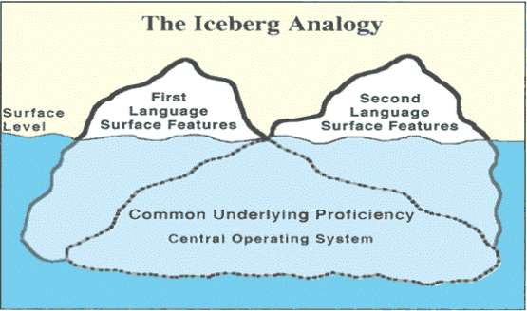
Linguistic Interdependence Hypothesis
Cummins, J. 1981, Bilingualism and Minority Language Children, Toronto: Ontario Institute for Studies in Education

Slide 6
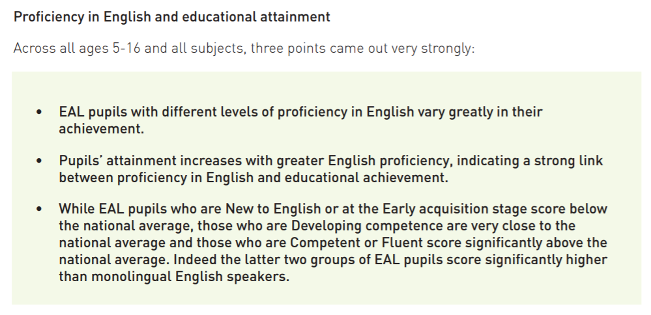
EAL learners and attainment
Oxford University Research 2018
Hessel A., and Strands. (2018) English as an Additional Language, proficiency in English and pupils’ educational achievement: An analysis of Local Authority data Oxford University Press

Slide 7
EAL and Achievement:
findings of the Oxford study
EAL is a diverse and heterogeneous group of learners therefore proficiency of English levels are a more important indicator of likely achievement, than the coding EAL
The Proficiency in English Scale should be reinstated.
Early years and KS1 require most support, but data indicates 1 in 6 EAL learners at KS4 would benefit from support.
Bilingualism is not in itself a barrier to learning, in fact it can positive associations with achievement
Hessel A., and Strands. (2018) English as an Additional Language, proficiency in English and pupils’ educational achievement: An analysis of Local Authority data Oxford University Press
Notes:
EAL itself is a poor indicator of pupils’ likely level of educational achievement – proficiency in English is central to understanding achievement and levels of need among pupils with EAL. The EAL definition groups together a diverse and heterogeneous group of pupils all in a single group…. irrespective of their actual language skills.
English language support is most needed in the early years and KS1, but there is a need for support at all ages. y. If the aspiration of the school system is to provide full access to the (English language) curriculum to all pupils, language support would still be needed for one in six EAL pupils at KS4, where 15% were judged less than Competent in regard to their proficiency.
. Bilingualism can have positive associations with achievement. It is important to recognise that being bilingual is not a barrier to learning.
The Proficiency in English Scale should be retained in the School Census and the data should be available in the National Pupil Database (NPD) It was very welcome that following the publication of the report by Strand et al. (2015), the Government recognised the need for the assessment of learners with EAL and responded by introducing the Proficiency in English Scale in 2016. This brought England into line with best practice in Wales and Scotland both of which have been collecting data on pupils’ proficiency in English for many years. However, the DfE has recently announced it will no longer require schools to complete the Proficiency in English Scale from January 2019.

Slide 8
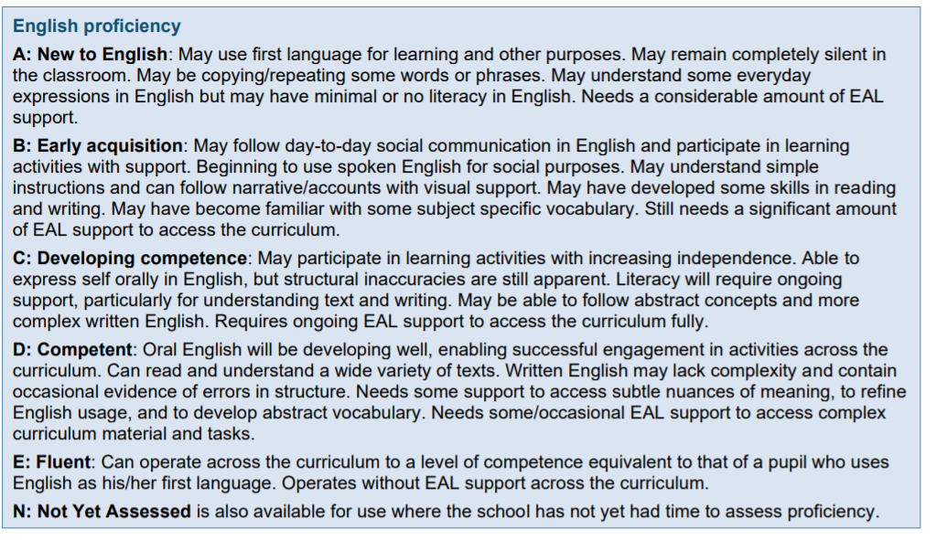
Proficiency in English Scale

Slide 9
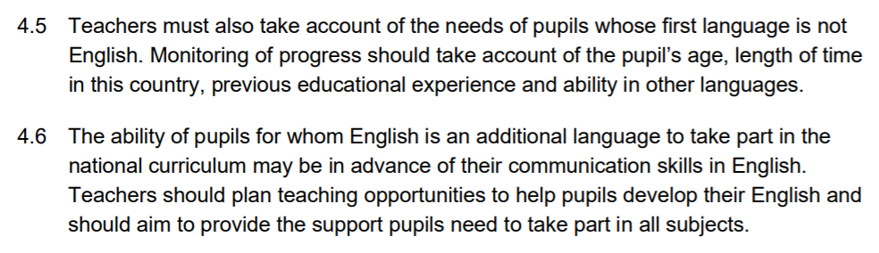
EAL learners and policy
No separate National Curriculum for EAL learners
The DfE expect that effective teaching and learning for EAL pupils will happen through the National Curriculum.
The EIF doesn’t mention EAL learners specifically, but states that the curriculum should be designed to ‘give all learners ….the knowledge and cultural capital they need to succeed in life’.
Proficiency in English only assessed by schools between 2016 and 2018
Which Teaching Standard mentions learners with English as an additional language?
Notes:
NFF National Funding Formula gives the same sum for pupils arriving in Year 7 as well as Year 11 (need much greater at yr11) funding is for 3 years.
TS5 have a clear understanding of the needs of all pupils, including those with special educational needs; those of high ability; those with English as an additional language; those with disabilities; and be able to use and evaluate distinctive teaching approaches to engage and support them.

Slide 10
Enquiry question
What planning and teaching challenges might you face with EAL learners?
Write your comments in the chat.
Notes:
Not all teachers have the meta language to help EAL students develop their English – what is the past continuous tense for example?

Slide 11
Enquiry question
What learning barriers might EAL pupils face?
Write your comments in the chat.

Slide 12
Possible Social and cultural barriers
Unfamiliar classroom norms, expectations and routines
View of teacher
Culture shock
Prior experience of schooling related to age or consistency
School starting ages are different between different countries.
Feelings of isolation and being unable to make their needs known – particularly at break times
Notes:
Hungary 3 UK/Nigeria 5 Finland 7 Bangladesh – law between 6-10 China 6

Slide 13
Possible Learning barriers
Low literacy levels in L1
Uneven skills profile
Levels of English proficiency of parents and siblings
Perception of certain groups as either high or low achievers
Teaching and learning approaches may be unfamiliar, for example more didactic
The language of learning will contain many vocabulary items specific to the subject that will be unfamiliar
EAL learners are sometimes categorised with SEND and inappropriately labelled as low ability (Cummins: BICS and CALP)
Alphabetic differences and logographic (symbols represent words) languages form L1 to L2 present writing challenges
Cummins J., BICS and CALP: Empirical and Theoretical Status of the Distinction (2014) In Street, B. & Hornberger, N. H. (Eds.). (2008). Encyclopaedia of Language and Education, 2nd Edition, Volume 2: Literacy. (pp. 71-83). New York: Springer Science + Business Media LLC.
Notes:
Languages that are alphabetic, like English, differ in the way that letters and sounds map on to each other: for example in Spanish the letter ‘b’ is pronounced more as an English ‘v’ would be spoken; in Polish there are 32 letters including 9 vowels but Q, V and X are excluded. Some languages are logographic rather than alphabetic meaning that their symbols represent words themselves (e.g. Chinese languages). Makes written English more difficult.
BICS = basic interpersonal communication skills (2 years) CALP = Cognitive Academic Language Proficiency (5-7 years)
Cummins argues that educators and policy-makers frequently ‘conflated conversational and academic dimensions of English language proficiency and that this conflation contributed significantly to the creation of academic difficulties for students who were learning English as an additional language.’

Slide 14
The disadvantage gap: EPI Annual report
The gap between pupils EAL pupils arriving late in secondary school and their white British peers has widened over the last decade.
“…research shows that the stage at which EAL pupils enter the English education system is key: the later they enter, the more disadvantaged they are, and this is related to their proficiency in the English language. At the end of primary school, late-arriving EAL pupils are 15.5 months behind native English speakers; at secondary, they are 20.7 months behind.”
Akhal A., Hutchinson J and Reader, M. (2020) Education In England Annual Report Education Policy Institute.
Notes:
We define late arriving EAL pupils as those who are recorded as having EAL, and who have entered the English state-school system in either Year 5 or Year 6 for key stage 2, or either Year 10 or Year 11 for key stage

Slide 15
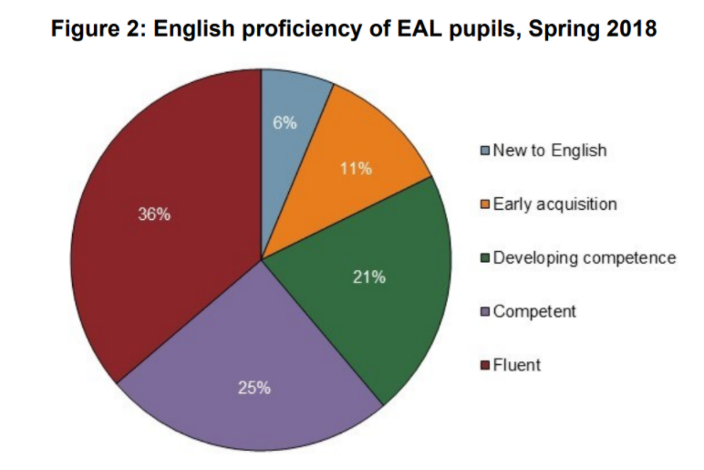
The disadvantage gap
Recorded as fluent/competent
SEND 59%
without SEND 64%
Primary 51%
Secondary 77%
5+ years in English school 80%
1-4 years in English school 40%
Department for education (2020) English Proficiency of Pupils with English as an Additional Language
Notes:
39 per cent pupils with special educational needs and disabilities were either “fluent” or “competent, compared with 64 per cent of those without SEND.
Language proficiency also depends on how old pupils are, and how long they have spent in an English school.
Seventy-seven per cent of EAL pupils in secondary schools were assessed as “competent” or “fluent” in spring 2018, compared to 51 per cent of those in primary schools.
And pupils who had been in an English school for five years or more were more likely to be assessed as competent or fluent in English (80 per cent) than pupils who had been in an English school for between one and four years (40 per cent).

Slide 16
Enquiry question
What strategies have you used to support EAL learners in your classrooms?
Write your comments in the chat.

Slide 17
Strategies to support EAL learners
‘Translanguaging’
Reduces the need to lower the cognitive demand
Watching videos in first language
Bilingual dictionaries
Translating key vocabulary
Writing initially in first language and then translating
Subtitles/google translate (for very short phrases of feedback)
Cenoz and Gorter 2017
Notes:
“Translanguaging” is the term used to describe intentional practices intended to integrate two or more languages in order to develop learners’ multilingual repertoire and language awareness (Cenoz & Gorter, 2020).

Slide 18
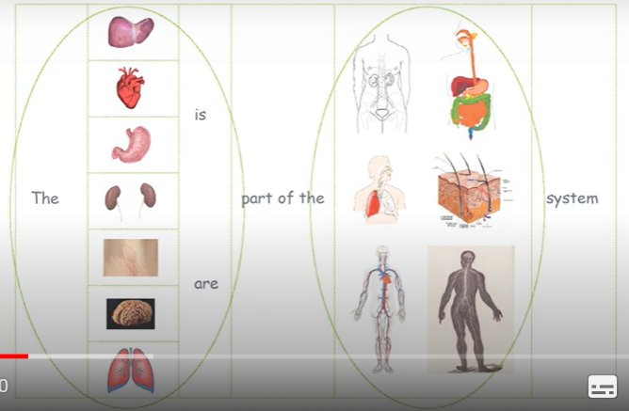
Strategies to support EAL learners
Presenting information visually
Helps learners understand the relationship between ideas
Venn diagrams
Flow charts
Bar charts
Cause and effect diagrams
Substitution tables – with images or text
https://www.bell-foundation.org.uk/eal-programme/guidance/effective-teaching-of-eal-learners/great-ideas/
Notes:
https://www.bell-foundation.org.uk/eal-programme/guidance/effective-teaching-of-eal-learners/great-ideas/

Slide 19
Strategies to support EAL learners
Chunking sentences/paragraphs into smaller sections (doesn’t simplify content)
Pre- teaching new vocabulary
Providing language models
Scaffolding
Giving feedback that extends new language learning
Collaborative activities in pairs and small groups
Communication with home in first language
Buddy systems
Notes:
https://www.bell-foundation.org.uk/eal-programme/guidance/effective-teaching-of-eal-learners/great-ideas/

Slide 20
Case Studies
Abas
Abas arrives in your class doing the first term in Year 8. He is living with a foster family. He has travelled from Afghanistan alone. It is unclear what his prior experience of school is. He is polite and attentive in class and he can communicate fairly well in spoken English. His proficiency in reading, writing and comprehension is low. He has one to one support in lessons but has told you that he doesn’t need this support as the support teacher doesn’t speak the same language as him.
Irina
Irina is Russian and she has come to England with her parents who are academics. She has almost no spoken English and proficiency in reading and writing is very low. You have been informed however that she is a high achiever in her first language. She has joined your class in February of Year 11.
How would you support these learners? Or how have you supported an EAL learner in your teaching practice? Consider support for the short and/or long term.

Slide 21
Reflection
Maintain high expectations of EAL learners
Utilise their prior knowledge
Increase motivation by not giving simplified or different content
Use a variety of strategies to build language and learning
Once proficiency in academic English has ben achieved, bilingualism is an asset.

Slide 22
References and Further Reading
Akhal A., Hutchinson J and Reader, M. (2020) Education In England Annual Report Education Policy Institute. Available at file:///C:/Users/u1970267/Downloads/EPI_2020_Annual_Report_.pdf (Accessed 8 March 2021)
Cenoz and Gorter (2017) Translanguaging as a Pedagogical Tool in Multilingual Education In Cenoz, J., Gortor D., and May S., (Eds) (2017) Language Awareness and Multilingualism 2nd Edition (pp 310-321) Springer International Publishing
Cummins J., BICS and CALP: Empirical and Theoretical Status of the Distinction (2014) In Street, B. & Hornberger, N. H. (Eds.). (2008). Encyclopaedia of Language and Education, 2nd Edition, Volume 2: Literacy. (pp. 71-83). New York: Springer Science + Business Media LLC
Department for education (2020) English proficiency of pupils with English as an additional language Available at: https://assets.publishing.service.gov.uk/government/uploads/system/uploads/attachment_data/file/868209/English_proficiency_of_EAL_pupils.pdf (Accessed 8 March 2021)
Department for Education (2014) The national curriculum in England: complete framework for key stages 1 to 4. Available at: https://www.gov.uk/government/publications/national-curriculum-in-england-framework-for-key-stages-1-to-4 (Accessed: 8 March 2021)
Hessel A., and Strand S., (2018) English as an Additional Language, proficiency in English and pupils’ educational achievement: An analysis of Local Authority data Oxford University Press
Sutton, D. (2020) New research on EAL learners shows the importance of looking behind headline attainment data. Available at: https://www.bell-foundation.org.uk/news/blog-new-research-on-eal-learners-shows-the-importance-of-looking-behind-headline-attainment-data/ (Accessed 8 march 2021)
Trzebiatowski, K (2021) Maintaining high expectations for learners using EAL. Available at https://www.sec-ed.co.uk/best-practice/maintaining-high-expectations-for-learners-using-english-as-an-additional-language-eal-pedagogy-resources-classroom-teaching/ (Accessed 8 March 2021)

