Slide 1
Overcoming barriers: autism- specific strategies for meeting the demands of a challenging curriculum
Inclusion Conference – University of Warwick
Mrs Sarah Rose – Deputy Headteacher/SENCo
Mrs Kate Foxon – Assistant Headteacher/Curriculum Lead for English

Slide 2
Corley Centre
Corley Centre is a secondary school for children with complex social and communication difficulties. Many of our students have a diagnosis of autism and their academic abilities span the full National Curriculum and GCSE range.
We gained Autism Accreditation through the National Autistic Society in November 2017 and re-accreditation was awarded in 2021.

Slide 3
Objectives
This session will aim to:
Improve our understanding of autistic learning behaviours.
Understand how executive functioning impacts on learning.
Identify autism specific challenges posed by a GCSE curriculum.
Explore strategies to overcome barriers to a GCSE focusing on literacy.

Slide 4
Our understanding and experiences of autism
First – Think about your understanding and previous experiences of autism.
Next - Make notes or discuss if you are with others.
Then – Add your comments to the ‘chat’ function.

Slide 5
https://www.online-stopwatch.com/countdown-timer/

Slide 6
Autism
Autistic Spectrum (Disorder/Condition) is a life long developmental condition that affects how people perceive the world and interact with others.
Autistic people see, hear and feel the world differently to other people. If you are autistic, you are autistic for life; autism is not an illness or disease and cannot be cured.

Slide 7
Autism is a life-long condition affecting around 1.1% of the population. It affects all races, classes and intellectual abilities. It is a spectrum condition meaning that it is extremely complex and affects people differently and to varying degrees.
Autism is broadly defined as affecting three main areas (known as the “triad of impairments”): social communication, social interaction and social imagination.
Everyone with autism is different. Whilst some people with autism lead independent lives, some need lifelong care. Others will need some degree of support, which will change over the course of their lifetime.

Slide 8
Autism is not a learning disability (or a Mental Illness) – about half of all people with autism have average or above-average intelligence.
However, one in three people with autism develop mental health difficulties due to the challenge of adapting to society.
People with autism often also have issues with sensory processing. They can either be over- or under-sensitive to any of their senses (sight, smell, touch, hearing, taste, balance and self-awareness).

Slide 9
Autism and related conditions
Epilepsy
Mental Health
OCD – Obsessive Compulsive Disorder
PDA – Pathological Demand Avoidance Disorder
Pica
Sensory Issues
Self injurious behaviour
Self stimulation or ‘Stimming’
Sleep problems
Tourette Syndrome
Visual Impairment
AD(H)D – Attention Deficit (Hyperactivity) Disorder
Anxiety
Asperger Syndrome
Attachment Disorder
Additional Learning Difficulties
Atypical Autism
Autistic Savant
Bipolar Disorder
Bowel/Immune
Depression
Dyslexia
Dyspraxia

Slide 10
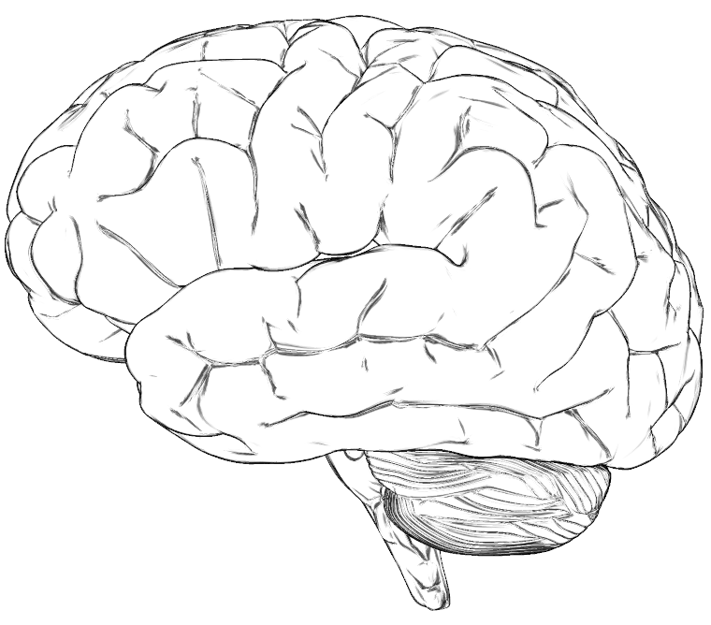
Current Research
Impaired connectivity between different areas of the brain is implicated in autism.
Object and people pathways.

Slide 11
Communication Skills
Use visual strategies, such as schedules, photos, symbols
Support Communication, PECS, technology, signs.
Language, consider literal interpretations, avoid metaphors, similes, sarcasm.
Give clear and precise instructions.
Social Skills
Utilise social stores, they provide visual support and simple sentences.
Ensure rules are understood, are structured and are simple.
Help students identify choices and an awareness of consequences.
Behaviour
Identify triggers, share this information.
Praise good behaviour, publically or privately depending what they prefer.
Develop strategies, allow a cooling off period, have rewards based on special interests.
Be clear about changes in routine.
Make tasks clear and achievable.
Sensory
Plan for coping strategies in the classroom, use of sensory tools and fidget items.
Pinpoint individual sensory difficulties, needs, dislikes etc.
Analyse, adapt, avoid, desensitise.

Slide 12
Theory of Mind Theory of mind is an important social-cognitive skill that involves the ability to think about mental states, both your own and those of others. It encompasses the ability to attribute mental states, including emotions, desires, beliefs, and knowledge. It is knowing who you are and who others are around you.
Central Coherence
In their interactions with the environment, or in recalling information most individuals will recall an overall impression or the gist of something Individuals on the autism spectrum tend to be more, focused on details; this can often be at the expense of understanding the actual meaning or appreciating the nature of a situation or context.
Executive Functioning
Executive Functioning is a set of mental skills that help you get things done, they help you.
Manage time
Pay attention
Switch focus
Plan and organize
Remember details
Avoid saying or doing the wrong thing
Do things based on your experience
Multitask

Slide 13
Executive Functioning is...
The ability to plan higher level thoughts and actions.
Notes:
Imagine summers day. Coach trip to seaside. I take you walk along the beach to a large cave. We all go inside deep into the dark. I tell youthat I am leaving you here. I leave with the only torch. HOW DO YOU FEEL?
Response from audience.
Ok. Now I say I\m not that cruel so I will leave you with a torch and a watch telling you I will be back in 10 minutes. HOW DO YOU FEEL ?
Response from audience.
Add motivator for achieving –Gin and tonic!
Having experienced the dark cave gives us an insight into the day for children with ASD. By looking at strategies we are offering the torch AND THE WATCH. Looking at motivators we are offering the gin!.

Slide 14
Executive Functioning
Common to many other disorders, e.g. ADHD, Dyslexia, Dyspraxia, etc
Works like an orchestra conductor co-ordinating a set of skills – without good EF, no-one knows when to play, at what tempo, in what key, when to start/finish or even what to play!

Slide 15
Good Analogy….
Having poor Executive Functioning is like a filing cabinet with no file dividers therefore very difficult to catalogue, file, sort, order, prioritise etc.
How do you know which drawer to go to when trying to locate a file?
How do you think this relates to a GCSE Curriculum and what challenges could it pose for a student with autism?

Slide 16
What challenges might someone with poor executive functioning face when studying a GCSE curriculum?

Slide 17
Executive Functioning challenges in a GCSE Curriculum
Working out what skills are needed to answer a specific question
Working out what equipment is needed for an exam eg Calculator Maths Exam, Technology practical.
Getting started on a task or exam question, particularly without prompts.
Working out how long to spend on a task/how long you have left (how many marks allocated)
Working out how/where to start a task/piece of writing, even with an image prompt.
Working out what order to do tasks in
Working out what to do if you get stuck on a question
Remembering what to remember!
Knowing what information is important.
How to prioritise for revision.
Using information from your memory to do a task (working memory)
Being able to evaluate your own work
Learning from your mistakes
Knowing when to stop, especially when extra pages are provided.

Slide 18
Corley Centre best practice to overcome these challenges.
Explicitly teach revision skills, specific to each subject area.
Teach the relevance of skills and information learnt, why it is important to them.
Teach students what certain question types mean eg. “Can you name the main characteristics of Macbeth’s personality?” requires more than the answer “yes”! (Explain, describe, compare, evaluate, state, identify)
Practise exam techniques in the appropriate places as it will be ‘on the day’ including access arrangements.
Teach students to recognise when it is and isn’t appropriate to include special interests.
Use of dividers and colour coded systems to compartmentalise curriculum areas by skill or topic.

Slide 19
Possible strategies to overcome these challenges.
Teach the rules and have them visible to refer to.
Use visual time prompts
Practise working within time limits
Practise past papers regularly to ensure familiarity
Explicitly teach how many marks are allocated for each question.
Refer to the mark scheme to justify points awarded.
Social stories to address perfectionism and exam stress.
Ensure the student has a visual exam timetable suitable to their level of functioning

Slide 20

Literacy specific strategies.
All subjects will require literacy skills and the more demanding GCSEs require analytical and evaluative tasks.

Slide 21
So what are the key principles behind our Literacy resources or strategies?
Clarity
Structure
Visual
Personalised
‘Process not product’

Slide 22
Visual clues and prompts
What?
- A photograph, clipart image or other visual (could just be a colour) which accompanies a text, instruction or resource. The photograph should be realistic where possible (e.g. no cars with eyes!)
Why?
-Signals the key Literacy skill students need
Links language to images which helps language acquisition
Gives a context to a story: e.g. setting, genre

Slide 23
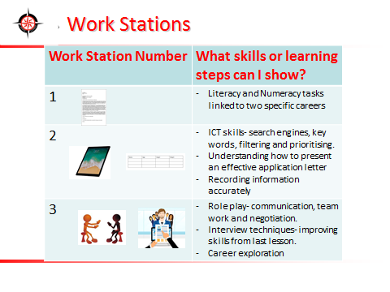
Example

Slide 24
Simple and clear texts
What?
- This does not mean shying away from complex and challenging texts as this will restrict our students from being ‘GCSE ready’. This means making it clear to read- not obstructing meaning through presentation. At Corley Centre, we use Calibri for everything and aim to use double or 1.5 spacing.
Why?
-Reduces sensory stimulation.
- Focuses students on content not distractions around it (this is not in reference to visual clue)

Slide 26
Reduce sensitivity
What?
Unless linked to the learning (e.g. listening to sound effects when studying a poem based on the weather), consider each of the senses and their impact on the resource or environment.
Why?
ASD students are often have sensory needs which vary but can include sensitivity to light, noise or smell.

Slide 27
Pace and processing time
What?
Pausing between questions or instructions when exposition is given verbally, using timers to schedule specific ‘time out’ between tasks and monitoring the delivery speed of the voice. This should not be confused with pace of progress.
Why?
Cognitively, ASD students typically need longer to process information, particularly when delivered verbally.

Slide 28
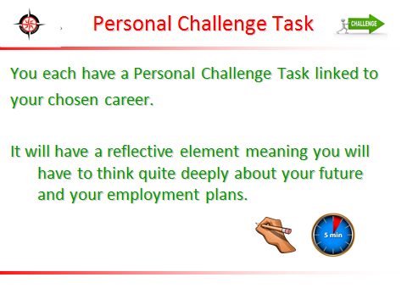

Slide 29
Structure and Scaffolding
What?
Using ‘first, next and then’ to introduce a series of tasks, literacy processes or instructions. Providing a writing frame for an extended task, ‘chunking’ tasks into manageable parts and provided opening sentences or word banks.
Why?
Students will need to understand parts of a text or concept in order to grasp the ‘whole’. Manageable ‘chunks’ and ‘first’, ‘next’ and ‘then’ reassures students of progress (particularly in writing) and emphasises the building or development of skills.

Slide 30
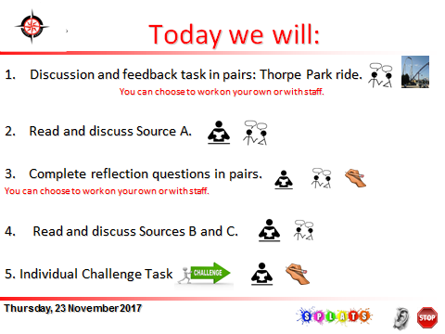
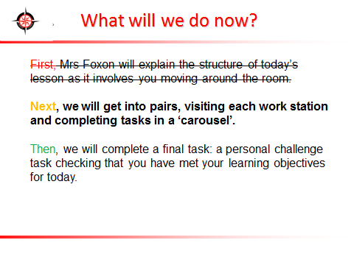

Slide 31
Comic strips and storyboards
What?
A comic or series of pictures which shows a plot in simple stages or images to explain part of a text or help them sequence a narrative. Students can also be given a blank storyboard which they can use to plan their writing or show their understanding of a text.
Why?
This is another visual means of presenting or understanding information. Thought or speech bubbles added to the images also help ASD students to grasp the concept of another person’s thoughts or words which can lead to important reflections on character’s behaviour or actions.

Slide 32
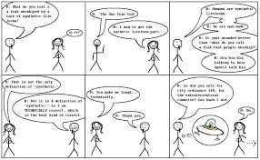
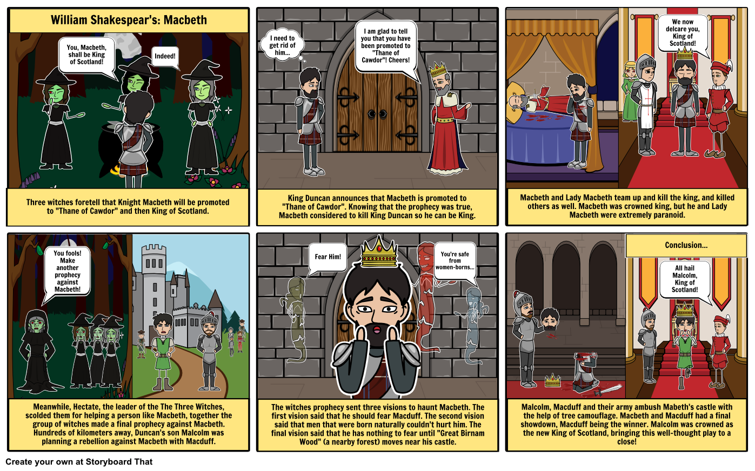

Slide 33
Colour coding
What?
Using a key to colour code techniques in a passage: e.g. poetic techniques, themes, persuasive techniques. Students choose the colours that match their key and identify the elements in non-fiction and fiction texts. This can also be used in self and peer assessment
Why?
This is a highly visual way to find techniques, comment on how frequently poets or writers use them and identify them in their own or others’ work. It feels comforting in its logical sense as it is ‘matching’ and ‘sorting’. At the end of the activity, the student can usually more accurately comment on the range of techniques used as it is seen at a glance. In terms of literature, students can see how a writer threads a particular theme throughout a passage.

Slide 34
Numeracy: Venn diagrams and character emotion graphs
What?
Students use venn diagrams to compare two texts or two characters, finding differences and common ground. Students label a horizontal axis with the chapter names or key ‘moments’ in the text and the vertical axis with either a word (‘Happy’) or visual (☺) to represent feelings. The feelings are then plotted against this.
Why?
The mathematical security of a Venn diagram and its visual element allows the challenging skill of comparison to be presented quickly and clearly. The venn diagram can be differentiated appropriately- partly filled in, filled in with cloze activity or not filled in depending on ability.

Slide 35
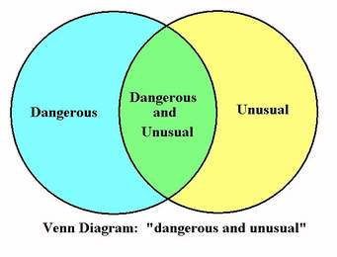
Examples that we have used:
A Venn diagram comparing Mary Maloney and The Landlady in two short stories by Roald Dahl
A ‘power’ graph for Lady Macbeth in Shakespeare’s play- Act and Scene on horizontal axis and level of power (from weak to powerful on a scale of 0-10) on the vertical axis

Slide 36
Visuals for abstract concepts
What?
Using a visual to represent figurative language such as metaphors, similes, personification or alliteration makes something abstract more concrete. A P.E.E. sandwich, for example, also identifies the need to develop a deeper level of analysis through a visual.
Why?
ASD students can find most concepts hard to visualise but abstract concepts that have no familiarity or ‘grounding’ in their world can be challenging. In this way, anything visual that supports something that cannot be ‘seen’ will reduce anxiety and clarify understanding.

Slide 37

PEEL burger
P
The first piece of bread is your point about the question – introduce your first point in a couple of sentences.
Remember to use the PEEL burger paragraph to help structure your answer.
E
The middle of the burger must always be supported by two pieces of bread. Remember the quotation is your evidence and is condiment to you answer.
E
You must support your quotation. EXPLAIN how your quote supports your point. Without any explanation, your burger will have no meat (substance) to it. Especially if you ignore the effects of language!
L
Now you need to link your point back to the original question. Without this link, your burger will fall apart!

Slide 38
‘Bloom’s’ for reading
What?
Using ‘Bloom’s Taxonomy’ of lower to higher order skills in terms of scaffolding reading tasks or challenge. Start students with comprehension-based information retrieval, move towards asking them to describe or explain a concept and finally use the reading source as a springboard for students to create their own text (e.g. a diary entry as one of the characters).
Why?
Reducing anxiety is key- GCSE English exams are also often structured in this way; starting students with a task they can manage and building them towards more complexity or inference supports their self-confidence. They learn to gradually ‘dig deeper’ into a text and that a text has layers.

Slide 39
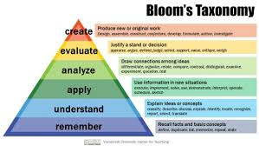
Example:
Where did Billy Weaver travel to?
Why did Billy Weaver think it was a good idea to walk ‘briskly’?
3. The living room seems inviting. Using evidence from the text, explain why.
4. Look at lines 24-48. In what ways does Roald Dahl present the Landlady as being unusual? Use evidence from the text in your response.
5. One student said, “The start and middle of this story foreshadows the sinister ending.” How far do you agree with this statement?
6. Imagine that you are Billy Weaver. You are in your bedroom shortly after drinking the tea (which tasted “faintly of bitter almonds”). Explain your thoughts, feelings and worries.

Slide 40
Build familiar into unfamiliar or difficult concepts
What?
Using a student’s special interests in the body of a spelling test, SPaG based activity or any text used to explore a new or challenging concept.
Why?
ASD students often have a special interest and this can therefore mean that any inclusion of it in resources or texts can be a ‘way in’ or a ‘hook’. This can be as simple as using an image linked to their interest next to a spelling test but works best if it is embedded (however tenuously!) into the content.

Slide 41
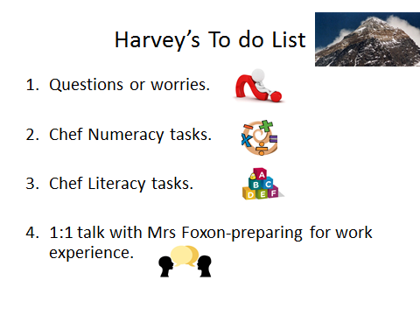
Add punctuation to the following paragraph:
Mum and dad were so happy with josh because he had won both trampoline competitions and collected bronze silver and gold in his football tournament after school they decided to take him to the odeon cinema in coventry to watch his favourite film the watchmen

Slide 42
Thoughts to go away with:
What have you learned about autism that you did not know before?
What strategies or techniques can you use in your teaching practice?
How can you adapt your teaching approach to cater for autistic students sitting GCSEs?
If time, please add your reflections into the Chat function.

