Slide 1

Teaching Early Numeracy to Children with Developmental Disabilities
Dr Corinna Grindle
14th December, 2020 Research in Action Conference

Slide 2

Overview of todays session
How are children with a learning disability doing when it comes to learning mathematics in school?
What is Teaching Early Numeracy to Children with Developmental Disabilities (TEN-DD)?
How do we know that TEN-DD is effective?
How does TEN-DD benefit children?

Slide 3

Background
Why is it important to teach mathematics to children with a developmental disability?
How are they doing when it comes to learning mathematics in our schools?
Only 21% of children with SEN reach expected levels in numeracy by the time they leave primary school at age 11
Only 7% of adults with a developmental disability are in paid employment

Slide 4

Why are children not performing well?
Reduced opportunities to learn mathematics
Structured teaching may not be emphasized
Teachers lack confidence (they feel unprepared)
Children can be difficult to teach
Teachers struggle translating research into practice

Slide 5

What does the research tell us?
Systematic Review evidence
- Browder et al (2008)
- Spooner et al (2019)
Teaching approach associated with best outcomes is:
Systematic Instruction

Slide 6

What does this all mean?
Children with a developmental disability can learn even quite complex mathematical skills provided they are taught systematically
But there is a problem……..

Slide 7

The problem
Research (on teaching maths to children with a developmental disability) only focuses on how best to teach a specific skill
Very few studies have described and evaluated a comprehensive curricula
Maybe we need to look outside of the developmental disability literature……

Slide 8
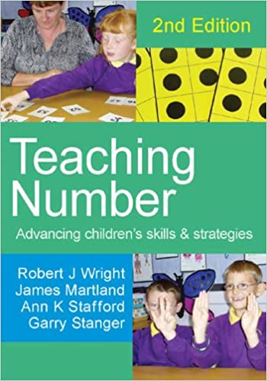
Maths Recovery
Maths Recovery was developed initially for low attaining typically developing children (6-7 year olds)
The curriculum is divided into five developmental stages with progressive levels of sophistication

Slide 9
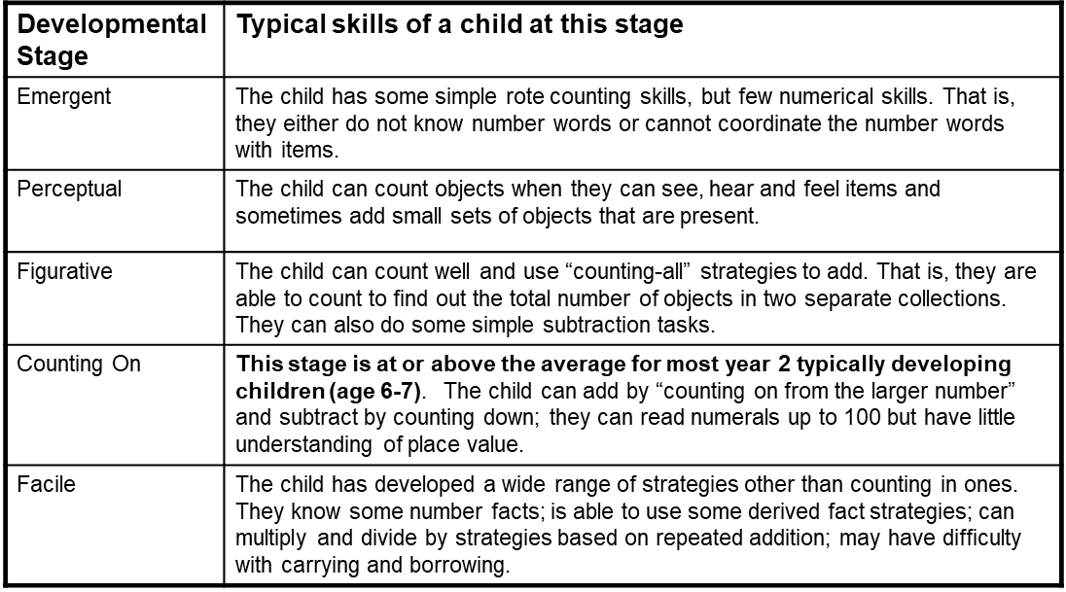

Slide 10
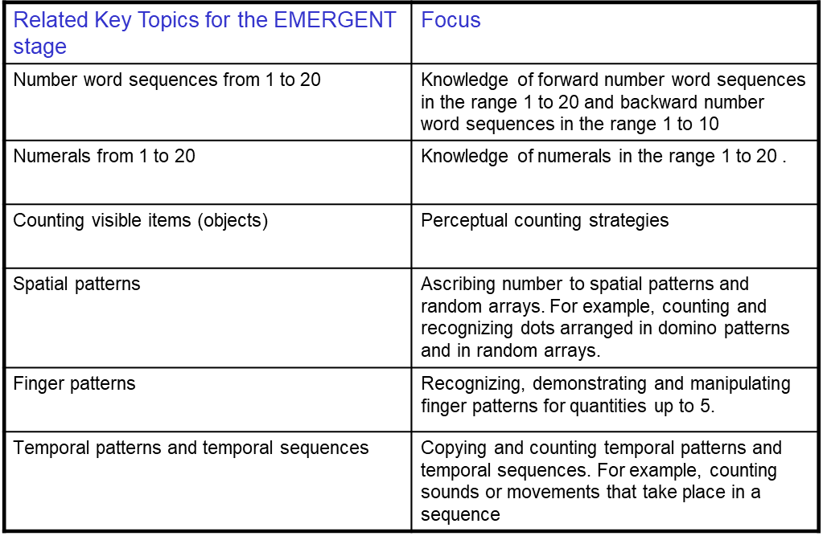

Slide 11
Teaching Activities within Each Key Topic:
Emergent stage- Number Word Sequences from 1-20
Short forward number word sequences
Short backward number word sequences
Saying alternate number word forwards
Saying alternate number words backwards
Saying the next number word forwards
Saying the next number word backwards
Saying the number word after
Saying the number word before

Slide 12
Numeracy Targets Organised:
Horizontally - different groups of activities within the same ability level – key topics
Vertically - within each key topic there are progressive stages of difficulty.
Emergent stage- 32 teaching activities
Perceptual stage- 30 teaching activities
Figurative stage- 42 teaching activities
Counting on stage- 42 teaching activities
Facile stage- 33 teaching activities
179 teaching activities

Slide 13
Why might Maths Recovery be suitable to adapt?
It is an evidenced based approach
It offers a comprehensive approach
It can be used with students who have yet to acquire any numeracy skills
It involves an individualized teaching approach
It has many elements consistent with systematic instruction (e.g., micro adjusting and scaffolding)

Slide 14
Adaptations
“What” to teach
- the curriculum/ lesson plans
2. “How” to teach
- pedagogy/ teaching strategies

Slide 15
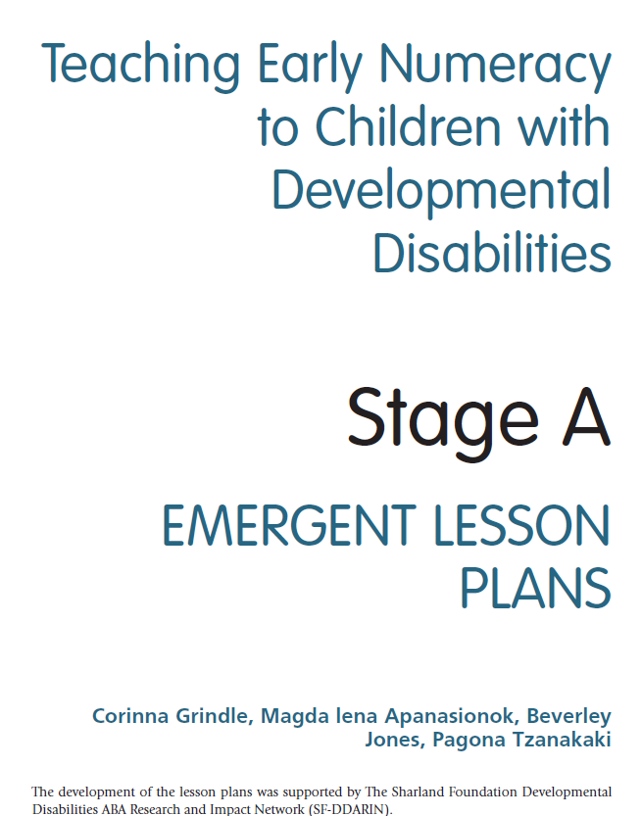
Adaptations to the lesson plans
Task analysis of difficult to teach skills- smaller steps
Short, succinct verbal instructions
Prompting and prompt fading suggestions
Mastery criterion
Generalisation strategies
…….and written in an accessible format for teachers and teaching assistants

Slide 16
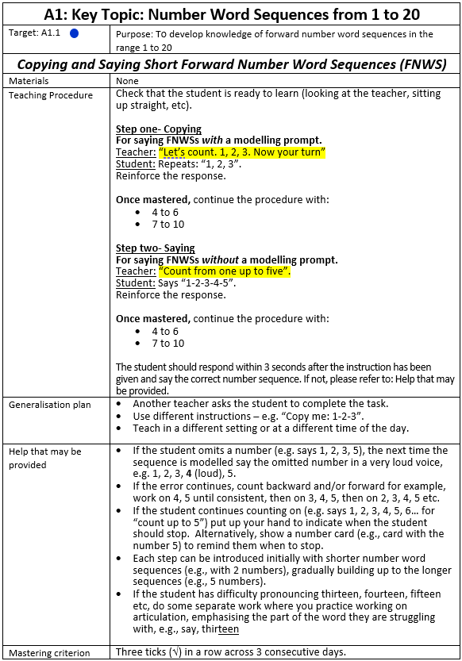
Structure of the Lesson Plans
Each lesson plan has six key sections:
Target specification and learning objective
Materials
Teaching procedure
Generalisation plan
Help that may be provided
Mastering criterion

Slide 17

Adaptations to the teaching practices
Assessment interview replaced with probe tests
Specification on strategies for how to increase motivation for learning
Emphasis on repeated practice through using systematic instruction teaching procedures
Fast paced sessions with monitoring (data collection) and feedback (e.g., error correction)

Slide 18
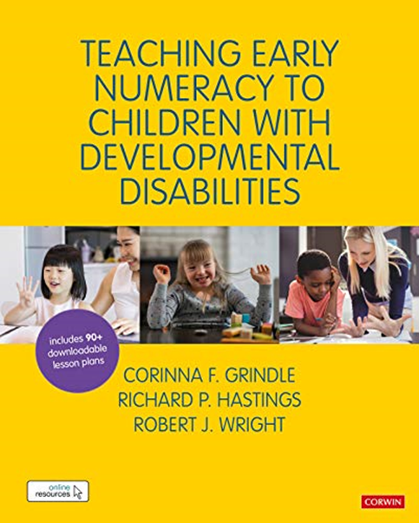
What is TEN-DD?
Published in a comprehensive practical guide, available on Amazon
Book sets out key principles of teaching and learning
Book comes with a comprehensive set of online resources, including 90+ lesson plans
Teachers and teaching assistants can be trained to deliver the principles described in the book
Evidence- based numeracy curriculum for children with developmental disabilities

Slide 19
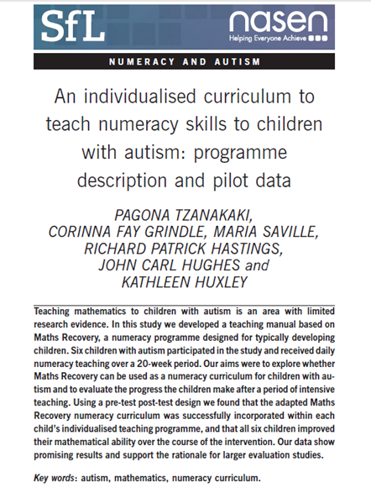

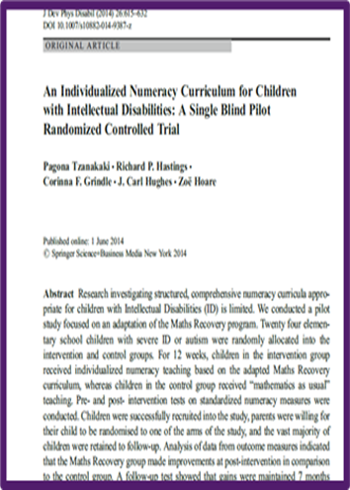
How do we know that TEN-DD is effective?
Research programme at the Centre for Educational Development, Appraisal and Research (CEDAR) spanning more than a decade
Effective with young children as “first” numeracy programme
Effective with older children as “catch up” numeracy programme
Can be delivered one-to-one or in small groups

Slide 20
Very first study
Tzanakai, Grindle et al (2014, Support for Learning)
6 boys with autism (aged 4-6 ) in autism resource setting
Is it feasible to use TEN-DD with children with autism? Do children’s mathematic skills improve?
Specialist tutors deliver the intervention, on average 50 mins a week for 20 weeks
Standardised test (Test of Early Mathematics Ability 3rd Edition (TEMA-3, Ginsburg & Barody, 2003) used at pre and post test
Positive results: Math age scores increased between 9 and 15 months in 5 months of teaching, treatment gains maintained at follow up

Slide 21
Study 2- pilot small scale RCT evaluation
Tzanakaki, Grindle et al (2014, Journal of Developmental and
Physical Disabilities)
Can a RCT evaluation be conducted in a special school setting? Will numeracy skills improve in a TEN-DD group compared to “maths as usual”? Will gains be maintained at follow up?
24 participants (age 6 to 11) randomly allocated to intervention or waiting list control (12 in each group, matched for age)
TEN-DD group- 13-30 1:1 sessions (3.5 hours- 10 hours)- 12 weeks
TAU- usual maths lessons (25+ hours for numeracy)- 12 weeks
Standardised Test of Early Mathematics Ability 3rd Edition (TEMA-3, Ginsburg & Barody, 2003) used to measure progress

Slide 22
Individual child data – Math age

Slide 23
Some Limitations
These evaluations of TEN-DD were conducted with staff members experienced in using systematic instruction procedures or with researchers delivering the intervention.
Teachers views need to be taken into consideration in developing the TEN-DD approach, so that it “fits” everyday mathematical delivery in everyday school settings

Slide 24
Other Research
Apanasionok et al. (2020, in press)
Implementing the TEN-DD programme in a large special school in the UK using a school staff delivery model
Teachers’ suggestions for improving training and implementation of TEN-DD obtained
Tryggestad et al. (2014)
Norwegian Journal of Applied Behaviour Analysis
Cross cultural relevance of TEN-DD?
Also being translated into Spanish (to use in Paraguay) and in Chinese

Slide 25
Other Research
Allallawi et al. (2020, under review)-
“I’m a big thumbs up with TEN-DD: Special educators’ experiences of a numeracy curriculum (TEN-DD) for students with Autism Spectrum Disorder”
Qualitative interview study
TEN-DD perceived as being a valuable experience for both the educators and their students
Initial scepticism about approach, transferred to conviction over the course of the implementation period.

Slide 26
“when they know how to count, and they recognize numbers, I was amazed to see- my God like- they are able to do it and we didn’t give them the chance to do that”
“I spoke to a parent of a child I used to teach… and he still hasn’t learned how to count…..and he can’t do the course that they want in a college because he can’t count, whereas if he had something like this……… and he doesn’t like to count now because he thinks he can’t do it - so if he had that intervention earlier then I think it would have benefited him”.

Slide 27
Other Research
Allallawi et al. (2020, under review)-
Training and supporting parents to deliver TEN-DD
Pilot study with three families
Lesson plans translated into Arabic
Children’s maths ability improved from pre-post test (using a standardised test of mathematical ability)
Parents described positive experiences of the training and approach
Provides initial evidence that TEN-DD can be adapted for parents to use in a home context.

Slide 28
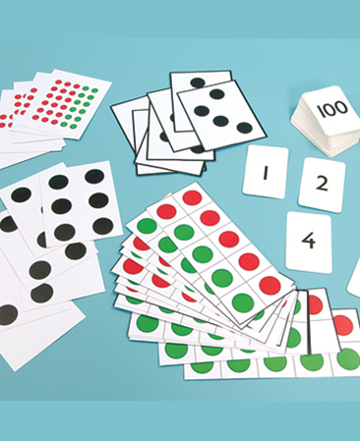
Summary- how may TEN-DD benefit children and schools?
Improving numeracy attainment
Enabling access to other areas of the curriculum and functional living skills
Promoting the use of evidence-based interventions and raising standards in mathematics
Promoting high quality, cost effective, individualized and small group instruction to children with autism and learning difficulties

Slide 29
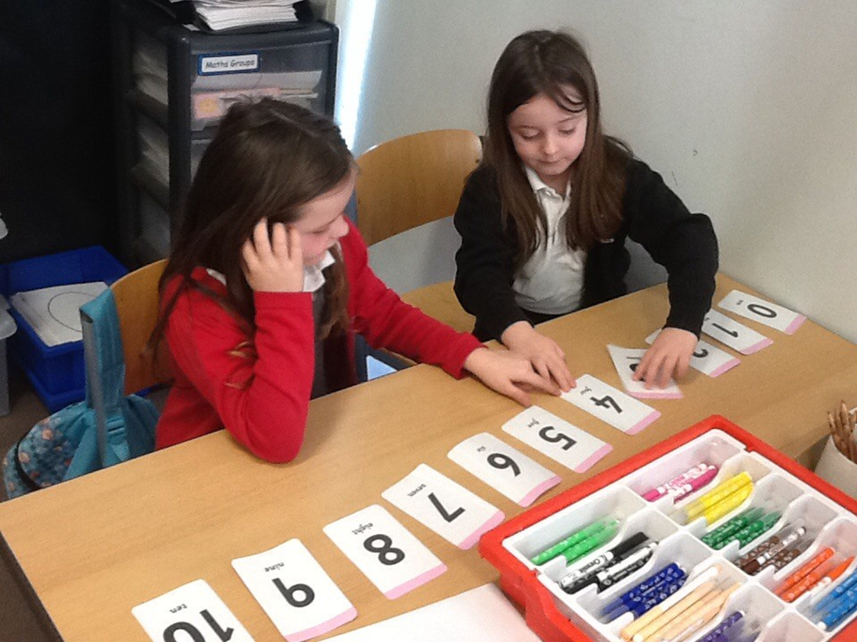
Summary- which Children will benefit from TEN-DD?
Those children struggling to learn numeracy using the schools’ typical methods
Primary and secondary school pupils
Attending special or mainstream school settings
Certain prerequisite skills required for maximal benefit, including imitation (so that modeling prompts can be used)

Slide 30
Charlotte Madine, Chair, Mathematics Recovery Council UK & Ireland
“This very useful book adapts the Maths Recovery Programme to suit the learning needs of students with a developmental disability. It provides an extensive and detailed approach to assessment, learning and teaching that embodies evidence-based best practice”.

Slide 31
Professor Adam Boddison, Chief Executive of the National Association for Special Educational Needs (NASEN)
“This much needed book is an essential read not only for educators but for educational leaders everywhere………. This book is a vital tool in maximising the numeracy potential of all children and I wish somebody had given this to me when I became a maths teacher more than 15 years ago”.

Slide 32

Twitter: @CorinnaGrindle
Email: c.grindle@warwick.ac.uk

