Slide 1






The Joy of Not Knowing ™ Enabling learners to feel comfortable with being uncomfortable
Research in Action Conference 2020
University of Warwick
14th December 2020
Marcelo Staricoff
PhD NPQH FCCT
JONK™ Thinking and Learning
www.jonklearning.co.uk
@MStaricoff
marcelo-staricoff
info@jonklearning.co.uk
Staricoff, M (Routledge, 2021) The Joy of Not Knowing
Routledge: https://bit.ly/33AxqNG

Slide 2
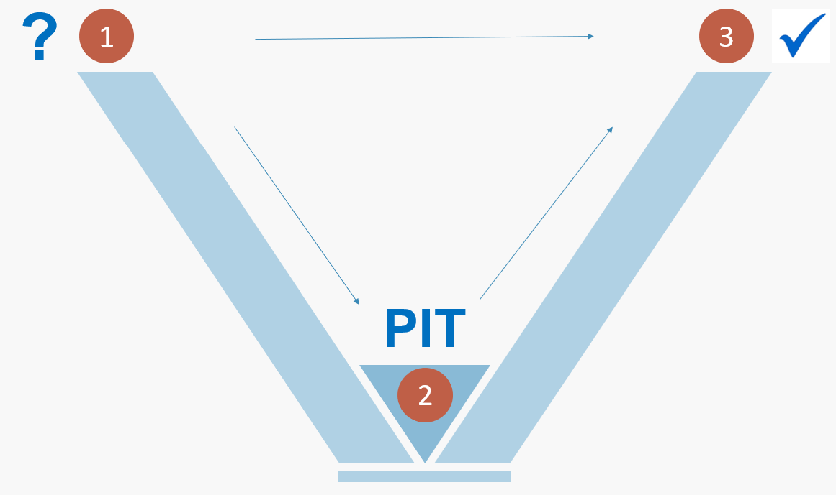
The joy of not knowing
The JONK Model of Learning
Staricoff, M (Routledge, 2021) The Joy of Not Knowing

Slide 3
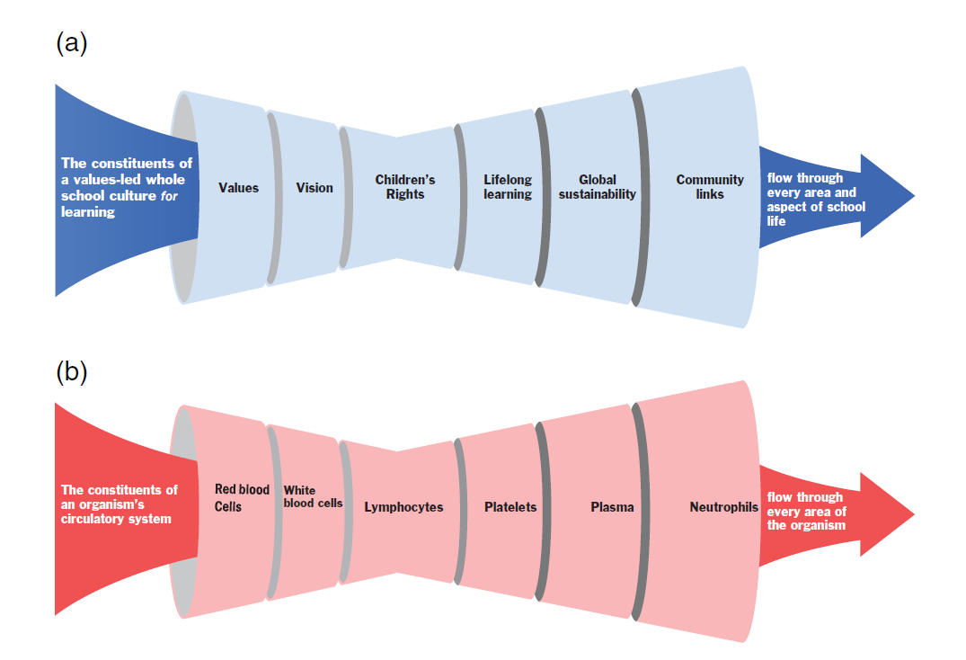
Developing a JONK culture of learning and for learning

Slide 4
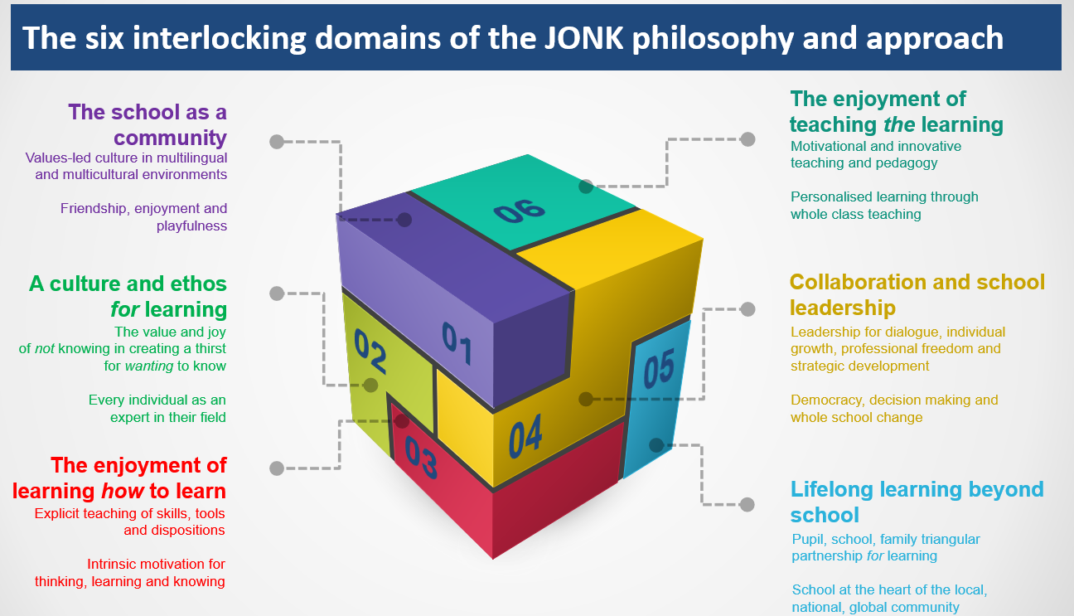
The vision flows through all aspects of school life

Slide 5
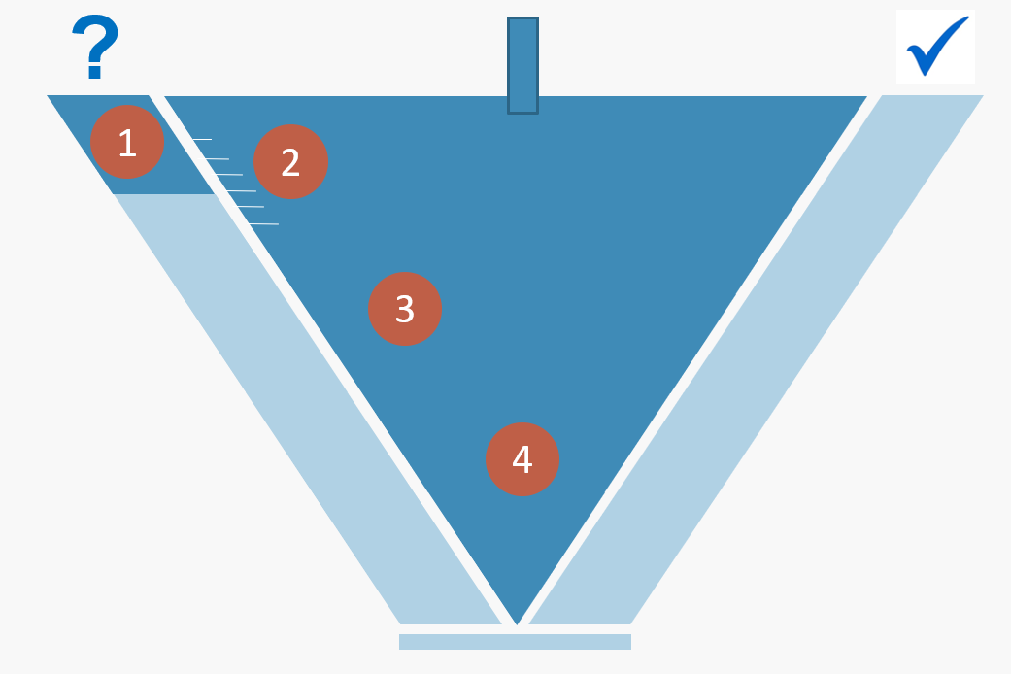
JONK enables every child to access and engage with the learning at their own pace and at their own depth…
The Four Stages of Accessing the Learning
Staricoff, M (Routledge, 2021) The Joy of Not Knowing

Slide 6
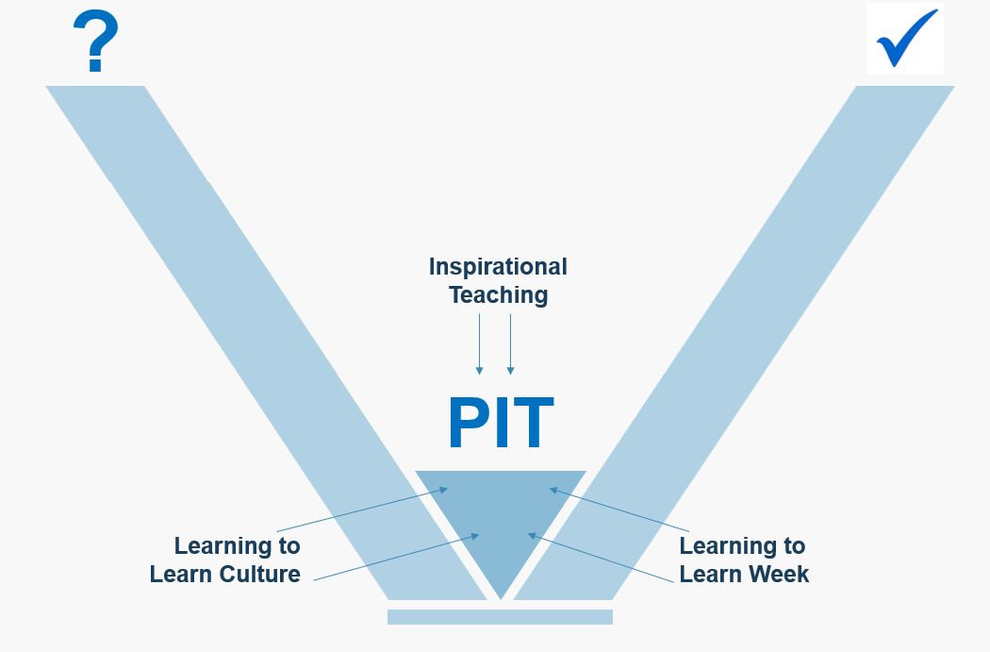
Feeling equipped to succeed… …feeling free to access the learning multilingually and multiculturally
The JONK Model of Learning
Staricoff, M (Routledge, 2021) The Joy of Not Knowing

Slide 7
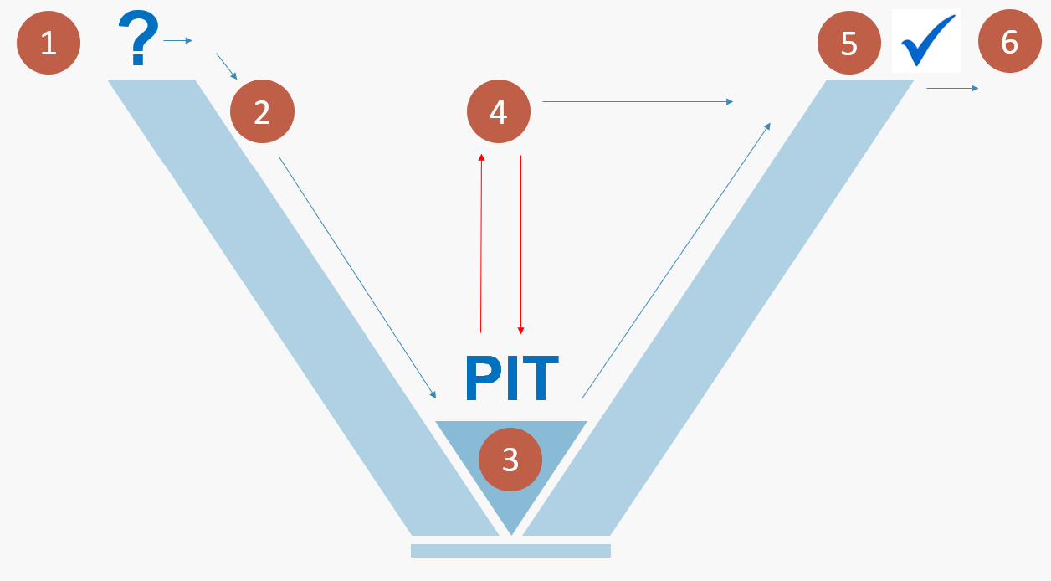
What are the six stages of the JONK learning process and how can we ensure that every child feels successful at each stage?
The Six Stages of the JONK Model of Learning
Staricoff, M (Routledge, 2021) The Joy of Not Knowing

Slide 8
What are the six metacognitive stages of the JONK learning process and how can we ensure that every child is able to think how to move across the stages?
The Six Stages of the JONK Model of Learning
Staricoff, M (Routledge, 2021) The Joy of Not Knowing

Slide 9
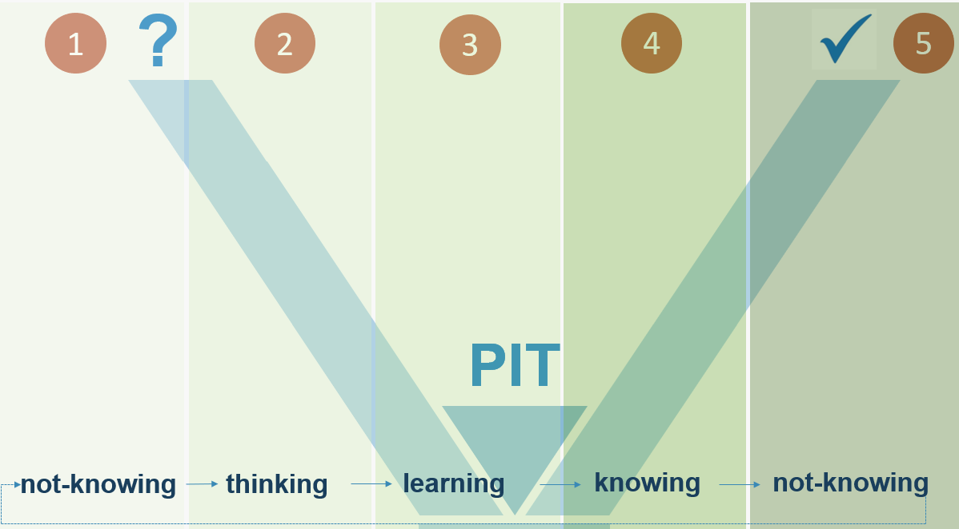
Creating a link between the concepts that underpin knowledge, learning and thinking…
The JONK Model of Learning
Staricoff, M (Routledge, 2021) The Joy of Not Knowing

Slide 10
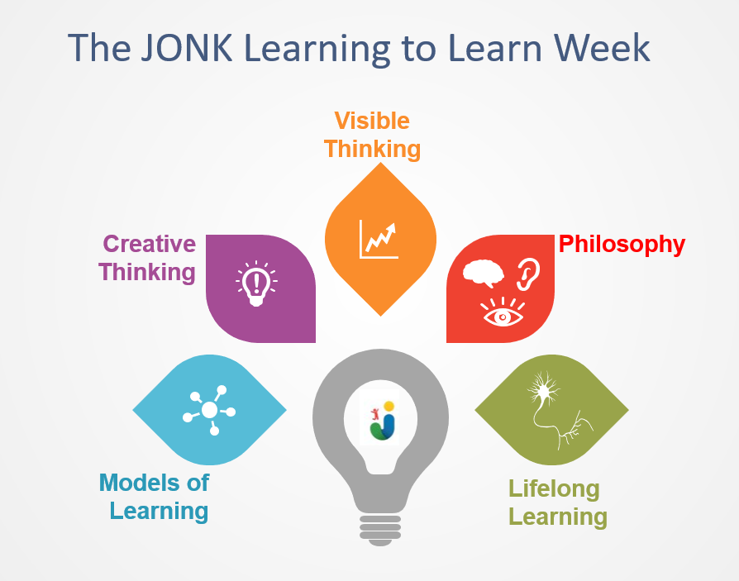
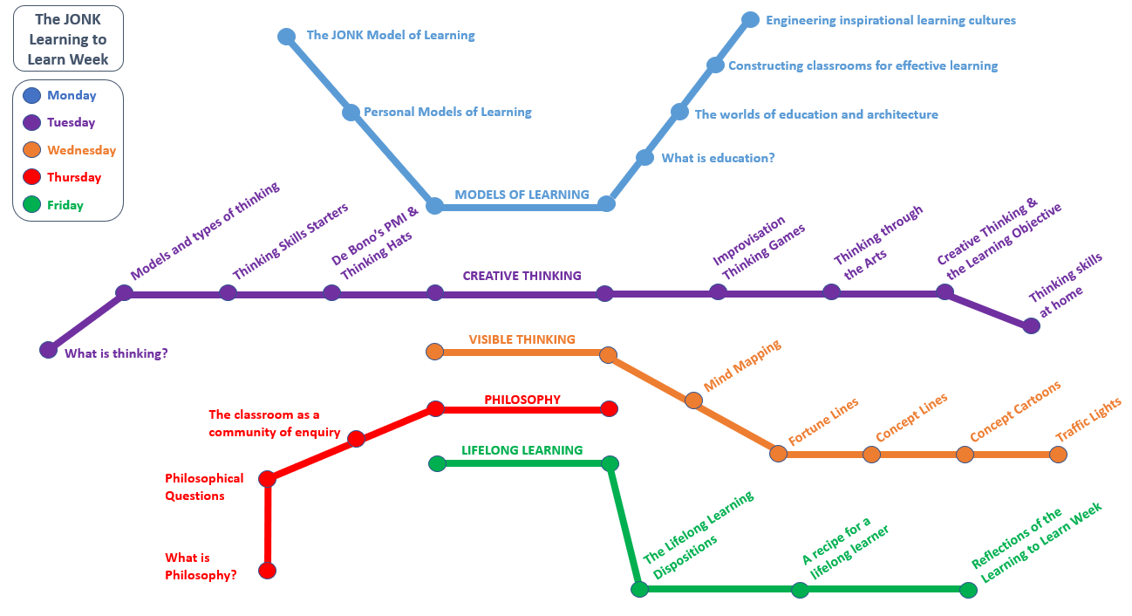
The JONK Learning to Learn Week Philosophy and Practice

Slide 11


The JONK Classroom as a Community of Enquiry

Slide 12
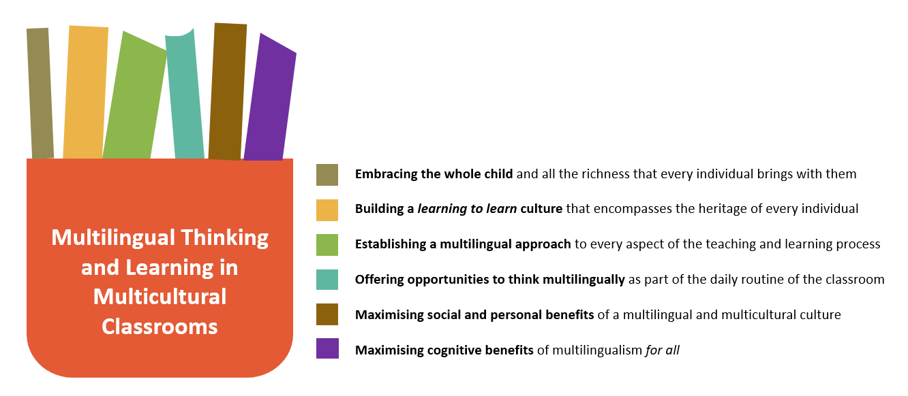
The vision flows through all aspects of every child’s life

Slide 13
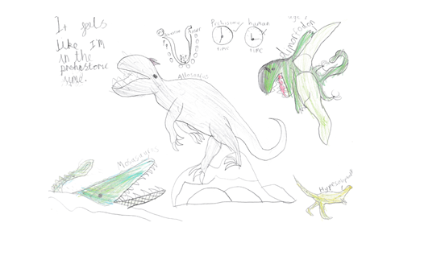
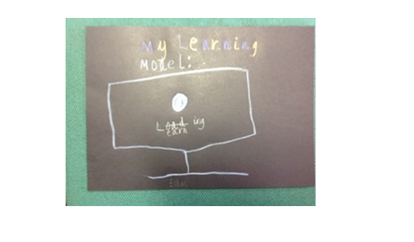
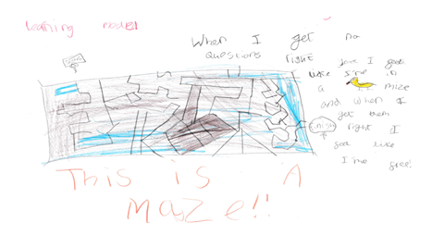
The JONK Personal Models of Learning

Slide 14
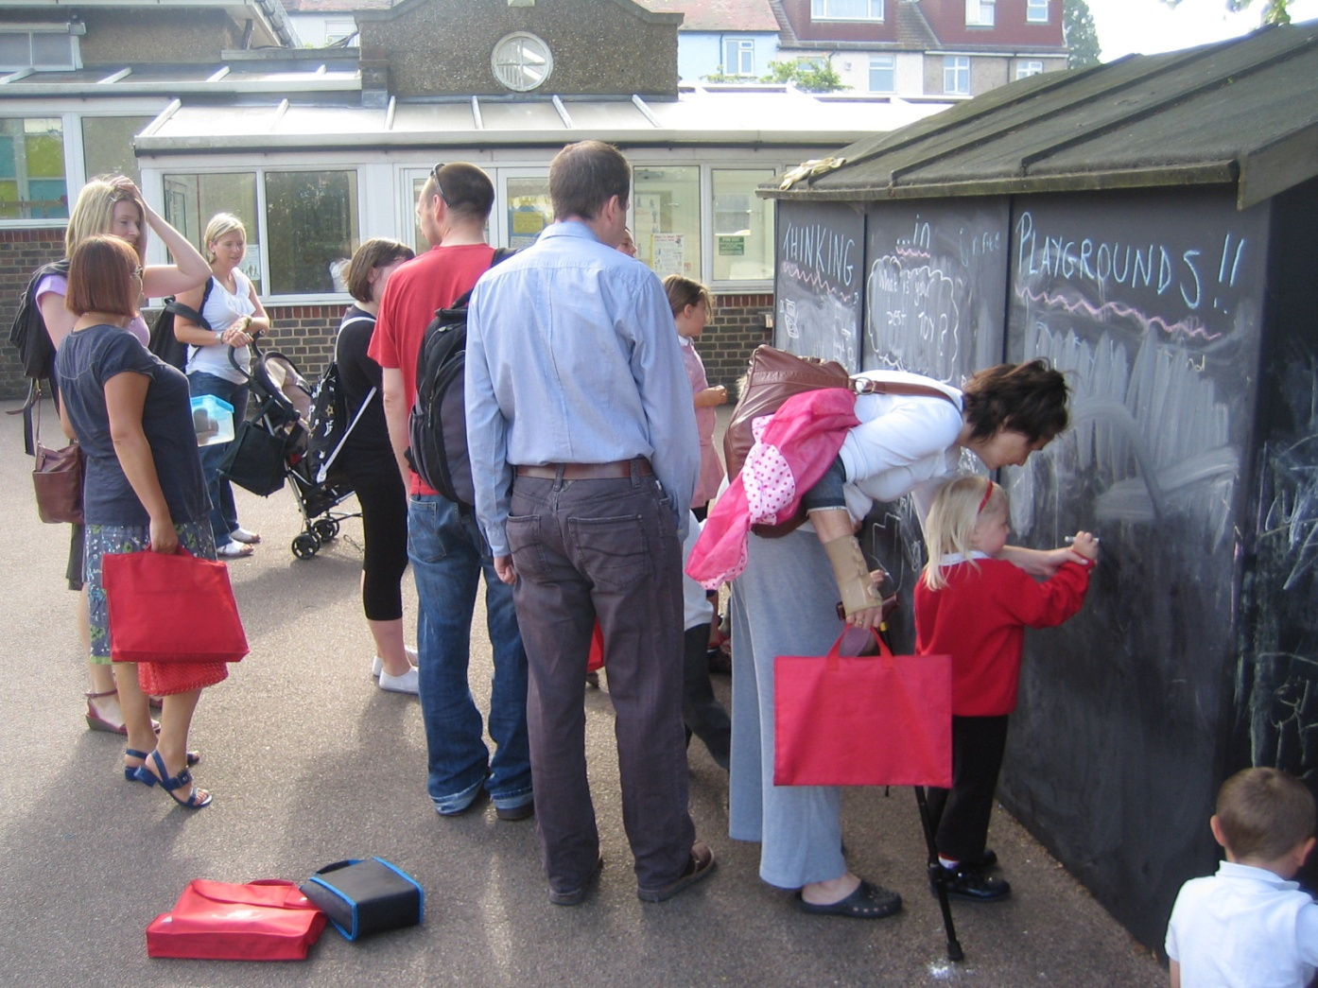
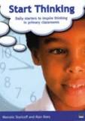
The JONK Thinking Skills Starters
.
.
.
.

Slide 15
Visible Thinking and Learning
Fortune Lines
Concept Lines
good
evil
Birbal
story

Slide 16
Philosophy and a Philosophical Approach to the Curriculum
Questions that have no answers
Questions that have more than one answer
Questions that are impossible to answer

Slide 17
Students thriving as learners and now and throughout their lives
robotic
strategically aware
rule bound
creative
passive
curious
fragmented
meaning making
dependent
effective partner
fragile
resilient

Slide 18
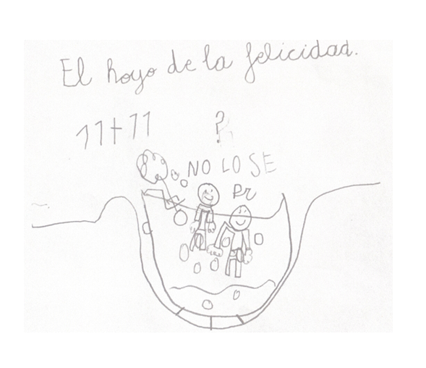
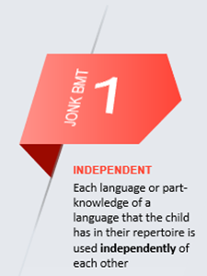
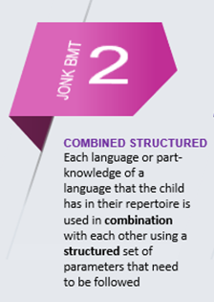
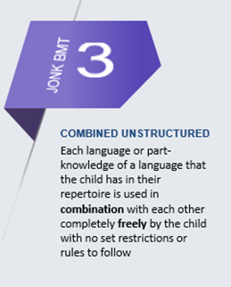
The wonders of a multilingual and multicultural approach

Slide 19
The Joy of Not Knowing ™ Multilingual Thinking in Multicultural Classrooms
Research in Action Conference 2020
University of Warwick
14th December 2020
‘If you talk to a man in a language
that he understands, that goes
to his head. If you talk to him in
his language, that goes to his heart’
Nelson Mandela
Marcelo Staricoff
PhD NPQH FCCT
JONK™ Thinking and Learning
www.jonklearning.co.uk
@MStaricoff
marcelo-staricoff
info@jonklearning.co.uk
Routledge: https://bit.ly/33AxqNG

