Slide 1






The Joy of Not Knowing ™
Multilingual Thinking in
Multicultural Classrooms
Research in Action Conference 2020
University of Warwick
14th December 2020
Marcelo Staricoff
PhD NPQH FCCT
JONK™ Thinking and Learning
www.jonklearning.co.uk
@MStaricoff
marcelo-staricoff
info@jonklearning.co.uk
Staricoff, M (Routledge, 2021) The Joy of Not Knowing
Routledge: https://bit.ly/33AxqNG

Slide 2
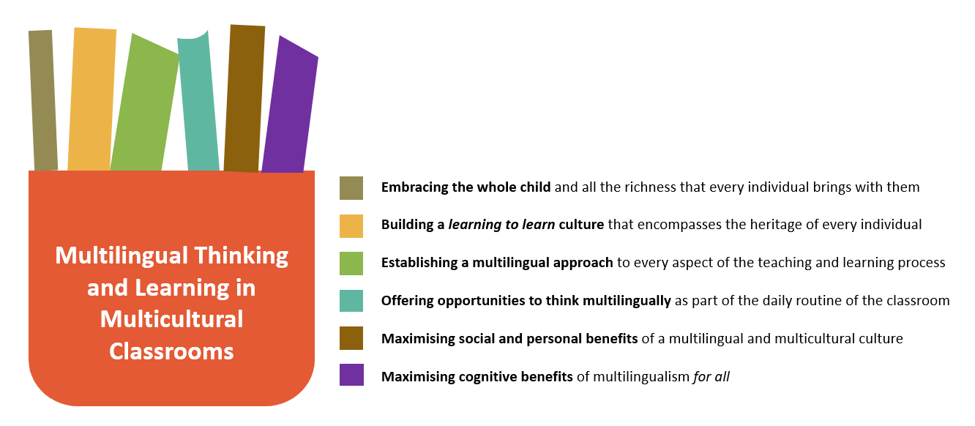
The importance of embracing all the linguistic and cultural richness that every child brings with them

Slide 3
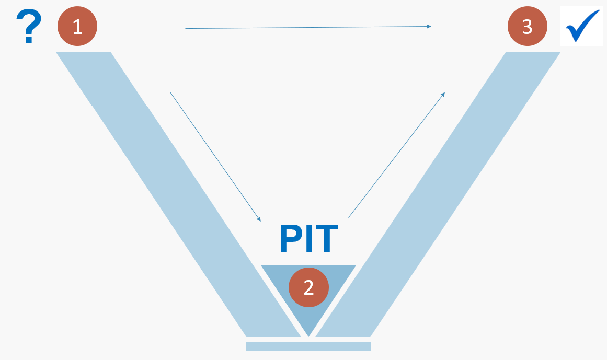
The joy of not knowing
The JONK Model of Learning
Staricoff, M (Routledge, 2021) The Joy of Not Knowing

Slide 4
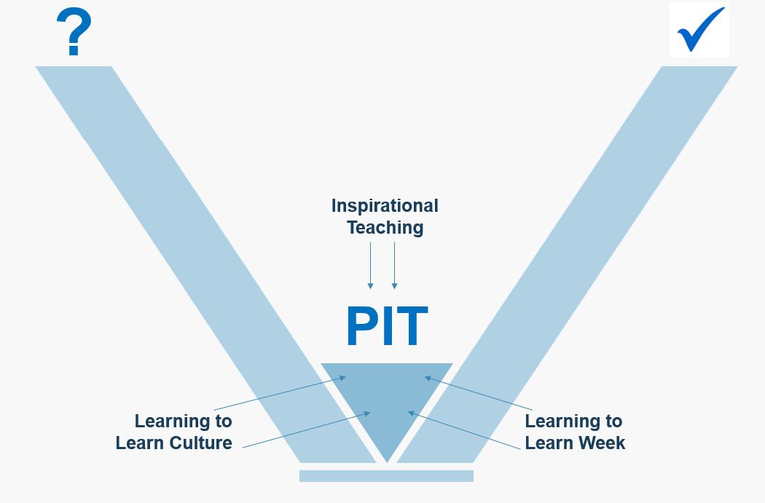
Feeling equipped to succeed…
…feeling free to access the learning multilingually and multiculturally
The JONK Model of Learning
Staricoff, M (Routledge, 2021) The Joy of Not Knowing

Slide 5
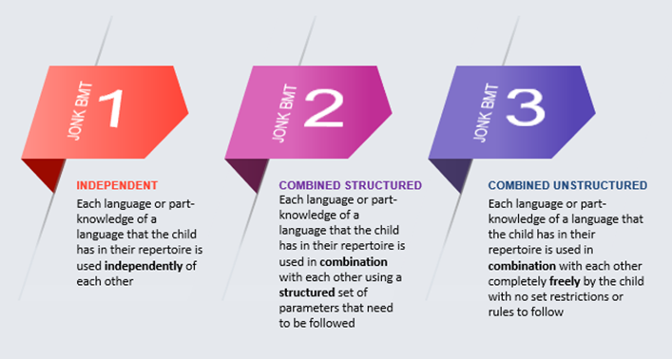
The JONK Multilingual Thinking Approach
Staricoff, M (Routledge, 2021) The Joy of Not Knowing

Slide 6
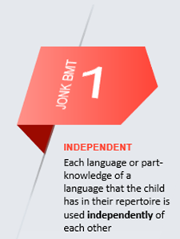
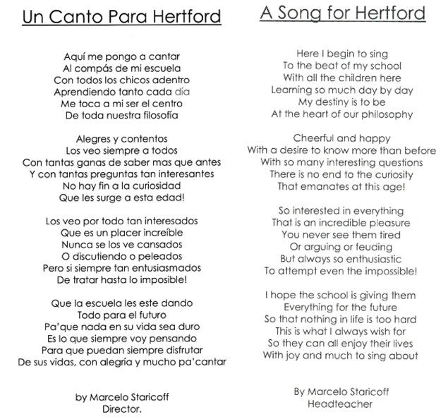
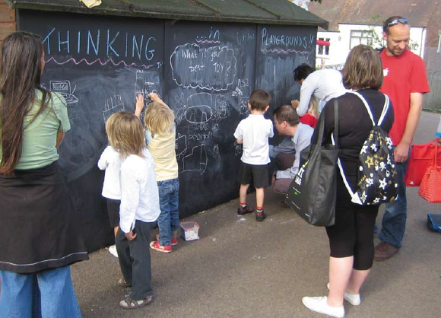
The JONK Multilingual Thinking Approach
JONK™ Multilingual and
Multicultural
Thinking in Playgrounds

Slide 7
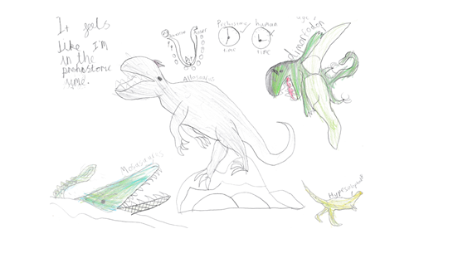
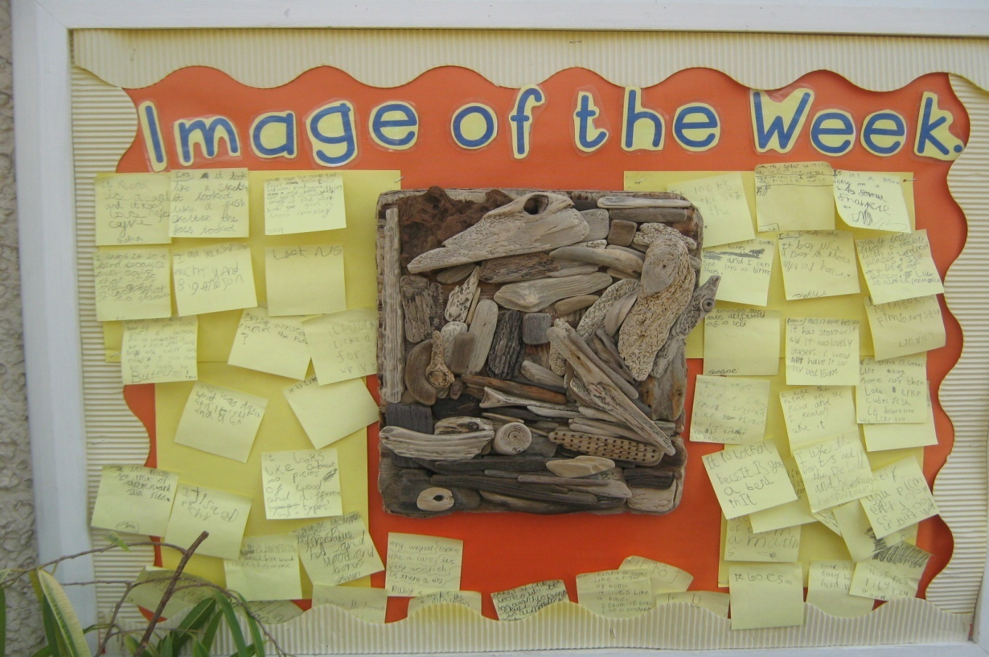
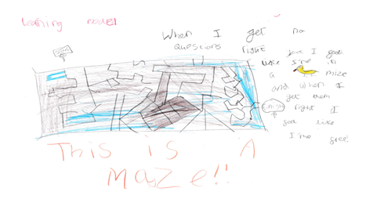
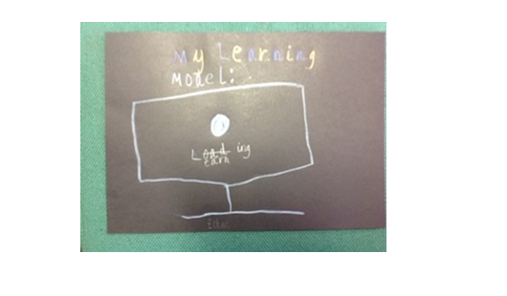
The JONK Multilingual Thinking Approach

Slide 8
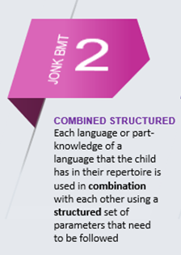
The JONK Multilingual Thinking Approach
A-Z of Animals
A Ardilla
B Badger
C Cocodrilo
D Dog
A Ardilla
B Badger
C Chien
Word Associations
Salt and pepper
Si y no
Fish and chips
Derecha y izquierda
Salt y pimiento
Si and no

Slide 9
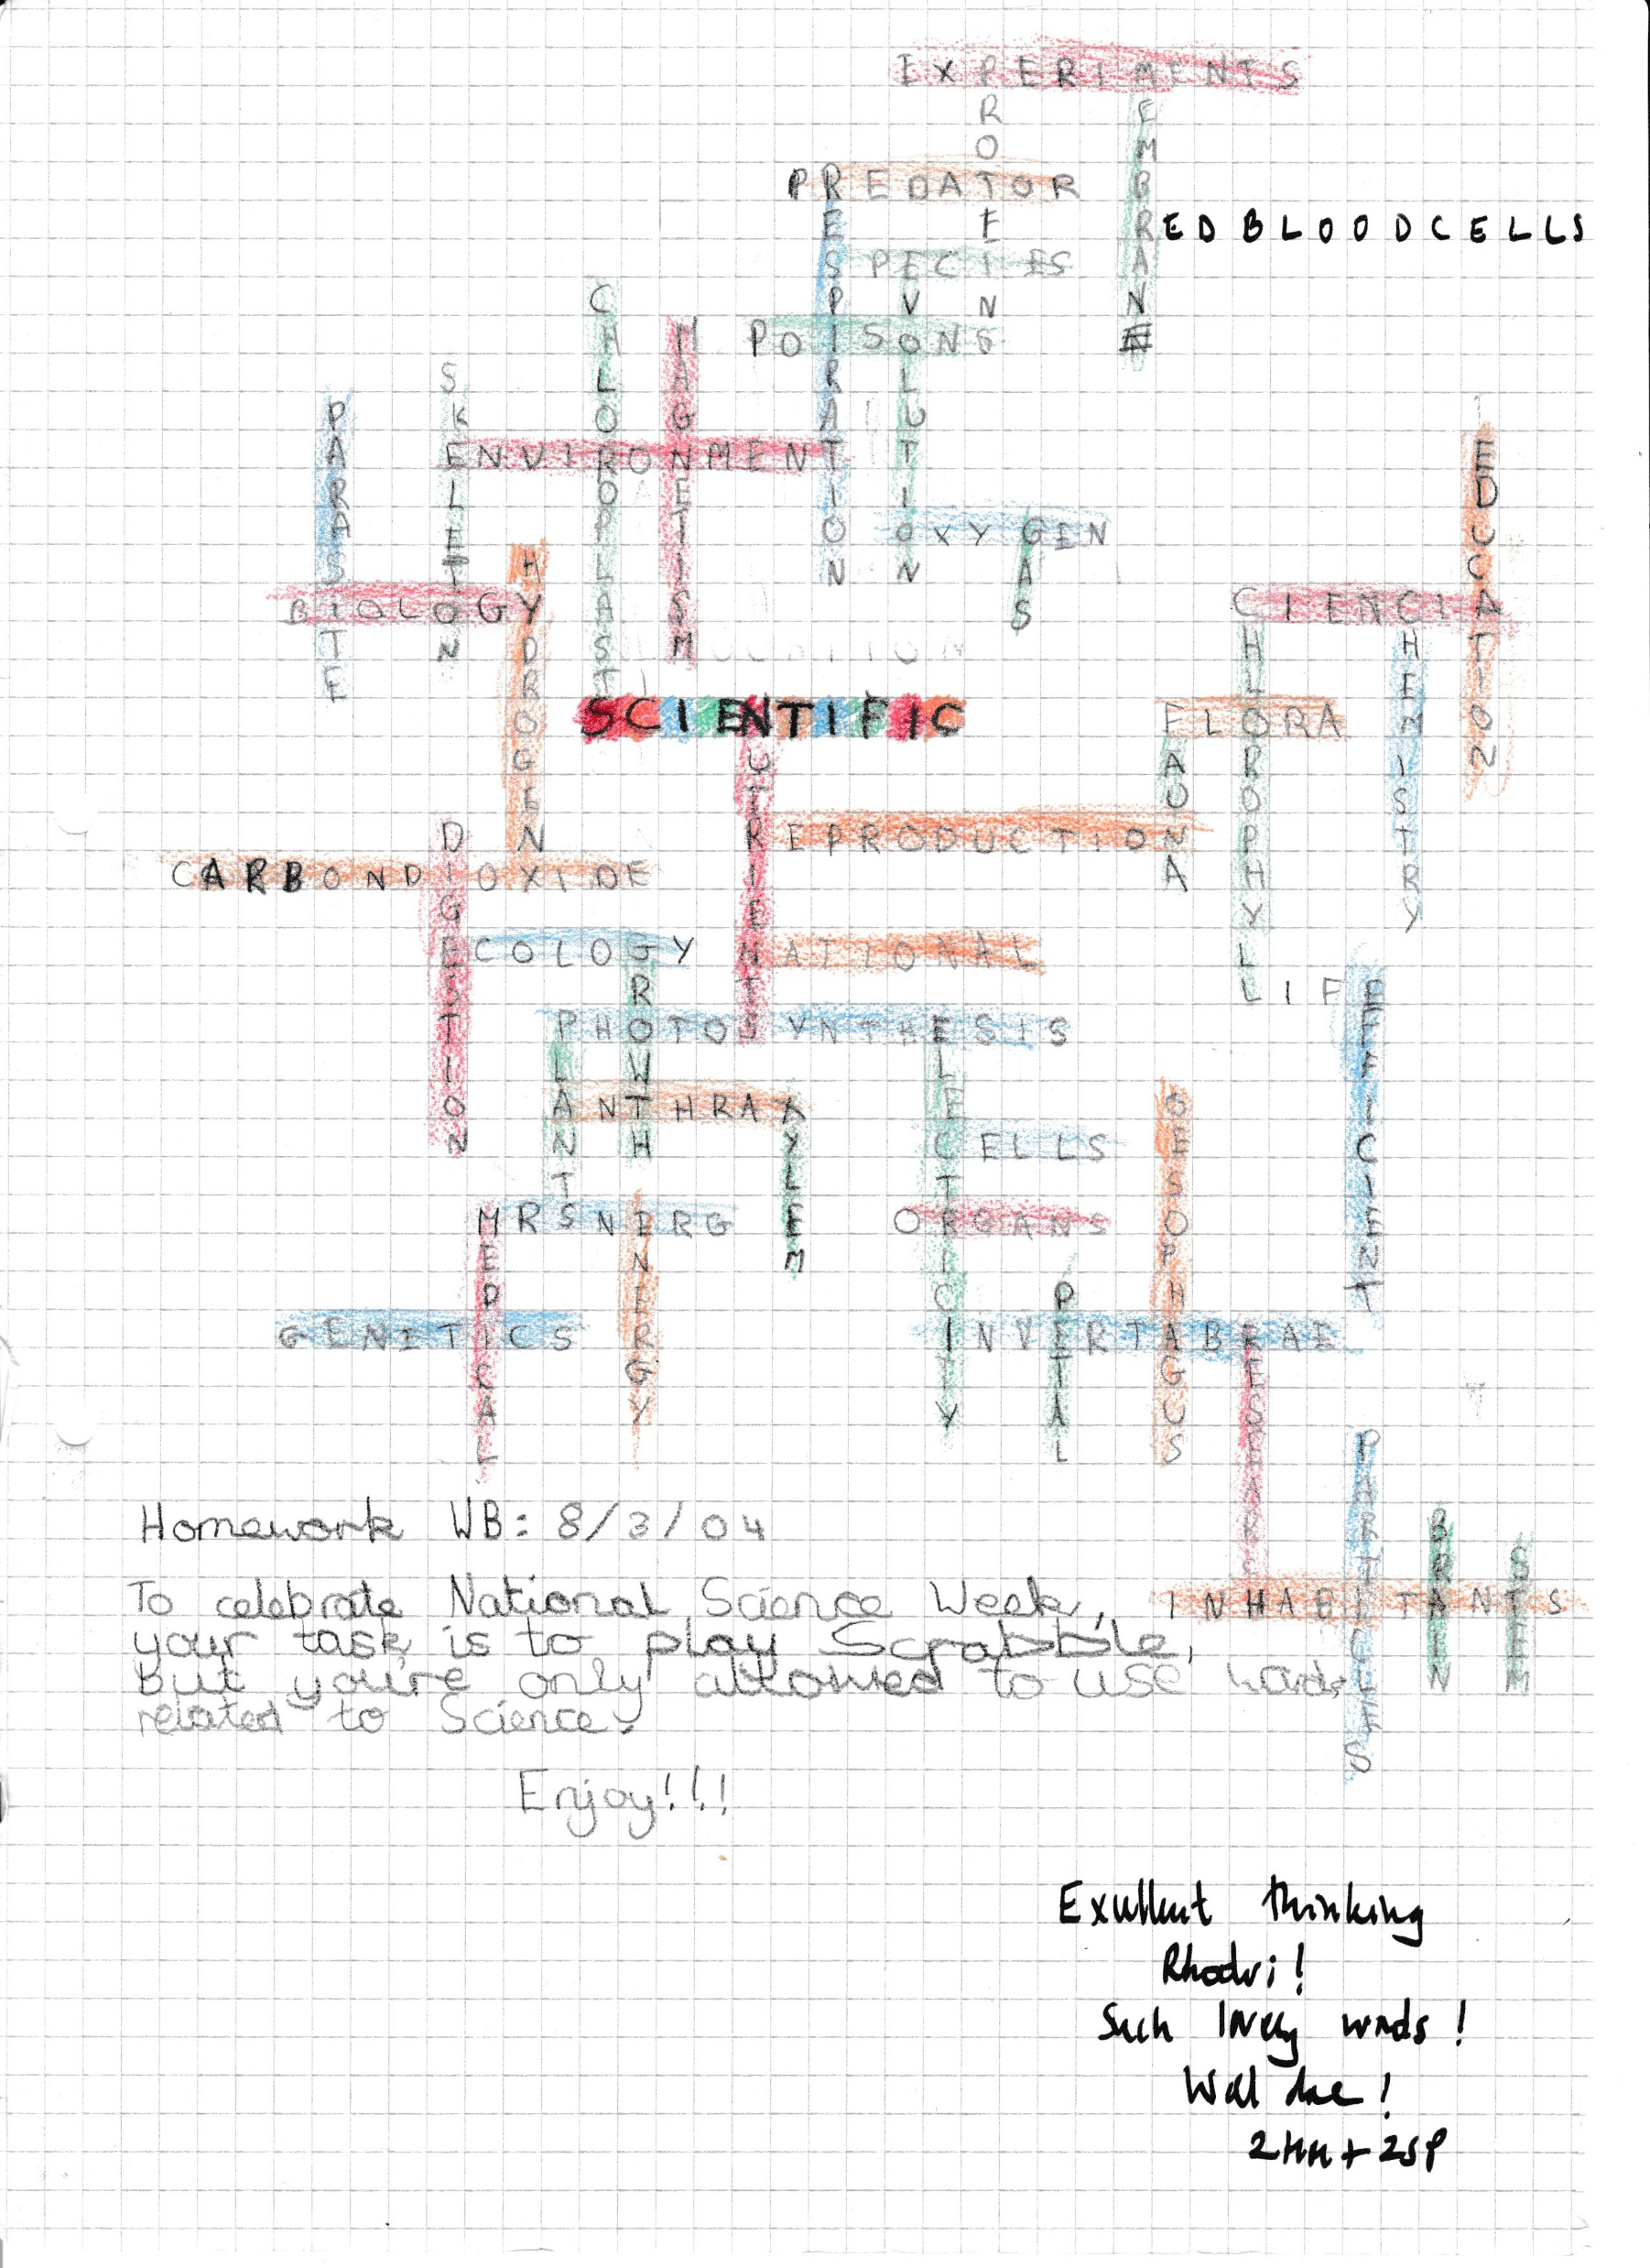
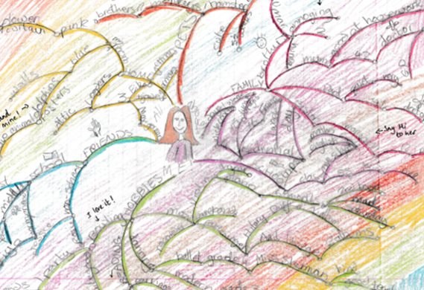
The JONK Multilingual Thinking Approach

Slide 10
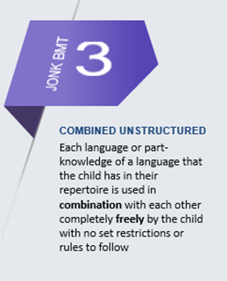
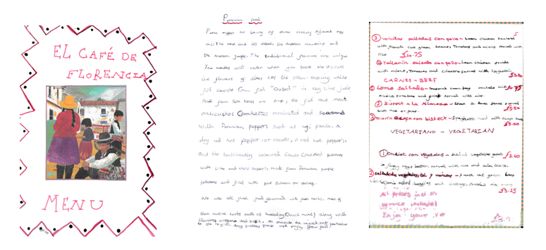
The JONK Multilingual Thinking Approach
1 ‘a’
2 ‘bi’
3 ‘tri’
4 ‘four’
5 ‘cinco’
6 ‘one six’
7 ’un siete’

Slide 11
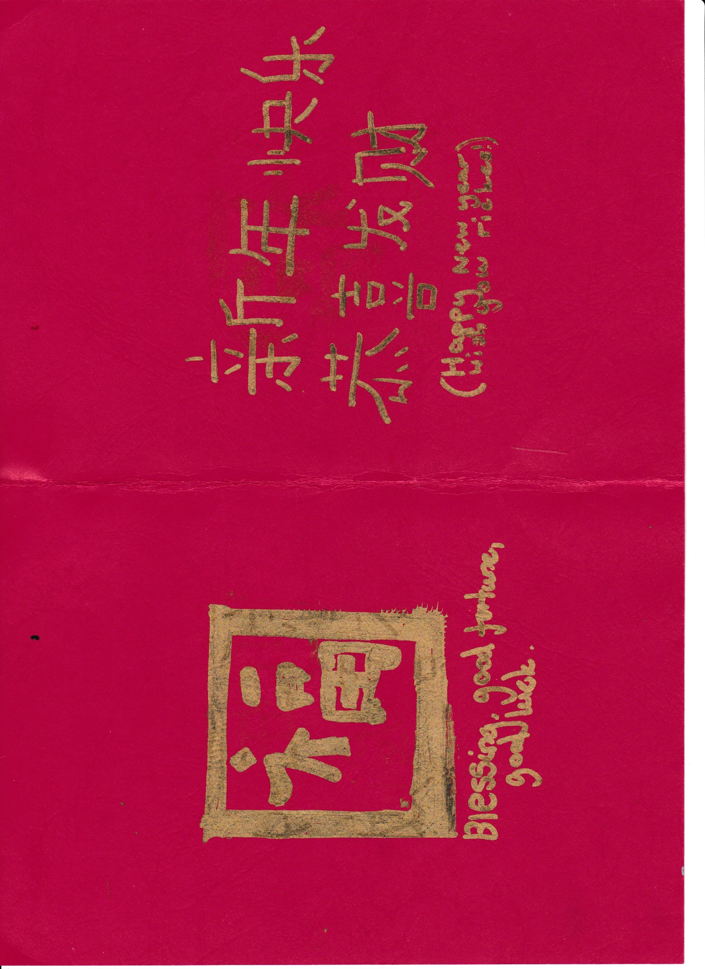
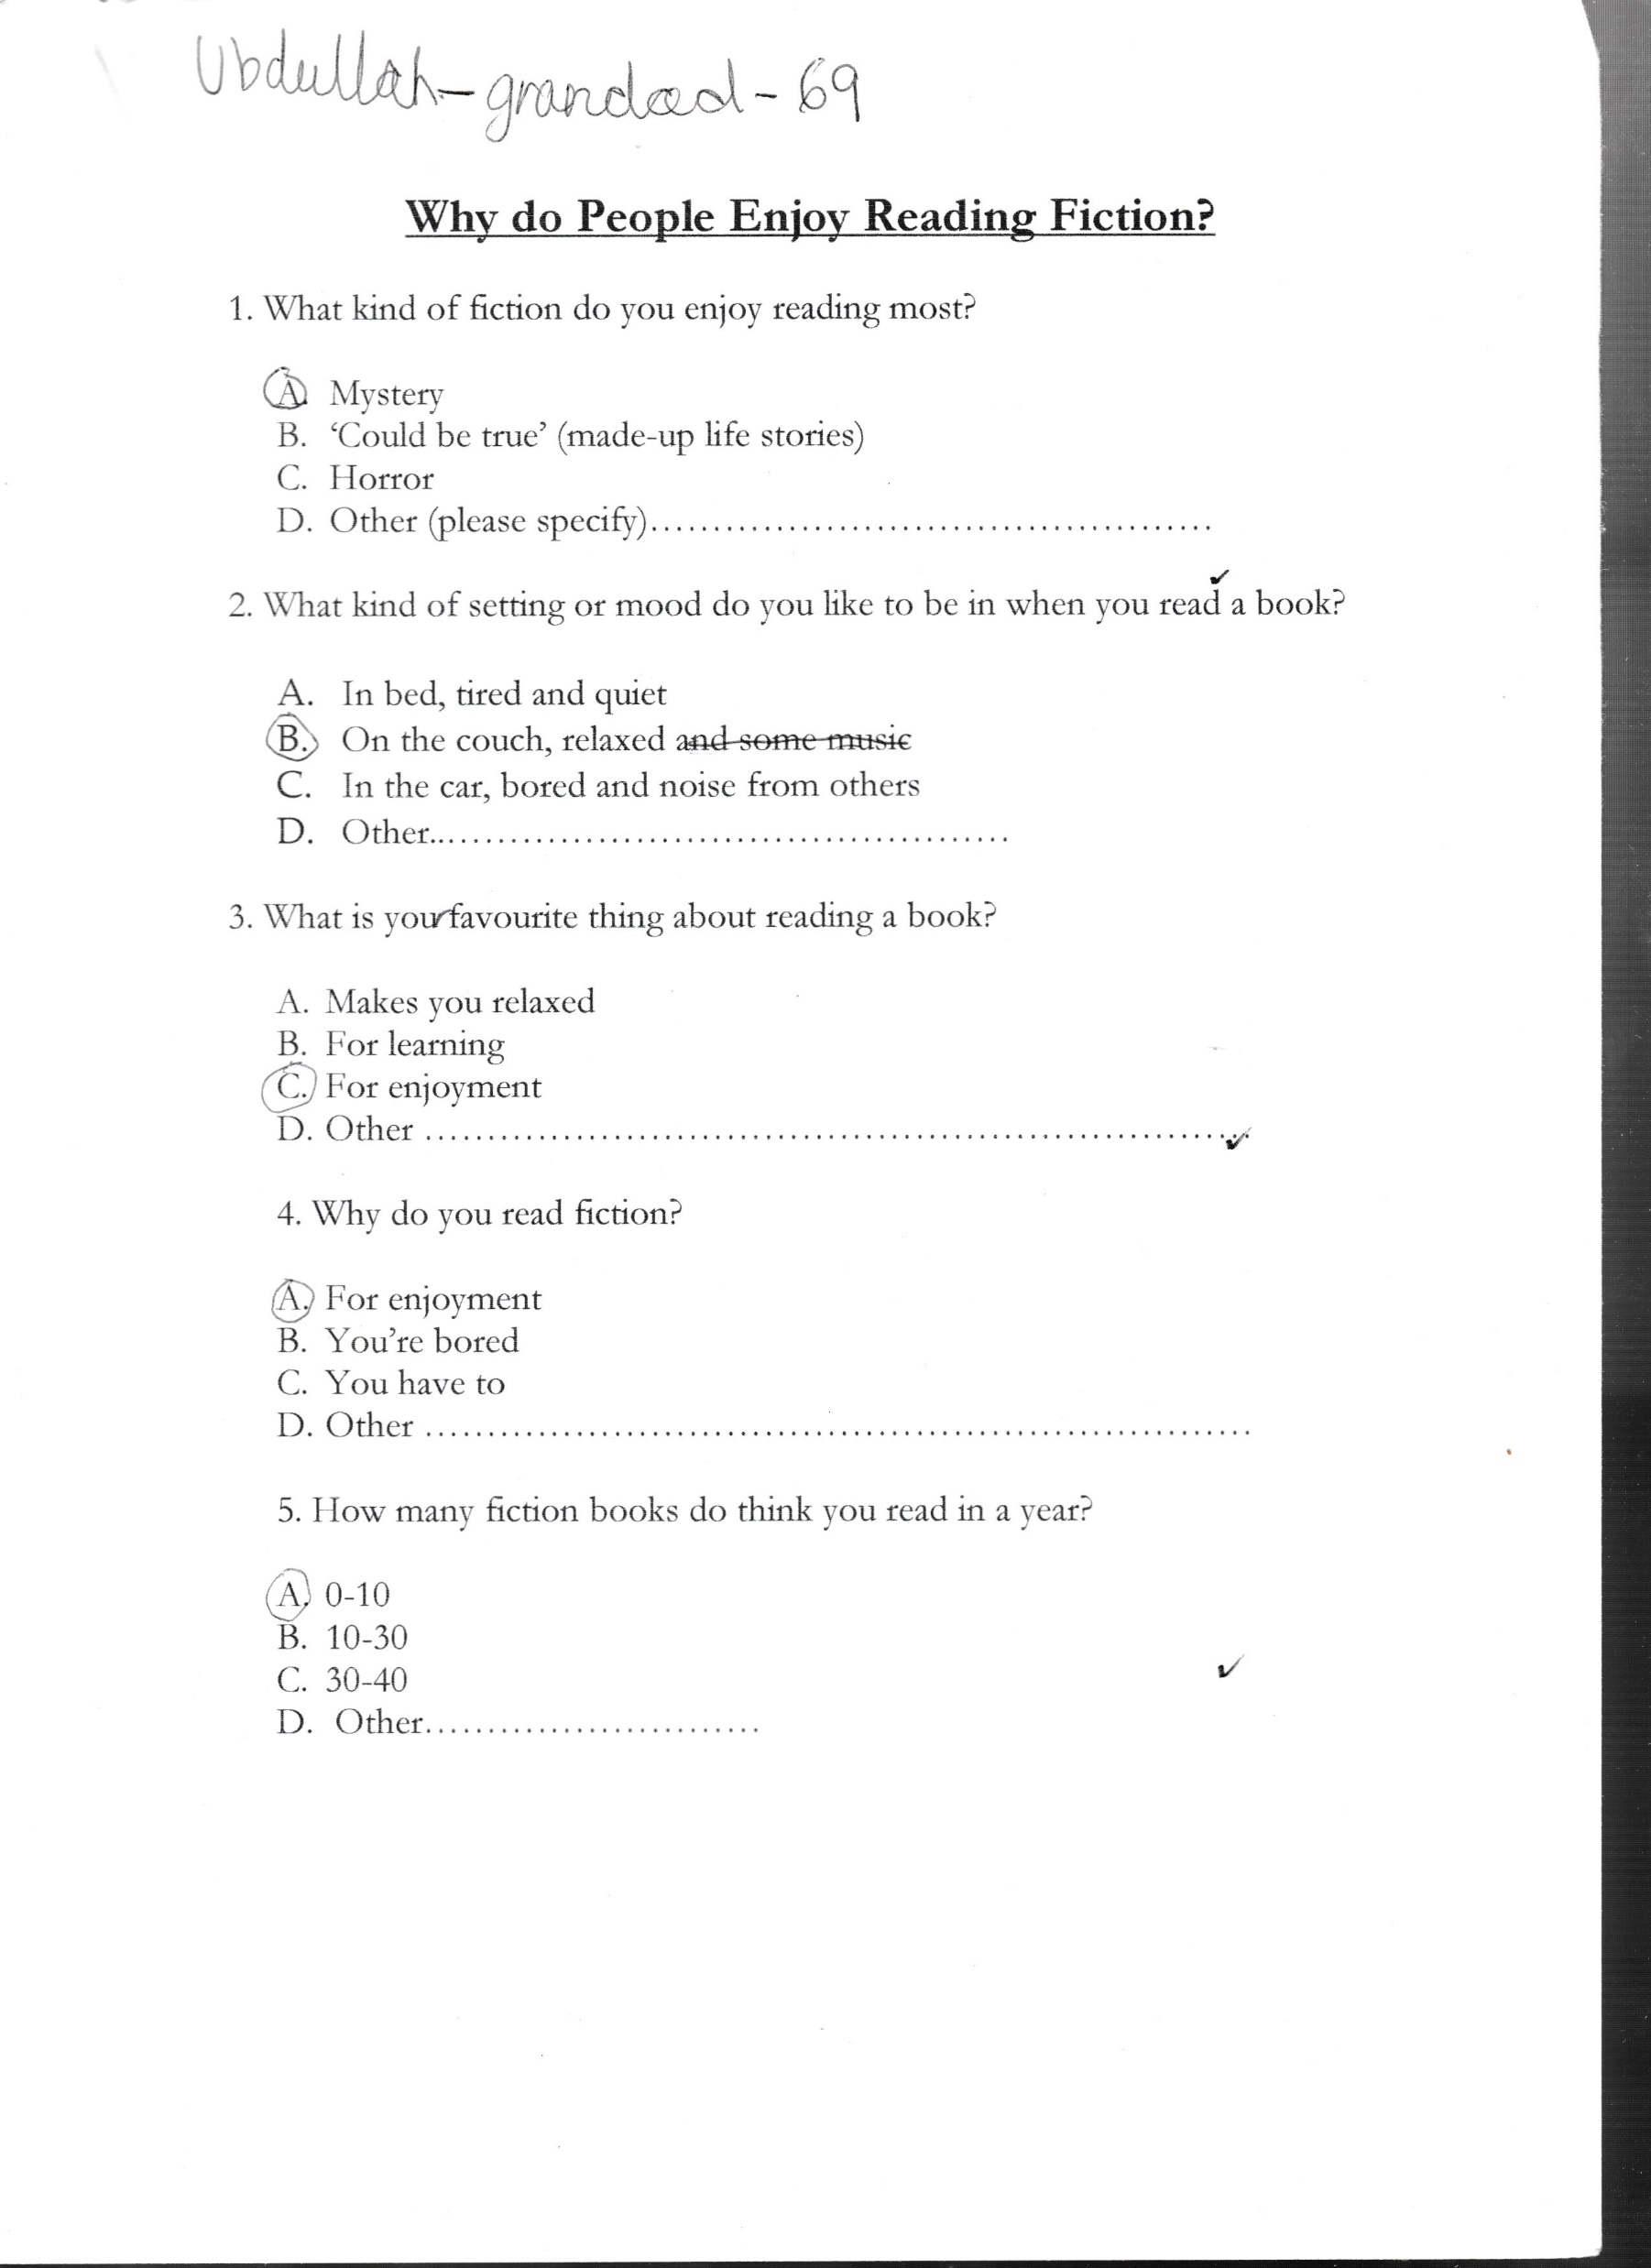
The JONK Multilingual Thinking Approach

Slide 12
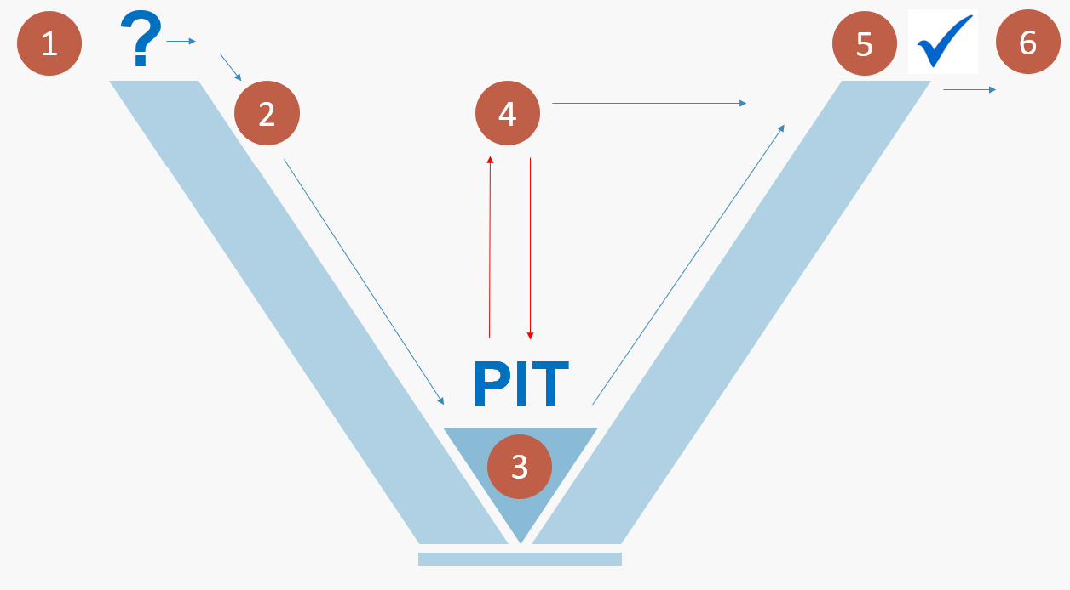
Multilingual thinking opportunities for all are at the heart of the teaching and learning routine enriching the experiences at each stage of the learning process
The Six Stages of the JONK Model of Learning
Staricoff, M (Routledge, 2021) The Joy of Not Knowing

Slide 13
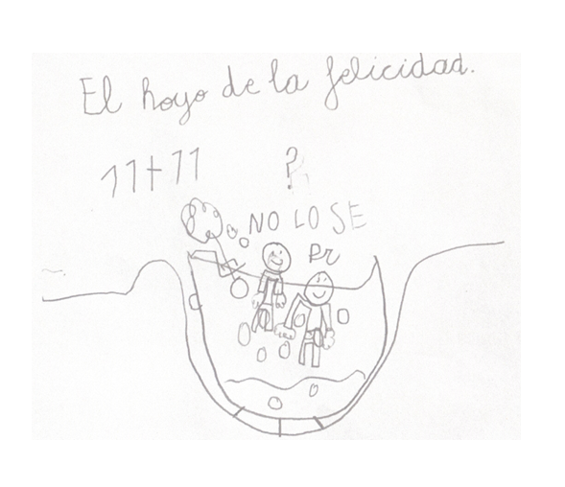
The wonders of a multilingual and multicultural approach

Slide 14
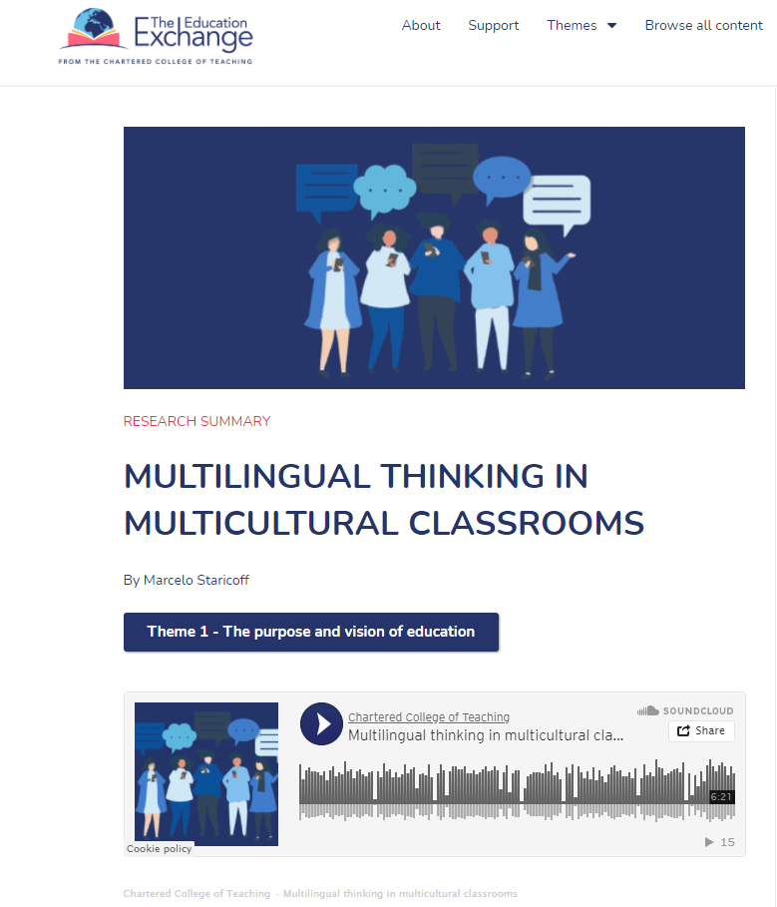


https://theeducation.exchange/multilingual-thinking-in-multicultural-classrooms/

Slide 15
The Joy of Not Knowing ™
Multilingual Thinking in
Multicultural Classrooms
Research in Action Conference 2020
University of Warwick
14th December 2020
‘If you talk to a man in a language
that he understands, that goes
to his head. If you talk to him in
his language, that goes to his heart’
Nelson Mandela
Marcelo Staricoff
PhD NPQH FCCT
JONK™ Thinking and Learning
www.jonklearning.co.uk
@MStaricoff
marcelo-staricoff
info@jonklearning.co.uk
Routledge: https://bit.ly/33AxqNG

