Slide 1


Writing your own ‘Teacher Manifesto’
Paul Taylor-McCartney

Slide 2
Aim This interactive session aims to immerse you in a series of critical and creative exercises, using an established model in creative writing practice (Harris, 2015) to help develop your emerging teacher identity.

Slide 3
Transference Model
Interdisciplinary discourse
Deepens learning experience
Highly personalized
Promotes creativity and criticality
Promotes reflection (self actualization)
Innovative discoveries
BA CREATIVE WRITING AND ART HISTORY
LITERATURE (CHILDREN’S) AND CREATIVE WRITING
CREATIVE STUDIES AND ENGLISH LANGUAGE
CREATIVE AND CRITICAL WRITING
(HEA, 2017)

Slide 4
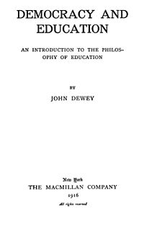
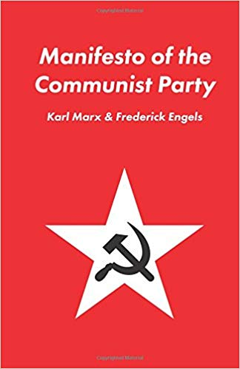
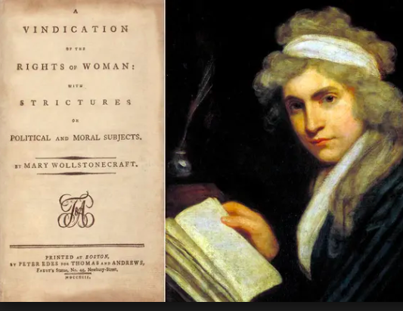
Famous Manifestos

Slide 5
Process …
A mysterious inborn talent
Something produced solely for others; a means of pleasing an audience
Formalist
A commodity
Expression that is shaped and crafted
The honoring of tradition
A pile of crap; a hoax; excuse for not having a REAL job
Creative Writing
Art
Formalist
A learnable skill
Emotional or psychological therapy
The subversion of tradition
Expression that is wide-open and free
… Product
Formalist
Self-expression; solely for self ; exploration of one’s unique vision
(NDSU, Creative Writing HE, 2018)

Slide 6
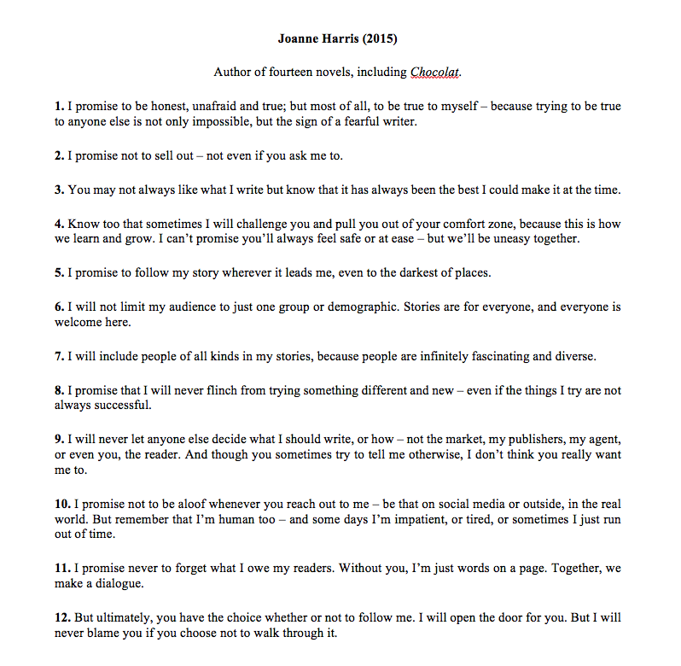
To what extent is the role of the teacher similar to that of the creative writer/author?
What might be considered the processes and products of teaching?
Who are the consumers of a teacher’s output?

Slide 7

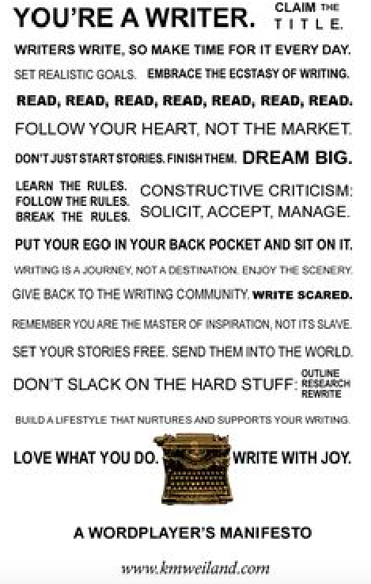
Writer
Manifesto
Examples

Slide 8
To record the world as it is. To set down the past before it is all forgotten. To excavate the past because it has been forgotten. To satisfy my desire for revenge. Because I knew I had to keep writing or else I would die. Because to write is to take risks, and it is only by taking risks that we know we are alive. To produce order out of chaos. To delight and instruct. To please myself. To express myself. To express myself beautifully. To create a perfect work of art. To hold a mirror up to the reader. To paint a portrait of society and its ills. To express the unexpressed life of the masses. To name the hitherto unnamed. To defend the human spirit, and human integrity and honour. To thumb my nose at Death. To make money so my children could have shoes.
(Margaret Atwood)
Writer
Manifesto
Example
What image or phrase stands out to you? What does it tell us about the author’s personality? Her principles/values? What about style and technique?

Slide 9
What might a manifesto look like for a teacher?

Slide 10
Research Task
Think of your Teacher Manifesto as a public statement -
an open declaration of your values/teaching philosophy!
Why you’ve chosen to teach
What you enjoy about teaching
Who you want to help
How you will achieve your goals
What you promise to do every day
How you want to be remembered/your legacy

Slide 11

I teach because …
I value …
I encourage …
I foster …
I promote ….
I endorse …
I will …
Critics tell me …
In my difficult moments I remember …
I am …
Personal Writing &
Sharing

Slide 12
Chat Panel Plenary
1. How did it make you feel writing your own manifesto?
2. What did you discover about yourself through the process?
3. What key themes stood out in your writing? In others’?
4. In what ways might this help you in your subject or with pupils?
5. How might you use this in terms of your own development?

Slide 13
What next?
Share with me for research purposes:
pault@truro-penwith.ac.uk
Put a copy of your scanned Manifesto onto your e-portfolios.
Share with your mentors in school/university tutor.
Consider getting some of your classes to draft their own subject/pupil manifestoes.

Slide 14
Works Cited
Harris, J. (2015). Writer’s Manifesto. Manchester Literature Festival journal. Manchester. Arts Council Press.
HEA Academy (2017). Transference Models of Learning. London.
Jubilee Centre for Character and Virtues (2014). Statement on Youth Social Action and Character Development. Birmingham. University of Birmingham Press.
NDSU (2018). NDSU Creative Writing Department Handbook. North Dakota State University. USA.

