Slide 1
Introduction to
Mathematical Resilience
& the growth zone model
Sue Johnston-Wilder

Slide 2
Introductions

Slide 3
Aims of this session
To understand why maths anxiety is so prevalent
To begin to understand what we can do about it, for ourselves and our students

Slide 4
Sharing experiences
Share your personal experiences of maths learning on the board – put positive experience on the right and negative experiences on the left.

Slide 5
Sharing experiences
Negative | Positvie

Slide 6
Maths teaching
A.L.I.V.E. maths
Accessible
Linked
Inclusive
Values-based
Engaging
(Johnston-Wilder et al, 2015)
T.R.I.E.D. maths
Tedious
Rote
Isolated
Elitist
De-personalised
(adapted from Nardi & Steward, 2003)

Slide 7
Maths anxiety
“A feeling of tension, apprehension, or fear that interferes with maths performance” (Ashcraft, 2002)
Results in:
Negative attitudes & motivation towards maths
Avoidance
Lower grades
Negative self-perceptions
Impact on working memory
http://www.mccc.edu/~jenningh/Courses/documents/math_anxiety.pdf

Slide 8
The problem
Learners are naturally curious
Fear is learned
Things that cause fear become avoided
Vicious cycle
Combined with fixed mindsets:
“I am not a maths person”
Self-fulfilling prophecy

Slide 9
The facts
As a survival strategy the brain seeks to distinguish challenge from threat to well-being
The brain doesn’t distinguish between physical and social threats, such as being left behind or humiliated or shouted at
Previous threats are remembered
When the brain (sub-consciously) perceives a threat, it responds by fight or flight mode, at least initially

Slide 10
Student experience
[the teacher]would shout across the classroom: ‘You can do it! I know you can! (N:109)
[the teacher] would make you stand in front of everyone, and then she would just be, like, “You’re not good, you don’t understand, you’re stupid. (H:107)
I always felt like I was stupid … There were times when I did something, and I knew I’d done it right, but it didn’t make any difference. It didn’t outweigh the other times. (N:63)
Starting maths this year it still gives me chills, (N:245)
‘Cos even now, you know, that fear of saying ‘Oh I don’t get it! I still don’t get it!’ is still there. (N:142)

Slide 11
‘It is not just behaviour it is managing fear, it is managing a very deep sense of failure, being rubbish’.
‘In the early stages [of teaching] it’s 90% psychology and only 10% maths’
(Quotations from maths teachers: ETF (2014) ‘Effective Practices in Post-16 Vocational Maths’)

Slide 12
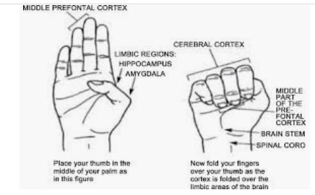
The hand model of the brain

Slide 13
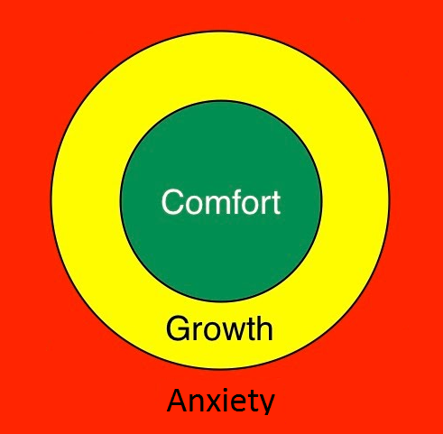
The growth zone model

Slide 14
The growth zone model

Slide 15
The growth zone model
Accept feeling of stupidity in red zone as temporary
How to get out of the red zone?
Building experience of being in and extending the orange zone

Slide 16
Getting out of the red zone
Relaxation response (Benson 2000)
Rest and digest
5/7 breathing
Focus on 5 things you can hear
Go for a walk
Don’t try to do maths whilst your brain is focused on the “tiger”!
Has anyone met mindfulness?
…

Slide 17
Building the orange zone
Ask questions
Try a simpler example
Support each other
Use the Internet
Expect to get stuck
Expect to make mistakes
Use rough work
...

Slide 18
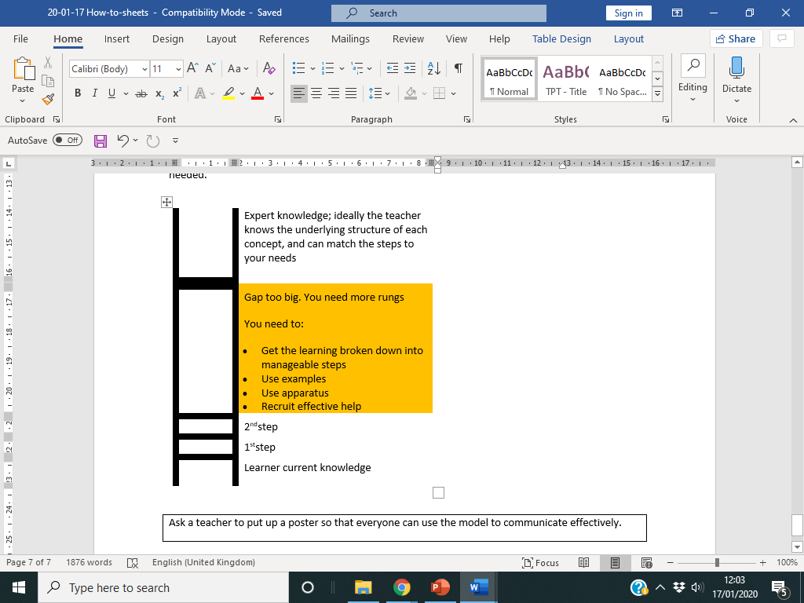
The ladder model
To use in the orange zone.
“I need
another
rung”

Slide 19
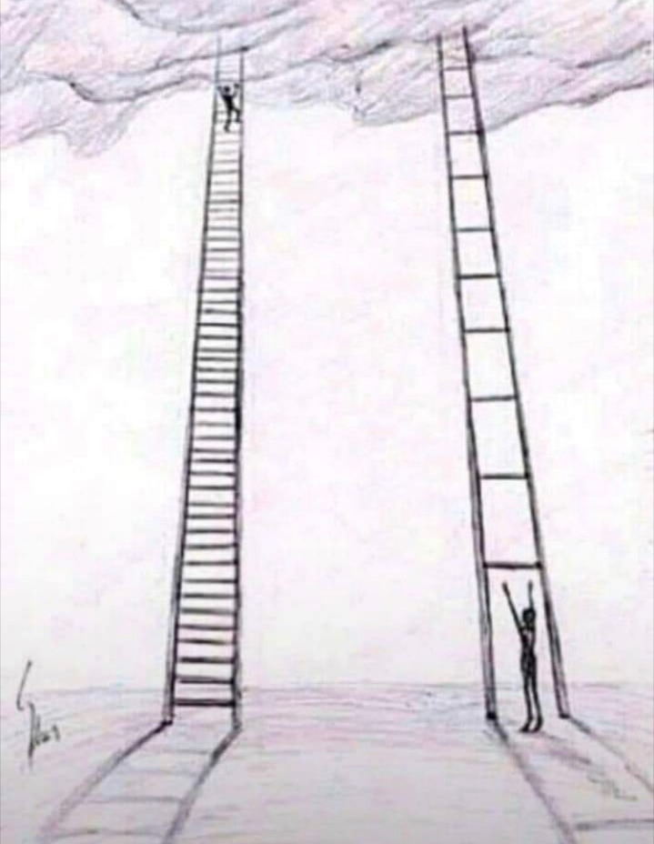
The ladder model

Slide 20
Tools in practice
Building a shared language for mathematical safeguarding
Red means stop talking and listen! This practice takes a while to develop as a teacher!
Some teachers give each learner a copy of the GZM to use with a coin
Some teachers give learners opportunity to write their own words for the feelings in each zone
How would you use the tools in your own practice?
Notes:
Break into groups then reconvene for sharing and questions

