Slide 1
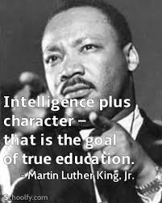
The Ethical Teacher:
Why Character and Virtues Matter in the Teaching Profession
Julie Taylor
Centre for Teacher Education

Slide 2
Aims of Session
To consider what character education is and is not
To explore why character education and ethical practice is important for teachers and their students
To develop an understanding of what it means to be an ethical teacher through the consideration of relevant research
To consider ways to develop character in the children and young people we teach
Creativity
Intellectual curiosity
Social justice

Slide 3
Introduction
Assistant Professor/Deputy Phase Leader for Primary at CTE
15 years primary teacher – AHT; Curriculum Lead; ECT/trainee mentor; English Lead Practitioner – interest in developing the whole child and how this contributes to flourishing
MA in Character Education – University of Birmingham
Completed research on: Character Education in ITE; Professional Ethics; Ethical Leadership; Citizenship and Civic Education; the role of the virtuous practitioner and the value of ethical dilemmas as a key aspect of critical reflection
Dissertation: The ethical role of the ITE mentor
Various contributions to the field of character education including Warwick trainees contributing to a study on Character Perspective of Student Teachers, presented at numerous character related conferences and webinars and written a case study for a book on character education Understanding Character Education and Personal Development: Approaches, Issues and Applications
Upcoming: paper accepted to present at the JCCV Integrating Research on Character and Virtues: 10 Years of Impact’ international Conference and I have been selected to attend a consultation on character in HE in February to inform recommendations for policy
Research has influenced programme design at CTE – our work is considered to be pioneering in the field of ITE - rarely addressed explicitly in other institutions

Slide 4
Different Interpretations of Character Education
Not a new concept – with the exception of a few decades at the end of the 20th century, the cultivation of character was given considerable emphasis throughout the history of schooling
Recent resurgence has resulted in different interpretations and critiques:
Life skills – performative interpretation US 2010s – dismissed the need for any ‘nice guy values’ - preparation for the world of work or academic success e.g. grit (Tough, 2013; Duckworth, 2017)
Resume v Eulogy virtues (e.g. Brooks, 2015) performance v moral
Old fashioned
Paternalistic/indoctrinating – conditioning young people to behave and think in certain ways
Political
Religious
No such thing as character – situationalist movement refutes the existence of ‘broad and stable character traits’ (Harman, 2003) – considers human behaviour purely situation-dependent

Slide 5
Character
The teacher as a virtuous practitioner
Developing character and virtues in the children and young people we teach
Flourishing
Notes:
Term virtues not always used in schools – could be values, dispositions, traits etc.

Slide 6
Character is a set of personal traits or dispositions that evoke specific emotions, inform motivation and guide conduct.
Character education is an umbrella term for all explicit and implicit educational activities that help young people develop positive personal traits called virtues.
Flourishing: Human flourishing is the widely accepted goal of life. To flourish is not only to be happy, but to fulfil one’s potential. Flourishing is the ultimate aim of character education.
(Jubilee Centre for Character and Virtues, 2017)
Notes:
Definitions that have informed my understand of character education – based on the work of Aristotle
More to education than just academic success.

Slide 7

Pause for thought…
What do you remember about your favourite teacher?
Why did they make such a lasting impression on you?
How would you describe them in 3 words or less?
Notes:
Before we dig deeper into ethical practice we are going to pause to reflect on some of our own teachers that we remember fondly – what was it about the teacher that made them so memorable? Ask participants to add to the chat box or on the next blank page depending on number of attendees

Slide 8


Slide 9

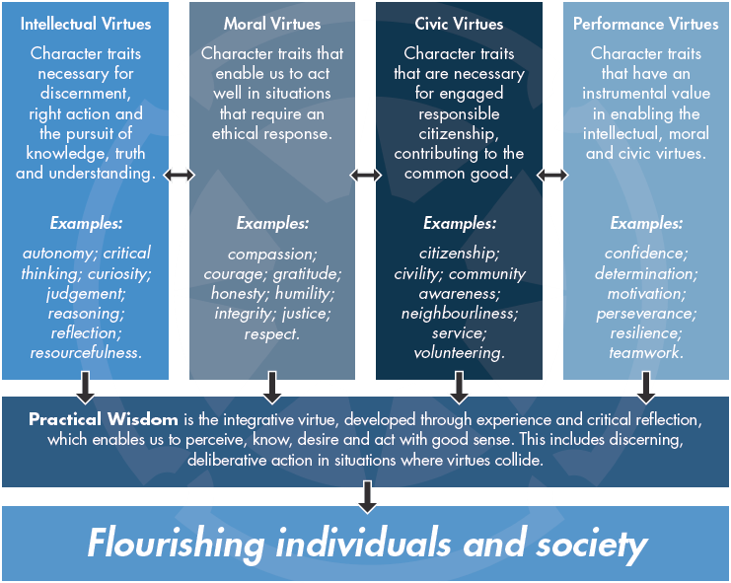
Notes:
Despite altruistic reasons for most teachers entering the profession – performance values can often dominate in school due to the testing culture that is so prevalent in the English education system – on their own these values are not necessarily positive unless considered in a moral way e.g. resilience – link to HT example

Slide 10


My Character and its Importance
Examples related to the different virtues:
Resourcefulness (intellectual) – the ability to alter a lesson based on the children’s understanding or needs
Compassion (moral) – supporting children going through difficult situations in their home lives
Volunteering (civic) – giving up your own time to support a child to understand a new concept
Resilience (performance) – seeking advice and support instead of giving up after a poor lesson observation
- Which virtues have you role modelled in your classroom this week? Did you do this deliberately?
- Which virtues do your children find challenging? How could role modelling these support their character development?
Notes:
The importance of reflecting on your own character and how this will impact on the children/young people you teach.

Slide 11
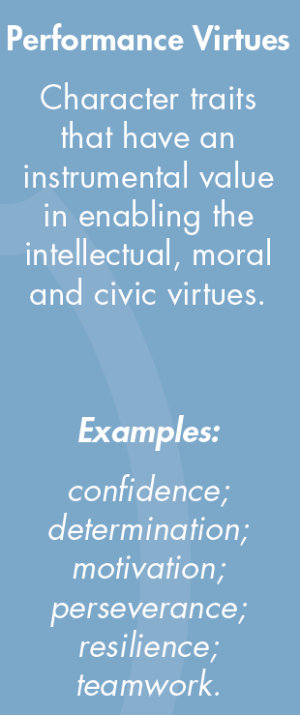
Why do you think schools place considerable emphasis on the performance virtues e.g. resilience?
Are these virtues always a positive trait?
Notes:
Performance virtues can be positive or negative depending on how they are applied – use example of superheroes v villains – all have performance virtues – super heroes use these virtues in a moral way for good.

Slide 12

Résumé v Eulogy Values…
Résumé virtues are the ones you list on your CV, the skills that you bring to the job market and that contribute to your external success as a professional.
The eulogy virtues are deeper. They are the virtues that get talked about at your funeral, the ones that exist at the core of your being -whether you are kind, brave, honest or faithful; what kind of relationships you formed.

Slide 13
Carl Jung
“One looks back with appreciation to the brilliant teachers, but with gratitude to those who touched our human feelings. The curriculum is so much necessary raw material, but warmth is the vital element for the growing plant and for the soul of the child.”

Slide 14
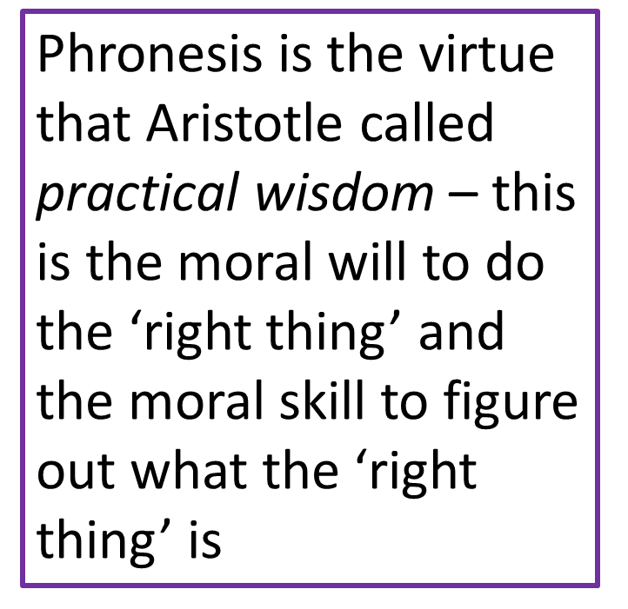
Phronesis
“Good sense”
Practical Wisdom is the integrative virtue, developed through experience and critical reflection, which enables us to perceive, know, desire and act with good sense. This includes discerning, deliberative action in situations where virtues collide.
Notes:
Phronesis = doing the right thing at the right time for the right reason

Slide 15
My Research:
MA dissertation: surveys – primary school colleagues who mentored a student teacher in 19/20
Semi-structured interviews with trainees and mentors – also drew on practice observed by class teachers
Some emerging themes specific to the mentor-mentee relationship but a number of themes related to how experienced and novice teachers perceive ethical practice
3 key ideas applicable to – teachers as virtuous professionals; teachers as moral exemplars and the role of the teacher in the development of practical wisdom were consistent with other research related to the ethical role of the teacher

Slide 16
The Teacher as a Virtuous Practitioner

Slide 17
How do the CCF and Teacher Standards relate to character?
Trainees need to have a clear understanding of the expectations regarding personal and professional conduct of a teacher and the ethics of the teaching profession.
CCF1: Teachers have the ability to affect and improve the wellbeing, motivation and behaviour of their pupils.
Teachers are key role models, who can influence the attitudes, values and behaviours of their pupils.
A culture of mutual trust and respect supports effective relationships.
CCF7: The ability to self-regulate one’s emotions affects pupils’ ability to learn, success in school and future lives.
Teachers can influence pupils’ resilience and beliefs about their ability to succeed, by ensuring all pupils have the opportunity to experience meaningful success.
Building effective relationships is easier when pupils believe that their feelings will be considered and understood.
Pupils are motivated by intrinsic factors (related to their identity and values) and extrinsic factors (related to reward).
Pupils’ investment in learning is also driven by their prior experiences and perceptions of success and failure.
CCF8: Reflective practice, supported by feedback from and observation of experienced colleagues, professional debate, and learning from educational research, is also likely to support improvement
Teachers can make valuable contributions to the wider life of the school in a broad range of ways, including by supporting and developing effective professional relationships with colleagues.
Building effective relationships with parents, carers and families can improve pupils’ motivation, behaviour and academic success.
Notes:
Professional standards not a particularly effective way of providing ethical guidance

Slide 18
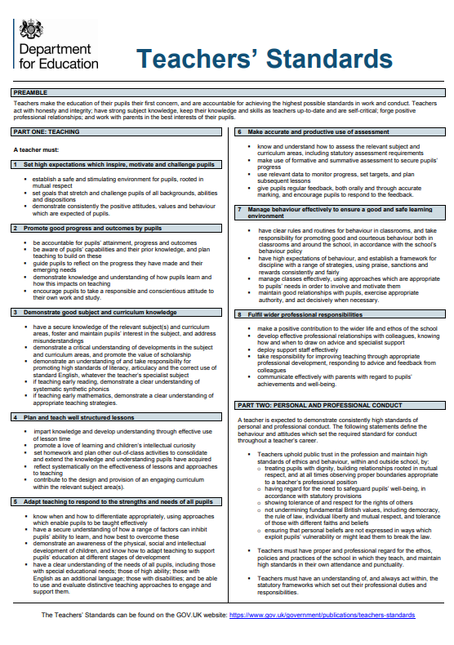
A teacher must:
Demonstrate consistently the positive attitudes, values and behaviours which are expected of pupils.
Promote a love of learning and children’s intellectual curiosity.
Maintain good relationships with pupils, exercise appropriate authority, and act decisively when necessary.
Preamble: ‘Teachers act with honesty and integrity’
Part 2: Teachers uphold public trust in the profession and maintain high standards of ethics and behaviour
What does maintaining high standards of ethical practice actually mean for teachers?
Notes:
Professional standards not a particularly effective way of providing ethical guidance

Slide 19
Societal Expectations
Whilst ethical practice is of significance to all professions, the people professions, which includes teaching (Bondi et al., 2011), engender additional moral expectations from the public, as professionals are relied upon to consistently demonstrate “moral probity, diligence, fairness and resolve” (Jubilee Centre, 2016: p. 2).
However, despite many teachers acknowledging the moral aspect of their role, and teaching often being selected as a career choice for altruistic reasons (Arthur et al., 2015), the absence of any virtue-based content in professional education and school CPD can make the embodiment of such high moral expectations difficult for teachers to achieve.

Slide 20
The Teacher as A Virtuous Professional
Being a good teacher is more than just good classroom practice
Most teachers enter the profession as a result of a moral motivation such as a desire to positively impact on the lives of young people
Variation in how teachers view their ethical responsibilities – recognition that the English education system itself can be a barrier to developing the whole child
Survey (wider sample) - greater prominence given to the technical aspects of the role rather than the ethical
Professionalism often viewed as compliance and become overly focused on measurable aspects such as punctuality and attendance

Slide 21
Narrow view of professionalism does not mean school colleagues do not demonstrate ethical practice – when considering virtues that were significant to them as teachers, moral virtues were considered to be more significant than the other virtue categories – justified within an education-specific context: compassion, honesty and respect were highly valued virtues
Recognition by school colleagues that limited or no training in ethics/moral development may impact on both their own practice and how they teach character to their own students - a dichotomy can emerge between the university interpretation of ethical practice and teacher perceptions – how to develop a shared understanding?

Slide 22
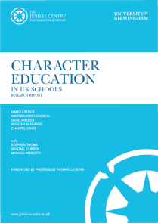
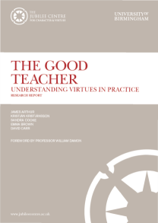
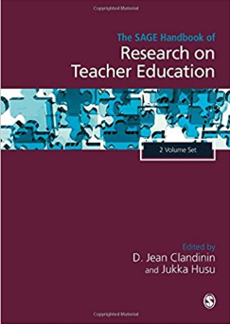
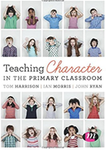
The Teacher as a Moral Exemplar
Character Education in UK Schools (2015)
99% of teachers consider themselves to be ‘a moral role model’
The Good Teacher (2015)
As teachers inevitably serve as role models within the classroom and beyond, it is reasonable to consider the character of the ‘good’ teacher and to understand what kind of person makes that kind of teacher
The Moral Work of Teaching: A virtue-ethics approach to teacher education (Cooke, 2017)
‘…whether teachers acknowledge their role as an exemplar or not, young people in their care will learn from their manner, behaviour, attitudes and dispositions’
Teaching Character in the Primary Classroom (Harrison et al., 2016)
‘Primary school teachers are emphasising and reinforcing moral virtues every day – whether this is done implicitly or explicitly’

Slide 23
Teaching has an unavoidably moral nature and teachers are viewed as moral exemplars by students - words, actions, body language, interactions with colleagues
Teachers have a key role to play ‘in showcasing their ethical knowledge’ (Campbell, 2003: p.142) and have a moral responsibility to support the habituation of the virtues (Sanderse, 2012; Sanger and Osguthorpe, 2013)
Where teachers were more attuned to their ethical responsibilities – they viewed their moral role as a necessity for not just the moral development of their students but the greater good of the profession as a whole

Slide 24
For trainees who were mentored by teachers who consistently embodied ethical practice, this was considered to have a very positive impact on personal and professional development, with many believing that learning from such positive moral exemplars had influenced the kind of teacher they want to be – aligns with teacher/pupil research
Teachers explicitly modelling virtues has a positive impact – moral virtues in particular are key to positive relationships with your pupils and colleagues

Slide 25
Trainees had a particularly positive experience working with teachers who demonstrated humility and who didn’t always present themselves as the ‘expert’. Teachers modelling the personal challenges of the learning process and a commitment to their own personal development can inspire pupils to want to do the same
Research shows that if students have a teacher who demonstrates unethical practice and they are not able to identify this as being unethical, they are likely to emulate poor ethical practice themselves.

Slide 26
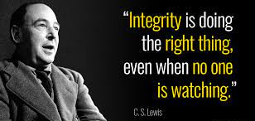

Slide 27
Teachers as Reflective Practitioners and the development of Practical Wisdom (Phronesis)
Teaching involves ‘engaging with unique individuals in unique situations” (Arthur et al., 2015: p.9)
Teachers are regularly required to make judgements “in the face of conflicting demands” from a variety of stakeholders (Jubilee Centre, 2016: p. 2).
These “messy and imprecise problems” that teachers encounter on a day to day basis, “defy a formulaic response” (Hare, 1997: p.62), and are therefore too complex to be resolved with mere adherence to professional codes of conduct (Schwarz and Sharpe, 2011)

Slide 28
Little time is allocated to reflection on character in schools generally (Arthur et al., 2015)
Teachers at all stages of their careers benefit from designated time to reflect on situations which “require flexible and sensitive judgement in context-variable professional circumstances” (Cooke and Carr, 2014: p. 91)
When reflecting on moral matters, collaborative reflection is useful as it takes into account more than one moral standpoint (Husu and Tirri, 2001)
Where schools did facilitate opportunities for personal reflection, teachers believed this had contributed to their personal and professional growth and subsequently impacted on how they viewed themselves as a teacher
As teachers it is important we develop the wisdom to do the right thing at the right time for the right reason.

Slide 29
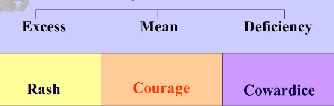

‘The Golden Mean’
Aristotle’s concept of the golden mean helps us to think about doing the right thing, at the right time, for the right reason.
Vice
Virtue
Vice
To show good character, we should aim to achieve the mean between extremes of behaviours – the development of phronesis can help us to make informed, moral decisions.
Notes:
Where the virtues are shown in excess or there is a deficiency – these can become vices
Important that as teachers, we support the children we teach to develop phronesis so we they can start to make the ‘right’ decisions for themselves – reinforce the importance of role modelling so our students see us role modelling the challenges of making moral decisions and our responsibility as citizens to choose the right ethical path.

Slide 30
Developing character and virtues in the children and young people we teach

Slide 31
How do Character Virtues Develop?
The influence of significant adults such as parents and teachers during upbringing
Over time and through experience
Habituation

Slide 32
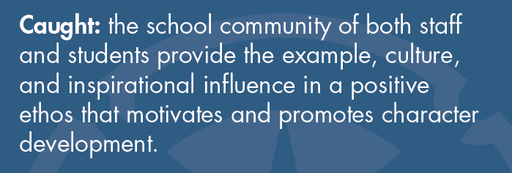
Character is…

Slide 33
Character Caught in Practice
The school ethos, culture and vision
How might your school’s ethos contribute to the development of character in your pupils?
Behaviour
The learning environment
The language of character
Positive relationships

Slide 34
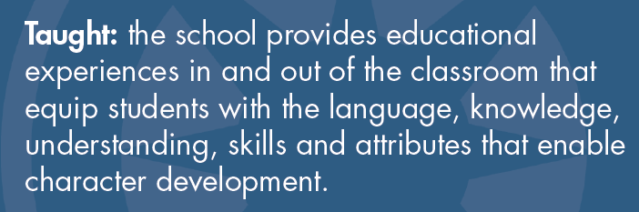
Character is…

Slide 35
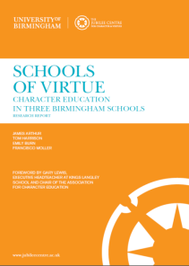

How do you teach character?
No one size fits all approach.
But in schools who prioritise character education, children are taught about the qualities of virtuous character through standalone activities or through the incorporation of character education within subjects
Character education is a conscious part of the school day
Virtue literacy is key

Slide 36
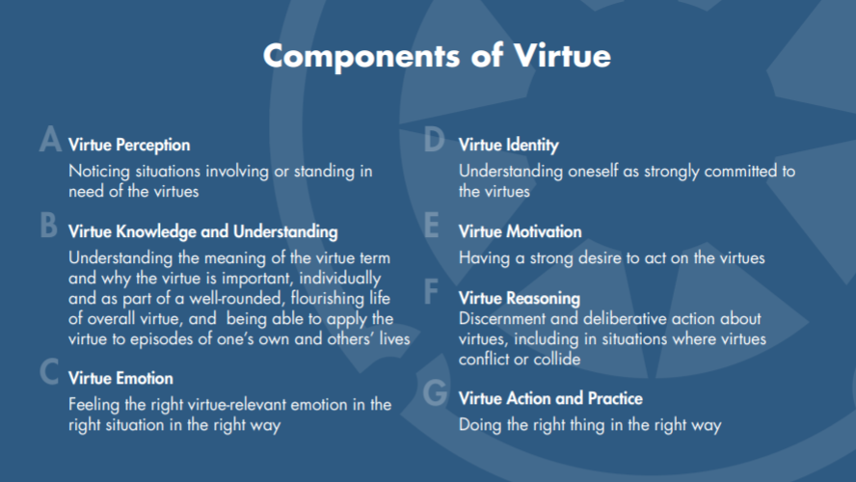

Slide 37
Approaches to teach character
The use of literature: fictional characters, historical figures, biographical accounts etc.
Moral dilemmas and discussion
Opportunities for reflection e.g. journal keeping
Ethical exemplars
Discussion-based learning
Co-operative learning
Enquiry-based and experiential learning
Can you think of any examples from your school placements where you have seen character being taught explicitly?

Slide 38
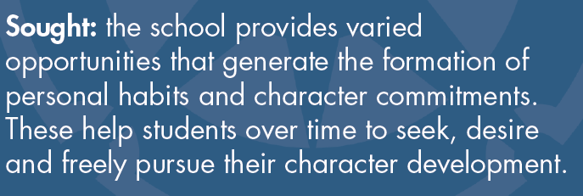
Character is…

Slide 39
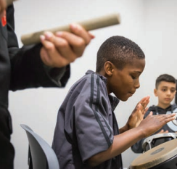
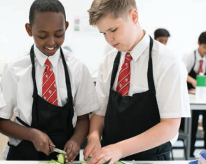
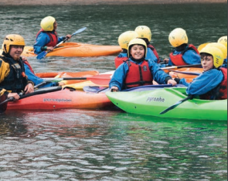

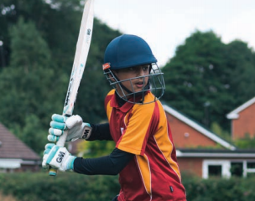
Character Education through Enrichment
What extra-curricular opportunities do you offer at your school that could have a positive impact on character development? How might the enrichment opportunities at your school be developed further?
Youth social action and volunteering opportunities
Interaction with the local community
Residential trips
A variety of sports activities and clubs
An opportunity to put theory into practice

Slide 40
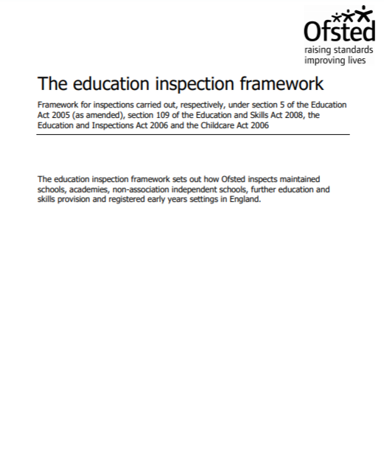
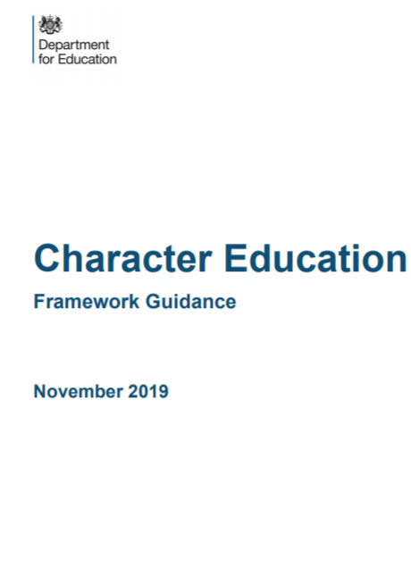
Character and Ofsted
Inspectors will make a judgement on the personal development of learners by evaluating the extent to which…:
“The curriculum and the provider’s wider work support learners to develop their character – including their resilience, confidence and independence – and help them know how to keep physically and mentally healthy” (Ofsted, 2019: p.11)
“Education for character is already integral to the work of excellent schools. In these schools there is no tension between a rigorous and stretching academic education on the one hand and outstanding wider personal development on the other. Indeed, these and other aspects of the school’s work all contribute to forming well-educated and rounded young adults ready to take their place in the world” (DfE, 2019: p.4).

Slide 41
Post-session Reflection:
How do the points raised in this session relate to the key note?
Reflect on yourself as a moral exemplar and virtuous practitioner – how well do you embody the virtues in your day to day practice and how can you continue to develop both personally and professionally?
How do you want the students you teach to remember your character in the future? What impact do you want to make on your students and their character? How can you achieve these aspirations throughout your teaching career?
Next term, make a concerted effort to think about how you can have a positive influence on the character development of the students you teach. Which virtues need teaching explicitly and how can you build in opportunities to do this with your class/form or through your subject?

Slide 42


For teacher resources, research publications and recordings of webinars, visit the Jubilee Centre for Character and Virtues Website: https://www.jubileecentre.ac.uk/

Slide 43
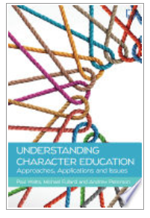
Understanding Character Education: Approaches, Applications and Issues
Physical and e-copies in the library
Available from: https://www.mheducation.co.uk/understanding-character-education-approaches-applications-and-issues-9780335250516-emea-group 20% if you use the code OPENUP20

Slide 44

Free CPD programme
https://www.jubileecentre.ac.uk/2857/character-education/online-cpd-leading-character-education

Slide 45
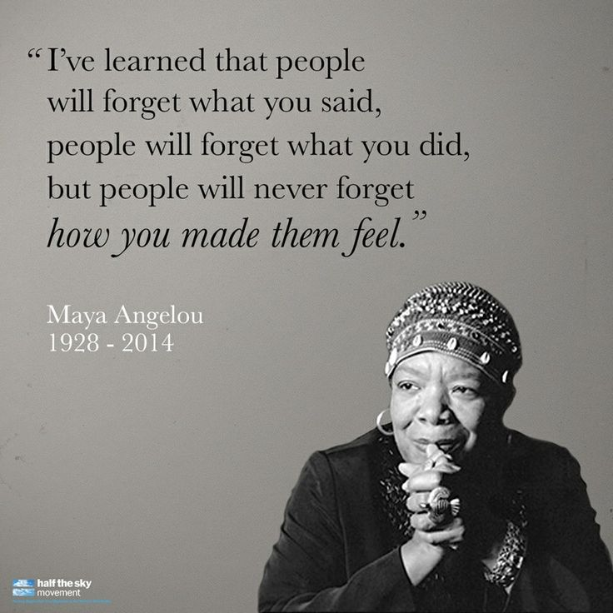

Any questions?
Julie Taylor
J-A.Taylor@warwick.ac.uk
@j_ataylor_77

Slide 46
References
Arthur, J., Kristjansson, K., Cooke, S., Brown, E. and Carr, D. (2015) The Good Teacher: Understanding Virtues in Practice. Birmingham: University of Birmingham. Online at: http://www.jubileecentre.ac.uk/userfiles/jubileecentre/pdf/Research%20Reports/The_Good_Teacher_Understanding_Virtues_in_Practice.pdf
Arthur, J., Kristjansson, K., Walker, D., Sanderse, W. and Jones, C. (2015) Character Education in UK Schools. Birmingham: University of Birmingham. Online at: https://www.jubileecentre.ac.uk/userfiles/jubileecentre/pdf/Research%20Reports/Character_Education_in_UK_Schools.pdf
ASCL (2019) Navigating the Educational Moral Maze. Leicester: Association of School and College Leaders. Online at: https://www.ascl.org.uk/ASCL/media/ASCL/Our%20view/Campaigns/Navigating-the-educational-moral-maze.pdf
Campbell, E. (2003) The Ethical Teacher. Maidenhead: Open University Press.
Department for Education (2013) Teachers’ Standards: Guidance for School Leaders, School Staff and Governing Bodies London: Department for Education. Online at: https://www.gov.uk/government/uploads/system/uploads/attachment_data/file/665520/Teachers__Standards.pdf
Department for Education (2019) Character Education Framework Guidance. London: Department for Education. Online at: https://www.gov.uk/government/publications/character-education-framework
Hare, W. (1997) “Review of Ethical Judgment in Teaching by K.D. Hostetler”, Journal of Educational Administration and Foundations, 12(2): pp. 61-66.
Harrison, T., Morris, I. and Ryan, J. (2016) Teaching Character in the Primary Classroom. London: Learning Matters.

Slide 47
Jubilee Centre for Character and Virtues (2016) Statement on Character, Virtue and Professional Wisdom in Professional Practice. Birmingham: University of Birmingham. Online at: http://www.jubileecentre.ac.uk/userfiles/jubileecentre/pdf/Statement_Character_Virtue_Practical_Wisdom_Professional_Practice.pdf
Jubilee Centre for Character and Virtues (2017) A Framework for Character Education in Schools. Birmingham: University of Birmingham. Online at: http://www.jubileecentre.ac.uk/userfiles/jubileecentre/pdf/character-education/Framework%20for%20Character%20Education.pdf
Ofsted (2020) Initial Teacher Training Inspection Framework and Handbook (draft). Manchester: Ofsted. Online at: https://assets.publishing.service.gov.uk/government/uploads/system/uploads/attachment_data/file/860554/Draft_ITE_framework_and_handbook_for_consultation.pdf
Sanderse, W. (2012) “The meaning of role modelling in moral and character education”, Journal of Moral Education, 42(1): pp. 28-42.
Sanger, M.N. and Osguthorpe, R.D. (2013) “Modeling as moral education: documenting, analyzing, and addressing central belief of preservice teachers”, Teaching and Teacher Education, 29(): pp. 167-176.
Schwartz, B. and Sharpe, K. (2010) Practical Wisdom: The Right Way to Do the Right Thing. New York: Riverhead Books.

