Slide 1
Gratitude
What is it and why is it important?

Slide 2
Gratitude is…
‘…has been conceptualized as an emotion, a virtue, a moral sentiment, a motive, a coping response, a skill, and an attitude. It is all of these and more. Minimally, gratitude is an emotional response to a gift. It is the appreciation felt after one has been the beneficiary of an altruistic act’
(Emmons & Crumpler, 2000)
Notes:
SO we know that gratitude is linked to joy and appreciation, it a feeling or emotion that humans can experience.
It is often not linked to money or possessions but is a significant and important feeling for all humans.
Gratitude has many positive impacts on us. We know that those who express and experience higher levels of gratitude have lower levels of ill health, this relates to physical and mental health, showing that those with higher levels of gratitude have lower blood pressure and are more resilient, have stronger relationships, and able to cope better with stress and trauma, have stronger immune systems and suffer less insomnia
When we think about gratitude, or being grateful, we think of this as a passing emotion. However there is research that would suggest that people can deliberately cultivate gratitude, as a practice, and this then becomes a personality trait. It is also some thing that we have some control over.

Slide 3
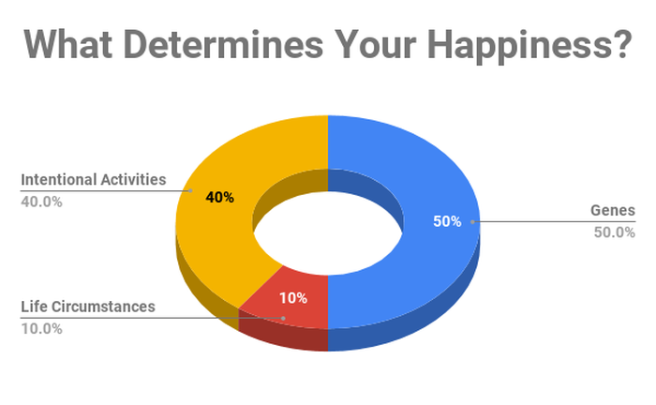
Notes:
Society assume that our happiness is about our circumstances, how mush money we have, where we live, the car we have, the holidays that we are able to go on. However this only accounts for 10 percent of our happiness.
The intentional activities element has a much bigger influence on our overall happiness levels. This element relates to the activities that we engage in such as appreciating what we have, being grateful for the position we are in. Choosing to see the positives in life and the positives in our own situation is more important than acquiring more.

Slide 4
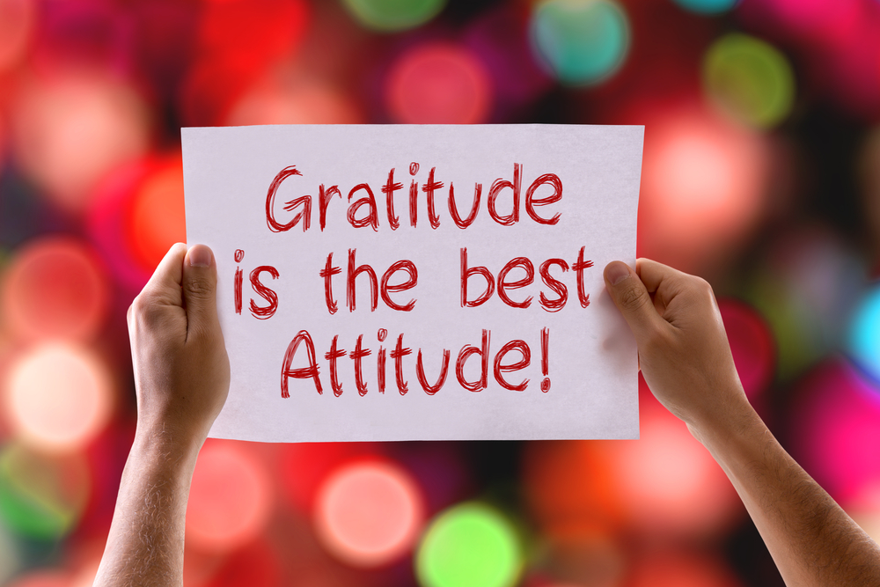
The attitude of gratitude…
‘Cultivate the habit of being grateful for every good thing that comes to you, and to give thanks continuously. And because all things have contributed to your advancement, you should include all things in your gratitude.’
Ralph Waldo Emerson
Notes:
Research tells us then those individuals who look for opportunities to be grateful are more likely to be happier. Take a look at the Brene Brown clip, its only 3 minutes, to explore whay this might be.

Slide 5
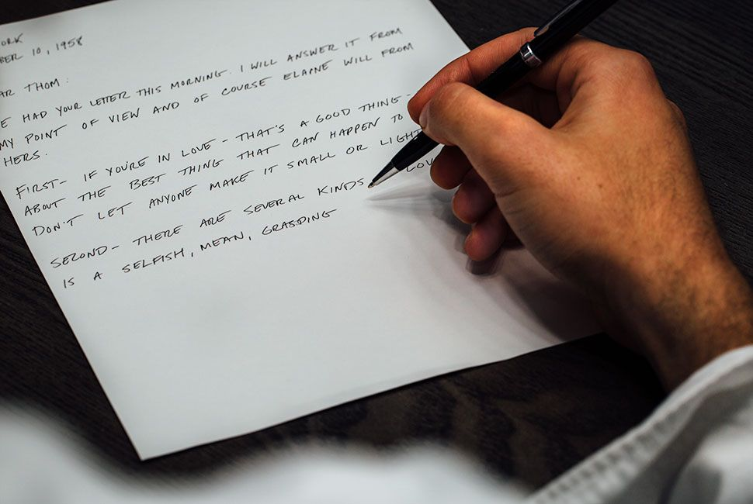
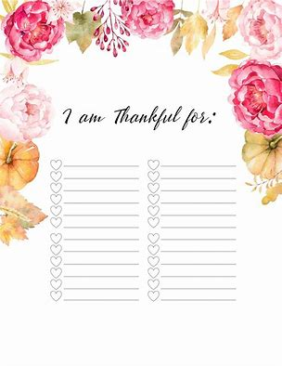

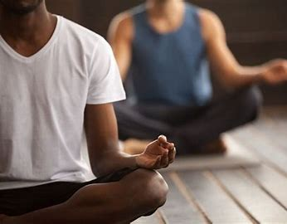

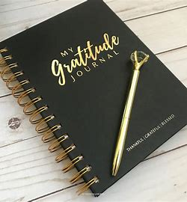

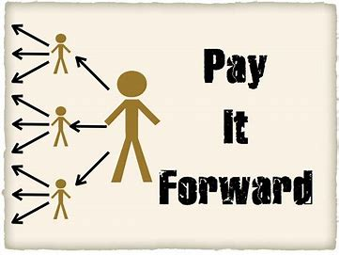
Notes:
So what can you do to cultivate gratitude.
There are some small and relatively simple steps that you can take to develop your personal attitude to gratitude and support your own wellbeing.
Maybe try one or two of these and reflect on how they impact on your wellbeing.
You could write a letter to someone you are grateful to, you don’t have to send it but just write down why you are grateful for a certain friend or partner or maybe your mentor.
Mindfulness and meditation, taking 5 minutes from your day to think about what you are grateful for and also to clear your mind of negative thoughts.
Making a list, when you get up in a morning think of 3 things you are grateful for, it might be something big or it could be something as small as having enough fresh milk left to enjoy with your coffee.
If you enjoy writing you could begin to journal. Looking at gratitude prompts and writing for 5 minutes each day on each of the prompts.
Implement a practice in your home, Brene Brown talks about everyone saying one thing that they are grateful for each evening at dinner. Encouraging everyone to reflect on the things they are grateful for in their day.
Share appreciation – can you give a compliment or praise to someone, put the positive energy out there.
Reframe events – when things go wrong think about what you can learn from the experience and how could you prevent it happening again. Try to see the opportunity that it presents when things don’t go to plan.
Another way to practice gratitude is to pay forward the kindness you have received from others. This may mean giving a pupil some extra support as you benefited from this previously. It could be that you make some one in the staff room a coffee who is under pressure to manage a number of tasks during break.

