Slide 1
Self-Management
Self-Awareness

Slide 2

What is self-awareness and why does it matter????????
Notes:
Self awareness is ability to see our personal thoughts, desires and behaviours.
We are only able to control and express our thoughts and emotions appropriately if we are aware of them.
SO how do we do this? There are models or tools that we can use to develop our self-awareness and enable us to be more authentic in our communications with ourselves and others.
One tool that can be useful is the Johari Model.

Slide 3
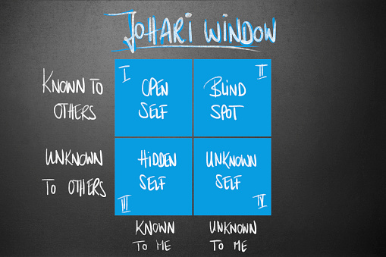
The Johari Window (1955)
Notes:
This model was developed by Joseph Luft and Harrington Ingram in 1955.
They identified four areas that we should focus on and consider to develop our self-awareness. Two of these areas relate to ourselves and two to others.
Each of these areas provides us with a window into ourselves, hence the Johari Window.

Slide 4

Open Self ‘I know, you know’
Notes:
The open self is also referred to as the ‘I know, you know’ window. This includes all the things that you know about yourself and the things that you are happy to communicate and share with others. This could be that you enjoy cycling, your favourite food is pizza, you have children, you are training to be a teacher. These are the things that you know and understand about yourself and you happily share with friends, family and maybe even casual acquaintances. These are the parts of you that you are fully aware of and are happy to share with the world.

Slide 5

Hidden Self ‘I know but you don’t know’
Notes:
The hidden self refers to the parts of yourself that you know and are aware of but other don’t know about you.
This could relate to something that you have done in your past that you don’t want people to know about, something that you are embarrassed about or feel you may be judged for.
It could also relate to your hopes and dreams, these may not be shared because you fear that others may laugh or suggest that you are incapable of achieving these things.
Over time this are may reduce and the open self may increase. As you develop stronger friendships you may share more information with people, strengthening the links that you have with them.

Slide 6

Blind Spot ‘I don’t know but you know’
Notes:
Your blind spot relates to the things that you cannot see about yourself but others can see. These can be positive and negative attributes and learning what they are can help us to grow.
It might be that we cannot see our own kindness and generosity but it is seen and appreciated by others. It may be that we are impatient and become agitated quickly.
By asking others for feedback we can learn about ourselves and this can support not only our self-awareness but enable us to grow. If we become aware of our own impatience we can alter our behaviour when we recognise it in ourselves, helping us to manage ourselves better.
Again this area can decrease over time as we ask for feedback from others.

Slide 7

Unknown Self ‘I don’t know, you don’t know’
Notes:
This window links to new experiences that we may have.
There are things about ourselves that we do not know and at this point in time others do not know.
If you have never been on an aeroplane you don’t know if you enjoy flying or not, and neither do those people we interact with. Once you have taken your first flight you will have new information about yourself, you may share this with others so this then feeds into the open area.
Similarly you may just be learning about whether you will enjoy teaching, if you feel you are able to plan a lesson or control a classroom.
As you learn through these new experiences you will learn about yourself.

Slide 8
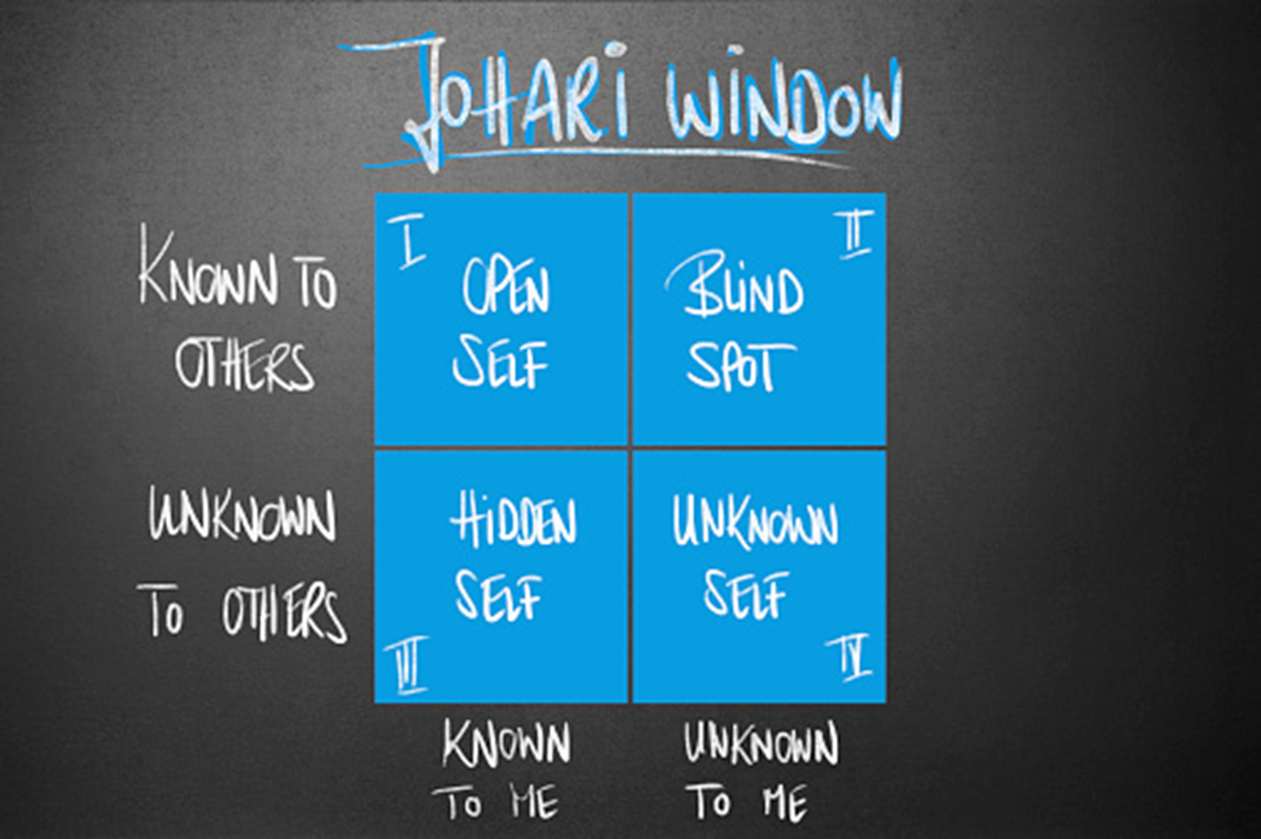
What next?????
Notes:
You will find a link to a blank Johari Window proforma.
Spend some time this week completing the open self and hidden self boxes. Take some time to ask friends or family to provide you with some information for the blind spot window. Try to embrace the feedback that you receive, what can you learn about yourself from this?
Once you start to become aware of yourself your level of self-awareness will increase.

