Slide 1
EC 936 ECONOMIC POLICY MODELLING
LECTURE 3:
PART I
MULTIPLIER ANALYSIS IN A
SOCIAL ACCOUNTING FRAMEWORK

Slide 2

MULTIPLIER DECOMPOSITION
The purpose of multiplier decomposition is to enable the researcher to deconstruct the sources of a particular change in endogenous outcomes among its various sources, i.e. to make the input-output table and social accounting matrix less of a black box and more amenable to systematic analysis.
There are two basic ways to decompose a multiplier—multiplicative and additive. We will begin by the simplest case—multiplicative decomposition of a social accounting matrix.
We begin by reminding ourselves of the structure of the SAM, viz:
S =
where A is the input-output matrix; V is the value-added matrix; C is the matrix of final expenditure coefficients; H is the matrix of transfers among institutions; and Y is the allocation of value-added among institutions.

Slide 3






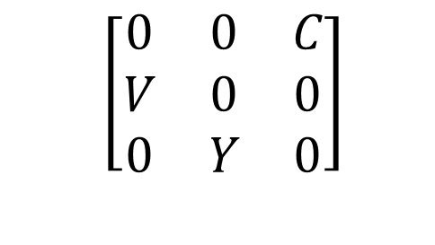
We separate S into two additive matrices, which we designate Q and R, such that:
$$\left[\begin{matrix}0 & 0 & C \\ V & 0 & 0 \\ 0 & Y & 0\end{matrix}\right]$$
Q =
R =
The system may be expressed as:
which we rewrite as
In this case, the solution is:
The next steps may seem at first look like meaningless manipulations, but the benefits will become clear by the end of the slide

Slide 4



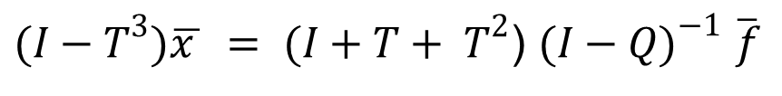
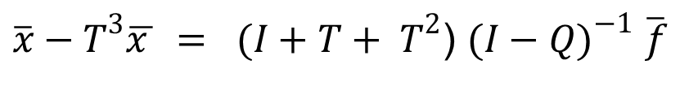
Define
(1)
Pre-multiply (1) by
Substitute into (1)
Pre-multiply by
If we substitute this back into (1), we produce:
which may be rewritten as:
$\overline{x}−T^{3}\overline{x } = (I+T+ T^{2}$) ${(I−Q)}^{−1}$ $\overline{f}$
or
$(I−T^{3})\overline{x } = (I+T+ T^{2}$) ${(I−Q)}^{−1}$ $\overline{f}$

Slide 5


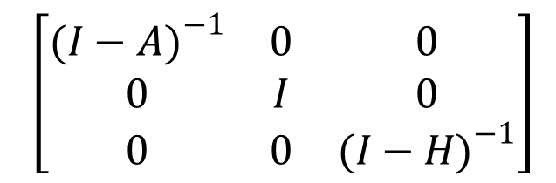
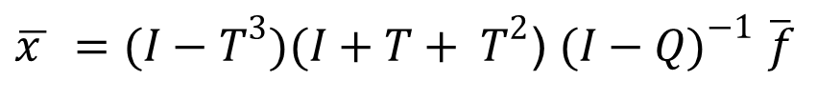
It therefore follows that:
$\overline{x } =(I−T^{3})(I+T+ T^{2}$) ${(I−Q)}^{−1}$ $\overline{f}$
Which may be expressed as:
where
$$\left[\begin{matrix}{(I−A)}^{−1} & 0 & 0 \\ 0 & I & 0 \\ 0 & 0 & {(I−H)}^{−1}\end{matrix}\right]$$
This is a matrix of the ‘own-effects’ or transfer multipliers, including the inter-industry effects captured in the input-output table as well as the distribution of profits from corporations to households or from one household type to another, within the H matrix.

Slide 6


and
This multiplier matrix tracks the repercussions of an exogenous change in one part of the system on all the other parts. It is sometimes referred to as the matrix of ‘open-loop’ or cross-multipliers. Note that the diagonal entries are a series of identity matrices.

Slide 7

and, finally:
This multiplier matrix follows through the reverberations of an initial disturbance as it circulates around the system and back to its point of origin in a series of diminishing cycles. It is sometimes referred to as the matrix of ‘closed-loop’ or circular multipliers. Note that all the entries are on the diagonal and that all off-diagonal entries are zero.

Slide 8





Finally, note that these multipliers may be represented as additive, rather than multiplicative, i.e.:
where
= matrix of direct or ‘own’ multipliers (= )
= matrix of indirect of cross or ‘open-loop’ multipliers
=
$$M^{3}M^{2}M^{1}−M^{3}M^{1}$$
= matrix of circular or ‘closed-loop’ multipliers
=
or in a different variant, as
$$M={(I−S)}^{−1}=I+N_{1}+N_{2}+N_{3}$$
where the four elements capture the initial injection, the net contribution of transfer multiplier effects, the net contribution of the open-loop, and the net contribution of the closed-loop multiplier effects, respectively.

Slide 9




MATRIX INVERSION IN PARTITIONED MATRICES

Slide 10


2
DERIVATION OF M2 = (I + T + T
)
let

Slide 11



+
+
=

