Slide 1
EC 936 ECONOMIC POLICY MODELLING
LECTURE 4:
FROM SAM TO CGE:
STRUCTURE, CALIBRATION, AND CLOSURE RULES

Slide 3
FROM SAM TO CGE
Exogenous vs endogenous activities
Modelling endogenous behaviour, by determining functional form and parameter values that appropriately describe economic activity, e.g. production functions, factor supply equations, consumption (demand) equations
Incorporate prices formally
Identity equations

Slide 4
CONSUMER DEMAND
Nested demand function
i) Demand for commodities (utility function)
ii) Source of commodities (domestically produced goods vs. imports)
Corresponds to distinction between commodities and activities in the SAM
Uses Armington aggregation function to determine balance of domestic and imported goods in the consumption bundle
May also add a third layer
iii) Choice of imports across countries in response to relative prices (eg Italian vs Chinese footwear)

Slide 5
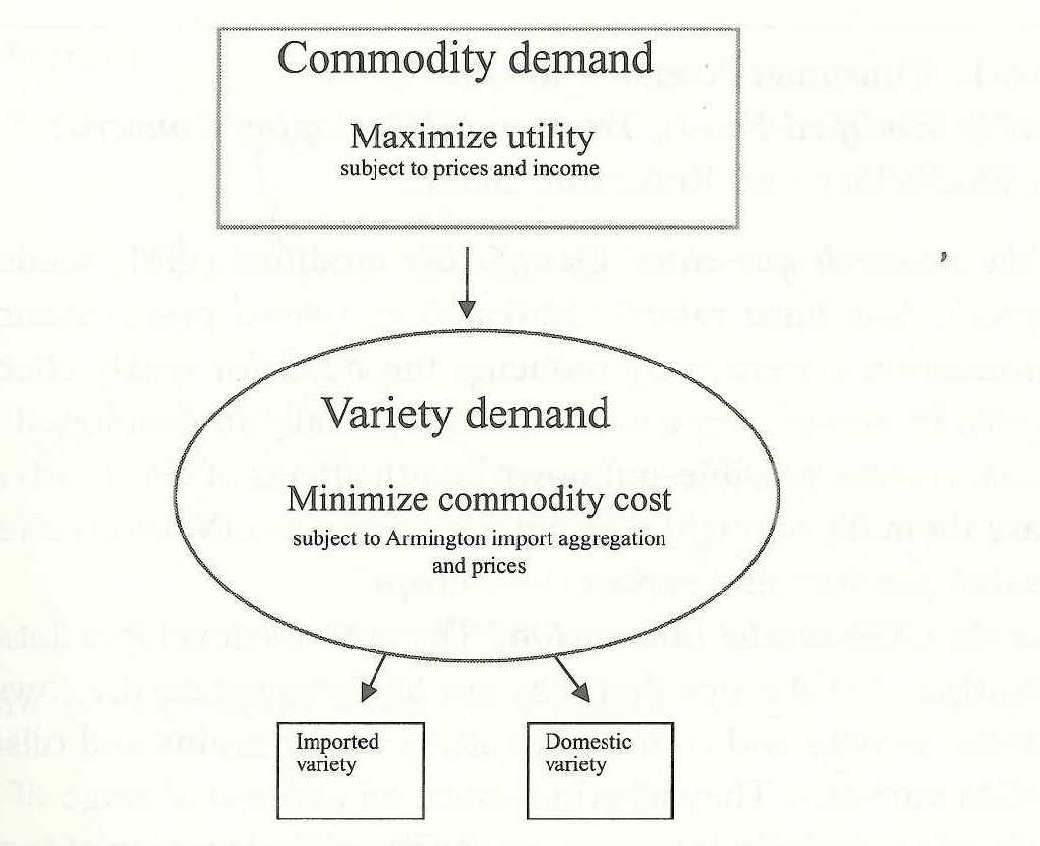
Two-stage consumer demand

Slide 6
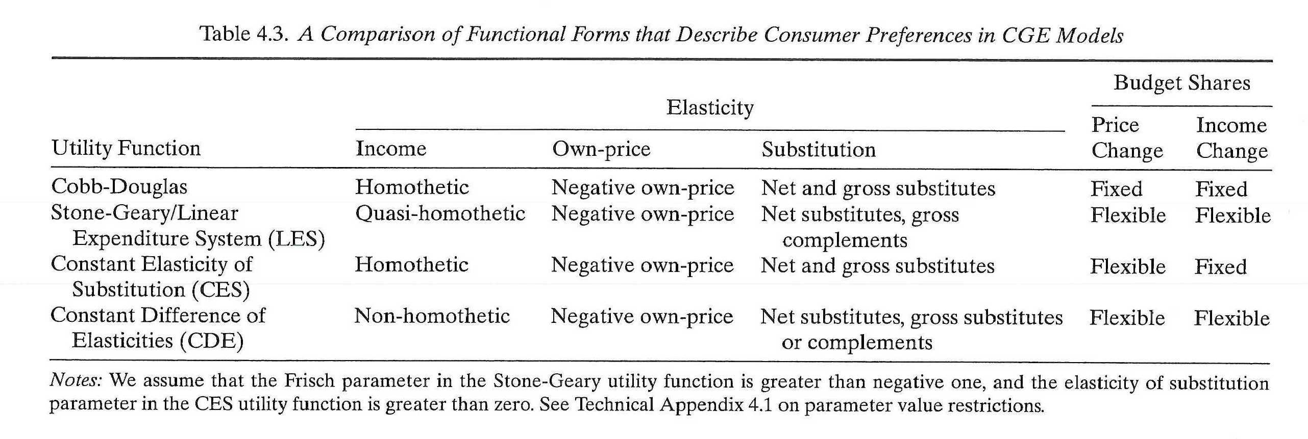

Slide 7
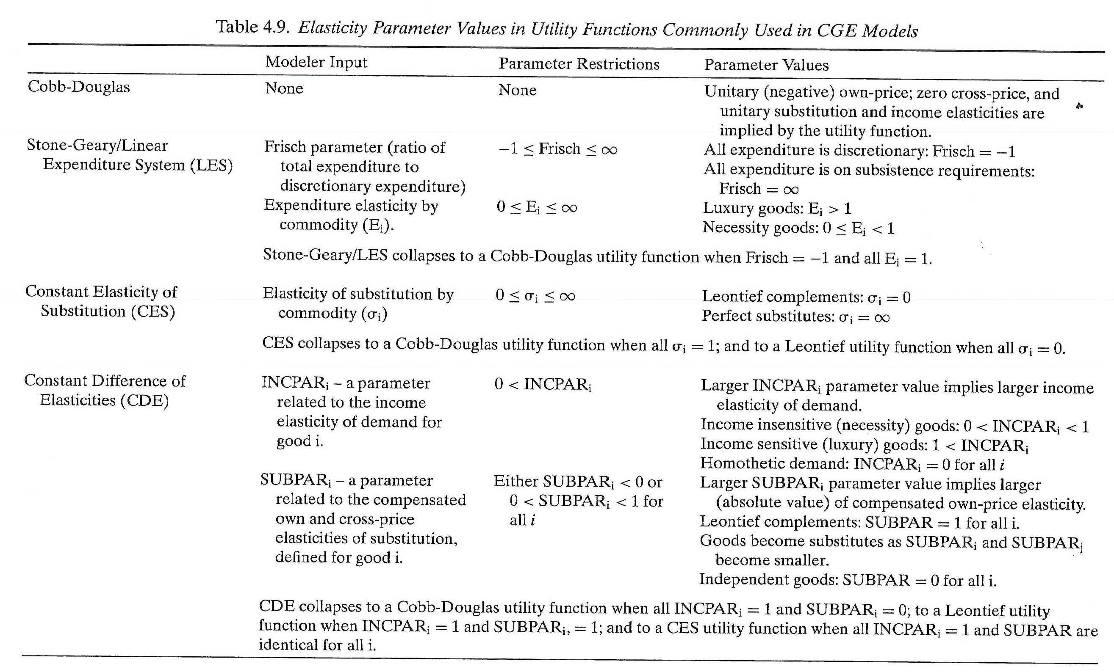

Slide 8
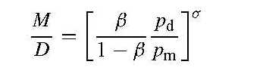
ARMINGTON ELASTICITIES

Slide 9
PRODUCTION ACTIVITIES
Nested production function
i) Intermediate inputs (Leontief, Cobb-Douglas)
ii) Value-added function (CES, Cobb-Douglas)
iii) Final production function (CES, Cobb-Douglas)

Slide 10
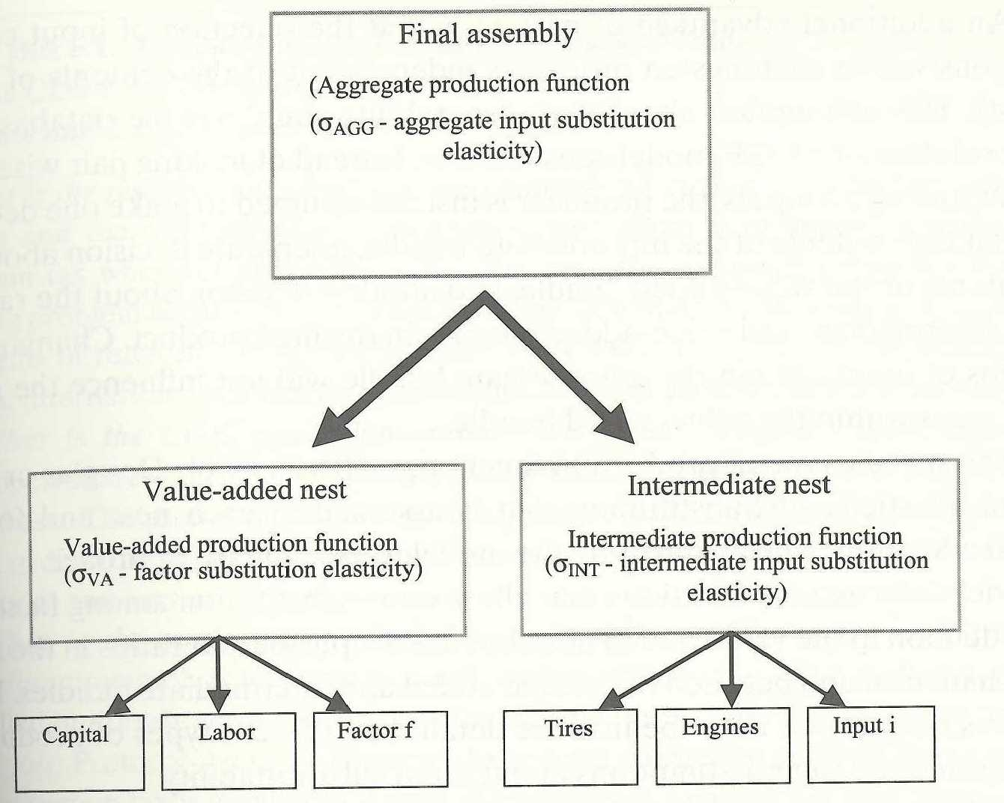
NESTED PRODUCTION FUNCTION

Slide 11
EXPORT SUPPLY
How do domestic producers in a small country respond to a relative change in world price of exportables?
Export transformation elasticities (CET model)

Slide 12
FACTOR SUPPLIES
Factor mobility:
i) Fully mobile factors
ii) Immobile factors
iii) Factor mobility elasticity (-1< σ_{f} < 0)
Capital
Labour

Slide 13
MICRO CLOSURE
Market clearing assumptions:
i) Excess supply (fixed price model)
ii) Full employment (flex price model)

Slide 14
PRICE EQUATIONS
Exogenous world prices for imports (small country assumption)
Mix of endogenous and exogenous prices for exports (small country assumption relaxed for key export sectors, eg cocoa in Ghana)
Domestic price of imports are world prices plus transportation margins, distribution mark-ups, tariffs (net of subsidies)
Prices of domestically produced goods are determined by production costs plus transportation margins, distribution costs and indirect taxes (net of subsidies)
Normalize prices in base-year, such that all changes are relative to base-year values
Money is neutral

Slide 15
NUMERAIRE
CGE models operate in relative price space (Walras’ Law)
Choice of numeraire:
wage level (Johansen, 1960)
consumer price index
producer price index
GDP deflator (IFPRI models)
global factor price index (GTAP)

Slide 16
CALIBRATION
Selection of parameters to replicate the initial equilibrium (base SAM)
Solve for parameters in reverse, e.g.
i) Estimate elasticities econometrically, or
ii) Select elasticities from data bank
Sensitivity analysis

Slide 17
MACRO CLOSURE (Sen, 1963)
Closed Economy model:
S ≡ I
Savings driven (‘neo-classical’)
Investment driven (‘structural’)

Slide 18
MACRO CLOSURE
Open Economy model:
S – I ≡ X + R – M – O
Open Economy with Government:
S – I ≡ X + R – M – O + G – T

Slide 19
SOLUTION STRATEGIES
Most CGE model are exercises in comparative statics i.e.
Shock the system by manipulating
i) External parameters (e.g. rate of foreign lending; terms of trade)
ii) Policy parameters (e.g. tariff rate; government expenditure)
iii) Structural parameters (e.g. sector-specific technological change)
Compare new results with originals
Test sensitivity of results to
i) different elasticities
ii) different macro closure rules
iii) different political reaction functions
Some experiments with dynamic CGE models (e.g. allowing capital equipment effects and including vintage effects in production activities) as well as path analysis of outcomes

Slide 20
MACRO CLOSURE MATTERS
CGE analysis of trade liberalization for Costa Rica, 1991 (Cattaneo et al., 1999)
Savings-driven (neoclassical) model, but tests
i) external closure rule: fixed foreign savings vs flexible foreign savings
ii) public sector closure rule: flexible government revenue vs fixed government revenue (via increase in corporate taxes or in sales taxes)

Slide 21
RESULTS

Slide 22
