Slide 1
EC936 Development Policy Modelling
USING CGE MODELS FOR POVERTY AND INEQUALITY ANALYSIS
Jeff Round
February 2012

Slide 2
Poverty impact analysis
Impact of economic shocks on poverty
Various manifestations of poverty
money-metric (income, expenditure, assets), health, etc
What are ‘shocks’?
limited to shocks that have economic consequences
domestic policy-induced shocks: trade liberalisation, reductions in government expenditures, redistributive/fiscal policies
external shocks: fall in world price of staple export commodity
natural disasters: foot & mouth disease, drought
Why is ‘analysis’ such a problem?
socio-economic system is complex
analysis relies on our ability to understand how individuals and institutions react and behave
quantitative vs qualitative analysis

Slide 3
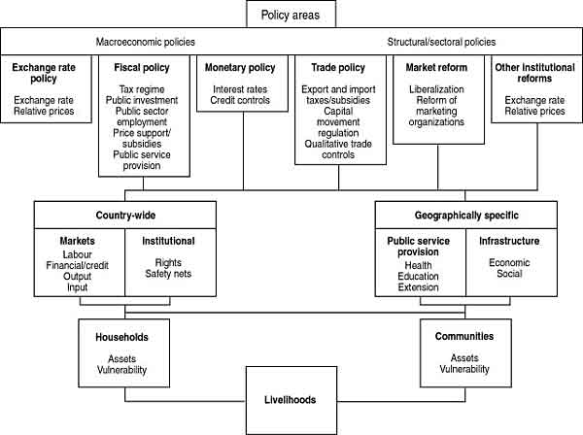
Overview: Macro-Meso-Micro channels
MACRO
MESO
MICRO

Slide 4
Examples of policy impacts on households
Trade liberalisation (tariff reduction) – channels and pathways:
Goods markets channel
- effects on prices and on HHs: depends on transmission mechanism
- many reasons for price effects not to filter through
Factor markets channel
- HOS: suggests that increase in price of good will increase returns to
factor used intensively, etc.
- depends on strong assumptions (full employment, perfect competition)
Government taxes and spending
- revenue from tariffs may have to be replaced by other taxes or a
reduction in govt expenditure (revenue neutral policy): impact on HH
Other channels
- transmission to HHs may be affected by - market failures; extent of
subsistence activity; private transfers; intra HH distribution, etc.

Slide 5
Various approaches to analysing the impact of shocks
Applying theoretical analysis
- many relevant and useful results in economic theory (Barnum-Squire
AHMs, HOS, etc); but many simplifying assumptions to make it tractable
- not possible to find sufficient theory to analyse all impacts on all HH types
Econometric analysis
- extensive econometric evidence on poverty incidence; estimation of price
and income elasticities, etc (Sadoulet and de Janvry)
- much effort in estimating poverty elasticities (esp World Bank 1990s, 2000s)
- data problems for disaggregated analysis; backward-looking estimation, etc
Simulation methods
- SAM-based multiplier analysis
- CGE models (comparative static, RHMs and microsimulation)
- CGE models (dynamic linked with microsimulation)

Slide 7
Simple CGE models: equations
Specifying economic behaviour and technology
Production functions
Consumer demand equations
Trade and Armington functions
Balance equations
Closure rules and macroeconomic balances
Factor market closures
Micro and macro closures
Introducing rigidities into market-clearing features

Slide 8
Simple CGE models: role of a SAM
Establishing the model structure
Defining the agents, markets, framework and level of disaggregation, etc
Calibrating the model
Helps to define a benchmark equilibrium
SAM provides ‘share’ coefficients parameters (CES, CD etc)
Elasticities have to be sought elsewhere
Integrating the link between Macro-Meso-Micro
Provides a link with national accounts and micro-simulation (where applicable)

Slide 9
CGEs and poverty analysis: RHG approach
SAM-CGE defines household groups (RHGs) on the basis of a HH survey
- There might be as many as 30-50 RHGs, but usually fewer
- Defined by urban-rural/ region/ SEG (status of HoH?)/etc
Poverty measures are measures associated with RHGs
- is a headcount < z
- usually estimated by assuming some analytical distribution fits income
distribution
- usually use lognormal, Beta, or Pareto
Lognormal
- where
- estimate and from HH survey data
- assume is constant – does not change in the experiments
- new mean income for RHG h after shock:
- given unchanged z re-compute

Slide 10
CGEs and poverty analysis: microsimulation approach
In RA-CGE intra-group variance is exogenously-determined
- usually assumed to be constant
- but bear in mind analysis by Bourguignon et al ‘growth-inequality-poverty’
triangle; inequality (~ by intra-group variance) is often part of the story
More recent approach TD/BU CGE-microsimulation
- CGE model solved for prices, incomes and all macro-meso variables (top
component)
- individual HHs from the HH survey are used ‘un-grouped’
- HH model (bottom component): individual income and demand equations
for each HH.
- Earliest models: individual HH equations are the same as the CGE (with the
same parameters)
- Recent models: use econometrically-estimated earnings functions, etc.
- intra-group variance is now endogenised.

Slide 11
Example: Ghana CGE model
Simple, standard, open static model (e.g. similar to IFPRI)
Calibrated to the 1993 SAM
Compact model:
9 production sectors,
9 factors
10 household groups
Designed to simulate effects of poverty-reducing income transfers (e.g. similar to Chia et al study for Cote d’Ivoire)
Plus – investigating the effects of
- alternative model closures
- alternative methods of linking poverty analysis

Slide 12
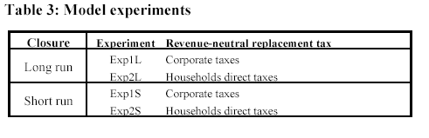
Ghana CGE model: poverty reduction experiments
Universal transfers: transfer an amount z to each household
Recover the total amount of transfers through taxes (revenue neutral)

Slide 13
Ghana CGE model: poverty reduction experiments
Model specification matters
To investigate whether closure rules matter
Long run closure
Labour and capital perfectly mobile across sectors
Wage rates and capital rental rates are fixed (excess supply of factors)
Short run closure
Labour and capital are fully employed
Capital is sector-specific
Labour is mobile across sectors

Slide 14
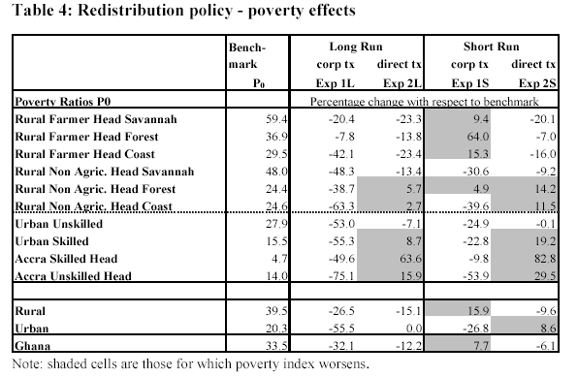
Ghana CGE model: poverty reduction experiments

Slide 15
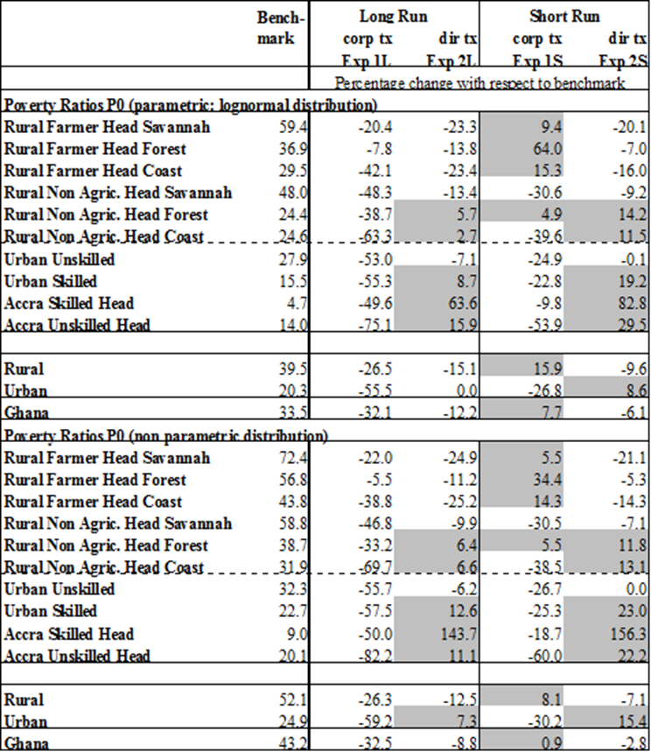
Ghana CGE model: poverty reduction experiments

