Slide 1
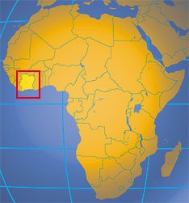
A GENERAL EQUILIBRIUM-BASED SOCIAL POLICY MODEL FOR
CÔTE D´IVOIRE
Ngee-Choon Chia
Sadek M. Wahba
John Whalley
1992

Slide 2
Outline
Introduction
Social Policy model
Poverty-reduction targeting programs
Conclusions

Slide 3

INTRODUCTION
Analysis of social policy options
Implications of any proposed policy change
Gains or losses in the different groups

Slide 4
SOCIAL POLICY MODEL
ECONOMY
  Population: 12 million (1989)
  French Colony
  Key Member of the West African Monetary Union
CÔTE D´IVOIRE

Slide 5
History
1960: Independence
1965-1973: Average annual growth rate 8.9%
1976: Coffee price boom, only one year
*implementation of an investment program in spite of the fact that cocoa prices had fallen.
1980: Structural adjustment programs
1981: Budget deficit 12%of GDP,
1986: Terms of Trade had fallen by 40%
1990: External debt: 125% of GDP
Internal debt: 37% of GDP

Slide 6
SOCIAL POLICY MODEL
General Equilibrium Model
  Objective:
    Assessment of the social consequences of the adjustment programs since 1981.
  Characteristics:
    Based on SAM
    Focuses on incomes and distribution
    Operation of the underlying real economy
    Predictions of what is likely to happen when changes are introduced.
  Weaknesses:
    Doesn´t capture macro imbalances
    Can´t capture effects on infraestructure and social development(education, health)
CÔTE D´IVOIRE

Slide 7
SOCIAL POLICY MODEL
Structure (15 sectors)
Tradables
7
Agricultural
Export sector
Nontradables
8
Gas and Electricity
Manufacturing Industries
First transformation sector
Transport
Financial services
Construction
Government Services
Other Services
Traditional
Nontraditional
Formal
Informal
Informal
Formal
Informal
Formal
Formal
Informal
CÔTE D´IVOIRE

Slide 8
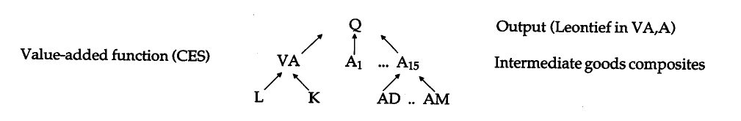
SOCIAL POLICY MODEL
Production
Production functions: CES, Leontief and Cobb.Doublas
Intermediate inputs (domestic and imported goods)
CÔTE D´IVOIRE

Slide 9
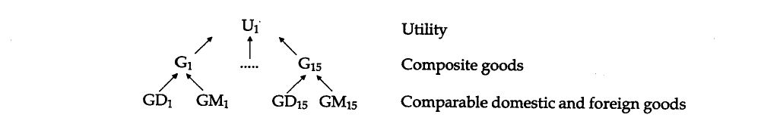
Demand
7 households types
Income from endowments and tranfers (Abroad, HH and government)

Slide 10
Government
Public Services (security, defense,etc)
Activities financed by taxes
Labour Market
Capital: Sector specific and mobile
Labour: Agricultural(F), Skilled(M) and Unskilled(M)
External Sector
Closure Rule
Small open price taking economy (SOPTE)
Armington Assumption
M, X taken as given

Slide 11
Armington
Armington Assumption
Final products traded internationally are differentiated on the basis of the location of production
In one country each industry produces only one product – this is distinct from the product of the same industry from another country
Accomodates ‘Cross-hauling’ – a problem in CGE models

Slide 12
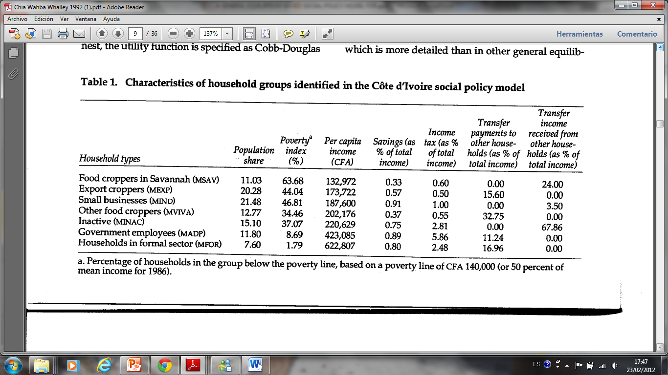
SOCIAL POLICY MODEL

Slide 13
Export Taxes
(STAB)
Subsidies: Price lower internationally
Government Revenue: Price higher internationally
Income Tax
Marginal rates increase with income
Taxes on goods and Production VA tax
Taxes at rate$τ_{i}$ enter the model as well as value added tax from each sector.
Taxes at rate𝜏_𝑖 enter the model as well as value added tax from each sector.
$${PIT}^{h}=τ_{h}\sum_{k=1}^{3}{π_{k}ω_{k}^{h}}$$
〖𝑃𝐼𝑇〗^ℎ=𝜏_ℎ ∑24_(𝑘=1)^3▒〖𝜋_𝑘 𝜔_𝑘^ℎ 〗
Tax:
Revenue:
$$R^{h}=\sum_{h=1}^{7}{{PIT}^{h}}$$
𝑅^ℎ=∑24_(ℎ=1)^7▒〖𝑃𝐼𝑇〗^ℎ
$$R^{c}=\sum_{i=1}^{15}{\sum_{h=1}^{7}{τ_{h}p_{i}G_{i}^{h}}}$$
𝑅^𝑐=∑24_(𝑖=1)^15▒∑_(ℎ=1)^7▒〖𝜏_ℎ 𝑝_𝑖 𝐺_𝑖^ℎ 〗
$$R^{p}=\sum_{i=1}^{15}{t_{i}VA_{j}}$$
𝑅^𝑝=∑_(𝑖=1)^15▒〖𝑡_𝑖 𝑉𝐴_𝑗 〗

Slide 14
Spent on:
Goods and services
Transfers
Savings
Total Tax Revenue:
$$R^{T}=R^{H}+R^{C}+R^{P}$$
Total Tax Revenue:
𝑹^𝑻=𝑹^𝑯+𝑹^𝑪+𝑹^𝑷

Slide 15
Incidence of Taxes
Tax System
Tax incidence changing over time
Features
Strongly biased against exports (subsidies instead of taxes due to the cocoa price reduction)
Large trasnfers between households
Dependence on import duties
Narrow base of key taxes
Protected environment taking into consideration the trade taxes
By modifying the taxes, sectors will be affected in different ways, specially if we consider transfers among households.
Incidence

Slide 16
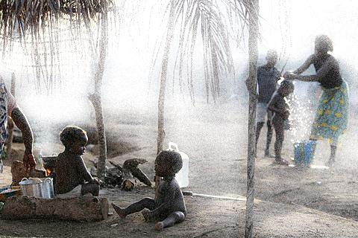
Effectiveness of Poverty-Reducing Targeting Programs

Slide 17
Poverty-Reducing Targeting programs
Social expenditure Programs = highest share of total government expenditure
Any tranfer scheme to reduce poverty will be at expense of some other governement expenditure (trade-off)

Slide 18
Disaggregation of the Household sectors
Identify households by income level is a great constraint for targeting process and makes it impossible to target a specific group and track it since income varies.
Measures of poverty and income distribution
Headcount index given a poverty line z
The model uses a division of households sectors accorging to different categories instead of income levels
Log normal distribution to each household group

Slide 19
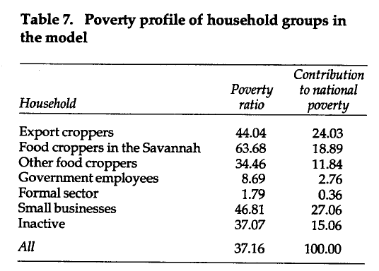
Poverty-Reducing Targeting programs

Slide 20
Poverty-Reducing Targeting programs
Principles of targeting
Social cost of implementing adjustment programs
+
Deterioration in general welfare
=
Targeting mechanisms as a result
Objetive of targeting
Transfers to poor houselholds to push their income just above the poverty line.
Types of targeting
Perfect targeting
Universal targeting

Slide 21
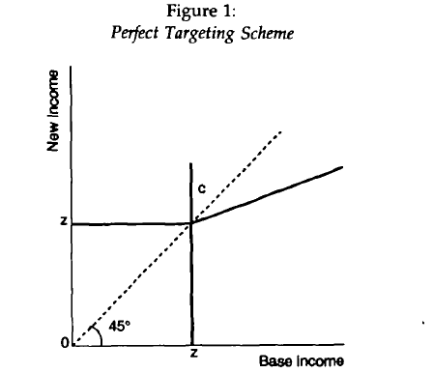
Poverty-Reducing Targeting programs
There is a cost of identification
Very difficult to apply
Self-financed
Taxes from rich HH
=
Transfer to poor HH
Complete Identification of Households
Tranfer only to the poor households
PERFECT TARGETING
Poverty
Line

Slide 22
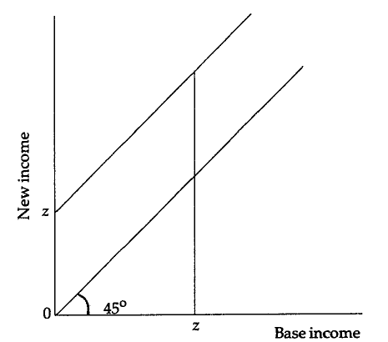
Poverty-Reducing Targeting programs
Tranfer to all households
Tranfers are higher than in PT
No cost of identification
More realistic
Aim: erradicate poverty completely
UNIVERSAL TARGETING

Slide 23
Poverty-Reducing Targeting programs
Perfect T.
$$T_{p}=\sum_{i=1}^{q}{\left(z−y_{i}\right)}$$
Perfect T.
𝑇_𝑝=∑24_(𝑖=1)^𝑞▒(𝑧−𝑦_𝑖 )
Poverty Index
$$P_{α}=\frac{1}{n}\sum_{i=1}^{q}{{\left[\frac{z−y_{i}}{z}\right]}^{α}}$$
Poverty Index
𝑃_𝛼=1/𝑛 ∑24_(𝑖=1)^𝑞▒[(𝑧−𝑦_𝑖)/𝑧]^𝛼
Universalistic Scheme
$$T_{u}=nz$$
Universalistic Scheme
𝑇_𝑢=𝑛𝑧
Amount needed to eliminate poverty (T)
TRANSFER SIZE

Slide 24
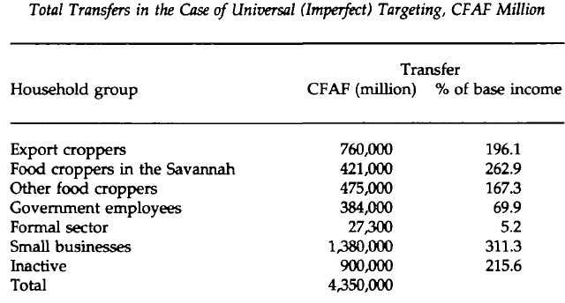
Poverty-Reducing Targeting programs
UNIVERSAL TARGETING
Cost of the programs
PERFECT TARGETING
In the case of perfect targeting the porverty-reduction program would represent 3% of GDP

Slide 25
GHANA
Perfect: 7% GDP
Universal:
60% GDP

Slide 26
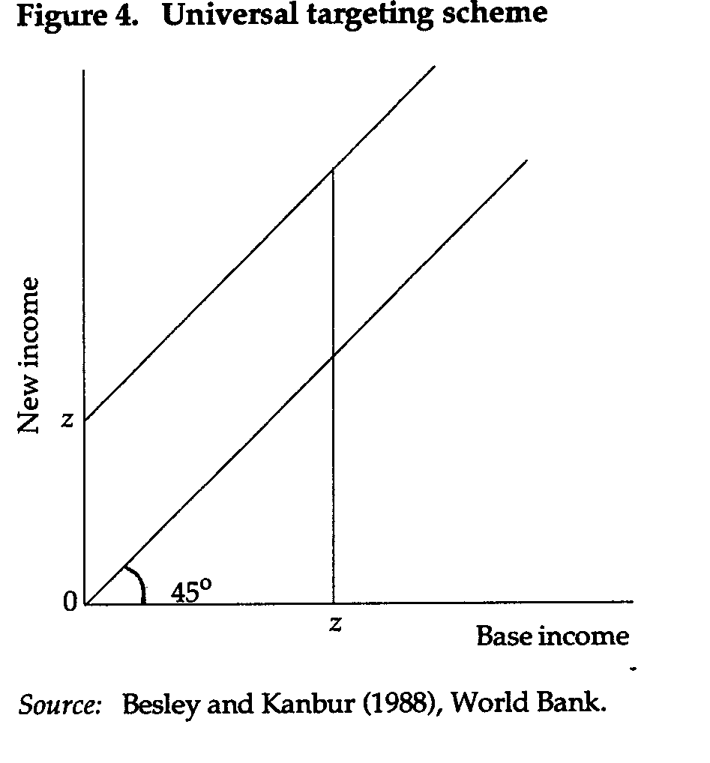
GENERAL EQUILIBRIUM ANALYSIS
Targeting programs would shift the function upwards
Funds distributed to all households simultaneously or individually

Slide 27
GENERAL EQUILIBRIUM ANALYSIS
GE effects
*Size of tranfers and its goal (zero head-count ratios)
*Leakages
*All vs group schemes
Size of Transfer
If the size of the tranfer is proportional to the gain in income
Political Implications
Feasibility of the programs

Slide 28


GENERAL EQUILIBRIUM ANALYSIS
Total Real Government revenues (expenditures) are kept constant
In both counterfactuals all households are taxed, including the beneficiaries
2 types of counterfactuals:
All case: tranfers distributed simultaneously to all groups
Household Case: each household is targetted separately
$$Γ^{h}\left(1−t_{h}\right)$$
GE effects
Universalistic Approach
Tranfer:$Γ^{h}$
Tax: $t_{h}$

Slide 29
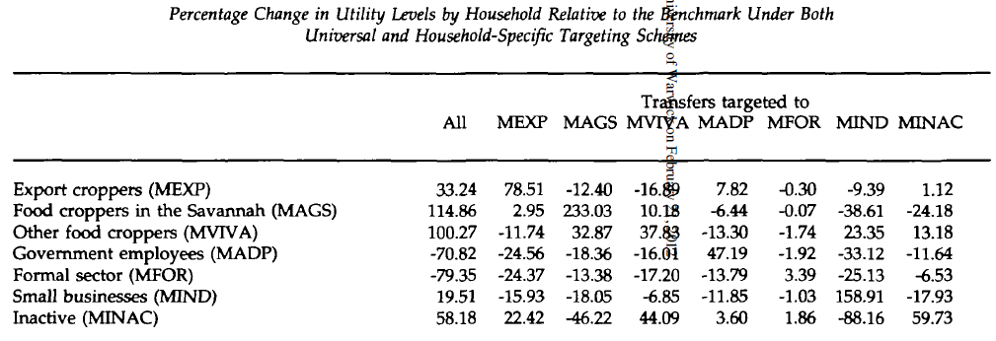
GENERAL EQUILIBRIUM ANALYSIS
Percentage increase in final real income is less than the percentage increase in base income due to the transfer.
HH transfers are included, hence some HH gain (lose) from a targeting program directed to other group. MVIVA-MINAC
Government and formal private sector lose from the universal targeting scheme

Slide 30
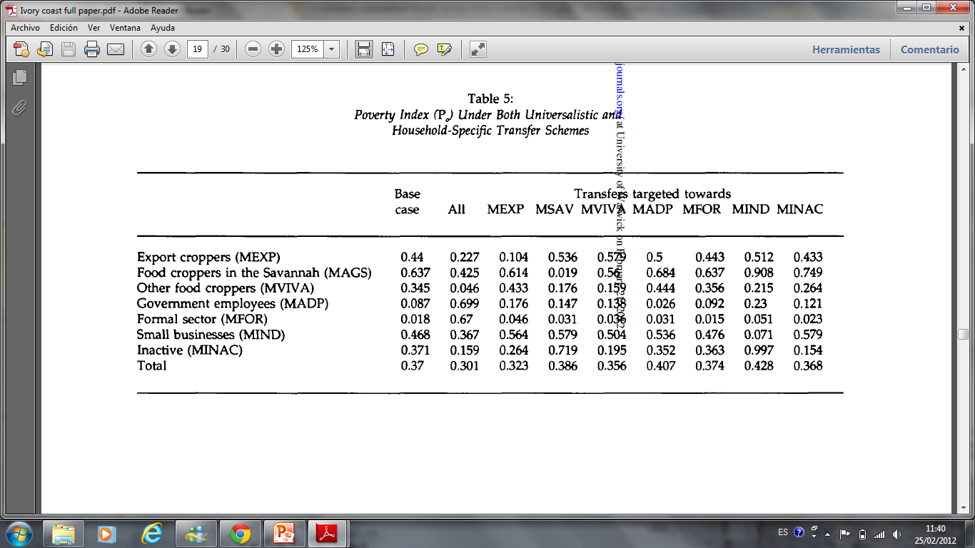
Universal targeting scheme reduces poverty by 7 percentage points
Reduction of poverty
(ALL, MEXP, MVIVA, MINAC)
Increase in poverty
(MSAV, MADP, MFOR, MIND)

Slide 31
GENERAL EQUILIBRIUM ANALYSIS
Universal Targeting vs. Individual targeting
Universal
Better for agricultural households
Has the greater poverty reducing effect (if directed to correct households)
Leakage effects
Individual
Total poverty for the group not eliminated
Effects the final income of other households through inter-house transfers

Slide 32
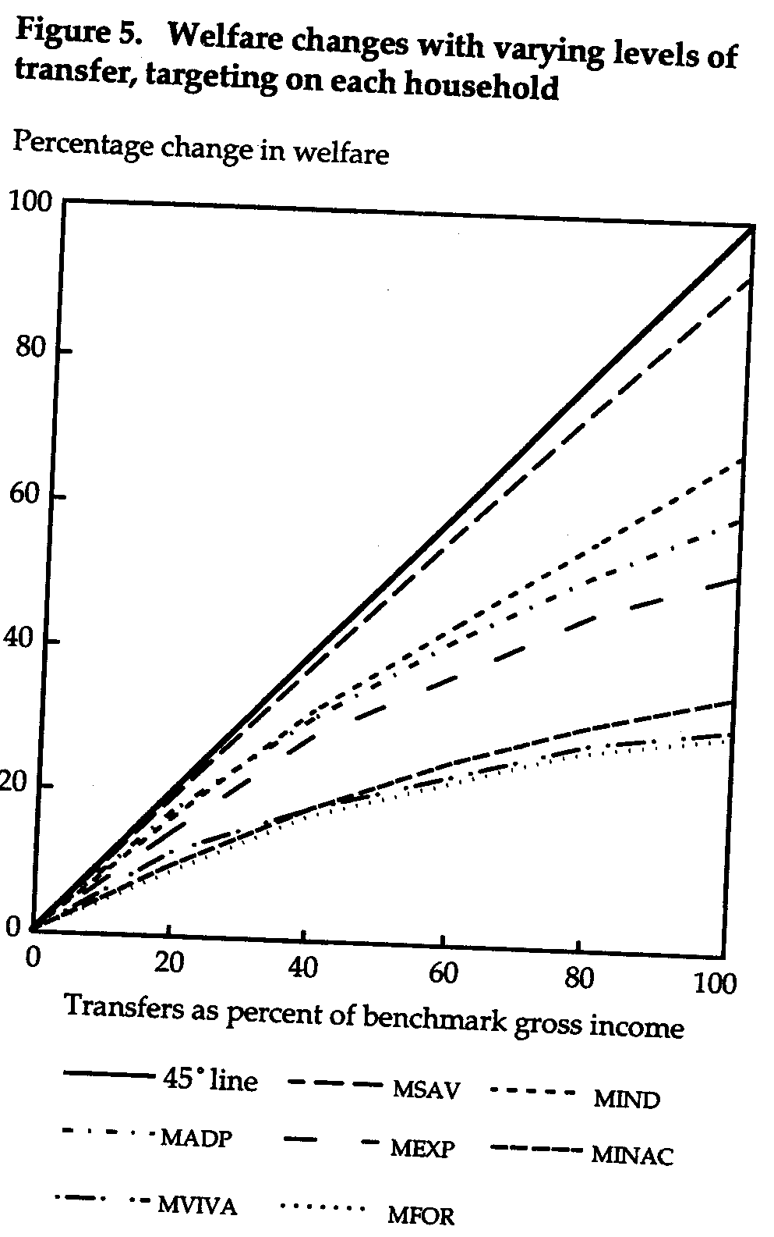
GENERAL EQUILIBRIUM ANALYSIS
Smaller transfers have a greater relative effective than larger transfers
Increase in transfers relative to base income leads to increased leakages
The cost is higher than expected for most of the household groups
Size of Transfer

Slide 33
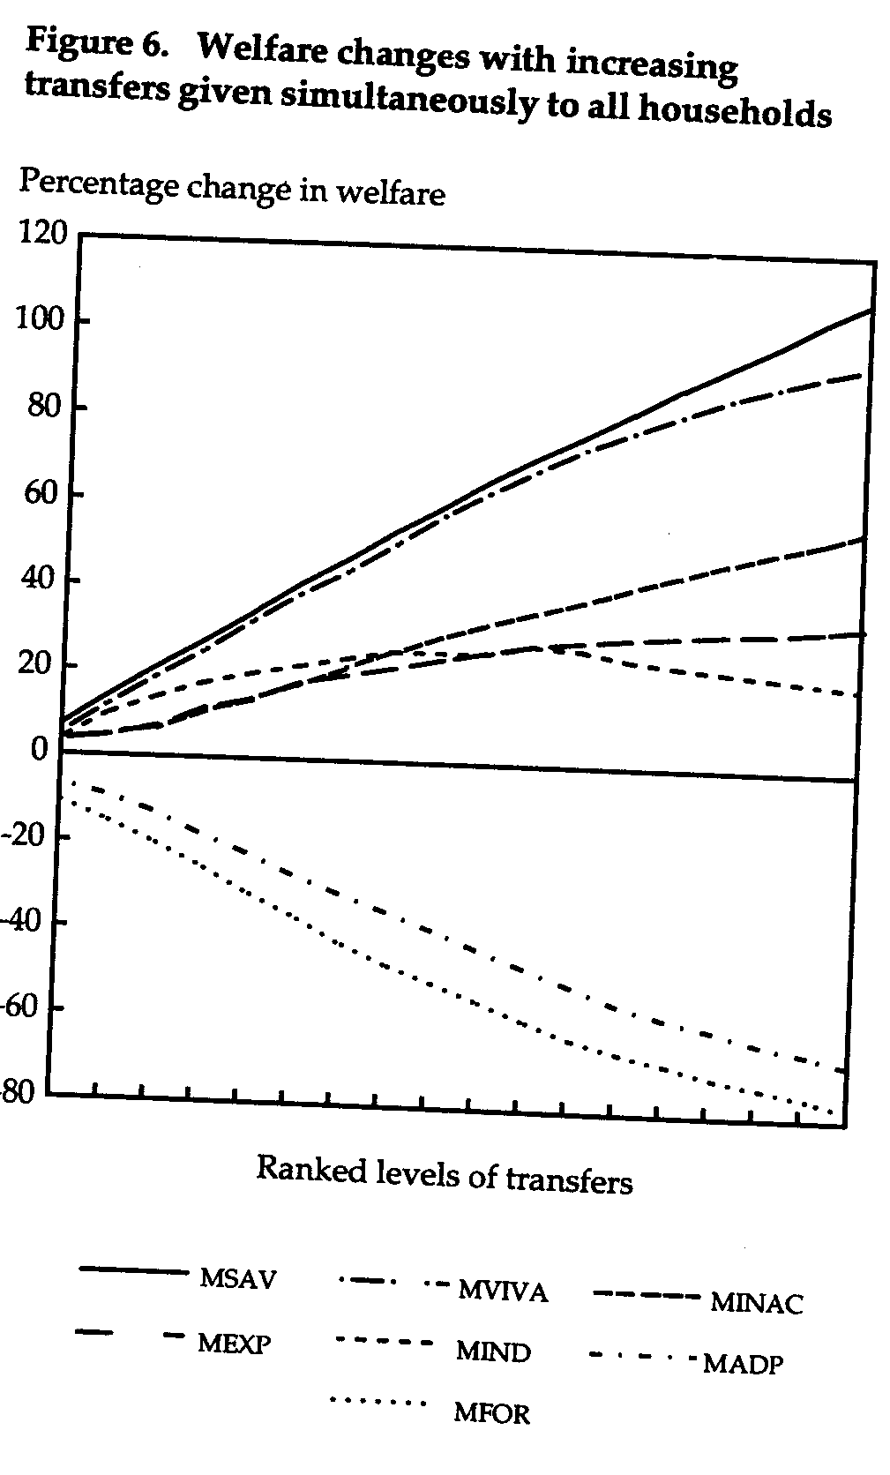
GENERAL EQUILIBRIUM ANALYSIS
Government and formal sector households have negative net gains
Tax the high income groups is politically unfeasible
Political Implications

Slide 34
CONCLUSION
Distribution of tax and social policies in Cote d’Ivoire
Targeting programs and general equilibrium effects
Inter-house transfers play an important role in poverty reduction
Politically feasible
Provides a useable social policy framework

Slide 35
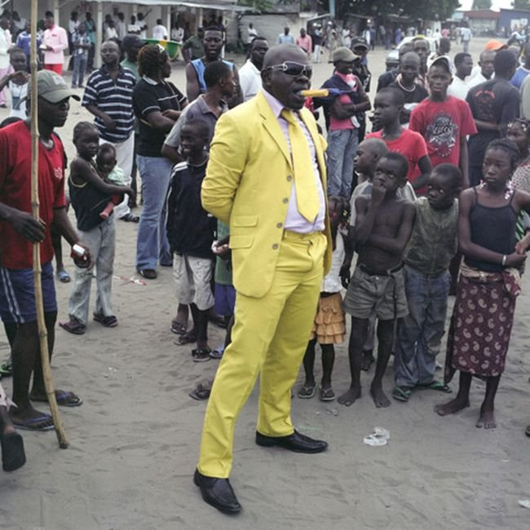

QUESTIONS?

