Slide 1
MRes Year 2 Induction
4th October 2021

Slide 2
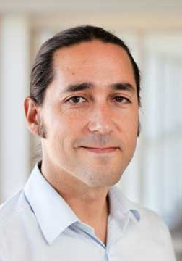
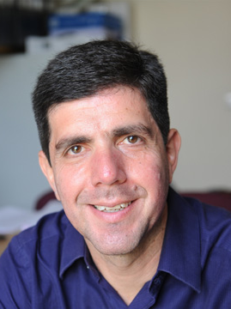
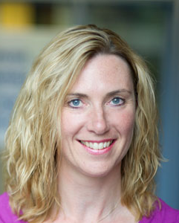
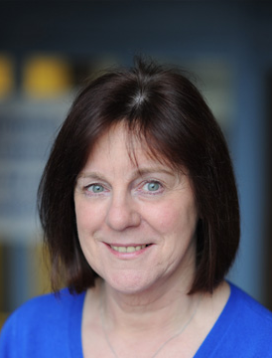
Key Staff
Professor Manuel Bagues
Director MRes/PhD Programme
Manuel.Bagues@Warwick.ac.uk
Room S2.122
Professor Pablo Beker
Deputy Director MRes/PhD Programme
Manuel.Bagues@Warwick.ac.uk
Room S2.93
Natalie Deven
Programmes Officer (PGR)
N.S.Deven@warwick.ac.uk
Room S1.132 (moving to S2.138)
Margaret Nash
Research Administration Assistant
m.j.nash@Warwick.ac.uk
Room S2.136

Slide 3
Professor Manuel Bagues
Director of MRes/ PhD
Room s2.122
Manuel.Bagues@warwick.ac.uk
Advice and feedback hours: By appointment

Slide 4
Welcome - update on departmental procedures
Encourage vaccinations
Twice weekly lateral flow tests
Face coverings
when moving around buildings
‘strongly encouraged’ in teaching rooms
can remove when seated in offices
Social distancing
1.5m inside university buildings
No restrictions in retail outlets
Notes:
Alternative workspace on campus: main library; postgrad hub- now in the junction building; learning grid Rootes and in University House.

Slide 5
Dissertation
Progression to dissertation not automatic
How to get started:
Many modules require research proposals
Be pro-active: contact faculty members with related research interests
Start writing beginning of term 3 (latest)
Dissertation Guidance available (current student page)
Supervision
Ethical Approval for student led research
https://warwick.ac.uk/services/skills/pgr/elearning/
Roadmap:
Presentation proposal in mid-June
Submission early September (extension to following March)
Dissertation presentation mid-September
Notes:
I wanted to say a little more about the dissertation, given its importance as part of the requirements for the MRes but also as the basis for your future PhD research. Progress to the dissertation is not automatic: students must pass all taught modules in order to progress to the dissertation. Decisions on progression to dissertation will be made by the June exam board in year two. Students formally start the dissertation at the start of term 3 in year two however, many students will start to explore and develop ideas for the dissertation during the EC9AA project. Students are responsible for finding their own supervisor for the MRes dissertation through discussion with faculty in the students area of interest. We will ask you to notify us of your chosen supervisor before the end of term 3 and will assist any student experiencing difficulties. Please make yourself aware of ethical approval requirements. Training in research ethics is available on the university’s Skills and Student Development web pages. Please think about this well in advance of carrying out any fieldwork involving personal data, as it can be stressful to discover at a late stage (perhaps just before a submission date) that you need to apply for ethical approval from the University. Submission deadline for the dissertation will be early September (week 49 in the University academic week calendar) and we will confirm the exact date before the start of summer term. This will be a hard deadline, with no extension available (except in mitigating circumstances). If a student does have mitigating circumstances, they will be permitted to submit at the next submsison point which will be March in the following year. The student would then enter the PhD in the following September.

Slide 6
Progression to PhD
Progression to PhD not automatic
Achieve an average of 65% (over all taught modules in year 1 and 2);
Demonstrate strong performance in the core modules (i.e. an average of not less than 60%); and
Achieve a mark of at least 65% in the dissertation.
If you do not expect to satisfy these requirements please let me know

Slide 7
Scholarships
ESRC (deadline for Oct 2022 entry is January 2022).
Chancellors International Scholarship (30 available deadline Jan 22)
Skeoch Scholarships (2 for 2022 entry)
Other funding opportunities on Doctoral College web pages.

Slide 8
Teaching Opportunities
Graduate Teaching Assistants (warwick.ac.uk)
Delivery of UG classes, advice and feedback hours, exam marking
Training provided
In person delivery with some online teaching for students who cannot travel
Strict 20h rule for those on a ‘Student Route’ visa (previously called Tier 4)
Room available for ‘advice and feedback hours’
Department private tutoring policy
https://warwick.ac.uk/fac/soc/economics/current/ug/handbook/support-and-personal-development#private-tutoring-policy
Notes:
We see teaching as part of the training for a PhD student and in our department we rely heavily on PhD students to deliver teaching particularly at UG level.
Tier 4 students are only allowed to work a maximum of 20 hours per week in total. Further information is on the immigration team web pages, if you are ever unsure please ask, because the consequences are serious.
If you decide to teach you will be offered training which is mandatory.

Slide 9
Plagiarism
Assignments and dissertations will be checked through Turnitin plagiarism software.
Examples of plagiarism are included in the handbook
Penalties are severe for plagiarism, collusion and other forms of cheating (e.g. cheating in tests or exams)
PlagiarWise online tutorial: https://moodle.warwick.ac.uk/course/view.php?id=24642
Notes:
Still on assessment and dissertation, you should be aware that all written assessments and dissertations are checked through Turnitin plagiarism software. Please see the MRes/PhD handbook for further guidance on plagiarism and if you are at all uncertain take the online module.

Slide 10
Attendance
You are expected to be here during term-time
Attend all your lectures and classes
Monitoring points: support and feedback classes; module evaluation
If you are planning to be away from campus for more than 3 months you must tell us (Change in Study Location form: Student Visa requirement)
Notes:
As mentioned your attendance records can be viewed from your Tabula page. The main monitoring points for first year MRes students are attendance at classes and module evaluation at the end of each term. A full list of monitoring points is included in the handbook and Natalie also send out a list at the beginning of each term. We do monitor attendance records and if you miss three or more points we will contact you to find out if there is a problem. Monitoring points are particularly important for Tier 4 students. Please also be aware that there are restrictions on the number of hours that Tier 4 students are allowed to work. For further information please see the immigration web page. Letting us know if you are gong to be away from campus for more then 3 months is also very important for Tier 4 students.

Slide 11
Monitoring Points
List of monitoring points for 2021-22
Attendance at option modules
Module evaluation (term 1 and 2)
Submission of name of proposed dissertation supervisor and topic title (week 32)
Presentation of dissertation research proposal (week 36)
Submission of dissertation (week 48)

Slide 12
Departmental Seminar Series
When you’re not in classes
Research Field Seminars
External speakers
Mondays through Wednesdays, usually 14.00-15.30;
Field days:
Mondays (Political Economy)
Tuesdays (CAGE/Empirical)
Wednesdays (CRETA/Theoretical)
Thursdays (Macro/International)
See our webpages/events calendar for details
Notes:
When you're not in classes, you are encouraged to attend one or more of our seminar series. You are expected to regularly attend the seminar series in your area of interest.

Slide 13
IT issues
There are 15 pcs available in the MRes hot desk room (s0.76 and s0.78)
Report any IT issues economics.it@warwick.ac.uk
Printing is available s2.82 and s2.81a (free of charge within reason)
IT issues can also be brought to our attention through GSSLC
Notes:
The MRes hot desk work room contains

Slide 14
Any Questions

