Slide 1
PhD Induction Years 2-4 October 2021
Manuel Bagues
Director MRes/PhD
Natalie Deven
Programme Officer (PGR)

Slide 2
Welcome - update on departmental procedures
Encourage vaccinations
Twice weekly lateral flow tests
Face coverings
when moving around buildings
‘strongly encouraged’ in teaching rooms
can remove when seated in offices
Social distancing
1.5m inside university buildings
No restrictions in retail outlets
Notes:
Alternative workspace on campus: main library; postgrad hub- now in the junction building; learning grid Rootes and in University House.

Slide 3
Presentation plan
Length of time for PhD
Supervision
Progress monitoring
Format of thesis
The viva
Time away from Warwick
Resources
Teaching
Feedback

Slide 4
How long do I have to do my PhD?
4 years of registration
Extension only in truly exceptional circumstances
Ready to submit end 3rd year
Job market paper (end of year 3)
Job market (Dec/Jan of Year 4)
Submission anytime up to your final submission date.

Slide 5
Supervision
Supervisor Panel (3 members)
Assistant Professor as supervisor
Change in supervisor arrangements
Monthly meetings (upload to Tabula)

Slide 6
What I can expect from my supervisor?
Guidance about standards, planning, sources, and techniques
Discuss training requirements (TNA)
Make you aware of relevant regulations and requirements
Monitor and report on your progress
Provide constructive criticism on written work
Maintain regular contact
Recommend examiners
https://warwick.ac.uk/services/dc/policies_guidance/supervisionpgr/

Slide 7
What we expect from you
Familiarity with regulations and guidelines (see handbook)
Agree schedule of meetings (term-time/ vacation with supervisor)
Inform supervisor of others you are working with
Belong to a research group
Present twice a year (PhD Forum and one other)
Attend two seminars per week (online check)
Regularly discuss your research with other faculty members
Submit on time!

Slide 8
Progress Monitoring
Monthly meeting with supervisor (minimum)
6 monthly progress report for Director PhD (Nov 2021)
Annual PhD Forum (a paper required at the end of each year)
One workshop or poster presentation per year

Slide 9
What should my thesis look like
3 significant pieces of work
Joint authorship
University requirements for the presentation of your thesis
https://warwick.ac.uk/services/dc/pgrassessments/gtehdr/
PhD in Economics+
You will be examined on your submitted thesis
Notes:
It is possible that some students will have an interest that bridges more than one discipline e.g. Economics and Politics. It is possible to be awarded a PhD in Economics and one other subject, but you must have a supervisor in both disciplines and you must also have an examiner in both disciplines and the examiners decide the award.

Slide 10
Final Examination
Complete nomination of examiners form with your supervisor
Approval of examiners (by dept and university)
One internal examiner
One external examiner
Examinations Advisor (possibly)
Viva within 4 months

Slide 11
Away from Warwick
Let the MRes/PhD Office know asap
Monthly monitoring points
Change of study location (Tier 4)
Risk assessment may be required (https://warwick.ac.uk/services/gov/riskmanagement/travel_risk_management/)
Review University travel insurance (https://warwick.ac.uk/services/finance/insurance/

Slide 12
Ethical scrutiny
Research integrity training
https://warwick.ac.uk/services/ris/research_integrity/trainingandmentoring/
University code of practice:
https://warwick.ac.uk/services/ris/research_integrity/code_of_practice_and_policies/research_code_of_practice
Consider ethical scrutiny at an early stage- HSSREC timescales
ESRC Framework:
https://esrc.ukri.org/files/funding/guidance-for-applicants/esrc-framework-for-research-ethics-2015/

Slide 13
Leave of absence
Circumstances which affect your progress- tell us early
Temporary withdrawal- stops clock
Up to 12 month period (24 months in total)*
Implications for Tier 4 students
Authorised absence is also possible (up to 6 weeks, does not stop clock)

Slide 14
Wellbeing
Library on line courses to help you cope with the realities of postgraduate life:
https://warwick.ac.uk/services/library/students/your-library-online
Doctoral College support web pages:
https://warwick.ac.uk/services/dc/support/wellbeing/
The PG Hub have regular events to provide support, distraction and fun!: https://warwick.ac.uk/services/library/pghub
University student support services (for all students: undergraduate, postgraduate and research students):
https://warwick.ac.uk/services/wss/

Slide 15
Resources - operational
Office space
Dedicated desk and PC in shared office
Keep tidy- limit personal belongings
Dept visitors may need to use PGR office space
IT Support
Economics.IT@warwick.ac.uk
Staff in S0.81 and S0.83
Optional introductory session to be arranged
Common room
Shared with staff this year (S2.132)
Kitchen facilities on ground and second floors
Respect other users
Notes:
Dedicated desk – most departments provided hot desking facilities
IT queries should be directed to the dedicated email account or pop by offices on ground floor (S0.81 or S0.83) (and not direct to supervisors who are unlikely to be able to resolve the issue). The IT Manager Caroline has offered to run an introductory session for the PhD students.

Slide 16
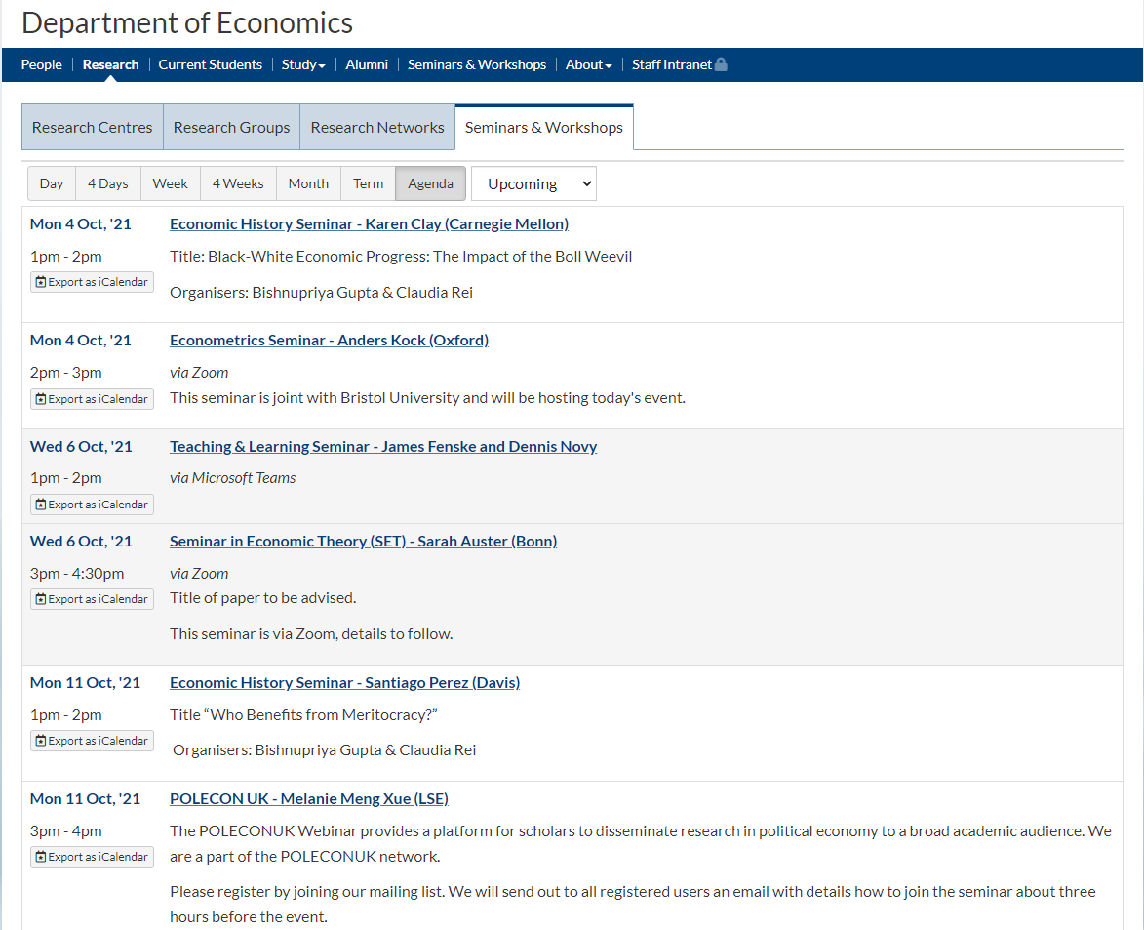
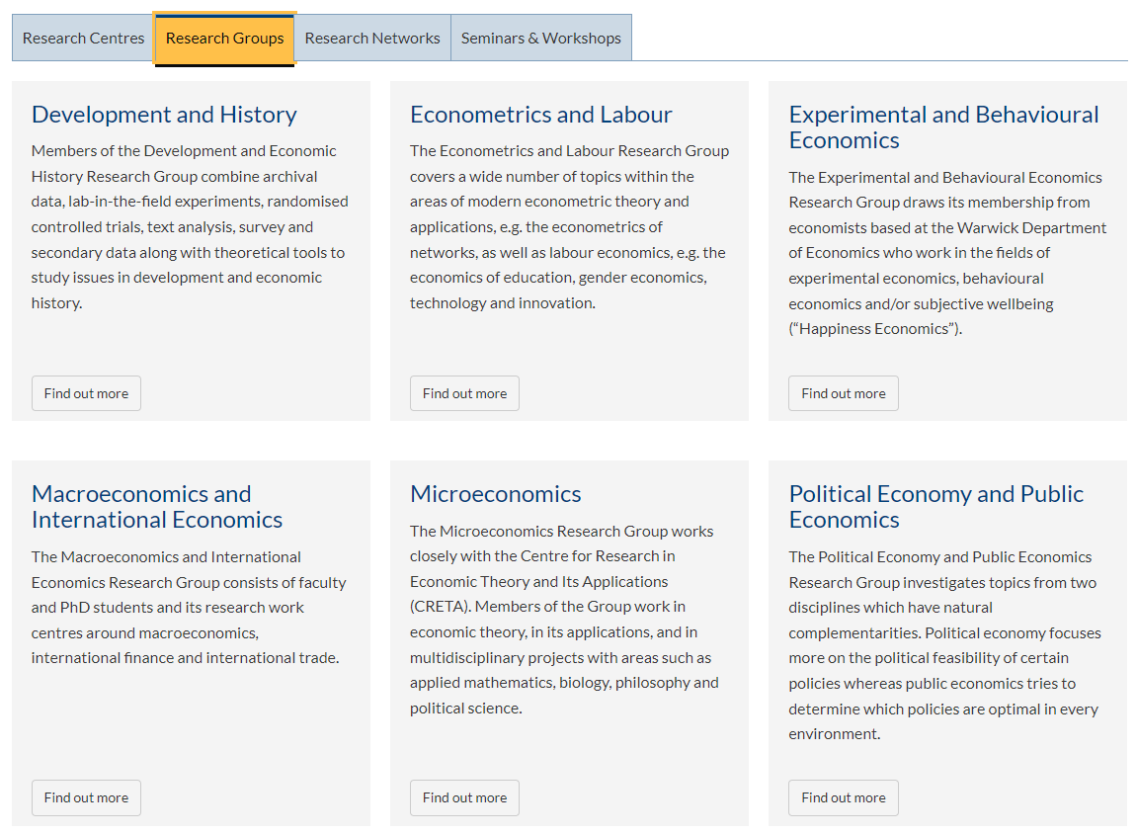
Resources - academic
Notes:
6 research groups
Daily seminars during term time

Slide 17
Resources - financial support
Research
Personal budget for conference attendance, journal submission fees, other appropriate research activities
Apply for additional department funding to support experiments, field work, conferences…..
Job Market
Proof reading of job market paper
Personal budget to support job market activities, e.g. travel, accommodation

Slide 18
Job Market?
Academic job or non academic job
Year 4 is job market year
Key references (updated August 2020)
American Economic Association
https://www.aeaweb.org/resources/students/grad-prep/job-market
European Economic Association
https://www.eeassoc.org/index.php?site=&page=288&trsz=287
Careers and Skills (Careers Beyond Academia Day, PhD employer networking events)

Slide 19
Tips for Success
This is advice on how to fulfill the formal requirements
To excel, you need to seek advice widely and from multiple sources, and benchmark yourself against successful recent job market candidates from other universities.
Two tips:
Check (all) the material on Masa Kudamatsu's "Tips4Economists" website
Watch videos of job market paper presentations by participants in the RESTUD tour.
Notes:
This is advice on how to fulfill the formal requirements. i.e. How to do the bare minimum. That's not the same as excelling, or making yourself someone that a research university would want to hire. To excel, you need to seek advice widely and from multiple sources, and benchmark yourself against successful recent job market candidates from other universities. There is no one simple formula for this, but a good start would be to familiarize yourself with the material on Masa Kudamatsu's "Tips4Economists" website. Yes, all of it. And go watch videos of recent RESTUD tourists presenting their job market papers.

Slide 20
Questions from you?

