Slide 1

Academic Skills
for MSc Economics/EIFE/BES

Slide 2
Outline
Study skills for economics MSc
  Using lectures, seminars and problem sets to pass exams
Academic support in the Department
Plagiarism and how to avoid it
The UK grading system
Academic writing hints and tips, referencing
Research and the dissertation
University resources
Feedback between us

Slide 3
MSc students – great Academic Skills?
Been away from study for a while?
First time studying in the UK?
Decide late an MSc was for you?
Currently unsure if an MSc is for you?
Pre-sessional very different from your undergrad?
  Pace
  Maths focus
  Problem oriented approach

Slide 4
Studying for MSc Econ
This is a subject to study actively
You’ve got to get messy
Especially with maths!
No one came up with a proof by working neatly line to line
No one gets to understand a proof/derivation by working neatly line to line

Slide 5
Studying for MSc Econ
You are trying to understand methods
And how to answer our questions using these methods
Best approach is to try the questions
Wrong attempts are informative
Learning answers is uninformative
Start with a blank piece of paper
Use the questions to guide you through the lecture material and readings

Slide 6
Studying for MSc Econ
You are here to try and answer questions
You are not here to learn old answers
Exams contain new questions
More so than U.G.
You are here to answer questions
You are not here to produce revision notes

Slide 7
Studying for MSc Econ
Do you go to the Seminar?
Do you think this is good and productive of you?
Have you attempted the questions?
  (and got most wrong/incomplete)
No…
May as well not bother
Yes…
Great, You are studying effectively for MSc Econ/EIFE/BES

Slide 8
Studying for MSc Econ
There is no expectation you present correct work in seminars
  Or in discussions with academics
The British system is based on trying and getting it wrong
You need tools not answers
Independence is the key to your future

Slide 9
Using lectures, seminars and problems sets to pass exams
The lecture is
an introduction
a guide to priorities
an entertainment
an efficient way to start learning
The lecture is not the answer
The lecture is not the end. It is the beginning
The lecture is not sufficient to pass exams
Go to it!

Slide 10
Using lectures, seminars and problem sets to pass exams
Problem set is the key
Problem set is how to address lecture notes and readings
Try the problem from scratch
Re-try with notes
Attend the seminar with incomplete and wrong answers
Re-try following the seminars
Do you understand where you went wrong?
Yes: good. No: seek further help

Slide 11
Academic Support in the Econ Department
Seminar tutor office hours
Lecturer office hours
Support sessions for pre-sessional Maths and Stats
Lecturer Office Hours
Follow up meeting with Alex Karalis to discuss low marks
Additional Maths and Stats test: check your progress
Nick Jackson’s maths office hours
www.warwick.ac.uk/economics/current/shared/msc_academic_support.

Slide 12
Plagiarism offences
Do the training and read the policy at Academic Integrity
https://warwick.ac.uk/students/supportservices/academic_integrity
Penalties range from 0 on the question to 0 on the assessment
  For first offences; and rise from there
There is no excuse for this
We catch people using software, judgement, experience

Slide 13
Plagiarism: Policy and penalties
An extremely serious offence
Large penalties
  Low or Zero marks for the submitted work
  Breach of University Regulations and disciplinary proceedings
An attempt to pass off some one else’s ideas/effort as your own
  Self-plagiarism is an offence
  Must submit new work for credit
Ignorance is not an excuse
https://warwick.ac.uk/fac/soc/economics/current/msc/handbook/assessment#suspected-cheating

Slide 14
Plagiarism: examples
Reproducing ideas from another published work without citing the source
Reproducing words from another published work without quotation marks and a citation of the source
Copying another student’s work and pretending it is yours, with or without their permission
Including sections from a piece of work that you have submitted previously at any institution
Downloading part or all of a document or ready-made essay from an internet website and pretending it is your own work
Contract cheating
Use of AI outside of the expectations of the assessment. E.g. Chat GPT wrote your essay
  Tend to generate low marks
  Investigation by Viva exam is increasingly common esp for the Dissertation module

Slide 15
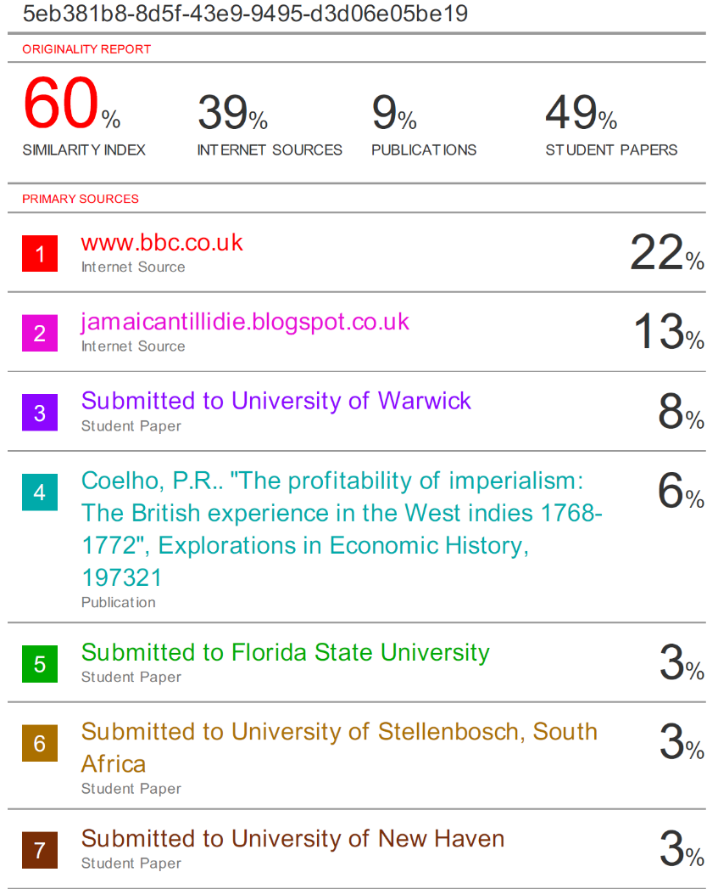
Plagiarism: Turnitin

Slide 16
Plagiarism: If in doubt
Take the course: PlagiarWISE (19/20)
Run by the library
It’s a Moodle course
Google it…

Slide 17
The UK grading system (MSc)
A U.K. 60 is equivalent to a Chinese or U.S. 80
A U.K. 70 is an outstanding mark
The top mark overall is usually around 82/83. Sometimes less
Pass = 50;
Merit = 60;
Distinction = 70.

Slide 18
Academic Writing
A big topic for some, comfortable for others
Asynchronous material already available EC959 Moodle
  Developing questions and titles, as well as writing up your findings
  Live sessions depending on demand and timetable constraints
Everyone should contribute to writing in the Metrics project

Slide 19
Academic writing
Read journal articles and look at how they work
  Abstract
  Introduction (literature review)
  Methods/Techniques/Model
  Results
  Discussion
  Conclusion is basically the abstract
Don’t try to write like professors in text books
Keep your style simple. Convey information. Don’t make normative judgements (about the importance of your work or results)

Slide 20
Referencing
Pick a referencing style
Stick to it
It is essential the reader can find the article (source) based on your reference
Citations are in-line: Author (DATE)
Footnotes are minimal if they exist
All citations in the Bibliography. Nothing else is in the bibliography
Use software : endonote, bibtex etc.

Slide 21
Research and the dissertation
You will forget everything I say now by the time you need it
It’s good to be thinking of areas, questions now
Lectures should inspire some questions. You will have others
Optional modules are a very productive place to find questions
There is an EC959 methods course: more on specialist applied metrics
Dissertation discussions/ briefings EIFE
From an article of interest
  Track the bibliography backwards
  Track the citations forwards in EconLit/IDEAs/GoogleScholar

Slide 22
University Resources
Postgraduate Hub
Library
Student Opportunity: MSc Skills
  https://warwick.ac.uk/services/skills
  Example courses
    Master Your Dissertation, Communicate Clearly …
    Each contains up to 20 online modules you can take/review
    In person sessions in the Summer

Slide 23
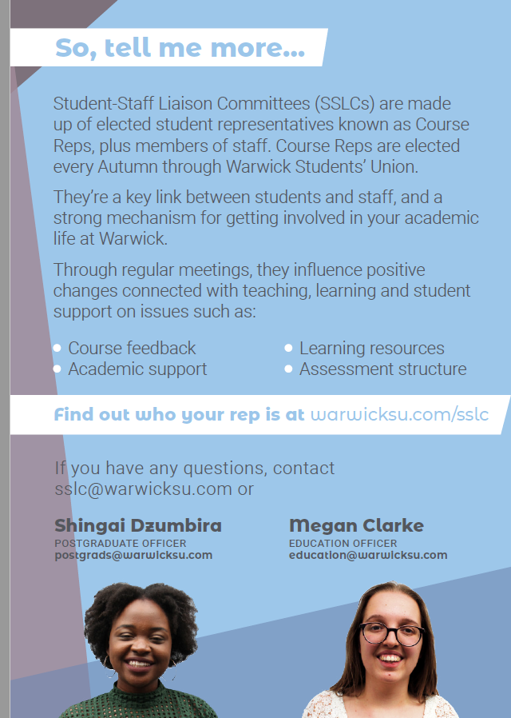
Feedback between us:
Staff Student Liaison Committee SSLC

Slide 24

Are you a potential SSLC member?

Slide 25
Vote for your SSLC reps
Voting opens Monday 7th October
warwicksu.com/elections
An effective SSLC is a big step towards a successful year for all

