Slide 1
Welcome to the Library An introduction for postgraduate economics
Jackie Hanes, Research and Academic Support Librarian
jackie.hanes@warwick.ac.uk

Slide 2
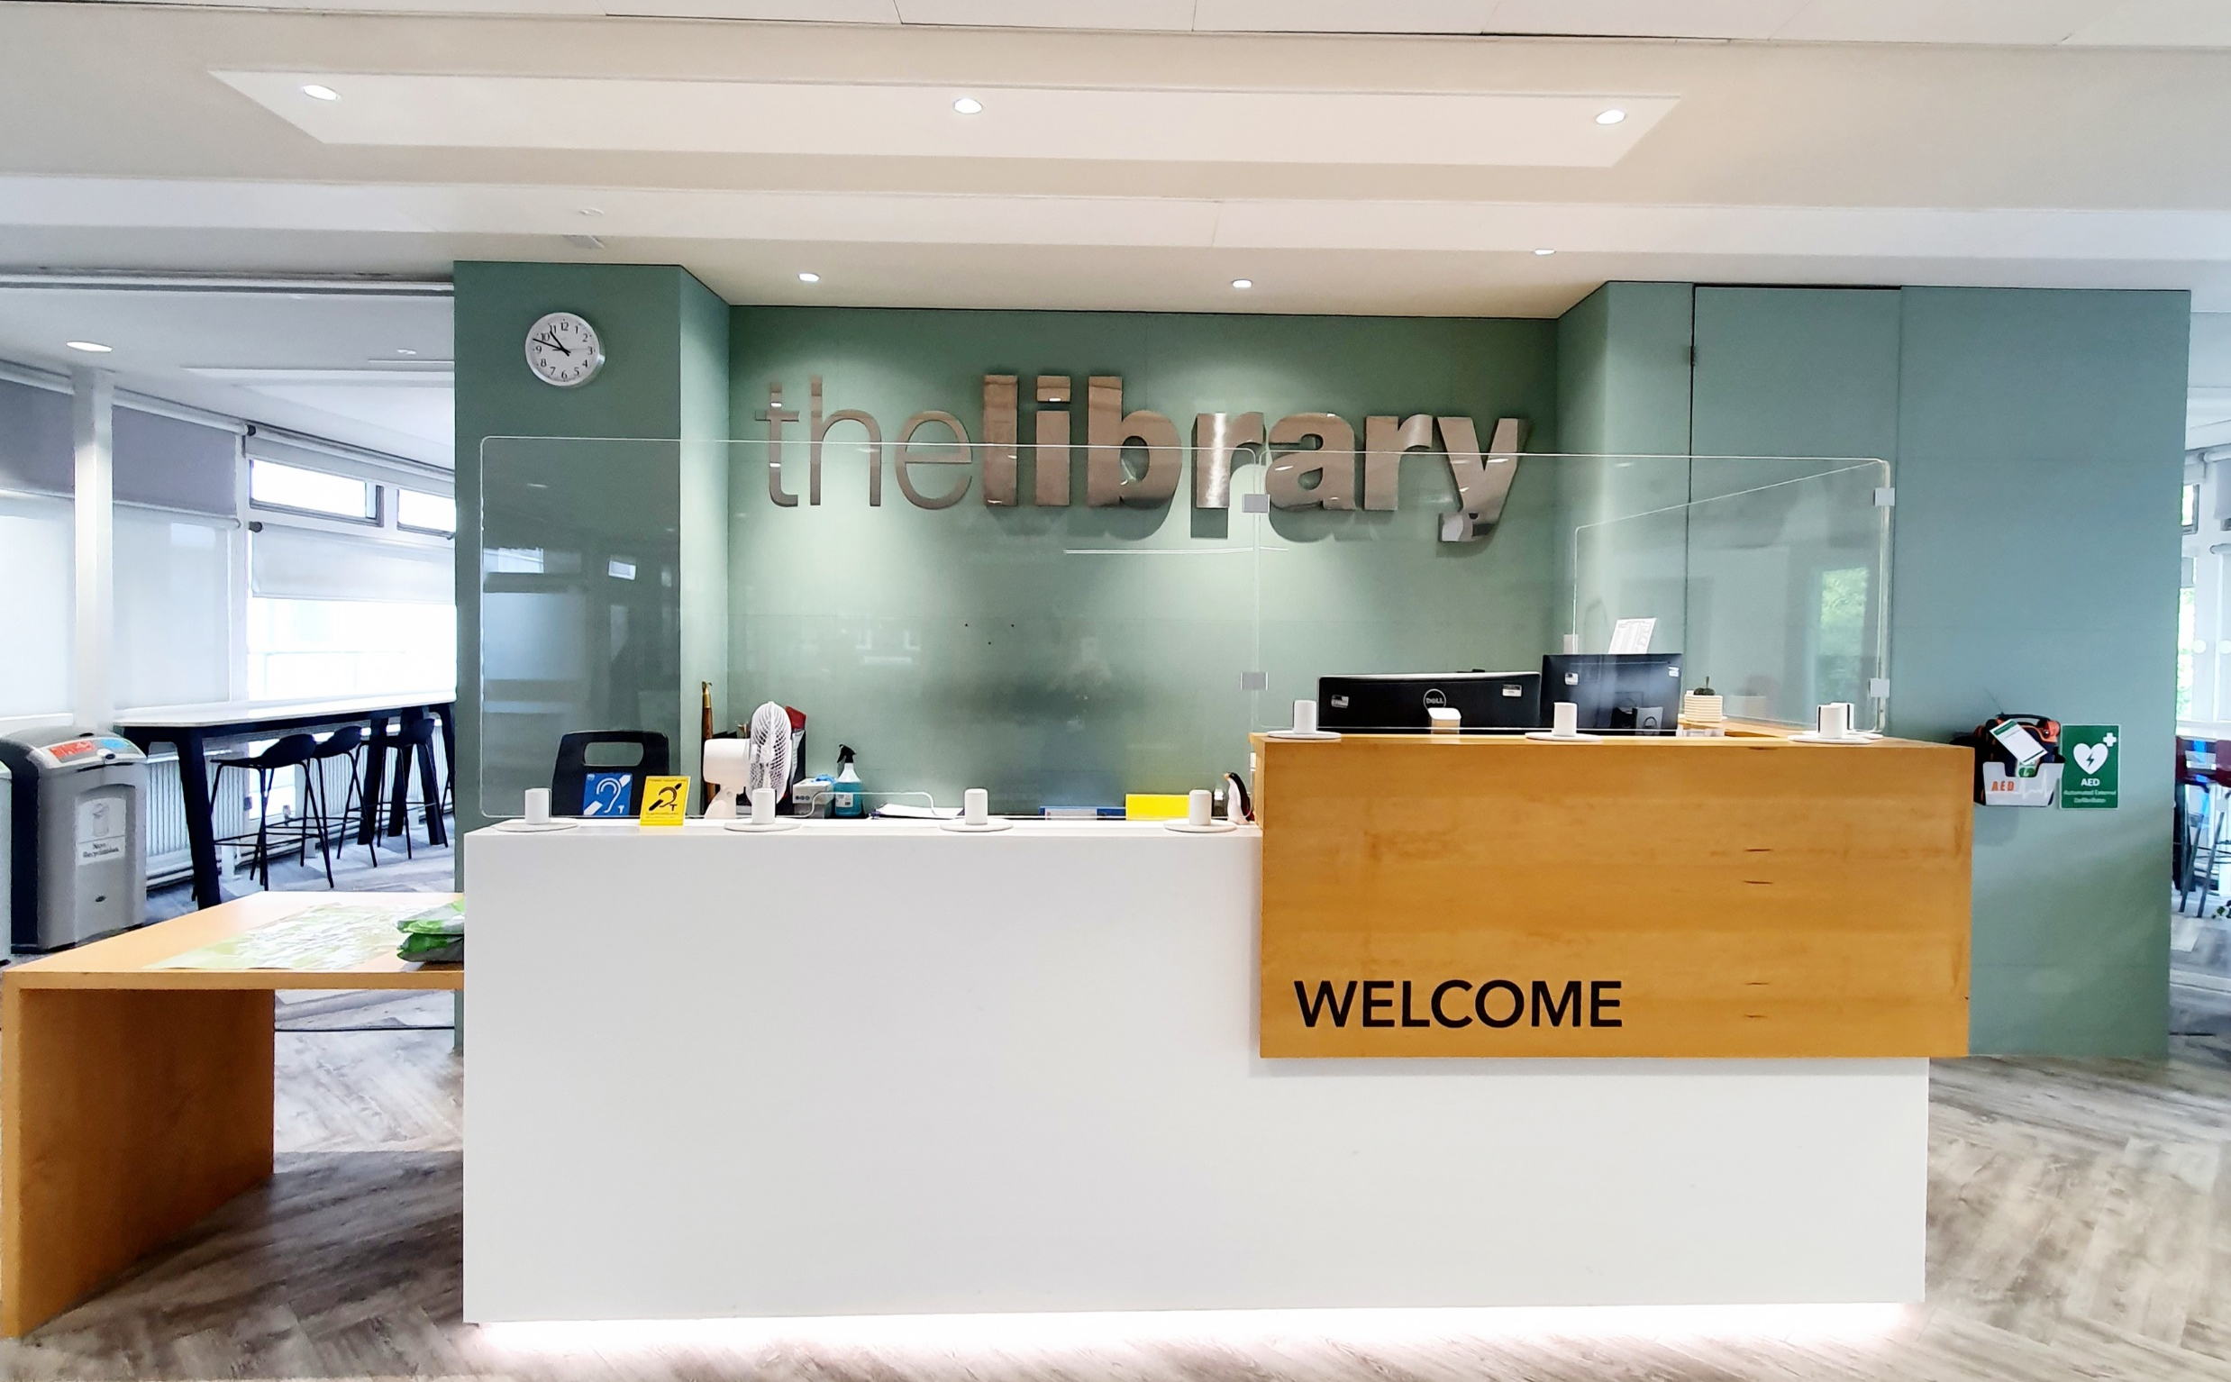


The Library
Open 24/7 (staffed 8am-8pm)
1st floor library entry and help
University ID card required
library@warwick.ac.uk​
+44 (0)24 765 22026
https://warwick.ac.uk/services/library/

Slide 3
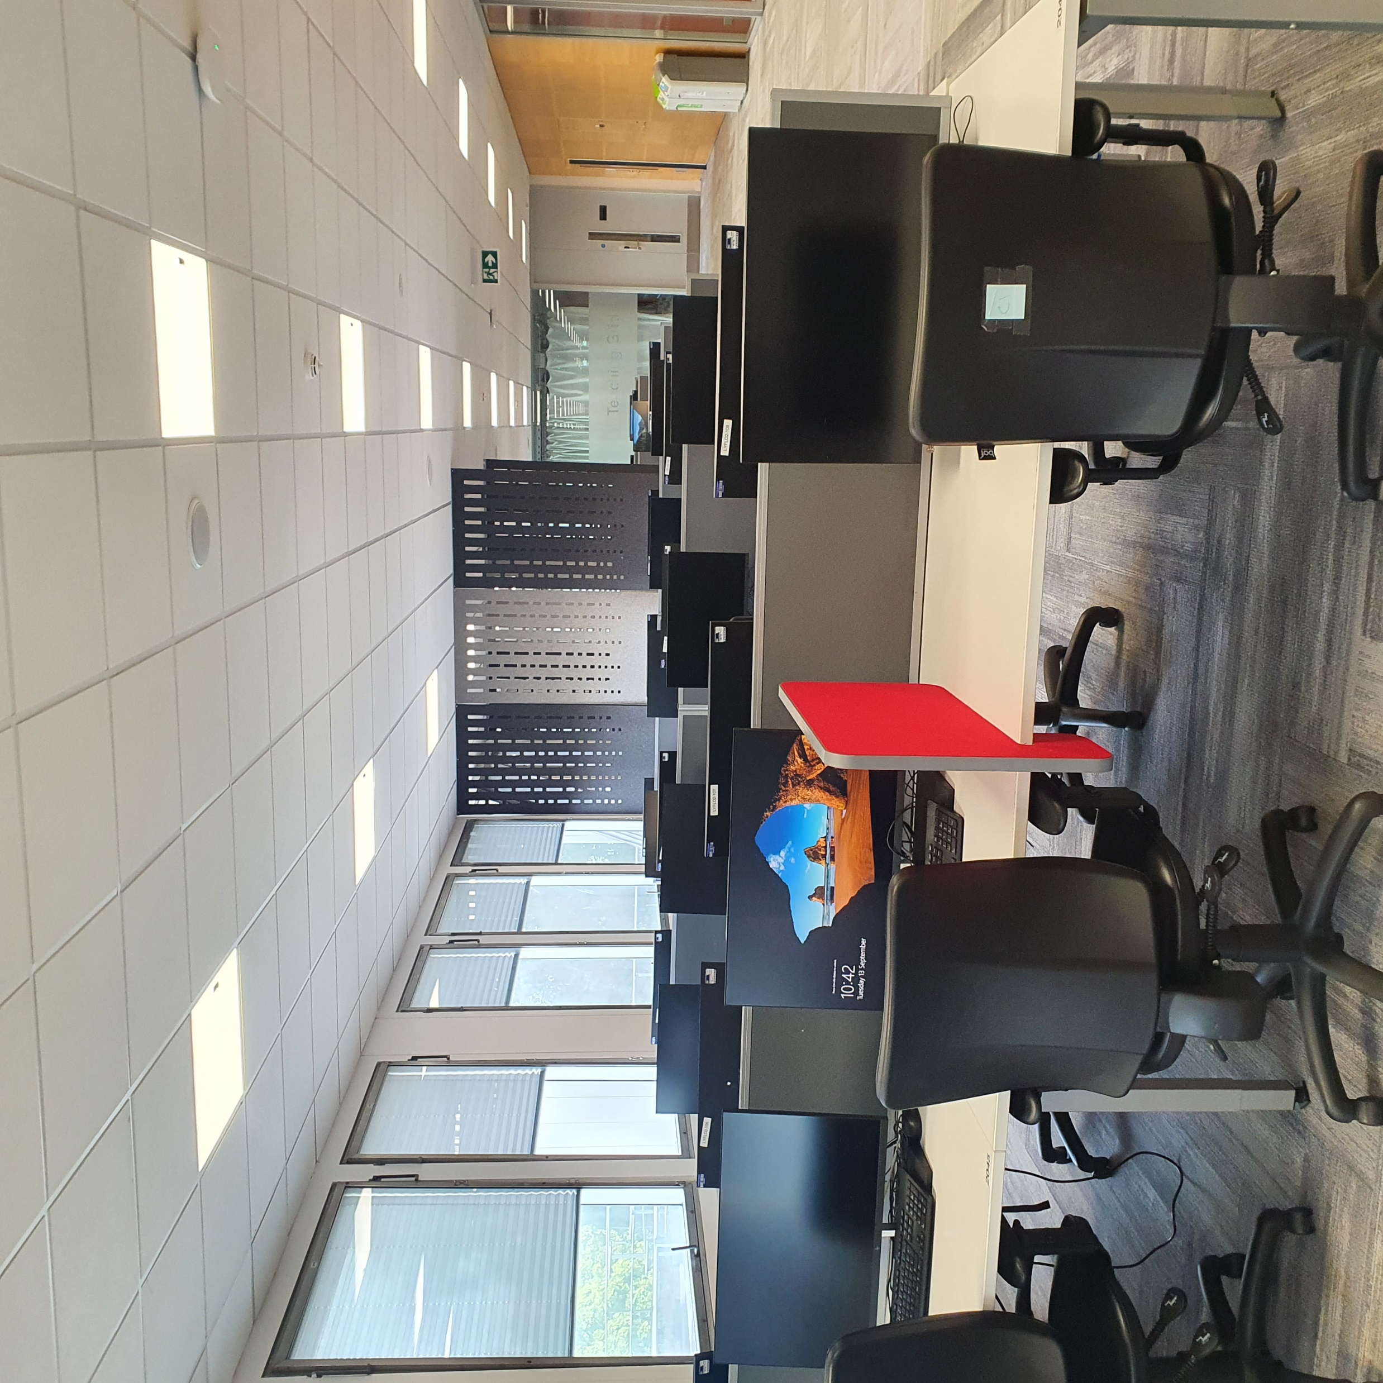
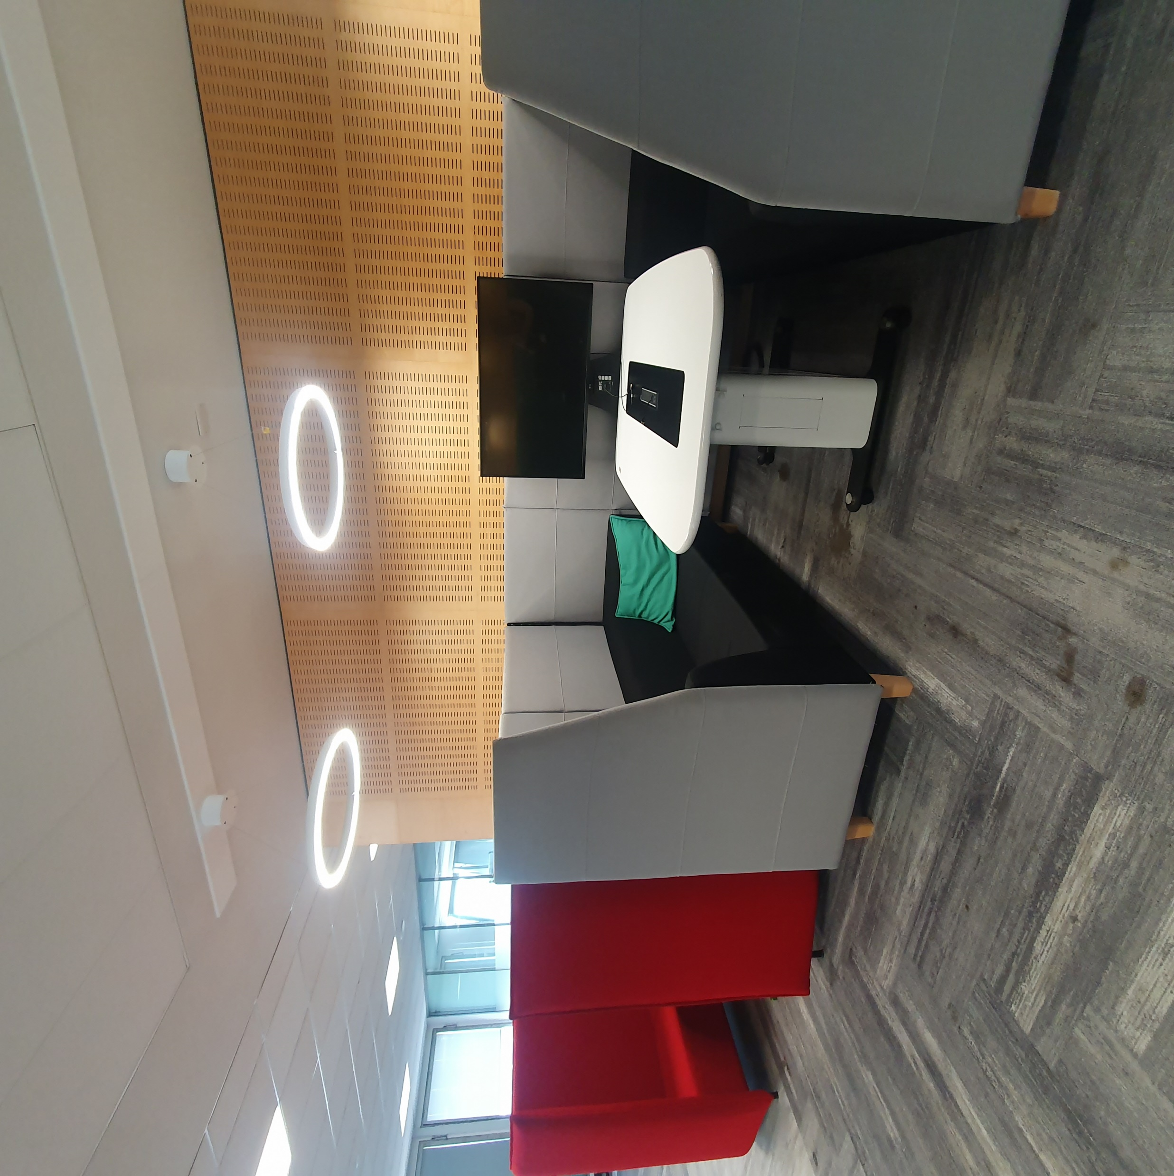
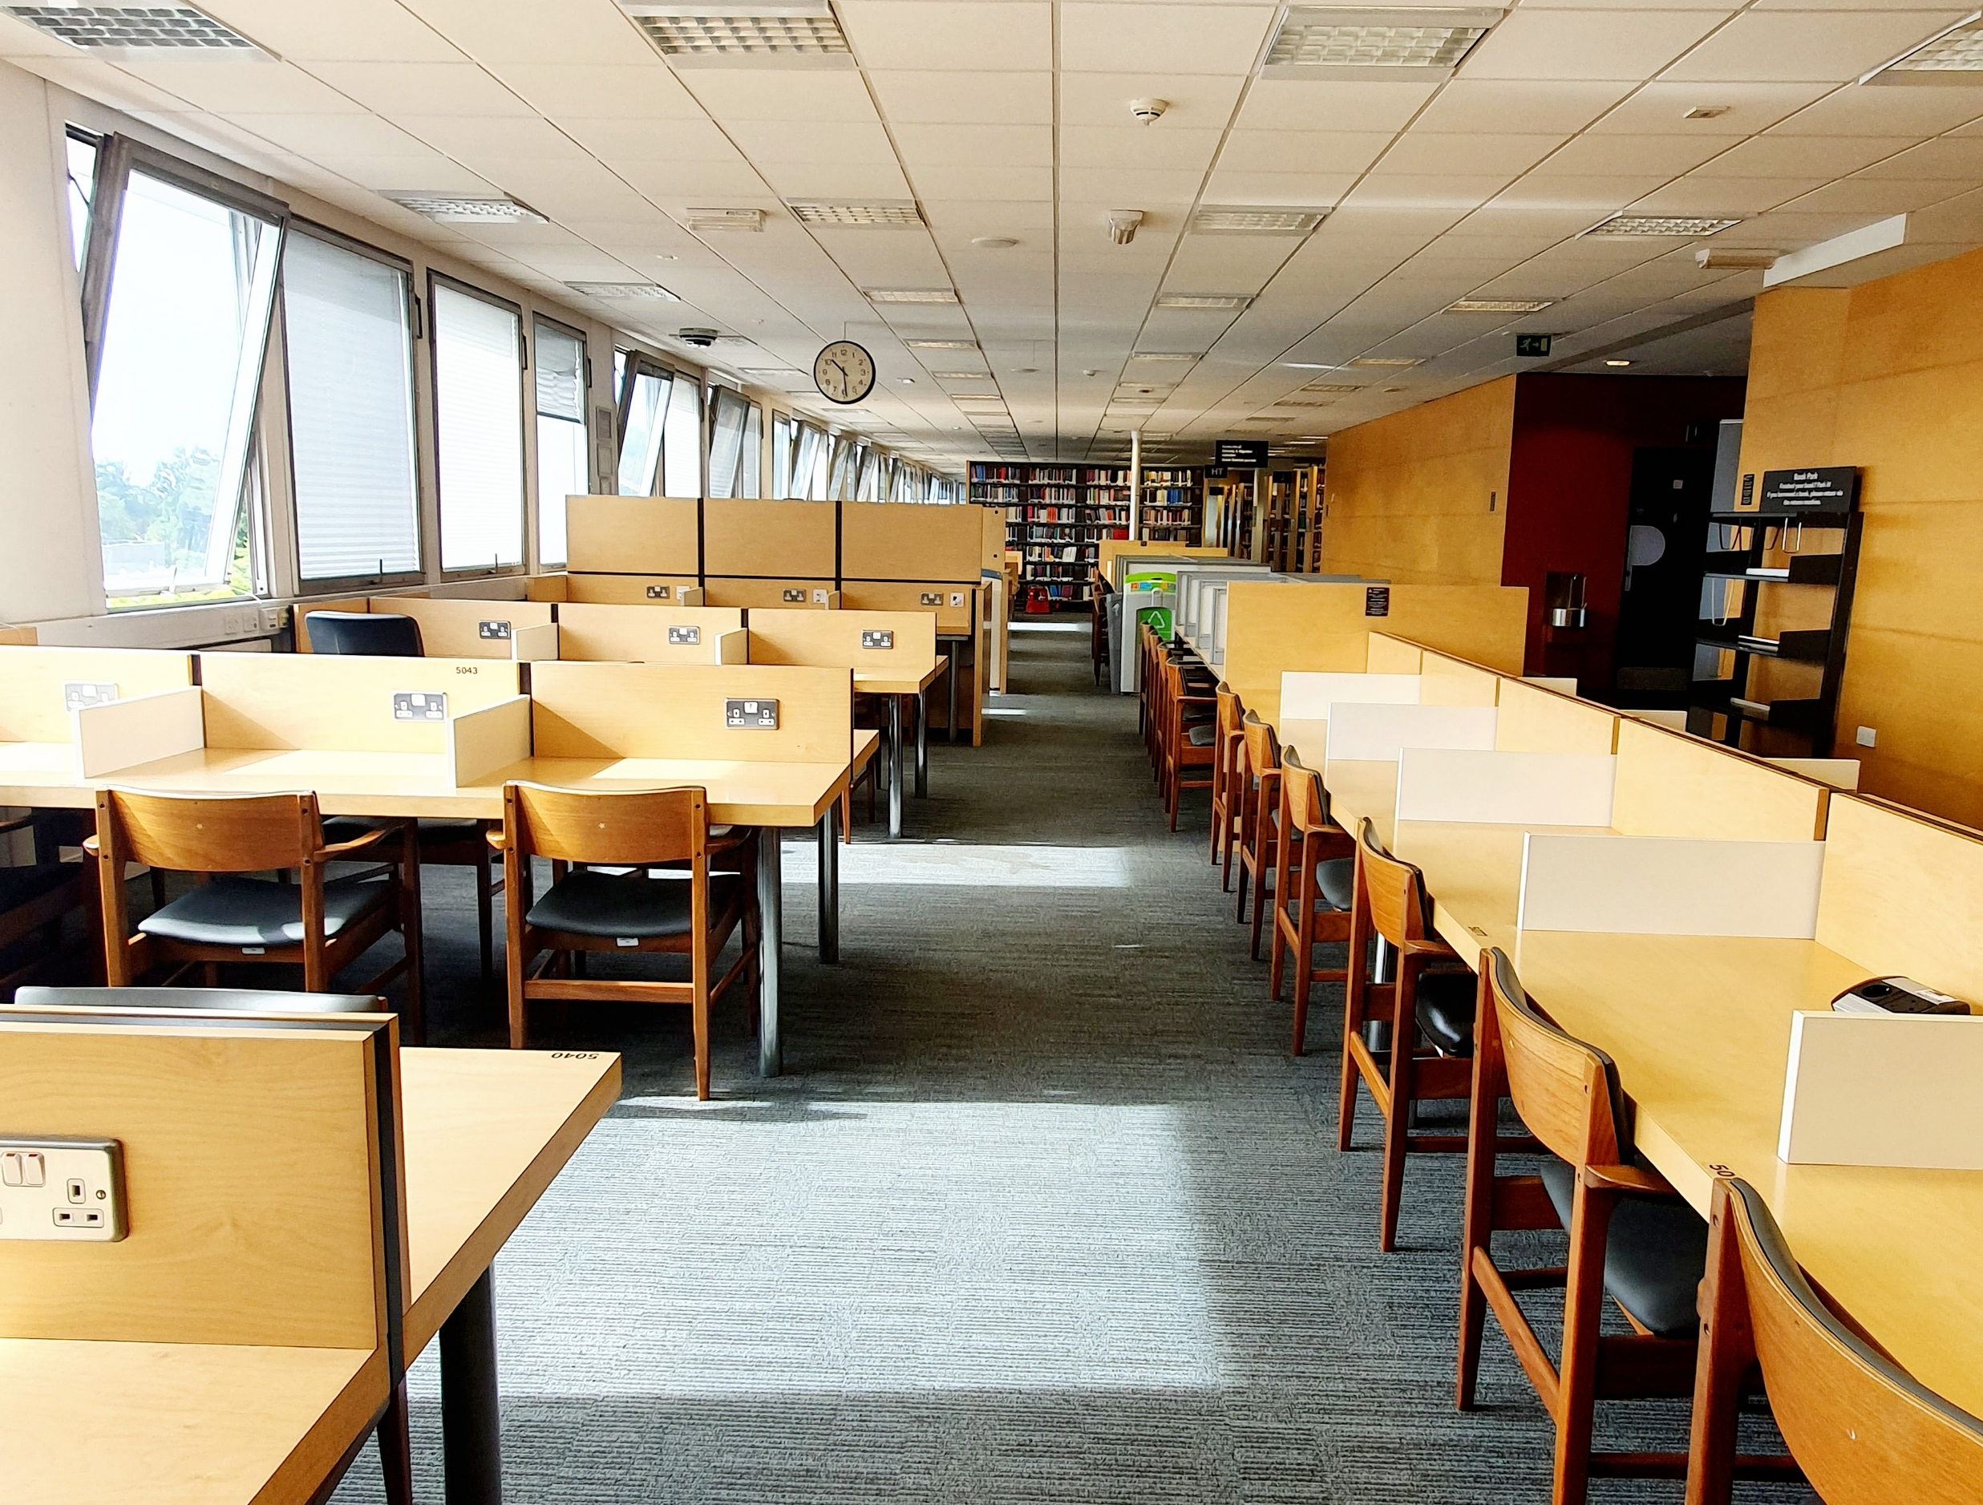
Study spaces
Silent study: 2nd and 3rd floor extension
Quiet study: 3rd, 4th and 5th floors
Collaboration: 1st and 2nd floors (social/group)
Assistive technology area: 1st floor and 2nd floor ext
Accessible and sensory study rooms Pre-bookable by students registered with Disability Services
Learning Grids: Rootes and University House
https://warwick.ac.uk/services/library/using/libspaces/

Slide 4
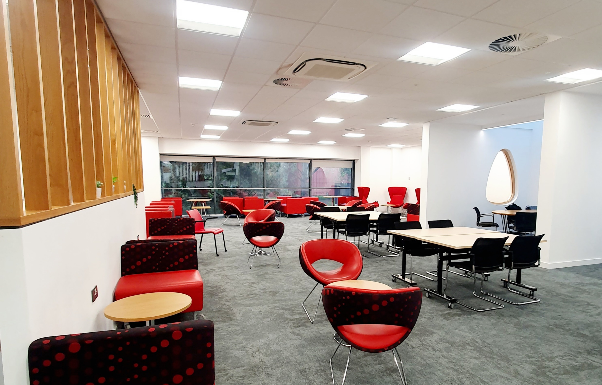
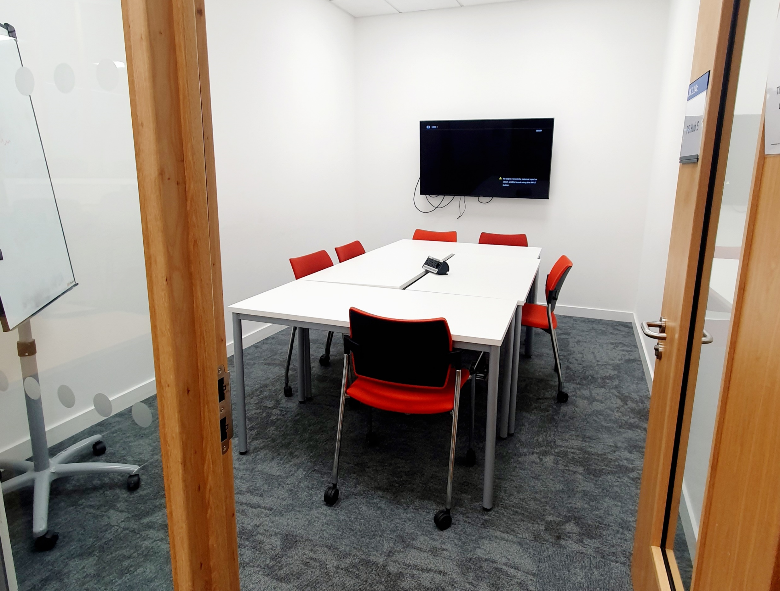
Postgraduate study spaces
Postgrad Hub @ The Junction
A dedicated study space for all postgraduate students (PGT & PGR)
Open 8am-10pm Monday-Sunday
University ID required
PG Tips social event
3pm-4pm Tuesdays (term-time)
https://warwick.ac.uk/services/library/pghub/about/postgraduate_hub/

Slide 5
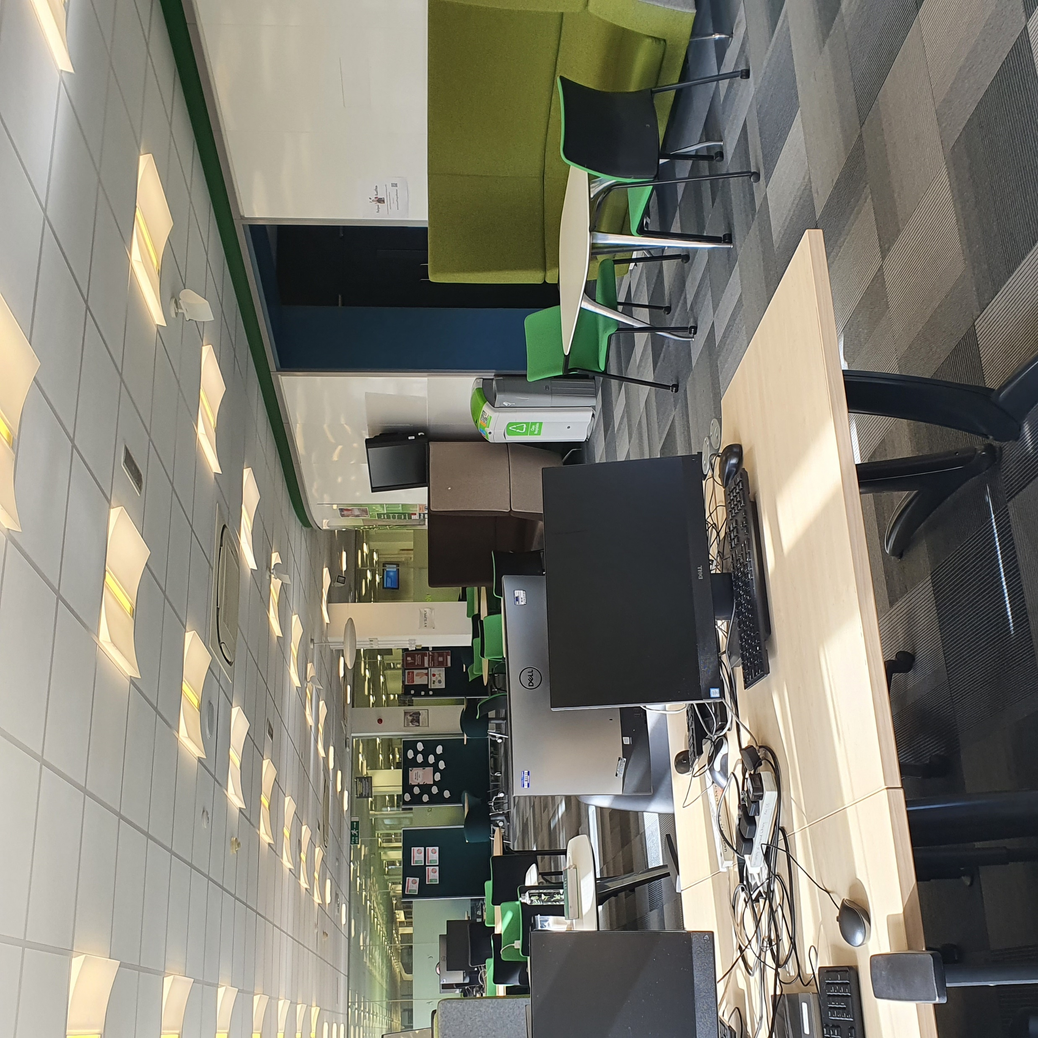
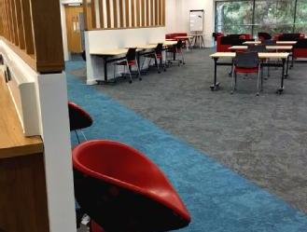
Postgraduate spaces
Postgrad Hub @ The Junction
Open 9am to midnight
Available to PGT & PGR students
Research Exchange (3X)
Open 24/7 as per main library
Available to MRes, PGR & Staff only
Study space, seminar rooms, printers
Kitchenette & lockers
https://warwick.ac.uk/services/library/students/postgraduates/

Slide 6

Postgraduate events
PG Tips A weekly event to meet fellow postgraduates and to enjoy free tea, coffee and biscuits, alongside discussions on all things related to postgrad study and postgrad life.
Research Refresh A weekly event for researchers to connect with peers, take a break, and enjoy some free refreshments and activities.
PGR Write Here Write Now A focused study session using the Pomodoro technique. Study with peers and take controlled breaks to help you get work done. Longer sessions to help with the PGR workload.
Postgraduate Library Events

Slide 7
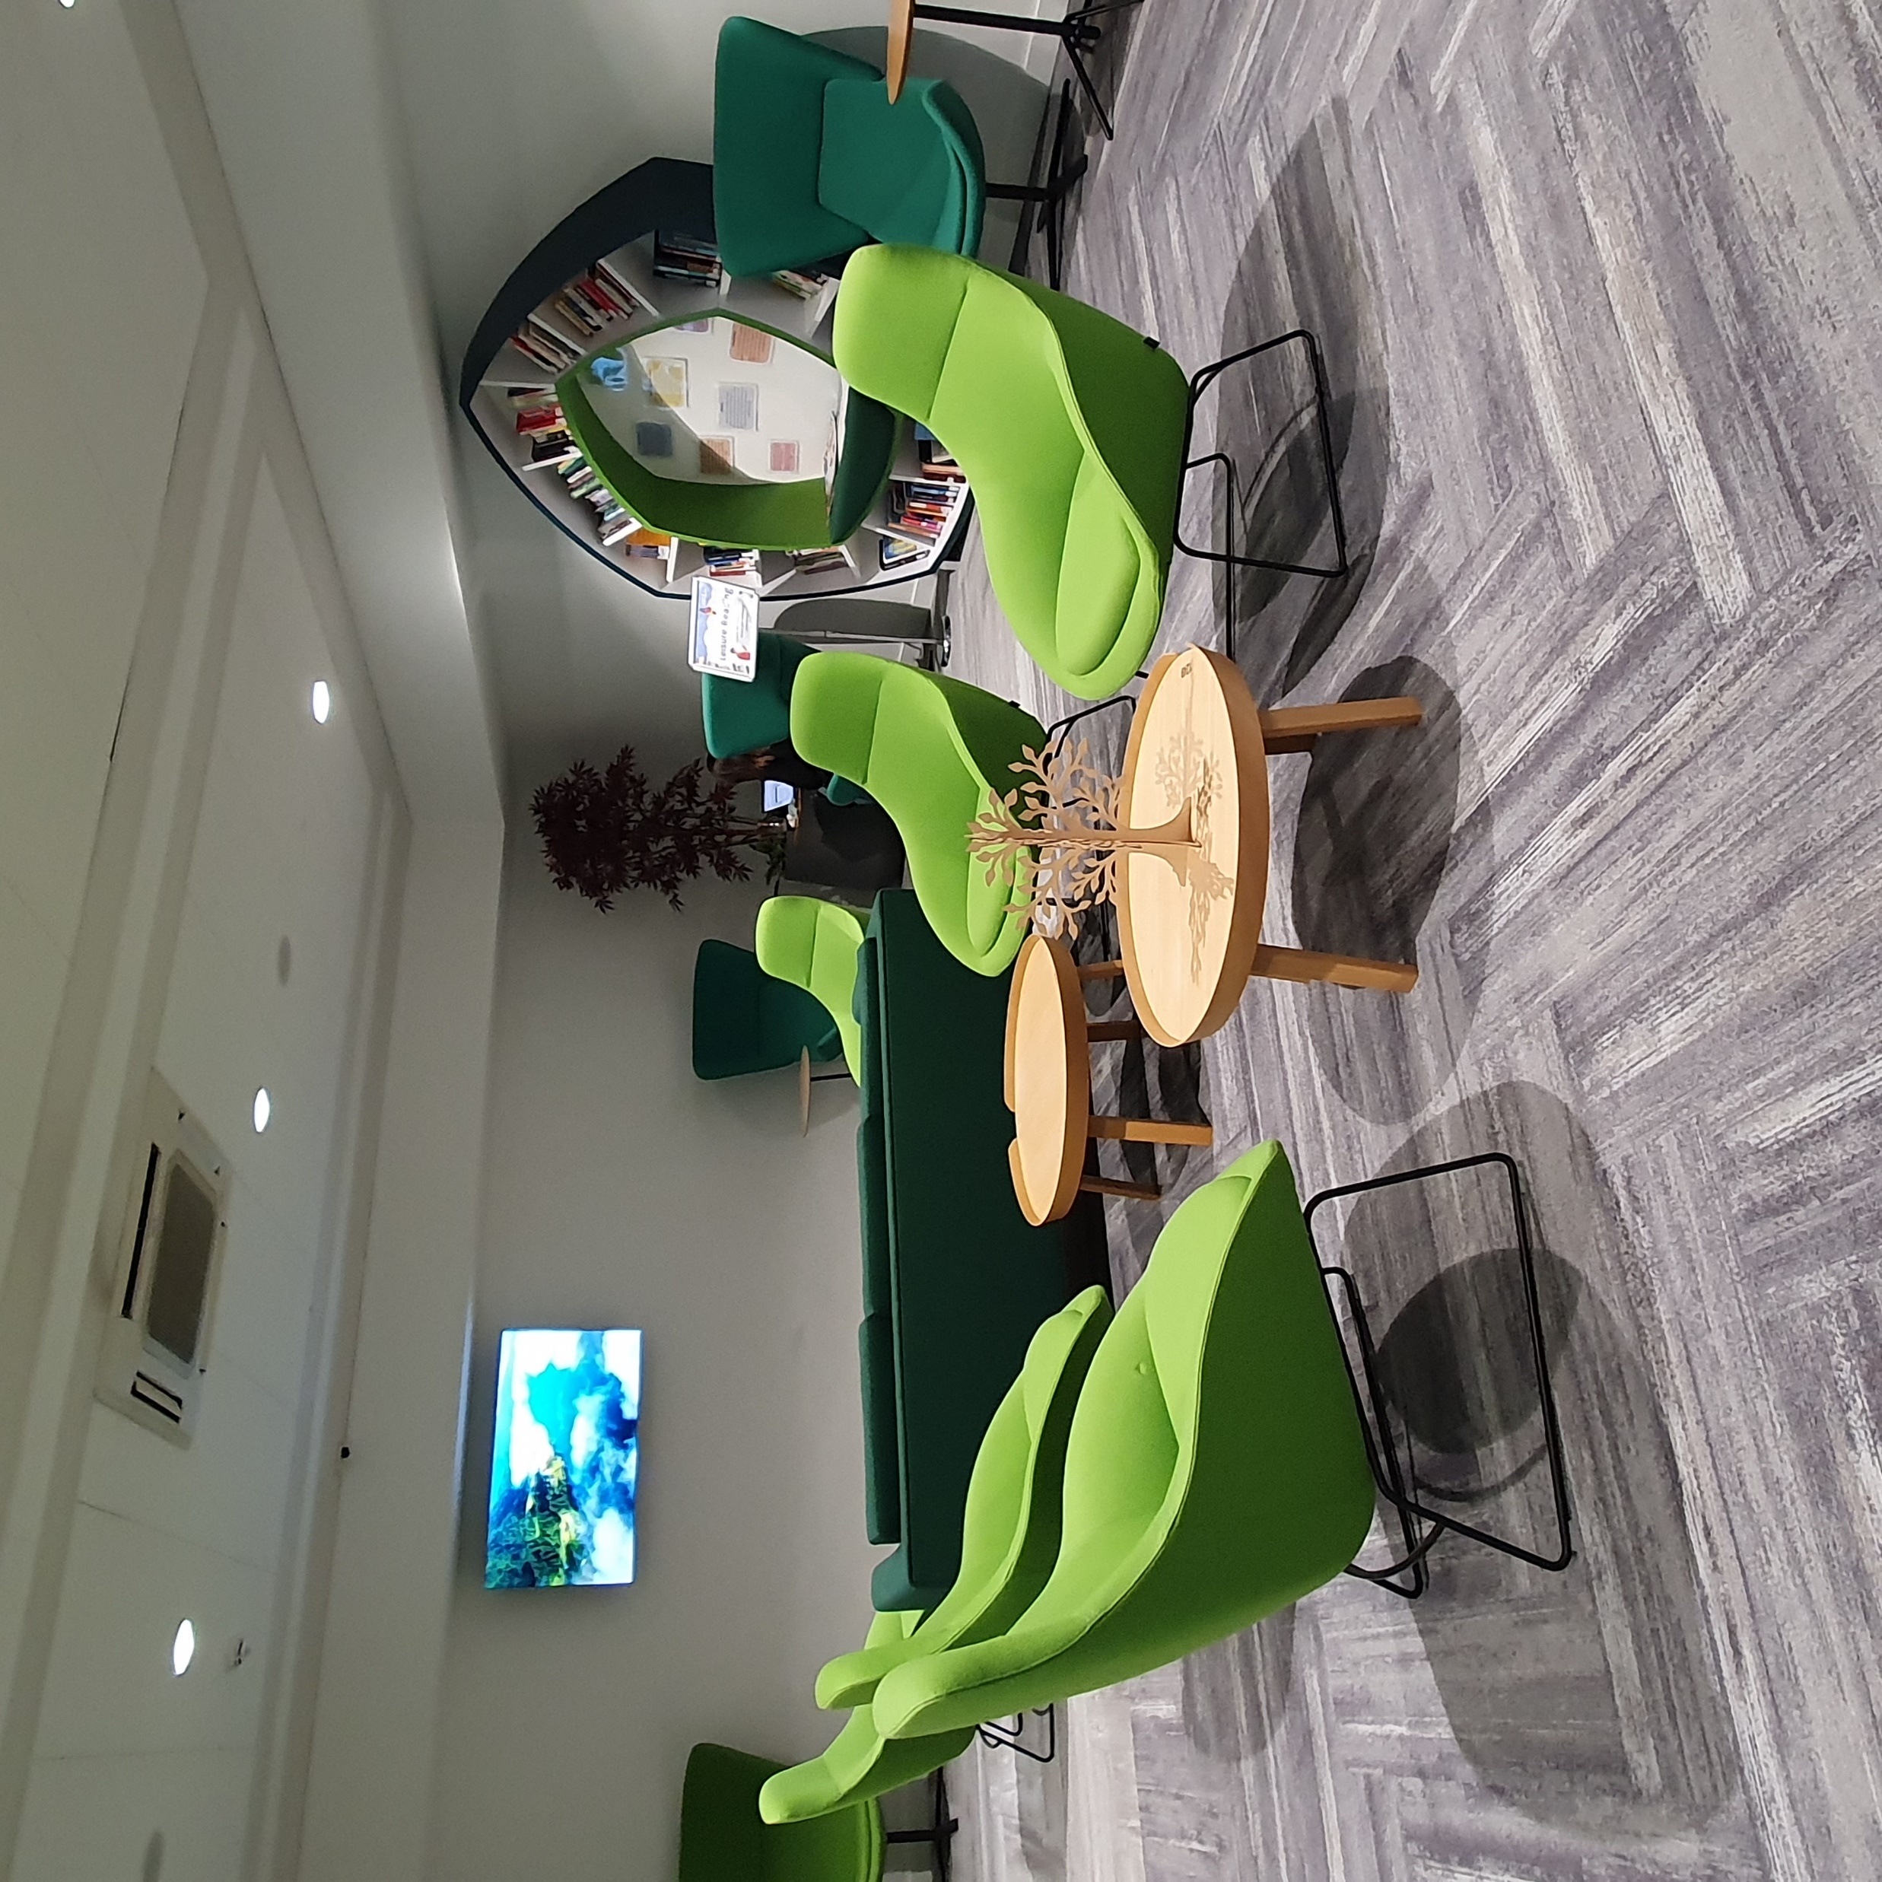
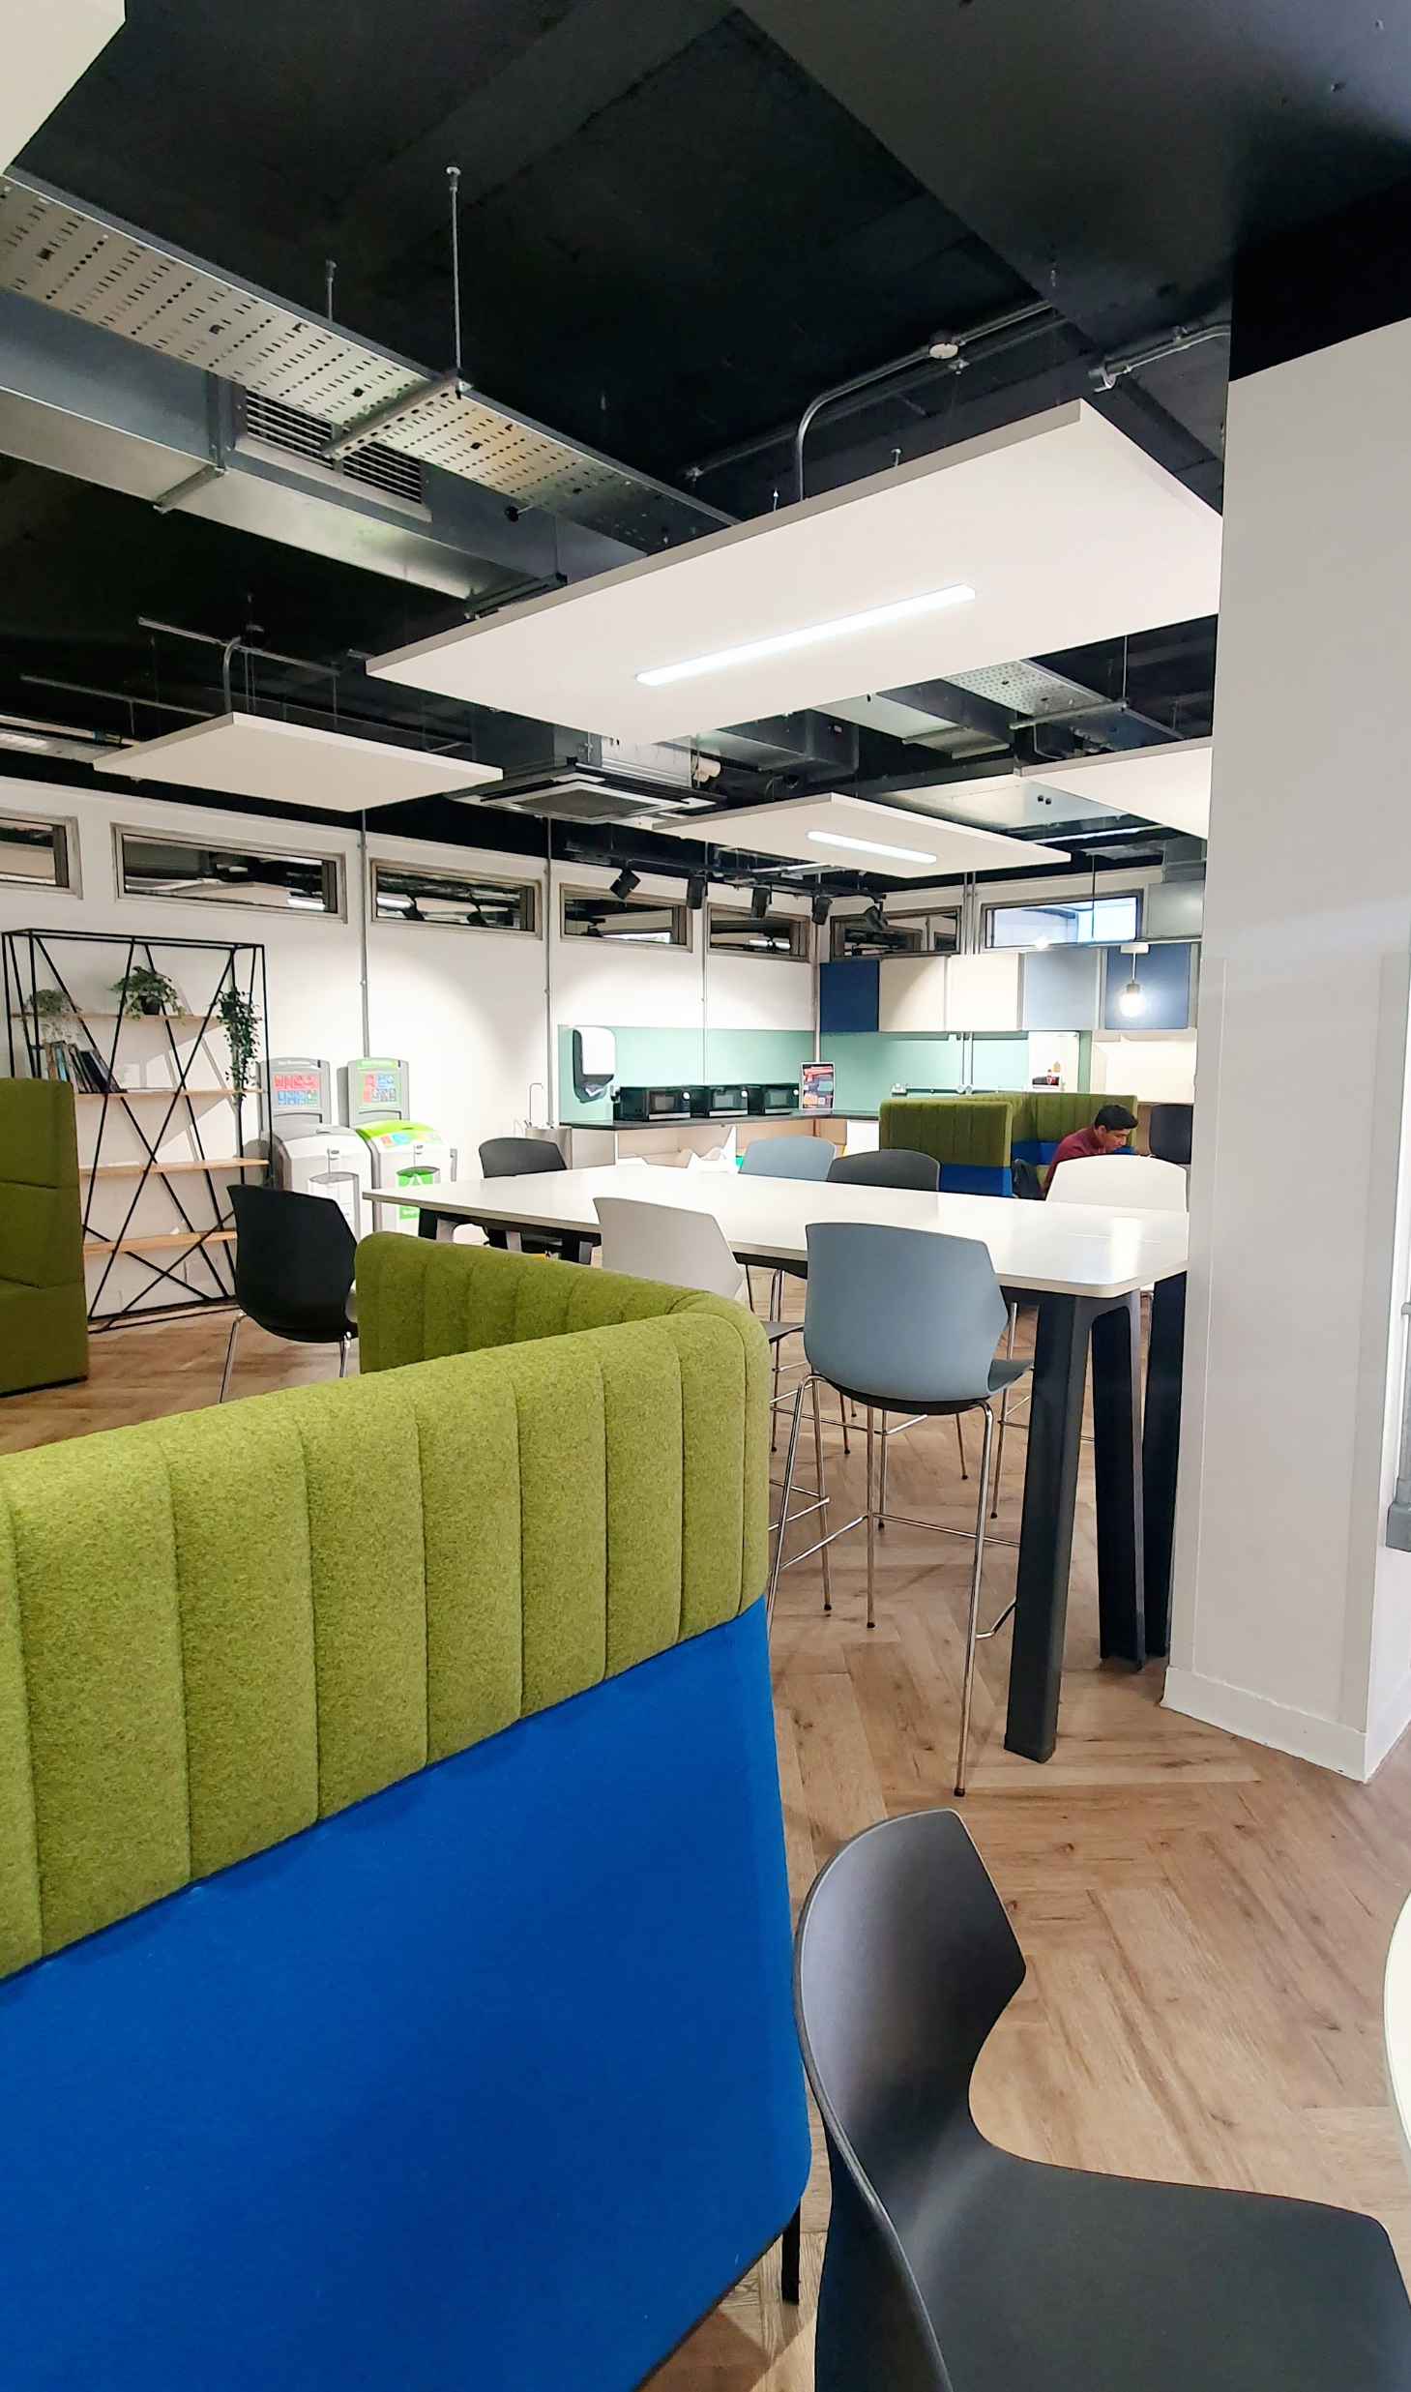

Social spaces
The library has two cafes:
Café Library: Ground floor
Library Coffee Bar: 1st floor
To enjoy your own food and drink:
The Eating Place: Ground floor
For relaxation and well-being:
The Breathing Space: 1st floor
https://warwick.ac.uk/services/library/using/libspaces/

Slide 8
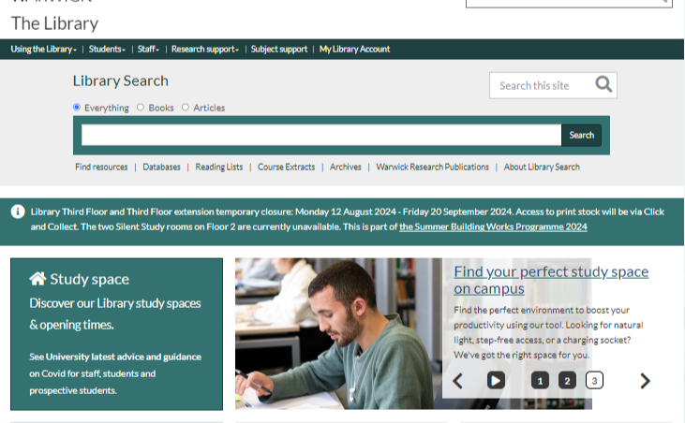
Library resources
The library provides resources for teaching, learning and research
Reading lists
Library Search
Books and journals
Databases
Economics books are located on 5th floor of library in classmark H
5-H
https://warwick.ac.uk/services/library/

Slide 9
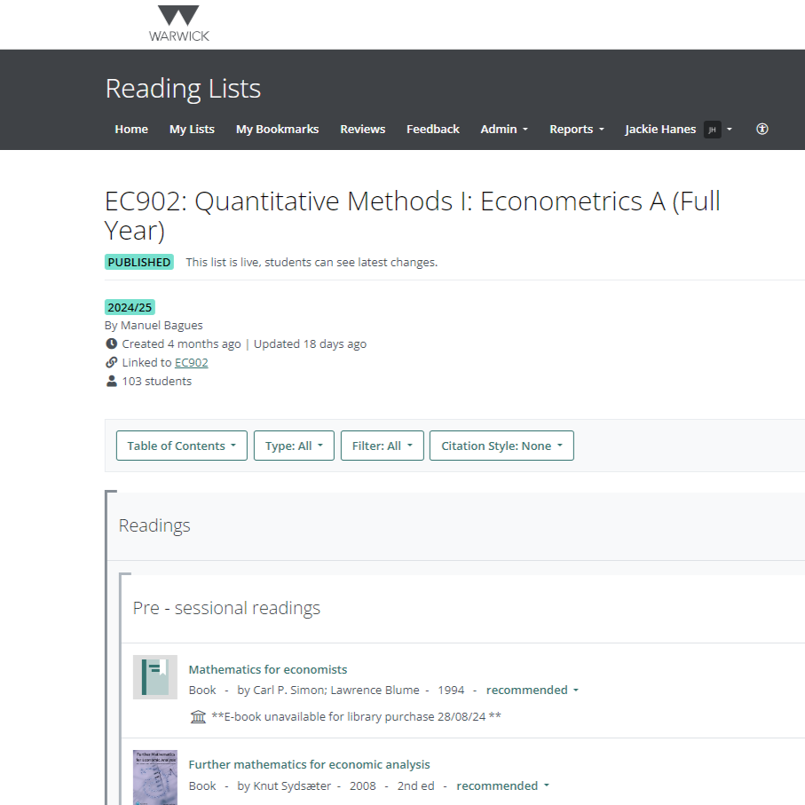
Reading List
http://readinglists.warwick.ac.uk/
Most modules have an online reading list
Find and access your recommended reading
Link directly from the reading list to library resources
Reading List available via Moodle or Library website
Search for your reading list by module code or title
Login to mark your reading status and add own notes

Slide 10
Library Search
https://warwick.ac.uk/services/library/
Library Search is the library’s search engine or discovery service
Find books/chapters, journals/articles, databases and more
Search by author, title or keyword. Limit results by subject, date, resource type
Access library account: view and renew items on-loan
Recall & reserve on-loan items and request click & collect

Slide 11
Finding books
https://warwick.libguides.com/economics/books
Harford, T. (2012) The Undercover Economist. 2nd edn. Oxford: Oxford University Press.
Print books
Ebooks
Library Search will tell you copies, classmark and availability (5-H)
Unlimited borrowing (999 copies)
1 year loan period (unless recalled)
If all copies of book are on-loan, request book using Click & Collect
Library Search = Full-Text Online
Login to ebooks with University IT user number and password
Restrictions on use of ebooks:
Copies: single, multiple, unlimited users
Printing: 10% pages, 1 chapter, unlimited
Download: read online only, download chapters as PDFs, download to ereader

Slide 12
Finding journals
https://warwick.libguides.com/economics/journals
Bowles, S. and Carlin, W. (2020) ‘What Students Learn in Economics 101: Time for a Change’, Journal of Economic Literature, 58(1), pp. 176-214
Author & ‘Article Title’
Journal Title
Library Search
Bowles Students Learn Economics
Content type = Journal Article
Full-Text Online
Library Search
Journal of Economic Literature
Content type = Journal/eJournal
Full-Text Online
Connect = Full text via EconLit
Login to ejournals with University IT user number and password

Slide 13

Access to digital library resources
Login with University of Warwick IT user number and password
via University Library
via Institutional Login
You are recommended to access digital resources via Library routes
Reading Lists
Library Search
Database A-Z
Library Guide
You will be prompted to login with your IT user number and password
If you find digital resources via Google, you may be denied access to the full-text
Look for an Institutional Login option
Search for University of Warwick
You will be prompted to login with your IT user number and password

Slide 14
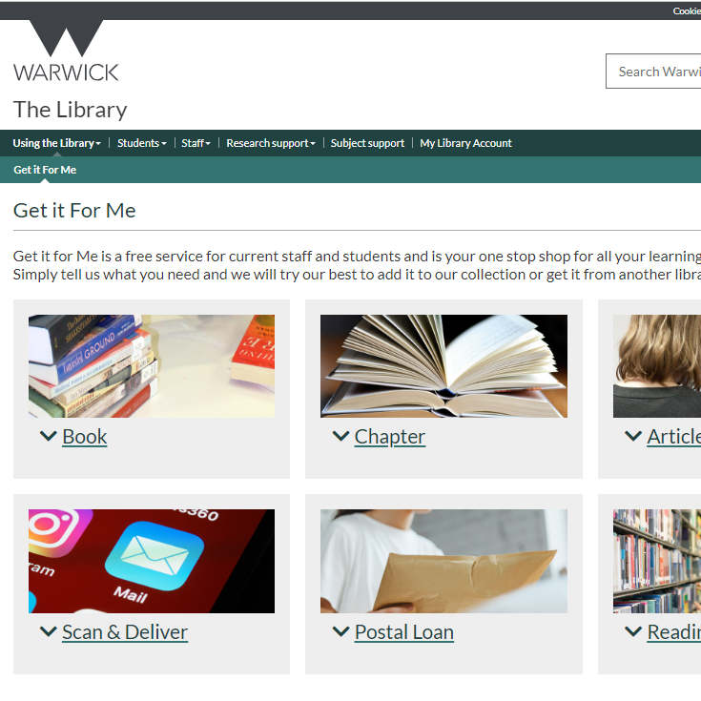
Document supply
https://warwick.ac.uk/services/library/using/get-it-for-me/
Get It For Me is the library’s document supply service
Access to books, chapters and articles not available in the library:
Book Suggestion: ask us to buy a book for the library
Inter-Library Loan: borrow a book from another library
Digitisation: of articles and chapters from another library
You can also request postal loan of print books held in our library

Slide 15
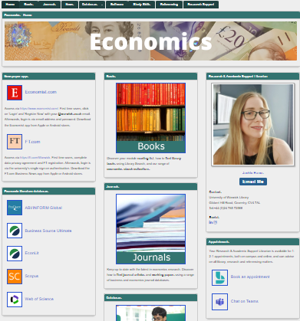
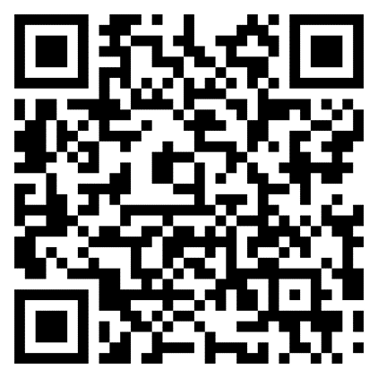
Economics library guide
https://warwick.libguides.com/economics/
A guide to economics books, journals and newspapers
Literature searching databases for articles and books
Data databases for company, economic and financial data
Study skills, research and referencing support
Librarian’s email, telephone and book appointments

Slide 16


Newspapers
https://warwick.libguides.com/economics/news
Economist https://www.economist.com/
Register and login with your @warwick.ac.uk email address
Financial Times https://ft.com/Warwick
Register and login with your @warwick.ac.uk email address

Slide 17



Literature databases
EconLit
Index of 1,000+ economic journals, working papers, books and theses Selected full-text journal articles including American Economic Association (AEA)
Scopus
Index and citations to multidisciplinary academic journals and pre-prints
Web of Science
Index and citations to multidisciplinary academic journals and pre-prints

Slide 18
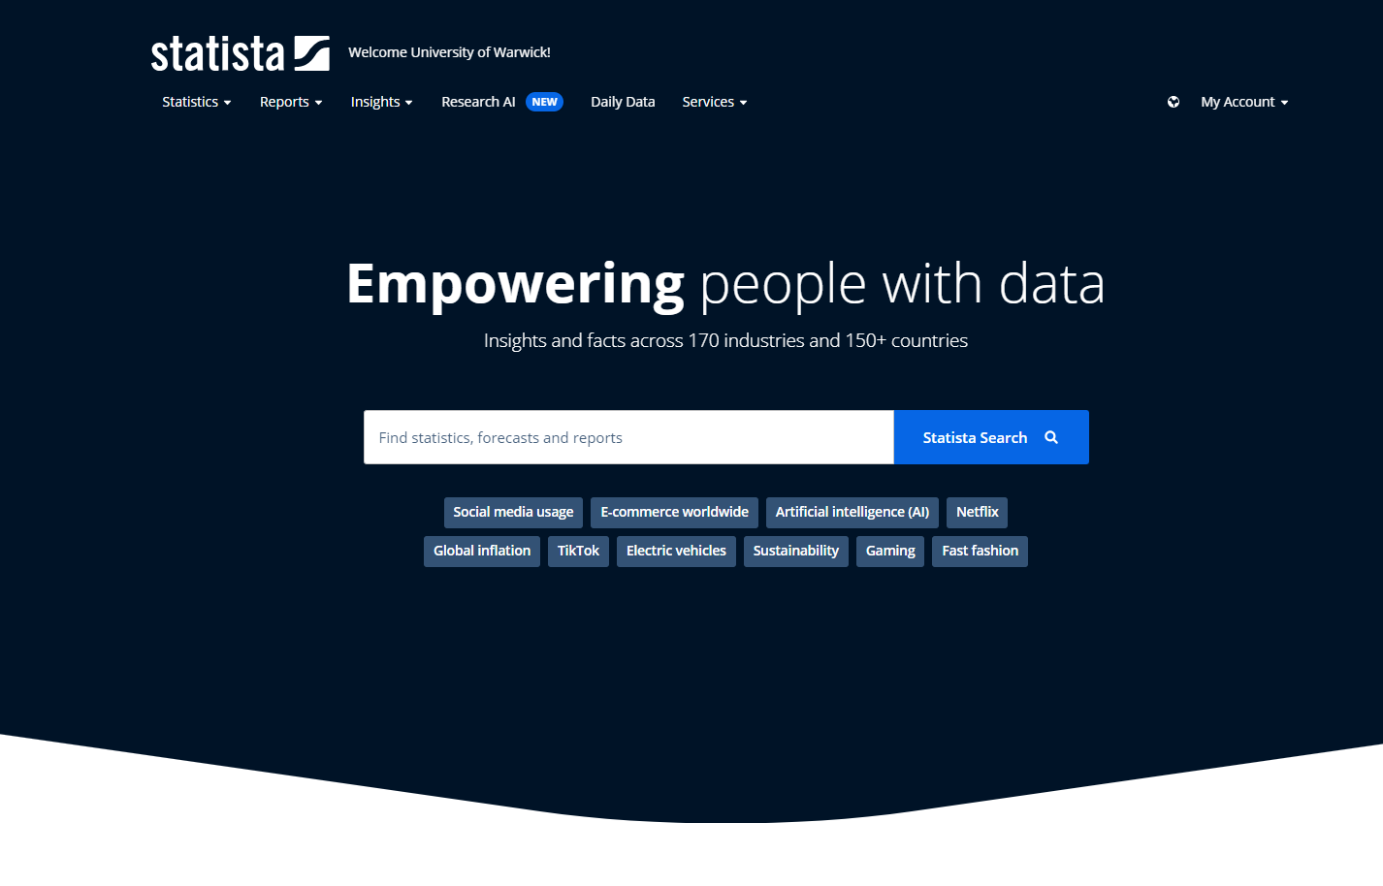

Statista
Statista is a global data and statistics platform
Statistics, reports and outlooks on:
150+ countries and regions
170+ industries and markets
Data visualisation, charts, maps, infographics
A great starting place for data research needs
https://www.statista.com/

Slide 19
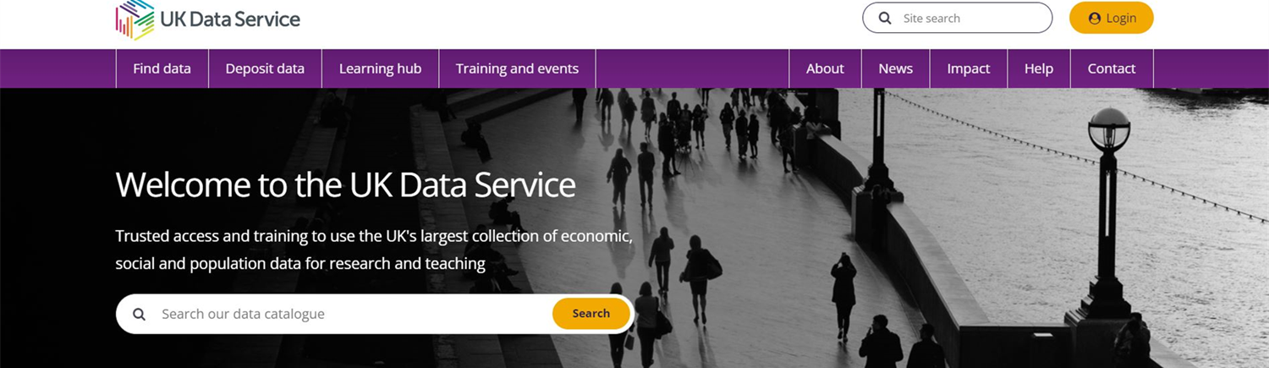
UK Data Service
https://ukdataservice.ac.uk/
UK’s national repository of economic, social and population data
Includes macro and micro data from ONS, IMF, OECD and World Bank
Access: register with @warwick.ac.uk email & login to download data

Slide 20


Company databases
https://warwick.libguides.com/economics/company
Business Source Ultimate
Global company and industry profiles and SWOT analyses from MarketLine
Fame, Orbis and Orbis Bank Focus
Company information for UK and Ireland (Fame) and world (Orbis) from Moody’s

Slide 21


Financial databases
https://warwick.libguides.com/economics/financial
Capital IQ
Global company and financial markets database from S&P Global
Global Financial Database
Historical global economic and financial markets data (long time-series data)

Slide 22
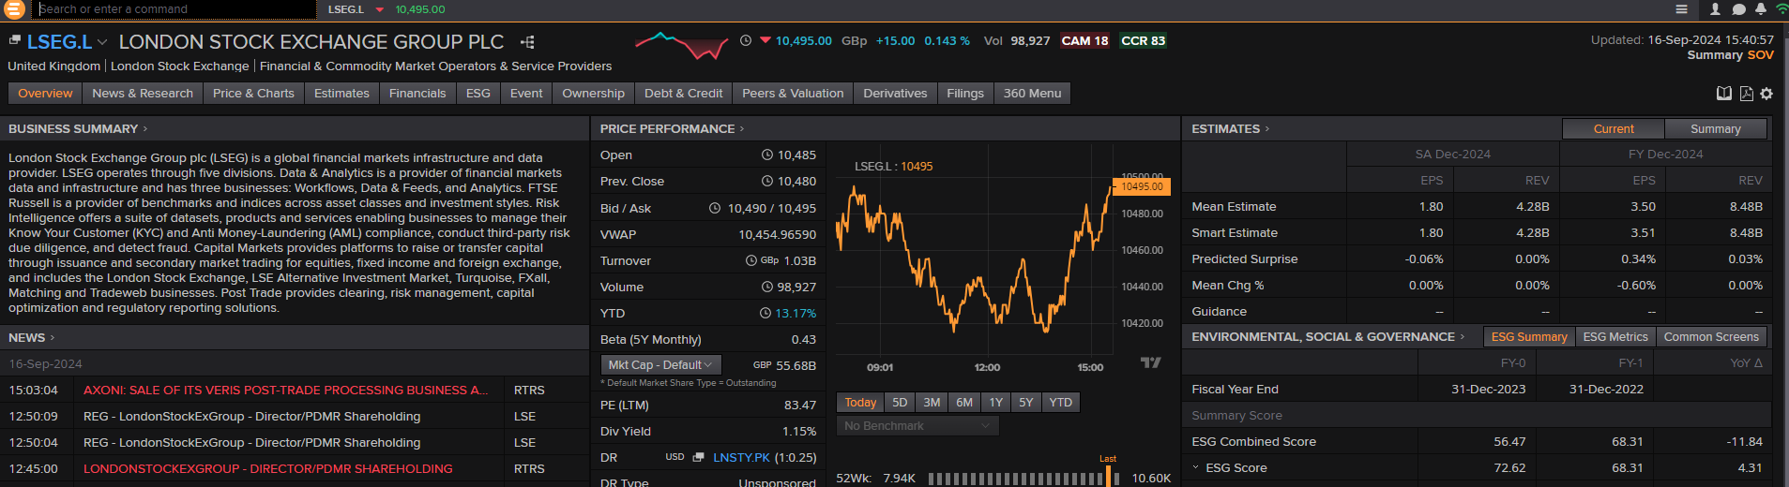
LSEG Eikon
Eikon is a global company and financial markets database from LSEG
Environment, social and governance (ESG) & mergers and acquisitions (M&A)
Time-series data available via Eikon and Datastream Excel add-ins
Eikon is available on-campus only via pre-bookable PC on 1st floor of library
Eikon training and certification available via LSEG Learning Centre

Slide 23
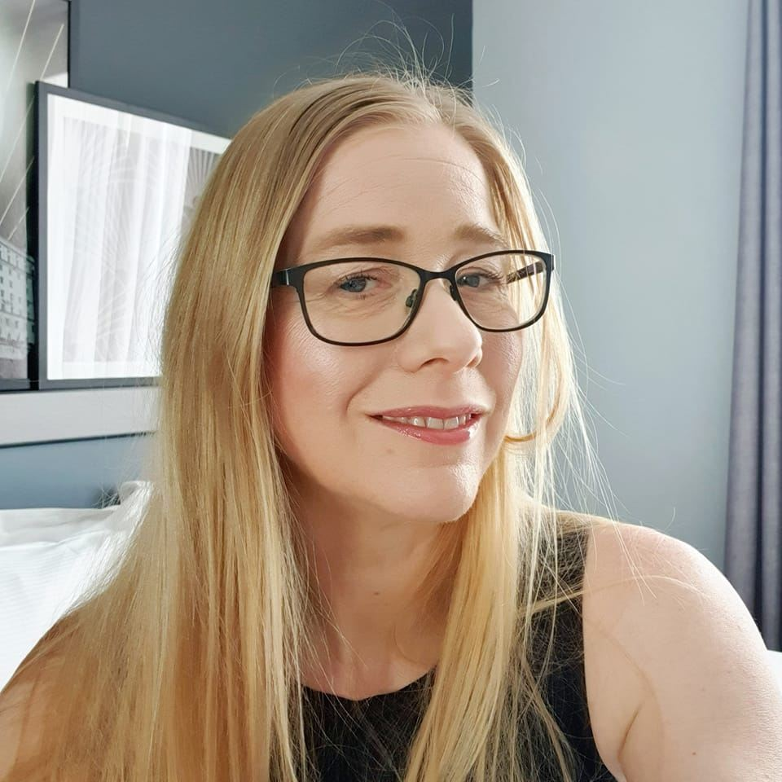
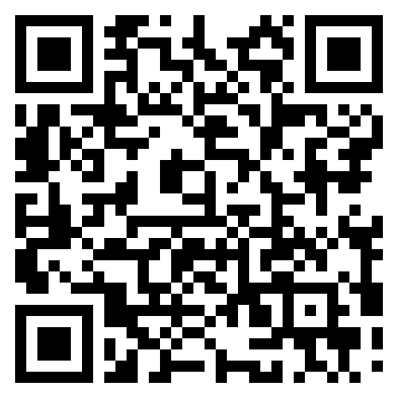

Economics librarian
https://warwick.libguides.com/economics/
Jackie Hanes
Research and Academic Support Librarian
Advice on all library, research and referencing matters
Appointments available on-campus and online
Jackie.Hanes@warwick.ac.uk
+44 (0)24 765 72588
Book Appointment

Slide 24



Connect with @WarwickLibrary
Facebook
https://www.facebook.com/WarwickUniLibrary
Instagram
https://www.instagram.com/warwicklibrary/
X
http://twitter.com/#!/warwicklibrary

